Slide 1
Your Move-Out Plan: Affording Independence
The Unit 9 capstone - pull together budgeting, income, saving, credit, and insurance into one realistic plan for when and how you can afford to move out on your own.
© More Lessons Less Planning | morelessonslessplanning.com
Notes:
This is the capstone of Unit 9 and, really, of the whole Personal Finance course: can you afford to live on your own yet, and if not, what is the plan to get there? Students learn that affording independence is not one number but three pieces working together - a monthly budget that adds up to a cost of living, the take-home income needed to cover it with a safety margin, and a savings target you hit before you move. Everything is worked through Devon Brooks, a young person planning his first move-out, coached by independence coach Priya Raman. By the end, students can build a real move-out plan and say honestly whether someone is ready to go.

Slide 2
Learning Targets
Build a move-out monthly budget and find its total cost of living
★
Calculate the take-home income needed to cover it with a safety margin
★
Set a savings target (move-in costs plus emergency fund) and find the timeline
★
Use a budget chart and a readiness checklist to decide if you can move out yet
★
© More Lessons Less Planning | morelessonslessplanning.com
Notes:
Read the four targets and connect them to the arc of the lesson. Target 1 is the budget: list your monthly expenses and add them for your MONTHLY COST OF LIVING. Target 2 is the income skill: find the TAKE-HOME INCOME NEEDED = cost of living + a safety margin, so you bring home more than the bills. Target 3 is the savings piece: set a MOVE-OUT SAVINGS TARGET = move-in costs + an emergency fund, and figure the timeline to save it. Target 4 is the judgment: read a budget bar chart and run a readiness checklist - income, budget, savings, credit, insurance - to decide honestly whether someone can move out yet. By the end, students can build a move-out plan for anyone.

Slide 3
Affording Independence
Independent living
INDEPENDENT LIVING means supporting yourself on your own income, away from family support
Moving out is a plan
Moving out is a plan you build and save for, not something you rush into
Meet Devon
Devon Brooks wants to move out; independence coach Priya Raman helps him build a realistic plan
What it takes
Affording independence takes steady income, a real budget, and savings before you go
Key Concept: INDEPENDENT LIVING means paying your own way - it takes a plan, not just a wish.
© More Lessons Less Planning | morelessonslessplanning.com
Notes:
Frame the whole capstone. INDEPENDENT LIVING means supporting yourself on your own income, away from family support - paying your own rent, bills, and food. Make the key point up front: moving out is a plan you build and save for, not something you rush into on a feeling. Introduce the persona and the real problem: Devon Brooks wants to move out but is not sure he can afford it yet, and independence coach Priya Raman is going to help him build a realistic plan instead of guessing. Tell students affording independence takes three things working together - steady income, a real monthly budget, and savings in the bank before you go - and this lesson builds all three. Key term - Independent living: supporting yourself on your own income.

Slide 4
The Income You'll Need
Take-home pay
TAKE-HOME PAY is the money left in your paycheck after taxes and deductions
✔
Cover your costs
Your take-home pay each month must cover all your living costs with room to spare
✔
Safety margin
A SAFETY MARGIN is extra room in a budget so income covers more than just the bills
✔
Income needed
TAKE-HOME INCOME NEEDED = MONTHLY COST OF LIVING + a safety margin of about 10 percent
✔
Key Concept: Bring home MORE than your bills - TAKE-HOME INCOME NEEDED = COST OF LIVING + a 10% SAFETY MARGIN.
© More Lessons Less Planning | morelessonslessplanning.com
Notes:
Teach the income side of the plan. TAKE-HOME PAY is the money left in your paycheck after taxes and deductions - not your gross pay, the amount that actually lands in your account (this connects back to Unit 1 paychecks and Unit 7 taxes). Make the rule clear: your take-home pay each month must cover all your living costs with room to spare, not exactly match them. That room is the SAFETY MARGIN - extra space in the budget so income covers more than just the bills, so one surprise does not sink you. Put the labeled rule on the board: TAKE-HOME INCOME NEEDED = MONTHLY COST OF LIVING + a safety margin of about 10 percent of your costs. Preview Devon: once his cost of living is $2,000, he needs $2,000 + $200 = $2,200 take-home. Key terms - Take-home pay: what is left after taxes and deductions. Safety margin: extra room so income beats the bills.

Slide 5
The Move-Out Budget (Cost of Living)
Cost of living
COST OF LIVING is the total of your monthly living expenses - rent, utilities, food, and more
Fixed expense
A FIXED EXPENSE stays about the same each month, like rent; others like food can vary
The categories
A move-out budget lists rent, utilities, food, transportation, phone & insurance, and savings
Rent is biggest
Rent is usually the biggest expense, so where you live drives your whole cost of living
Key Concept: COST OF LIVING = the sum of your monthly expenses; rent is usually the biggest piece.
© More Lessons Less Planning | morelessonslessplanning.com
Notes:
Build the budget itself. COST OF LIVING is the total of your monthly living expenses - rent, utilities, food, transportation, phone and insurance, and a little for savings and extras. Teach the difference between kinds of costs: a FIXED EXPENSE stays about the same each month, like rent, while others like food or gas can vary. Lay out the categories a move-out budget lists so students have a template: rent, utilities, food, transportation, phone & insurance, and savings & misc. Make the money point that carries the whole lesson: rent is usually the biggest expense by far, so where you live - and whether you live alone or with a roommate - drives your whole cost of living more than any other choice. Tell students the chart in Part 4 shows Devon's six categories, and they will add them to find his cost of living. Key terms - Cost of living: the sum of your monthly expenses. Fixed expense: a cost that stays about the same each month.

Slide 6
Savings Target Before Moving
Move-in costs
MOVE-IN COSTS are the upfront cash to move in: first month's rent plus a security deposit and setup
Security deposit
A SECURITY DEPOSIT is money a landlord holds up front, often equal to one month's rent
Emergency fund
An EMERGENCY FUND is savings that covers a few months of expenses if your income stops
Move-out savings target
MOVE-OUT SAVINGS TARGET = MOVE-IN COSTS + EMERGENCY FUND - the cash saved before you move
Key Concept: Save before you move - MOVE-OUT SAVINGS TARGET = MOVE-IN COSTS + EMERGENCY FUND.
© More Lessons Less Planning | morelessonslessplanning.com
Notes:
Teach the savings piece - the part first movers most often skip. MOVE-IN COSTS are the upfront cash you need just to get the keys: first month's rent, plus a SECURITY DEPOSIT (money a landlord holds up front, often equal to one month's rent, returned if you leave the place in good shape), plus setup costs like utility deposits and basic supplies. Then teach the cushion: an EMERGENCY FUND is savings that covers a few months of expenses if your income stops - a job loss, a cut in hours, a big surprise bill. Put the second labeled model on the board: MOVE-OUT SAVINGS TARGET = MOVE-IN COSTS + EMERGENCY FUND - the total cash you should have saved before you move. This is why you save for months before moving out: you need both the upfront cash to get in and a cushion so one bad month does not force you back home. Preview Devon: move-in costs $2,500 + emergency fund $6,000 = an $8,500 target. Key terms - Move-in costs, Security deposit, Emergency fund, Move-out savings target.

Slide 7
Building a Safety Margin - The Two Models
The first model
MONTHLY COST OF LIVING = the sum of your monthly expenses; Devon's is $2,000
✔
The second model
MOVE-OUT SAVINGS TARGET = MOVE-IN COSTS + EMERGENCY FUND
✔
Size the fund
A starter EMERGENCY FUND is about 3 months of cost of living: 3 x $2,000 = $6,000
✔
Devon's target
Devon's target = move-in costs $2,500 + emergency fund $6,000 = $8,500
✔
Key Concept: MONTHLY COST OF LIVING = sum of expenses. MOVE-OUT SAVINGS TARGET = MOVE-IN COSTS + EMERGENCY FUND (about 3 months).
© More Lessons Less Planning | morelessonslessplanning.com
Notes:
These are the two central quantitative models - teach them explicitly and put them on the board under clear labels before students calculate. THE FIRST LABELED MODEL - MONTHLY COST OF LIVING = the sum of your monthly expenses - you add every category (rent, utilities, food, transportation, phone & insurance, savings & misc); Devon's adds to $2,000. THE SECOND LABELED MODEL - MOVE-OUT SAVINGS TARGET = MOVE-IN COSTS + EMERGENCY FUND - the cash you need before you move. Teach how to size the emergency fund: a starter emergency fund is about 3 months of your cost of living, so Devon's is 3 x $2,000 = $6,000 (that is the safety margin for savings - enough that one bad stretch does not force him back home). Then combine: Devon's target = move-in costs $2,500 + emergency fund $6,000 = $8,500. Work it live so students see both models produce a single, concrete number. Tell students Activity Part 3 asks them to apply both models to a mover's numbers. Key terms - Monthly cost of living: the sum of the expenses. Move-out savings target: move-in costs plus an emergency fund.

Slide 8
Your Move-Out Budget (Chart Intro)
Six categories
The next chart shows Devon's six monthly cost-of-living categories as bars
Read each bar
Each bar's height is the dollars Devon spends in that category each month
Add them up
Add the six bars to get Devon's total monthly cost of living
Rent is tallest
Rent is the tallest bar at $1,050 - far more than any other category
Key Concept: The tallest bar is RENT ($1,050); add all six bars to get the $2,000 cost of living.
© More Lessons Less Planning | morelessonslessplanning.com
Notes:
Set up the chart by teaching what it will show: Devon's six monthly cost-of-living categories, each drawn as one bar, so students can see where his money goes at a glance. Teach how to read it: each bar's height is the dollars Devon spends in that category each month, so a taller bar means a bigger monthly cost. Teach the move that matters: add the six bars together to get Devon's total monthly cost of living. Preview the pattern students will notice: rent is the tallest bar by far at $1,050 - more than all the other categories combined - which is exactly why where you live drives the whole budget. Tell students Activity Part 4 asks them to read each bar, total the six for the cost of living, identify the biggest category, and use the total to find the income Devon needs.

Slide 9
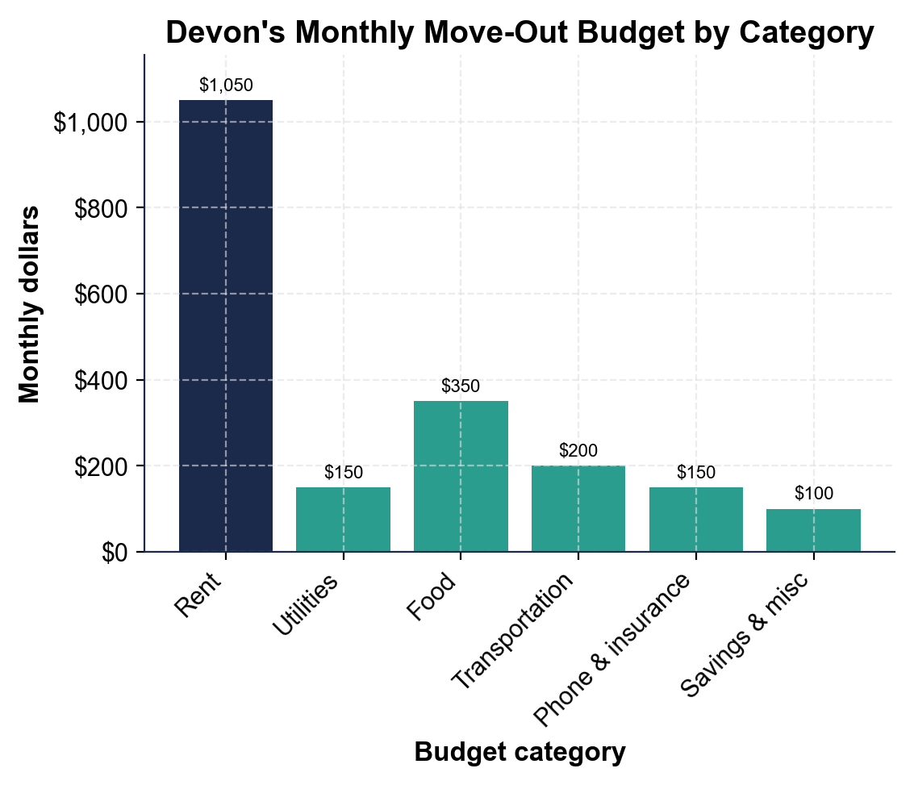
Devon's Monthly Move-Out Budget by Category
Rent ($1,050) towers over the other bars; all six add to $2,000.
© More Lessons Less Planning | morelessonslessplanning.com
Notes:
Give students a moment to read the six bars before discussing. The bar chart shows Devon's monthly move-out budget by category: Rent $1,050, Utilities $150, Food $350, Transportation $200, Phone & insurance $150, Savings & misc $100. Work the takeaways live. Rent is by far the tallest bar at $1,050 - about 52.5% of the whole budget, more than all the other categories combined. The other five are $150 or less each except food at $350. Add the six bars to get Devon's monthly cost of living: $1,050 + $150 + $350 + $200 + $150 + $100 = $2,000. Connect to the plan: once the cost of living is $2,000, a 10% safety margin ($200) makes his take-home income needed $2,200. This is the chart Activity Part 4 reads; students read each bar, total the six, find the biggest category, and apply the income rule. Remind students these are realistic examples, not fixed amounts - costs vary by city and lifestyle.
Reference labels (point to these chart features when teaching): Rent: $1,050 (about 52.5%); Cost of living: $2,000/month

Slide 10
The Readiness Checklist
Income ready
Steady TAKE-HOME PAY that covers your cost of living plus a safety margin
✔
Budget & savings ready
A realistic monthly budget written, and your move-out savings target hit before you move
✔
Credit & insurance ready
Good-enough credit for the rental application, and renter's plus health insurance lined up
✔
Prioritizing
PRIORITIZING means deciding what to fund first, putting needs and safety ahead of extras
✔
Key Concept: You are move-out ready when income, budget, savings, credit, and insurance all check out - PRIORITIZE needs and safety first.
© More Lessons Less Planning | morelessonslessplanning.com
Notes:
This is the Units 1-9 synthesis - the whole-picture check that tells you whether someone can actually move out. INCOME READY: steady take-home pay that covers your cost of living plus a safety margin (Units 1 and 7). BUDGET & SAVINGS READY: a realistic monthly budget written down, and your move-out savings target - move-in costs plus an emergency fund - saved before you move (Units 2 and 6). CREDIT & INSURANCE READY: good-enough credit so you pass the rental application and are not stuck with a high deposit (Units 4 and 5), and renter's plus health insurance lined up so one accident does not wipe you out (Unit 8). Tie it together with the habit that runs the whole course: PRIORITIZING means funding needs and safety first, before any extras. Teaching point: being move-out ready is not one number - it is income, budget, savings, credit, and insurance all lining up. Tell students the Activity capstone asks them to run this checklist for a client. Key term - Prioritizing: funding needs and safety first.

Slide 11
Calculate Your Move-Out Number
Step 1 - Cost of living
Add every category for the MONTHLY COST OF LIVING - Devon's is $2,000
✔
Step 2 - Income needed
TAKE-HOME INCOME NEEDED = cost of living + safety margin = $2,000 + $200 = $2,200
✔
Step 3 - Savings target
MOVE-OUT SAVINGS TARGET = move-in costs $2,500 + emergency fund $6,000 = $8,500
✔
Step 4 - Timeline
SAVINGS TIMELINE = target / monthly savings = $8,500 / $850 = 10 months
✔
Key Concept: Cost of living $2,000 -> income needed $2,200 -> savings target $8,500 -> save $850/mo = 10 months.
© More Lessons Less Planning | morelessonslessplanning.com
Notes:
Give students the exact repeatable four-step process they use in the Activity capstone, worked all the way through with Devon. STEP 1 - COST OF LIVING: add every budget category for the monthly cost of living; Devon's six categories add to $2,000. STEP 2 - INCOME NEEDED: TAKE-HOME INCOME NEEDED = cost of living + safety margin = $2,000 + $200 (10%) = $2,200 take-home per month; Devon brings home $2,400, so his income is ready. STEP 3 - SAVINGS TARGET: MOVE-OUT SAVINGS TARGET = move-in costs $2,500 + emergency fund $6,000 = $8,500. STEP 4 - TIMELINE: SAVINGS TIMELINE = savings target / monthly savings = $8,500 / $850 = 10 months, so if Devon saves $850 a month he is ready to move in about 10 months. Walk students through the Activity Part 5, where coach Priya has a client - Jasmine Carter - and students run these same four steps, then decide whether Jasmine is ready and how long she needs. Tell students the pattern: the savings target, not the monthly income, is usually the thing that sets the timeline.

Slide 12
Key Takeaways
MONTHLY COST OF LIVING = the sum of your monthly expenses; Devon's is $2,000
★
TAKE-HOME INCOME NEEDED = cost of living + a 10% margin; Devon needs $2,200
★
MOVE-OUT SAVINGS TARGET = move-in costs + emergency fund; Devon's = $8,500
★
SAVINGS TIMELINE = target / monthly savings; $8,500 / $850 = 10 months
★
Move-out ready = income, budget, savings, credit, and insurance all lined up
★
© More Lessons Less Planning | morelessonslessplanning.com
Notes:
Read each takeaway and connect it back to the learning targets. T1 (the budget) -> MONTHLY COST OF LIVING = the sum of your monthly expenses; Devon's six categories add to $2,000. T2 (the income) -> TAKE-HOME INCOME NEEDED = cost of living + a 10% safety margin, so Devon needs $2,200 take-home. T3 (the savings) -> MOVE-OUT SAVINGS TARGET = move-in costs + emergency fund = $2,500 + $6,000 = $8,500. T4 (the timeline) -> SAVINGS TIMELINE = savings target / monthly savings = $8,500 / $850 = 10 months. T5 (the whole picture) -> being move-out ready means income, budget, savings, credit, and insurance all line up, not just one of them. Close by returning to the opening question: students can now build a real move-out plan and say honestly whether someone is ready to afford independence, and what it takes to get there.

