Slide 1
Your First Paycheck: Why It's Smaller Than You Think
What gross pay is, where every deduction goes, what FICA funds, and how to calculate the take-home pay that actually lands in your account.
© More Lessons Less Planning | morelessonslessplanning.com
Notes:
Open with the hook. A teen takes a job at $15/hour for 40 hours - they expect $600. The deposit is $497. Where did $103 go? Today's lesson explains gross vs net pay, the deductions that shrink every paycheck, and how to calculate take-home pay.

Slide 2
Learning Targets
Distinguish gross pay from net pay and explain why net pay is smaller
★
Identify the major deductions: federal tax, state tax, and FICA
★
Explain what FICA (Social Security + Medicare) funds
★
Calculate net pay by subtracting deductions from gross pay
★
© More Lessons Less Planning | morelessonslessplanning.com
Notes:
Read the four targets aloud. Tell students the activity puts them in the role of Jordan, a new hire decoding their first pay stub, and Part 4 will ask them to calculate net pay from gross using real numbers.

Slide 3
Why Your Paycheck Is Smaller Than Your Offer
The Surprise
A Real Example
Your offer letter quotes GROSS pay
Your bank deposit is NET pay
The gap is deductions - mostly taxes
This catches almost every first-time earner
Offer: $15/hour x 40 hours = $600
Federal tax, state tax, and FICA come out
Actual deposit: about $497
$103 vanished before you saw it
Did You Know? The money is not lost - it is withheld and sent to the government and benefit programs on your behalf, every single pay period.
© More Lessons Less Planning | morelessonslessplanning.com
Notes:
Make the gap concrete and emotional. Students will earn their first paycheck and be confused by the smaller deposit. Frame the whole lesson as solving this mystery: the offer letter is gross pay, the deposit is net pay, and the difference is deductions.

Slide 4
Gross Pay Defined
What Counts as Gross Pay
How to Calculate It
Total earnings BEFORE any deductions
Hourly wages OR salary
Plus overtime, tips, commission, bonuses
It is the biggest number on your pay stub
Hourly: hourly rate x hours worked
Example: $15/hr x 40 hrs = $600 gross
Salary: annual salary / pay periods
Example: $52,000 / 26 = $2,000 biweekly gross
Key Concept: Gross pay is your starting point. Every deduction is subtracted FROM gross pay - so it must always be the largest figure on the stub.
© More Lessons Less Planning | morelessonslessplanning.com
Notes:
Define gross pay precisely: total earnings before anything is taken out. Show both the hourly calculation (rate x hours) and the salary calculation (annual / pay periods). This is the number students must start from in every net-pay calculation.

Slide 5
The Deductions: Federal, State, and FICA
Deduction
Any amount withheld from your gross pay, either required (taxes) or voluntary (insurance, retirement)
Withholding
The portion of each paycheck an employer holds back and sends to the government on your behalf
Federal income tax
Money withheld for the federal government, based on your earnings and your W-4 form
State income tax
Money withheld for your state government; some states (TX, FL, WA) have none
W-4 form
The form you give your employer that tells them how much federal income tax to withhold
Voluntary deduction
A withholding you choose, such as a 401(k) contribution or a health insurance premium
Note: Required deductions (federal tax, state tax, and FICA) cannot be opted out of. A voluntary deduction (retirement, insurance) is your choice.
© More Lessons Less Planning | morelessonslessplanning.com
Notes:
Walk through the deductions and name each precisely: a deduction is any amount withheld; withholding is the portion the employer sends to the government; federal and state income tax are required; the W-4 form sets federal withholding; a voluntary deduction (401k, insurance) is one you choose. Stress the required-vs-voluntary distinction.

Slide 6
Social Security and Medicare: The FICA Tax
FICA
Federal Insurance Contributions Act; the combined Social Security + Medicare tax, 7.65% of gross pay
Social Security tax
6.2% of gross pay; funds retirement, disability, and survivor benefits
Medicare tax
1.45% of gross pay; funds health insurance for people 65 and older
The combined rate
6.2% + 1.45% = 7.65% taken from almost every worker's paycheck
Employer match
Your employer pays another 7.65% on top - you only see your half on the stub
Did You Know? On $600 gross pay, FICA is $600 x 7.65% = $45.90. That money funds the Social Security and Medicare you may collect one day.
© More Lessons Less Planning | morelessonslessplanning.com
Notes:
Break FICA into its two parts: Social Security (6.2%) and Medicare (1.45%), totaling 7.65%. Use the $600 example: 7.65% of $600 = $45.90. Note that the employer matches this amount - workers only see their half on the stub. This is the most quizzed numeric fact in the lesson.

Slide 7
Net Pay = Take-Home Pay
The Definition
The Formula
Net pay is gross pay MINUS all deductions
Also called take-home pay
It is the amount deposited in your account
It is the number to use when budgeting
Net Pay = Gross Pay - Total Deductions
Start: $600 gross
Subtract: federal + state + FICA
Result: about $497 take-home
Key Concept: Always budget with NET pay, not gross. The $600 you earned is not the $600 you can spend - plan around your take-home pay.
© More Lessons Less Planning | morelessonslessplanning.com
Notes:
Define net pay as gross pay minus all deductions, also called take-home pay. Give the formula explicitly: Net = Gross - Total Deductions. Stress the budgeting lesson: students must plan around net pay, not the bigger gross number, or they will overspend.

Slide 8
Reading the Bottom Line: Your Pay Stub
Pay stub
The itemized statement attached to a paycheck showing gross pay, every deduction, and net pay
✔
Earnings section
Shows gross pay - hourly wages, overtime, and any bonuses for the period
✔
Deductions section
Lists each withholding separately: federal tax, state tax, Social Security, Medicare
✔
Net pay line
The bottom-line take-home figure - the amount actually deposited
✔
Year-to-date (YTD)
Running totals since January 1; check these to confirm your withholding is on track
✔
Warning: Always check your pay stub. Errors happen - a wrong hourly rate or a missing deduction can cost you real money over a year.
© More Lessons Less Planning | morelessonslessplanning.com
Notes:
Teach students to read an actual pay stub top to bottom: the earnings section (gross), the deductions section (each withholding itemized), the net pay line (take-home), and the year-to-date totals. Emphasize checking the stub for errors - this is a real-life financial skill.

Slide 9
Where Your Gross Pay Actually Goes
The Whole Pie
The $600 Breakdown
Most of your gross pay is still take-home
But every deduction is a real slice
FICA alone is 7.65% of the whole
Taxes claim the rest of the gap
Net pay (take-home): about $497
FICA (Social Security + Medicare): $45.90
Federal income tax: about $45
State income tax: about $12
Key Concept: Picture your paycheck as a pie. The biggest slice is yours to keep, but three smaller slices are gone before you ever see the deposit.
© More Lessons Less Planning | morelessonslessplanning.com
Notes:
Set up the pie-chart visualization on the next slide. Frame each deduction as a slice taken out of the gross-pay pie. The biggest slice is net pay, but the four deduction slices (federal, state, Social Security, Medicare) add up to a meaningful chunk students must understand.

Slide 10
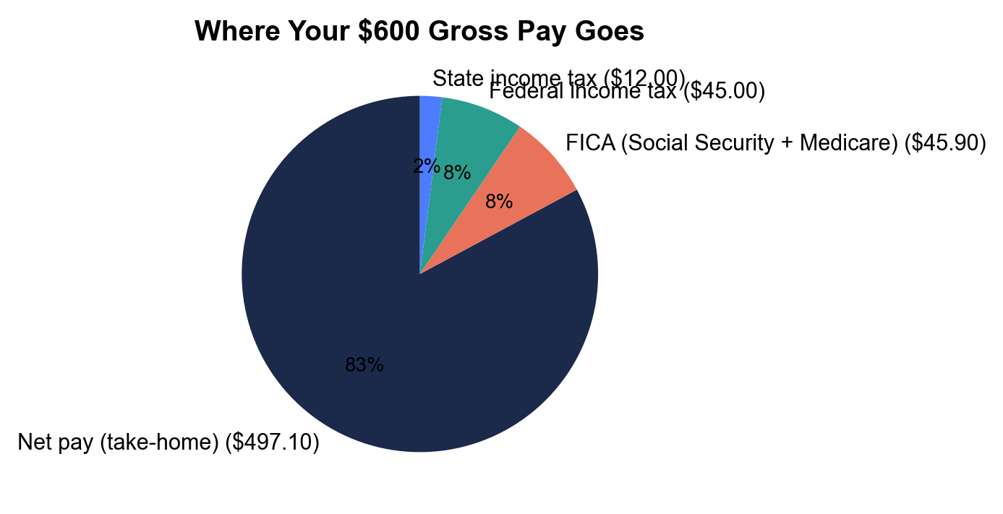
Note: Where Your $600 Gross Pay Goes
Breakdown of a $600 biweekly paycheck: net pay vs each deduction.
© More Lessons Less Planning | morelessonslessplanning.com
Notes:
Have students read the pie chart slice by slice. The largest slice is net pay (take-home, ~$497). The three deduction slices are FICA (Social Security + Medicare combined, $45.90), federal income tax (~$45), and state income tax (~$12). This is the chart Activity Part 3 reads.
Reference labels (point to these chart features when teaching): Net pay: biggest slice; FICA: 7.65%

Slide 11
Calculate Net Pay From Gross
Step 1: Find gross pay
Hourly rate x hours, or salary / pay periods. Example: $15 x 40 = $600
✔
Step 2: Calculate FICA
Gross x 7.65%. Example: $600 x 0.0765 = $45.90
✔
Step 3: Add the income taxes
Federal + state withholding from the pay stub. Example: $45 + $12 = $57
✔
Step 4: Subtract all deductions
Net = Gross - (FICA + federal + state). Example: $600 - $102.90 = $497.10
✔
Remember: FICA is always 7.65% of gross. Income-tax withholding varies by your W-4 and state - read those amounts off the pay stub.
© More Lessons Less Planning | morelessonslessplanning.com
Notes:
Walk the four-step net-pay calculation explicitly: (1) find gross, (2) compute FICA at 7.65%, (3) add federal + state withholding, (4) subtract everything from gross. Use the $600 example throughout so students see the same numbers from the pie chart resolve to net pay. This is the exact skill Activity Part 4 tests.

Slide 12
Key Takeaways
Gross pay = earnings before deductions; net pay = take-home after deductions
★
The three big deductions are federal tax, state tax, and FICA
★
FICA is 7.65% of gross (6.2% Social Security + 1.45% Medicare)
★
Net Pay = Gross Pay - Total Deductions
★
Always budget with net pay, not gross
★
© More Lessons Less Planning | morelessonslessplanning.com
Notes:
Read each takeaway and connect to the learning targets. T1 (gross vs net) -> Part 1 + Part 4. T2 (the deductions) -> Part 2 classification. T3 (FICA) -> Part 2 + Part 4. T4 (calculate net) -> Part 4 math. Tell students the activity puts them in the shoes of Jordan, a new hire decoding their first pay stub.

