Slide 1
Your First Job: Onboarding, I-9 & Direct Deposit
After a job offer, finish onboarding: I-9, W-4, direct deposit, and first-day documents.
© More Lessons Less Planning | morelessonslessplanning.com
Notes:
Open with the hook: getting the offer is only step one. Day one of a new job is paperwork day. Meet Jordan Ellis, a high school senior starting as a stocker at Brightway Grocery. By the end of this capstone lesson students will complete a full onboarding simulation - the same steps Jordan does - so they walk into their own first job knowing exactly what to do.

Slide 2
Learning Targets
Identify the paperwork and steps required to start a new job
★
Explain what the I-9 verifies and which documents prove work eligibility
★
Set up direct deposit using a routing number and account number
★
Assemble first-day documents and meet basic workplace expectations
★
© More Lessons Less Planning | morelessonslessplanning.com
Notes:
Read the four targets aloud. Tell students the activity puts them in Jordan Ellis's shoes on day one: read a real I-9, complete a W-4, set up direct deposit with bank numbers, and pack the right first-day documents. This pulls together everything from Unit 1 into one onboarding run-through.

Slide 3
You Got the Job - Now What?
Onboarding Is Day One
Meet Jordan Ellis
ONBOARDING makes you an official employee.
It happens before your first paycheck.
You prove eligibility, set taxes, and set up pay.
Jordan starts as a Brightway Grocery stocker.
Jordan completes the I-9 and W-4.
DIRECT DEPOSIT sends pay to the bank.
Key Concept: Onboarding makes you an employee before your first paycheck.
© More Lessons Less Planning | morelessonslessplanning.com
Notes:
Define onboarding as the paperwork and steps that make you an official employee, completed on your first days before your first paycheck. Introduce the four onboarding pieces: I-9 (can you work), W-4 (how to tax you), direct deposit (how to pay you), and first-day documents (what to bring). Jordan Ellis is the running example all lesson.

Slide 4
The I-9 and Work Eligibility
What the I-9 Proves
Who Fills Out What
Acceptable Documents
FORM I-9 verifies work eligibility.
WORK ELIGIBILITY means you can legally work.
Every new hire in the U.S. completes one.
The employee completes SECTION 1.
The EMPLOYER reviews documents and completes SECTION 2.
Section 1 is your work-eligibility attestation.
Documents prove identity and work authorization.
List A, such as a passport, proves both.
Or use a List B ID plus a List C card.
Key Concept: I-9 - employee Section 1; employer Section 2; List A or List B + C.
© More Lessons Less Planning | morelessonslessplanning.com
Notes:
Define Form I-9 (Employment Eligibility Verification) and work eligibility (legally allowed to work in the U.S.). Stress the two sections: the EMPLOYEE completes Section 1 (attestation); the EMPLOYER completes Section 2 after reviewing documents. Acceptable documents = List A alone, OR List B (identity) + List C (work authorization). Jordan does Section 1; Brightway does Section 2. The next slide shows the real form.

Slide 5
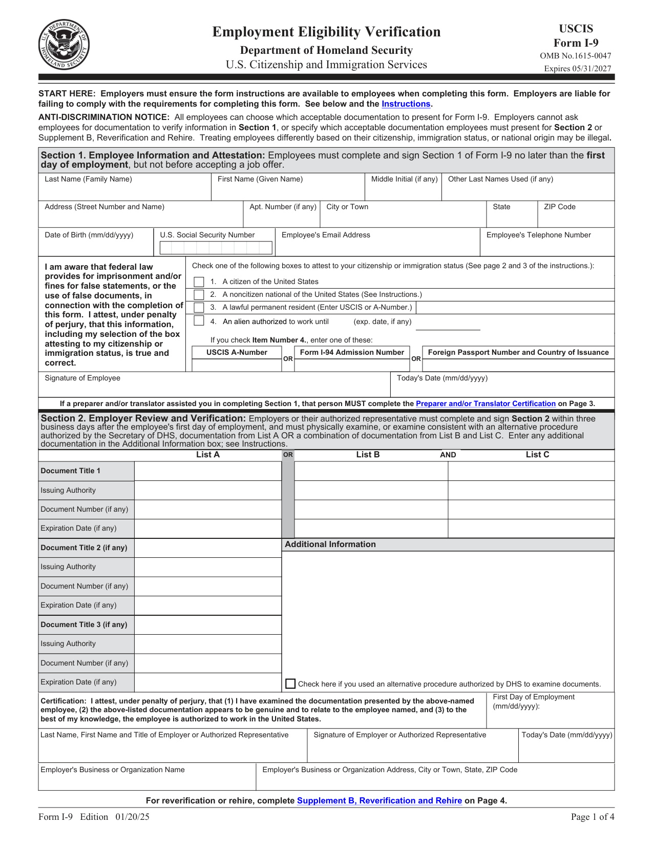
Note: The Official USCIS Form I-9
The official one-page USCIS Form I-9 (public domain, uscis.gov).
© More Lessons Less Planning | morelessonslessplanning.com
Notes:
Display the official USCIS Form I-9. Walk students to Section 1 (Employee Information and Attestation - the part Jordan completes) and Section 2 (Employer Review and Verification - the part Brightway completes). Point out the List A / List B / List C document columns. Tell students they will read this same form in Activity Part 3.
Reference labels (point to these chart features when teaching): Section 1: employee; Section 2: employer

Slide 6
The W-4 (Quick Recall)
What the W-4 does
FORM W-4 tells your employer how much federal income tax to withhold from each paycheck
✔
When you complete it
You complete the W-4 during onboarding, right alongside the I-9, before your first paycheck
✔
What you fill in
Step 1 is your name, address, Social Security number, and filing status; Step 5 is your signature - those two steps are required for everyone
✔
Why it matters
A W-4 that matches your situation means the right amount is withheld - not too much, not too little - so there are no surprises at tax time
✔
Remember: The W-4 sets your federal income tax WITHHOLDING. The I-9 proves you can work; the W-4 sets how you are taxed.
© More Lessons Less Planning | morelessonslessplanning.com
Notes:
Quick recall of the W-4 from earlier in the unit (TK_03). Form W-4 tells the employer how much federal income tax to withhold. Completed during onboarding alongside the I-9. Steps 1 and 5 are required for everyone (personal info + filing status, and signature). A matching W-4 means the right withholding and no tax-time surprises. Keep this brief - it is recall, and students complete a W-4 in Activity Part 4.

Slide 7
Setting Up Direct Deposit
What Direct Deposit Is
The Two Numbers You Need
DIRECT DEPOSIT sends your pay straight into your bank account
It is automatic - no paper check to cash or lose
Pay usually arrives 1-2 days faster than a paper check
Most employers now require or strongly prefer it
Your ROUTING NUMBER is the nine-digit number that identifies your bank
Your ACCOUNT NUMBER identifies your specific account
Find both on a check or in your bank's app
Give both to payroll so your paycheck lands automatically
Key Concept: DIRECT DEPOSIT needs two numbers - your ROUTING NUMBER (your bank) and your ACCOUNT NUMBER (your account).
© More Lessons Less Planning | morelessonslessplanning.com
Notes:
Define direct deposit: an electronic transfer that sends pay straight into your bank account automatically, faster and safer than a paper check. To set it up payroll needs two numbers: the routing number (9 digits, identifies the bank) and the account number (identifies your account). Both are on a check (or a voided check) or in the bank app. Jordan sets this up so the Brightway paycheck arrives automatically.

Slide 8
First-Day Documents Checklist
A photo ID
Bring a government photo ID such as a driver's license or state ID - it is your List B identity document for the I-9
✔
Proof of work authorization
Bring a Social Security card (List C) as work authorization, or one passport (List A) for both
✔
Your bank numbers
Bring your routing number and account number (a voided check works) so you can set up DIRECT DEPOSIT
✔
Personal information
Know your address, Social Security number, and an emergency contact for the W-4 and other onboarding forms
✔
Remember: Pack your FIRST-DAY DOCUMENTS - a photo ID, proof of work authorization, and your bank numbers - so you finish in one trip.
© More Lessons Less Planning | morelessonslessplanning.com
Notes:
First-day documents = what you bring so you can finish onboarding in one visit. The I-9 drives the list: a List B photo ID (driver's license/state ID) plus a List C document (Social Security card), OR one List A document (passport). Plus bank routing and account numbers for direct deposit, and personal info (address, SSN, emergency contact) for the W-4. Forgetting documents means a second trip and a delayed start.

Slide 9
Workplace Expectations
Show up on time
WORKPLACE EXPECTATIONS start with reliability - arriving on time and ready for every shift is the number one thing a new employee can control
Dress for the job
Follow the dress code or uniform rules; looking the part shows you take the job seriously
Follow the rules
Learn and follow your employer's policies - safety rules, break rules, and phone rules - from your first shift
Communicate
Tell your supervisor early if you will be late or absent, and ask questions when you are unsure instead of guessing
Did You Know? WORKPLACE EXPECTATIONS - on time, dressed right, following rules, communicating - are how a new hire keeps the job.
© More Lessons Less Planning | morelessonslessplanning.com
Notes:
Define workplace expectations: the basic standards a new employee is expected to meet. The big four for a first job: show up on time (reliability), dress for the job (dress code/uniform), follow the rules (safety, breaks, phones), and communicate (tell your supervisor early, ask questions). These keep the job you just onboarded into. Keep it practical and encouraging.

Slide 10
Simulate: Complete the Onboarding
Step 1: Prove you can work
Step 2: Set taxes and pay
Step 3: Be ready to work
Complete I-9 Section 1.
Show documents proving WORK ELIGIBILITY.
The employer completes Section 2.
Complete the W-4 for tax withholding.
Give routing and account numbers for DIRECT DEPOSIT.
Payroll can now withhold taxes and pay you.
Bring FIRST-DAY DOCUMENTS.
Meet WORKPLACE EXPECTATIONS from shift one.
Finish onboarding and become an employee.
Key Concept: Order - I-9, W-4 plus direct deposit, then first-day documents.
© More Lessons Less Planning | morelessonslessplanning.com
Notes:
Tie the whole lesson together as a three-step onboarding sequence: (1) prove work eligibility with the I-9, (2) set taxes (W-4) and pay (direct deposit), (3) bring first-day documents and meet workplace expectations. This is exactly the simulation students complete in the activity for Jordan Ellis and then for themselves. The order matters: you cannot be put to work until the I-9 is done.

Slide 11
Key Takeaways
ONBOARDING is the paperwork that makes you an official employee
★
FORM I-9 proves WORK ELIGIBILITY: employee does Section 1, employer Section 2
★
Acceptable documents = List A alone, OR a List B ID plus a List C document
★
DIRECT DEPOSIT needs your ROUTING NUMBER and ACCOUNT NUMBER
★
Bring FIRST-DAY DOCUMENTS and meet WORKPLACE EXPECTATIONS to finish
★
© More Lessons Less Planning | morelessonslessplanning.com
Notes:
Read each takeaway and tie it to the activity. T1 (onboarding) -> Parts 1-2 vocabulary + the simulation. T2/T3 (I-9) -> Part 3 reading the real I-9. T4 (direct deposit) + W-4 -> Part 4. T5 (first-day docs + expectations) -> Part 5 plan. The activity has students complete a full onboarding for Jordan and then build their own onboarding checklist. This is the Unit 1 capstone - everything from paychecks to the W-4 comes together here.

