Slide 1
Xenia - The Sacred Law of Hospitality
The guest-host code that separates the Odyssey's heroes from its monsters - and what it reveals about ancient Greek values and religion.
© More Lessons Less Planning | morelessonslessplanning.com
Notes:
Open with the scene that begins the whole lesson: a ragged, exhausted stranger arrives at your door with nothing. Do you feed him and take him in, or turn him away? In ancient Greece there was a clear, sacred answer - a custom called XENIA, the law of hospitality. A host was expected to welcome, feed, and shelter a stranger before even asking who he was, and the gods themselves were believed to watch over the exchange. Set the frame at once: xenia is the single most important social value in the Odyssey. It is the invisible rule that the whole epic tests. The suitors break it, the Cyclops perverts it, and the Phaeacians and the swineherd Eumaeus honor it - and how each character treats a guest tells you exactly whether the poem sees them as a hero or a monster. Preview the honesty move too: xenia was a REAL ancient Greek custom (real history), while the Odyssey's story is MYTH - epic literature that dramatizes and idealizes that value. Both ideas will be held at once all lesson.

Slide 2
Learning Targets
Define xenia and its duties: welcome, feed, and shelter a stranger
★
Use xenia to read the Odyssey: the suitors, the Cyclops, and the Phaeacians
★
Myth vs. history: xenia was a real custom; the Odyssey idealizes it
★
© More Lessons Less Planning | morelessonslessplanning.com
Notes:
Read each target aloud. Target 1 maps to slides 3-6 (what xenia is, the duties of host and guest, the feast, and the religious backing of Zeus Xenios). Target 2 maps to slides 7-9, the heart of the lesson - the three contrasting episodes in which xenia is violated (the suitors), perverted (the Cyclops), and honored (the Phaeacians). Target 3 maps to slides 10-11 (reciprocity and guest-gifts across generations, and the honest myth-vs-history verdict). Stress the load-bearing honesty ideas from the start: xenia was a genuine, well-attested Greek custom - real history - while the Odyssey's characters and events are myth. The epic reflects and idealizes the value of xenia; it does not prove exactly how every ancient Greek behaved.

Slide 3
What Is Xenia? The Sacred Law of Hospitality
A Sacred Bond, Not Just Good Manners
Two Sides of One Word
XENIA is the sacred Greek law of hospitality: the reciprocal guest-host bond
A host must welcome, feed, and protect a STRANGER; the guest must be grateful
It was a serious religious and social duty, not merely polite behavior
XENOS is a Greek word that means BOTH 'stranger/guest' AND 'host'
The one word shows guest and host were tied together by mutual obligation
To be a good Greek was to know how to be both a good host and a good guest
Key Concept: XENIA is the sacred law of hospitality - the reciprocal bond between a host and a STRANGER-guest (XENOS), watched by the gods.
© More Lessons Less Planning | morelessonslessplanning.com
Notes:
Define the central term before anything else. XENIA (say: ZEN-ee-uh) is the sacred ancient Greek law of hospitality - the reciprocal guest-host bond. The core idea: when a STRANGER arrived at your home, you were expected to take him in, feed him, and protect him, and in return the guest owed you courtesy, gratitude, and the same treatment if you ever came to his door. Stress that this was a serious social AND religious duty, not just good manners - a Greek who mistreated a guest was breaking a sacred rule. Teach the key vocabulary word XENOS: in Greek this single word means BOTH 'stranger/guest' AND 'host.' That is not an accident - the language itself shows that guest and host were bound together by mutual obligation; they were two sides of the same relationship. Explain why xenia mattered so much in a world with no hotels, no police to protect travelers, and dangerous roads: a traveler far from home was completely vulnerable, so a culture-wide rule that any household must shelter a stranger was, in effect, ancient Greece's safety net for travelers. Set up the rest of the lesson: this real custom is the invisible rule the whole Odyssey is built to test.

Slide 4
The Rules of Xenia: What Host and Guest Owe
What the HOST Owes
What the GUEST Owes
Show HOSPITALITY: welcome, bathe, feed, and shelter the stranger
Do all this BEFORE asking who the guest is or why he has come
When the guest leaves, send him off safely with a guest-gift
A good GUEST is courteous, grateful, and does not overstay or plunder
The guest must respect the host's home and never abuse the welcome
Later, the guest owes the host the same hospitality in return
Key Concept: HOSPITALITY means welcoming, feeding, and sheltering a stranger BEFORE asking who they are - and a good guest never abuses that welcome.
© More Lessons Less Planning | morelessonslessplanning.com
Notes:
Now make the abstract custom concrete by listing the actual duties. Start with the HOST, whose duty is HOSPITALITY - the core action of xenia. A proper Greek host was expected to welcome the stranger at the door, give him water to wash, provide a comfortable seat, and above all FEED him a real meal - and to do all of this BEFORE asking who he was, where he came from, or what he wanted. That order matters: you help the stranger FIRST, and ask questions later, because a person in need must be cared for before anything else. When the guest finally departs, the host sends him off safely and gives him a parting guest-gift. Now the GUEST's side, because xenia runs both ways. A good guest is courteous and grateful, respects the host's home, does not overstay his welcome, and above all does not abuse or plunder his host. And crucially, the guest owes the host the SAME hospitality in return if the host ever comes to his door - which is what makes the bond last. Preview the next slide: to picture the feast at the center of Greek hospitality, we will look at a real ancient Greek vase showing a symposium - a Greek feast - and the great mixing bowl (krater) used to serve wine to guests.

Slide 5
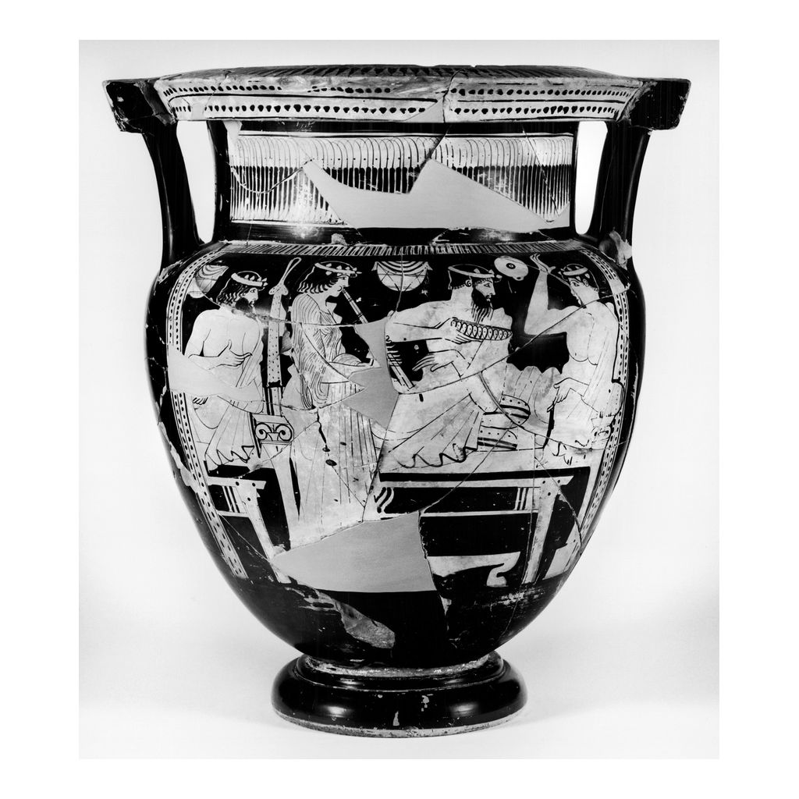
A Greek Feast: The Krater at the Center of Hospitality
Attic red-figure krater: banqueters around the wine-mixing bowl of a Greek feast
© More Lessons Less Planning | morelessonslessplanning.com
Notes:
This is a real ancient Greek vase - an Attic red-figure krater. A KRATER is a large mixing bowl, and it was the single most important object at a Greek feast, or symposium: wine was poured into it, mixed with water, and then ladled out to every guest. In other words, the krater IS the vessel of Greek hospitality - the bowl from which a host served his guests. Have students look at the painted scene of Greek men at a feast and notice how central shared food and drink were to Greek social life. Connect the image honestly to the previous slide: feeding a guest was the heart of xenia, and this vase shows the real feasting culture behind that custom. Keep the honest caption in view: this is genuine ancient Greek ART depicting a real Greek feast - NOT a scene from the Odyssey and NOT a movie image. It is here to help students picture what 'feed the stranger' actually looked like in the Greek world: a place at the feast and a cup from the great mixing bowl.
Reference labels (point to these chart features when teaching): the krater (wine-mixing bowl); banqueters at the feast

Slide 6
Zeus Xenios: Hospitality as a Sacred Duty
Zeus Xenios
ZEUS XENIOS is Zeus in his role as protector of guests, strangers, and suppliants. Because he watched over hospitality, how you treated a guest was watched by the gods.
Suppliant
A SUPPLIANT is a person who begs for protection or hospitality, often a stranger far from home; suppliants were placed under the special protection of the gods.
Why it was sacred
Xenia was not just polite - it was a religious duty. Mistreating a guest was an offense against the gods and risked DIVINE punishment; honoring one earned divine favor.
Strangers come from Zeus
The Greek belief was that any stranger might be under Zeus's protection - so you fed the stranger first, because 'strangers and beggars come from Zeus.'
Big Idea: ZEUS XENIOS protected guests, strangers, and SUPPLIANTS - so mistreating a guest risked DIVINE punishment from the gods.
© More Lessons Less Planning | morelessonslessplanning.com
Notes:
Explain WHY xenia was so binding: it was backed by religion. Introduce ZEUS XENIOS - the same Zeus, king of the gods, but named here in his special role as the protector of guests, strangers, and SUPPLIANTS. (Teach the word SUPPLIANT: a person who begs for protection or hospitality, often a stranger or traveler far from home and completely at the mercy of others; the Greeks believed suppliants were placed under the special protection of the gods.) Make the religious logic clear and academic: because Zeus Xenios watched over hospitality, how you treated a guest was, in effect, watched by the gods. Mistreating a guest was not just rude - it was a SACRED offense that risked DIVINE punishment, while honoring a guest earned divine favor. This is the belief captured in the famous line students will read in the primary source: 'strangers and beggars come from Zeus.' It meant that any ragged stranger at your door MIGHT be under the protection of Zeus - even, in some stories, a god in disguise testing you - so the safe and pious thing was to feed the stranger first and ask questions later. Handle all of this academically, in the Unit 5 manner: we are studying what the ancient Greeks BELIEVED and how that belief shaped their behavior, not endorsing the religion. The gods and Zeus Xenios are ancient belief and practice, analyzed as history.

Slide 7
The Suitors: Xenia Violated
Guests Who Plunder Their Host
Why It Dooms Them
The SUITORS move uninvited into Odysseus's house while he is away
They DEVOUR his herds, wine, and wealth for years and abuse his servants
They are guests who plunder their host - the opposite of a good guest
They wreck the guest's side of xenia: they abuse the HOUSEHOLD, not honor it
They even mistreat the disguised Odysseus when he comes as a beggar
In the epic, breaking xenia is the crime the gods finally punish
Key Concept: The SUITORS VIOLATE xenia - guests who DEVOUR their host's HOUSEHOLD instead of respecting it.
© More Lessons Less Planning | morelessonslessplanning.com
Notes:
Now use xenia to read the Odyssey, starting with its clearest villains: the SUITORS. Remind students of the setup: Odysseus has been gone from Ithaca for twenty years, and while he is away, a crowd of local men - the suitors - move UNINVITED into his house, claiming to court his wife Penelope. But watch what they actually do: they DEVOUR his herds, drink his wine, and burn through his wealth for years, while bullying his servants and even abusing the disguised Odysseus when he returns dressed as a beggar. Frame this precisely through xenia: the suitors are the great VIOLATORS of hospitality. They wreck the GUEST'S side of the bond - instead of being grateful, respectful guests who never overstay or plunder, they are the exact opposite: guests who plunder their host's HOUSEHOLD and consume everything. This is the key point for students: in the Odyssey, the suitors' real crime is not just rudeness - it is a fundamental violation of xenia, the sacred law. And because xenia was sacred, breaking it so grossly is what marks the suitors for destruction; the epic treats their eventual downfall as fully deserved. The suitors show what xenia looks like when a GUEST betrays it.

Slide 8
The Cyclops: Xenia Perverted
Polyphemus
POLYPHEMUS is the one-eyed Cyclops who traps Odysseus and his men in his CAVE. Instead of feeding his guests, he eats them - a monstrous host.
Xenia turned upside down
The Cyclops PERVERTS xenia: he is a host who devours his guests. He mocks the whole custom and says he cares nothing for the gods of hospitality.
Why he is a monster
Odysseus even asks for the guest-gift a host owes; the Cyclops 'gift' is to eat Odysseus last. Breaking xenia this way is what makes him a monster.
The punishment
Odysseus blinds the Cyclops to escape. In the epic, a host who devours guests has earned his fate - the perversion of xenia is the point.
Key Concept: POLYPHEMUS the Cyclops PERVERTS xenia - a HOST who eats his guests in his CAVE instead of feeding them - the mirror image of the suitors.
© More Lessons Less Planning | morelessonslessplanning.com
Notes:
Give students the second, mirror-image test case: the Cyclops POLYPHEMUS. Where the suitors are bad GUESTS, the Cyclops is the ultimate bad HOST. Tell the episode through the lens of xenia: Odysseus and his men land on the Cyclops's island and enter his CAVE, expecting the normal rules of hospitality - a host should feed a guest. Instead, the giant Polyphemus traps them inside by rolling a huge stone across the entrance, and then, horrifyingly, begins EATING his guests two at a time. This is the deliberate literary point: the Cyclops PERVERTS xenia - he turns it completely upside down. A host is supposed to feed his guests; this host devours them. Homer even sharpens the contrast: Odysseus formally asks for the guest-gift a host owes a visitor, and the Cyclops sneers that his 'gift' will be to eat Odysseus LAST - a cruel mockery of the custom. Polyphemus also declares that the Cyclopes care nothing for Zeus or the gods of hospitality, which in the Greek moral world marks him as savage and lawless. So when Odysseus blinds the Cyclops with a burning stake to escape, the epic frames it as deserved: a host who eats his guests has broken the most sacred of bonds. Together, the suitors (bad guests) and the Cyclops (bad host) show xenia violated from BOTH sides.

Slide 9
The Phaeacians: Xenia Honored
The Ideal Hosts
Guest-Gifts and Safe Passage
The PHAEACIANS find the shipwrecked Odysseus washed up with nothing
They bathe him, feast him, and treat him as an honored guest
They do it before they even know his name - textbook xenia
They load Odysseus with rich GIFTS to honor the bond of xenia
Then they give him what he needs most: a ship to sail him HOME
The Phaeacians are the poem's model of hospitality done right
Key Concept: The PHAEACIANS HONOR xenia perfectly - they feast the shipwrecked stranger, load him with GIFTS, and sail him safely HOME to Ithaca.
© More Lessons Less Planning | morelessonslessplanning.com
Notes:
Give students the third test case - the positive model that completes the pattern: the PHAEACIANS. After the gods wreck his raft, Odysseus washes up, exhausted and with nothing, on the island of the Phaeacians (Scheria), ruled by King Alcinous. Watch how they treat a helpless stranger: they clothe and BATHE him, seat him in the place of honor, FEAST him, and hold games and entertainment for him - and, importantly, they do all of this BEFORE they even know who he is. This is textbook xenia, hospitality done exactly right. Then they complete the custom in the two ways that matter most. First, they load Odysseus with rich GUEST-GIFTS - treasure to honor the bond of hospitality and send him off in dignity. Second, and most important of all, they give him the one thing he truly needs: a ship and crew to carry him safely HOME to Ithaca at last, ending his ten-year journey. The Phaeacians are the poem's shining model of xenia HONORED. Set the full three-part pattern for students: the SUITORS violate xenia (bad guests), the CYCLOPS perverts it (bad host), and the PHAEACIANS honor it (perfect hosts). One custom - xenia - sorts the entire cast of the Odyssey into heroes and villains. Note that the primary-source reading will show a fourth, humbler example of xenia honored: the poor swineherd Eumaeus, who feeds the disguised Odysseus though he has almost nothing.

Slide 10
Reciprocity and Guest-Gifts: A Bond Across Generations
Reciprocity
RECIPROCITY is the mutual give-and-take at the heart of xenia: a host gives shelter and gifts, and the guest owes courtesy, gratitude, and hospitality in return.
Xenion (guest-gift)
A XENION is the guest-gift a host gives a departing guest to honor the bond of xenia and create a lasting tie between their two households.
A lasting BOND
The bond of xenia did not end when the guest left - it lasted, and could be passed down, so descendants of guest-friends still owed each other hospitality.
Why gifts mattered
Guest-gifts were not payment - they were proof of the bond. Exchanging xenia gifts turned strangers into permanent guest-friends across cities and generations.
Big Idea: RECIPROCITY makes xenia last - a XENION (guest-gift) seals a BOND between households that could be passed down for generations.
© More Lessons Less Planning | morelessonslessplanning.com
Notes:
Deepen students' understanding of what made xenia more than a one-time meal: RECIPROCITY. Xenia was built on mutual give-and-take - the host gives shelter, protection, and gifts, and in return the guest owes courtesy, gratitude, and the SAME hospitality if the two ever meet again. Introduce the guest-gift by its Greek name, the XENION: the parting present a host gives a departing guest. Stress the crucial point: guest-gifts were NOT payment for a night's stay - they were proof of the bond, physical tokens that turned two strangers into permanent 'guest-friends.' And here is what students often find surprising: the BOND created by xenia did not end when the guest went home. It lasted - and it could be passed DOWN through families. Descendants of two men who had exchanged xenia still owed each other hospitality generations later; in the Iliad, two warriors on opposite sides even refuse to fight once they discover their grandfathers were guest-friends, and they exchange armor instead. So xenia was a way of building lasting alliances and trust across different cities in a world with no international law: a network of guest-friendships, sealed by gifts, that bound households together across distance and time. This is the real historical custom - reciprocity, guest-gifts, and lasting bonds - that stands behind every hospitality scene in the Odyssey.

Slide 11
Myth vs. History: Xenia Was Real, the Odyssey Is Epic
What Is Real History
What Is Myth
XENIA was a genuine, well-attested ancient Greek CUSTOM
Reciprocity, guest-gifts, and Zeus Xenios were real Greek belief and practice
This part is citable history - it shows what the Greeks truly VALUED
The Odyssey's characters and events are MYTH - epic literature
The suitors, the Cyclops, and the Phaeacians are story, not documentary
The epic REFLECTS and idealizes xenia; it does not prove how every Greek acted
Big Idea: Xenia the CUSTOM is real history; the Odyssey is MYTH that idealizes it - revealing Greek VALUES, not documenting real behavior.
© More Lessons Less Planning | morelessonslessplanning.com
Notes:
Pull the lesson together with the honest-historian move, keeping the two ideas cleanly separate. First, what is REAL history: XENIA itself was a genuine, well-attested ancient Greek CUSTOM. Historians know from many sources that Greeks really did practice reciprocal guest-friendship, really did exchange guest-gifts, and really did connect hospitality to religion through Zeus Xenios. Reciprocity, the xenion, and the protection of suppliants were real Greek belief and practice - this part is citable history, and it shows us what the ancient Greeks genuinely VALUED. Now, just as clearly, what is MYTH: the Odyssey's characters and events are epic literature. There was (almost certainly) no man-eating Cyclops, no island of magically generous Phaeacians, no exact house of exactly these suitors. So we must NOT say 'the Odyssey PROVES the Greeks did X.' The honest way to read it is this: the Odyssey REFLECTS and IDEALIZES the real value of xenia. It takes a custom the Greeks actually held sacred and dramatizes it - showing xenia perfectly honored (the Phaeacians, Eumaeus), grossly violated (the suitors), and monstrously perverted (the Cyclops) - to teach and reinforce that value. So the epic is a window into what the Greeks VALUED about hospitality, not a documentary record of how every Greek behaved. Hold both truths at once: the custom is history; the story is myth that reveals the culture's ideals.

Slide 12
Key Takeaways
XENIA: the sacred law of hospitality - welcome, feed, and shelter a stranger
★
ZEUS XENIOS protected guests - breaking xenia risked divine punishment
★
Suitors VIOLATE xenia, the Cyclops PERVERTS it, the Phaeacians HONOR it
★
Xenia the CUSTOM is real history; the Odyssey is MYTH that idealizes that value
★
© More Lessons Less Planning | morelessonslessplanning.com
Notes:
Close the lesson by reviewing the four takeaways aloud. Students should be able to: (a) define XENIA as the sacred Greek law of hospitality and list its core duty - welcome, feed, and shelter a stranger before even asking who they are, sealing the bond with a guest-gift (xenion) and reciprocity; (b) explain that xenia was backed by religion through ZEUS XENIOS, protector of guests, strangers, and suppliants, so that mistreating a guest risked divine punishment ('strangers and beggars come from Zeus'); (c) use xenia to read the Odyssey's cast - the SUITORS violate it (bad guests who devour their host's household), the Cyclops POLYPHEMUS perverts it (a host who eats his guests), and the PHAEACIANS (and the swineherd Eumaeus) honor it (feasting the stranger, giving gifts, sending him home); and (d) draw the honest line - xenia the CUSTOM is genuine, citable history that reveals Greek values, while the Odyssey is MYTH / epic literature that reflects and idealizes that value, not a documentary record of how every Greek behaved. The Primary Source Spotlight now asks students to read the swineherd Eumaeus welcoming the disguised Odysseus in Homer's own words (Odyssey, Book XIV) and connect it to everything above.

