Slide 1
World Religions: A Comparative Introduction
A four-part framework for studying the world's religious traditions side by side - fairly, academically, and with respect.
© More Lessons Less Planning | morelessonslessplanning.com
Notes:
Opening slide. This lesson begins the unit on world religions - but it does not teach any single religion's doctrine yet. Instead, it teaches the METHOD: how to study the world's religions comparatively and academically. Students learn that comparative religion describes what each tradition teaches from a neutral, respectful, third-person stance, and that we can compare any tradition fairly by asking the same four questions - about its sacred text, its founder or origin, its core belief, and its central practice. By the end, students can build a comparison chart they will reuse for every religion in the unit. Set the tone from the first minute: we describe, we do not judge; every tradition is treated with equal respect.

Slide 2
Learning Targets
Explain what comparative religion is and why scholars compare traditions.
★
Name the four dimensions: sacred text, founder/origin, core belief, practice.
★
Use terms like monotheism, polytheism, doctrine, and ritual accurately.
★
Apply the four-dimension framework to build a reusable comparison chart.
★
© More Lessons Less Planning | morelessonslessplanning.com
Notes:
Read the four learning targets. Today's lesson pairs a big idea - that the world's religions can be studied fairly and academically - with a concrete tool: a four-dimension framework. Keep the neutral, comparative stance in mind throughout: our goal is to understand each tradition, not to decide which is right. The four dimensions and the comparison chart are things students will use again and again as the unit continues.

Slide 3
Studying Religions Academically
What comparative religion is
How we talk about belief
The academic study of the world's religious traditions.
It describes what each tradition teaches, side by side.
Its goal is to understand each one, not to judge or convert.
We use neutral, third-person language.
We say 'Followers of a tradition believe...'
We treat every tradition with equal respect.
Key Concept: COMPARATIVE RELIGION is the academic study of the world's traditions side by side - to understand each, not to judge.
© More Lessons Less Planning | morelessonslessplanning.com
Notes:
Let's define the method. COMPARATIVE RELIGION is the academic study of the world's religious traditions side by side, describing what each tradition teaches in order to understand every tradition more fully. Notice the key word: describe. A scholar of comparative religion is not trying to decide which religion is true, or to defend or attack any belief. The job is to understand - to lay out fairly what people in each tradition believe and do. That is why we always use neutral, third-person language: we say 'Followers of this tradition believe...' or 'The tradition teaches...', never 'we believe' or 'they are wrong.' We treat every tradition with equal respect and study each on its own terms. This neutral, describing stance is what makes the study academic, and it is the ground rule for everything else in the unit.

Slide 4
The Four-Dimension Framework
1. Sacred text (scripture)
The writings a tradition treats as holy or authoritative.
✔
2. Founder or origin
The person a tradition names as its beginning, or its origin story.
✔
3. Core belief
The central teaching about the divine, human life, and the world.
✔
4. Central practice
The main ritual or observance that followers regularly perform.
✔
Key Concept: Compare any tradition using four DIMENSIONS - SCRIPTURE, FOUNDER or origin, CORE BELIEF, and central PRACTICE.
© More Lessons Less Planning | morelessonslessplanning.com
Notes:
Here is the heart of the lesson: the four-dimension framework. To compare any tradition fairly, we ask the same four questions about it. First, its SACRED TEXT, or SCRIPTURE: what writings does the tradition treat as holy or authoritative? Second, its FOUNDER or ORIGIN: who or what began the tradition - a single founder, or a longer origin story? Third, its CORE BELIEF: what does the tradition centrally teach about the divine, human life, and the world? Fourth, its central PRACTICE: what do followers regularly do - pray, worship, keep festivals, make pilgrimages? These four questions - the four dimensions - fit every tradition, which is exactly why they let us compare fairly. Over the next slides we will look at each dimension in turn, and then use all four to build a comparison chart.

Slide 5
Dimension 1: Sacred Text
scripture
The sacred writings a religious tradition treats as authoritative or holy; also called its sacred text.
doctrine
An official teaching or principle held and passed on by a religious tradition.
Key Concept: A tradition's SCRIPTURE is its sacred writings; the official teachings drawn from them are its DOCTRINE.
© More Lessons Less Planning | morelessonslessplanning.com
Notes:
The first dimension is the sacred text, or SCRIPTURE. Scripture is the sacred writings a religious tradition treats as authoritative or holy. Different traditions have different sacred texts - for example, followers of Judaism regard the Torah as sacred, Christians the Bible, Muslims the Qur'an, many Hindu traditions the Vedas, and Confucian scholars the Analects. We describe these neutrally: each is the text that followers of that tradition treat as authoritative. From a tradition's scripture come its official teachings, which we call DOCTRINE - an official teaching or principle held and passed on within the tradition. When we compare traditions, we ask: what does each treat as its sacred text, and what doctrines does it draw from it? We describe these; we do not argue about which text is 'the real' one.

Slide 6
Dimension 2: Founder or Origin
Founder
The person a religious tradition names as its originator or first great teacher.
✔
Origin
The story of how, where, and when a religious tradition began.
✔
Key Concept: Some traditions trace themselves to a FOUNDER; others describe an ORIGIN story rather than a single founder.
© More Lessons Less Planning | morelessonslessplanning.com
Notes:
The second dimension asks how a tradition began. Some traditions name a FOUNDER - the person the tradition identifies as its originator or first great teacher. For example, Buddhist tradition looks to the Buddha, Christian tradition to Jesus, and Islamic tradition to Muhammad as the figure through whom the tradition began or was taught. Other traditions do not point to one founder at all. Instead they have an ORIGIN - a story of how, where, and when the tradition began, developing over many centuries. Hindu traditions, for instance, are usually described as having deep, gradual origins rather than a single founder. When we compare, we ask: does this tradition name a founder, or does it describe an origin without one? Both answers are normal; the framework simply lets us record what each tradition itself says.

Slide 7
Dimension 3: Core Belief
core belief
A central teaching of a tradition about the divine, human life, and the world.
monotheism
The belief in a single God.
polytheism
The belief in many gods.
Key Concept: A CORE BELIEF is a tradition's central teaching; belief about the divine ranges from MONOTHEISM (one God) to POLYTHEISM (many gods).
© More Lessons Less Planning | morelessonslessplanning.com
Notes:
The third dimension is a tradition's CORE BELIEF - a central teaching about the divine, human life, and the world. This is often where traditions differ most, and it is where we must be most careful to describe and not judge. One important comparative axis is how a tradition understands the divine. MONOTHEISM is the belief in a single God; Judaism, Christianity, and Islam are usually described as monotheistic traditions. POLYTHEISM is the belief in many gods; some traditions describe many deities. Still other traditions, such as certain forms of Buddhism, are organized around teachings that do not fit neatly into either label. Using words like monotheism and polytheism lets us compare core beliefs precisely and fairly - they are descriptions of what a tradition teaches, never a ranking of which belief is better.

Slide 8
Dimension 4: Central Practice
Practice
A central ritual, observance, or action that followers of a tradition regularly perform.
✔
Ritual
A set, repeated religious ceremony or action.
✔
Key Concept: A tradition's PRACTICE is what followers regularly do; a set, repeated action is a RITUAL.
© More Lessons Less Planning | morelessonslessplanning.com
Notes:
The fourth dimension is central PRACTICE - a central ritual, observance, or action that followers of a tradition regularly perform. Belief is not the whole of a religion; what people actually do matters just as much. Practices include prayer, worship, festivals, dietary rules, and pilgrimage. Many practices take the form of a RITUAL - a set, repeated religious ceremony or action, performed the same way each time. For example, traditions may have set times of daily prayer, weekly gatherings for worship, or yearly festivals. When we compare, we ask: what does each tradition ask its followers to do regularly, and which of these are rituals? Describing practice completes the picture: together with scripture, founder or origin, and core belief, it gives us four fair questions to ask of any tradition.

Slide 9
Putting It Together: The Comparison Chart
One chart, every tradition
Why compare this way
List the four dimensions down the side.
List each religion across the top.
Fill the same four rows for every tradition.
The same questions make comparisons fair.
Similarities and differences stand out clearly.
You understand each tradition more fully.
Key Concept: The comparison CHART asks the same four dimensions of every tradition - the heart of COMPARATIVE RELIGION: study side by side.
© More Lessons Less Planning | morelessonslessplanning.com
Notes:
Now we put the four dimensions to work in a comparison CHART. The chart is simple: list the four dimensions - scripture, founder or origin, core belief, and practice - down the left side, and list each religion across the top. Then, for every tradition, you fill in the same four rows. Because each tradition is asked exactly the same four questions, the comparison is fair: no tradition is measured by another's standards. And because everything sits side by side, similarities and differences jump out - you can see at a glance which traditions share a founder figure, which are monotheistic, which emphasize the same kinds of practice. This is exactly what comparative religion does. You will build and add to this chart for each religion in the unit - Hinduism, Buddhism, Judaism, Christianity, Islam, Confucianism, and Daoism - so keep it handy.

Slide 10
Where the World's Religions Are Today
A global picture
Read the map carefully
Major traditions are spread across every continent.
Some are concentrated in regions; others are worldwide.
The map shows where each is most widely followed.
A map shows where, not how strongly, people follow.
Borders on the map are not sharp in real life.
Many places are religiously mixed and diverse.
Key Concept: The world's major religious traditions are spread across the globe; a distribution MAP shows where each is most widely followed today.
© More Lessons Less Planning | morelessonslessplanning.com
Notes:
Before we practice the method, let's get a global picture. On the next slide is a distribution MAP showing where each of the world's major religious traditions is most widely followed today. A few things to notice, all in our neutral, careful spirit. First, the world's major traditions are spread across every continent; some are concentrated in particular regions, while others are followed worldwide. Second, read a map like this carefully: it shows WHERE a tradition is most common, not how strongly individuals believe or practice. Third, the crisp colors and borders on the map are simpler than reality - almost every region is religiously mixed and diverse, and boundaries are fuzzy. So we use the map as a helpful overview of distribution, not as a claim that any place has only one kind of belief.

Slide 11
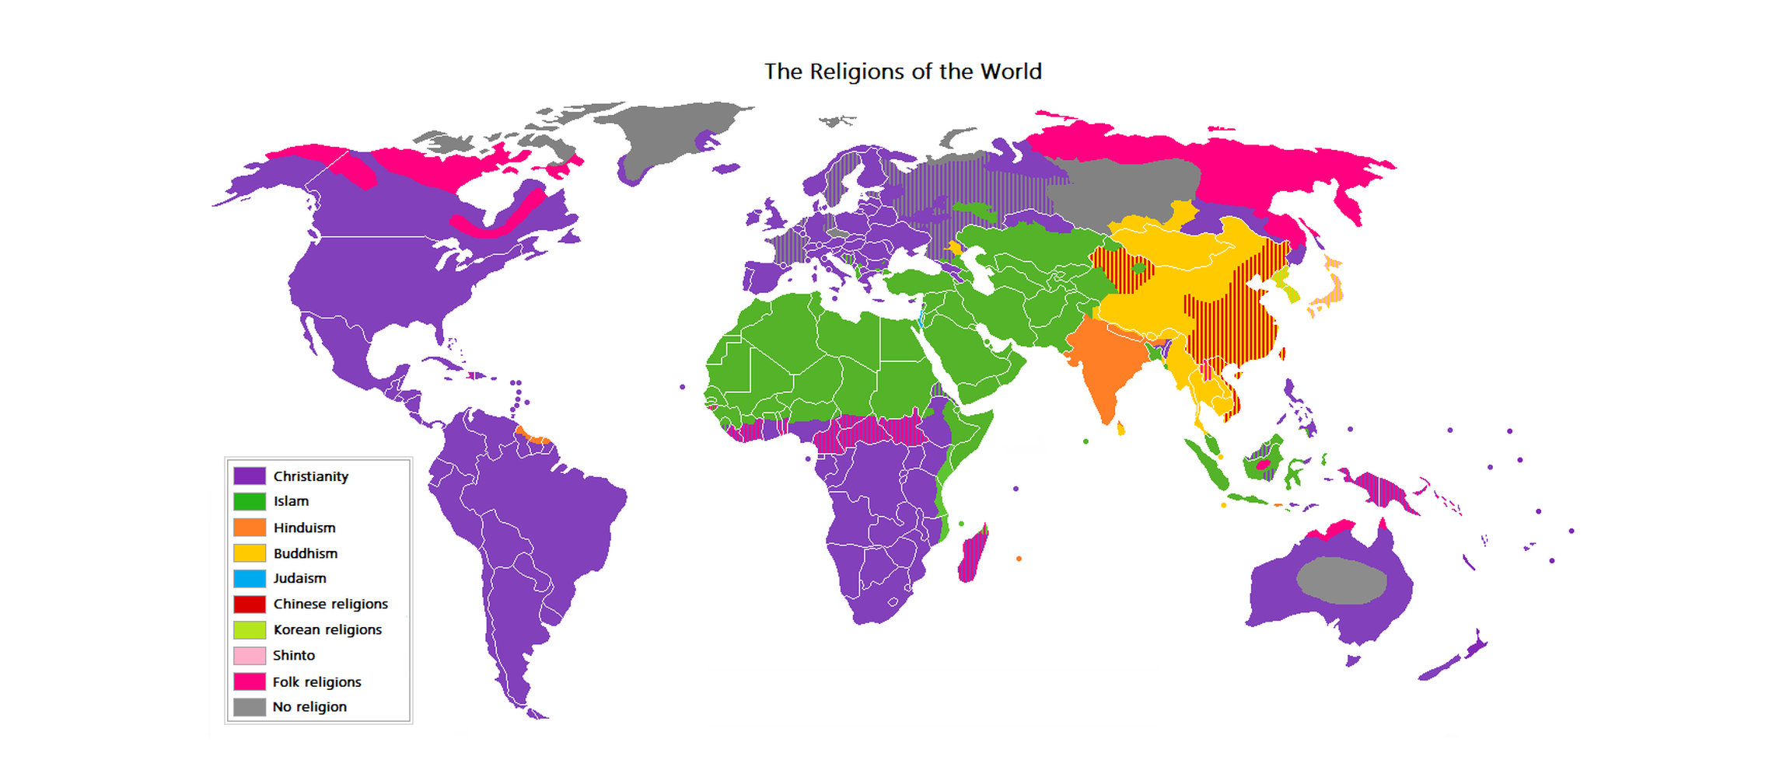
Mapping the World's Religions
The geographic distribution of the world's major religions today.
© More Lessons Less Planning | morelessonslessplanning.com
Notes:
Public-domain world map ('The Religions of the World', Wikimedia Commons) colored by prevailing tradition, with a legend covering Christianity, Islam, Hinduism, Buddhism, Judaism, Chinese religions, Korean religions, Shinto, folk religions, and no religion. Use it purely as a reference overview of where traditions are most widely followed. Remind students of the cautions from the previous slide: it shows distribution, not strength of belief, and real regions are mixed. Students are not asked to decode the map as evidence.

Slide 12
A Pioneer of Comparative Study: F. Max Muller
Who he was
F. Max Muller (1823-1900) was a scholar at Oxford who helped found the modern academic study of religion.
✔
What he did
He edited The Sacred Books of the East, translating major scriptures so Western readers could study them fairly.
✔
His key idea
You understand any one religion better by comparing it with others; this is the heart of comparative religion.
✔
Key Concept: F. MAX MULLER argued that studying religions COMPARATIVELY - side by side - reveals each one more fully.
© More Lessons Less Planning | morelessonslessplanning.com
Notes:
Where does the comparative method come from? One of its pioneers was F. MAX MULLER (1823-1900), a German-born scholar who worked at Oxford in England and helped found the modern academic study of religion. Muller's most famous project was editing The Sacred Books of the East, a large series that translated the major scriptures of Asian traditions - Hindu, Buddhist, Confucian, Daoist, and others - so that Western readers could study them fairly and at first hand, instead of relying on rumor. His central idea is the one behind our whole lesson: you understand any single religion better when you compare it with others. Muller famously argued that someone who knows only one religion, in a sense, understands none - because without comparison you cannot tell what is essential to a tradition and what is simply familiar. In the Activity, you will read a passage from his 1879 argument for exactly this comparative approach.

Slide 13
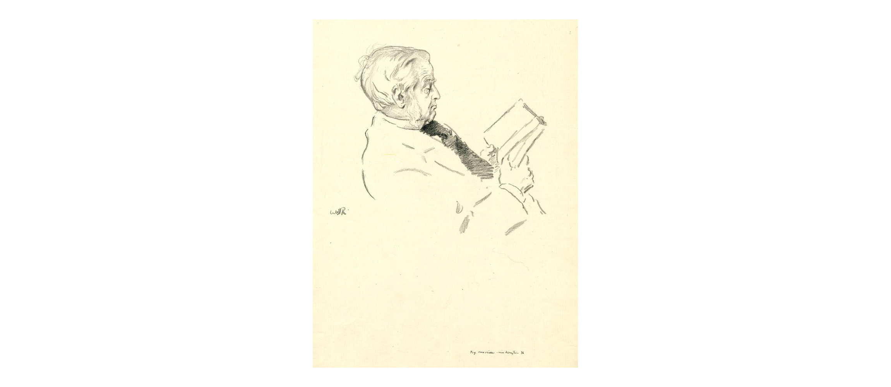
F. Max Muller (1823-1900)
F. Max Muller, a pioneering scholar of comparative religion (1894 portrait).
© More Lessons Less Planning | morelessonslessplanning.com
Notes:
Public-domain 1894 lithograph portrait of F. Max Muller (British Museum, Wikimedia Commons), shown seated in profile reading a book. Use it simply to put a face to the scholar whose 1879 argument students analyze in the Primary Source Spotlight. Students are not asked to decode the portrait as evidence.

Slide 14
Key Takeaways
Comparative religion studies traditions side by side - describe, don't judge.
★
The four dimensions: sacred text, founder/origin, core belief, practice.
★
Belief ranges from monotheism to polytheism; the framework describes, not ranks.
★
The same four-dimension chart works for every tradition you study.
★
© More Lessons Less Planning | morelessonslessplanning.com
Notes:
Let's recap the method you now have. First, comparative religion is the academic study of the world's traditions side by side; its goal is to understand each one, using neutral, third-person language and treating every tradition with equal respect - we describe, we never judge. Second, we compare any tradition using the four dimensions: its sacred text or scripture, its founder or origin, its core belief, and its central practice. Third, comparative vocabulary such as monotheism and polytheism, or doctrine and ritual, lets us describe differences precisely without ranking any belief as better or worse. Fourth, the four dimensions combine into one comparison chart that you will reuse for every religion in the unit. As F. Max Muller argued back in 1879, you understand any one tradition more fully by comparing it with others. That method is the tool you will carry through the rest of Unit 5.

