Slide 1
Why Your Mortgage Is 7%
Why 30-year mortgages are tied to Treasury bonds, not the fed funds rate - and why that froze the housing market.
© More Lessons Less Planning | morelessonslessplanning.com
Notes:
Open with the price-tag shock. A typical 30-year fixed mortgage in 2026 charges about 7% interest. Just three years earlier the same loan cost about 3%. That doubling is the largest, fastest mortgage rate move since 1981 - and it is the reason housing supply collapsed and a generation of homeowners is now stuck in place. Today's lesson explains WHY mortgage rates moved the way they did, the mechanical connection to the 10-year Treasury yield, and the lock-in effect that froze the U.S. housing market in 2023-2024.

Slide 2
Learning Targets
Explain why mortgage rates track the 10-year Treasury, not fed funds
★
Trace the 2022-2024 mortgage rate spike from about 3% to about 7%
★
Evaluate the lock-in effect: how a wide rate gap freezes housing supply
★
© More Lessons Less Planning | morelessonslessplanning.com
Notes:
Read the three targets aloud. Tell students the activity will put them in the seat of a financial advisor reviewing four real-world homeowner profiles - each deciding whether to sell their home and rebuy at 7%. They will compute the rate gap, the monthly payment delta, and write a stay-or-sell recommendation for each family. Then they will zoom out: when millions of households face the same math, the entire housing market freezes.

Slide 3
Why Are Mortgages 7% in 2026?
7%
3%
Average 30-year mortgage rate, 2026
Average 30-year mortgage rate, late 2020-2021
Did You Know? October 2023 saw 30-year mortgage rates hit 7.79% - the highest in 23 years (since 2000).
© More Lessons Less Planning | morelessonslessplanning.com
Notes:
Anchor the price tag. A 30-year mortgage at 3% lets a family borrow $400,000 for about $1,686 per month (principal and interest). The same loan at 7% costs $2,661 per month. That is $975 more per month for the same house - about $11,700 more per year - and it compounds over the 30-year loan into roughly $350,000 in extra interest. This is the lived experience that makes housing feel impossible in 2026. The rest of the lesson explains WHY mortgage rates moved this way and what it would take for them to come back down.

Slide 4
Mortgages Are LONG-TERM Loans
How a 30-Year Mortgage Works
Why Term Length Matters
Term: 30 years (the standard U.S. mortgage)
Rate: typically FIXED for the entire 30 years
Backed by collateral: the home itself
Lender: a bank or credit union (initially)
30-year loan = lender's money tied up 30 years
Lender prices the loan based on LONG-TERM rates
Short-term rates (fed funds) are mostly irrelevant
The benchmark is the 10-year Treasury yield
Key Concept: A 30-year loan is priced against the 10-year Treasury yield, NOT the overnight fed funds rate.
© More Lessons Less Planning | morelessonslessplanning.com
Notes:
The single most common student misconception is that the Federal Reserve directly sets mortgage rates. It does not. The Fed sets the federal funds rate, which is the OVERNIGHT rate for banks lending to each other. A 30-year mortgage is a 30-year loan. To price a 30-year loan, lenders look at LONG-TERM interest rates - specifically the 10-year Treasury yield, which is the most-watched long-term U.S. government bond rate. This distinction is the key to understanding why mortgage rates barely moved in fall 2024 even when the Fed cut its rate.

Slide 5
The 10-Year Treasury Connection
What Is the 10-Year Treasury?
Why Mortgages Follow It
Who Sets the Yield?
U.S. government debt with a 10-year maturity
Often considered the safest dollar investment
Its YIELD benchmarks long-term lending
Mortgages are long-term loans backed by collateral
Investors compare their risk with Treasuries
They yield MORE, so rates move with Treasury yields
Global bond investors trade Treasuries daily
Supply and demand set the yield; the Fed only influences it
Inflation expectations are the main driver
Note: The 10-year Treasury yield is set by GLOBAL BOND MARKETS - the Fed influences it, but does not set it.
© More Lessons Less Planning | morelessonslessplanning.com
Notes:
Walk students through the linkage. The 10-year Treasury bond is U.S. government debt that matures in 10 years. Its YIELD - the interest rate the government effectively pays - is set by global bond markets every day. About $20 trillion in U.S. Treasury debt is outstanding and trades constantly. Mortgages are long-term loans secured by a home, which makes them similar in risk profile to long-term Treasuries (with a bit more risk and less liquidity, hence the spread). When Treasury yields rise, mortgage rates have to rise too, or no investor would buy mortgage-backed securities. This is the central mechanism of the entire lesson.

Slide 6
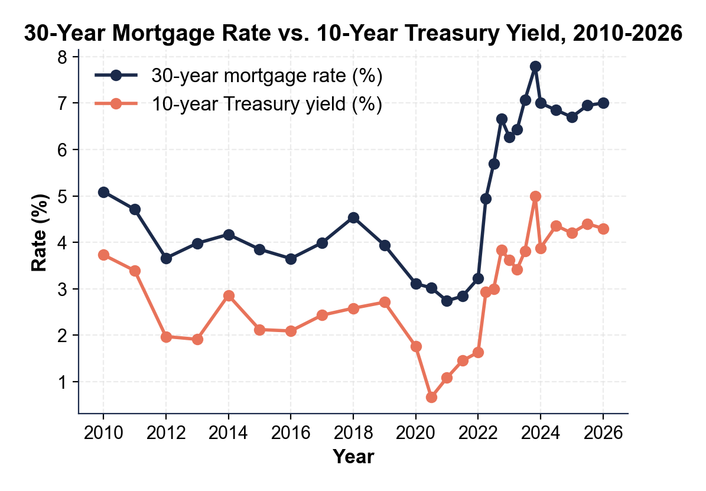
Mortgage Rate vs. 10-Year Treasury
Note: The lines move in lockstep; the gap is the spread.
© More Lessons Less Planning | morelessonslessplanning.com
Notes:
Trace both curves with students. The 10-year Treasury yield (lower line) and the 30-year mortgage rate (upper line) move in parallel - that parallel movement is the visual proof that mortgages track Treasuries, not fed funds. The gap between the two lines is roughly 150 to 200 basis points (1.5 to 2.0 percentage points) and represents lender margin and the small extra risk of mortgages versus government debt. Notice the 2010-2021 era of low rates, the sharp 2022 climb, the late 2023 peak, and the slight 2024-2026 easing.
Reference labels (point to these chart features when teaching): Spread ~150-200 bp; Both move together

Slide 7
How Mortgage Rates Are Actually Set: Treasury + Spread
Step 1: 10-Year Treasury Yield
Set by global bond markets - investor demand for safe long-term debt
✔
Step 2: Add the Mortgage Spread
Roughly 150 to 200 basis points (1.5 to 2.0 percentage points) added on top
✔
Spread Reflects
Prepayment risk + servicing costs + credit risk + investor margin
✔
Example: October 2023
10-year Treasury at 4.99% + mortgage spread of 2.80 pp = 7.79% mortgage rate
✔
Example: January 2021
10-year Treasury at 1.08% + mortgage spread of 1.65 pp = 2.73% mortgage rate
✔
Tip: Worked-out formula - 30-year mortgage rate is approximately 10-year Treasury yield plus 150 to 200 basis points. Memorize that relationship.
© More Lessons Less Planning | morelessonslessplanning.com
Notes:
Walk through the arithmetic. A 30-year mortgage rate equals the 10-year Treasury yield plus the mortgage spread. In normal times the spread is about 150 to 200 basis points - lender margin plus the small extra risk of mortgages compared to government debt. In October 2023 the spread temporarily widened to about 280 basis points (lenders demanded extra margin during the rate shock), pushing mortgages to 7.79% on top of a 4.99% Treasury. Students who memorize the formula will be able to predict mortgage rates from Treasury yields in any future news cycle.

Slide 8
The 2022 Shock: 3% to 7% in 18 Months
2.65%
7.79%
30-year mortgage rate, January 2021 (record low)
30-year mortgage rate, October 2023 (peak)
Warning: A $400,000 buyer in 2021 could only afford about $253,000 by 2023.
© More Lessons Less Planning | morelessonslessplanning.com
Notes:
Walk students through the timeline. In January 2021, in the depths of COVID, 30-year mortgage rates hit a record low of 2.65%. By January 2022 they were near 3.2%. By April 2022, after the Fed started hiking, they crossed 5%. They hit 6% in September 2022, 7% in October 2022, and peaked at 7.79% in late October 2023. The doubling from about 3% to about 6% in nine months (Jan to Sep 2022) is the largest, fastest mortgage rate move since 1981. It happened because the 10-year Treasury yield was climbing fast (Fed tightening plus inflation expectations) and the mortgage spread temporarily widened too.

Slide 9
Why the Shock Happened: Fed Tightening + Inflation Expectations
Fed Tightening
Inflation Expectations
11 rate hikes from March 2022 to July 2023
Federal funds rate: 0.25% to 5.50% (5.25 pp total)
Pulled the 10-year Treasury yield up from 1.5% to 5%
INDIRECT effect on mortgages, not direct
CPI peaked at 9.1% in June 2022 - highest since 1981
Bond investors demanded higher yields to lend long-term
Inflation expectations component widened in 2022-2023
Mortgage spread also widened during the shock
Key Concept: Two forces pushed Treasury yields up - Fed hiking AND inflation expectations. Both showed up in mortgage rates.
© More Lessons Less Planning | morelessonslessplanning.com
Notes:
Two forces lifted long-term Treasury yields, and therefore mortgage rates, between 2022 and 2023. First, the Fed delivered 11 rate hikes that took the federal funds rate from 0.25% to 5.50%. That pulled SHORT-term yields up directly, and long-term yields up indirectly as investors repriced the entire yield curve. Second, inflation expectations rose sharply: when CPI hit 9.1% in June 2022, bond investors demanded higher yields to compensate for the risk of losing purchasing power on long-term debt. The 10-year Treasury yield climbed from about 1.5% to 5.0% during this period, and mortgage rates followed.

Slide 10
The Lock-In Effect: Homeowners Stuck in Place
Lock-in effect
When homeowners refuse to sell because moving would mean re-borrowing at a much higher rate
The math
Selling and rebuying a similar home at 7% adds about $900-$1,200 to the monthly payment
How many are locked in?
About 80% of U.S. homeowners had a rate BELOW 5% by 2023; 60% below 4%
Bigger gap, stronger lock-in
Share refusing to sell rises sharply as rate gap widens; 3-point gap is the threshold where most refuse to sell
Even life events do not unfreeze them
Job change, growing family, retirement - rate gap overpowers the move trigger
Did You Know? By 2024, about 80% of U.S. mortgages were below 5% and 25% were below 3%. Those homeowners are NOT moving until rates drop.
© More Lessons Less Planning | morelessonslessplanning.com
Notes:
This is the cognitive payoff of the lesson. The lock-in effect is the behavioral consequence of the rate shock. A homeowner with a 3% mortgage who would normally sell and move (for a job, a bigger family, retirement) now faces a brutal math problem: if they sell and rebuy at 7%, their monthly payment for the same-priced home goes up by $900 to $1,200 or more. Most people refuse to make that trade. The result is that life events that normally trigger home sales (job change, family growth, retirement) stop driving the housing market. By 2024 about 80% of U.S. homeowners had a rate below 5%, and 25% had a rate below 3%, and almost none of them are selling.

Slide 11
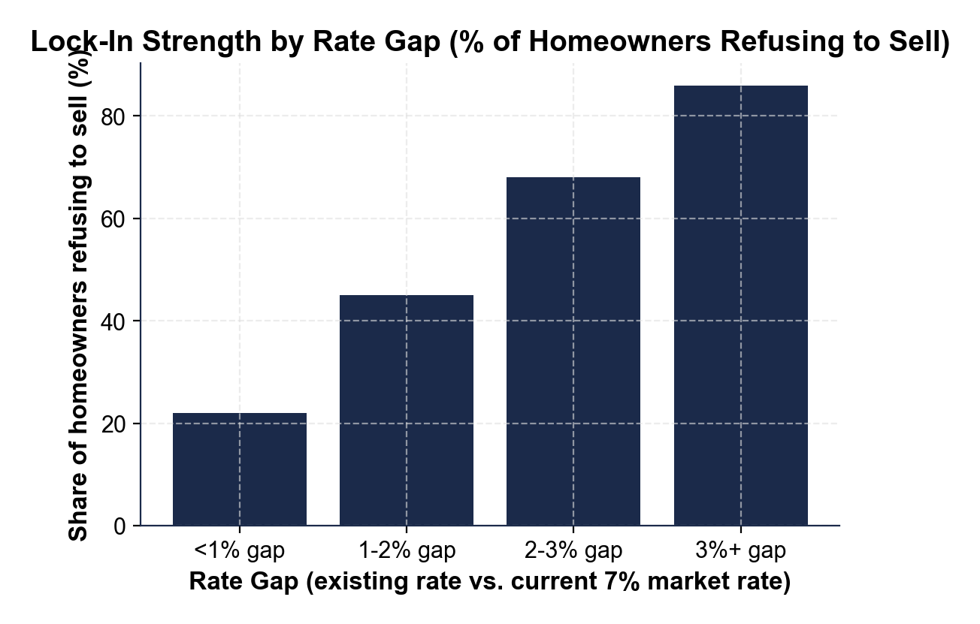
Note: Lock-In Strength by Rate Gap
Bigger rate gap, stronger lock-in. Most refusals happen at 3%+ gaps.
© More Lessons Less Planning | morelessonslessplanning.com
Notes:
Have students read the chart. The x-axis groups homeowners by rate gap - the difference between their existing mortgage rate and today's 7% market rate. The y-axis is the share of homeowners refusing to sell. As the gap grows, the share locked in rises sharply: under 1% gap, most homeowners are still willing to move. From 2 to 3% gap, more than half will not sell. Above 3% (which describes most homeowners with sub-4% pandemic-era loans), the lock-in is near-universal. This chart is the visual story of why 2023-2024 saw the lowest existing-home sales since 1995.
Reference labels (point to these chart features when teaching): 3%+ gap = strongest lock-in; Share locked in rises with gap

Slide 12
Housing Market Frozen: Supply Collapses
Existing-Home Sales Crash
Buyer Pain
Seller Pain
Sales fell from 6.1 million in 2021 to about 4.0 million in 2024
That was a 35% drop and the lowest total since 1995
Inventory hit 30-year lows in 2022-2023
$400,000 home: payment $975 higher at 7% vs 3%
Affordability fell about 37% from 2021
First-time buyers' share hit record lows
Median first-time buyer age: 38 in 2024 (29 in 1981)
Locked-in sellers stayed put even after life changes
Job moves and downsizing slowed
Multi-generational households increased
Warning: The 2023-2024 housing freeze hit BOTH buyers (cannot afford) AND sellers (refuse to move). When both sides freeze, the whole market freezes.
© More Lessons Less Planning | morelessonslessplanning.com
Notes:
The frozen market hits both sides. Buyers who could afford a $400,000 home at 3% can afford only about $253,000 at 7% - the 37% affordability collapse. First-time buyers (who do not have existing low-rate mortgages to lock in) get squeezed out, and the median FIRST-TIME buyer age hit a record 38 in 2024 - up from about 29 in 1981. Sellers with locked-in mortgages do not list, so inventory stays at 30-year lows. Existing-home sales dropped from 6.1 million per year in 2021 to about 4.0 million in 2024, the lowest annual total since 1995 - a 35% decline in three years.

Slide 13
When Rates Eventually Fall: What Unfreezes
What Would Unfreeze the Market
What Will NOT Be Enough
10-year Treasury yield falls toward 3% or lower
Mortgage rates drift to 5% range or below
Rate gap for most homeowners drops below 2 points
Pent-up movers (job changers, retirees) return
Modest Fed cuts (50-100 bp) - effect is too small
Falling fed funds alone if 10-year yield stays high
Mortgage rates between 5.5% and 7% - still locks most in
Quick fixes - this is a multi-year unwind
Key Concept: For the housing market to thaw, the 10-YEAR TREASURY must fall - not just the fed funds rate. They are NOT the same lever.
© More Lessons Less Planning | morelessonslessplanning.com
Notes:
The unfreeze depends on the 10-year Treasury yield, not the federal funds rate. The Fed cut rates by 50 basis points in September 2024 and another 25 in November - mortgage rates barely moved because the 10-year Treasury did not move much in response. For mortgages to drop to 5%, the 10-year Treasury needs to fall to about 3% or lower, which requires either a recession (unlikely in the soft-landing scenario), a sustained drop in inflation expectations toward 2%, or a major Fed pivot to multiple aggressive cuts. None of these is guaranteed in the near term, which is why most forecasters expected mortgage rates to stay between 6% and 7% through 2026.

Slide 14
Key Takeaways
30-year mortgages are tied to the 10-year Treasury yield, NOT the fed funds rate
★
Formula: mortgage rate = 10-year Treasury + 150 to 200 basis point spread
★
Mortgages doubled from about 3% (early 2021) to 7.79% (Oct 2023) in 33 months
★
About 80% of U.S. homeowners are LOCKED IN below 5% - they refuse to sell
★
Until the 10-year Treasury falls, the housing market stays frozen
★
© More Lessons Less Planning | morelessonslessplanning.com
Notes:
Read each takeaway and connect to learning targets. T1 (Treasury linkage) -> Parts 1, 2 of the activity. T2 (rate spike) -> Part 3 (math on the shock). T3 (lock-in effect) -> Parts 4, 5 (homeowner decision matrix and macro reflection). Tell students the activity will put them in the seat of a financial advisor reviewing four homeowner profiles - each deciding whether to sell their home now that rates have moved.

