Slide 1
Why Your Internet Only Has One Provider
Why most U.S. households have only ONE choice for home internet - and what local broadband monopolies cost you every month.
© More Lessons Less Planning | morelessonslessplanning.com
Notes:
Open with the question: how many providers does your house have for wired home internet? Most students will say one or two. About 30 percent of U.S. households genuinely have only ONE wired option at high speeds. Today we apply the TK 22 monopoly model to home internet and see why this happens.

Slide 2
Learning Targets
Apply MONOPOLY four features to local broadband ISPs
★
Define NATURAL MONOPOLY and the sunk infrastructure cost barrier
★
Read 3 charts; write a Final Recommendation Memo for the FCC
★
© More Lessons Less Planning | morelessonslessplanning.com
Notes:
Read the three targets aloud. Target 1 reuses the TK 22 four-features model and applies it to the most universal monopoly experience students have - their home internet bill. Target 2 is the new concept (natural monopoly + sunk costs). Target 3 is the synthesis - the Final Recommendation Memo at the end of the activity.

Slide 3
Why Your Home Internet Has One Provider
The Local Broadband Reality
Why This Happens
Roughly 30% of U.S. households have ONE wired provider
Roughly 50% have TWO (usually one cable + one telecom)
LOCAL MONOPOLY exists within a geographic area such as a zip code
The names: Comcast, Spectrum, AT&T, Verizon, Cox
Laying fiber/cable to every home costs $1,200-$2,500 PER HOME
Once one provider has built the network, a SECOND is rarely profitable
Result: most local markets are MONOPOLIES or DUOPOLIES
The FCC tracks this at the CENSUS BLOCK level
Big Idea: home internet is the textbook LOCAL MONOPOLY - the barrier is the SUNK COST of laying cable to every house.
© More Lessons Less Planning | morelessonslessplanning.com
Notes:
Frame the lesson. This is not Big Tech (TK 26) - this is the most local monopoly in U.S. life. Stress: students' parents pay for this every month. Each percentage point of local broadband competition matters for the household budget.

Slide 4
Recap - What Is a Monopoly?
MONOPOLY (from TK 22)
A market structure with ONE seller, no close substitutes for the product, and high barriers preventing new firms from entering
The Four Features
(1) One seller, (2) No close substitutes, (3) High barriers to entry, (4) Price-maker firm - exactly the model we used for Ticketmaster in TK 25
Why it matters here
Local broadband ISPs meet all four features in many markets - one provider, no real substitute, sunk infrastructure barrier, price-maker without competitive pressure
Big Idea: the TK 22 monopoly model works for ISPs the same way it worked for Ticketmaster - what changes is the BARRIER (sunk infrastructure cost).
© More Lessons Less Planning | morelessonslessplanning.com
Notes:
One-slide recap. Stress that the four-features model is unchanged. What changes in ISPs is the BARRIER - the cost of laying physical cable to every home is a sunk infrastructure cost.

Slide 5
Natural Monopoly + Sunk Infrastructure Costs
Natural monopoly
A market where ONE provider serves all demand at LOWER cost than two competing providers - because the fixed cost (laying cable) is so high duplication wastes resources
Sunk cost
Cost already spent and cannot be recovered - laying fiber/cable to every home costs $1,200-$2,500 per home passed; once spent there is no way to get the money back
Classical examples
Wired broadband, electricity, water, natural gas, sewers - infrastructure with high fixed costs that one network serves more cheaply than two
Big Idea: ISPs are a NATURAL monopoly - one network is cheaper than two because the cost of the network is mostly the SUNK cost of laying cable.
© More Lessons Less Planning | morelessonslessplanning.com
Notes:
Define natural monopoly. Stress this is DIFFERENT from Big Tech monopolies (TK 26) - in Big Tech the barrier is network effects; here the barrier is physical infrastructure cost. Both lead to monopoly but via different mechanisms.

Slide 6
U.S. Broadband Competition - The Picture
Wired Providers per Household (2024)
What These Numbers Mean
ONE provider (monopoly): ~30% of U.S. households
TWO providers (duopoly): ~50% of U.S. households
THREE providers: ~15% of U.S. households
FOUR or more: ~5% of U.S. households
80% of households have at MOST two wired choices
Only 20% live in a competitive market
Rural households are most likely to be monopoly markets
Image on next slide visualizes the distribution
Big Idea: 80% of U.S. households have at most TWO wired broadband providers - and 30% have only ONE.
© More Lessons Less Planning | morelessonslessplanning.com
Notes:
Walk the four shares. Stress these are FCC Form 477 estimates for 2024 at 100 Mbps. Lower thresholds (25 Mbps) look better; higher thresholds (1 Gbps) look much worse. The 100 Mbps threshold matches the current FCC broadband definition.

Slide 7
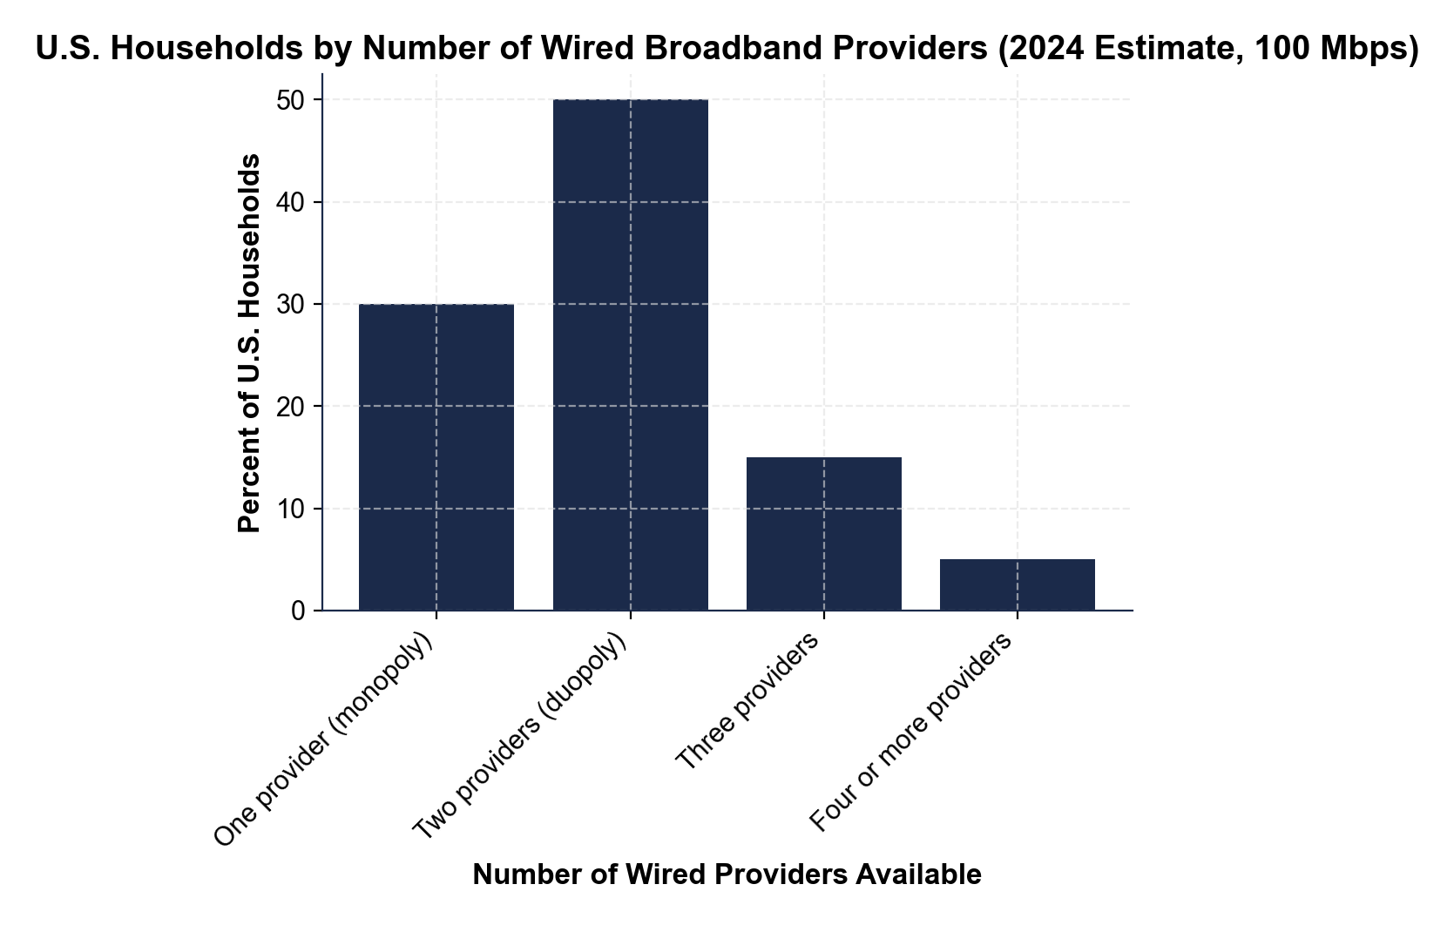
U.S. Broadband Competition - Visualized
About 30% of U.S. households still have only ONE wired broadband provider.
© More Lessons Less Planning | morelessonslessplanning.com
Notes:
Display the chart full-bleed. Have students read each bar aloud. Anchor the monopoly bar (30%) and the combined monopoly+duopoly bar (80%) - these are the numbers used in the FCC complaints and policy briefs.
Reference labels (point to these chart features when teaching): Chart 1

Slide 8
Why Most Households Have One or Two Providers
Sunk infrastructure cost
Laying fiber/cable to every home costs $1,200-$2,500 per home passed - the central barrier to entry no startup can overcome
Franchise history
Cities granted exclusive franchises to one cable + one phone company historically - non-exclusive since 1992 Cable Act but the physical networks already existed
Pole attachment fees
New entrants pay incumbent utilities to attach fiber to existing poles - incumbent-set fees can be high enough to deter overbuilding
Big Idea: the sunk cost of laying cable is the central barrier - it is why Google Fiber paused most overbuilds after 2016.
© More Lessons Less Planning | morelessonslessplanning.com
Notes:
Walk the three structural reasons. Stress that the sunk cost is the central issue. Google Fiber tried to overbuild in 14 cities (2010-2016); they paused new builds because the economics did not work. If Google cannot afford to overbuild, nobody can.

Slide 9
What Local Monopoly Costs You Every Month
Average Monthly Price by Market Type
Why the Gap Exists
MONOPOLY market (1 provider): ~$85/month
DUOPOLY market (2 providers): ~$68/month
COMPETITIVE market (3+ providers): ~$55/month
Gap: $30/month, or $360/year per household
Monopoly firm is a PRICE-MAKER (feature 4 of monopoly)
No competitive pressure forces prices down
Households cannot 'shop around' for a better deal
The $30/month gap is the MONOPOLY PRICE PREMIUM
Big Idea: living in a local broadband monopoly costs the average household $360/year more than living in a competitive market.
© More Lessons Less Planning | morelessonslessplanning.com
Notes:
Walk the three prices. Stress the $30/month gap. Multiply: $30 x 12 = $360/year per household. Across ~30% of U.S. households in monopoly markets, that is roughly $30 billion/year in extra consumer cost - the central FCC economic argument.

Slide 10
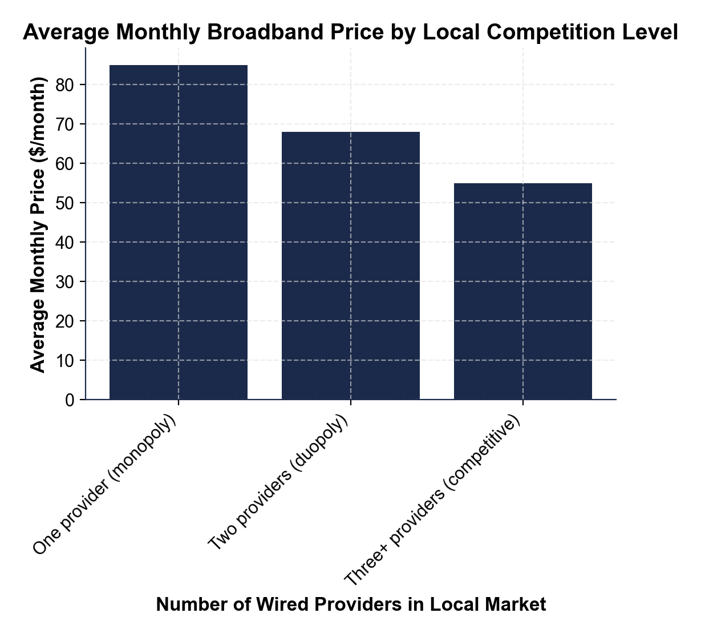
Monopoly Price Premium - Visualized
$85 in monopoly markets vs $55 in competitive markets - a $30/month gap.
© More Lessons Less Planning | morelessonslessplanning.com
Notes:
Display the chart. Walk the three bars: $85 (monopoly), $68 (duopoly), $55 (competitive). Anchor the $30/month gap - this is the monopoly price premium that the four-features model predicts.
Reference labels (point to these chart features when teaching): Chart 2

Slide 11
The Chattanooga Case - Municipal Broadband Works
Chattanooga EPB Fiber (Launched 2010)
Why Chattanooga Matters
City-owned electric utility built fiber-to-the-home network
Offered 1 Gbps when Comcast was offering 30 Mbps
Pre-launch (2009): Comcast monopoly at $89/month
Two years in (2012): average price $58/month
Most-studied U.S. municipal broadband case
$31/month or 35% price DROP in 2 years
Both EPB AND Comcast cut prices (Comcast had to compete)
Proof that entry CAN erode local broadband monopoly
Big Idea: Chattanooga's municipal fiber dropped broadband prices 35% in 2 years - proof monopoly pricing is market power, not cost.
© More Lessons Less Planning | morelessonslessplanning.com
Notes:
Walk the Chattanooga case. Stress that this is the most-studied U.S. municipal broadband case and is cited in FCC and academic policy work. The price drop happened in TWO ways: EPB priced low AND Comcast cut prices to compete.

Slide 12
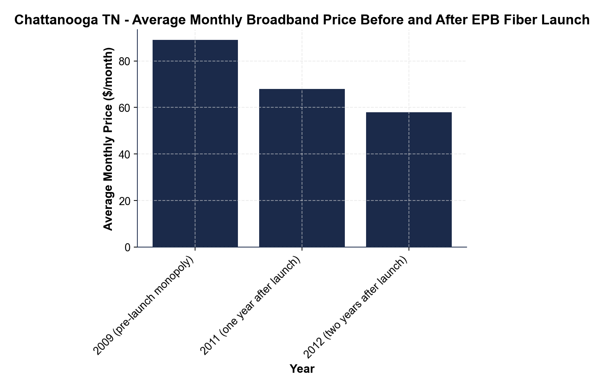
Chattanooga Price Drop - Visualized
$89 to $58 in two years - the Chattanooga municipal broadband effect.
© More Lessons Less Planning | morelessonslessplanning.com
Notes:
Display the chart. Walk the three bars: $89 (2009), $68 (2011), $58 (2012). Stress the $31/month drop. Anchor: this is direct evidence that monopoly pricing reflects market power, not cost.
Reference labels (point to these chart features when teaching): Chart 3

Slide 13
Why 19 States Ban Municipal Broadband
The state ban map
19 U.S. states restrict or prohibit local governments from building broadband networks - Tennessee, North Carolina, Texas, Florida, Wisconsin and others
Who lobbies for these bans
Incumbent ISPs (Comcast, AT&T, Charter) lobby state legislatures for these bans because municipal networks competing with them cut their prices and margins
What the bans typically restrict
Some bans prohibit municipal broadband outright; others require referendums, public hearings, or financial tests that effectively prevent cities from building
Big Idea: 19 states have made the Chattanooga story IMPOSSIBLE to replicate - by law - thanks to incumbent ISP lobbying.
© More Lessons Less Planning | morelessonslessplanning.com
Notes:
Walk the state ban landscape. Stress that this is the central federalism question: should states be allowed to forbid cities from building their own broadband networks? The FCC has tried to preempt these bans (2015 Wilson NC + Chattanooga preemption ruling) but lost in federal court.

Slide 14
Possible FCC Remedies - Three Approaches
Three Policy Levers
How Each Lever Works
TITLE II + price regulation (restored April 2024)
FEDERAL SUBSIDIES - BEAD $42.5B (2021 Infrastructure Act)
PREEMPT state municipal broadband bans (in all 50 states)
Title II: FCC regulates ISP prices like a 1934 utility
Subsidies: pay ISPs to build rural networks (access not pricing)
Preemption: allow cities to compete (politically and legally hard)
Big Idea: the FCC has THREE main policy levers - regulate prices, subsidize builds, or unblock municipal competition.
© More Lessons Less Planning | morelessonslessplanning.com
Notes:
Walk the three remedy approaches. Stress that no single remedy solves everything. Title II is the most aggressive; subsidies are easiest politically but slowest; municipal preemption is the most direct but legally contested.

Slide 15
ISP Monopoly Vocabulary (1 of 3)
Natural monopoly
A market where one provider serves all demand at lower cost than two competitors because fixed costs make duplication wasteful (wired broadband, electricity, water)
Sunk cost
A cost already spent that cannot be recovered - laying cable to every home costs $1,200-$2,500 per home passed; the central ISP barrier
Barrier to entry
Anything that prevents new firms from competing - sunk infrastructure cost, franchise rules, pole attachment fees in ISPs
Key Point: natural monopoly + sunk cost + barrier to entry = the ISP monopoly toolkit.
© More Lessons Less Planning | morelessonslessplanning.com
Notes:
Drill these three terms. The next slides have franchise + municipal broadband + overbuilding, then FCC Form 477 + Title II + common carrier.

Slide 16
ISP Monopoly Vocabulary (2 of 3)
FRANCHISE AGREEMENT - historical city contract granting an ISP a license
MUNICIPAL BROADBAND - local government builds and operates its own network
OVERBUILDING - second wired ISP lays a duplicate network (rare)
Why most fail: sunk infrastructure cost still applies to overbuilders
Key Point: franchise + municipal + overbuilding = the three competition pathways and why most fail.
© More Lessons Less Planning | morelessonslessplanning.com
Notes:
Drill these three terms. They appear in the Final Memo.

Slide 17
ISP Monopoly Vocabulary (3 of 3)
FCC Form 477
The FCC broadband deployment dataset - all ISPs report which census blocks they serve; basis for federal competition analysis
Title II classification
1934 Communications Act class for common-carrier utilities; FCC restored Title II for broadband in April 2024
Common carrier
Designation for essential infrastructure (phones, freight rail, pipelines) that must serve all customers at non-discriminatory FCC-regulated prices
Key Point: Form 477 + Title II + common carrier = the FCC regulatory framework for broadband.
© More Lessons Less Planning | morelessonslessplanning.com
Notes:
Drill these three terms. They appear in the Final Memo when students recommend a remedy.

Slide 18
Key Takeaways
30% of U.S. households have ONE wired broadband provider - a local monopoly
The barrier is sunk infrastructure cost ($1,200-$2,500 per home passed)
Monopoly markets pay $30/month MORE than competitive markets ($360/year)
Municipal broadband works (Chattanooga $89 to $58) but 19 states ban it
FCC remedies: Title II + subsidies + preempt state bans
Big Idea: the four-features model still works for ISPs - the barrier is the sunk infrastructure cost of laying cable.
© More Lessons Less Planning | morelessonslessplanning.com
Notes:
Synthesize the lesson. The four-features model applies. The barrier is sunk infrastructure cost. Municipal broadband works when allowed. 19 states ban it. FCC has three policy levers.

