Slide 1
Why Young People Pay More (or Less): Risk Pricing in Auto Insurance
Learn how insurers price risk, why age and driving record drive your premium, and how to calculate what a policy actually costs.
© More Lessons Less Planning | morelessonslessplanning.com
Notes:
Open by naming the frustration every teen driver feels: a quote that seems shockingly high compared to a parent's premium. Tell students today's lesson answers exactly why. Insurers are not guessing and they are not punishing young people on purpose - they PRICE RISK, using real statistics about which drivers are most likely to file a claim. By the end of class students will be able to explain the labeled model insurers use (ANNUAL PREMIUM = BASE RATE x RISK MULTIPLIER), name the two biggest factors in a young driver's premium (age/experience and driving record), and calculate exactly how much more one driver pays than another. Set the practical tone: understanding risk pricing is not just trivia - it explains real choices students can make (keeping a clean record, taking a driver's ed course, maintaining good grades) that lower their own premium over time.

Slide 2
Learning Targets
Explain how insurers price risk and why premiums vary
★
Explain why age and driving experience affect a young driver's premium
★
Explain how a driving record changes a driver's risk multiplier
★
Calculate the annual premium and premium difference using a labeled model
★
© More Lessons Less Planning | morelessonslessplanning.com
Notes:
Read the four targets and connect them to the arc of the lesson. Target 1 is the big idea: insurers price RISK, not people - a premium is a dollar amount built from statistics about how likely a claim is. Target 2 is the number one factor for teens: AGE and driving EXPERIENCE, because new, young drivers crash far more often per mile than experienced adults. Target 3 is the factor students control: DRIVING RECORD - tickets and accidents raise your price, and a clean record over time lowers it. Target 4 is the math and the heart of the lesson: students will calculate the ANNUAL PREMIUM from a base rate and a risk multiplier, and the PREMIUM DIFFERENCE and PERCENT DIFFERENCE between two driver profiles. By the end, students can read an insurance quote and explain exactly why it is priced the way it is.

Slide 3
How Insurers Price Risk
Insurers do not guess
Insurers use UNDERWRITING - the process of measuring your RISK and setting your PRICE - to set every premium
✔
Statistics, not stereotypes
Underwriting uses real ACTUARIAL RISK data - the statistical likelihood a group of drivers will file claims
✔
Riskier drivers cost more to insure
A driver statistically more likely to crash costs the insurer more in claims, so that driver pays a higher PREMIUM
✔
It applies to every driver
The SAME pricing process applies to a new teen driver and a 50-year-old with 30 years of experience
✔
Key Concept: Insurers use UNDERWRITING - measuring your RISK with real ACTUARIAL RISK data - to set your PREMIUM.
© More Lessons Less Planning | morelessonslessplanning.com
Notes:
Open with the reframe that changes how students see their own future insurance quote: insurers do not guess at prices, and they are not out to get teenagers. They use UNDERWRITING - the process of measuring how risky a driver is and setting a price to match. Underwriting is built on ACTUARIAL RISK: real statistical data on how likely a GROUP of similar drivers is to file a claim, and how costly those claims tend to be. This is not a stereotype about teenagers - it is decades of claims data showing that certain groups of drivers, on average, file more or costlier claims than others. The core economic logic: a driver who is statistically more likely to crash costs the insurance company more money in claims, so that driver has to pay a higher PREMIUM to keep the system fair for everyone in the RISK POOL - the group of policyholders whose payments cover each other's claims. Make clear this process is universal: the same underwriting method applies to every driver who buys a policy, a new 17-year-old and a 50-year-old with three decades of clean driving alike - only the risk factors and the resulting price differ. Key terms - Underwriting: the process an insurer uses to measure your risk and set your price. Actuarial risk: the statistical likelihood that a group of drivers will file claims. Risk pool: the group of policyholders whose payments cover each other's claims. Establish four everyday insurance terms students will use throughout the lesson. First, a RISK POOL is the group of policyholders whose payments cover each other's claims - insurers combine many drivers into one pool so no single driver pays for a loss alone. The contract each driver buys is a POLICY - the contract that spells out what your insurance covers and what it costs. When a driver files a claim, they first pay a DEDUCTIBLE - the amount you pay out of pocket on a claim before insurance pays the rest; choosing a higher deductible is one common way to lower a premium. And LIABILITY COVERAGE is the part of auto insurance that pays for damage you cause to others, for example the other car in a crash you caused.

Slide 4
What Risk Pricing Means - The Labeled Model
A LABELED MODEL (the premium)
ANNUAL PREMIUM = BASE RATE x RISK MULTIPLIER - the formula behind every driver's price
✔
The base rate is the anchor
The BASE RATE ($1,200/year) is the starting price for a 25-year-old with a clean record - risk multiplier x1.00
✔
The multiplier does the work
The RISK MULTIPLIER raises or lowers that base rate based on how risky YOU are predicted to be
✔
Same formula, different price
Every driver's PREMIUM comes from this one formula - only the risk multiplier changes
✔
Key Concept: ANNUAL PREMIUM = BASE RATE x RISK MULTIPLIER. The base rate ($1,200) is fixed; the risk multiplier is what changes your price.
© More Lessons Less Planning | morelessonslessplanning.com
Notes:
This is the quantitative heart of the lesson - teach the labeled model explicitly before students calculate with it, and put it on the board under a clear label. A LABELED MODEL - RISK PRICING: ANNUAL PREMIUM = BASE RATE x RISK MULTIPLIER. Define each piece precisely. The BASE RATE is the starting annual premium for a baseline driver - in this lesson, a 25-year-old with a clean driving record, priced at $1,200/year with a risk multiplier of exactly x1.00 (the anchor point; neither a discount nor a surcharge). The RISK MULTIPLIER is a number that raises or lowers that base rate depending on how risky the specific driver is predicted to be: a multiplier above 1.00 means higher risk and a higher premium; a multiplier below 1.00 means lower risk and a lower premium. The key insight for students: every single driver's premium comes from this SAME formula - a new teen driver, a driver with a ticket, and a clean-record 40-year-old are all priced with ANNUAL PREMIUM = BASE RATE x RISK MULTIPLIER. The only thing that changes from driver to driver is the risk multiplier, because that number captures everything the insurer knows about how risky that driver is. Tell students the next few slides teach exactly which factors push that risk multiplier up or down, and then a chart puts four real driver profiles side by side using this exact model. Key terms - Base rate: the starting price for a clean-record adult driver before risk factors adjust it. Risk multiplier: a number that raises or lowers your premium based on how risky you are.

Slide 5
Age as a Factor - Why New Drivers Cost More
New drivers crash more often
An 18-year-old NEW DRIVER has little or no experience behind the wheel - statistically the most likely group to file a claim
Experience lowers risk
Every year of safe driving experience lowers a driver's statistical chance of a claim, which lowers the RISK MULTIPLIER
The multiplier shows it
An 18-year-old new driver's RISK MULTIPLIER (x3.00) is the highest of any profile in this lesson - triple the base rate
It is temporary
Age-related risk falls automatically over time - the same driver's multiplier drops as they gain years of experience
Key Concept: A NEW DRIVER'S inexperience makes them the riskiest group - an 18-year-old's RISK MULTIPLIER (x3.00) is the highest of any profile.
© More Lessons Less Planning | morelessonslessplanning.com
Notes:
Now teach the single biggest factor in a young driver's premium: AGE, or more precisely, driving EXPERIENCE. Define the term plainly: a NEW DRIVER is a driver with little or no experience behind the wheel, and this group is statistically the most likely to file a claim of any group insurers track. This is not opinion - it reflects real claims data: brand-new drivers have not yet built the judgment, reaction time, and hazard awareness that come only from time on the road, so they are involved in far more accidents per mile driven than experienced adults. Make the mechanism explicit: every year of safe driving experience statistically lowers a driver's chance of filing a claim, and that falling risk is exactly what lowers the RISK MULTIPLIER over time. Put a number on the extreme case in this lesson's data: an 18-year-old new driver has a RISK MULTIPLIER of x3.00 - triple the base rate - the highest multiplier of any of the four profiles students will study. That means, using the labeled model from the last slide, this driver's annual premium is three times what a clean-record 25-year-old pays for the exact same coverage. Close with the reassuring point: this risk is temporary and automatic. A new driver does not stay in the highest-risk group forever - as they age and accumulate years of clean driving, their multiplier falls on its own, even before considering deliberate steps like a safety course. Key term - New driver: a driver with little or no experience behind the wheel, statistically the most likely group to file a claim.

Slide 6
Driving Records - The Factor You Control
Your driving record
Your DRIVING RECORD - your history of tickets and accidents - is a factor insurers use to help set your risk multiplier
One ticket changes the price
A single speeding ticket can push a driver's risk multiplier noticeably higher, even if their age does not change
Unlike age, you control this
You cannot change your age, but you CAN choose to drive safely and avoid tickets and accidents
Records improve over time
Most insurers let old tickets and accidents age off your record after a few years, which can lower your multiplier again
Key Concept: DRIVING RECORD is the factor you control - a single ticket raises your risk multiplier, and a clean record over time lowers it back.
© More Lessons Less Planning | morelessonslessplanning.com
Notes:
Now teach the second major factor, and the one students have direct power over: DRIVING RECORD. Define it plainly: your driving record is your history of tickets and accidents, and insurers use it to help set your risk multiplier because it is direct, individual evidence of how risky YOU personally are, on top of general age-based statistics. Make the point concrete with the lesson's own data: a single speeding ticket can push a 20-year-old driver's risk multiplier from a lower level up to x2.00 - a real, immediate cost increase from one violation. Draw the crucial contrast with the last slide: age is a factor you cannot control (everyone starts as a new driver and ages at the same rate), but your driving record is something you actively choose every time you get behind the wheel. Every ticket avoided and every accident prevented keeps that multiplier from climbing. Finally, give students the hopeful mechanical detail: driving records are not permanent. Most insurers let violations and accidents 'age off' your record after a set number of years (commonly three to five), so a driver who gets one ticket and then drives clean for several years will usually see their multiplier fall back down - a driving record is a rolling window, not a life sentence. Key term - Driving record: your history of tickets and accidents that insurers use to price you.

Slide 7
A Labeled Model - Calculating the Annual Premium
A LABELED MODEL (the premium)
ANNUAL PREMIUM = BASE RATE x RISK MULTIPLIER - apply this to any driver profile
✔
Worked example - the riskiest profile
18-year-old new driver: ANNUAL PREMIUM = $1,200 x 3.00 = $3,600 a year
✔
Worked example - the safest profile
40-year-old, clean record: ANNUAL PREMIUM = $1,200 x 0.85 = $1,020 a year
✔
Comparing two profiles
PREMIUM DIFFERENCE = higher premium - lower premium; PERCENT DIFFERENCE = (difference / lower premium) x 100
✔
Key Concept: ANNUAL PREMIUM = BASE RATE x RISK MULTIPLIER. An 18-yr new driver pays $3,600; a 40-yr clean-record driver pays only $1,020.
© More Lessons Less Planning | morelessonslessplanning.com
Notes:
Now work the labeled model with real numbers so students see exactly how it produces the four premiums they will use all lesson. Restate the model on the board: ANNUAL PREMIUM = BASE RATE x RISK MULTIPLIER, with the base rate fixed at $1,200/year. Work the riskiest profile first: an 18-year-old new driver has a risk multiplier of x3.00, so ANNUAL PREMIUM = $1,200 x 3.00 = $3,600 a year - exactly the shocking quote from the opening hook. Then work the safest profile for contrast: a 40-year-old with a clean record has a risk multiplier of x0.85 (BELOW 1.00, because this driver is statistically safer than even the base-rate 25-year-old), so ANNUAL PREMIUM = $1,200 x 0.85 = $1,020 a year. Now introduce the comparison tools students will use in the activity: PREMIUM DIFFERENCE = higher premium - lower premium (here, $3,600 - $1,020 = $2,580), and PERCENT DIFFERENCE = (premium difference / lower premium) x 100 (here, ($2,580 / $1,020) x 100 = about 253% more). Tell students the next slides explain WHY teens land on the high end, then a chart puts all four premiums side by side, and Activity Part 3 and Part 4 ask them to run these exact calculations on different profile pairs. Key terms reminder - Base rate: the starting price for a clean-record adult driver before risk factors adjust it. Risk multiplier: a number that raises or lowers your premium based on how risky you are.

Slide 8
Why Teens Pay High Auto Rates (Chart Intro)
Two factors stack together
A teen driver combines the highest AGE risk (new driver) with zero driving-record history to prove they are safe
No track record yet
An adult with 20+ years of clean driving has PROVEN their risk is low; a new teen driver has not had the chance yet
It is the highest multiplier of the four
The 18-year-old new driver's x3.00 multiplier is the highest in this lesson's data - by far the most expensive profile
The next slide shows it
The chart on the next slide puts all four annual premiums side by side so you can see the full staircase
Key Concept: Teens pay the most because AGE risk (new driver) and an unproven DRIVING RECORD stack together into the highest risk multiplier.
© More Lessons Less Planning | morelessonslessplanning.com
Notes:
Pull together the two factors just taught to explain, in plain language, exactly why teens land at the top of the price scale. It is not one thing - it is two risk factors STACKING on the same driver. First, AGE: a brand-new driver is statistically the riskiest group of any age, because they lack the experience adults have built up over years behind the wheel. Second, DRIVING RECORD: an experienced adult with 20 or more years of clean driving has an established track record PROVING they are low-risk - real claims history the insurer can point to. A brand-new teen driver has not had the chance to build that track record yet; there is no history to prove they will be safe, so the insurer prices them at the statistically riskiest level until they build one. That is why, in this lesson's data, the 18-year-old new driver's risk multiplier (x3.00) is the single highest of any profile - by far the most expensive to insure. Set up the visual: the next slide is a chart that puts all four annual premiums from this lesson side by side - the 18-year-old new driver, the 20-year-old with a ticket, the 25-year-old with a clean record (the base rate), and the 40-year-old with a clean record - so students can see the full staircase from riskiest and most expensive down to safest and cheapest. Activity Part 4 asks students to read that chart and calculate the differences between profiles.

Slide 9
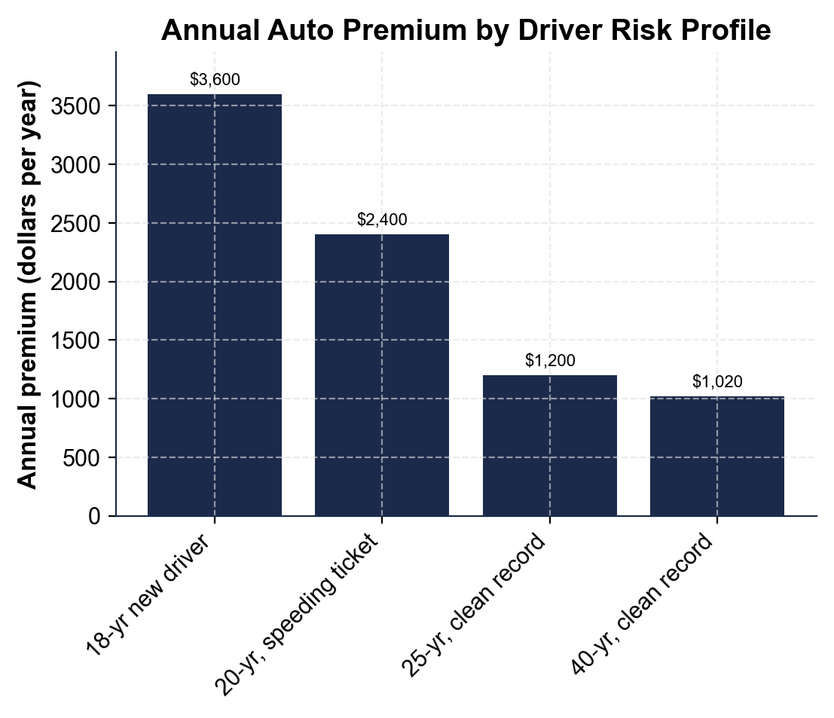
Annual Auto Premium by Driver Risk Profile
Four annual premiums, same $1,200 base rate: riskier driver profiles pay more.
© More Lessons Less Planning | morelessonslessplanning.com
Notes:
Give students a moment to read all four bars on their own before discussing. The chart shows four annual auto insurance premiums, ordered from riskiest (left, tallest bar) to safest (right, shortest bar). The tallest bar is the 18-year-old new driver at $3,600 a year - the highest risk multiplier (x3.00) of any profile. Next is the 20-year-old with a speeding ticket at $2,400 a year (x2.00) - proof that driving record alone can double a premium. Then the 25-year-old with a clean record at $1,200 a year - this IS the base rate, at exactly x1.00. The shortest bar is the 40-year-old with a clean record at $1,020 a year (x0.85) - the safest, cheapest profile in the data. Point out the pattern: the bars step DOWN from left to right, visually showing that risk and price move together. Ask students to compute the gap between the tallest and shortest bars in their heads before you reveal it: $3,600 - $1,020 = $2,580 a year, which is about 253% more. Connect it to the whole lesson: every one of these four numbers comes from the exact same formula, ANNUAL PREMIUM = BASE RATE x RISK MULTIPLIER, applied to the exact same $1,200 base rate - the only thing that changes is the risk multiplier. This is the chart Activity Part 4 reads and analyzes; students will read all four values and calculate premium differences and percent differences between named profiles.
Reference labels (point to these chart features when teaching): 18-yr new driver: $3,600; 40-yr clean record: $1,020

Slide 10
Lowering Your Premium
Keep a clean driving record
Avoiding tickets and accidents is the single biggest thing a young driver controls to keep their risk multiplier low
✔
Take a driver-safety course
A DEFENSIVE DRIVING COURSE can lower your risk multiplier by demonstrating safer driving skills to the insurer
✔
Ask about a good-student discount
A GOOD-STUDENT DISCOUNT rewards student drivers who maintain good grades with a lower risk multiplier
✔
Let time and experience work for you
Every year of clean driving experience lowers your multiplier automatically, even without doing anything extra
✔
Key Concept: You lower your own premium with a clean record, a DEFENSIVE DRIVING COURSE, a GOOD-STUDENT DISCOUNT, and time behind the wheel.
© More Lessons Less Planning | morelessonslessplanning.com
Notes:
Now give students the practical payoff: concrete, doable ways a young driver actually lowers their own premium over time. First and most important: keep a clean driving record. This is the single biggest lever a young driver controls - every ticket and accident avoided keeps the risk multiplier from climbing, and an existing violation eventually ages off. Second: take a DEFENSIVE DRIVING COURSE - many insurers offer a discount (lowering the risk multiplier) to drivers who complete an approved safety course, because it demonstrates real skills beyond just time behind the wheel. Third: ask about a GOOD-STUDENT DISCOUNT - many insurers reward student drivers who maintain good grades with a lower risk multiplier, based on data showing a correlation between academic responsibility and safer driving. Fourth, the one that requires no action at all: time itself lowers your multiplier, because every year of clean driving experience statistically reduces your risk, and insurers build that into their pricing automatically. Put it all together with a simple takeaway: a 17-year-old cannot change their age, but they have real, specific control over how quickly their premium comes down - a clean record, a safety course, good grades, and patience all move the risk multiplier in their favor. Key terms - Good-student discount: a discount some insurers offer to student drivers who maintain good grades, lowering the risk multiplier. Defensive driving course: a driver-training course that can lower a driver's risk multiplier by demonstrating safer driving skills.

Slide 11
Scenario - One Ticket Changes Everything
Meet the 20-year-old driver
A 20-year-old with a clean record would pay close to the $1,200 base rate for auto insurance
One speeding ticket happens
After a single speeding ticket, this driver's risk multiplier rises to x2.00
The new premium
ANNUAL PREMIUM = $1,200 x 2.00 = $2,400 a year - exactly double what a clean record would cost
The lesson
One driving-record violation can DOUBLE a premium - proof the record factor is not small
Key Concept: One speeding ticket raises a driver's multiplier to x2.00, doubling the premium from $1,200 to $2,400 a year.
© More Lessons Less Planning | morelessonslessplanning.com
Notes:
Make the driving-record factor concrete with a scenario students will run themselves in the activity. Picture a 20-year-old driver who, with a clean record, would be priced close to the $1,200 base rate - a reasonable, near-adult premium. Then this driver gets a single speeding ticket. Nothing else about them changes: same age, same car, same address - just one ticket on their driving record. Walk the new math out loud: that one ticket raises the driver's RISK MULTIPLIER to x2.00, so ANNUAL PREMIUM = $1,200 x 2.00 = $2,400 a year - exactly DOUBLE what a clean-record driver of the same age would pay. Ask students to sit with that for a second: one ticket did not add a small surcharge, it doubled the entire annual cost. Draw the lesson explicitly: this proves the driving-record factor is not a minor detail - it can be as powerful as age itself in setting a premium, and it is the one factor a driver has full control over every time they get behind the wheel. Tell students Activity Part 3 asks them to run exactly this kind of premium calculation, and Part 4 asks them to compare this profile to the others on the chart.

Slide 12
Calculate Premium Differences by Risk
Step 1 - Find the annual premium
Use ANNUAL PREMIUM = BASE RATE x RISK MULTIPLIER for each driver profile
✔
Step 2 - Find the premium difference
PREMIUM DIFFERENCE = higher-risk annual premium - lower-risk annual premium
✔
Step 3 - Find the percent difference
PERCENT DIFFERENCE = (premium difference / lower-risk annual premium) x 100
✔
Step 4 - Explain what it means
Connect the number back to the risk factors (age, driving record) that caused it
✔
Key Concept: Compare any two premiums in three steps - find each premium, subtract for the dollar difference, then divide for the percent difference.
© More Lessons Less Planning | morelessonslessplanning.com
Notes:
Turn the whole lesson's math into a repeatable four-step process students can run on any two driver profiles. Step 1 - FIND THE ANNUAL PREMIUM for each driver using the labeled model: ANNUAL PREMIUM = BASE RATE x RISK MULTIPLIER. Step 2 - FIND THE PREMIUM DIFFERENCE: subtract the lower-risk driver's premium from the higher-risk driver's premium (PREMIUM DIFFERENCE = higher premium - lower premium). Step 3 - FIND THE PERCENT DIFFERENCE: take that dollar difference, divide by the LOWER premium, and multiply by 100 (PERCENT DIFFERENCE = (premium difference / lower premium) x 100) - this tells you how much MORE, as a percent, the riskier driver pays relative to the safer one. Step 4 - EXPLAIN WHAT IT MEANS: always connect the number back to WHY - was it age (a new driver), driving record (a ticket), or both stacking together? Run the whole process once on the two extreme profiles from this lesson so students see it end to end: 18-year-old new driver ($3,600) vs 40-year-old clean record ($1,020) gives a PREMIUM DIFFERENCE of $2,580 and a PERCENT DIFFERENCE of about 253%. Tell students Activity Part 4 asks them to run this exact process on different pairs of profiles from the chart, and Part 5 asks them to explain the results to a new driver. This is the capstone skill: turning a chart of numbers into a clear, math-backed explanation of risk pricing.

Slide 13
Key Takeaways
Insurers PRICE RISK using UNDERWRITING, not guesswork or stereotypes
★
ANNUAL PREMIUM = BASE RATE x RISK MULTIPLIER ($1,200 x multiplier)
★
AGE/experience and DRIVING RECORD are the two biggest factors for young drivers
★
One ticket can DOUBLE a premium; a clean record over time lowers it
★
You lower your own premium with a clean record, a safety course, and good grades
★
© More Lessons Less Planning | morelessonslessplanning.com
Notes:
Read each takeaway and connect it back to the learning targets and the process. T1 (how pricing works) -> insurers use UNDERWRITING and real ACTUARIAL RISK data to PRICE RISK - it is a process, not a guess or a punishment aimed at any group. T2 (the labeled model) -> ANNUAL PREMIUM = BASE RATE x RISK MULTIPLIER; every driver in this lesson is priced from the same $1,200 base rate, and only the risk multiplier changes (x3.00 for an 18-yr new driver down to x0.85 for a 40-yr clean-record driver). T3 (the two big factors) -> AGE/EXPERIENCE is the biggest factor for young drivers because new drivers statistically crash more often, and DRIVING RECORD is the factor students control - tickets and accidents raise the multiplier, a clean record over time lowers it. T4 (the ticket scenario) -> a single speeding ticket doubled a 20-year-old's premium from about $1,200 to $2,400, proof the driving-record factor is powerful, not minor. T5 (what to do about it) -> students lower their OWN premium with a clean record, a defensive driving course, and a good-student discount, plus the automatic effect of gaining years of experience. Close by returning to the opening hook: students can now explain exactly why a teen's insurance quote is what it is, calculate the dollar and percent difference between any two driver profiles, and name concrete steps to bring their own premium down over time.

