Slide 1
Why Save? The Power of Starting Young
Starting ten years sooner can turn the same $100 monthly saving into more than twice as much—learn how to make time your advantage.
© More Lessons Less Planning | morelessonslessplanning.com
Notes:
Open with the big idea of the whole Saving & Investing unit: WHEN you start saving matters even more than how much you save. Introduce the two savers students will follow - Maya, who starts saving $100 a month at age 18, and Jordan, who saves the same $100 a month but does not start until age 28. Both earn 7% a year, and both save until 65. The only difference is a ten-year head start. That head start is worth a fortune: by 65 Maya has $438,642.92 while Jordan has $209,654.44, even though Maya only put in $12,000 more over her lifetime. Preview the four ideas students will learn: build a saving habit and pay yourself first, use a long time horizon so compounding can work, see how small amounts add up, and where to keep short-term savings and how to set a first goal. As the first toolkit of Unit 6, this lesson gives students the motivation - the WHY - behind every saving and investing decision that follows.

Slide 2
Learning Targets
Explain why saving early and paying yourself first builds long-term wealth
★
Describe how a longer time horizon lets compounding grow small savings
★
Compare two savers who start ten years apart and explain why starting young wins
★
Choose where to keep short-term savings and set a first savings goal
★
© More Lessons Less Planning | morelessonslessplanning.com
Notes:
Read the four targets aloud. Tell students the lesson follows two savers - Maya, who starts at 18, and Jordan, who starts at 28 - who save the same $100 a month at 7%. Target 1 is the WHY and the habit: saving early and paying yourself first (moving money to savings before you spend) is what builds wealth over time. Target 2 is the engine: a long time horizon - the number of years you leave money to grow - lets compounding turn small, regular deposits into large sums. Target 3 is the proof: comparing Maya and Jordan shows a ten-year head start can more than double the final result, even with the same monthly deposit. Target 4 is the action: decide where to keep money you will need soon (short-term savings in a safe, reachable account) and set a specific first savings goal. By the end students should be able to explain why starting young matters and take a first concrete step.

Slide 3
Why Save at All?
Saving buys you choices
Money set aside gives you options later - to handle a surprise, take an opportunity, or reach a goal
✔
It protects you from surprises
An EMERGENCY FUND is short-term savings for surprise costs, kept safe and easy to reach
✔
It turns income into wealth
WEALTH comes from the part of your income you KEEP and let grow, not from how much you make
✔
The best time to start is now
Every year you wait is a year of growth you can never get back - young savers have the biggest advantage: time
✔
Key Concept: Saving buys choices, protects you with an EMERGENCY FUND, and turns income into wealth - and the best time to start is now.
© More Lessons Less Planning | morelessonslessplanning.com
Notes:
Give students the motivation before the math. First, saving buys you choices: money set aside means you get to decide later - handle a surprise, jump on an opportunity, or reach a goal - instead of being stuck with only what you can afford in the moment. Second, saving protects you: an EMERGENCY FUND is short-term savings set aside for surprise expenses, kept somewhere safe and easy to reach like a savings account, so a car repair or a missed paycheck does not turn into a crisis. Third, saving is how income becomes wealth: how much you earn is not the same as how wealthy you become - wealth comes from the part of your income you keep and let grow, so two people with the same paycheck can end up in very different places. Finally, the punchline of the whole lesson: the best time to start is now, because every year you wait is a year of growth you can never get back. That is why a teenager with very little money still has the single biggest advantage in all of personal finance - time.

Slide 4
Pay Yourself First
Make saving the first bill you pay
Why 'leftovers' never work
PAY YOURSELF FIRST: move money to savings as soon as you are paid
Save before spending, not from whatever happens to be left over
Build a scheduled saving habit; automate the transfer so willpower is not required
Saving only leftovers usually means saving nothing
Treat savings like a bill so it gets paid every time
A small fixed amount builds the habit; starting consistency matters most
Key Concept: PAY YOURSELF FIRST - move money to savings as soon as you are paid - turns saving into a SAVING HABIT instead of an afterthought.
© More Lessons Less Planning | morelessonslessplanning.com
Notes:
Teach the single most useful habit in personal finance. PAY YOURSELF FIRST means you move money into savings as soon as you are paid, before you spend on anything else - you treat saving like a bill that has to be paid, not like an optional extra. The opposite - saving 'whatever is left over' - almost never works, because at the end of the month there is usually nothing left. A SAVING HABIT is a regular routine of setting money aside on a schedule, so saving happens automatically instead of only when you remember or feel like it. The easiest way to build the habit is to automate it: set up an automatic transfer so a fixed amount moves to savings every payday without you having to decide each time. Emphasize that when you are starting out, the HABIT matters more than the AMOUNT - even $20 or $100 saved every single time builds the routine that, combined with time, becomes real money. This is exactly what Maya does at 18 that Jordan does not start until 28.

Slide 5
Time Horizon Is Your Superpower
Time horizon
TIME HORIZON is how many years you leave money to grow before you need it; a longer time horizon gives compounding more years to snowball
Compounding
COMPOUNDING means earning returns on both the money you put in and your returns, not just on your deposits, so growth speeds up over time
The saving model
FV = PMT x (((1 + i)^m - 1)/i) is the future value of saving a fixed amount every month; the months m in the exponent make the total explode
The Rule of 72
Years to double is about 72 divided by the rate percent; at 7%, 72 / 7 is about 10, so money doubles about every decade and starting young wins
Key Concept: A long TIME HORIZON lets COMPOUNDING snowball; the Rule of 72 says 7% money doubles about every decade, so starting early adds doublings.
© More Lessons Less Planning | morelessonslessplanning.com
Notes:
Teach the engine behind the whole lesson: time. TIME HORIZON is how many years you leave your money invested before you need it - the longer the horizon, the more powerful saving becomes. COMPOUNDING means you earn returns on both the money you put in AND the returns it has already earned, so the balance grows faster and faster the longer it sits. Put together, a long time horizon gives compounding the years it needs to snowball. Introduce the labeled foundational model for saving a fixed amount every month: FV = PMT x (((1 + i)^m - 1) / i), where PMT is the monthly deposit, i is the monthly rate (the annual rate divided by 12), and m is the number of months. Students do not evaluate this by hand - it is the rule the pf_calc engine and the chart use - but they should see that the exponent m (the months, and therefore the years) is what makes the number explode. Then give them the mental shortcut: the RULE OF 72 says money roughly doubles in about 72 divided by the rate percent. At 7%, 72 / 7 is about 10, so money left to compound roughly doubles every decade. That is the punchline: a ten-year head start can buy you one extra doubling, which is why starting young beats saving more money later.

Slide 6
The Saver Who Starts at 18 vs 28
Maya starts at 18
Jordan starts at 28
Saves $100/month at 7% from age 18 to 65 (47 years)
Total she puts in over her life: $56,400
Balance at 65: $438,642.92
Her early dollars have the most years to compound
Saves the SAME $100/month at 7% from age 28 to 65 (37 years)
Total he puts in over his life: $44,400
Balance at 65: $209,654.44
A 10-year late start costs him more than half his ending money
Key Concept: Maya put in only $12,000 more than Jordan but ended with $228,988.48 more - the ten-year head start, not the extra deposits, did it.
© More Lessons Less Planning | morelessonslessplanning.com
Notes:
This is the heart of the lesson - the head-start comparison. Both savers do the exact same thing: save $100 a month into an account earning 7% a year, and keep it up until age 65. The ONLY difference is when they start. Maya starts at 18 and saves for 47 years; over her life she puts in $56,400 (that is $100 x 12 x 47), and by 65 her balance is $438,642.92. Jordan starts at 28 and saves for 37 years; he puts in $44,400 ($100 x 12 x 37), and by 65 his balance is $209,654.44. Now make students do the comparison out loud: Maya only put in $12,000 more than Jordan over her whole life ($56,400 vs $44,400), but she ended with $228,988.48 MORE ($438,642.92 vs $209,654.44). The extra money did not come from bigger deposits - it came from ten extra years of compounding on her earliest dollars. Those first ten years, when Jordan was not saving at all, are what more than doubled Maya's result. This is the single most important number in the unit: a ten-year head start turned $12,000 of extra saving into about $229,000 of extra wealth. The next slide shows the two growth paths as a chart so students can see the gap widen.

Slide 7
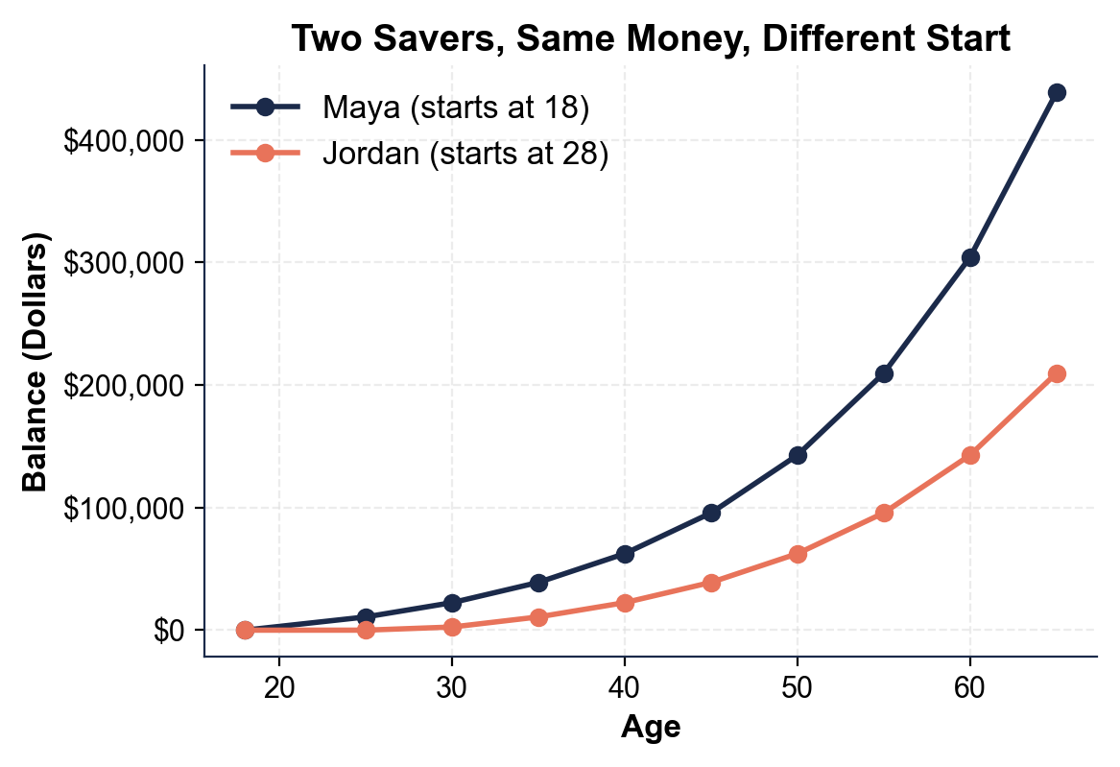
Two Savers, Same Money, Different Start
Same $100/month at 7%: Maya (starts 18) pulls far ahead of Jordan (starts 28).
© More Lessons Less Planning | morelessonslessplanning.com
Notes:
Have students read the two-line chart. The x-axis is age (18 to 65) and the y-axis is the account balance in dollars, both for the same $100 saved every month at 7%. The upper line is MAYA, who starts saving at 18. The lower line is JORDAN, who does not start until 28 - his line sits flat at $0 until age 28, then begins to climb. Both lines curve upward because of compounding, but Maya's line is always about ten years further along, so it stays well above Jordan's and the space between them keeps widening. By age 65 Maya reaches $438,642.92 while Jordan reaches $209,654.44 - a gap of $228,988.48. The picture makes the lesson obvious: the two savers deposit the same $100 a month, but the earlier start means Maya's line has a decade of extra compounding, and that head start more than doubles her ending balance. This is the chart Activity Part 3 reads.
Reference labels (point to these chart features when teaching): Maya (starts 18): $438,643; Jordan (starts 28): $209,654

Slide 8
Small Amounts Add Up
$100 a month is $1,200 a year
A small, steady amount does not feel like much, but saved every month at 7% it becomes real money - $56,400 of Maya's deposits grew to $438,642.92
Consistency beats size
Saving a little every single time, on a schedule, builds more wealth than saving a lot once in a while and then stopping
Opportunity cost of waiting
OPPORTUNITY COST is what you give up by choosing one option over another; by waiting 10 years, Jordan gave up about $228,988.48 of growth
You can start with any amount
You do not need a big income to begin - even $25 or $50 a month started young, then increased over time, puts compounding to work for you
Key Concept: Small, steady deposits add up because time compounds them; the OPPORTUNITY COST of waiting is lost growth, not just skipped deposits.
© More Lessons Less Planning | morelessonslessplanning.com
Notes:
Break the myth that you need a lot of money to start saving. First, small amounts really do add up: $100 a month is only $1,200 a year, which does not feel like much, but saved every month at 7% it becomes real money - Maya's total deposits of $56,400 grew to $438,642.92. Second, consistency beats size: saving a little every single time, on a schedule, builds more wealth than saving a big chunk once and then stopping, because the steady deposits keep feeding the compounding. Third, name the cost of waiting precisely - OPPORTUNITY COST is what you give up by choosing one option over another. Jordan's opportunity cost for waiting ten years was not the $12,000 in deposits he skipped; it was the roughly $228,988.48 of GROWTH those early dollars would have earned. That is the real price of waiting. Finally, reassure students that they can start with any amount: you do not need a big income to begin - even $25 or $50 a month, started young and increased as your income grows, puts compounding to work for you. The takeaway: the amount you start with matters far less than starting at all.

Slide 9
Where to Keep Short-Term Savings
Short-term money: safe and reachable
Match the account to the timeline
Money needed within a few years should be SAFE, not invested for growth
A savings account keeps it protected and easy to reach
A HIGH-YIELD SAVINGS ACCOUNT pays more; an emergency fund stays reachable
Need it soon (emergency fund or near goal)? Keep it in savings
Need it decades from now (retirement)? Investing fits there, later in this unit
Do not keep large savings as cash at home: it earns nothing and is easy to lose
Key Concept: Keep money you need soon SAFE in a savings account (a HIGH-YIELD SAVINGS ACCOUNT pays more); invest money that is decades away later.
© More Lessons Less Planning | morelessonslessplanning.com
Notes:
Give students a simple, practical rule for WHERE savings should live, matched to WHEN they will need the money. The key idea: money you will need within the next few years should be kept SAFE, not put at risk chasing growth. A regular SAVINGS ACCOUNT at a bank or credit union keeps short-term money protected and easy to reach. A HIGH-YIELD SAVINGS ACCOUNT is a savings account that pays a higher interest rate than a regular one while staying just as safe and reachable - a common smart choice for short-term savings. An EMERGENCY FUND belongs here too: it needs to be reachable in a day, not locked up. Then teach students to match the account to the timeline: money you might need soon (an emergency fund, or a goal a year or two away) stays safe in savings, while money you will not touch for decades - like retirement - is where investing for higher growth fits, which the unit covers later. Warn against two common mistakes: keeping large savings as cash at home (it earns nothing and is easy to lose or spend) and, on the other side, tying up money you will need soon in something risky. Remind students this first lesson is about starting the saving habit and knowing where short-term money goes; the investing side comes later in Unit 6.

Slide 10
Your First Savings Goal
Make it specific
A SAVINGS GOAL is a specific dollar amount for a purpose and target date - 'save $500 by December' beats 'save more'
✔
Break it into small deposits
Divide the goal by the time you have: $500 in 10 months is just $50 a month you pay yourself first
✔
Automate and track it
Set up an AUTOMATIC TRANSFER that moves money to savings every payday, so the SAVING HABIT runs itself without willpower
✔
Start now, grow it later
Begin with a starter goal; as your income grows, raise the amount - the point is to start the habit young
✔
Key Concept: Set a SPECIFIC SAVINGS GOAL with a dollar amount and date, break it into small automatic deposits, and start now.
© More Lessons Less Planning | morelessonslessplanning.com
Notes:
End the lesson with a concrete first step students can actually take. A SAVINGS GOAL is a specific dollar amount you decide to save for a particular purpose and target date - and being specific is what makes it work. 'Save more' is a wish; 'save $500 for an emergency fund by December' is a goal, because it has a number and a deadline you can plan around. Show students how to make any goal doable: break it into small deposits by dividing the amount by the time you have. $500 in 10 months is just $50 a month - an amount you can pay yourself first every payday. Then automate and track it: set up an automatic transfer so the SAVING HABIT runs itself without willpower, and check your progress so you can watch the balance climb toward the target, which keeps you motivated. Finally, tell students to start now and grow it later: begin with a realistic first goal, like a small starter emergency fund, and as their income rises they can raise the amount. Tie it back to Maya and Jordan: the specific number and the early start are exactly what separated them. The whole point of this first lesson is to turn the WHY of saving into one specific, startable goal.

Slide 11
Key Takeaways
PAY YOURSELF FIRST and build a SAVING HABIT - save before you spend
★
A long TIME HORIZON lets COMPOUNDING turn small savings into big money
★
Same $100/month at 7%: starting at 18 gives $438,642.92 vs $209,654.44 at 28
★
The OPPORTUNITY COST of waiting is the growth you give up, not just deposits
★
Set a specific SAVINGS GOAL, keep short-term money safe, and start now
★
© More Lessons Less Planning | morelessonslessplanning.com
Notes:
Read each takeaway and connect it to the learning targets. T1 (why save + habit) -> the most important habit is to PAY YOURSELF FIRST and build a SAVING HABIT: move money to savings as soon as you are paid, before you spend, so saving is automatic instead of an afterthought. T2 (time horizon + compounding) -> a long TIME HORIZON lets COMPOUNDING earn returns on your returns, turning small, regular savings into large sums the longer they sit. T3 (start young vs late) -> the proof is Maya and Jordan: the same $100 a month at 7% gives $438,642.92 if you start at 18 but only $209,654.44 if you wait until 28, even though the later starter only put in $12,000 less - the ten-year head start more than doubled the result. T4 (opportunity cost + action) -> the OPPORTUNITY COST of waiting is the roughly $228,988.48 of growth Jordan gave up, not just skipped deposits; so set a specific SAVINGS GOAL, keep short-term money safe and reachable, and start now. The spine of the lesson: WHEN you start matters more than how much you save, and the best time to start is today. As the first toolkit of Unit 6, this sets up the saving and investing work ahead.

