Slide 1
Why Gen Z Can't Buy a House
The Modern Housing Affordability Crisis - Four Causes and What Could Fix It
© More Lessons Less Planning | morelessonslessplanning.com
Notes:
Open by asking students who in their family owns a home and how old they were when they bought it. Tell students this lesson explains why their own first home will probably come much later than their parents' did.

Slide 2
Learning Targets
Identify the four causes of the modern housing affordability crisis
★
Compare Gen Z and millennial first-home ages to earlier generations
★
Evaluate the main proposed policy solutions
★
© More Lessons Less Planning | morelessonslessplanning.com
Notes:
Read each target aloud. Tell students they will leave able to explain why a starter home in 2026 costs roughly twice as much (in income terms) as it did in 1985.

Slide 3
The Affordability Crisis in Numbers
Price-to-Income
Mortgage Rates
First-Home Age
1985: ratio was 3.2 (home cost 3x income)
2026: ratio is 7.1 (home costs 7x income)
Modern level beats the 2006 bubble peak
2021: rates near 3% were normal
2024: rates hit about 7%
Same priced home, payment doubled
Boomers bought first home at age 29
Gen Z first-home age is now 37
Eight years later than their grandparents
Key Concept: The crisis is not one number; it is FOUR forces hitting at once - rates, prices, supply, and zoning.
© More Lessons Less Planning | morelessonslessplanning.com
Notes:
Set the scale of the problem before naming the four causes. Stress that in 1985 a household earning the median income could buy the median home with about three years of income; today it takes more than seven. Key term - Price-to-income ratio: the median home price divided by the median household income; about 3 was the long-run norm and 7 or more is the modern crisis level. Key term - Affordability index: a score where 100 means the median family earns exactly enough to afford the median home; below 100 means the median family cannot afford the median home.

Slide 4
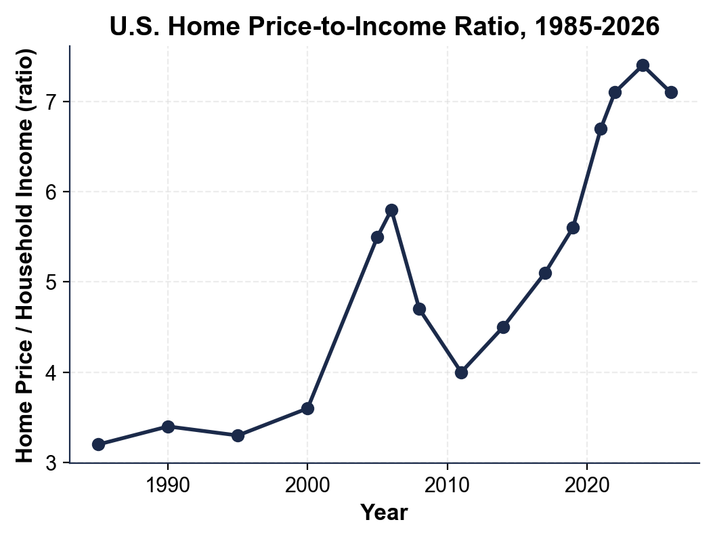
U.S. Home Price-to-Income Ratio, 1985-2026
Note: 2024 ratio (~7.4) is higher than the 2006 bubble peak (~5.8)
© More Lessons Less Planning | morelessonslessplanning.com
Notes:
Have students point to the 2006 peak (the housing bubble) and the 2024 peak. Ask: which one looks worse on this chart? Then point out that the 2026 ratio is 7.1 - barely down.
Reference labels (point to these chart features when teaching): 1985: ~3.2; 2024: ~7.4

Slide 5
Cause 1: Mortgage Rates Jumped to 7%
What Happened
Why It Hurts Buyers
2021: 30-year mortgage rate was about 3%
Fed raised rates to fight inflation
By 2024, mortgage rates hit about 7%
Even in 2026, rates are still around 6.5%
Same priced home, payment nearly doubles
$300K loan at 3% = $1,265/month
$300K loan at 7% = $1,996/month
Buyers qualify for ~30% less house
Did You Know? The interest rate matters more than the price for monthly payment - a small rate change moves the payment a lot.
© More Lessons Less Planning | morelessonslessplanning.com
Notes:
Walk through the $300K example slowly. Point out that the rate change ALONE adds $731 a month to the same $300K loan - even if the price never changed. Key term - Mortgage rate: the interest rate on a home loan; it rose from about 3 percent in 2021 to about 7 percent by 2024, which doubled the monthly payment on the same priced home.

Slide 6
Cause 2: Prices Up 50% Since 2019
2019 median home price
About $278,000 nationally
2026 median home price
About $416,000 nationally - up roughly 50%
Why prices spiked
COVID-era low rates pulled buyers in fast; supply was already short
Why they did not drop
Existing owners with 3% mortgages will not sell; supply stays locked
The lock-in effect
Selling means giving up your 3% rate for a 7% rate - so most owners stay put
Tip: Wages did NOT rise 50% since 2019 - they rose about 25% - so the gap between price and pay grew.
© More Lessons Less Planning | morelessonslessplanning.com
Notes:
Make sure students see the math: prices up 50%, wages up 25%, the price-to-income ratio HAS to climb. Then explain the lock-in effect: low-rate owners will not list, so even with high prices supply does not flow back to buyers. Key term - Lock-in effect: when existing homeowners with low 3 percent mortgages refuse to sell because moving means trading their 3 percent rate for a 7 percent rate, which locks housing supply away from buyers.

Slide 7
Cause 3: The 4 Million Home Supply Shortage
U.S. is short about 4 million housing units (Freddie Mac estimate)
Builders stopped keeping up with population after 2008
Starter-home construction nearly disappeared after 2008
From 2010 to 2020 the U.S. built ~5.5 million homes; we needed ~9 million
Existing homes are not for sale because of the lock-in effect
When supply is short and demand is steady, prices stay high
Key Point: A shortage this big takes a decade or more to fix even if every policy lever is pulled at once.
© More Lessons Less Planning | morelessonslessplanning.com
Notes:
Stress the persistence of the shortage: a 4 million unit gap cannot be closed in a year or two. New construction takes 12-18 months from permit to completion, and many cities are not even issuing the permits. Key term - Housing supply shortage: the roughly 4 million housing units the U.S. is short of what it needs; the gap has grown since 2008 because builders did not keep up with population growth.

Slide 8
Cause 4: NIMBY Zoning Blocks New Building
Zoning
Local rules that decide what can be built where
Single-family zoning
Allows only ONE detached house per lot - covers about 75% of U.S. residential land
NIMBY
Not In My Back Yard - existing owners who oppose new housing nearby
Upzoning
A change that allows MORE units (duplexes, ADUs, apartments) on the same land
ADU
Accessory Dwelling Unit - a backyard cottage, basement apartment, or garage conversion
Warning: Existing homeowners benefit from rising prices, so many oppose new building - even when their own kids cannot buy in town.
© More Lessons Less Planning | morelessonslessplanning.com
Notes:
Walk students through the political incentive: every existing homeowner is sitting on a major asset that gains value when supply stays scarce. They show up at zoning meetings; renters and would-be buyers usually do not. That asymmetry shapes outcomes. Key term - Single-family zoning: zoning rules that allow only one detached house per lot; they cover about 75 percent of U.S. residential land and are the biggest single zoning constraint on new supply. Key term - NIMBY: short for Not In My Back Yard; existing homeowners who oppose new housing being built near them through public hearings, lawsuits, or zoning votes. Key term - Upzoning: a zoning change that allows more units on the same land such as duplexes, apartments, and accessory dwelling units; the main supply-side reform economists recommend. Key term - ADU (Accessory Dwelling Unit): a small additional home on the same lot as a single-family house such as a backyard cottage, basement apartment, or garage conversion; legalizing ADUs is a common upzoning reform.

Slide 9
The Builder Pullback After 2022
What Builders Saw
How Big the Drop
The Catch-22
Mortgage rates jumped, buyers vanished
Material and labor costs stayed high
Builders cut starts and laid off crews
New home starts fell about 30% from 2021 to 2023
Single-family permits down sharply
Crews and skilled labor moved to other work
We need MORE building to fix prices
But high rates make building unprofitable
So the shortage gets worse, not better
Note: The same high rates that hurt buyers ALSO hurt builders - creating a feedback loop that locks the shortage in.
© More Lessons Less Planning | morelessonslessplanning.com
Notes:
This is the loop: high rates -> fewer buyers -> builders stop -> supply shrinks more -> prices stay high. Have students name what would break the loop (a clue: lower rates AND more permits).

Slide 10
Do the Math: A Starter Home + 7% Mortgage
Item | Amount | What It Means
Median home price (2026) | $416,000 | What you pay total
Down payment (10%) | $41,600 | Cash up front (years of saving)
Loan amount | $374,400 | What the bank lends you
Mortgage rate (2026) | 6.5% | Interest the bank charges yearly
Monthly principal + interest | $2,367 | Just the loan - no taxes/insurance
Property tax + insurance | $650 | Estimate, varies by metro
TOTAL monthly payment | $3,017 | What you actually owe each month
Note: Affording this needs about $129,300/year (the 28% rule), but the median household earns only about $80,000.
© More Lessons Less Planning | morelessonslessplanning.com
Notes:
Walk the table line by line. Stress the income-needed line: a buyer needs $129K of household income to NOT be cost-burdened on the median home. The actual median is $80K. That gap is the affordability crisis in one number.

Slide 11
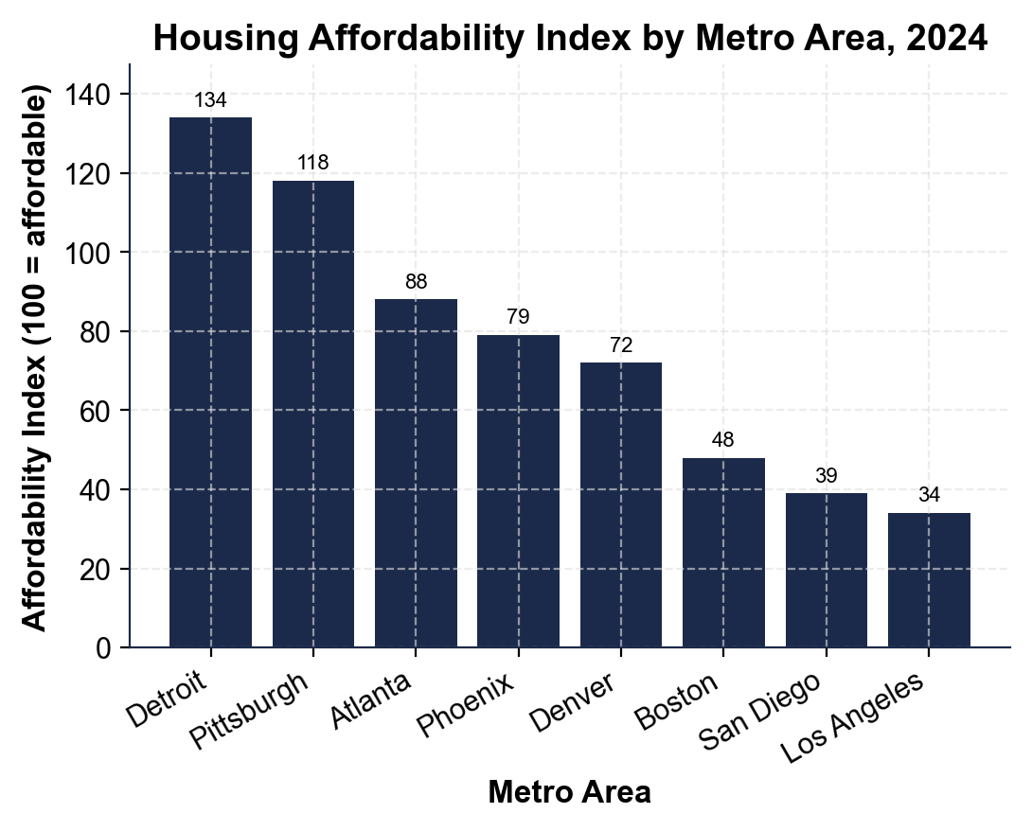
Housing Affordability Index by Metro Area, 2024
Note: Index 100 = median family can afford median home; below 100 cannot.
© More Lessons Less Planning | morelessonslessplanning.com
Notes:
Have students name a metro they would move to (or have family in) and check it on the chart. Ask: what does an index of 34 mean for a family in LA? (They earn about a third of what they need to afford the median home.)
Reference labels (point to these chart features when teaching): Detroit ~134 (most affordable); LA ~34 (least affordable)

Slide 12
Each Generation Buys Later Than the One Before
Boomers bought first home at age 29
Gen X bought first home at age 31
Millennials bought first home at age 34
Gen Z (so far) is buying at age 37
That is 8 years later than Boomers were
Each generation has waited longer than the one before
Big Idea: Eight extra years of renting means eight fewer years of building home equity for retirement.
© More Lessons Less Planning | morelessonslessplanning.com
Notes:
Set up the chart on the next slide. The pattern is monotonic - every generation has been buying later than the previous one. The biggest single jump is Millennials to Gen Z (3 years).

Slide 13
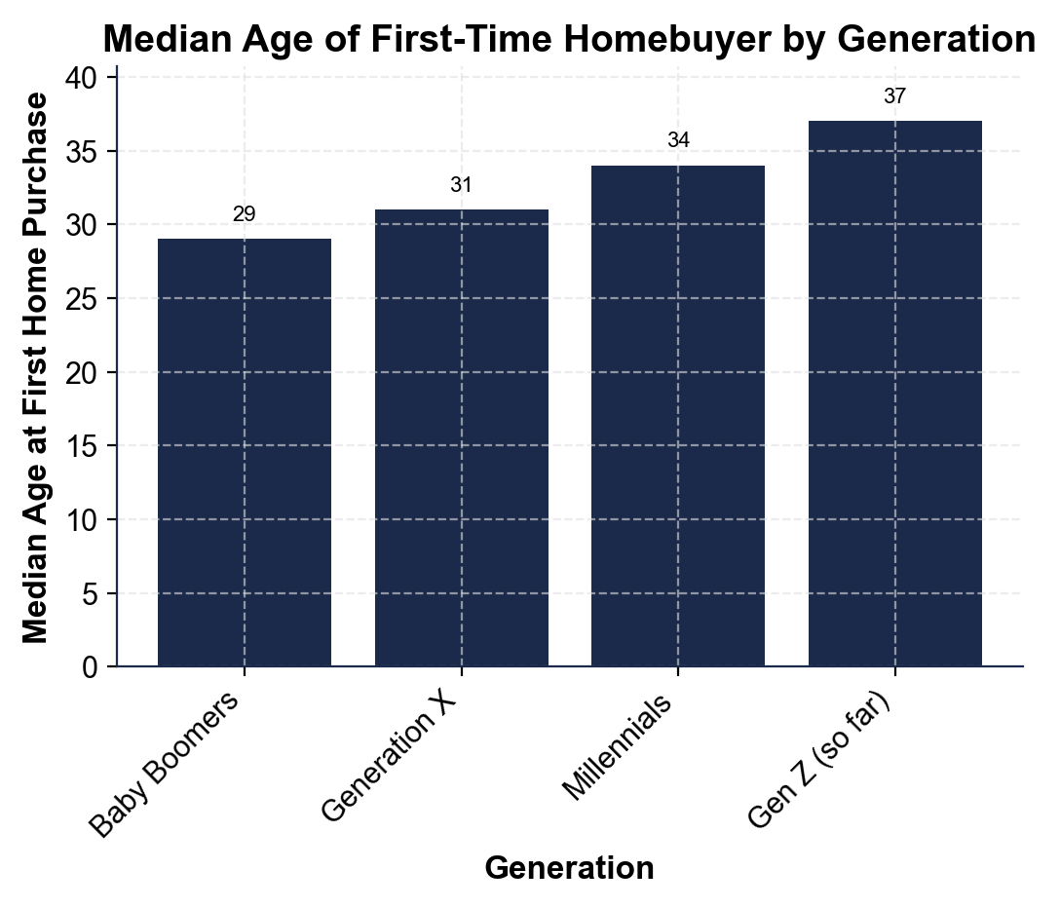
Median Age of First-Time Homebuyer, by Generation
Note: Median first-home age has climbed from 29 (Boomers) to 37 (Gen Z so far).
© More Lessons Less Planning | morelessonslessplanning.com
Notes:
Read the chart left to right. Ask: what would your life look like if you do not own a home until 37? More renting, less wealth building, later kids, later retirement saving.
Reference labels (point to these chart features when teaching): Boomers age 29; Gen Z age 37

Slide 14
Policy Options to Fix It
Upzoning
Legalize ADUs, duplexes, and apartments on more land - the main supply-side reform
✔
Builder Incentives
Tax breaks and faster permits for new construction, especially starter homes
✔
Down-Payment Assistance
State and federal grants for first-time buyers - helps demand without raising prices much
✔
Lower Rates
Fed rate cuts would lower mortgage rates - but the Fed cuts only when inflation cools
✔
What Will Not Work Alone
Rent control, blanket subsidies, or doing nothing - none address the supply shortage
✔
Tip: Most economists agree the biggest single fix is BUILDING MORE - everything else helps less without that.
© More Lessons Less Planning | morelessonslessplanning.com
Notes:
Have students rank the options 1-4. Then point out that supply-side reforms (upzoning, builder incentives) take years to bite, while demand-side reforms (down-payment help, lower rates) act faster but can push prices up if supply stays tight. Key term - Down-payment assistance: state, local, and federal programs that help first-time buyers cover their down payment; a leading demand-side policy that helps buyers without raising prices much.

Slide 15
Key Takeaways
Four forces caused the modern crisis: rates, prices, supply shortage, and zoning
★
The price-to-income ratio is now 7+, more than double the 1985 norm of about 3
★
Gen Z buys a first home about 8 years later than Boomers did
★
The biggest single fix is BUILDING MORE - upzoning is the leading reform
★
Down-payment help is faster but smaller than supply-side change
★
© More Lessons Less Planning | morelessonslessplanning.com
Notes:
Read each takeaway. Connect back to the learning targets. Ask: which of these surprised you the most?

