Slide 1
Why Explore: God, Gold, Glory
What a 1455 papal decree reveals about faith, trade, power, and overseas voyages
© More Lessons Less Planning | morelessonslessplanning.com
Notes:
Open with the lesson question: what motives does Romanus Pontifex reveal in its own 1455 language? God, Gold, and Glory is historians shorthand, not a quotation used by explorers or rulers.

Slide 2
Learning Targets
Trace religious, economic, and political motives in a source
★
Explain why God, Gold, and Glory is modern shorthand
★
Connect caravels and repeated voyages to exploration
★
Analyze a 1455 papal decree critically
★
Describe conquest and enslavement authorization factually
★
© More Lessons Less Planning | morelessonslessplanning.com
Notes:
The five targets keep the lesson centered on the approved record: motives, the modern mnemonic, the caravel, repeated Portuguese expeditions, and critical source analysis.

Slide 3
A Helpful Shorthand - Not a Period Quote
God, Gold, and Glory is historians shorthand.
It was not a slogan used by 1400s explorers or rulers.
Period documents state motives in their own terms.
This decree names faith, trade monopoly, and dominion.
Use the shorthand only after checking the source.
Key Concept: Treat God, Gold, and Glory as a modern organizing tool, never as words spoken by period explorers.
© More Lessons Less Planning | morelessonslessplanning.com
Notes:
The approved misconception correction is binding: introduce God, Gold, and Glory as historians shorthand. Romanus Pontifex states motives through faith, crusade, trade monopoly, and dominion.

Slide 4
Romanus Pontifex: A Decree with Power
The Document
The Subject
Pope Nicholas V issued it
January 8, 1455
An official papal decree
Praises Prince Henry
Supports Portuguese voyages
Links faith with overseas power
Did You Know: A papal bull was an official decree issued by the pope.
© More Lessons Less Planning | morelessonslessplanning.com
Notes:
Pope Nicholas V issued Romanus Pontifex on January 8, 1455. The decree praises Prince Henry and supports Portugal's African voyages.

Slide 5
What Motives Appear in the Decree?
Faith
Trade
Power
Zeal for salvation of souls
Spread the Christian faith
Religious authority supports voyages
Exclusive trade rights
Control through Guinea and beyond
Gold dust reached Portugal in 1441
Dominion over land and people
Conquest of non-Christian peoples
Legal cover for enslavement
Warning: Describe the enslavement authorization factually in modern prose; do not reproduce its legal clauses.
© More Lessons Less Planning | morelessonslessplanning.com
Notes:
The record supports faith, exclusive trade rights, dominion, conquest, and legal cover for enslavement. Present the authorization factually in modern prose.

Slide 6
Technology and the Voyage System
The decree calls the ships very swift caravels.
A caravel was small, fast, and built for ocean exploration.
By 1455, Henry had sent expeditions for twenty-five years.
The expeditions sailed nearly every year.
A chart helps us visualize the ocean-voyage world.
Key Concept: Technology mattered because repeated voyages depended on ships built for ocean exploration.
© More Lessons Less Planning | morelessonslessplanning.com
Notes:
Romanus Pontifex says expeditions sailed in very swift ships called caravels. By 1455 Henry had sent expeditions nearly every year for twenty-five years.

Slide 7
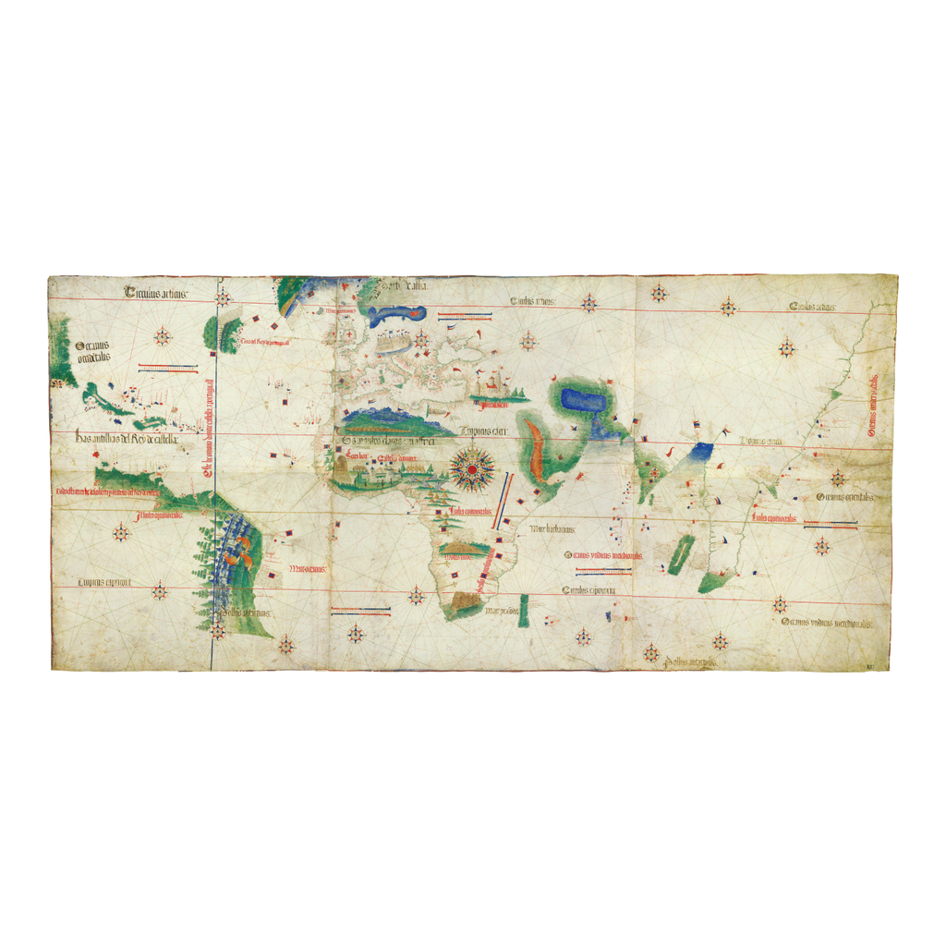
Cantino Planisphere (1502)
Cantino planisphere (1502), a Portuguese chart; Biblioteca Estense, Modena
© More Lessons Less Planning | morelessonslessplanning.com
Notes:
This is the Cantino planisphere, a 1502 Portuguese chart held by the Biblioteca Estense in Modena. Use it as a historical reference image, not as evidence for claims beyond the approved record.
Reference labels (point to these chart features when teaching): Portuguese chart; 1502

Slide 8
A Pattern of Voyages and Trade
1441
25 years
First enslaved Africans and gold dust reached Portugal
Expeditions sent nearly every year by 1455
Trade: The Guinea trade grew quickly.
Rights: The decree gave Portugal exclusive trade rights.
Reach: Those rights extended through Guinea and beyond.
Remember: The source ties overseas voyages to trade control and human enslavement.
© More Lessons Less Planning | morelessonslessplanning.com
Notes:
In 1441 the first enslaved Africans and gold dust reached Portugal. By 1455 Henry had sent expeditions nearly every year for twenty-five years, and the decree gave Portugal exclusive trade rights through Guinea and beyond.

Slide 9
Why the Decree Had Teeth
Individuals
Communities
Between Nations
Violators faced automatic excommunication
Excommunication expelled a person from Church sacraments
The penalty gave spiritual weight
Whole communities faced interdict
The penalty extended beyond one person
Religious authority shaped compliance
The pope's spiritual authority mattered
Excommunication and interdict added weight
The decree backed Portugal's claims
Key Concept: Spiritual penalties gave papal decisions weight between nations.
© More Lessons Less Planning | morelessonslessplanning.com
Notes:
Individuals violating the decree faced automatic excommunication, while whole communities faced interdict. These spiritual penalties gave papal decisions weight between nations.

Slide 10
Reference Guide: Source and Voyage Terms
papal bull
An official decree issued by the pope.
caravel
A small, fast ship built for ocean exploration.
monopoly
Exclusive control of a trade or business.
infante
A Portuguese prince; Henry's title.
Saracens
Old European church term for Muslims.
Tip: These terms help decode the source's language and the voyage system it supported.
© More Lessons Less Planning | morelessonslessplanning.com
Notes:
Review the five record-defined terms exactly: papal bull, caravel, monopoly, infante, and Saracens.

Slide 11
Reference Guide: Power and Place Terms
excommunication
Being expelled from the Church and its sacraments.
dominion
Complete authority over land and people.
conquest
Taking land or people by force.
Guinea
Europe's name for the West African coast.
Age of Exploration
The 1400s-1600s era of European overseas voyages.
Tip: Use these terms to explain how religious authority, political power, and geography connect.
© More Lessons Less Planning | morelessonslessplanning.com
Notes:
Review the five record-defined terms exactly: excommunication, dominion, conquest, Guinea, and Age of Exploration.

Slide 12
Read the Source in Its Own Words
greatly inflamed with zeal for the salvation of souls and with fervor of faith
— Pope Nicholas V, Romanus Pontifex (1455), in F. G. Davenport, ed., European Treaties (Carnegie Institution, 1917), Doc. 1.
Remember: The excerpt most directly reveals the religious language used to praise the voyages.
© More Lessons Less Planning | morelessonslessplanning.com
Notes:
The excerpt praises Prince Henry as greatly inflamed with zeal for the salvation of souls and with fervor of faith. It says he aspired to have the Creator's name revered throughout the world and to bring others into the faith.

Slide 13
From Source Evidence to Motive Claims
Religious
Economic
Political
Zeal for salvation of souls
Fervor of faith
Spreading the Creator's name
Exclusive trade rights
Guinea and beyond
Gold dust and growing trade
Dominion and conquest
Portugal's exclusive claims
Papal penalties added weight
Key Concept: Strong historical claims link each motive to specific source evidence.
© More Lessons Less Planning | morelessonslessplanning.com
Notes:
Use only the record's evidence: religious zeal and faith in the excerpt; exclusive trade rights, Guinea, and gold dust for economic motives; dominion, conquest, and papal penalties for political power.

Slide 14
Misconception Check: What Can We Claim?
Say
Historians use God, Gold, and Glory as shorthand.
✔
Do not say
Explorers used the phrase as their own slogan.
✔
Say
The decree joined faith, trade monopoly, and dominion.
✔
Say
It gave legal cover for conquest and enslavement.
✔
Describe carefully
Use factual modern prose, never sensational legalese.
✔
Warning: A memorable phrase is not evidence until it is checked against a period source.
© More Lessons Less Planning | morelessonslessplanning.com
Notes:
Apply the misconception flag and wording constraint exactly. The mnemonic is modern. The decree's own terms support faith, trade monopoly, dominion, conquest, and enslavement authorization. Describe enslavement factually in modern prose.

Slide 15
Key Takeaways
God, Gold, and Glory is historians shorthand, not a period quotation.
★
Romanus Pontifex (1455) reveals faith, trade monopoly, dominion, and conquest.
★
Caravels and nearly yearly expeditions supported sustained ocean voyages.
★
The decree gave legal cover for conquest and enslavement.
★
Strong claims trace directly to the approved source record.
★
© More Lessons Less Planning | morelessonslessplanning.com
Notes:
Close with the essential question. Use the shorthand cautiously and support each motive with a record-backed detail.

