Slide 1
What Is the Federal Reserve?
America's central bank: structure, role, and independence.
© More Lessons Less Planning | morelessonslessplanning.com
Notes:
Open with the hook. The Federal Reserve is the single most powerful economic institution in the U.S. - it sets interest rates, supervises banks, and prints the money in your wallet. But almost no one can explain its structure. Today's lesson teaches the Fed's anatomy: the Board of Governors in Washington (7 members), the 12 regional Federal Reserve Banks scattered across the country, the FOMC that sets rates (12 voting members), and the Chair who speaks for it. We also tackle the question Sam's students always ask: why is the Fed independent from Congress, and is that a good thing?

Slide 2
Learning Targets
Describe the Federal Reserve's structure and primary roles
★
Distinguish the Fed from a typical commercial bank
★
Explain why the Fed was created and how it remains independent from Congress
★
© More Lessons Less Planning | morelessonslessplanning.com
Notes:
Read each target aloud. Target 1 maps to slides 3-10 (the Fed's anatomy). Target 2 maps to slide 12 (Fed vs. commercial bank). Target 3 maps to slides 13-14 (independence). The activity (Template E) is a classification sort - students sort 12 institutional facts into Board / Regional Banks / FOMC / Not the Fed - which exercises target 1 directly. The quiz includes items on all three targets.

Slide 3
What Is a Central Bank?
What a Central Bank Does
Why Every Major Country Has One
Issues the national currency (dollars)
Sets monetary policy (interest rates)
Supervises commercial banks
Acts as banker to the government
Crisis lender: prevents bank panics
Inflation control: limits money supply
Smooth payments: clears checks, wires
U.S. central bank = the Federal Reserve
Key Concept: A central bank is the bank for banks, not for individuals.
© More Lessons Less Planning | morelessonslessplanning.com
Notes:
Set up the topic. A central bank is a national institution that issues the country's currency, sets monetary policy (mainly interest rates), supervises commercial banks, and acts as banker to the government and to other banks. Every major economy has one - the European Central Bank in Europe, the Bank of England in the UK, the Bank of Japan, and so on. The U.S. central bank is the Federal Reserve System, usually called 'the Fed.' Critically, a central bank does NOT take deposits from the public or make loans to individuals - that is the job of commercial banks like Chase or Wells Fargo. The central bank is the bank FOR banks, not for you.

Slide 4
The Fed Was Created in 1913
Founding law
The Federal Reserve Act, signed by Woodrow Wilson on December 23, 1913
What triggered it
The Panic of 1907 - a bank-run crisis; J.P. Morgan personally bailed out banks
The political fight
Americans were suspicious of a powerful central bank; Andrew Jackson killed the prior one in 1836
The compromise
A DUAL structure: a Board in Washington + 12 regional banks across the country
Original purpose
Create an 'elastic currency' that could expand and contract to prevent bank panics
Note: The Fed was the THIRD U.S. central bank. The first two were killed by political opposition.
© More Lessons Less Planning | morelessonslessplanning.com
Notes:
Give the origin story. The Federal Reserve Act was signed by President Woodrow Wilson on December 23, 1913. What forced its creation? The Panic of 1907 - a bank-run crisis that nearly collapsed the U.S. financial system. With no central bank, the wealthy banker J.P. Morgan personally organized a private bailout of failing banks. Congress decided the country could not depend on a single private banker to save the system. After six years of political fighting (Americans were historically suspicious of a powerful central bank - Andrew Jackson had killed the Second Bank of the United States in 1836), Congress passed the Federal Reserve Act. The compromise was the DUAL structure: a Board in Washington (federal power) plus 12 regional banks (decentralized regional input). The original mission was an 'elastic currency' - a money supply that could expand in a crisis to prevent panics.

Slide 5
The Dual Structure: Board + 12 Regional Banks
Board of Governors (Washington, D.C.)
12 Regional Federal Reserve Banks
7 members appointed by the President
Senate confirms; 14-year terms
Sets policy direction; supervises the system
The Chair speaks for the Board
Each serves a region of the country
Each has its own President (separate from US Pres)
Run daily operations: cash, payments, supervision
Five vote on the FOMC each year
Key Concept: The Fed is BOTH a federal agency AND a network of 12 regional banks.
© More Lessons Less Planning | morelessonslessplanning.com
Notes:
Drill the dual structure. The Federal Reserve is NOT a single agency - it is a hybrid. At the top is the Board of Governors, a federal agency in Washington with 7 members appointed by the President and confirmed by the Senate. Each governor serves a fixed 14-year term. The Chair (currently Jerome Powell) is appointed for a 4-year term as Chair, separate from the governor term. The Board sets the overall direction. Below the Board are 12 regional Federal Reserve Banks - each headquartered in a major U.S. city (Boston, New York, Philadelphia, Cleveland, Richmond, Atlanta, Chicago, St. Louis, Minneapolis, Kansas City, Dallas, San Francisco). Each regional bank has its own President, chosen by its regional board (NOT by the U.S. President). The regional banks run the day-to-day operations - processing cash, clearing payments, supervising banks in their district. Five of the 12 regional Presidents serve as voting members of the FOMC each year on a rotating basis (the New York Fed President always votes).

Slide 6
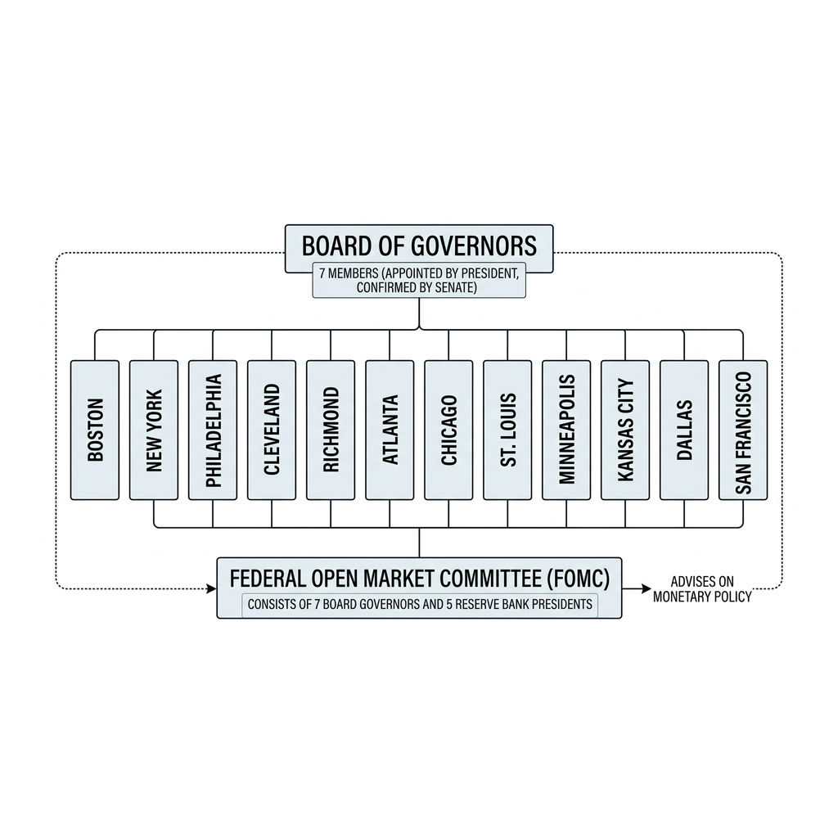
Federal Reserve System Structure
Note: Fed structure
© More Lessons Less Planning | morelessonslessplanning.com
Notes:
Read the diagram. The Board of Governors sits at the top (7 members, Washington DC). Below it sit the 12 regional Federal Reserve Banks as a row of boxes labeled by city. The FOMC overlaps both: it includes ALL 7 Board governors + the New York Fed President (always) + 4 other regional Presidents (rotating). Students should be able to point to a structure box and tell you what it does.
Reference labels (point to these chart features when teaching): 7 governors; 12 banks

Slide 7
The Board of Governors
Members
7 Governors, including the Chair and the Vice Chair
Appointment
Appointed by the U.S. President and confirmed by the Senate
Term length
14 years - longer than three presidential terms; insulates them from politics
Where they sit
The Eccles Building in Washington, D.C.
Powers
Sets reserve requirements; supervises regional banks; votes on every FOMC decision
Did You Know: Fed governors serve 14-year terms - the structural anchor of Fed independence (longer than three presidential terms).
© More Lessons Less Planning | morelessonslessplanning.com
Notes:
Detail the Board. The Board of Governors has 7 members: the Chair, the Vice Chair, the Vice Chair for Supervision, and 4 other Governors. Each is appointed by the U.S. President and confirmed by the Senate. The term length is 14 years - one of the longest fixed terms in the federal government. Three presidential terms is 12 years, so a governor can outlast the president who appointed them. That length is intentional: it insulates governors from short-term political pressure. The Board sits in the Marriner S. Eccles Building in Washington, D.C. - the only Fed building most Americans have heard of. The Board's powers include setting reserve requirements, supervising the 12 regional banks, voting on every FOMC interest-rate decision, and overseeing large banks.

Slide 8
The 12 Regional Federal Reserve Banks
The 12 District Cities
What Regional Banks Do
Boston, New York, Philadelphia, Cleveland
Richmond, Atlanta, Chicago, St. Louis
Minneapolis, Kansas City, Dallas
San Francisco
Distribute currency and coin in their district
Clear checks and process payments
Supervise local commercial banks
Conduct regional economic research
Key Concept: Each region has its own Fed bank. Your dollar bills come from the one in your district.
© More Lessons Less Planning | morelessonslessplanning.com
Notes:
Cover the regional banks. There are 12 Federal Reserve Districts, numbered 1 through 12, each with a regional Federal Reserve Bank: 1-Boston, 2-New York, 3-Philadelphia, 4-Cleveland, 5-Richmond, 6-Atlanta, 7-Chicago, 8-St. Louis, 9-Minneapolis, 10-Kansas City, 11-Dallas, 12-San Francisco. Each regional bank has its own President, chosen by its district's board of directors (NOT appointed by the U.S. President). The regional banks do the operational work: distributing currency to commercial banks, clearing checks, processing electronic payments, supervising the small and mid-sized commercial banks in their district, and producing regional economic research. The New York Fed is the most powerful because it conducts open-market operations on behalf of the entire system - it is the only regional bank that always votes on the FOMC.

Slide 9
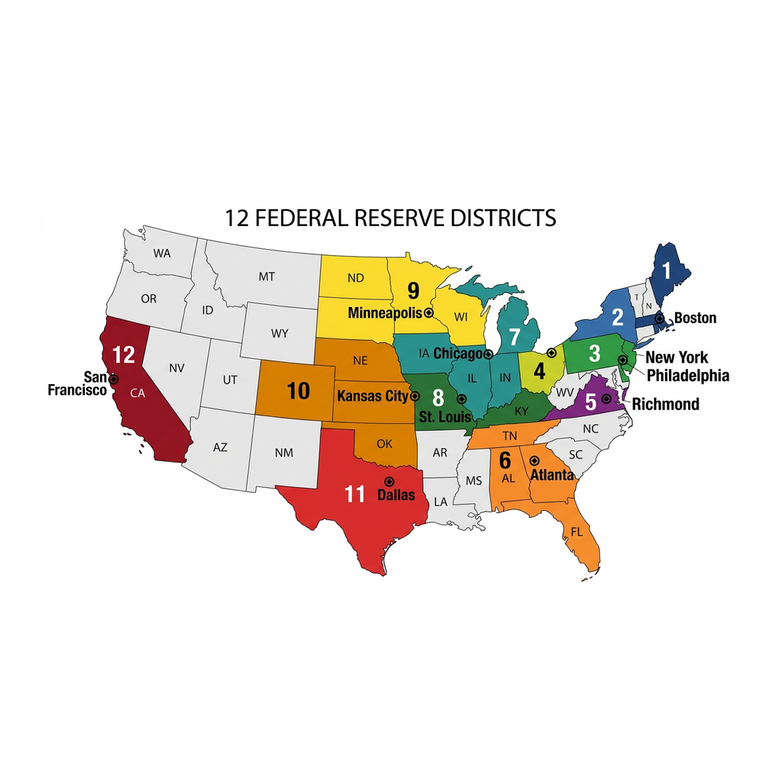
The 12 Federal Reserve Districts
Note: 12 Fed districts
© More Lessons Less Planning | morelessonslessplanning.com
Notes:
Read the map. Students should find their state and identify which Federal Reserve District they live in. Note the lines do NOT match state boundaries - the districts were drawn in 1913 to reflect commerce and banking patterns at the time. The 12th District (San Francisco) is by far the largest in geography, covering all of the western U.S. plus Alaska and Hawaii. The 2nd District (New York) is the smallest geographically but the largest economically.
Reference labels (point to these chart features when teaching): 12 districts; 12 cities

Slide 10
The FOMC and Rate-Setting
What FOMC stands for
Federal Open Market Committee - the rate-setting body of the Federal Reserve
Who votes
12 voting members: all 7 Board Governors + New York Fed President + 4 rotating regional Presidents
What it decides
The federal funds rate - the interest rate banks charge each other for overnight loans
How often
Meets 8 times per year (roughly every 6 weeks); Chair gives a press conference after each meeting
Why markets watch
FOMC decisions move trillions in financial markets and shape mortgages, car loans, and business borrowing
Big Idea: When you hear 'the Fed raised rates,' it means the FOMC voted to raise the federal funds rate.
© More Lessons Less Planning | morelessonslessplanning.com
Notes:
Explain the FOMC. The Federal Open Market Committee (FOMC) is the rate-setting body of the Federal Reserve. It has 12 voting members: all 7 Board Governors + the New York Fed President (always) + 4 other regional Presidents on a rotating basis. The FOMC meets 8 times per year, roughly every 6 weeks. Its main decision is the federal funds rate target - the interest rate at which commercial banks lend reserves to each other overnight. That single rate is the anchor for nearly every other U.S. interest rate: mortgages, car loans, credit cards, business loans, and Treasury yields. After each meeting the Chair holds a press conference; market traders move trillions of dollars based on the Chair's words. When you hear in the news that 'the Fed raised rates,' it means the FOMC voted to raise the federal funds rate target.

Slide 11
The Fed Chair's Role
What the Chair Does
The Chair's Power
Chairs FOMC meetings (sets the agenda)
Speaks for the Fed publicly
Testifies before Congress twice a year
Signs every Federal Reserve Note (dollar bill)
4-year term as Chair (renewable)
Markets parse every speech word
Most influential single voice in U.S. monetary policy
Jerome Powell since February 2018
Tip: The Chair holds enormous influence but only ONE vote on the FOMC. Persuasion is the real job.
© More Lessons Less Planning | morelessonslessplanning.com
Notes:
Drill the Chair role. The Fed Chair is the most influential single voice in U.S. monetary policy - but, importantly, the Chair holds only ONE of the 12 FOMC votes. The Chair's real power is agenda-setting, persuasion, and consensus-building. The Chair is appointed by the President to a 4-year renewable term as Chair (separate from their 14-year term as a Governor). The Chair chairs every FOMC meeting, holds the press conference after each meeting, testifies before Congress twice a year (the Humphrey-Hawkins testimony), and signs every Federal Reserve Note (the dollar bill in your wallet - check it). The current Chair is Jerome Powell, appointed by President Trump in 2018 and renewed by President Biden in 2022. Markets parse every word the Chair says - a single sentence in a speech can move trillions of dollars in bond and stock markets.

Slide 12
How the Fed Differs From Your Bank
Feature | The Federal Reserve | A Commercial Bank (Chase, Wells Fargo)
Customers | Banks and the U.S. government | Individuals and businesses
Goal | Stable economy + healthy banking system | Profit for shareholders
Issues currency? | YES (Federal Reserve Notes = dollars) | NO (only the Fed can issue currency)
Sets interest rates? | YES (the federal funds rate) | NO (banks follow the Fed's rate)
Takes your deposits? | NO (cannot open an account with the Fed) | YES (checking, savings, CDs)
Lends to you? | NO (lends only to banks) | YES (mortgages, car loans, etc.)
Key Concept: The Fed is a BANKER'S BANK. You cannot deposit money at the Fed.
© More Lessons Less Planning | morelessonslessplanning.com
Notes:
Drill the Fed vs. commercial bank distinction. Students often think the Fed is just a really big bank where the government keeps its money. Wrong. The Fed is a BANKER'S BANK. Its customers are commercial banks (Chase, Wells Fargo, Bank of America, your local credit union) and the U.S. Treasury - NOT individuals. The Fed does not take public deposits or make individual loans. Its goal is a stable economy and a healthy banking system, not profit. Only the Fed can issue Federal Reserve Notes (the dollar bills in your wallet). Only the Fed sets the federal funds rate - other banks just respond to it. If a student asks how to 'open an account at the Fed,' explain that ordinary people cannot - you can only open accounts at commercial banks, which themselves hold reserve accounts at the Fed.

Slide 13
Independence From Congress
What it means
The Fed makes monetary-policy decisions WITHOUT Congressional approval
Structural protections
14-year governor terms; President cannot fire governors for policy disagreement
Funding independence
The Fed pays its own costs from interest on bond holdings - no Congressional money
Accountability
Fed reports to Congress twice a year, but Congress cannot vote on rate decisions
Created by Congress
Independence is statutory, not constitutional - Congress could amend the Fed Act
Big Idea: The Fed is INDEPENDENT, not unaccountable. Congress created it but cannot vote on rates.
© More Lessons Less Planning | morelessonslessplanning.com
Notes:
Explain independence. The Fed is INDEPENDENT from Congress and the White House in its day-to-day monetary policy. Independence has three structural pillars: (1) Governors serve 14-year fixed terms; the President cannot fire them just for disagreeing on policy. (2) The Fed funds itself - it pays operating costs from interest earned on the bonds it holds, so it does NOT need annual appropriations. (3) Congress does not vote on rate decisions; the FOMC does. Important nuance: 'independent' does NOT mean 'unaccountable.' The Fed was CREATED by Congress in the Federal Reserve Act and reports to Congress twice a year (Humphrey-Hawkins testimony). Congress could amend the Federal Reserve Act tomorrow if it wanted to - the Fed's independence is statutory, not constitutional. Recent Presidents have publicly pressured the Fed Chair (President Trump in 2018-2020 was the most prominent example), but the Fed kept making rate decisions on its own.

Slide 14
Why Independence Matters
The Case For Independence
The Critics' Case
Politicians want low rates before elections
Low rates boost growth short-term but cause inflation
Independent Fed can raise rates when needed
Most economists support independence
Congress's dual mandate: maximum employment and stable prices
Powerful agency not directly elected
Rate decisions hurt some Americans (savers vs. borrowers)
Some lawmakers want more Congressional control
Audit-the-Fed proposals appear regularly
Did You Know: This is a live democratic-theory debate, not a settled question.
© More Lessons Less Planning | morelessonslessplanning.com
Notes:
Frame the debate. The case FOR independence: elected politicians want low rates before elections (low rates boost growth and employment short-term, which helps incumbents). But low rates that go too long cause inflation. An independent Fed can raise rates when the economy is overheating even if politicians do not want it to. Most economists support central-bank independence; countries with independent central banks have historically had lower inflation. The case AGAINST: the Fed is enormously powerful and not directly elected. Its rate decisions hurt some Americans (savers when rates are low; borrowers when rates are high) and help others. Some lawmakers - Senator Bernie Sanders, Senator Rand Paul, others - want more Congressional control or an 'audit the Fed' law. This is a genuine democratic-theory debate, not a settled question. Treat it as a discussion prompt, not a lecture.

Slide 15
Key Takeaways
Fed = America's central bank, created 1913
★
Dual structure: 7-member Board + 12 regional banks
★
The Fed is a BANKER'S BANK - serves banks, not you
★
Independence: 14-year terms, self-funded, no Congress vote
★
© More Lessons Less Planning | morelessonslessplanning.com
Notes:
Close the lesson. Review the five takeaways aloud. Tell students they should be able to (a) state the Fed's structure (Board + 12 regional banks + FOMC), (b) explain why the Fed is NOT like Chase or Wells Fargo, and (c) explain at least one reason for and one reason against Fed independence. The activity (classification sort) and quiz will test all three skills.

