Slide 1
What Is Insurance? Paying to Protect Yourself
Pay a little to protect yourself from a lot - how insurance spreads the financial risk of a big loss across many people.
© More Lessons Less Planning | morelessonslessplanning.com
Notes:
Open with a question every young adult eventually faces: what happens if something expensive goes wrong - a car crash, a trip to the ER, an apartment fire - and you have to pay for it yourself? For most people, a single disaster like that would be financially devastating. Tell students that insurance is the tool people use to protect themselves from exactly those big, rare, expensive losses. This is the first lesson of Unit 8 (Insurance and Risk), and it answers the most basic question: what IS insurance, and why does it exist? Preview the four things students will be able to do by the end: define insurance in plain language, explain how risk pooling makes it work, name the basic parts (premium, deductible, policyholder, insurer, claim), and explain why paying a small regular premium is smarter than risking a huge unexpected loss. Set the tone: this is a practical, everyday-money lesson, not a legal one.

Slide 2
Learning Targets
Define insurance as trading a small premium for protection from a big loss
★
Explain how risk pooling lets many premiums cover the losses of the unlucky few
★
Name the basic parts: premium, deductible, policyholder, insurer, and claim
★
Explain how insurance spreads risk and find the protection value of coverage
★
© More Lessons Less Planning | morelessonslessplanning.com
Notes:
Read the four targets aloud and connect them to the arc of the lesson. Target 1 is the definition: insurance transfers the financial risk of a big, rare loss to an insurer in exchange for a small, regular premium. Target 2 is the how: risk pooling - many people's premiums go into a shared pool that pays the big claims of the unlucky few. Target 3 is the vocabulary students need to talk about any insurance: the premium (what you pay), the deductible (what you pay before the insurer pays), the policyholder (you), the insurer (the company), and the claim (your request to be paid). Target 4 is the payoff and the math: insurance spreads risk across many people, and students will calculate the protection value of coverage (how much financial risk a premium transfers to the insurer). By the end, students can explain what insurance is and why it is worth it.

Slide 3
Paying to Protect Yourself
The problem without insurance
What insurance does
One big loss can wipe out your savings
An uninsured ER visit can cost about $3,000
A totaled car can cost about $15,000 to replace
You would pay the whole loss out of your own pocket
You pay a small, regular amount instead
The insurer agrees to pay the big loss if it happens
You trade a small known cost for protection
INSURANCE transfers the risk of a big loss to the insurer
Key Concept: INSURANCE is a way to transfer the financial risk of a big, rare loss to an insurer in exchange for a small, regular payment.
© More Lessons Less Planning | morelessonslessplanning.com
Notes:
Define the whole lesson in one idea, then unpack it. Start with the problem: without insurance, one big loss - a car totaled in a crash (about $15,000 to replace), an uninsured trip to the ER (about $3,000), an apartment fire that destroys everything you own - falls entirely on YOU. Most young adults cannot pay a loss like that out of pocket, so a single disaster could set them back for years. Now the solution: INSURANCE is a way to transfer the financial risk of a big, rare loss to an insurer in exchange for a small, regular payment. Instead of risking the whole $15,000 yourself, you pay the insurer a small amount on a schedule, and the insurer agrees to pay the big loss if it happens. You are trading a small KNOWN cost (the payment) for protection against a large UNKNOWN cost (the disaster). That trade is the entire point of insurance, and everything else in this lesson explains how it works and why it is smart. Key term - Insurance: a way to transfer the financial risk of a big, rare loss to an insurer in exchange for a small, regular payment.

Slide 4
The Idea of Risk
Risk of loss (defined)
RISK OF LOSS is the uncertainty that a costly event - like a crash, an illness, or a fire - could happen to you
Rare but expensive
A big loss is usually unlikely in any one year, but if it does happen it can cost thousands you did not plan for
You cannot predict WHO
No one knows in advance which person will have the crash or the fire this year - only that it will happen to SOMEONE
Risk is why insurance exists
Because a costly event is possible but unpredictable, people pay to protect themselves against it in advance
Key Concept: RISK is the uncertainty a costly event could happen to you - usually rare, but expensive when it happens, and you cannot predict who.
© More Lessons Less Planning | morelessonslessplanning.com
Notes:
Give students the idea that makes insurance necessary: risk. RISK is the uncertainty that a costly event - a car crash, a serious illness, a house fire, a theft - could happen to you. Two features of risk make it hard to handle alone. First, a big loss is usually RARE: in any given year, most people do not total their car or have a fire, so it feels far away and easy to ignore. Second, when a loss DOES happen, it is EXPENSIVE - thousands of dollars you did not plan for, all at once. The trap is that these two features pull against each other: because a loss is rare, people assume it will not happen to them; but because it is expensive, being wrong even once can be financially ruinous. Add a third feature: you cannot predict WHO. Out of a whole group of people, someone will have the crash or the fire this year - but no one knows in advance which person it will be. Insurance exists precisely because a costly event is possible but unpredictable: rather than gamble that it will not happen to them, people pay a small amount ahead of time to protect themselves. Key term - Risk of loss: the uncertainty that a costly event - a crash, an illness, or a fire - could happen to you.

Slide 5
Risk Pooling - How Insurance Works
Many people pay in
RISK POOLING means many people each pay premiums into a shared pool held by the insurer
✔
The pool pays the unlucky few
Most people will not have a loss this year, but the pool pays the big claims of the few who do
✔
Worked example (labeled model)
POOL MONEY = people x premium each. 100 renters x $180 = $18,000 in the pool - enough to cover one person's $15,000 loss
✔
Everyone else paid only a little
The one unlucky person's big loss is covered, while everyone else paid just $180 - risk is spread across the group
✔
Key Concept: RISK POOLING - many people pay premiums into a shared pool that pays the big claims of the unlucky few. POOL MONEY = people x premium.
© More Lessons Less Planning | morelessonslessplanning.com
Notes:
Explain the mechanism that makes insurance possible: risk pooling. RISK POOLING means many people each pay premiums into a shared POOL held by the insurer. Here is why it works: in any given year, MOST people in the pool will not have a loss - but a few will. Because everyone paid in, the pool has enough money to pay the big claims of the unlucky few, while everyone else paid only a small amount. Work the labeled model so it is concrete: POOL MONEY = number of people x premium each. Suppose 100 renters each pay a $180 premium: 100 x $180 = $18,000 in the pool. If one of those 100 renters has a $15,000 loss (say, most of their belongings destroyed in a fire), the pool has more than enough to cover it - and the other 99 people each paid just $180. That is the magic of pooling: the group together can absorb a loss that would crush any one person alone. State the big idea plainly - insurance is not really 'the company paying you'; it is everyone in the pool sharing each other's risk, with the insurer organizing it. Key term - Risk pooling: many people each pay premiums into a shared pool, and the pool pays the big claims of the unlucky few.

Slide 6
The Premium - Your Regular Payment
Premium (defined)
The PREMIUM is the regular payment you make to keep your insurance coverage active
Small and predictable
Premiums are usually monthly or yearly and are small compared to a disaster - renters about $180/year, car about $1,200/year
The deductible (a related part)
The DEDUCTIBLE is the amount you pay out of pocket on a claim before the insurer pays the rest
Miss the premium, lose coverage
If you stop paying the premium, your coverage can lapse - so you are back to facing the whole risk yourself
Key Concept: The PREMIUM is your regular payment that keeps coverage active. The DEDUCTIBLE is what you pay on a claim before the insurer pays.
© More Lessons Less Planning | morelessonslessplanning.com
Notes:
Explain the payment that makes coverage work: the premium. The PREMIUM is the regular payment you make to keep your insurance coverage active - usually monthly or yearly. The key feature of a premium is that it is SMALL and PREDICTABLE compared to a disaster: renters insurance might cost about $180 a year (roughly $15 a month), and car insurance might cost about $1,200 a year (roughly $100 a month). Those are realistic mid-range figures, not fixed prices - the point is the scale: a premium is a small, plannable cost, while the loss it protects against is huge. Introduce a closely related part students will hear about constantly: the DEDUCTIBLE, which is the amount you pay out of pocket on a claim before the insurer pays the rest. For example, with a $500 deductible on a $15,000 car loss, you pay the first $500 and the insurer pays the remaining $14,500. Finally, one warning: if you stop paying the premium, your coverage can LAPSE - meaning it ends - and you are right back to facing the whole risk yourself. So the premium is not optional if you want the protection to stay in place. Key term - Premium: the regular payment you make to keep your insurance coverage active. Deductible: the amount you pay out of pocket on a claim before the insurer pays the rest.

Slide 7
Protection Against Big Losses
The premiums are small
A renters premium is about $180/year and a car premium about $1,200/year - small, regular, plannable costs
✔
A CATASTROPHIC LOSS is huge
A CATASTROPHIC LOSS is one too large to pay yourself - an uninsured ER visit $3,000, a totaled car $15,000, a house fire $50,000
✔
PROTECTION VALUE (labeled model)
PROTECTION VALUE = uninsured loss - premium. A $15,000 car loss vs a $1,200 premium transfers $13,800 of risk to the insurer
✔
You will read this off a bar chart next
The next slide shows the premiums and the disasters side by side so you can SEE how much bigger the disasters are
✔
Key Concept: A small premium protects against a huge loss. PROTECTION VALUE = uninsured loss - premium - the risk the insurer takes off your hands.
© More Lessons Less Planning | morelessonslessplanning.com
Notes:
Set up the chart students are about to read by lining up the two sides first. On one side are the PREMIUMS - the small, regular payments: a renters premium of about $180 a year and a car premium of about $1,200 a year. On the other side are the DISASTERS - the big, rare losses you would pay entirely out of pocket without insurance: an uninsured ER visit of about $3,000, a totaled car of about $15,000, and a house fire of about $50,000. Make the load-bearing point the chart is built to show: the disasters are MANY times bigger than the premiums. That gap is exactly why insurance is worth it - you trade a small known premium to protect against a huge unknown loss. Introduce the labeled model students will use: PROTECTION VALUE = cost of the uninsured loss - cost of the premium. For example, a $15,000 totaled car versus a $1,200 premium means insurance transfers $13,800 of financial risk off your shoulders and onto the insurer. Tell students the next slide shows all five costs as a bar chart so they can SEE how much larger the disasters are before they read the exact values in the activity. Key term - Catastrophic loss: a loss so large you could not pay it yourself (like the $15,000 car or the $50,000 fire); protecting against a catastrophic loss is the main reason to buy insurance. Protection value = uninsured loss - premium.

Slide 8
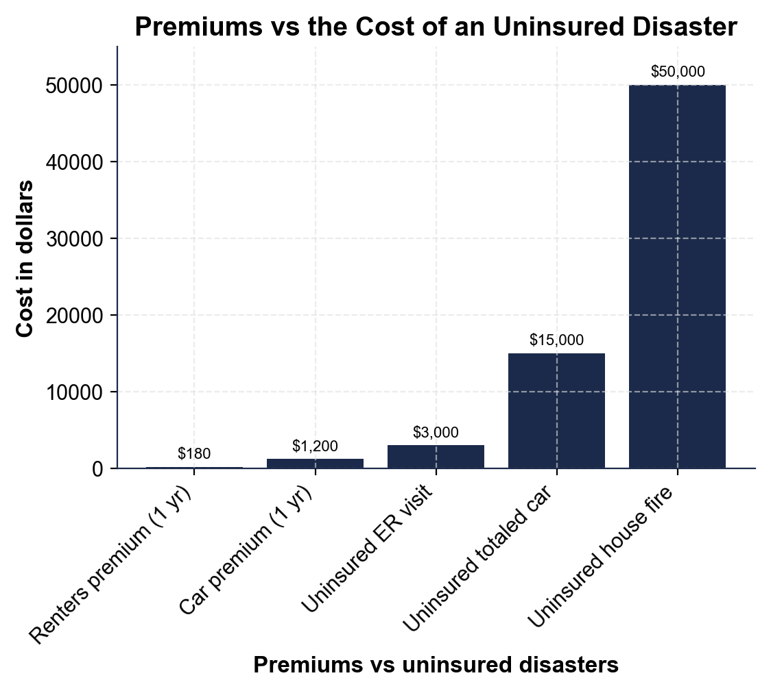
Premiums vs the Cost of an Uninsured Disaster
Small premium bars ($180, $1,200) are dwarfed by disaster bars up to $50,000.
© More Lessons Less Planning | morelessonslessplanning.com
Notes:
Give students a moment to read the bars on their own before discussing. There is one bar for each of five costs. The first two bars are small - a renters premium of about $180 for a year and a car premium of about $1,200 for a year. The next three bars are much taller - an uninsured ER visit at about $3,000, a totaled car at about $15,000, and a house fire at about $50,000. Point out the pattern that jumps out instantly: the disaster bars tower over the premium bars. Ask students to state the takeaway in their own words: a premium is tiny compared to the loss it protects against. Then connect it to the model they will use: PROTECTION VALUE = uninsured loss - premium, so the height difference between a disaster bar and a premium bar is roughly the financial risk insurance takes off your hands. This is the chart Activity Part 4 reads and analyzes.
Reference labels (point to these chart features when teaching): Premiums: $180 and $1,200; Disasters: up to $50,000

Slide 9
The Parts of an Insurance Policy
Policyholder
The POLICYHOLDER is the person who buys the insurance and is protected by it - that is you, when you own a policy
Insurer
The INSURER is the company that collects premiums, holds the pool, and pays out claims when a covered loss happens
Policy
The POLICY is the contract that spells out what is covered, what you pay, and what the insurer pays
Claim
A CLAIM is a request you file with your insurer to be paid for a covered loss
Key Concept: The POLICYHOLDER (you) pays premiums to the INSURER under a POLICY; when a covered loss happens, you file a CLAIM to be paid.
© More Lessons Less Planning | morelessonslessplanning.com
Notes:
Give students the shared vocabulary that applies to every kind of insurance, so they can talk about any policy. First, the POLICYHOLDER: the person who buys the insurance and is protected by it - that is YOU when you own a policy. Second, the INSURER: the company that collects everyone's premiums, holds the pooled money, and pays out claims when a covered loss happens. Third, the POLICY: the actual contract between you and the insurer that spells out exactly what is covered, what you pay (your premium and deductible), and what the insurer pays when there is a loss - read it so you know what you are actually buying. Fourth, the CLAIM: when a covered loss happens, you file a claim, which is a formal request to your insurer to be paid for that loss; after you pay any deductible, the insurer pays the rest according to the policy. Put the whole relationship in one sentence so it sticks: the policyholder (you) pays premiums to the insurer under a policy, and when a covered loss happens, you file a claim to be paid. These four terms - plus premium and deductible from the last slide - are the whole toolkit for understanding any insurance. Key term - Policyholder: the person who buys the insurance. Insurer: the company that collects premiums and pays claims. Policy: the contract. Claim: a request to be paid for a covered loss.

Slide 10
Why Insurance Exists - A Worked Example
The situation
Devon has a used car worth about $15,000 and cannot afford to replace it out of pocket if it is totaled in a crash
The premium (small, known)
Devon pays a car premium of about $1,200 a year - a small, predictable cost Devon can plan around
The protection value (labeled model)
PROTECTION VALUE = uninsured loss - premium = $15,000 - $1,200 = $13,800 of financial risk moved to the insurer
The smart trade
Devon would rather lose a small KNOWN $1,200 than risk a huge UNKNOWN $15,000 - that trade is why insurance exists
Key Concept: Devon trades a small known $1,200 premium for protection from a huge unknown $15,000 loss. PROTECTION VALUE = $15,000 - $1,200 = $13,800.
© More Lessons Less Planning | morelessonslessplanning.com
Notes:
Work one complete example that pulls the lesson together, because the activity will ask students to do the same thing. Meet Devon: a new adult with a used car worth about $15,000. If that car is totaled in a crash and Devon has no insurance, Devon has to replace it entirely out of pocket - $15,000 Devon does not have. Now bring in insurance. Devon pays a car premium of about $1,200 a year - a small, predictable cost Devon can plan around. Apply the labeled model: PROTECTION VALUE = cost of the uninsured loss - cost of the premium = $15,000 - $1,200 = $13,800. That $13,800 is the financial risk Devon has moved off of themselves and onto the insurer: if the car is totaled, the insurer covers the loss (after any deductible), and Devon is out only the premium, not the whole $15,000. State the reasoning in the way that makes insurance click: Devon would rather lose a small KNOWN amount ($1,200) for certain than risk losing a huge UNKNOWN amount ($15,000) they cannot afford. That trade - small certain cost for protection against large uncertain loss - is exactly WHY insurance exists, and it is the same logic behind every kind of insurance. Tell students this worked example is the direct model for the activity's calculation task. Key term reminder - Protection value = uninsured loss - premium.

Slide 11
Scenario: Who Needs Insurance?
Insure what you could NOT afford to lose
Insurance makes sense when a loss would be too big to pay yourself - a car, an apartment's contents, your health
✔
Devon's car - YES
A $15,000 loss Devon could not cover is exactly what insurance is for; insuring the car makes sense
✔
Devon's apartment - YES
Renters insurance (about $180/year) protects belongings and covers a big loss like a fire, so it makes sense too
✔
A $30 pair of headphones - NO
You would not insure something cheap you could easily replace - the premium would not be worth it for a small loss
✔
Key Concept: Insure what you could NOT afford to lose (a car, your home's contents, your health). Skip small losses you could easily replace yourself.
© More Lessons Less Planning | morelessonslessplanning.com
Notes:
Turn the whole lesson into a decision rule students can actually use: who needs insurance, and for what? The rule is simple - insure the things you could NOT afford to lose, and do not bother insuring small losses you could easily cover yourself. Walk Devon's real choices. Devon's car is worth about $15,000; if it were totaled Devon could not pay $15,000 out of pocket, so insuring the car clearly makes sense - that is exactly the kind of catastrophic loss insurance is for. Devon's apartment is next: renters insurance costs only about $180 a year and protects Devon's belongings and covers a big loss like a fire, so it makes sense too - a small premium for protection against a loss Devon could not absorb. Now the contrast: a $30 pair of headphones. You would NOT insure something that cheap, because you could easily replace it yourself, and the premium plus deductible would cost more than the item is worth. State the underlying principle clearly: insurance is worth it when the potential loss is large enough that it would be a financial disaster, and not worth it when the loss is small enough to shrug off. That is how a smart adult decides what to insure. This decision is exactly what the activity asks students to make for a first-time adult.

Slide 12
Putting It Together: Is Insurance Worth It?
Step 1 - Name the risk
What costly event could happen (a crash, a fire, an illness), and how much would it cost you if it did?
✔
Step 2 - Compare premium to loss
Is the premium small compared to the loss? PROTECTION VALUE = uninsured loss - premium tells you how much risk you transfer
✔
Step 3 - Ask: could I pay it myself?
If the loss would be a financial disaster you could not cover, insure it; if it is small and replaceable, you can skip it
✔
Step 4 - Keep the coverage active
Pay your premium on time so your coverage does not lapse, and know your deductible and how to file a claim
✔
Key Concept: Decide in four steps - name the risk, compare premium to loss, ask if you could pay it yourself, and keep coverage active.
© More Lessons Less Planning | morelessonslessplanning.com
Notes:
Turn everything into a decision process students can actually run when they face an insurance choice as adults. Step 1 - NAME THE RISK: identify the costly event that could happen (a crash, a fire, a serious illness, a theft) and how much it would cost you if it did. Step 2 - COMPARE THE PREMIUM TO THE LOSS: look at the premium (small and regular) next to the potential loss (large and rare), and use the labeled model - PROTECTION VALUE = uninsured loss - premium - to see how much financial risk the coverage would transfer to the insurer. Step 3 - ASK THE KEY QUESTION: could I pay this loss myself? If a loss would be a financial disaster you could not cover out of pocket, insure it; if the loss is small and easily replaceable, you can skip the coverage and self-insure. Step 4 - KEEP THE COVERAGE ACTIVE: once you decide to insure something, pay your premium on time so your coverage does not lapse, and know the basics - your deductible (what you pay first) and how to file a claim if a loss happens. Tell students the activity Part 5 asks them to run exactly this process to advise a new adult. This is the capstone skill of the lesson: deciding, like a smart adult, whether a given insurance is worth it. Every step uses a term from this lesson - risk, premium, protection value, deductible, and claim.

Slide 13
Key Takeaways
INSURANCE transfers the risk of a big, rare loss for a small premium
★
RISK POOLING - many people's premiums cover the big claims of the unlucky few
★
The PREMIUM is your regular payment; the DEDUCTIBLE is what you pay first
★
Insure what you could NOT afford to lose; skip small, replaceable losses
★
PROTECTION VALUE = uninsured loss - premium: the risk the insurer takes on
★
© More Lessons Less Planning | morelessonslessplanning.com
Notes:
Read each takeaway and connect it back to the learning targets and the opening hook. T1 (define insurance) -> insurance transfers the financial risk of a big, rare loss to an insurer in exchange for a small, regular premium; you trade a small known cost for protection against a huge unknown one. T2 (risk pooling) -> insurance works because many people each pay premiums into a shared pool, and the pool pays the big claims of the unlucky few - 100 renters x $180 = $18,000 can cover one person's $15,000 loss. T3 (the parts) -> the premium is your regular payment that keeps coverage active, and the deductible is what you pay on a claim before the insurer pays the rest; the policyholder (you) and insurer (the company) are connected by a policy, and you file a claim to be paid. T4 (who needs it) -> insure what you could NOT afford to lose (a car, your home's contents, your health) and skip small losses you could easily replace. T5 (protection value) -> PROTECTION VALUE = uninsured loss - premium, so a $15,000 car loss vs a $1,200 premium transfers $13,800 of risk to the insurer. Close by returning to the opening question: now you know exactly what insurance is and why people pay for something they hope never to use - because a small premium protects you from a loss big enough to change your life.

