Slide 1
What Is a Loan? Principal, Interest & Terms
A loan lets you borrow money now and pay it back over time - but a lender charges interest, so you repay more than you borrowed. The same $6,000 car loan adds $1,200 of interest, for $7,200 repaid. This is the first lesson of Unit 5.
© More Lessons Less Planning | morelessonslessplanning.com
Notes:
Open with the hook: almost everyone takes out a loan at some point - for a car, a home, or school - but few people can name the parts of one. A LOAN is a sum of money you borrow and agree to pay back, with interest, over a set period of time. Today students learn what a loan is, the four parts every loan has (PRINCIPAL, INTEREST, TERM, and the MONTHLY PAYMENT), the difference between a SECURED and an UNSECURED loan, why lenders charge interest, and the single most important fact: you repay the principal PLUS interest, so the total repaid is more than the amount borrowed. They follow Marcus Bell, a recent grad who needs a $6,000 used car, and break down his loan: $6,000 borrowed, $1,200 interest, $7,200 repaid, over a 2-year term at $300 a month. As the first toolkit of Unit 5, this lesson lays the foundation for student loans, mortgages, and managing debt.

Slide 2
Learning Targets
Define a loan as money you borrow and repay, with interest, over a set term
★
Name the four parts of a loan: principal, interest, term, and monthly payment
★
Tell a secured loan from an unsecured loan and why lenders charge interest
★
Explain why you repay more than you borrowed, and how the term changes the cost
★
© More Lessons Less Planning | morelessonslessplanning.com
Notes:
Read the four targets aloud. Tell students the activity puts them in the role of advising Marcus Bell, a recent grad taking out a $6,000 loan for a used car. Target 1 is the definition: a loan is money you borrow and repay, with interest, over a set term. Target 2 is the four parts: the PRINCIPAL is the amount borrowed, the INTEREST is the extra you pay for borrowing, the TERM is how long you have to repay, and the MONTHLY PAYMENT is what you pay each month. Target 3 is the two kinds of loans (SECURED loans are backed by collateral like a car or house; UNSECURED loans are not) and why lenders charge interest. Target 4 is the cost: you repay the principal plus interest, so the total repaid is more than the amount borrowed, and a longer term lowers the monthly payment but raises the total interest.

Slide 3
Borrowing Money You Repay
A loan is borrowing you pay back
A LOAN is a sum of money you borrow and agree to pay back, with interest, over a set period of time
✔
You get the money now
A loan lets you get a car, pay for school, or buy a home now and repay the lender in pieces over time instead of all at once
✔
There is always a LENDER
The LENDER is the bank, credit union, or company that provides the loan money and is repaid the principal plus interest
✔
Marcus's choice
Marcus Bell needs a $6,000 used car to get to his new job; a loan would let him drive it now and repay the lender over the next two years
✔
Key Concept: A LOAN is a sum of money you borrow and agree to pay back, with interest, over a set period of time.
© More Lessons Less Planning | morelessonslessplanning.com
Notes:
Set up the whole lesson. A LOAN is a sum of money you borrow and agree to pay back, with interest, over a set period of time. The core idea: you get the money now and repay it in pieces over time instead of all at once. People take out loans to buy a car, pay for school, or buy a home - things that cost more than they have on hand. Every loan has a LENDER: the bank, credit union, or company that provides the money and is repaid the principal plus interest. Marcus Bell, a recent grad, needs a $6,000 used car to get to his new job but does not have the cash. A loan would let him drive the car now and repay the lender over the next two years - but, as the rest of the lesson shows, he repays more than $6,000 because of interest.

Slide 4
The Parts of a Loan
Principal
The PRINCIPAL is the original amount of money you borrow, before any interest is added - for Marcus, the $6,000 car price
Interest
INTEREST is the extra money you pay the lender for borrowing, usually a percent of what you owe - it is the cost of the loan
Term
The TERM is the length of time you have to repay the loan, often given in months or years - Marcus's term is 2 years
Total repaid
The TOTAL REPAID is the principal plus all the interest - so you always repay more than you borrowed
Key Concept: A loan has a PRINCIPAL (amount borrowed), INTEREST (the cost), and a TERM (time to repay); the TOTAL REPAID is principal plus interest.
© More Lessons Less Planning | morelessonslessplanning.com
Notes:
Name the parts of every loan. The PRINCIPAL is the original amount of money you borrow, before any interest is added - for Marcus, the $6,000 price of the car. INTEREST is the extra money you pay the lender for borrowing, usually a percent of what you owe; it is the cost of the loan. The TERM is the length of time you have to repay - often given in months or years - and Marcus's term is 2 years (24 months). Put those together and you get the TOTAL REPAID: the principal plus all the interest. For Marcus's loan at 10% over 2 years, the interest is $1,200 (6,000 x 0.10 x 2, a simplified teaching model), so the total repaid is $6,000 + $1,200 = $7,200. He borrows $6,000 but repays $7,200 - $1,200 more, because of interest. The next slide shows it as a chart.

Slide 5
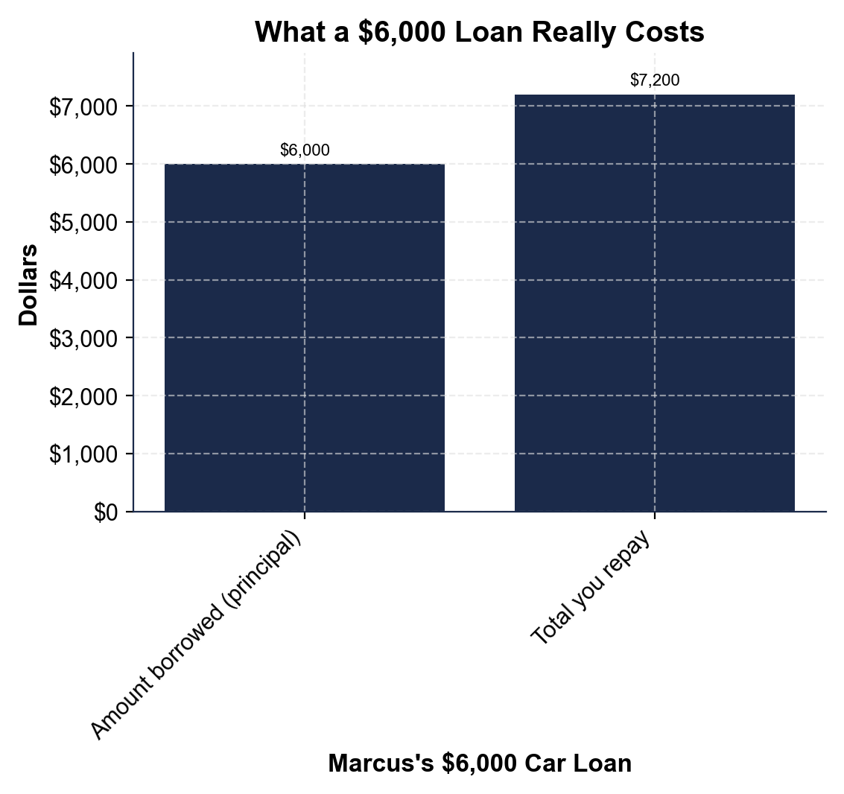
Note: What a $6,000 Loan Really Costs
Borrow $6,000, repay $7,200: the $1,200 gap is the interest.
© More Lessons Less Planning | morelessonslessplanning.com
Notes:
Have students read the two-bar chart. The left bar, 'Amount borrowed (principal),' is $6,000 - the amount Marcus borrows. The right bar, 'Total you repay,' is $7,200 - the same $6,000 principal plus $1,200 of interest for repaying over two years. The picture makes the lesson obvious: the total-repaid bar is taller, and the gap between the bars is exactly the $1,200 of interest - the cost of the loan. Borrow less, repay more. This is the chart Activity Part 3 reads.
Reference labels (point to these chart features when teaching): Borrowed: $6,000 (principal); Repaid: $7,200 (with interest)

Slide 6
The Monthly Payment
What the Monthly Payment Is
Marcus's $6,000 Loan
The MONTHLY PAYMENT is the set amount you pay each month to repay the loan
You pay it every month for the whole term until the loan is paid off
It covers part of the principal and part of the interest each time
Add up every monthly payment and you get the total repaid
TOTAL REPAID = $7,200 ($6,000 principal + $1,200 interest)
TERM = 2 years = 24 months
MONTHLY PAYMENT = $7,200 / 24 = $300 a month
A LONGER term means a smaller monthly payment but MORE total interest
Key Concept: The MONTHLY PAYMENT is total repaid divided by the number of months; Marcus pays $7,200 / 24 = $300 a month.
© More Lessons Less Planning | morelessonslessplanning.com
Notes:
Now the payment students actually feel. The MONTHLY PAYMENT is the set amount you pay each month to repay the loan, every month for the whole term until it is paid off. Each payment covers part of the principal and part of the interest, and if you add up every monthly payment over the term you get the total repaid. Make it concrete with Marcus. His total repaid is $7,200 ($6,000 principal + $1,200 interest) and his term is 2 years, which is 24 months. So his monthly payment is $7,200 divided by 24 = $300 a month (a simplified teaching model). Here is the part students must understand about the term: a LONGER term spreads the same loan over more months, so the monthly payment is smaller - but you pay interest for more years, so the total interest is HIGHER. A shorter term means a bigger monthly payment but less total interest. The term is a trade-off between the monthly bill and the total cost.

Slide 7
Secured vs Unsecured Loans
Secured Loans
Unsecured Loans
A SECURED loan is backed by COLLATERAL the lender can take if you do not repay
Collateral is something of value, like a car or a house
Marcus's car loan is secured - the car is the collateral
Because the lender has backup, secured loans usually charge LESS interest
An UNSECURED loan is NOT backed by collateral
The lender relies on your promise and your creditworthiness
Credit cards and many personal loans are unsecured
Because there is no backup, unsecured loans usually charge MORE interest
Key Concept: COLLATERAL is something of value a borrower pledges that the lender can take if the loan is not repaid; a SECURED loan is backed by it.
© More Lessons Less Planning | morelessonslessplanning.com
Notes:
There are two big families of loans, and the difference is collateral. A SECURED loan is backed by COLLATERAL - something of value the lender can take if you do not repay, such as a car or a house. Marcus's car loan is secured: if he stops paying, the lender can repossess the car. Because the lender has that backup, secured loans usually charge LESS interest - the lender's risk is lower. An UNSECURED loan is not backed by any collateral; the lender relies on the borrower's promise to repay and on their creditworthiness. Credit cards and many personal loans are unsecured. Because there is no item the lender can take, the lender's risk is higher, so unsecured loans usually charge MORE interest. The takeaway: collateral lowers the lender's risk, and lower risk usually means a lower interest rate for the borrower.

Slide 8
Why Lenders Charge Interest
They give up the use of their money
While you have the loan, the lender cannot use that money for anything else, so interest pays them for the wait
✔
They take on risk
Some borrowers do not repay; interest helps cover the lender's RISK that a loan will not be paid back
✔
Lending is their business
Interest is how a bank or credit union earns money - it is the price they charge for providing a loan
✔
Your rate depends on you
A more creditworthy borrower, or a secured loan, looks less risky - so the lender usually charges a LOWER interest rate
✔
Key Concept: Interest is the price of a loan - it pays the lender for waiting, covers their risk, and is how lending earns money.
© More Lessons Less Planning | morelessonslessplanning.com
Notes:
Explain why interest exists at all - it is not just a fee, it is the price of the loan, and it makes sense from the lender's side. First, while you have the borrowed money, the LENDER cannot use it for anything else, so interest pays them for giving up the use of their money and waiting to be repaid. Second, lending is risky - some borrowers do not repay - and interest helps cover the RISK that a loan will not be paid back. Third, lending is a business: interest is how a bank or credit union earns money, the price they charge for providing the loan. Finally, the rate you pay depends on how risky you look: a more creditworthy borrower, or a secured loan backed by collateral, looks less risky to the lender, so the lender usually charges a LOWER interest rate. Riskier borrowers and unsecured loans usually pay more. Interest, in short, is the lender's pay for waiting and for taking a risk.

Slide 9
Reading a Loan Agreement
Find the PRINCIPAL
Look for the amount borrowed - the loan amount or 'amount financed' - this is the principal you must repay
✔
Find the RATE and the INTEREST
Look for the interest rate (often the APR) and the total interest or finance charge - the extra you pay to borrow
✔
Find the TERM and the MONTHLY PAYMENT
Look for the number of months (the term) and the set amount due each month (the monthly payment)
✔
Find the TOTAL REPAID
Look for the 'total of payments' - the full amount you repay over the loan; it is the principal plus all the interest
✔
Key Concept: A loan agreement lists the same four parts - the principal, the rate and interest, the term and monthly payment, and the total repaid.
© More Lessons Less Planning | morelessonslessplanning.com
Notes:
Show students that a real loan agreement is just the four parts written down - if they know the parts, they can read any loan offer. First, find the PRINCIPAL: it is the amount borrowed, often labeled the loan amount or the 'amount financed.' Second, find the RATE and the INTEREST: look for the interest rate (often the APR, the yearly rate) and the total interest, sometimes called the finance charge - this is the extra you pay to borrow. Third, find the TERM and the MONTHLY PAYMENT: the term is the number of months you have to repay, and the monthly payment is the set amount due each month. Fourth, find the TOTAL REPAID, usually labeled the 'total of payments' - the full amount you pay over the life of the loan, which is the principal plus all the interest. For Marcus's loan, the agreement would show: principal $6,000, interest $1,200, term 24 months, monthly payment $300, total of payments $7,200. Reading a loan agreement is just matching those labels to the four parts.

Slide 10
Scenario: Break Down a Loan Offer
What to Check on Any Loan
Marcus's Two Offers
What is the PRINCIPAL - how much am I actually borrowing?
What is the INTEREST - how much extra will I pay to borrow?
What is the TERM - how many months until it is paid off?
What is the MONTHLY PAYMENT - can I afford it every month?
Offer A: 2-year term, $300 a month, $1,200 total interest
Offer B: 4-year term, $175 a month, $2,400 total interest
Offer B is easier each month but costs $1,200 MORE in interest
The smart choice depends on what Marcus can afford and his goals
Key Concept: To judge a loan, check the principal, interest, term, and monthly payment; a longer term lowers the monthly but raises total interest.
© More Lessons Less Planning | morelessonslessplanning.com
Notes:
Bring it home: students use the parts to break down a real loan offer and make a judgment. To judge any loan, check four things: the PRINCIPAL (how much am I actually borrowing?), the INTEREST (how much extra will I pay?), the TERM (how many months until it is paid off?), and the MONTHLY PAYMENT (can I afford it every month?). Now give Marcus two offers for the same $6,000 car loan at 10%. Offer A is a 2-year term: $300 a month and $1,200 of total interest. Offer B is a 4-year term: only $175 a month, but $2,400 of total interest - $1,200 more than Offer A. Offer B is easier to afford each month, but it costs far more overall because the loan runs twice as long. There is no single right answer: the smart choice depends on what Marcus can afford every month and on his goals - paying less per month, or paying less overall. That judgment is exactly what students do in Part 5.

Slide 11
Key Takeaways
A LOAN is money you borrow and repay, with interest, over a set TERM
★
The four parts: PRINCIPAL, INTEREST, TERM, and the MONTHLY PAYMENT
★
You repay the principal PLUS interest, so you repay more than you borrowed
★
A SECURED loan is backed by collateral; an UNSECURED loan is not
★
Marcus's $6,000 loan costs $7,200; a longer term raises the total interest
★
© More Lessons Less Planning | morelessonslessplanning.com
Notes:
Read each takeaway and connect it to the learning targets. T1 (define a loan) -> a loan is money you borrow and repay, with interest, over a set term. T2 (the four parts) -> principal is the amount borrowed, interest is the cost, term is the time to repay, and the monthly payment is what you pay each month. T3 (secured vs unsecured + why interest) -> a secured loan is backed by collateral and usually costs less interest; an unsecured loan is not, and lenders charge interest to be paid for waiting and for risk. T4 (the cost) -> you repay the principal plus interest, so Marcus's $6,000 loan costs $7,200, and a longer term lowers the monthly payment but raises the total interest. The spine of the lesson: a loan lets you buy now, but you always repay more than you borrowed, and the parts you choose - especially the term - change what it costs. As the first toolkit of Unit 5, this lays the foundation for student loans, mortgages, and managing debt.

