Slide 1
Wealth Inequality: The Top 1% Explained
How Much the Top 1% Owns and Why the Wealth Gap Keeps Growing
© More Lessons Less Planning | morelessonslessplanning.com
Notes:
Open by asking students to estimate what share of all U.S. wealth they think the top 1% owns. Then write down the actual answer (30%) and the bottom 50% share (about 2.5%). The gap usually surprises students.

Slide 2
Learning Targets
Identify how wealth inequality is measured (Gini and percentile shares)
★
Compare U.S. wealth concentration to other developed countries
★
Evaluate the racial wealth gap and what drives it
★
© More Lessons Less Planning | morelessonslessplanning.com
Notes:
Read each target aloud. Tell students they will leave able to define the Gini coefficient, name the top 1% wealth share, and explain at least one driver of the racial wealth gap.

Slide 3
Wealth vs Income Inequality
Income
Wealth
What you EARN each year (wages, profits)
Top 1% of earners take about 20% of income
Reset every paycheck
Less unequal than wealth
What you OWN minus what you owe
Top 1% holds about 30% of all wealth
Compounds across years and lifetimes
Far more unequal than income
Key Concept: Wealth is a STOCK; income is a FLOW. Wealth is far more concentrated.
© More Lessons Less Planning | morelessonslessplanning.com
Notes:
The single biggest mistake students make is treating wealth and income as the same thing. Drill the distinction. Income resets each year; wealth carries forward and compounds. Wealth inequality is always larger than income inequality in any country. Key term - Wealth: What a household owns (home, savings, retirement accounts, stocks, a business) minus what they owe in debt; a stock that carries forward across years and lifetimes. Key term - Income: The money a household earns each year from wages, business profits, or investments; measured before taxes; a flow that resets each paycheck.

Slide 4
The Gini Coefficient Explained
Gini = 0
Perfect equality - every household has the same wealth
Gini = 1
Total inequality - one household owns everything
Lorenz curve
A graph plotting cumulative wealth share against cumulative population share
Diagonal line
The line of perfect equality - the further the curve from the diagonal, the more unequal
U.S. wealth Gini
About 0.85 - among the highest of any developed country
Key Point: The Gini number alone is abstract; the Lorenz curve makes it visual.
© More Lessons Less Planning | morelessonslessplanning.com
Notes:
Walk through the scale before showing the chart. Gini of 0 means perfect equality; 1 means one household owns everything. The U.S. is around 0.85 for wealth - close to the inequality end of the scale. Key term - Gini coefficient: A single number from 0 to 1 that measures inequality; 0 means perfect equality and 1 means total inequality where one household owns everything. Key term - Lorenz curve: A graph that plots the cumulative share of wealth against the cumulative share of population; the further it drops below the diagonal line of equality, the more unequal the country.

Slide 5
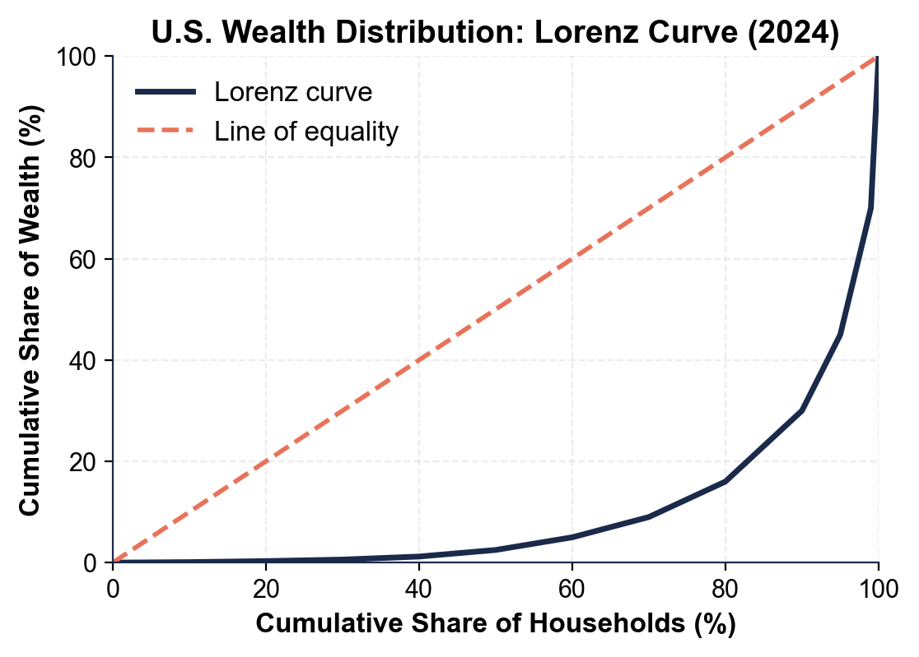
U.S. Wealth Distribution: Lorenz Curve
Note: The farther the curve drops from the diagonal, the more unequal.
© More Lessons Less Planning | morelessonslessplanning.com
Notes:
Have students point to the bottom-50% mark on the x-axis (50%). The y-axis at that point shows about 2.5%. That means the entire bottom half of U.S. households owns only 2.5 cents of every wealth dollar in the country.
Reference labels (point to these chart features when teaching): Bottom 50% holds ~2.5%; Top 1% holds ~30%

Slide 6
Top 1% Holds 30%, Top 10% Holds 70%
Top 1%
Top 10%
Bottom 50%
Owns about 30% of all U.S. wealth
Average net worth: ~$15 million
Mostly stocks, businesses, real estate
Owns about 70% of all U.S. wealth
Includes most of the upper-middle class
Mostly home equity and retirement savings
Owns only about 2.5% of all U.S. wealth
Median net worth: ~$8,000 to $10,000
Mostly cars, small savings, no investments
Big Idea: 30% to the TOP 1%, only 2.5% to the BOTTOM HALF.
© More Lessons Less Planning | morelessonslessplanning.com
Notes:
Write the three numbers on the board: 30%, 70%, 2.5%. These are the headline numbers of the lesson. The first two come from Federal Reserve Survey of Consumer Finances data; the third number is the same data but measuring the bottom half. Key term - Top 1% wealth share: The share of all national wealth owned by the wealthiest 1 percent of households; the headline measure of wealth concentration at the very top. Key term - Median wealth: The middle household's wealth, where half of families have more and half have less; less skewed by billionaires than the average.

Slide 7
U.S. vs Other Developed Countries
U.S. wealth Gini ~0.85 - highest of major developed economies
France ~0.70 - much more equal wealth distribution
Germany ~0.79 - more equal but still high
Japan ~0.63 - one of the lowest among developed countries
Canada ~0.73 - similar to France
Higher Gini = wealth more concentrated at the top
Tip: Many other developed countries have Gini coefficients 0.10 to 0.20 lower than the U.S.
© More Lessons Less Planning | morelessonslessplanning.com
Notes:
Set up the chart on the next slide. Stress that even other rich countries with capitalist economies have far less wealth concentration than the U.S. The U.S. is an outlier on this measure, not the average.

Slide 8
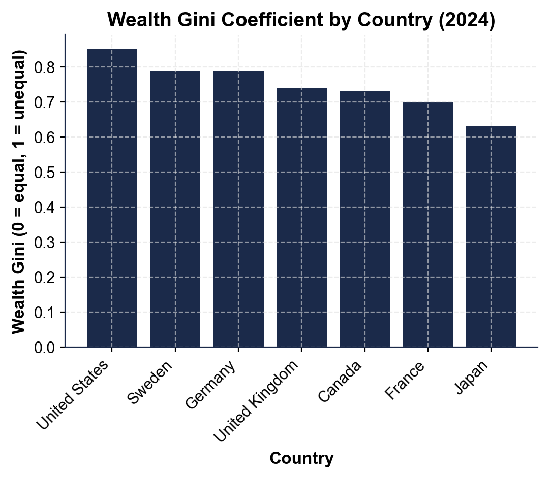
Wealth Gini Coefficient by Country
Note: Higher bars = more wealth concentration. U.S. tops the chart.
© More Lessons Less Planning | morelessonslessplanning.com
Notes:
Have students rank the countries from most to least equal. Ask: what would the U.S. need to change to get its Gini down to France level? (Answer: more progressive taxation, stronger inheritance tax, broader homeownership and retirement savings.)
Reference labels (point to these chart features when teaching): U.S. ~0.85 (highest); Japan ~0.63 (lowest)

Slide 9
The Racial Wealth Gap (6x Median)
Median white household wealth
About $285,000 (2022 SCF data)
Median Black household wealth
About $44,900 - far below white-household wealth
Median Hispanic household wealth
About $61,600 - well below white-household wealth
Main historical driver
Redlining - 20th-century practice of denying home loans to Black neighborhoods
Why it persists
Wealth is inherited; lost decades of home equity carry forward
Warning: The median white household has about 6 TIMES the wealth of the median Black household.
© More Lessons Less Planning | morelessonslessplanning.com
Notes:
Walk through the median numbers. Stress that median (not average) is what matters here - the average is skewed by billionaires. Connect redlining to home equity, which is the single largest source of wealth for most middle-income families. Key term - Racial wealth gap: The gap in median wealth between white households and Black or Hispanic households; one of the largest and most persistent gaps in U.S. economics. Key term - Redlining: The 20th-century practice of denying home loans to Black neighborhoods; one of the biggest historical drivers of the racial wealth gap.

Slide 10
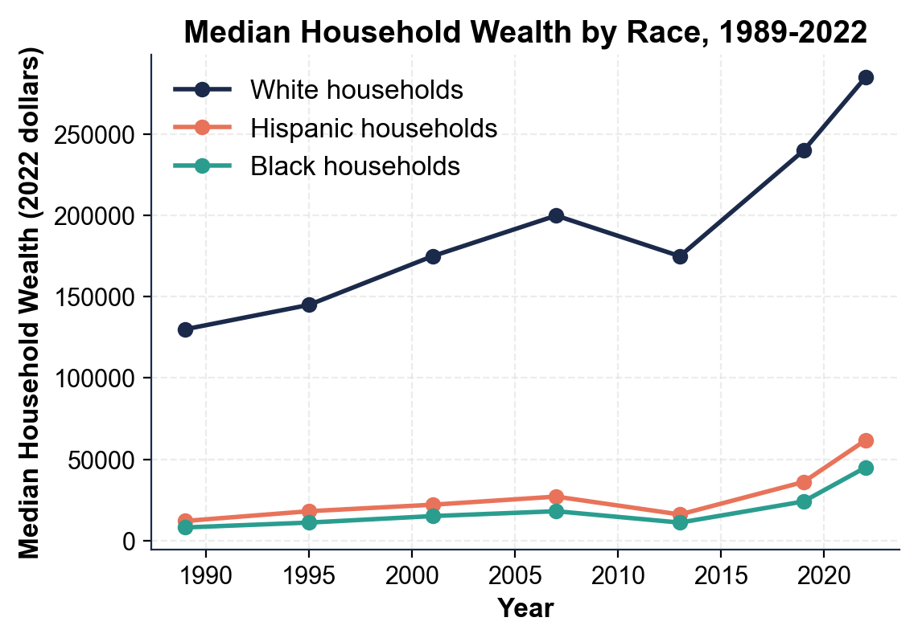
Racial Wealth Gap Over Time
Note: White median wealth has grown faster than Black or Hispanic medians.
© More Lessons Less Planning | morelessonslessplanning.com
Notes:
Read the chart left to right. Ask: has the gap closed since 1989? (No - it has stayed roughly the same in ratio terms; in dollar terms it has actually widened.)
Reference labels (point to these chart features when teaching): White 2022: ~$285K; Black 2022: ~$45K

Slide 11
Why Wealth Compounds (The Snowball)
Wealth grows on top of past wealth - that is COMPOUNDING
$10,000 invested at 7%/year for 40 years becomes ~$150,000
$100,000 invested at 7%/year for 40 years becomes ~$1,500,000
Larger starting balances compound MUCH faster in dollar terms
Inheritance gives a head start that lasts a lifetime
About 30 to 40 percent of U.S. wealth comes from inheritance
Did You Know? A 10x larger starting balance produces a 10x larger ending balance, every time.
© More Lessons Less Planning | morelessonslessplanning.com
Notes:
Compounding is THE mechanism that produces wealth concentration. Two families saving the same percentage of their income end up with very different totals if their starting balances differ - because compounding is multiplicative, not additive. Key term - Compounding: When investment returns earn returns on top of past returns, so wealth grows faster and faster over time; the main reason wealth concentrates at the top. Key term - Inherited wealth: Money or assets passed down from parents or grandparents; a large share of U.S. wealth comes from inheritance rather than the owner's own earnings.

Slide 12
Recent Trends (2020-2026)
Stock market boom
2020-2024 stocks rose sharply; top-10% wealth grew fastest
✔
Home price boom
Homes up about 50% since 2019; owners gained equity, renters did not
✔
Pandemic stimulus
Bottom-50% wealth briefly rose in 2020-2021 from stimulus checks
✔
Inflation 2022-2023
Cost of living rose ~17%; hit lower-wealth households hardest
✔
Net effect
Top 10% wealth share rose to about 70% by 2024; bottom-50% near 2.5%
✔
Real Talk: Asset booms widen wealth inequality. Owners gain; non-owners do not.
© More Lessons Less Planning | morelessonslessplanning.com
Notes:
Connect this slide back to the unit theme. The 2020-2024 period was great for asset owners (stocks, homes) and tough for renters and low-savers. Booms in capital markets always widen wealth inequality unless paired with policies that broaden ownership.

Slide 13
Key Takeaways
Wealth inequality is measured by the Gini coefficient and top-percentile shares
★
Top 1% holds about 30%; top 10% holds about 70%; bottom 50% holds only 2.5%
★
U.S. wealth Gini ~0.85 is the highest among major developed economies
★
Median white household has about 6 times the wealth of median Black household
★
Wealth compounds, so starting balances and inheritance shape lifetime outcomes
★
© More Lessons Less Planning | morelessonslessplanning.com
Notes:
Read each takeaway. Connect back to the learning targets. Ask: which of these surprised you the most? Then point at the policy questions in the activity (wealth tax, estate tax, broader homeownership).

