Slide 1
Washington's First Command: The Ohio Valley, 1754
US History - Unit 2: Colonial America
© More Lessons Less Planning | morelessonslessplanning.com
Notes:
Open by asking what happens when two empires draw claims over the same land and put a 22-year-old in charge of the argument. That is this lesson.

Slide 2
Learning Targets
Explain why Britain and France both claimed the Ohio Valley in the 1750s.
★
Describe what happened at Jumonville Glen and at Fort Necessity in 1754.
★
Explain how Native nations chose sides to serve their own goals.
★
Use Washington's own 1754 letter to judge how he explained the fight.
★
Trace how one small clash grew into a war between empires by 1763.
★
© More Lessons Less Planning | morelessonslessplanning.com
Notes:
Read the five targets aloud once. Tell students target 4 is the hardest - judging Washington's own words - and that the Activity asks them to do exactly that.

Slide 3
Two Empires, One Valley
Britain's Claim
France's Claim
Virginia's royal charter stretched its western border into the Ohio Valley.
Land companies like the Ohio Company wanted to sell that land to settlers.
French explorers had linked Canada to Louisiana along the Ohio River.
France built forts across the region to hold its claim to this land.
Key Concept: A frontier is the outer edge of colonial settlement, where colonial claims met Native homelands.
© More Lessons Less Planning | morelessonslessplanning.com
Notes:
Point out that neither empire's claim came from asking the nations who lived there. That absence is the setup for the next slide.

Slide 4
The Ohio Nations Had Their Own Plan
Alliance
An agreement between nations to support each other, usually in war or trade
Neutrality
A policy of refusing to take either side in a conflict between other powers
Remember: Ohio Country nations picked whichever path served their own interests.
© More Lessons Less Planning | morelessonslessplanning.com
Notes:
Do not let students flatten this into picking a side. Neutrality was a real strategy, not indecision.

Slide 5
Britain, France, or Neither?
Support Britain
Support France
Commit to Neither
British traders offered goods but wanted land opened to settlers.
British help could mean support against nearby French forts.
Tanaghrisson, a Mingo leader, pushed for closer ties to the British.
French traders wanted furs, not permanent farms on Native land.
French forts sat closer to many Ohio Country towns already.
Some Shawnee and Delaware leaders leaned French because French posts sat closer.
Staying uncommitted kept both empires competing for favor.
An uncommitted town could trade with whichever side offered more.
Leaders often changed course as the situation on the ground changed.
Did You Know: Different Ohio Country towns made different choices at the same time.
© More Lessons Less Planning | morelessonslessplanning.com
Notes:
Point out that this was a real, ongoing calculation, not a one-time vote.

Slide 6
Who Was George Washington in 1754?
Militia
A group of citizens called up for short military service, not trained professional soldiers
Envoy
An officer sent by one government to carry an official message or demand to another
Key Concept: Washington was 22, with almost no combat experience, in 1753-54.
© More Lessons Less Planning | morelessonslessplanning.com
Notes:
Sit with the age for a second. Washington's whole reputation was still ahead of him in 1754 - this lesson is where it starts.

Slide 7
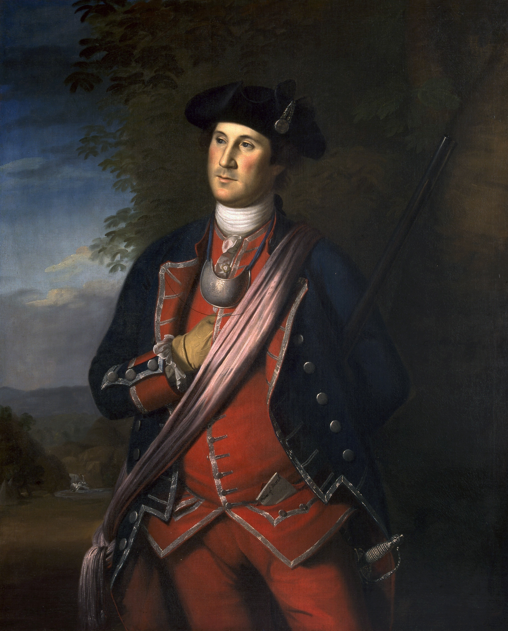
Washington, Colonel of the Virginia Regiment
Painted by Charles Willson Peale in 1772, eighteen years after these events.
© More Lessons Less Planning | morelessonslessplanning.com
Notes:
Ask what students notice before naming the artist. Then say the date out loud - 1772 - and ask what that means for using this as evidence of 1754.
Reference labels (point to these chart features when teaching): Not painted from life; Peale, 1772

Slide 8
The Night March, May 27-28, 1754
Evening, May 27
Washington's force left camp, marching in heavy rain.
✔
Overnight
Guides lost the trail more than once in the dark, wet terrain.
✔
Near Dawn, May 28
The column reached Tanaghrisson's camp.
✔
Tanaghrisson Agrees
He agrees to lead the men to a nearby French party.
✔
Before First Light
The combined group moves out to surround the French camp.
✔
Tip: A night march in rain with no clear trail set up everything that followed.
© More Lessons Less Planning | morelessonslessplanning.com
Notes:
This slide is the setup for the excerpt students read in the Activity - keep it sequential, not analytical yet.

Slide 9
Jumonville Glen: Fifteen Minutes
At dawn, May 28, Washington's men surrounded a French party in a hollow.
Firing broke out almost immediately; who fired first is disputed.
It lasted about fifteen minutes and ten French soldiers died.
Their commander, Joseph Coulon de Jumonville, was among the dead.
Twenty-one French soldiers were captured; one escaped to warn a fort.
Did You Know: This was a skirmish, a short fight between small groups rather than a full battle.
© More Lessons Less Planning | morelessonslessplanning.com
Notes:
Do not resolve the battle-or-ambush question here - that is the next slide. Stick to the sequence and the outcome.

Slide 10
Was It a Battle or an Ambush?
What the British Side Said
What the French Side Said
The British side said Jumonville's party was scouting an attack.
British accounts said Tanaghrisson, not Washington's men, killed Jumonville.
France said Jumonville's message was meant to be delivered peacefully.
France called the killing an assassination under a flag of truce.
Warning: Jumonville carried a summons - a written order demanding someone leave or answer a claim.
© More Lessons Less Planning | morelessonslessplanning.com
Notes:
Let the disagreement stand unresolved. Students will meet Washington's own words on this in the Activity.

Slide 11
A Fort in a Bad Place
Entrenchment
A ditch and earth wall dug by soldiers to protect a position
Garrison
The troops stationed at a fort to hold and defend it
Note: Great Meadows was low, open ground ringed by higher wooded ridges.
© More Lessons Less Planning | morelessonslessplanning.com
Notes:
Ask students to picture standing in a low meadow while someone else holds the tree line above you. That is the whole problem with this site.

Slide 12
July 3, 1754
Jumonville's brother led 600-900 troops from New France and Native allies.
Fighting continued all day in a heavy downpour.
Defenders' gunpowder and weapons were soaked; casualties mounted.
By nightfall Washington's men were surrounded with little dry powder.
Washington agreed to discuss terms after dark on July 3.
Key Concept: A full day of rain-soaked fighting left Washington no good options.
© More Lessons Less Planning | morelessonslessplanning.com
Notes:
Point out the family connection - Jumonville's own brother led this attack. That is not a coincidence; it is the point.

Slide 13
The Papers Washington Signed
What the Document Said
The Word That Caused Trouble
Washington signed papers letting his men march out with their weapons.
The document was written in French, a language he read only haltingly.
The French text used a word later translated as assassination.
By signing, he appeared to admit to a killing he always denied.
Warning: A capitulation sets the terms on which a surrendering force may leave.
© More Lessons Less Planning | morelessonslessplanning.com
Notes:
This is the document students will judge against Washington's own letter in the Activity. Keep both columns visible in their notes.

Slide 14
From One Clash to a World War
Theater | What Happened There
Europe | Britain and Prussia fought France, Austria, and Russia starting in 1756.
The Caribbean | British and French fleets and armies fought over sugar-rich islands.
West Africa | Britain seized French trading posts along the coast.
India | British and French trading companies fought for territory and trade.
The Philippines | British forces captured Manila from Spain, France's ally, in 1762.
Did You Know: Historians call this global conflict the Seven Years' War.
© More Lessons Less Planning | morelessonslessplanning.com
Notes:
Have students trace this on a mental map - a fight in a Pennsylvania hollow reaching all five of these places within two years.

Slide 15
1763: What Changed
France
Britain
Native Nations
France lost nearly all its mainland North American territory.
France gave up claims east of the Mississippi to Britain.
France kept only a few Caribbean sugar islands and Newfoundland fishing rights.
Britain gained Canada and all French land east of the Mississippi.
Britain took on a massive war debt from years of fighting.
Britain now had to govern and defend a much larger territory.
Native nations lost France as a counterweight against British power.
Native nations faced British limits on settlement west of the Appalachians.
Some nations rose up against British forts within the year.
Remember: Every winner and loser here paid a price of some kind.
© More Lessons Less Planning | morelessonslessplanning.com
Notes:
Push students past 'Britain won' - ask what Britain now owed and owned, and what that will cost the colonies later.

Slide 16
Why This Matters Next
Britain now controlled an enormous new territory to govern and defend.
Paying off war debt became an urgent problem for the British government.
Colonial soldiers who fought beside British regulars formed their own views.
Britain would soon look to the colonies to help cover the cost of empire.
None of that had been decided yet in 1763 - it was still an open question.
Tip: Every empire that wins a war still has to pay for it.
© More Lessons Less Planning | morelessonslessplanning.com
Notes:
Do not teach the Stamp Act or taxes here - just leave the debt and the territory sitting on the table as an open question.

Slide 17
Key Takeaways
Britain and France both claimed the Ohio Valley without asking its nations.
★
Ohio Country nations weighed sides, or neither, to serve their own goals.
★
A short fight at Jumonville Glen and a July surrender started the war.
★
Washington's own signed and written words are disputed evidence, not fact.
★
By 1763 the local clash had grown into a war reshaping North America.
★
© More Lessons Less Planning | morelessonslessplanning.com
Notes:
Close on the last two together. A 22-year-old's decisions in one valley reshaped a continent within a decade.

