Slide 1
War in the Pacific
Island Hopping and the Long Road to Japan
© More Lessons Less Planning | morelessonslessplanning.com
Notes:
Ask students how they would attack an enemy spread across a thousand islands. Most will say take them one at a time. The lesson is about why the Allies refused to do that.

Slide 2
Learning Targets
Explain the island hopping strategy and why the Allies used it.
★
Describe how the 1942 carrier battles stopped the Japanese advance.
★
Trace the Allied route across the Pacific from 1942 to 1945.
★
Explain why airfields decided which islands were taken or bypassed.
★
Use a 1942 U.S. Navy communique as evidence about the war at sea.
★
© More Lessons Less Planning | morelessonslessplanning.com
Notes:
Point out that target one is a strategy, not an event. Students who can explain island hopping in their own words have the whole lesson.

Slide 3
Japan's Ocean Empire, Spring 1942
Japan seized the Philippines, Malaya, Singapore, and Burma in months.
The oil fields of the Dutch East Indies fell to Japan in March 1942.
Island bases guarded the empire in a ring thousands of miles wide.
Japan expected the Allies to trade for peace rather than pay the cost.
Instead the Allies chose to fight their way back across the ocean.
Key Concept: Japan's ring of island bases was built to make retaking the Pacific too costly to attempt.
© More Lessons Less Planning | morelessonslessplanning.com
Notes:
Start here so students see the size of the problem. The Allies were never choosing between islands one at a time; they were choosing which ones they could afford to skip.

Slide 4
Coral Sea: A Battle Without a Sight
What Happened
Why It Mattered
Fought May 4 to 8, 1942, north of Australia
The first battle fought entirely by carrier aircraft
The two fleets never sighted each other
The United States lost the carrier Lexington
Japan's advance on Port Moresby was turned back
A Japanese light carrier, the Shoho, was sunk
Two more Japanese carriers were knocked out of action
Those two carriers were still missing a month later
Australia's supply line to America stayed open
Note: Coral Sea was the first naval battle in history in which the opposing ships never saw one another.
© More Lessons Less Planning | morelessonslessplanning.com
Notes:
The right-hand column is the one that matters. Coral Sea looked like a draw on the day and turned out to be the reason Midway went the way it did.

Slide 5
Midway: Four Days in June
The code
American codebreakers identified Midway as Japan's next target
✔
The trap
Admiral Nimitz placed three carriers northeast of Midway and waited
✔
June 4
American dive bombers hit three Japanese carriers within minutes
✔
June 4 to 7
The fourth Japanese carrier was lost and the Yorktown sank on June 7
✔
Fact: Japan lost four fleet carriers at Midway and never regained the initiative in the Pacific.
© More Lessons Less Planning | morelessonslessplanning.com
Notes:
Keep the class off the idea that one heroic moment won this battle. Midway turned on codebreaking, on where the carriers were, and on which side could afford its losses.

Slide 6
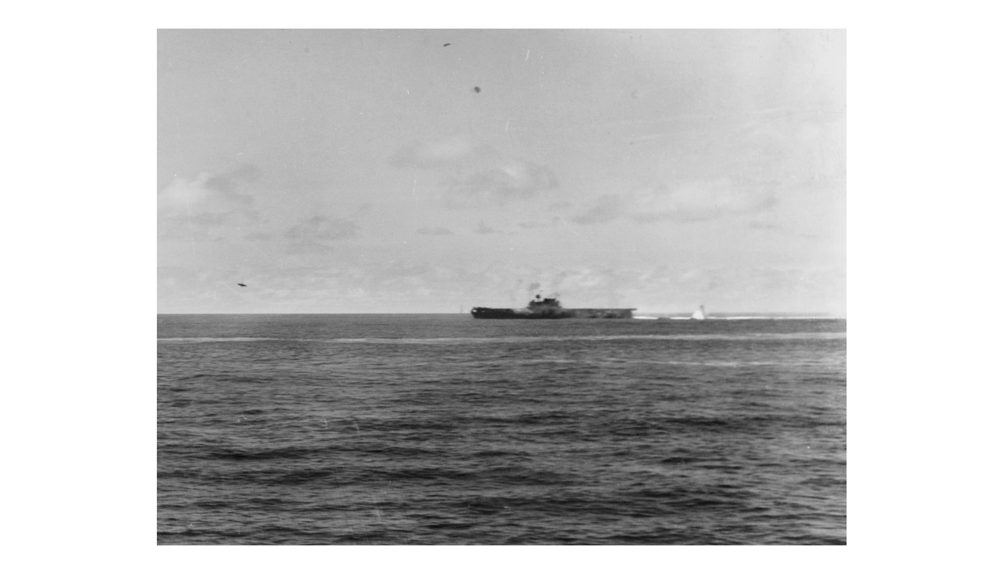
USS Yorktown Under Attack at Midway, June 4, 1942
Note: U.S. Navy photo.
© More Lessons Less Planning | morelessonslessplanning.com
Notes:
This was taken from the cruiser USS Astoria, several thousand yards away. Say that out loud: the photographer was on a different ship, and that distance is why the picture exists at all.
Reference labels (point to these chart features when teaching): Carrier low on the horizon; Open ocean in every direction

Slide 7
Midway by the Numbers
Measure | Japan | United States
Fleet carriers lost | 4 | 1
Heavy cruisers lost | 1 | 0
Destroyers lost | 0 | 1
Aircraft lost | About 250 | About 150
Men killed | About 3,000 | About 300
Key Concept: Japan could eventually replace the ships, but not the trained pilots and flight crews.
© More Lessons Less Planning | morelessonslessplanning.com
Notes:
Do not solve the arithmetic here. Students meet these figures again in the Activity, where they have to work with them.

Slide 8
The Turning Point in Three Words
Battle of the Coral Sea
The May 1942 carrier battle that stopped Japan's advance toward Australia
Battle of Midway
The June 1942 battle where Japan lost four carriers and the war's momentum
Codebreaking
Reading an enemy's secret radio messages to learn its plans in advance
Note: Coral Sea and Midway were fought a month apart and together decided the next three years.
© More Lessons Less Planning | morelessonslessplanning.com
Notes:
These three words are the hinge of the lesson. Everything after this slide is the Allies moving forward instead of backward.

Slide 9
Guadalcanal: The First Offensive
In August 1942 U.S. Marines landed on Guadalcanal in the Solomons.
The prize was an unfinished Japanese airfield near the north shore.
Americans finished the airstrip and named it Henderson Field.
Six months of land, sea, and air fighting followed the landing.
Japan gave up the island and withdrew in February 1943.
Did You Know: So many ships sank off Guadalcanal that sailors named the water Ironbottom Sound.
© More Lessons Less Planning | morelessonslessplanning.com
Notes:
Guadalcanal is where the pattern of the rest of the war appears: the objective is an airfield, and holding it costs more than taking it.

Slide 10
Take It or Bypass It
Reasons to Take an Island
Reasons to Bypass an Island
It has an airfield or harbor the next move needs
It sits within flying range of the following target
Leaving it would expose the Allied supply line
It can be taken with the forces already on hand
The garrison is large and dug in to stay
Its airfield can be bombed instead of captured
Ships and aircraft can cut off its supplies
A garrison that cannot be supplied stops mattering
Big Idea: Rabaul held about 100,000 Japanese troops and was never assaulted from the ground at all.
© More Lessons Less Planning | morelessonslessplanning.com
Notes:
Put the two columns side by side and ask which questions a commander asks first. The answer is always the airfield and the range.

Slide 11
Why Airfields Decided the Map
Range
Cover
Pressure
Aircraft could only fly so far.
Each airfield extended the reach.
The next target had to be in range.
Land planes protected the ships.
Carriers could not stay forever.
Bombers needed fighter escorts.
Bombers hit bypassed bases daily.
Cut-off garrisons could not resupply.
Isolated islands stopped fighting.
In practice: Every island taken became the airfield that made the next one possible.
© More Lessons Less Planning | morelessonslessplanning.com
Notes:
This is the mechanism behind the whole strategy. Once students see range as the limit, the route across the Pacific stops looking random.

Slide 12
The Strategy in Three Words
Island Hopping
Taking selected Pacific islands with airfields and bypassing the rest
Amphibious Assault
An attack launched from ships onto a defended beach using landing craft
Guadalcanal
The island where American forces first went on the offensive, 1942-1943
Key Concept: Island hopping traded ground the Allies did not need for time they did need.
© More Lessons Less Planning | morelessonslessplanning.com
Notes:
Island hopping is also called leapfrogging. Either name works; what matters is that students can say what gets skipped and why.

Slide 13
The Road to Japan
1943 Gilberts
Tarawa was taken in 76 hours at a cost of about 1,000 Marines
✔
1944 Marshalls
Kwajalein and Eniwetok fell quickly using the lessons of Tarawa
✔
1944 Marianas
Saipan, Tinian, and Guam put bombers within range of Japan
✔
1944 Philippines
Leyte Gulf destroyed Japan's fleet, and the Philippines campaign cut off its oil route
✔
Note: Two drives ran at once, MacArthur through New Guinea and Nimitz across the Central Pacific.
© More Lessons Less Planning | morelessonslessplanning.com
Notes:
Have students put a finger on each row in order. The point is not the names; it is that each step is closer to Japan than the last.

Slide 14
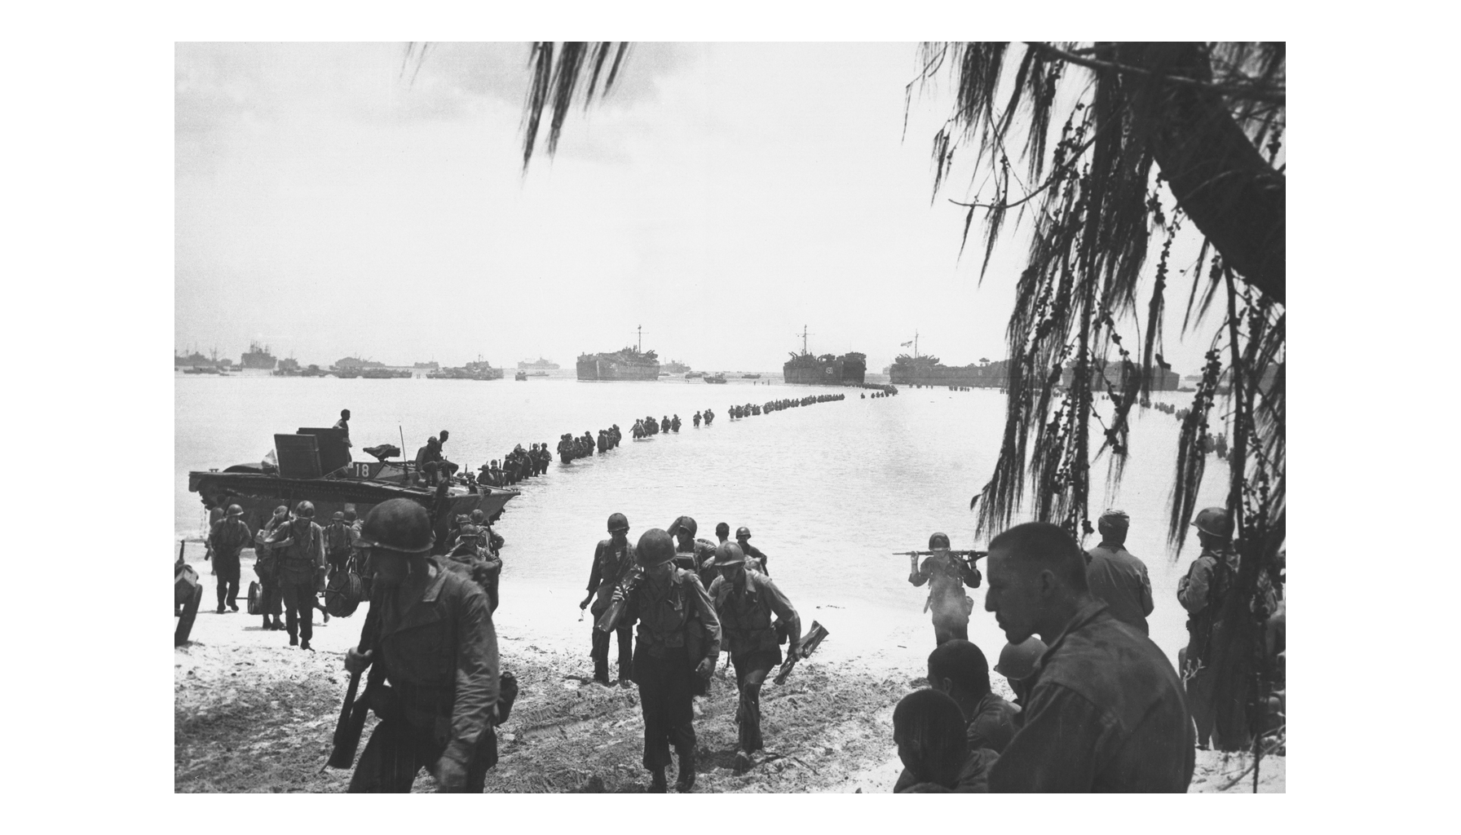
Reinforcements Wade Ashore at Saipan, June 1944
Note: U.S. Army photo.
© More Lessons Less Planning | morelessonslessplanning.com
Notes:
The curving line is men walking, not boats. The reef stopped landing craft well short of the beach, and that walk is what the word landing actually meant here.
Reference labels (point to these chart features when teaching): Landing ships offshore; Crossing the coral reef

Slide 15
The Price of an Island
Island | What the Allies did | Americans killed
Tarawa, November 1943 | Assaulted in 76 hours | About 1,000
Kwajalein, January-February 1944 | Assaulted in four days | About 370
Rabaul, 1943 to 1945 | Bypassed and cut off | No ground assault
Iwo Jima, February 1945 | Assaulted over 36 days | About 6,800
Okinawa, April 1945 | Assaulted over 82 days | About 12,500
Key Concept: The one island in this table that was bypassed cost no ground assault at all.
© More Lessons Less Planning | morelessonslessplanning.com
Notes:
Students use this exact table again in the Activity. Make sure they can read the Rabaul row before they leave; it is the one that carries the argument.

Slide 16
The Last Islands in Four Words
Rabaul
The large Japanese base the Allies cut off and bypassed instead of storming
Marianas Islands
The 1944 island group whose airfields put American bombers in range of Japan
Kamikaze
A Japanese pilot ordered to crash his aircraft into an Allied warship
Okinawa
The island 350 miles from Japan taken in an 82-day battle in 1945
Remember: The Marianas airfields are why the last islands mattered far more than their size.
© More Lessons Less Planning | morelessonslessplanning.com
Notes:
Two of these four words are places the Allies took, one is a place they refused to take, and one is a tactic. Ask students to sort them before you explain.

Slide 17
Iwo Jima and Okinawa: On Japan's Doorstep
Iwo Jima gave American bombers an emergency landing field.
Its 21,000 defenders fought from tunnels dug into the rock.
Okinawa lies about 350 miles from the Japanese home islands.
The 82-day battle there was the longest of the Pacific war.
Kamikaze aircraft struck the fleet off Okinawa in waves.
Fact: More than 100,000 Okinawan civilians are believed to have died during the battle for the island.
© More Lessons Less Planning | morelessonslessplanning.com
Notes:
This is where the lesson stops. What happens next, the decision about invading Japan itself, belongs to the lessons that follow.

Slide 18
The Navy Announces Midway
Pearl Harbor has now been partially avenged. [. . .] Perhaps we will be forgiven if we claim we are about midway to our objective!
— Admiral Chester W. Nimitz, CINCPAC Communique No. 3, June 6, 1942
Nimitz released this from Pearl Harbor on the third day of the battle, before the final count was in.
Remember: You will read a longer passage from this same announcement in Activity Part 4.
© More Lessons Less Planning | morelessonslessplanning.com
Notes:
Frame this as evidence, not as narration. This is how the United States Navy chose to talk to the public in June 1942, six months after Pearl Harbor, and the wording is part of what students are analyzing.

Slide 19
Why Island Hopping Worked
The Allies chose which islands to fight for and skipped the rest.
Bypassed garrisons were cut off and left behind the advance.
Each captured airfield brought the next target into range.
Three years took Allied forces from the Solomons to Okinawa.
By 1945 American bombers flew over Japan from captured islands.
Big Idea: The shortest road to Japan turned out to be the one that skipped the most islands.
© More Lessons Less Planning | morelessonslessplanning.com
Notes:
Ask students to name one island the Allies skipped and one they took, and to say why for each. That answer is the whole lesson in two sentences.

Slide 20
Key Takeaways
Coral Sea and Midway stopped Japan's advance in the spring of 1942.
★
American codebreaking gave Nimitz the ambush that won Midway.
★
Island hopping took the islands with airfields and skipped the rest.
★
Each captured airfield put the next target inside bomber range.
★
By mid-1945 Allied forces stood on Okinawa, 350 miles from Japan.
★
© More Lessons Less Planning | morelessonslessplanning.com
Notes:
Ask which takeaway students would defend in the Activity's written verdict. Picking a side out loud makes the paragraph much easier to write.

