Slide 1
Voltaire, Rousseau, and the Enlightenment
How two Enlightenment thinkers used reason, freedom, and the social contract to change what people expect from government
© More Lessons Less Planning | morelessonslessplanning.com
Notes:
Open with the lesson question: what does it mean to be free, and where should a government get its power? Preview that Voltaire and Rousseau answered these questions with reason, free speech, tolerance, the social contract, and popular sovereignty.

Slide 2
Learning Targets
Explain the core ideas of the Enlightenment: reason and freedom
★
Explain Voltaire's ideas: reason, free speech, and religious tolerance
★
Explain Rousseau's social contract, popular sovereignty, and general will
★
Explain the meaning of 'Man is born free, and everywhere he is in chains'
★
Explain how these ideas influenced the American and French Revolutions
★
© More Lessons Less Planning | morelessonslessplanning.com
Notes:
The five targets keep the lesson centered: what the Enlightenment was, Voltaire's core ideas, Rousseau's core ideas, the meaning of his famous line, and the accurate influence of both on the two revolutions.

Slide 3
What Was the Enlightenment?
An Age of Reason
Seeking Natural Laws
The Enlightenment was an 1700s movement built on reason
Thinkers used reason instead of tradition or authority
They questioned kings, churches, and old customs
They searched for natural laws about government and society
They believed society could be improved through reason
Their ideas helped inspire later revolutions
Key Concept: The Enlightenment used reason to question tradition and to seek natural laws about government and society.
© More Lessons Less Planning | morelessonslessplanning.com
Notes:
The Enlightenment was an 1700s movement built on reason. Thinkers used reason instead of tradition or authority and questioned kings, churches, and old customs. They searched for natural laws about government and society, believed society could be improved through reason, and their ideas helped inspire later revolutions.

Slide 4
Voltaire: Reason and Free Speech
Voltaire was a French Enlightenment writer who lived from 1694 to 1778.
He championed reason and used sharp wit to attack ignorance.
Voltaire defended free speech: the freedom to express ideas openly.
He believed no one should be punished for stating their opinions.
His writings made him one of the most famous thinkers of the Enlightenment.
Key Concept: Voltaire championed reason and free speech, the freedom to express ideas and criticize the government without punishment.
© More Lessons Less Planning | morelessonslessplanning.com
Notes:
Voltaire was a French Enlightenment writer who lived from 1694 to 1778. He championed reason and used sharp wit to attack ignorance. He defended free speech, the freedom to express ideas and criticize the government, and believed no one should be punished for stating their opinions. His writings made him one of the most famous thinkers of the Enlightenment.

Slide 5
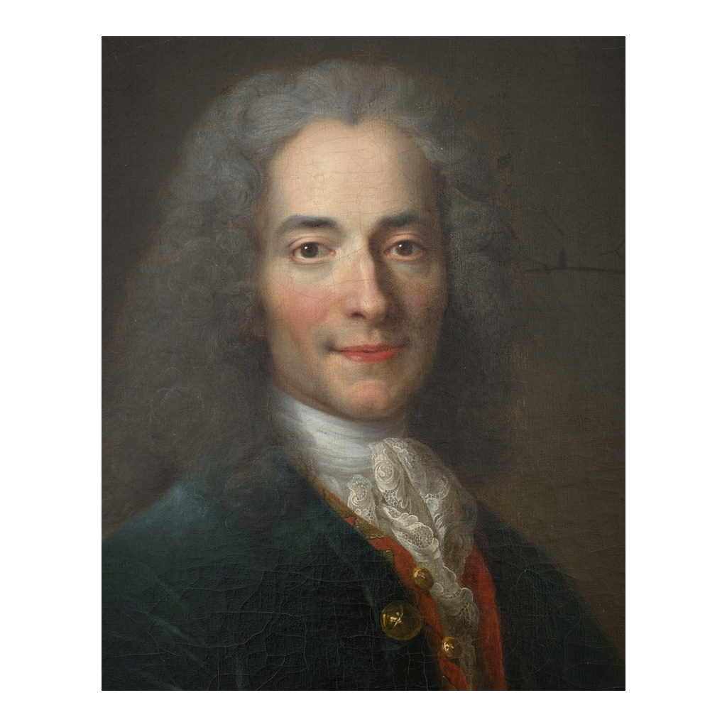
Voltaire (1694-1778)
Period portrait of Voltaire (1694-1778)
© More Lessons Less Planning | morelessonslessplanning.com
Notes:
This is a public-domain eighteenth-century portrait of a young Voltaire. Use it as a historical reference image, not as evidence for any claim beyond identifying Voltaire.

Slide 6
Voltaire: Tolerance and Critique of Tyranny
Religious Tolerance
Against Tyranny
Voltaire argued for religious tolerance
Religious tolerance means people may hold different beliefs without punishment
He criticized the church for persecuting people over religion
Voltaire attacked tyranny, the cruel and unjust use of power
He mocked corrupt rulers and unjust laws
He argued that reason should limit the power of church and state
Did You Know? Voltaire is remembered for defending everyone's right to speak, even people whose views he strongly disagreed with.
© More Lessons Less Planning | morelessonslessplanning.com
Notes:
Voltaire argued for religious tolerance, which means people may hold different beliefs without punishment, and he criticized the church for persecuting people over religion. He attacked tyranny, the cruel and unjust use of power, mocked corrupt rulers and unjust laws, and argued that reason should limit the power of church and state.

Slide 7
Rousseau: Man Is Born Free
Jean-Jacques Rousseau was a Genevan thinker who lived from 1712 to 1778.
He famously wrote, 'Man is born free, and everywhere he is in chains.'
Rousseau meant people are born free but are bound by unjust rulers and laws.
He argued that a just society must protect people's freedom.
Rousseau became a leading voice of the Enlightenment.
Key Concept: Rousseau wrote that 'Man is born free, and everywhere he is in chains,' meaning people are born free but bound by unjust rule.
© More Lessons Less Planning | morelessonslessplanning.com
Notes:
Jean-Jacques Rousseau was a Genevan thinker who lived from 1712 to 1778. He famously wrote, 'Man is born free, and everywhere he is in chains,' meaning people are born free but are bound by unjust rulers and laws. He argued that a just society must protect people's freedom, and he became a leading voice of the Enlightenment.

Slide 8
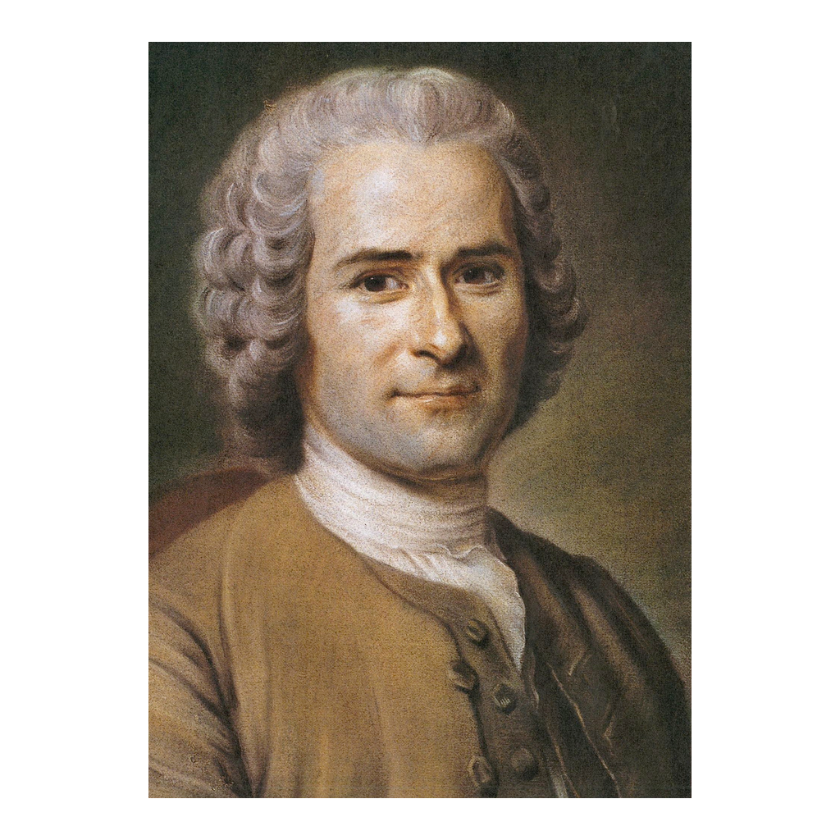
Jean-Jacques Rousseau (1712-1778)
Period portrait of Jean-Jacques Rousseau (1712-1778)
© More Lessons Less Planning | morelessonslessplanning.com
Notes:
This is a public-domain eighteenth-century portrait of Jean-Jacques Rousseau. Use it as a historical reference image, not as evidence for any claim beyond identifying Rousseau.

Slide 9
The Social Contract (1762)
In 1762 Rousseau published his book The Social Contract.
A social contract forms a government that serves the common good.
People give up some freedom in exchange for protection and order.
Rousseau argued that a legitimate government must serve the whole community.
The book begins, 'Man is born free, and everywhere he is in chains.'
Key Concept: In The Social Contract (1762), Rousseau argued people form government by agreement to serve the common good.
© More Lessons Less Planning | morelessonslessplanning.com
Notes:
In 1762 Rousseau published his book The Social Contract. A social contract is an agreement to form a government that serves the common good, in which people give up some freedom in exchange for protection and order. Rousseau argued that a legitimate government must serve the whole community, and the book begins with his famous line, 'Man is born free, and everywhere he is in chains.'

Slide 10
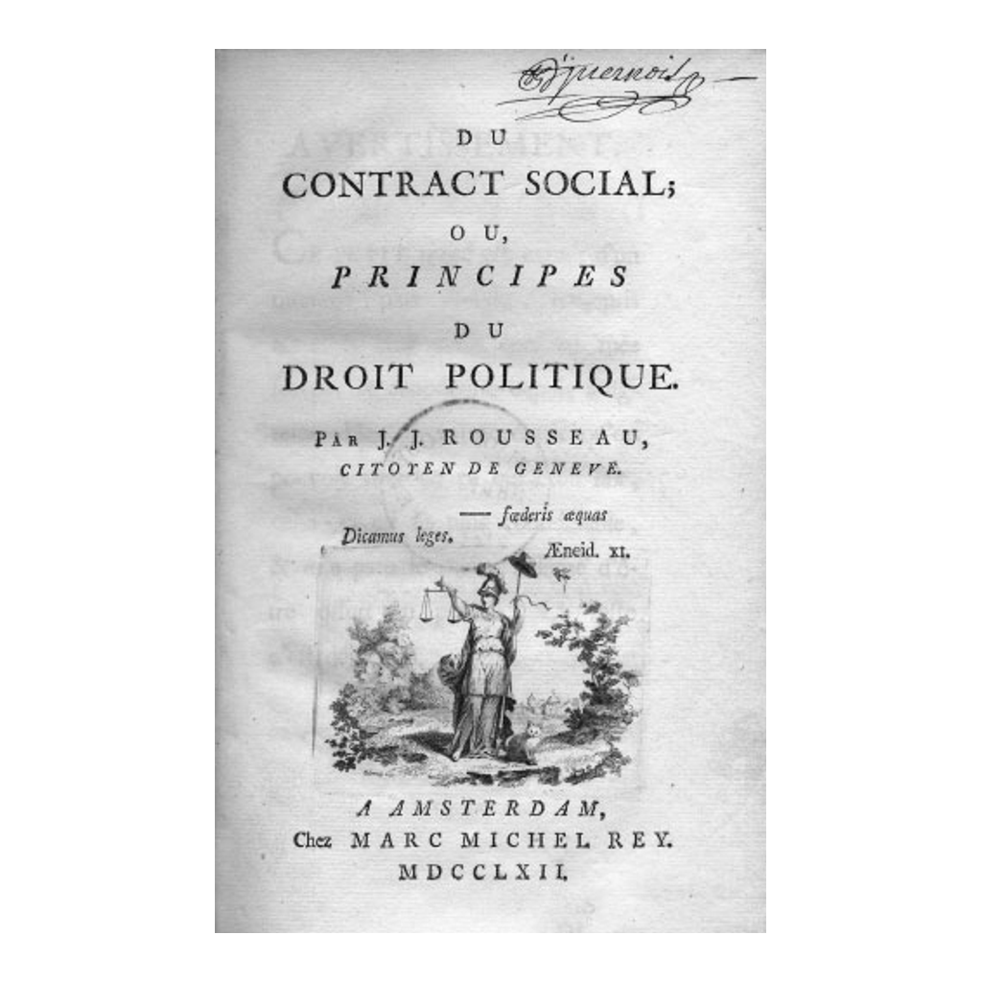
Title Page of Rousseau's The Social Contract (1762)
Title page of Du contrat social (The Social Contract), 1762
© More Lessons Less Planning | morelessonslessplanning.com
Notes:
This is the title page of the first edition of Rousseau's Du contrat social (The Social Contract), published in 1762. Use it as a historical reference to the book at the center of the lesson, not as a reading task.
Reference labels (point to these chart features when teaching): Du contrat social; Published 1762

Slide 11
Popular Sovereignty
Power Belongs to the People
Government Serves the People
Popular sovereignty means political power belongs to the people
The people are the true source of a government's authority
No king or noble is the rightful source of power
Rulers govern only on behalf of the people
If the people are the source of power, they decide who governs
This idea challenged the divine right of kings
Key Concept: Popular sovereignty means political power belongs to the people, the true source of a government's authority.
© More Lessons Less Planning | morelessonslessplanning.com
Notes:
Popular sovereignty means political power belongs to the people, who are the true source of a government's authority. No king or noble is the rightful source of power. Rulers govern only on behalf of the people, and if the people are the source of power, they decide who governs. This idea challenged the divine right of kings.

Slide 12
The General Will
The general will is what the whole community wants for the common good.
Rousseau said a legitimate government must follow the general will.
The general will is not just what a majority wants at one moment.
It is what is best for the community as a whole.
Following the general will keeps government tied to the people.
Note: For Rousseau, the general will is the community's shared interest in the common good, not simply private wishes.
© More Lessons Less Planning | morelessonslessplanning.com
Notes:
The general will is what the whole community wants for the common good. Rousseau said a legitimate government must follow the general will. The general will is not just what a majority wants at one moment; it is what is best for the community as a whole. Following the general will keeps government tied to the people.

Slide 13
Voltaire vs. Rousseau: Two Views of Freedom
Voltaire's Focus
Rousseau's Focus
Voltaire focused on freedom of thought and speech
He fought for religious tolerance and against tyranny
He trusted reason to limit abusive power
Rousseau focused on political freedom and the common good
He argued government must follow the general will
He said power belongs to the people
Did You Know? Voltaire and Rousseau often disagreed, but both reshaped how people think about freedom and government.
© More Lessons Less Planning | morelessonslessplanning.com
Notes:
Voltaire focused on freedom of thought and speech, fighting for religious tolerance and against tyranny, and trusting reason to limit abusive power. Rousseau focused on political freedom and the common good, arguing that government must follow the general will and that power belongs to the people. They often disagreed, but both reshaped how people think about freedom and government.

Slide 14
Influence on the American and French Revolutions
Enlightenment ideas about freedom spread across Europe and the colonies.
The idea of a social contract shaped the American Revolution of 1776.
Popular sovereignty influenced the French Revolution of 1789.
Revolutionaries argued that governments must serve the people.
These ideas connect Voltaire and Rousseau to the revolutions studied next.
Key Concept: Enlightenment ideas of freedom and the social contract helped inspire the American (1776) and French (1789) Revolutions.
© More Lessons Less Planning | morelessonslessplanning.com
Notes:
Enlightenment ideas about freedom spread across Europe and the colonies. The idea of a social contract shaped the American Revolution of 1776, and Rousseau's ideas about popular sovereignty influenced the French Revolution of 1789. Revolutionaries argued that governments must serve the people. These ideas connect Voltaire and Rousseau to the revolutions students study next in this unit.

Slide 15
Reference Guide: The Enlightenment and Voltaire
Enlightenment
An 1700s movement that used reason to question tradition and old authority.
reason
Using logical thinking, rather than tradition or authority, to understand the world.
Voltaire
French Enlightenment writer (1694-1778) who defended reason, free speech, and tolerance.
religious tolerance
Accepting that people may hold different religious beliefs without being punished.
free speech
The freedom to express ideas and criticize the government without punishment.
Tip: These five terms name the movement, its main tool, its most famous writer, and two freedoms Voltaire defended.
© More Lessons Less Planning | morelessonslessplanning.com
Notes:
Review the five terms exactly as defined: Enlightenment, reason, Voltaire, religious tolerance, and free speech. Students use these definitions to complete the Reference Guide in the Activity.

Slide 16
Reference Guide: Rousseau and Government by Consent
Rousseau
Genevan Enlightenment thinker (1712-1778) who argued for popular sovereignty.
social contract
An agreement in which people form a government that serves the common good.
popular sovereignty
The idea that political power belongs to the people, the true source of authority.
general will
What the whole community wants for the common good, which government must follow.
The Social Contract
Rousseau's 1762 book arguing that government must follow the general will.
Tip: These five terms name Rousseau, his big idea of agreement, the source of power, the common good, and his 1762 book.
© More Lessons Less Planning | morelessonslessplanning.com
Notes:
Review the five terms exactly as defined: Rousseau, social contract, popular sovereignty, general will, and The Social Contract. Students use these definitions to complete the Reference Guide in the Activity.

Slide 17
Key Takeaways
The Enlightenment used reason to question tradition and seek natural laws.
★
Voltaire championed free speech and religious tolerance and attacked tyranny.
★
Rousseau argued that people are born free and that power belongs to the people.
★
In The Social Contract, legitimate government must follow the general will.
★
These ideas helped inspire the American and French Revolutions.
★
© More Lessons Less Planning | morelessonslessplanning.com
Notes:
Close with the essential question. Each takeaway connects the Enlightenment's use of reason to Voltaire's freedoms, Rousseau's social contract and general will, and the accurate influence of both on the American and French Revolutions.

