Slide 1
Venmo, Zelle, Cash App: The Hidden Costs
If the app is free, what is it actually costing you?
© More Lessons Less Planning | morelessonslessplanning.com
Notes:
Open with the hook: 'Show of hands - how many of you used Venmo, Zelle, or Cash App in the last week? OK now keep your hand up if you can tell me what fee the app charged you for that payment. Most of you cannot. By the end of class everyone in this room can.' This toolkit teaches the actual rules of Venmo, Zelle, and Cash App - the fees, the scams, the FDIC limits - so students who already use these apps daily stop losing money to them.

Slide 2
Learning Targets
Compare Venmo, Zelle, and Cash App on speed, fees, and scam protection.
★
Identify common P2P scams and explain why apps usually do NOT refund victims.
★
Evaluate which app (if any) is safe to use for a given payment situation.
★
© More Lessons Less Planning | morelessonslessplanning.com
Notes:
Read each target aloud. Target 1: COMPARE the three apps on speed, fees, and protection. Target 2: IDENTIFY the most common scams and understand why the apps usually do not refund you. Target 3: EVALUATE - given a real payment situation, pick the right app or pick NONE.

Slide 3
The Rise of Peer-to-Peer Payment
P2P apps moved over $1 TRILLION in U.S. payments in 2023-2024
Average American adult uses P2P at least once per week
Three apps dominate: Zelle, Venmo, Cash App
Replaced cash and checks for most everyday peer payments
Same speed and convenience that scammers love
Big Idea: P2P apps are now the default way Americans send money to each other - and the default way scammers steal it.
© More Lessons Less Planning | morelessonslessplanning.com
Notes:
Set the scale. Peer-to-peer payment apps (P2P) - Venmo, Zelle, Cash App, and a few smaller ones - moved over ONE TRILLION dollars in U.S. payments in 2023-2024 combined. That is more than the GDP of most countries. The average American adult uses a P2P app at least once a week. P2P has replaced cash and personal checks for most everyday peer-to-peer payments - splitting a dinner bill, paying rent to a roommate, paying back a friend. Three apps dominate: Zelle (built into your bank app), Venmo (owned by PayPal), and Cash App (owned by Block, founded by Jack Dorsey). The same convenience and speed that make these apps useful for paying friends also make them perfect for scammers.

Slide 4
Venmo - Social and Slow
How Venmo works
Venmo extras
Owned by PayPal, launched 2009
Money sits in Venmo BALANCE - not your bank
Free bank transfer takes 1-3 business days
Instant transfer costs 1.75 percent (min $0.25, max $25)
Social feed: payments visible to your friends list
Privacy is PUBLIC by default - change in settings
Goods and services payment fee: 1.9 percent + $0.10
Venmo balance is NOT FDIC-insured by default
Tip: Switch your Venmo privacy to private the day you sign up. Your payment history is public by default.
© More Lessons Less Planning | morelessonslessplanning.com
Notes:
Drill the Venmo basics. Owned by PayPal since 2013 (Venmo itself launched in 2009). Money you receive sits in a VENMO BALANCE - which is held with Venmo, not your bank. You can spend the balance, send it to other Venmo users, or transfer to your bank. Free bank transfer takes 1-3 BUSINESS DAYS. INSTANT transfer (to your bank in 30 minutes) costs 1.75 percent of the amount - minimum $0.25, maximum $25. Sending and receiving between Venmo users is free for personal payments. Venmo is famous (or infamous) for its SOCIAL FEED - every payment you make is visible to your friends list (and to the public by default) unless you change your privacy settings. The amount is hidden but the name and emoji/note are visible. There is a GOODS AND SERVICES fee of 1.9 percent plus $0.10 if the payment is to a seller (which unlocks buyer protection). The Venmo balance is NOT FDIC-insured by default - only when Venmo sweeps the money to a partner bank do certain funds become insured.

Slide 5
Zelle - Bank-to-Bank Fast
Built INTO your bank app
Chase, BoA, Wells, and 1,800+ partner banks - no separate app.
✔
Bank-to-bank in minutes
Money moves directly between bank accounts in minutes.
✔
No fee, no balance
Zelle charges nothing - money stays in your FDIC-insured bank account.
✔
IRREVERSIBLE
Once sent, the money is gone - no dispute process, no refunds.
✔
Best for trusted people
Rent to a roommate, money to family - NOT for strangers.
✔
Warning: Zelle is fast AND irreversible. If you are scammed via Zelle, your bank will probably tell you it was your fault.
© More Lessons Less Planning | morelessonslessplanning.com
Notes:
Drill Zelle. Zelle is different from Venmo and Cash App because it is not a separate app - it is BUILT INTO the apps of major U.S. banks (Chase, Bank of America, Wells Fargo, plus over 1,800 partner banks and credit unions). When you Zelle someone, the money moves directly bank-to-bank, usually in MINUTES, inside the U.S. banking network. There is NO BALANCE - the money lives in your normal bank account the whole time, which is FDIC-insured by your bank up to $250,000. Zelle does not charge a fee. The trade-off: Zelle is IRREVERSIBLE. Once you press send, the money is gone - there is no buyer protection, no dispute process for scams, no refund. Your bank will almost always treat a Zelle scam as your fault because you authorized the payment. Zelle is best for people you already trust - paying rent to a roommate, sending money to family. Treat it like cash.

Slide 6
Cash App - Crypto-Friendly
How Cash App works
Cash App extras
Owned by Block (Jack Dorsey), launched 2013
Money sits in Cash App BALANCE - not your bank
Standard bank transfer free in 1-3 days
Instant transfer 0.5-1.75 percent of amount
Cash Card: a Visa debit card linked to your balance
Buy/sell Bitcoin AND stocks inside the app
Goods and services fee: 2.75 percent
Balance is NOT FDIC-insured by default
Tip: Cash App targets younger users - extra features mean extra ways to lose money if your account is compromised.
© More Lessons Less Planning | morelessonslessplanning.com
Notes:
Drill Cash App. Owned by Block (formerly Square), founded by Jack Dorsey - the same guy who founded Twitter. Cash App launched in 2013 and grew fastest among teen and young-adult users. Money received sits in a CASH APP BALANCE held with Block, not your bank. Standard bank transfer is free in 1-3 business days. INSTANT transfer to your bank costs 0.5 to 1.75 percent of the amount. Sending and receiving between Cash App users is free for personal payments. Cash App offers extras the other two do not - a CASH CARD (a real Visa debit card linked to your Cash App balance, with optional Boosts/cash back), the ability to BUY AND SELL BITCOIN inside the app, and the ability to BUY STOCKS inside the app. The GOODS AND SERVICES fee for paying a seller is 2.75 percent. The Cash App balance itself is NOT FDIC-insured by default - only when you opt into Cash App Savings or use the Cash Card with pass-through partner banks do certain funds become insured.

Slide 7
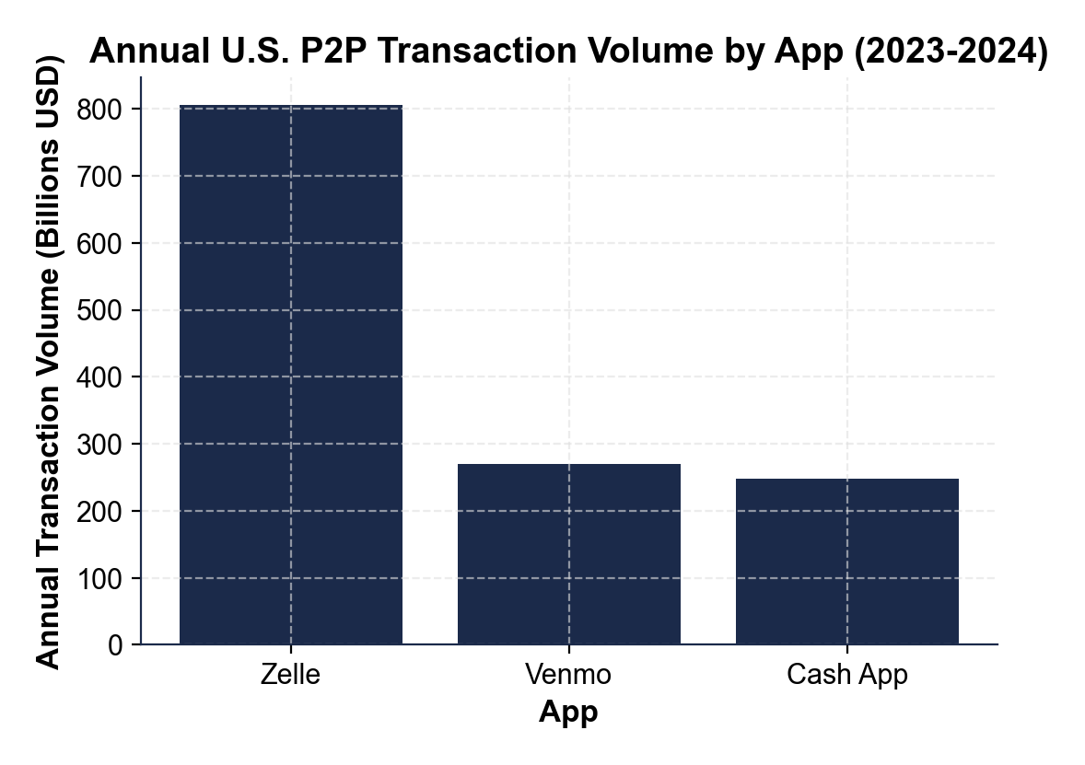
Annual U.S. P2P Volume by App (2023-2024)
Note: Zelle $806B vs Venmo $270B vs Cash App $248B.
© More Lessons Less Planning | morelessonslessplanning.com
Notes:
Display the P2P volume bar chart. Three bars compare U.S. annual transaction volume by app (2023-2024 reference period). Zelle leads at about $806 billion. Venmo comes in second at about $270 billion. Cash App is third at about $248 billion. The visual makes the point that ZELLE moves more money than Venmo and Cash App COMBINED ($806B vs $518B), even though most students think of Venmo or Cash App first. The reason: Zelle is built into every major bank app, so people use it automatically when their bank prompts them to.
Reference labels (point to these chart features when teaching): Zelle dominates

Slide 8
The Hidden Fees - Instant + Business
Venmo instant transfer
1.75 percent of amount (min $0.25, max $25).
✔
Cash App instant transfer
0.5 to 1.75 percent of amount.
✔
Venmo goods and services
1.9 percent + $0.10 - paid by the seller.
✔
Cash App goods and services
2.75 percent - paid by the seller.
✔
Credit card funding (Venmo/Cash App)
3 percent on Venmo and Cash App. Zelle does not support credit-card funding.
✔
Tip: Free bank transfer takes 1-3 business days. Pay the 1.75 percent only if you actually need the money today.
© More Lessons Less Planning | morelessonslessplanning.com
Notes:
Walk through the hidden fees. THE INSTANT TRANSFER FEE is the most common one students hit. Free bank transfer takes 1-3 business days. If you tap INSTANT (money in your bank in 30 minutes) you pay 1.75 percent on Venmo (min $0.25, max $25) or 0.5-1.75 percent on Cash App. On a $200 payment, that is $3.50 on Venmo - real money on a tight budget. THE GOODS AND SERVICES FEE is paid by the seller when you tap 'paying for a good or service' instead of 'paying a friend' - 1.9 percent + $0.10 on Venmo, 2.75 percent on Cash App. Sellers often try to push buyers to use the friend payment option (no fee, but ALSO no buyer protection). THE CREDIT CARD FUNDING FEE is 3 percent on VENMO and CASH APP when you fund the payment from a credit card instead of your bank account or debit card. ZELLE DOES NOT SUPPORT CREDIT CARD FUNDING AT ALL - it only moves money bank account to bank account, so there is no credit-card option or fee to compare. If you are chasing credit card points, the 3 percent fee usually wipes out any 1-2 percent cash-back rewards. Zelle has no fees because the money never leaves your bank account.

Slide 9
The Scam Problem - Fake Refund + Fake Bank Call
Fake Cash App refund page
Fake bank call - Zelle variant
Scammer DMs you a fake refund-page screenshot
Asks you to send money to 'verify' your account
Real refunds NEVER ask you to send money first
Common on Cash App giveaway / cash flip scams
Spoofed caller ID shows your real bank number
Caller says: 'fraud on your account - act now'
Asks you to Zelle money to yourself 'to protect it'
Real banks NEVER tell you to Zelle yourself
Real Talk: Two simple rules. Real refunds NEVER ask you to send. Real banks NEVER tell you to Zelle yourself.
© More Lessons Less Planning | morelessonslessplanning.com
Notes:
Drill the two most common scams on these apps. THE FAKE CASH APP REFUND PAGE works like this. You see a 'cash flip' or 'cash giveaway' post on Instagram, TikTok, or Twitter - 'Send me $10 and I'll send you back $100.' You send. The scammer DMs you a SCREENSHOT that looks like a real Cash App refund notification - clean Cash App green, an amount like $100 about to land in your account, plus a message saying 'Please confirm by sending $20 to verify your account.' Real refunds NEVER ask you to send money first. The screenshot is fake. You lose another $20 on top of the original $10. THE 'YOUR BANK CALLED' SCAM (the Zelle variant) works like this. Your phone rings and caller ID shows your bank's real customer service number (spoofed - the scammer is using software that fakes any number). The caller says 'we detected fraud on your account - someone is trying to move money out right now. To protect your money, please Zelle the funds to yourself at this new safe account.' Real banks NEVER tell you to Zelle yourself. Once you press send, the Zelle is irreversible and your bank will probably not refund you. These two scams together account for a huge share of P2P fraud losses.

Slide 10
The Venmo Overpayment Scam
You list something for sale (iPhone, console, concert ticket)
Buyer Venmos you MORE than the agreed price 'by accident'
Buyer asks you to send back the difference
Original payment was a stolen card - gets reversed days later
You are out the refund you sent AND the item if you shipped it
Warning: A buyer who 'accidentally' overpays is running a script. Refund the WHOLE amount through Venmo - never send a partial refund.
© More Lessons Less Planning | morelessonslessplanning.com
Notes:
Drill the Venmo overpayment scam (also runs on Cash App and Zelle). Setup: you list something for sale on Facebook Marketplace, OfferUp, or Craigslist - say a $300 iPhone. Buyer agrees. Buyer Venmos you $400 'by mistake' (or the buyer 'meant to type 300, fat-fingered 400'). Buyer apologizes and asks you to send back the $100 difference. The original $400 payment was funded by a STOLEN CREDIT CARD or a HACKED ACCOUNT. Days or weeks later, the real cardholder sees the charge, disputes it, and Venmo claws back the original $400 from your balance. You sent the scammer $100 in clean money AND - if you shipped the iPhone - you also lost the $300 item. The script always involves OVERPAYING and asking for a partial refund. The fix: if a buyer overpays you, send the WHOLE amount back through Venmo and re-do the payment correctly. Never send a partial refund. Better rule: don't sell to strangers via P2P. Use a marketplace with built-in buyer/seller protection (eBay, StockX, PayPal Goods and Services).

Slide 11
Why Apps Do NOT Refund - Authorized Push Payments
What 'authorized' means here
What apps actually refund
YOU pressed send - even though you were tricked
App treats your tap as approval, same as cash
P2P apps designed for speed, not protection
No chargeback right like credit cards have
Unauthorized access - someone hacked your account
Goods-and-services scam (Venmo / Cash App only)
App platform error or duplicate charge
Rare and slow - expect to lose, not win, a dispute
Key Concept: If YOU pressed send, the app treats it as authorized. The app is designed to move money fast, not to undo it.
© More Lessons Less Planning | morelessonslessplanning.com
Notes:
Explain WHY apps refuse to refund. The legal category is AUTHORIZED PUSH PAYMENT FRAUD - you were tricked into pressing send, but YOU pressed send. The app treats your tap as authorization, the same way it would treat handing over cash. P2P apps were designed for SPEED - paying friends in seconds with no friction - not for PROTECTION. Compare to credit cards: federal law gives you a chargeback right within 60 days for unauthorized charges. P2P apps do NOT have that. WHAT APPS WILL ACTUALLY REFUND: (1) UNAUTHORIZED ACCESS - if someone hacked your account and sent money without your knowledge, you usually get refunded. (2) GOODS AND SERVICES SCAM - if you paid using the goods-and-services option on Venmo or Cash App (with the fee), and the seller never delivered or sent a fake item, you can file a dispute and usually get refunded. (3) PLATFORM ERROR - duplicate charge, system bug. WHAT APPS DO NOT REFUND: friend-to-friend scams (you sent it on the 'paying a friend' option), Zelle scams of any kind, fake refund pages, fake bank calls, overpayment scams where you sent the refund. Expect to lose, not win, a dispute on these.

Slide 12
FDIC - What Is Actually Insured?
Zelle - FDIC INSURED
Money lives in your bank account, insured to $250,000 by your bank.
✔
Venmo balance - NOT insured by default
Pass-through coverage only when swept to a partner bank.
✔
Cash App balance - NOT insured by default
Pass-through coverage only via Cash App Savings or Cash Card.
✔
Big balance? Move it out
Never let serious money sit in a Venmo or Cash App balance.
✔
$250K cap is per depositor per BANK
Not per app, not per account number - per real bank.
✔
Big Idea: A Venmo or Cash App balance is NOT a bank. It is convenient storage that is one company problem away from being inaccessible.
© More Lessons Less Planning | morelessonslessplanning.com
Notes:
Drill FDIC coverage. FDIC INSURANCE protects up to $250,000 per depositor per bank - but only if the money is held in an FDIC-MEMBER BANK. Important: many P2P balances are held by fintech companies, NOT by banks. ZELLE is the clean case. Money you send or receive via Zelle stays in your normal bank account the whole time. That account is FDIC-insured by your bank up to $250K. VENMO balance is held by PayPal (Venmo's parent). By default the balance is NOT FDIC-insured. Pass-through coverage exists only when PayPal sweeps eligible funds to a partner bank (Synchrony Bank, etc.) and conditions are met. CASH APP balance is similar - held by Block, not FDIC-insured at the balance level. Pass-through coverage exists only via Cash App SAVINGS (where the money is moved to a partner bank like Wells Fargo) or via the Cash Card pass-through structure. THE PRACTICAL RULE: if you have more than a couple hundred dollars sitting in a Venmo or Cash App balance, move it to your actual bank. Not because Venmo or Cash App are likely to fail tomorrow - but because the balance is unprotected, and account lockouts (frozen by fraud algorithms, identity verification, etc.) lock the money out of reach for days or weeks.

Slide 13
When Each App Is Safe (And When It Is Not)
Generally SAFE situations
DANGER zone - use something else
Splitting a bill with friends who you trust
Paying rent to a roommate you know well
Sending weekly money to a family member
Tipping someone who has worked for you (babysitter)
Buying from a stranger on Craigslist or Marketplace
Selling to a stranger who insists on Venmo or Zelle
Anyone claiming to be your bank asking you to send (scam)
Any 'cash flip' or 'easy money' offer on social media
Real Talk: P2P apps are good for paying people you ALREADY trust. They are terrible for paying strangers - that is scam territory.
© More Lessons Less Planning | morelessonslessplanning.com
Notes:
Synthesize the lesson. P2P apps are TOOLS - safe for the right job, dangerous for the wrong one. GENERALLY SAFE: splitting a bill with friends you trust, paying rent to a roommate you know well, sending weekly money to a family member, tipping someone who has worked for you (babysitter, dog walker, tutor). In every safe case the recipient is a real person whose identity you already verified offline. DANGER ZONE: buying from a stranger on Craigslist, Facebook Marketplace, or OfferUp - use a marketplace with buyer protection instead. Selling to a stranger who insists on Venmo or Zelle - red flag, walk away. Anyone calling you from 'your bank' and asking you to send money - real banks never do this. Any 'cash flip' or 'easy money' offer on Instagram, TikTok, or Twitter - 100 percent scam. THE RULE OF THUMB: P2P apps are like cash with internet speed. Use them where you would use cash to a friend. Do not use them where you would want a chargeback right - that is what credit cards are for.

Slide 14
Key Takeaways
Zelle: bank-to-bank, fast, IRREVERSIBLE.
★
Venmo / Cash App balances are NOT FDIC-insured.
★
Instant transfer fee: 1.75 percent on Venmo.
★
YOU pressed send = no refund.
★
Trusted = P2P. Stranger = credit card.
★
© More Lessons Less Planning | morelessonslessplanning.com
Notes:
Close with the five rules. (1) ZELLE = fast bank-to-bank, no balance, FDIC-insured because the money stays in your bank - but IRREVERSIBLE so treat it as cash. (2) VENMO and CASH APP balances are NOT FDIC-insured by default - move money to your real bank if you have more than walking-around amounts sitting there. (3) FREE BANK TRANSFER takes 1-3 days; INSTANT TRANSFER costs 1.75 percent on Venmo, 0.5-1.75 percent on Cash App. Pay the fee only if you actually need the money today. (4) AUTHORIZED PUSH PAYMENT FRAUD is the legal name for 'YOU pressed send even though you were tricked.' Apps do not refund this. The protections that credit cards have do not exist on P2P. (5) USE P2P for people you ALREADY trust. Use a CREDIT CARD for strangers. Right tool, right job.

