Slide 1
Utilities & Setup: Turning On the Lights
Learn the utilities a first home needs, the cash it takes to turn them on, and how to add up your monthly bills so you can afford to keep the lights on.
© More Lessons Less Planning | morelessonslessplanning.com
Notes:
This is the 'how do you turn everything on?' lesson of Unit 9. Moving into a first apartment is exciting, but the lights, water, and internet do not turn on by themselves - and they are not free to start. Tell students the surprise: before a single bill arrives, you often pay a deposit and a setup fee just to begin service, and then a bill every month on top of rent. Today they learn the utilities a first home needs, the up-front cash to set them up, and how to add up the monthly bills. Students will leave able to calculate the cash a real person - Priya Nair, moving into her first apartment - needs to turn her utilities on and keep them running.

Slide 2
Learning Targets
Name the utilities a first home needs and who provides them
★
Calculate the up-front cash to set up your utilities
★
Add up your monthly bills and tell fixed from variable costs
★
Read a bar chart of monthly costs and check your savings
★
© More Lessons Less Planning | morelessonslessplanning.com
Notes:
Read the four targets and connect them to the arc of the lesson. Target 1 is the naming skill: name the utilities a first home needs (electricity, gas, water, internet, phone, trash) and who provides them. Target 2 is the first math skill: calculate the up-front cash to set up utilities using the labeled cash-to-set-up model. Target 3 is the second math skill: add up the monthly bills into a monthly utility total and tell fixed costs from variable costs. Target 4 is the payoff - reading a bar chart of monthly utility costs and judging whether a renter has saved enough to turn everything on. By the end, students can say what utilities cost up front and every month.

Slide 3
Turning On the Lights
Utilities keep a home running
UTILITIES are the basic services a home needs to run: electricity, gas, water, internet, phone, and trash
✔
The lights are not free to turn on
Turning on utilities costs CASH up front - a deposit and a setup fee - before you get a single bill
✔
Then a bill every month
After setup, each utility sends a monthly BILL you have to budget for on top of your rent
✔
Meet Priya
Priya Nair is moving into her first APARTMENT; her setup coach Devon Marsh helps her plan the cash she needs
✔
Key Concept: UTILITIES are the basic services a home needs; turning them on takes cash up front, then a bill every month.
© More Lessons Less Planning | morelessonslessplanning.com
Notes:
Frame the whole lesson: UTILITIES are the basic services a home needs to run - electricity, gas, water, internet, phone, and trash. Make the honest surprise clear: turning on utilities costs CASH up front - a deposit and a setup fee - before you ever get a bill. Then, after setup, each utility sends a monthly BILL you have to budget for on top of your rent, so utilities are both an up-front cost and an ongoing cost. Introduce the persona and the real problem: Priya Nair is moving into her first apartment, and her setup coach Devon Marsh is going to help her plan the cash she needs - both to turn everything on and to keep it running each month. This sets up the two labeled models that follow. Key term - Utilities: the basic services a home needs to run.

Slide 4
Electric, Gas, and Water
Electricity
ELECTRICITY powers your lights and outlets - usually one of the biggest monthly bills
Gas
GAS often heats your home and water and runs the stove; many homes have both gas and electric
Water and sewer
WATER/SEWER covers the water you use and the wastewater carried away
The provider
A PROVIDER is the company you buy a utility service from - you set up an account with each one
Key Concept: The core home utilities are electricity, gas, and water/sewer; a PROVIDER is the company you buy each one from.
© More Lessons Less Planning | morelessonslessplanning.com
Notes:
Teach the three core home utilities. ELECTRICITY powers your lights and outlets and is usually one of the biggest monthly bills, because so much of a home runs on it. GAS often heats your home and your water and runs the stove; many homes have both a gas bill and an electric bill. WATER/SEWER covers both the clean water you use and the wastewater carried away. Then introduce the vocabulary that ties them together: a PROVIDER is the company you buy a utility service from, and you set up a separate account with each provider (the electric company, the gas company, the water department). Make the practical point: in a first apartment you may deal with several providers, each with its own account, deposit, and bill. Key terms - Electricity: powers lights and outlets. Provider: the company you buy a utility service from.

Slide 5
Internet and Phone
Internet connects your home
INTERNET service connects your home to the web; it usually has a one-time SETUP FEE to install
✔
Phone or cell
PHONE/CELL service keeps you reachable; most people pay a monthly cell plan
✔
Mostly fixed bills
Internet and phone are usually FIXED COSTS - the bill stays about the same each month
✔
Bundling can save
Some PROVIDERS bundle internet and phone together for one lower monthly price
✔
Key Concept: INTERNET and PHONE/CELL are connectivity utilities; they are usually FIXED COSTS that stay about the same each month.
© More Lessons Less Planning | morelessonslessplanning.com
Notes:
Teach the connectivity utilities. INTERNET service connects your home to the web and usually has a one-time SETUP FEE to install (a technician visit or self-install kit) plus a monthly bill. PHONE/CELL service keeps you reachable; most people pay a monthly cell plan rather than a home landline. Make an important cost distinction: internet and phone are usually FIXED COSTS - the bill stays about the same each month no matter how much you use them - unlike electricity or water, which change with use. Give a money-saving tip: some PROVIDERS bundle internet and phone together for one lower monthly price, so it pays to compare. Connect back: internet's setup fee is one of the pieces that goes into the up-front cash to set up, coming next. Key term - Fixed cost: a bill that stays about the same each month.

Slide 6
Setup Fees and Deposits
The deposit
A DEPOSIT is a refundable up-front payment a utility holds in case you do not pay your bill
The setup fee
A SETUP FEE is a one-time charge to connect or activate a utility service
The labeled model
CASH TO SET UP = DEPOSITS + SETUP FEES - the up-front cash to turn your utilities on
Priya's cash to set up
Priya's deposits $250 + setup fees $150 = $400 cash to set up, due once at move-in
Key Concept: CASH TO SET UP = DEPOSITS + SETUP FEES. Priya's is $250 + $150 = $400, a one-time cost to turn utilities on.
© More Lessons Less Planning | morelessonslessplanning.com
Notes:
This is the first central quantitative model - teach it explicitly and put it on the board under a clear label before students calculate with it. First, the two kinds of up-front cost. A DEPOSIT is a refundable up-front payment a utility holds in case you do not pay your bill - you usually get it back when you close the account in good standing. A SETUP FEE is a one-time charge to connect or activate a utility service (an internet install, an electric hookup); unlike a deposit, it is spent, not returned. THE LABELED MODEL - CASH TO SET UP = DEPOSITS + SETUP FEES - is the total up-front cash to turn your utilities on. Work it with the persona: Priya's deposits total $250 (electric $150 + gas $100) and her setup fees total $150 (internet install $100 + electric hookup $50), so her cash to set up = $250 + $150 = $400, due once at move-in. Make the teaching point: this $400 is separate from her rent and separate from her monthly bills - it is the cash it takes just to begin. Tell students Activity Part 3 asks them to apply this exact model. Key terms - Deposit: a refundable up-front payment a utility holds. Setup fee: a one-time charge to connect a service. Cash to set up: deposits plus setup fees.

Slide 7
Estimating Your Monthly Bills
Add up every bill
MONTHLY UTILITY TOTAL = SUM OF EACH MONTHLY UTILITY BILL - add up all six bills
✔
Priya's monthly total
Priya's bills: electric $95 + gas $55 + water $60 + internet $70 + phone $80 + trash $30 = $390
✔
Variable costs move
A VARIABLE COST changes with how much you use, like electricity or water
✔
Fixed costs stay put
A FIXED COST stays about the same each month, like internet or trash
✔
Key Concept: MONTHLY UTILITY TOTAL = the sum of every monthly bill. Priya's six bills add up to $390 a month.
© More Lessons Less Planning | morelessonslessplanning.com
Notes:
This is the second central quantitative model - teach it explicitly. THE LABELED MODEL - MONTHLY UTILITY TOTAL = SUM OF EACH MONTHLY UTILITY BILL - is simply every monthly utility bill added together, and it is the ongoing monthly cost a renter must budget for on top of rent. Work it with the persona: Priya's six bills are electric $95, gas $55, water $60, internet $70, phone $80, and trash $30, which add up to a MONTHLY UTILITY TOTAL of $390. Then teach the cost distinction students will use to plan and save: a VARIABLE COST changes with how much you use (like electricity or water - use more, pay more), while a FIXED COST stays about the same each month (like internet or trash). Make the teaching point: knowing which bills are variable tells you which ones you can actually lower by changing your habits. Tell students Activity Part 3 asks them to add up a monthly total and Part 4 reads these six bills off a bar chart. Key terms - Monthly utility total: the sum of all your monthly bills. Variable cost: changes with use. Fixed cost: stays the same.

Slide 8
Monthly Utility Costs by Type (Chart Intro)
Six bars, one total
The next chart shows Priya's six monthly bills as BARS - the taller the bar, the bigger the bill
Electric is the biggest
The ELECTRIC bar is the biggest at $95 - the utility that costs the most each month
Trash is the smallest
The TRASH bar is the smallest at $30 - a small, steady fixed cost
The bars add up
All six bars together add up to Priya's $390 monthly utility total
Key Concept: On the chart, the ELECTRIC bar is the biggest ($95) and TRASH the smallest ($30); the six bars total $390.
© More Lessons Less Planning | morelessonslessplanning.com
Notes:
Set up the chart by teaching what it will show: Priya's six monthly utility bills drawn as BARS, where the taller the bar, the bigger the bill. Tell students the chart on the next slide lets them compare all six bills at a glance. Preview the two things to look for. First, the biggest bar: the ELECTRIC bar is the tallest at $95 - electricity is the utility that costs Priya the most each month, which makes sense because so much of a home runs on power and it is a variable cost. Second, the smallest bar: the TRASH bar is the shortest at $30 - a small, steady fixed cost. Make the teaching point: even though the bars are different heights, all six together add up to Priya's $390 monthly utility total - the chart is a picture of that $390. Set up the next slide as the evidence, and tell students Activity Part 4 asks them to read all six bars, name the biggest and smallest, and add them to confirm the monthly total.

Slide 9
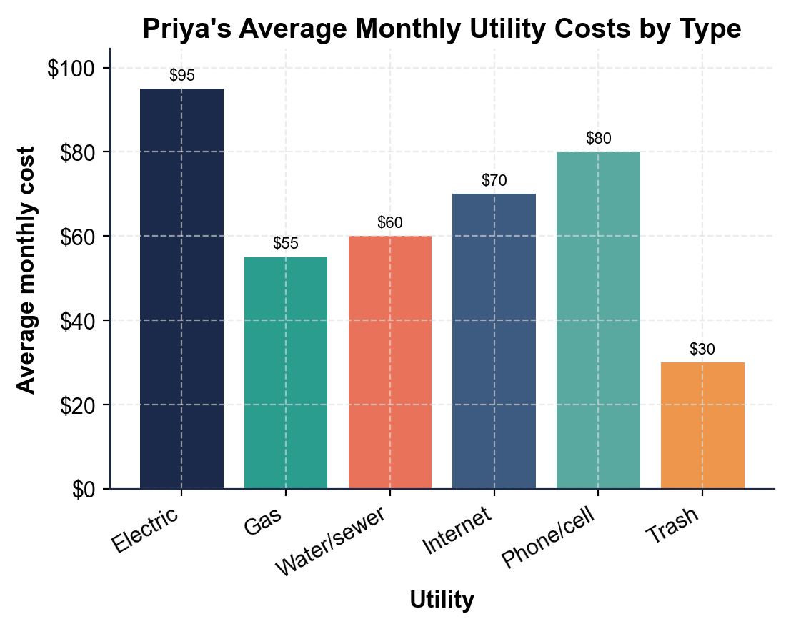
Priya's Average Monthly Utility Costs by Type
Priya's six monthly utility bills total $390; electric is the biggest at $95.
© More Lessons Less Planning | morelessonslessplanning.com
Notes:
Give students a moment to read the six bars on their own before discussing. The bar chart shows Priya's average monthly utility costs by type: ELECTRIC at $95 (the tallest bar), PHONE/CELL at $80, INTERNET at $70, WATER/SEWER at $60, GAS at $55, and TRASH at $30 (the shortest bar). Point out the ranking from tallest to shortest: electric, phone, internet, water, gas, trash. Work the takeaways live. The six bars add to $390 - Priya's total monthly utility total, the amount she budgets every month on top of rent. Note the point that helps students plan: electric is the biggest because it is a variable cost that rises with use, so it is the bill Priya has the most power to lower; trash is the smallest and is a fixed cost she cannot change much. This is the chart Activity Part 4 reads and analyzes; students will read all six bars, name the biggest and smallest, and add them to confirm the $390 monthly total.
Reference labels (point to these chart features when teaching): Electric biggest: $95; Six bills total: $390

Slide 10
Saving on Utilities
Use less, pay less
Because electric and water are VARIABLE COSTS, using less power and water lowers those bills
✔
Energy efficiency helps
ENERGY EFFICIENCY means using less power to lower your electric and gas bills - LEDs and a smart thermostat
✔
Budget billing evens it out
BUDGET BILLING averages your bills into an equal monthly payment so winter spikes do not surprise you
✔
Shop your providers
Compare PROVIDERS for internet and phone; bundling or switching can lower a fixed cost
✔
Tip: Lower VARIABLE COSTS by using less; use BUDGET BILLING and ENERGY EFFICIENCY to keep bills steady and low.
© More Lessons Less Planning | morelessonslessplanning.com
Notes:
Teach the practical payoff: how to actually lower utility bills. Start with the variable costs, because those are the ones you can move: because electric and water are VARIABLE COSTS, using less power and water directly lowers those bills. Introduce ENERGY EFFICIENCY - using less power to lower your electric and gas bills - with concrete moves students can picture: LED bulbs, a smart thermostat, shorter showers, unplugging chargers. Teach a budgeting tool that smooths out the pain: BUDGET BILLING averages your bills into an equal monthly payment, so a big winter heating spike does not blow up one month's budget. Finally, teach shopping the fixed costs: compare PROVIDERS for internet and phone, because bundling or switching can lower a fixed cost that otherwise never changes on its own. Make the teaching point: you lower variable costs by using less, and you lower fixed costs by shopping around - two different strategies for two different kinds of bill. Key terms - Energy efficiency: using less power to lower bills. Budget billing: averaging bills into an equal monthly payment.

Slide 11
Calculate Your Utility Costs
Step 1 - Find the set-up cash
CASH TO SET UP = DEPOSITS + SETUP FEES - add the deposits and setup fees you owe up front
✔
Step 2 - Add the monthly total
MONTHLY UTILITY TOTAL = SUM OF EACH MONTHLY BILL - add up every monthly utility bill
✔
Step 3 - First-month cash
FIRST-MONTH CASH = CASH TO SET UP + MONTHLY UTILITY TOTAL - the cash you need the very first month
✔
Step 4 - Compare and plan
Compare the cash you need to what you have SAVED; if short, divide the gap by your weekly savings
✔
Key Concept: Find the cash to set up, add the monthly total for first-month cash, then compare to savings and plan the gap.
© More Lessons Less Planning | morelessonslessplanning.com
Notes:
Give students the exact repeatable math process they use in the Activity capstone to find and judge the cash a renter needs. Step 1: FIND THE SET-UP CASH using CASH TO SET UP = DEPOSITS + SETUP FEES - add the deposits and setup fees the renter owes up front. Step 2: ADD THE MONTHLY TOTAL using MONTHLY UTILITY TOTAL = SUM OF EACH MONTHLY BILL - add up every monthly utility bill. Step 3: FIND THE FIRST-MONTH CASH using FIRST-MONTH CASH = CASH TO SET UP + MONTHLY UTILITY TOTAL - because the very first month you pay both the one-time set-up cash and the first month of bills. Step 4, the judgment step: COMPARE AND PLAN - compare the cash the renter needs to what they have actually SAVED, and if they are short, divide the gap by their weekly savings to find how many weeks until they can afford it. Walk students through the Activity's Part 5 client: a renter who needs $680 the first month but has saved $500 is $180 short, and saving $60 a week, that is $180 / $60 = 3 more weeks. Tell students the Activity's final Part asks them to run exactly these four steps for a new client and decide whether that client is ready to move in.

Slide 12
Key Takeaways
Turning on UTILITIES takes cash up front - deposits plus setup fees
★
CASH TO SET UP = DEPOSITS + SETUP FEES; Priya's is $250 + $150 = $400
★
MONTHLY UTILITY TOTAL = the six bills added up; Priya's is $390 a month
★
Electric is the biggest bill (variable); trash is the smallest (fixed)
★
Lower bills with energy efficiency, budget billing, and shopping providers
★
© More Lessons Less Planning | morelessonslessplanning.com
Notes:
Read each takeaway and connect it back to the learning targets. T1 (the up-front cost) -> turning on utilities takes cash up front, deposits plus setup fees, before a single bill arrives. T2 (model 2) -> CASH TO SET UP = DEPOSITS + SETUP FEES; Priya's is $250 + $150 = $400, due once at move-in. T3 (model 1) -> MONTHLY UTILITY TOTAL = the six monthly bills added up; Priya's is $390 a month on top of rent. T4 (the chart) -> electric is the biggest bill and is a variable cost you can lower, while trash is the smallest and a fixed cost. T5 (saving) -> lower your bills with energy efficiency, budget billing, and shopping your providers. Close by returning to the opening question: students can now say what it costs to turn the utilities on and keep them running.

