Slide 1
Universal Basic Income: Free Money for Everyone?
Andrew Yang, Alaska, Stockton, and the $1000 a Month Question
© More Lessons Less Planning | morelessonslessplanning.com
Notes:
Open with the question on the title slide. Most students have heard 'free money' but think it's a joke. Tell them: one U.S. state has been doing it for 40 years, a 2020 presidential candidate ran on it, and a California city ran a real pilot. Today they will learn what UBI is, who has tried it, and whether it actually works. The answer is more complicated than either side wants to admit.

Slide 2
Learning Targets
Define UBI and identify recent U.S. proposals and pilots
★
Evaluate the Stockton SEED and Finland UBI experiments
★
Compare UBI to the existing safety net and the funding debate
★
© More Lessons Less Planning | morelessonslessplanning.com
Notes:
Read each target aloud. Tell students they will leave able to (1) define UBI and explain how it differs from food stamps or unemployment, (2) describe what Stockton ($500/month) and Finland (560 euros/month) actually found, and (3) walk through the math of what a $1,000/month national UBI would cost and how Yang proposed to pay for it. The lesson connects to TK90 (Wealth Inequality) and TK93 (Why Gen Z Can't Buy a House) - UBI is one proposed answer to the inequality story.

Slide 3
What is UBI? The Core Idea
Three Defining Features
How UBI Differs from Welfare
Universal: every adult gets it, no exceptions
Basic: enough to cover food, rent, the basics
Unconditional: no work or income requirement
SNAP requires income below 130% of poverty
Unemployment requires you lost a job
Medicaid requires income verification
UBI: no test, no phase-out, no paperwork
Key Concept: UBI replaces means-testing with universality - the government just cuts everyone the same check.
© More Lessons Less Planning | morelessonslessplanning.com
Notes:
Anchor the lesson on these three words: Universal, Basic, Unconditional. Universal means every adult citizen gets it - your billionaire neighbor and your unemployed neighbor get the same check. Basic means enough to cover food and rent (most proposals: $500-$1,500/month). Unconditional means no work requirement and no means-testing. This is the opposite of how the U.S. safety net works: SNAP requires income below ~130% of the federal poverty line, unemployment requires you lost a job, Medicaid requires income verification. UBI eliminates all of that. The argument FOR universality is administrative simplicity (no paperwork) and dignity (no stigma). The argument AGAINST is cost and work disincentives. Both arguments will return in the funding debate. KEY VOCABULARY: Universal basic income (UBI) = a government cash payment given to every adult, no strings attached, regardless of income or employment status. A means-tested benefit = a safety-net program that requires income or asset verification (SNAP, Medicaid, Section 8), the opposite of UBI. A phase-out = when a benefit gets reduced as income rises (SNAP cuts off above 130 percent of the poverty line); UBI eliminates these by giving cash to everyone.

Slide 4
The Yang $1000/Month Freedom Dividend
What
Andrew Yang's 2020 presidential campaign proposed $1,000 per month to every U.S. adult age 18+
Total cost
About $2.8 trillion per year for ~235 million eligible adults
How to pay
10% value-added tax (VAT) on goods and services; estimated to raise about $800B per year
Job-loss argument
AI and automation will displace truckers, retail workers, and clerks faster than new jobs replace them
Political fate
Yang dropped out before primaries; UBI moved from fringe to mainstream Democratic conversation
Big Idea: Yang made UBI the first major national U.S. policy proposal since the 1970s - even after he lost the 2020 race.
© More Lessons Less Planning | morelessonslessplanning.com
Notes:
Andrew Yang ran for the 2020 Democratic presidential nomination on UBI. His proposal: $1,000 per month to every U.S. adult age 18+, funded by a 10 percent value-added tax (VAT) on goods and services. Total cost: ~$2.8 trillion per year for ~235 million adults. The VAT would raise ~$800 billion per year, with the rest funded by economic growth, consolidation of some welfare programs (recipients would choose UBI OR existing benefits), and a financial transactions tax. Yang's central argument was AUTOMATION DISPLACEMENT - he repeatedly pointed to truckers (3.5M jobs at risk), retail clerks (8.5M), and call-center workers as professions about to be eliminated by AI. He polled at low single digits and dropped out before primaries, but he moved UBI from fringe to mainstream Democratic conversation. The chart on the next slide compares his proposal to other UBI cost estimates. KEY VOCABULARY: A value-added tax (VAT) = a consumption tax charged at each stage of production; Yang proposed a 10 percent rate to fund the Freedom Dividend. Automation displacement = the concern that AI and robots will replace human workers faster than new jobs are created, a key driver of Yang's UBI argument.

Slide 5
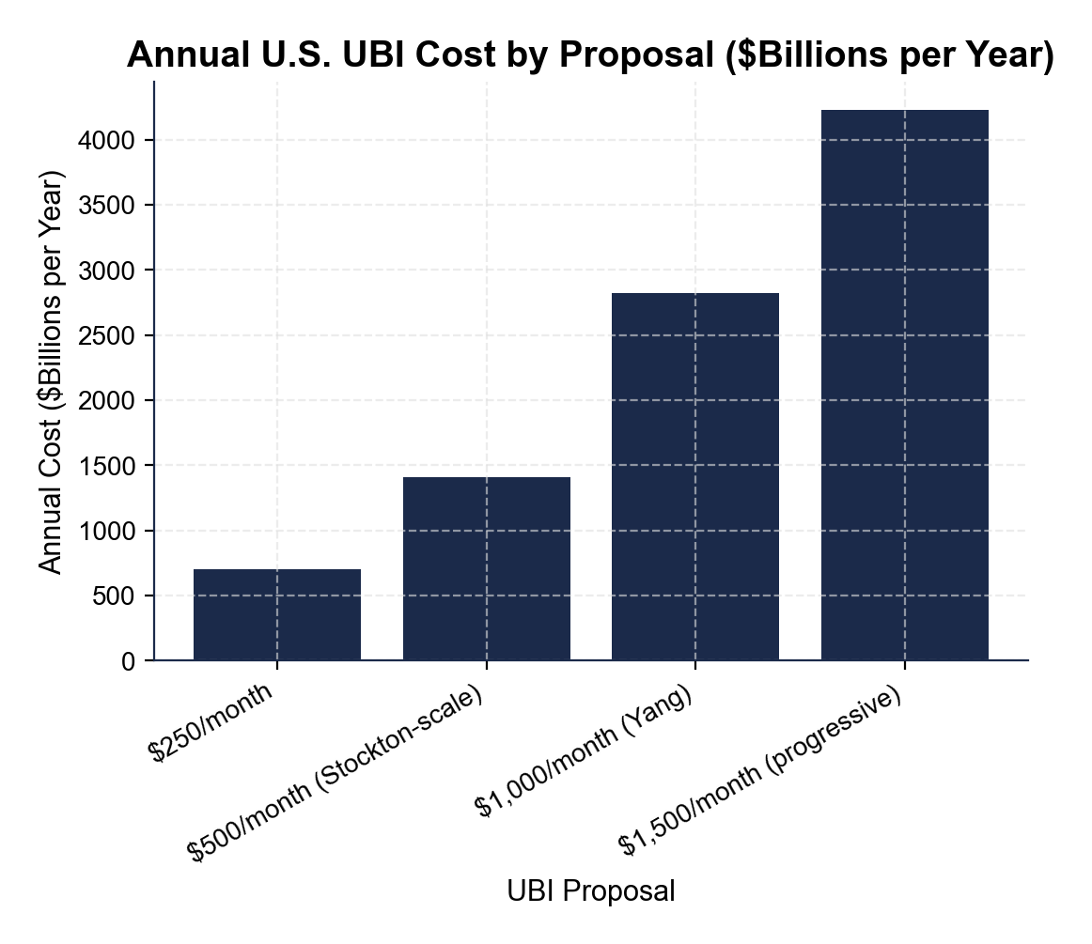
UBI Cost Estimates by Proposal
Note: Annual cost in $billions for major U.S. UBI proposals to all adults.
© More Lessons Less Planning | morelessonslessplanning.com
Notes:
Read the bars left to right by amount. Yang's $1,000/month Freedom Dividend would cost approximately $2,820B per year (~$2.8 trillion). A $500/month Stockton-scale national UBI would cost about $1,410B (~$1.4 trillion). A $250/month minimum proposal would cost about $705B. A $1,500/month proposal (advocated by some progressive economists) would cost about $4,230B (~$4.2 trillion). For comparison, the entire 2024 federal Social Security budget was about $1.5 trillion and total federal spending was about $6.8 trillion. Even the smallest proposal here ($250/month) is roughly 10 percent of the federal budget. Activity Part 3 Q1 and Q2 ask students to read these values directly off the chart and compare them to the federal budget.
Reference labels (point to these chart features when teaching): Yang $1000/mo ~$2.8T; Stockton-scale ~$1.4T

Slide 6
Alaska's Permanent Fund - The Only Real U.S. UBI
Started
1976 (fund); 1982 (first dividend payment)
Funding source
Oil revenue invested in stocks and bonds; the fund holds about $80 billion in 2024
Annual payout
Every Alaska resident gets a check; payouts ranged from about $300 to $3300 per person
Eligibility
Lived in Alaska 12+ months and intend to stay; including children; no income test
Political support
Supported by Republicans and Democrats; one of the most popular state programs in U.S. history
Tip: Alaska proves a real UBI can be funded and run for 40+ years - if you have a sovereign wealth fund.
© More Lessons Less Planning | morelessonslessplanning.com
Notes:
The Alaska Permanent Fund Dividend (PFD) is the closest thing to a real UBI in U.S. history. The Alaska Permanent Fund itself was created in 1976 to invest oil revenues from the Trans-Alaska Pipeline; the first dividend was paid in 1982. Every Alaska resident who lived there 12+ months and intends to stay gets the same check (children included). Payouts have ranged from ~$300 (low-oil years) to ~$3,300 (2022, after a special bonus). The fund is now ~$80 billion in invested assets. Politically, the PFD is bulletproof: every Alaskan governor for 40+ years (Republican and Democratic) has defended it. The PFD is small - usually $1,000-$2,000 per person per year - but it shows that universal cash payments are administratively feasible and politically durable when funded by a sovereign wealth fund. The chart on the next slide shows payouts year-by-year. KEY VOCABULARY: A sovereign wealth fund = a government-owned investment fund (Norway $1.6T, Alaska $80B); the Alaska Permanent Fund Dividend pays from one of these. The Alaska Permanent Fund Dividend = an annual cash payment to every Alaska resident from oil-revenue investments, the closest thing to a real UBI in U.S. history (since 1982).

Slide 7
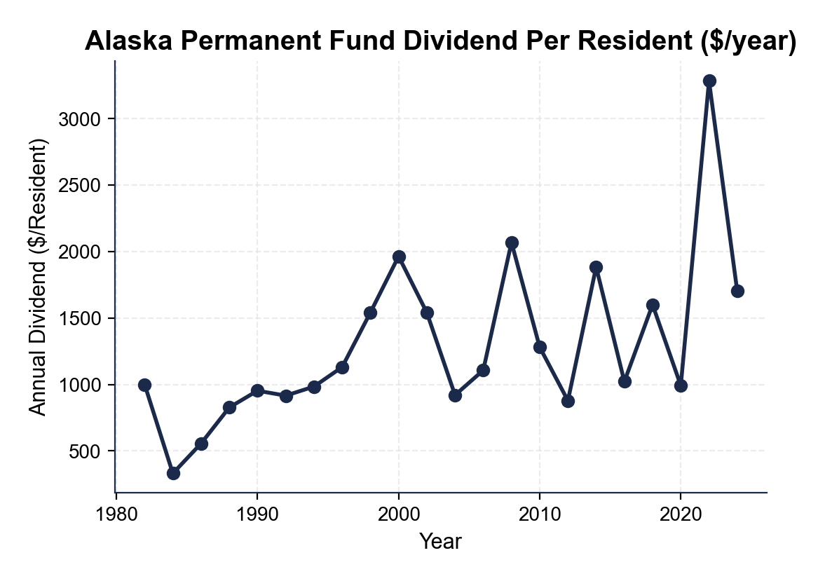
Alaska Permanent Fund Payouts 1982-2024
Note: Annual dividend per resident; volatile because oil prices swing.
© More Lessons Less Planning | morelessonslessplanning.com
Notes:
Read the line left to right. The first PFD payment in 1982 was about $1,000. Payouts swung from a low of ~$300 (1984) to a peak of about $3,300 (2022, after a special legislative bonus). The bumpy pattern reflects oil prices and fund returns - high oil years produce bigger dividends. The 40-year average is roughly $1,200 per Alaskan per year. The fund itself has grown from a few billion in 1982 to about $80 billion in 2024, even while paying out tens of billions in dividends. Activity Part 3 Q3 and Q4 ask students to read peak and low values from this chart and calculate average payouts.
Reference labels (point to these chart features when teaching): Peak ~$3,300 (2022); Low ~$300 (1984)

Slide 8
Stockton SEED - $500/Month Pilot Results
What Happened
What They Found (Phase 1, Year 1)
125 randomly selected Stockton residents
$500 per month for 24 months (2019-2021)
Mayor Michael Tubbs led the pilot
Privately funded; no work requirement
Phase 1 full-time employment: 28% to 40% (control ~32-37%, roughly flat)
Top spending: food, utilities, transportation
Less than 1% on alcohol or tobacco
Phase 2 (Year 2) hit COVID; gains did not replicate
Did You Know? Stockton SEED Phase 1 found employment ROSE - opposite of critics' prediction. But the pilot was small (n=125) and Phase 2 hit COVID.
© More Lessons Less Planning | morelessonslessplanning.com
Notes:
The Stockton Economic Empowerment Demonstration (SEED) was the first mayor-led UBI pilot in the U.S. Stockton Mayor Michael Tubbs (then 28, the youngest mayor of a major city) launched it in February 2019. 125 residents in low-income neighborhoods were randomly selected to receive $500 per month for 24 months, no strings attached. Funding was private (Economic Security Project and others); evaluation was led by researchers at the Center for Guaranteed Income Research (UPenn-affiliated). PHASE 1 RESULTS (Year 1, Feb 2019-Feb 2020): full-time employment ROSE from 28 percent to 40 percent among recipients (compared to a roughly flat 32-to-37 percent in the n=200 control group). Anxiety and depression dropped substantially. Most spending categories: food (37 percent), sales/merchandise (22 percent), utilities (11 percent), and auto (10 percent). Less than 1 percent of recipient spending was on alcohol or tobacco - cutting against the 'they will waste it' critique. PHASE 2 (Year 2, Feb 2020-Jan 2021) overlapped with the COVID-19 economic shock; the Phase 1 employment gains did NOT replicate cleanly in Phase 2, and the headline effect attenuated. CAVEATS to flag for students: (a) small sample (n=125 treatment, n=200 control); (b) Phase 2 was COVID-confounded; (c) privately funded with a close program-evaluator relationship; (d) one pilot in one city cannot tell us what a permanent national UBI would do. Skeptical economists (Hoynes & Rothstein; Mankiw; analysts at AEI and Mercatus) argue that 125 people for 24 months is too small to settle the work-disincentive question at national scale. The Stockton pilot inspired ~100 similar mayor-led UBI experiments nationwide. KEY VOCABULARY: Work disincentive = the economic concern that giving people unconditional cash reduces their incentive to take a paid job; it is the central UBI critique, and the Stockton and Finland pilots were designed to test it.

Slide 9
Finland's 2017-2018 UBI Experiment
Sample
2000 randomly selected unemployed Finns ages 25-58 (not all citizens)
Amount
560 euros per month, no work or job-search requirements, paid for two years
Employment effect
Tiny but positive: 6 extra days of work per year vs the control group
Wellbeing effect
Significantly better mental health, life satisfaction, and trust in institutions
Why it ended
Two-year funding ran out; Finland did not scale it nationwide
Real Talk: Finland did NOT find massive employment gains - but it did NOT find work disincentives either.
© More Lessons Less Planning | morelessonslessplanning.com
Notes:
Finland's 2017-2018 UBI experiment was the first national-government UBI pilot in the modern era. The Finnish social-security agency Kela randomly selected 2,000 unemployed Finns ages 25-58 (the experiment was limited to unemployed people, so it was a partial UBI). Each received 560 euros per month for two years with no work requirement and no job-search requirement - critically, the payments did NOT phase out if recipients found work. Headline finding: recipients worked 6 days more per year on average than the control group - a tiny but statistically positive employment effect. Wellbeing effects were larger and clearer: significantly better self-reported mental health, life satisfaction, trust in institutions, and trust in other people. Finland did NOT scale to a nationwide program - the two-year experiment ended on schedule and the funding was not renewed. The big takeaway: UBI does NOT seem to cause the work disincentive critics feared, but the labor-market effects are small.

Slide 10
The Funding Debate - How Do You Pay for UBI?
Cost reality
$1,000/month UBI for 235M adults = ~$2.8 trillion/year - 40% of the federal budget
Yang's plan
10% VAT (~$800 billion/year) + welfare consolidation + a financial transactions tax
Sovereign wealth fund
Alaska's model: invest resource revenue, pay dividends - works for resource-rich states
Wealth tax option
A 2% tax on wealth over $50M could partially fund a smaller UBI
Welfare replacement
Most plans make recipients choose UBI OR existing benefits, not both
Key Concept: The funding question is the hardest part of UBI - the math has never closed for a U.S.-scale program.
© More Lessons Less Planning | morelessonslessplanning.com
Notes:
The funding question is where most UBI plans break down. Yang's Freedom Dividend ($1,000/month for 235M adults = $2.82 trillion/year) is roughly 40 percent of the entire federal budget. Yang proposed paying with: (1) 10 percent VAT raising ~$800B/year, (2) welfare consolidation - recipients would choose UBI OR existing means-tested benefits; because Yang's plan was OPT-IN, independent scorers (Tax Foundation, UBI Center, Roosevelt Institute) estimate consolidation savings at $200-400B/year, not the $500-600B Yang's campaign claimed (high-benefit recipients like disabled adults or families with large SNAP/Medicaid usage typically would NOT opt in), (3) a financial transactions tax (~$50B/year), (4) carbon fees (~$50B/year), and (5) projected economic growth from increased consumer spending. Even with all those, every independent score of the plan leaves a hole of $1 trillion or more per year. The Alaska model (sovereign wealth fund from oil) only works if you have a giant resource to extract - it doesn't scale to most U.S. states or to the federal level. A wealth tax (Warren proposed 2 percent on wealth over $50M) raises ~$100-200B per year - enough for a partial UBI. The honest answer: the math has never closed for a U.S.-scale UBI.

Slide 11
UBI vs Targeted Welfare - The Trade-Off
✔
UBI advantage 1
Eliminates phase-outs - SNAP cuts off at 130% of poverty, creating high marginal tax rates
✔
UBI advantage 2
Administrative simplicity - no income verification, caseworkers, or fraud checks
✔
Targeted advantage 1
Money goes to those who need it most - $1,000 for a billionaire is wasted
✔
Targeted advantage 2
Existing programs (Medicaid, SNAP) work; UBI replacement could leave the poorest worse off
✔
Closest existing program: EITC
EITC - cash refunds to low-income workers; closest partial UBI, work-conditioned
✔
Historical precedent: NIT
Friedman's 1960s 'negative income tax' - cash below an income line; UBI ancestor
Key Point: UBI vs targeted welfare is the central design question - universal simplicity vs targeted help. The EITC is the closest partial UBI.
© More Lessons Less Planning | morelessonslessplanning.com
Notes:
The core policy debate is UBI versus targeted welfare. UBI's TWO BIG ADVANTAGES: (1) eliminates phase-outs - means-tested programs cut off as income rises, creating effective marginal tax rates of 50-90 percent for low-income workers (lose SNAP, lose Medicaid, lose Section 8 all at once when you take a job); UBI never phases out, so you keep every dollar you earn. (2) administrative simplicity - no income verification, no caseworkers, no eligibility forms; the IRS could deliver UBI through existing tax infrastructure. TARGETED WELFARE'S TWO BIG ADVANTAGES: (1) money goes to people who need it most; a $1,000 check to a billionaire is wasted; means-testing concentrates aid where it matters. (2) existing programs are mature and effective - Medicaid pays health bills, SNAP buys food, Section 8 pays rent; replacing them with cash leaves recipients to navigate complex insurance and housing markets. The HYBRID option (keep existing programs + add a smaller UBI of $250-500/month) is what many serious economists now propose. KEY VOCABULARY: A negative income tax = a 1960s economist proposal (Milton Friedman) to give cash to households below an income threshold, the intellectual ancestor of modern UBI. The earned income tax credit (EITC) = a refundable U.S. tax credit for low-income workers, the closest existing program to a partial UBI for working households.

Slide 12
Key Takeaways
UBI = universal, basic, unconditional cash; opposite of means-tested welfare
★
Yang's $1000/month Freedom Dividend would cost ~$2.8 trillion/year
★
Alaska's Permanent Fund has paid every resident $300-3300/year since 1982
★
Stockton and Finland found small or zero work-disincentive effects in pilots
★
The funding math is the hardest part - U.S.-scale UBI has never balanced
★
© More Lessons Less Planning | morelessonslessplanning.com
Notes:
Read each takeaway. Connect back to learning targets. Ask students which of the UBI proposals - Yang's $1,000/month, Stockton's $500/month, or Alaska's PFD model - they would advise the senator to champion in the activity. The activity puts them in the role of Maya Chen, a policy advisor briefing a senator who has to vote on three UBI-related bills in two weeks: a Yang-style federal Freedom Dividend, a smaller hybrid UBI of $400/month layered on existing welfare, and a federal sovereign wealth fund modeled on Alaska.

