Slide 1
Unions: Power in Numbers
From 33% to 10% - and the surprise comeback at Starbucks, Amazon, and the auto plants.
© More Lessons Less Planning | morelessonslessplanning.com
Notes:
Open with the headline number: about 1-in-3 U.S. workers were union members in 1955; today only 1-in-10 are. Then surface the surprise: after decades of decline, NLRB union election filings jumped 53% in FY2022, and high-profile organizing wins landed at Starbucks, Amazon, and the Big 3 automakers.

Slide 2
Learning Targets
Define a LABOR UNION and explain COLLECTIVE BARGAINING
★
Trace U.S. union membership from the 1955 peak (~33%) to today (9.9%)
★
Evaluate Starbucks, Amazon, and UAW organizing - and the pros-and-cons debate
★
© More Lessons Less Planning | morelessonslessplanning.com
Notes:
Read all three aloud. Target 1 = vocabulary + definition. Target 2 = chart reading off the line and bar charts in the activity. Target 3 = present BOTH SIDES of the union debate in Activity Part 4.

Slide 3
What Is a Labor Union?
A group of workers organized to bargain TOGETHER with the employer
Negotiates one written CONTRACT covering wages, benefits, hours, safety
Once certified (majority vote), it represents ALL workers in that unit
Federal law: the employer MUST bargain in good faith
Key concept: one worker alone has no legal right to bargain. A union turns one worker's complaint into a contract issue.
© More Lessons Less Planning | morelessonslessplanning.com
Notes:
Define a labor union concretely. The key shift is from individual to collective: one worker can ask for a raise; a union NEGOTIATES one contract that covers everyone. Federal law (NLRA 1935) gives unions this power and requires the employer to bargain in good faith.

Slide 4
Collective Bargaining: How It Works
The Bargaining Cycle
When Bargaining Stalls
Union elects a bargaining committee
Committee meets the employer at the table
Both sides exchange written proposals
Workers VOTE to ratify the deal
Union's biggest leverage: the STRIKE
Threat of lost production pressures employer
~95% of contracts settle WITHOUT a strike
Strike fund pays workers during walkout
Important: the credible THREAT of a strike is what makes the bargaining serious in the first place.
© More Lessons Less Planning | morelessonslessplanning.com
Notes:
Walk the negotiation cycle. The union elects a bargaining committee, meets the employer, exchanges proposals on wages, health insurance, scheduling, discipline, and safety. When both sides reach a tentative deal, the workers vote to ratify. If talks stall, the union can call a strike.

Slide 5
The 1950s Peak: ~1-in-3 Workers Were Union
1935 NLRA (Wagner Act): legal right to organize
1955 peak: 33.2% of U.S. workers were union members
Strong postwar manufacturing economy = strong unions
Steel, auto, mining, trucking - all heavily unionized
Fact: at the 1955 peak, roughly 1 in 3 American wage earners belonged to a union.
© More Lessons Less Planning | morelessonslessplanning.com
Notes:
Set up the line chart on the next slide. The 1935 NLRA created the legal right to organize; combined with the postwar manufacturing boom, U.S. unions hit a historic peak in the mid-1950s at about 33% of all wage and salary workers. The big industrial unions (steel, auto, mining) were the backbone.

Slide 6
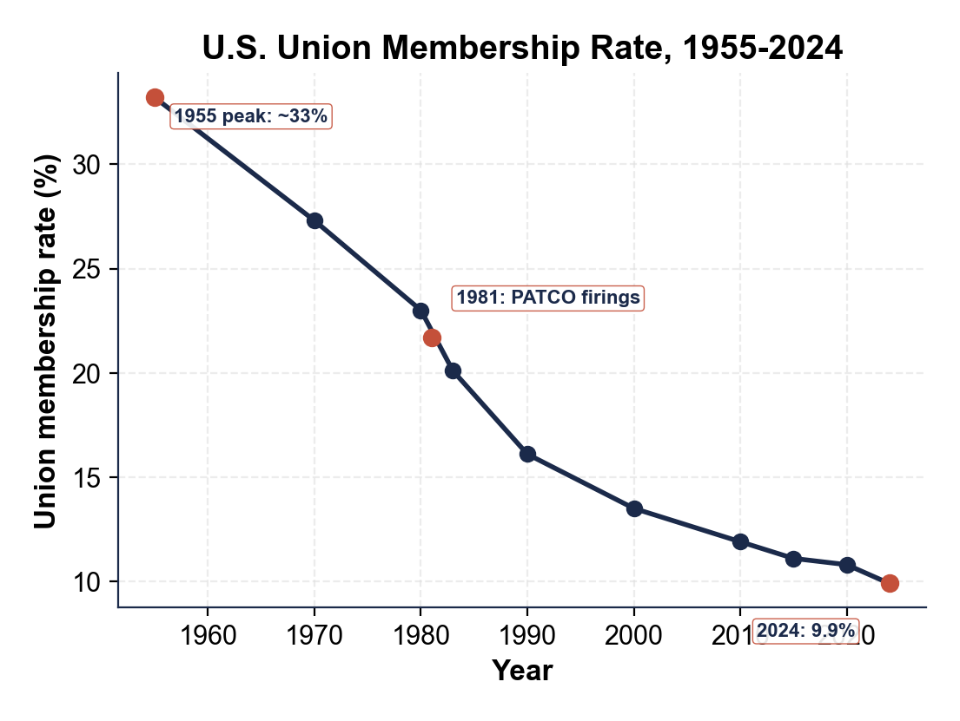
U.S. Union Membership Rate, 1955-2024
BLS: union rate fell from 33.2% in 1955 to 9.9% in 2024.
© More Lessons Less Planning | morelessonslessplanning.com
Notes:
Image-only reference slide. The chart shows the steady decline of U.S. union membership from the 1955 postwar peak (~33%) to today (9.9%). The line drops in every decade with no single break point - structural shift, not one event.
Reference labels (point to these chart features when teaching): 1955 peak: ~33%; Today: 9.9%

Slide 7
Why Unions Declined Post-1980
PATCO 1981: Reagan fires 11,345 striking air traffic controllers
Deindustrialization: factories shut down or moved overseas
Right-to-work laws spread (now 26 states)
Service-sector growth - retail and fast food HARDER to organize
Total drop from peak: 23.3 percentage points (33.2% in 1955 to 9.9% in 2024)
Note: no single cause of the decline. It's a structural shift across the whole economy.
© More Lessons Less Planning | morelessonslessplanning.com
Notes:
Walk through the main forces: 1981 PATCO signaled to private-sector firms that aggressive anti-union responses were now politically safe; deindustrialization wiped out the heavy-union manufacturing base; right-to-work laws spread to 26 states; the service-sector employers that replaced factories are harder to organize because workers are spread across thousands of small locations.

Slide 8
Where Unions Still Concentrate: By State
Top 5 States (2024)
Bottom 5 States (2024)
Hawaii: 26.5%
New York: 20.6%
Washington: 19.4%
Alaska: 18.7%
New Jersey: 17.5%
North Carolina: 2.4%
South Dakota: 2.7%
South Carolina: 2.8%
Arkansas: 3.5%
Utah: 3.7%
Fact: a worker in Hawaii is roughly 11 times more likely to be in a union than a worker in North Carolina.
© More Lessons Less Planning | morelessonslessplanning.com
Notes:
Set up the bar chart on the next slide. National union density is 9.9% but states vary from 2.4% (North Carolina) to 26.5% (Hawaii). The split is partly explained by right-to-work laws - all bottom-5 states are RTW; none of the top-5 are.

Slide 9
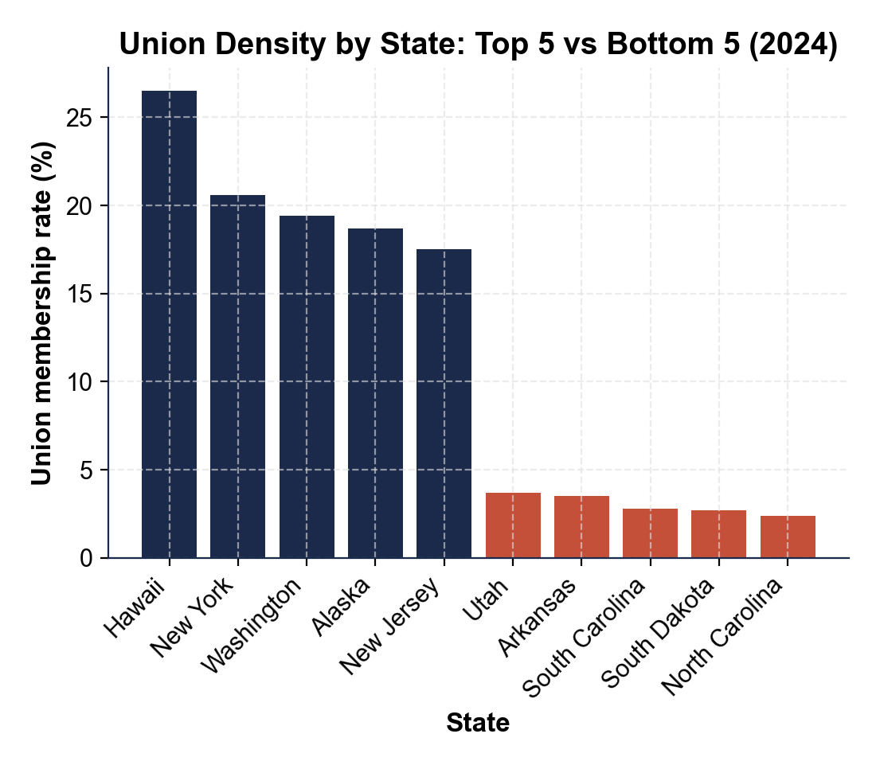
Union Density: Top 5 vs Bottom 5 States (2024)
BLS 2024: Hawaii leads at 26.5%; North Carolina lowest at 2.4%.
© More Lessons Less Planning | morelessonslessplanning.com
Notes:
Image-only reference slide. The navy bars on the left are the highest-density states (Hawaii 26.5%, NY 20.6%, WA 19.4%, AK 18.7%, NJ 17.5%); the coral bars on the right are the lowest (NC 2.4%, SD 2.7%, SC 2.8%, AR 3.5%, UT 3.7%). Visual punchline: about a 24-point gap between top and bottom; all bottom-5 are right-to-work.
Reference labels (point to these chart features when teaching): Top 5: 17-27%; Bottom 5: 2-5%

Slide 10
Revival #1: Starbucks Workers United (Dec 2021 ->)
First store voted yes: BUFFALO, NY - December 9, 2021
Independent worker-led union (not affiliated initially)
Spread to 400+ stores in roughly 3 years
Feb 2024: Starbucks agreed to bargain a framework deal
By 2024 about 400 Starbucks stores had organized through Workers United
Real talk: organizing one Starbucks store doesn't sound huge - but 400+ stores in 3 years is the fastest big-employer wave in decades.
© More Lessons Less Planning | morelessonslessplanning.com
Notes:
First post-pandemic organizing wave. Starbucks Workers United began with one Buffalo store on Dec 9, 2021. The model spread store-by-store across 400+ locations. After two years of legal fights, the company agreed in Feb 2024 to bargain a framework agreement covering the unionized stores. As of 2025, store-level contracts are still being negotiated.

Slide 11
Revival #2: Amazon Labor Union at JFK8 (Apr 2022)
The Historic Election
What's Happened Since
JFK8: Amazon Staten Island warehouse
Election: April 1, 2022
Vote: YES 2,654 to NO 2,131
FIRST successful Amazon union in U.S.
Amazon contested through 2022-2023
NLRB upheld the result
Bargaining has been slow - no contract yet
Mid-2024: ALU affiliated with Teamsters
Fact: ALU was an INDEPENDENT union - not affiliated with the AFL-CIO or any major federation at the time of the win.
© More Lessons Less Planning | morelessonslessplanning.com
Notes:
Independent worker-led union at Amazon's JFK8 warehouse in Staten Island. The NLRB election on April 1, 2022 was the first successful Amazon union vote in U.S. history (2,654-2,131). Amazon contested the result through 2022-2023; the NLRB upheld it. Bargaining has been slow - ALU later affiliated with the Teamsters in mid-2024 to gain resources.

Slide 12
Revival #3: UAW Stand-Up Strike (Sept-Oct 2023)
United Auto Workers vs Ford, GM, and Stellantis (Big 3)
Dates: September 15 - October 30, 2023 (~6 weeks)
New tactic: STAND-UP STRIKE - selected plants, expanding
Won: 25% wage hikes, COLA restored, ENDED tiered pay
Key point: the UAW won the BIGGEST auto contract gain in decades by striking SMART - not by walking out everywhere at once.
© More Lessons Less Planning | morelessonslessplanning.com
Notes:
The 2023 UAW Stand-Up Strike against Ford, GM, and Stellantis. New tactic: instead of pulling out all members at every plant on Day 1, the UAW called targeted strikes at selected plants and expanded as bargaining stalled. Won 25% cumulative wage hikes over the 4.5-year contract, restored cost-of-living adjustments (COLA), and ended the tiered pay schedule that paid new hires less.

Slide 13
Revival #4: Hollywood Double Strike (2023)
WGA (Writers)
SAG-AFTRA (Actors)
May 2 - September 27, 2023 (148 days)
First WGA strike since 2007
Won AI guardrails on script use
Won minimum TV writers' room staffing
July 14 - November 9, 2023 (118 days)
First dual writers+actors strike since 1960
Won AI-likeness consent rules
Won higher streaming residual pay
Real talk: the writers and actors went out OVER artificial intelligence - the first major strike to put AI protections in a union contract.
© More Lessons Less Planning | morelessonslessplanning.com
Notes:
The 2023 Hollywood strikes - Writers Guild of America from May 2 through September 27 (148 days); SAG-AFTRA actors from July 14 through November 9 (118 days). First dual writers + actors strike since 1960. Key wins included guardrails on AI-generated scripts and performances, higher streaming residuals, and minimum staffing rules for TV writers' rooms.

Slide 14
Strikes: How Economic Leverage Actually Works
Workers stop working = employer stops earning revenue
Every day out: workers lose pay, employer loses production
Strike fund: union pays members reduced wages while out
Public sympathy + media coverage can pressure the company
About 95% of union contracts settle WITHOUT a strike
Tip: a strike is a TEST of who can hold out longer - the workers without paychecks, or the employer without production.
© More Lessons Less Planning | morelessonslessplanning.com
Notes:
Strikes are the union's biggest source of economic leverage. The basic math: when workers stop working, the employer stops earning. Workers lose pay but receive partial wages from a strike fund (built from member dues over time). Public sympathy and media coverage add pressure. Most contracts settle without a strike; when strikes happen, they end when one side concludes the cost of holding out exceeds the cost of compromise.

Slide 15
Reference Guide Terms - Group 1 (Foundations)
Labor union
Workers organized to bargain together over wages, benefits, hours, and safety. Certified by NLRB majority vote.
NLRA (Wagner Act)
1935 federal law giving private-sector workers the right to organize, bargain, and strike. Created the NLRB.
Collective bargaining
The negotiation between a union and the employer to set wages, benefits, and rules in a written contract.
Tip: these three terms anchor the whole lesson - what a union IS, the law that makes it legal, and the process it uses.
© More Lessons Less Planning | morelessonslessplanning.com
Notes:
Reference Guide terms group 1 - the foundational legal and definitional terms. Tested in Part 2 of the activity.

Slide 16
Reference Guide Terms - Group 2 (Process)
Creating a Union
Removing a Union
NLRB ELECTION: secret-ballot vote
Simple majority wins (yes = certified)
BARGAINING UNIT: workers the union represents
Usually one workplace or job type
DECERTIFICATION: workers vote to REMOVE union
Same election process, opposite direction
Majority yes = union loses bargaining status
Petitions filed in a narrow contract window
Tip: certification creates a union; decertification removes one. Same election process, opposite direction.
© More Lessons Less Planning | morelessonslessplanning.com
Notes:
Reference Guide terms group 2 - the process terms covering union creation and removal. Tested in Part 2.

Slide 17
Reference Guide Terms - Group 3 (Tools + Data)
Strike
Coordinated work stoppage by union members to pressure the employer. Leverage = lost production every day workers are out.
Union density
Share of wage and salary workers who are union members. U.S. density was 33.2% in 1955 and 9.9% in 2024.
Union premium
Wage gap between union and non-union workers in similar jobs. BLS: union workers earn ~10-15% more per hour.
Right-to-work law
State law letting workers in a unionized workplace opt out of dues. 26 U.S. states are right-to-work.
Tip: STRIKE is the union's biggest economic tool; UNION DENSITY is the headline data; PREMIUM is the wage payoff; RTW is the policy variable.
© More Lessons Less Planning | morelessonslessplanning.com
Notes:
Reference Guide terms group 3 - the tools, data, and policy terms. Completes the 10-term vocabulary tested in Part 2.

Slide 18
Key Takeaways
Unions bargain COLLECTIVELY - one contract for all workers in the unit
★
Union density fell from 33% (1955) to 9.9% (2024) - structural shift
★
PRO-UNION: ~10-15% wage premium, better benefits, voice in conditions
★
ANTI-UNION: dues cost, less flexibility, RTW debate over forced representation
★
REVIVAL: Starbucks (2021), Amazon JFK8 (2022), UAW (2023), Hollywood (2023)
★
© More Lessons Less Planning | morelessonslessplanning.com
Notes:
Recap. Define a union (collective bargaining over a written contract). Recall the historical arc (33% peak in 1955; 9.9% today). Surface BOTH SIDES honestly - the wage premium and worker voice on one side, the dues cost and flexibility concerns on the other. Close with the recent revival as the evidence that the long decline may not be permanent.

