Slide 1
Unemployment Rate: How It's Calculated
Who counts as unemployed - and why the official rate hides millions of workers who want a job but are not in the labor force
© More Lessons Less Planning | morelessonslessplanning.com
Notes:
Open with a hook. Tell students: 'The U.S. unemployment rate is about 4.1% right now - sounds great, right? But there are about 7 million unemployed Americans actively looking for work, AND another 6 million who want a job but are not officially counted. That is more than 13 million people - a population the size of Pennsylvania. Why does the headline number leave them out?' Today's lesson teaches who is counted, who is NOT counted, the math behind U-3, and the broader U-6 measure that captures discouraged workers and underemployment. Students will compute both rates in the activity from real BLS-style data.

Slide 2
Learning Targets
Calculate the unemployment rate from labor force data
★
Distinguish U-3 (official) from U-6 (broader measure)
★
Identify who is and isn't counted in the official unemployment rate
★
© More Lessons Less Planning | morelessonslessplanning.com
Notes:
Read each target aloud. Connect target 1 to slides 3-5 (the formula and labor force definition). Connect target 2 to slide 6 (U-3 vs U-6) and slides 10-11 (the long-run chart). Connect target 3 to slides 7-8 (discouraged workers and underemployment). Tell students this is the most-watched economic indicator in the world - every first Friday of the month the BLS jobs report moves stock markets, signals recessions, and shapes Federal Reserve policy.

Slide 3
What Unemployment Actually Means
Unemployed means ALL THREE:
NOT Unemployed (just no job)
Without a job in the reference week
AVAILABLE to start work right now
ACTIVELY looked in the last 4 weeks
Retirees, students, stay-at-home parents
People who gave up looking
People who would take a job but did not look
People in prison or full-time military
Key Concept: To be officially UNEMPLOYED you must be jobless AND available AND actively looking. Miss any one and you are NOT counted.
© More Lessons Less Planning | morelessonslessplanning.com
Notes:
Set up the official BLS definition. To be counted as UNEMPLOYED requires THREE conditions: (1) without a job, (2) available to start work in the reference week, and (3) actively looked for work in the past 4 weeks. 'Actively looked' means a real job-search action - submitting an application, going to an interview, contacting an employer. Just thinking about looking does not count. Just browsing job postings does not count. The reference week is the calendar week containing the 12th of the month. The BLS interviews about 60,000 households in the Current Population Survey (CPS) and asks these questions. Anyone who fails any one of the three conditions is NOT counted as unemployed - they are either employed or NOT IN THE LABOR FORCE. This is the conceptual key to the lesson: the unemployment rate is a measure of ACTIVE job-seekers, not of everyone who wants a job.

Slide 4
The Labor Force: Who Counts
Civilian noninstitutional population (16+)
Everyone 16+ not in the military or an institution. About 270 million people.
Labor force = Employed + Unemployed
All 16+ people working OR actively looking for work. About 170 million people.
Not in the labor force
Everyone 16+ neither working nor looking. About 100 million (retirees, students, discouraged workers).
Labor force participation rate
Labor force / population x 100. Currently about 63% in the U.S.
The denominator matters
The rate uses the LABOR FORCE as the denominator, NOT the total population, so people who stop looking fall out.
Big Idea: Labor force = employed + unemployed. Everyone else is 'not in the labor force' - including people who WANT jobs but stopped looking.
© More Lessons Less Planning | morelessonslessplanning.com
Notes:
Walk through the labor-force hierarchy. The CIVILIAN NONINSTITUTIONAL POPULATION (about 270 million Americans 16+) splits into TWO groups: the LABOR FORCE (about 170 million who are either working OR actively looking) and NOT IN THE LABOR FORCE (about 100 million - retirees, students, stay-at-home parents, and discouraged workers). The LABOR FORCE itself splits into EMPLOYED (~163 million) and UNEMPLOYED (~7 million). The labor force participation rate is labor force / population x 100 = 170/270 x 100 = ~63%. This number has been falling for two decades, partly because the Baby Boomers are retiring. The KEY DENOMINATOR INSIGHT: the unemployment rate uses the labor force in the denominator (not the total population). So if someone gives up looking for work, they leave the labor force - the numerator goes down (one less unemployed) AND the denominator goes down (one less in the labor force). The result: the unemployment rate FALLS, even though no one got a job. This is the conceptual core of why U-3 understates unemployment.

Slide 5
The Unemployment Rate Formula
Formula
Unemployment Rate = (Unemployed / Labor Force) x 100
Labor Force
Employed + Unemployed (NOT the total population)
U.S. example (2026)
Unemployed = 7.0M; Labor Force = 170M; Rate = (7.0 / 170) x 100 = 4.1%
What it does NOT include
Discouraged workers (stopped looking), part-time workers who want full-time, retirees who would take a job
The x 100
Converts the fraction (0.041) to a percent (4.1%). The #1 student error is dropping the x 100.
Key Concept: Unemployment Rate = (Unemployed / Labor Force) x 100. The x 100 converts the fraction to a percent.
© More Lessons Less Planning | morelessonslessplanning.com
Notes:
The most important formula of the lesson: UNEMPLOYMENT RATE = (UNEMPLOYED / LABOR FORCE) x 100. Walk through it slowly. Step 1: Find UNEMPLOYED (the numerator). In 2026 U.S. data, about 7 million people are jobless AND available AND actively looking. Step 2: Find LABOR FORCE (the denominator). That is employed + unemployed = 163M + 7M = 170M. Step 3: Divide and multiply by 100. (7 / 170) x 100 = 0.0412 x 100 = 4.12%, which rounds to 4.1%. The x 100 converts the decimal fraction to a percent - the #1 student error is dropping it and reporting 0.041% instead of 4.1%. Drill the formula. Students will compute the rate three times in the activity from different scenarios (a normal year, a recession year, and a recovery year).

Slide 6
U-3 vs U-6: The Broader Measure
U-3 (Official) ~4.1%
U-6 (Broader) ~7.6%
Counts only ACTIVELY LOOKING
Numerator: 7M unemployed
Denominator: 170M labor force
(7 / 170) x 100 = 4.1%
U-3 + discouraged + part-time wanting full-time
Numerator: 7M + 1.5M + 4.5M = 13M
Denominator: 170M + 1.5M = 171.5M
(13 / 171.5) x 100 = 7.6%
Big Idea: U-6 is usually about 1.8 times U-3 (ratio of 1.8 ). The headline U-3 hides millions who want a job.
© More Lessons Less Planning | morelessonslessplanning.com
Notes:
The BLS publishes SIX unemployment measures, U-1 through U-6. U-3 is the official headline rate. U-6 is the broadest measure. U-6 adds three groups to U-3: (1) marginally attached workers (people who looked in the last year but not the last 4 weeks, includes discouraged workers), about 1.5 million; (2) part-time for economic reasons (people working part-time who would prefer full-time but cannot find it), about 4.5 million. So in 2026 U.S. data: U-6 numerator = 7M unemployed + 1.5M marginally attached + 4.5M involuntary part-time = 13M. U-6 denominator = labor force (170M) + marginally attached (1.5M) = 171.5M. (The 4.5M involuntary part-time are ALREADY in the labor force because they are employed; we only add the marginally attached to the denominator since they were not in the labor force originally.) U-6 = (13 / 171.5) x 100 = 7.58%, rounds to 7.6%. U-6 is almost always about 1.8x U-3 - the headline rate hides about half the people who want more work. Economists who write about labor markets often cite both.

Slide 7
Discouraged Workers (NOT Counted in U-3)
Definition
People who want a job and looked in the past year but stopped looking, believing no jobs are available.
Why they are NOT in U-3
U-3 requires actively looked in the last 4 weeks; discouraged workers stopped, so they leave the labor force.
Effect on U-3
When workers stop looking the unemployment rate FALLS - numerator and denominator drop - even with no new jobs.
Approximate count (2026)
About 500,000 discouraged workers; about 1.5M total marginally attached (the broader group).
Where they ARE counted
U-4 adds discouraged workers, U-5 adds all marginally attached, and U-6 adds involuntary part-time too.
Tip: A FALLING unemployment rate can mean MORE jobs OR fewer people looking. Check the labor force participation rate to tell the difference.
© More Lessons Less Planning | morelessonslessplanning.com
Notes:
Define DISCOURAGED WORKERS precisely. They want a job, they looked at some point in the last 12 months, but they stopped looking in the last 4 weeks because they believe no suitable jobs exist for them. Maybe they think their skills are obsolete, or their region has no openings, or they have been told they are overqualified or underqualified too many times. Whatever the reason, they stopped actively looking - and that means they fall out of the U-3 measure entirely. The key teaching point: when discouraged workers leave the labor force, the U-3 rate FALLS, even though employment did not rise. Numerator drops (one fewer unemployed) AND denominator drops (one fewer in labor force). This is why economists watch the LABOR FORCE PARTICIPATION RATE alongside the unemployment rate. A falling U-3 plus a falling participation rate often means discouraged workers leaving the labor force, NOT a healthier economy. The 2020 COVID period showed this dramatically - U-3 hit 14.7% in April 2020 then fell rapidly, but participation fell too as workers exited the labor force.

Slide 8
Underemployment: Working Part-Time When You Want Full-Time
Counted as EMPLOYED in U-3
Why this matters
Working 1+ hour for pay
Counts even if it is one hour a week
Even if you want full-time but cannot find it
About 4.5M Americans work part-time involuntarily
U-3 treats them the same as full-time workers
U-6 includes them as 'underemployed'
Hides true labor market slack
Did You Know? If you work just 1 hour for pay in the reference week, you count as EMPLOYED - even if you wanted full-time work and could not get it.
© More Lessons Less Planning | morelessonslessplanning.com
Notes:
Define UNDEREMPLOYMENT. To be counted as EMPLOYED by the BLS, you only need to work ONE HOUR for pay during the reference week. That means a person working 5 hours a week at a coffee shop while desperately trying to find a 40-hour-a-week job in their field counts as EMPLOYED in U-3 - exactly the same as a full-time engineer. The BLS calls this group PART-TIME FOR ECONOMIC REASONS (sometimes 'involuntarily part-time'). It is about 4.5 million Americans in 2026. These people are not counted as unemployed in U-3 because they have a job. But they would clearly say they are underemployed. U-6 captures them by adding them to the numerator (while leaving the denominator alone, since they were already in the labor force as employed). The teaching point: U-3 is a narrow measure - either you are working (any amount) or you are actively looking. U-6 captures the gray area where workers are technically employed but want more work.

Slide 9
Reading the Monthly Jobs Report
When it drops
First Friday of every month at 8:30 AM Eastern, from the BLS.
Number 1: Nonfarm payrolls
Jobs added that month, from a survey of 130,000 businesses.
Number 2: Unemployment rate
The U-3 rate, from a survey of 60,000 households.
Healthy growth
About 150,000-200,000 new jobs per month keeps up with population growth; below 100,000 is weak.
Watch the revisions
BLS revises the prior two months; a big downward revision can flip a strong report weak.
Tip: Two surveys feed the jobs report. Payrolls (jobs added) come from BUSINESSES. The unemployment rate comes from HOUSEHOLDS.
© More Lessons Less Planning | morelessonslessplanning.com
Notes:
Teach the monthly jobs report. The BLS releases the Employment Situation Report on the first Friday of every month at 8:30 AM Eastern. It contains TWO main data points from two separate surveys: (1) NONFARM PAYROLLS - the net change in jobs (from the Current Employment Statistics survey of about 130,000 businesses). (2) UNEMPLOYMENT RATE - U-3 (from the Current Population Survey of about 60,000 households). Healthy job growth is about 150,000-200,000 per month - enough to keep up with population growth. Below 100,000 is weak. Negative is recession. The two surveys CAN disagree because they measure different things from different respondents. A common pattern: payrolls strong but unemployment rate ticks up because the labor force grew (more people looking). The report also revises the prior two months - sometimes massively. A jobs report can look strong on Friday and weak after revisions a month later. The Federal Reserve watches both the jobs number and the unemployment rate when setting monetary policy.

Slide 10
U-3 vs U-6 Over Time
U-3 (Lower Line)
U-6 (Higher Line)
2000: ~4.0%
2009 recession peak: ~10.0%
April 2020 COVID peak: ~14.7%
2026: ~4.1%
Always above U-3 (about 1.8x)
2009 recession peak: ~17.1%
April 2020 COVID peak: ~22.8%
2026: ~7.6%
Key Concept: U-6 captures the workers U-3 misses. Both spike in recessions but U-6 reveals the true depth of labor-market slack.
© More Lessons Less Planning | morelessonslessplanning.com
Notes:
Setup for the U-3 vs U-6 chart on the next slide. Two lines: U-3 (the official headline, lower) and U-6 (the broader measure, higher). Both follow the same pattern - rising in recessions and falling in expansions - but U-6 is always ABOUT 1.8 times U-3. Three points to emphasize: (1) The 2007-2009 Great Recession: U-3 peaked around 10% in October 2009; U-6 peaked at 17.1%. The gap was 7 percentage points - millions of marginally attached and underemployed workers. (2) The April 2020 COVID shock: U-3 spiked to 14.7% (the highest since the Great Depression), U-6 spiked to 22.8%. The labor market collapsed in a single month. (3) The 2026 normal: U-3 at 4.1%, U-6 at 7.6%. Even in a healthy economy, U-6 reveals about 6 million more workers (discouraged + marginally attached + involuntarily part-time) that U-3 misses. Students will read approximate values for these three periods directly off the chart in the activity Part 4.

Slide 11
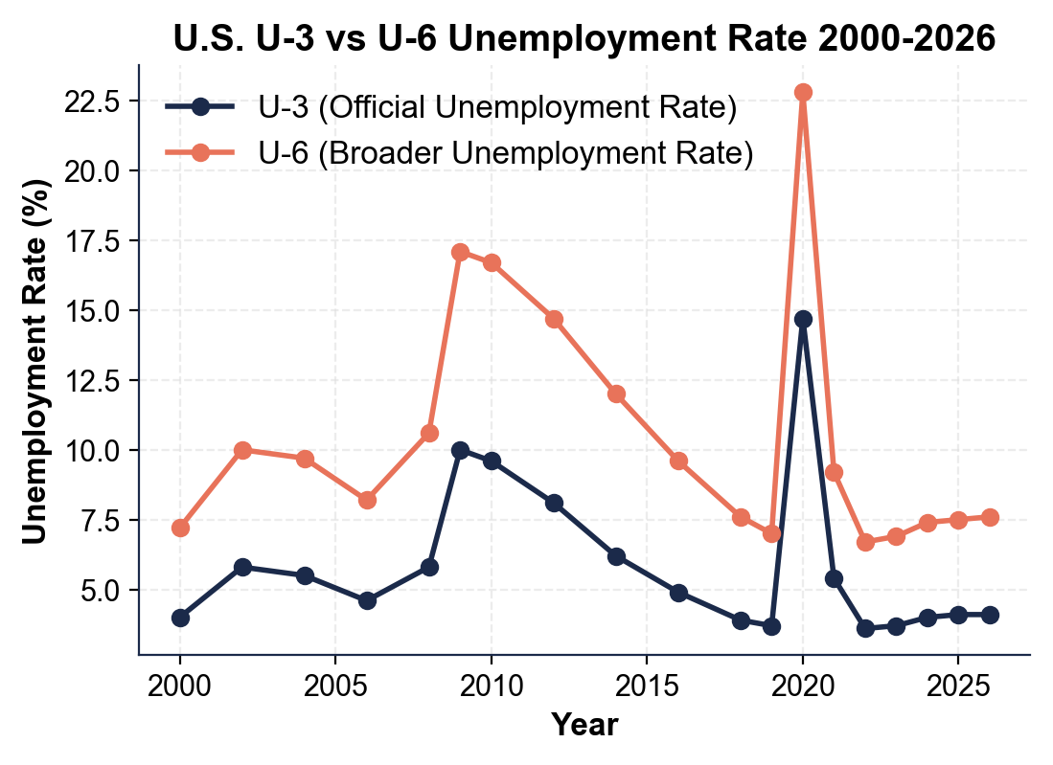
U-3 vs U-6 Unemployment Rate 2000-2026
Note: U-6 always above U-3. Both spike in 2009 and again in April 2020.
© More Lessons Less Planning | morelessonslessplanning.com
Notes:
Read the chart. Two lines: U-3 (the official headline, lower, ranging from about 3.5% to 14.7%) and U-6 (the broader measure, higher, ranging from about 7.0% to 22.8%). Both follow recession-expansion cycles. The 2009 peak: U-3 ~10%, U-6 ~17%. The April 2020 COVID spike: U-3 ~14.7%, U-6 ~22.8% - the largest single-month spike on record. The 2026 'normal' values: U-3 ~4.1%, U-6 ~7.6%. The chart makes one teaching point visually obvious: U-6 is ALWAYS higher than U-3, by roughly 3-8 percentage points depending on the cycle. Activity Part 4 will have students extract values for the 2009 peak, the April 2020 peak, and 2026.
Reference labels (point to these chart features when teaching): 2009 peak: U-3 ~10%, U-6 ~17%; Apr 2020: U-3 14.7% U-6 22.8%

Slide 12
Monthly Job Creation 2020-2026
The COVID Collapse
Monthly Averages by Year
March 2020: -1.7 million jobs
April 2020: -20.5 million jobs (worst ever)
May 2020: +2.7 million (start of recovery)
June 2020: +4.8 million
2021: about 610 thousand per month
2022-2023: 400K, 250K (normalizing)
2024-2026: 200K, 170K, 150K
Healthy benchmark: 150-200K
Big Idea: A typical 'good' jobs month is +150K to +200K. April 2020 was -20.5 MILLION. The COVID labor market shock has no historical comparison.
© More Lessons Less Planning | morelessonslessplanning.com
Notes:
Setup for the monthly jobs bar chart on the next slide. The chart shows nonfarm payroll change for the four critical COVID months (March-June 2020) and then annual averages for 2021-2026. The headline event: the April 2020 COVID lockdown - a single-month loss of about 20.5 million jobs, the worst on record (the prior worst was about 800,000 in a single month during the 2008-09 recession). May 2020 began the recovery (+2.7 million jobs), June 2020 +4.8 million. 2021 averaged ~610K/month as the economy continued recovering. 2022 averaged ~400K, 2023 ~250K, 2024 ~200K, 2025 ~170K, 2026 ~150K - the recovery has normalized to the BLS healthy benchmark of 150-200K. Students will read directly off the chart: identify the April 2020 trough, the recovery month, and the typical 2026 monthly job creation level. They will also compare 2026 to the healthy benchmark.

Slide 13
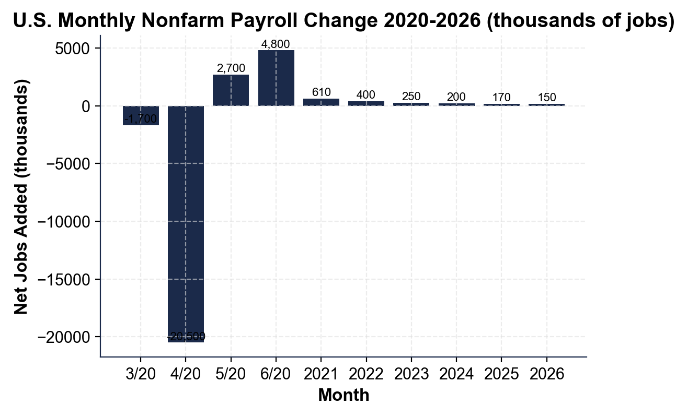
Monthly Nonfarm Payroll Changes 2020-2026
Note: April 2020 = -20.5M jobs (off the chart). Recovery starts May 2020.
© More Lessons Less Planning | morelessonslessplanning.com
Notes:
Read the chart. Bar chart showing monthly nonfarm payroll change from 2020 through 2026. The April 2020 bar dominates the entire chart at -20.5 million jobs. May 2020 begins the recovery at +2.7M. June 2020: +4.8M. July 2020: +1.8M. By mid-2022 the U.S. had recovered all 22 million lost jobs. The 2023-2026 period shows a normalized pattern with most months between +100K and +300K. Activity Part 4 will have students identify the April 2020 trough, the recovery month, and the typical 2026 monthly job-creation level. The chart makes one teaching point obvious: nothing in postwar U.S. economic history compares to the COVID labor market shock.
Reference labels (point to these chart features when teaching): April 2020: -20.5M; Typical 2026: +150K

Slide 14
Key Takeaways
Unemployment Rate = (Unemployed / Labor Force) x 100 (memorize this formula)
★
UNEMPLOYED = jobless AND available AND actively looking in last 4 weeks
★
Labor force = employed + unemployed (NOT the total population)
★
U-3 is the official headline rate (~4.1%); U-6 is the broader measure (~7.6%)
★
A falling U-3 can mean MORE JOBS or FEWER PEOPLE LOOKING - check participation
★
© More Lessons Less Planning | morelessonslessplanning.com
Notes:
Read each takeaway aloud. Connect to learning targets. Target 1 (calculate): takeaway 1 - the formula. Target 2 (distinguish U-3 from U-6): takeaway 4 - the official versus broader measure. Target 3 (identify who is and isn't counted): takeaways 2, 3, 5 - the active-looking requirement, the labor force denominator, and the warning that a falling rate can hide discouraged workers. The activity Part 5 final policy memo will require students to apply the distinction to a real-world claim about a 'historically low' unemployment rate.

