Slide 1
Trauma and Recovery: The Psychology of September 11
Psychology - September 11 and Its Legacy
© More Lessons Less Planning | morelessonslessplanning.com
Notes:
Open by naming the research question, not the event itself: how did psychologists study who was affected and why some people recovered faster than others? Documentary tone throughout; this is population-level science, not personal storytelling.

Slide 2
Learning Targets
Explain how experts found out who was affected.
★
Explain the difference between acute stress and PTSD.
★
Name things that raise or lower the risk of lasting harm.
★
Explain why most people get better after a hard event.
★
Describe how the government set up mental health help.
★
© More Lessons Less Planning | morelessonslessplanning.com
Notes:
Read target 2 aloud twice; the acute-stress/PTSD distinction is the hinge the rest of the lesson turns on and it is graded in the Guided Notes and the quiz.

Slide 3
A Question Psychologists Had to Answer
After 9/11, researchers confronted a basic question: who was affected?
Millions saw news coverage, but only some had direct exposure.
Researchers needed a way to study reactions across a whole population.
Federal agencies and universities launched surveys in the years after.
This lesson traces that research: exposure, reactions, risk, and response.
Key Concept: This lesson studies patterns in population-level data, not individual survivor accounts.
© More Lessons Less Planning | morelessonslessplanning.com
Notes:
Keep this framing-only. No incident narrative, no graphic detail. The goal is to set up the research question the rest of the deck answers.

Slide 4
Counting Who Was Affected
population exposure model
a way of grouping an affected population by how directly each group met the event
Did You Know: A systematic grouping let researchers compare very different levels of exposure.
© More Lessons Less Planning | morelessonslessplanning.com
Notes:
This is the only slide in the deck where the phrase 'population exposure model' appears - keep it off every other slide so the term stays teachable from this sentence alone.

Slide 5
Rings of Exposure
Exposure Group | What They Faced
On-site responders and workers | Direct exposure to the attack sites during rescue, recovery, and cleanup operations.
Evacuated survivors | Present in or near the buildings and evacuated during the attacks.
Nearby residents and students | Lived, worked, or attended school close enough to see or hear the attacks directly.
Bereaved family members | Lost a family member or close friend in the attacks.
The watching public | Followed the events through television and other media, often repeatedly.
Remember: The closer a group was to direct exposure, the more intensive the mental health response they typically needed.
© More Lessons Less Planning | morelessonslessplanning.com
Notes:
Keep each row at the mechanism level - who the group was and how they encountered the event - without describing what any group witnessed in detail.

Slide 6
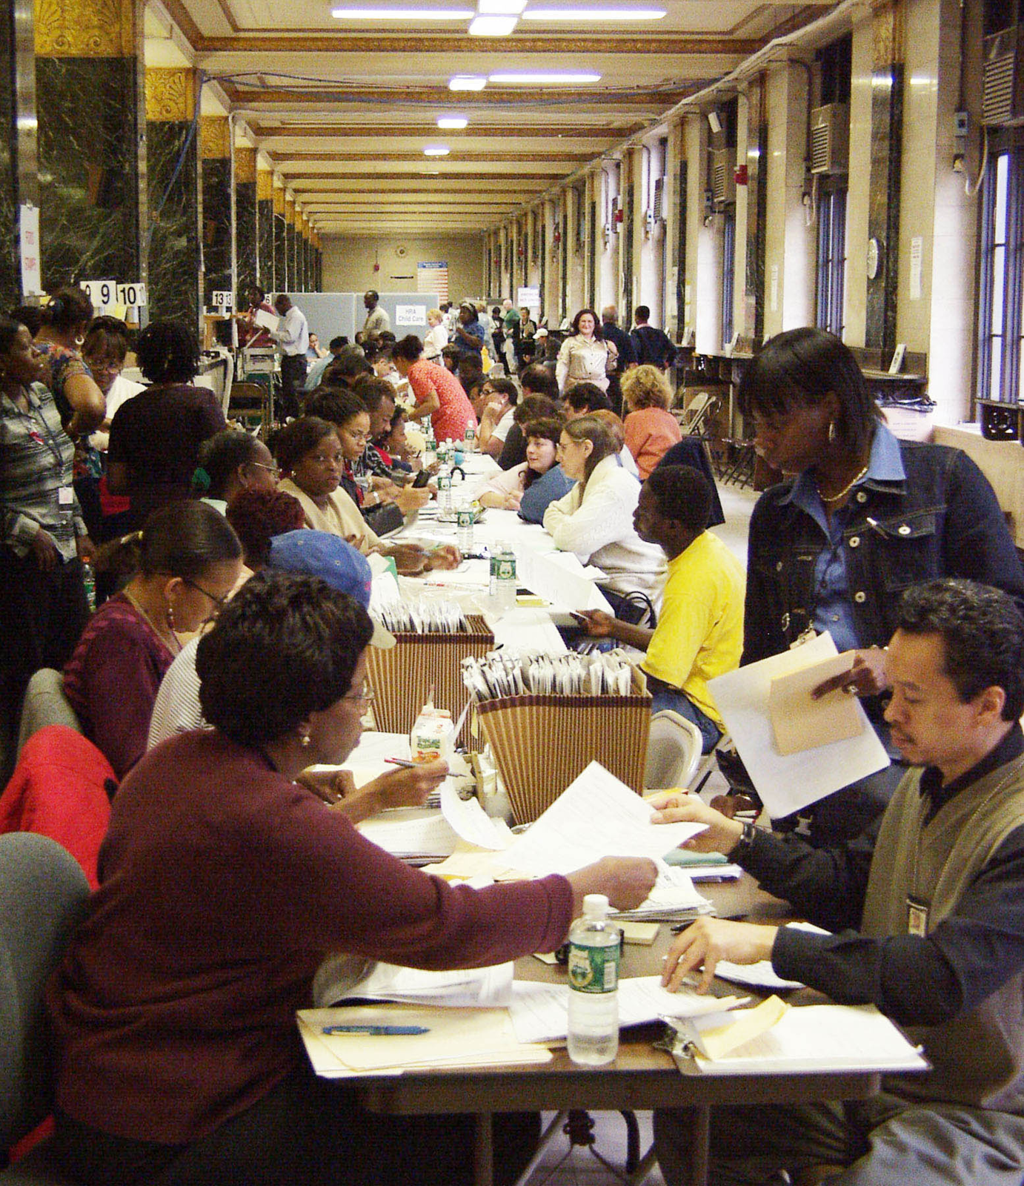
A Disaster Assistance Service Center
A Disaster Assistance Service Center, New York City, 2001. FEMA News Photo.
© More Lessons Less Planning | morelessonslessplanning.com
Notes:
Give the class ten seconds with the picture, then point out how many staffed tables it took to process one city's worth of paperwork.
Reference labels (point to these chart features when teaching): Rows of staffed tables; Public filling out forms

Slide 7
What Normally Happens First
traumatic stress
the set of physical and emotional reactions that follow a terrifying event
acute stress reaction
an intense short-term response that starts within hours or days and usually fades
Tip: Most early reactions are the body's normal alarm system responding to danger, not a sign of lasting harm.
© More Lessons Less Planning | morelessonslessplanning.com
Notes:
Keep both definitions on this slide only in this exact phrasing; the exact term 'traumatic stress' should not reappear on the surrounding timeline or PTSD slides.

Slide 8
The Usual Course Over Time
Time After the Event | What Reactions Typically Look Like
First hours to days | Shock, difficulty concentrating, trouble sleeping, and a heightened startle response are common.
First few weeks | Sleep, focus, and mood usually improve as routines return and social support kicks in.
After about a month | Most people report their difficulties have faded substantially or resolved.
Beyond a month, for a minority | A smaller group continues to struggle and may need clinical support.
Key Concept: For most survivors, reactions ease with time and support - lasting difficulty is the exception, not the rule.
© More Lessons Less Planning | morelessonslessplanning.com
Notes:
This slide is the pivot the lesson keeps returning to: most reactions fade, a minority persist. Do not name the lasting condition yet - that is the next slide.

Slide 9
Who Usually Notices First
Family and Friends
People close to a survivor may notice a change in mood or behavior before the survivor names it.
✔
School and Work
A drop in attendance, focus, or performance can be an early signal to a teacher or a supervisor.
✔
Primary Care
A routine doctor visit for an unrelated reason is where some survivors are first screened.
✔
Survey Self-Report
Surveys that simply ask survivors how they are doing remain one of the most direct sources.
✔
Note: Multiple channels - family, school, work, and screening - catch different survivors at different times.
© More Lessons Less Planning | morelessonslessplanning.com
Notes:
This bridges the timeline on the previous slide to the persisting condition on the next: it is usually someone else, or a routine check, that first flags a pattern worth a closer look.

Slide 10
When It Does Not Fade
post-traumatic stress disorder
a lasting condition in which trauma symptoms continue past a month and disrupt daily life
hyperarousal
a keyed-up state in which the body stays braced for danger long after the threat has passed
Remember: This is treatable, not a sign of weakness or a permanent state.
© More Lessons Less Planning | morelessonslessplanning.com
Notes:
Keep the full phrase 'post-traumatic stress disorder' off the timeline slide before this one and the comparison slide after it; use 'the lasting condition' there instead.

Slide 11
The Short-Term Reaction or the Lasting Condition?
The short-term reaction
The lasting condition
Begins within a day or two of the event.
Usually eases within about a month.
May include trouble sleeping and jumpiness.
Symptoms continue past the one-month mark.
Disrupts school, work, or relationships over time.
Affects a minority of survivors, not most.
Note: Time course is the key difference - not whether stress reactions happen, but how long they last.
© More Lessons Less Planning | morelessonslessplanning.com
Notes:
Use only the paraphrases 'the short-term reaction' and 'the lasting condition' on this slide; keep both full vocabulary phrases off it.

Slide 12
Same Event, Different Outcomes
Two individuals can meet the same event and respond very differently.
SAMHSA, the federal mental health services agency, documented this pattern.
Some recover quickly, others take longer - both patterns are normal.
Researchers asked: what explains the difference between these paths?
The rest of this lesson answers that using population-level research.
Did You Know: No single factor decides how a person will respond - researchers study a whole set of conditions together.
© More Lessons Less Planning | morelessonslessplanning.com
Notes:
Keep this at the population-research level. Do not ask students to speculate about their own reactions to a frightening event.

Slide 13
Conditions That Raise Vulnerability
risk factor
a condition that raises the chance a survivor will develop long-term difficulties
Remember: Prior traumatization, an earlier psychiatric or substance-abuse history, and a higher degree of exposure are examples researchers tracked.
© More Lessons Less Planning | morelessonslessplanning.com
Notes:
Keep the exact phrase 'risk factor' off the slides immediately before and after this one; use 'predictor' or 'condition' there instead.

Slide 14
The Balance Adds Up
Single Predictor
One condition, such as a previous psychiatric history, nudges vulnerability up or down on its own.
✔
Accumulated Weight
Having several conditions present at once shifts the balance further than any one condition does.
✔
Both Directions
The same set of conditions also includes things that protect a person, not only things that raise exposure to harm.
✔
Whole Pattern
Researchers look at a survivor's whole pattern of conditions, not one condition in isolation.
✔
Tip: Think of it as a scale - each predictor adds a small weight to one side or the other.
© More Lessons Less Planning | morelessonslessplanning.com
Notes:
Do not print the phrase 'risk factor' on this slide; use 'predictor' and 'condition' consistently to keep the giveaway off this page.

Slide 15
What Helps People Bounce Back
protective factor
a condition that lowers the chance a survivor will develop long-term difficulties
resilience
the capacity to understand, tolerate, and cope with the aftermath of severe trauma
Key Concept: Social support is one of the strongest protective factors researchers have identified.
© More Lessons Less Planning | morelessonslessplanning.com
Notes:
Keep the word 'resilience' off the checklist slide before this one and the recovery slide after it; use 'recovery' or 'bouncing back' there instead.

Slide 16
Why Most People Recover
A normal response
Time and support help
A minority need more
Most stress and grief reactions after a disaster are normal, not illness.
They are not a sign of weakness or a mental illness.
The body and mind are doing what they are built to do.
Family, friends, and community support speed up recovery.
Routines like school and work give people structure to rebuild around.
Most people report feeling better within weeks to months.
A smaller group of survivors develops lasting difficulty.
This group benefits from additional clinical support.
Researchers use this pattern to plan how many services a community will need.
Note: Most people recover without needing formal treatment - but a minority group needs it, and services have to be ready for both.
© More Lessons Less Planning | morelessonslessplanning.com
Notes:
Keep the word 'resilience' off this slide - use 'recover' and 'bouncing back' instead - since that vocabulary term is taught on the previous slide.

Slide 17
Designing the Response
psychological first aid
practical early support that meets basic needs and steadies people without forcing them to talk
Did You Know: The guiding rule for providers is to do no harm - never make a survivor's situation worse.
© More Lessons Less Planning | morelessonslessplanning.com
Notes:
Emphasize that this approach explicitly does not ask survivors to describe what happened; it is about immediate practical stabilization.

Slide 18
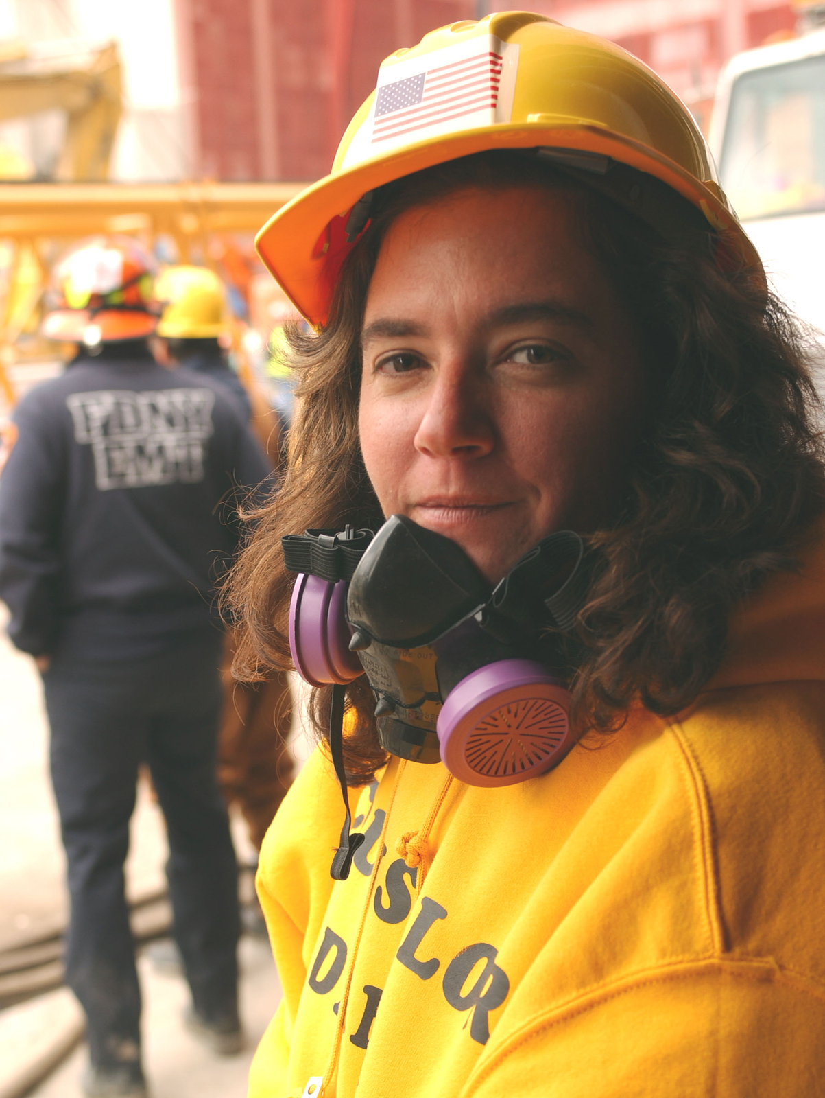
Support Where People Already Are
A volunteer offers support at the WTC site, September 2001. FEMA News Photo.
© More Lessons Less Planning | morelessonslessplanning.com
Notes:
Point out that the setting is outdoors at the work site, not a clinic - that is the whole point of meeting people where they already are.
Reference labels (point to these chart features when teaching): Protective gear; On-site work setting

Slide 19
Help That Comes to You
crisis counseling
short-term supportive help delivered where survivors already are instead of in a clinic
Tip: This kind of support meets people at shelters, schools, and community centers rather than requiring an office visit.
© More Lessons Less Planning | morelessonslessplanning.com
Notes:
Keep the exact phrase 'crisis counseling' off the slides immediately before and after this one; the previous image slide already avoids it.

Slide 20
The Long Term
Federal Funding
Congress and federal agencies funded mental health programs that continued for years afterward.
✔
Schools and Workplaces
Longer-term support reached people through the institutions they already used every day.
✔
Outcome Research
Scientists followed survivors for years to see how their reactions changed and what treatments helped.
✔
Range of Needs
Some survivors needed only a few sessions of support; others needed years of ongoing clinical care.
✔
Remember: Recovery support did not end when news coverage did - programs continued for years.
© More Lessons Less Planning | morelessonslessplanning.com
Notes:
Keep this factual and documentary. No policy commentary or partisan framing; the point is simply that support extended well past the emergency phase.

Slide 21
Key Takeaways
Researchers grouped survivors by how directly each group met the event.
★
Most early stress reactions are normal and fade within weeks to a month.
★
A minority develop a lasting condition, often linked to specific risk factors.
★
Protective factors and resilience explain why most people recover fully.
★
Support ran from practical steadying to short-term help to years of care.
★
© More Lessons Less Planning | morelessonslessplanning.com
Notes:
Close by tying the five takeaways back to the five learning targets in order; each takeaway answers one target directly.

