Slide 1
Totem Poles and the Potlatch of the Pacific Northwest
How a Coast With No Alphabet Kept the Record Straight
© More Lessons Less Planning | morelessonslessplanning.com
Notes:
Open with the question the whole lesson answers: if nobody on this coast wrote anything down, how did everyone know who held which rank?

Slide 2
Learning Targets
Explain what a crest column records and who has the right to raise one.
★
Explain how a potlatch claimed and confirmed standing in front of witnesses.
★
Use Boas's own words to describe how property worked as a record.
★
Name who set a record down, when, and from what standpoint.
★
Judge what these records can and cannot settle about the coast.
★
© More Lessons Less Planning | morelessonslessplanning.com
Notes:
Read target three aloud and stop on it. Students will be quoting a named source, not repeating a summary.

Slide 3
A Coast With No Alphabet
The Pacific Northwest Coast runs from Alaska south to northwestern California.
The Tlingit, Haida, and Kwakwaka'wakw nations live along that coast.
Kwakwaka'wakw was historically written "Kwakiutl" in older reports.
None of these nations used an alphabet or wrote on paper.
They still kept exact track of rank, family, and story.
Key Concept: No alphabet is not the same thing as no record.
© More Lessons Less Planning | morelessonslessplanning.com
Notes:
Fix the geography before anything else. Tlingit and Haida homelands sit largely in Alaska; the Kwakwaka'wakw are in British Columbia; the culture area runs on south past Washington. This is one coast crossing modern borders.

Slide 4
Three Words for a Family's Record
Crest
A figure such as a raven, bear, or whale that a clan has the right to display, and that shows which family a person belongs to
Crest column
A tall carved cedar post, commonly called a totem pole, that displays a family's crests and can be raised to keep alive the memory of a relative who has died
Clan
A group of families who trace descent from a common ancestor and who share the right to the same crests
Key Concept: A crest is property. A family owns the right to show it.
© More Lessons Less Planning | morelessonslessplanning.com
Notes:
The hard idea here is ownership. A crest is not a logo anybody may borrow; the right to display it belongs to a clan and had to be paid for.

Slide 5
What a Carved Column Holds
Boas: a crest ornaments "objects belonging to a member of the clan."
Crests are "carved on columns" to perpetuate a memory.
His phrase is "to perpetuate the memory of a deceased relative."
They are "painted on the house front" or on a column before the house.
The same crests are "also shown as masks in festivals of the clan."
Key Concept: A column is not decoration. It is a public claim about a family.
© More Lessons Less Planning | morelessonslessplanning.com
Notes:
Every phrase in quotation marks here is Boas's own wording from page 324, where he is describing the northern nations of the coast. Students meet this same sentence again in Activity Part 4.

Slide 6
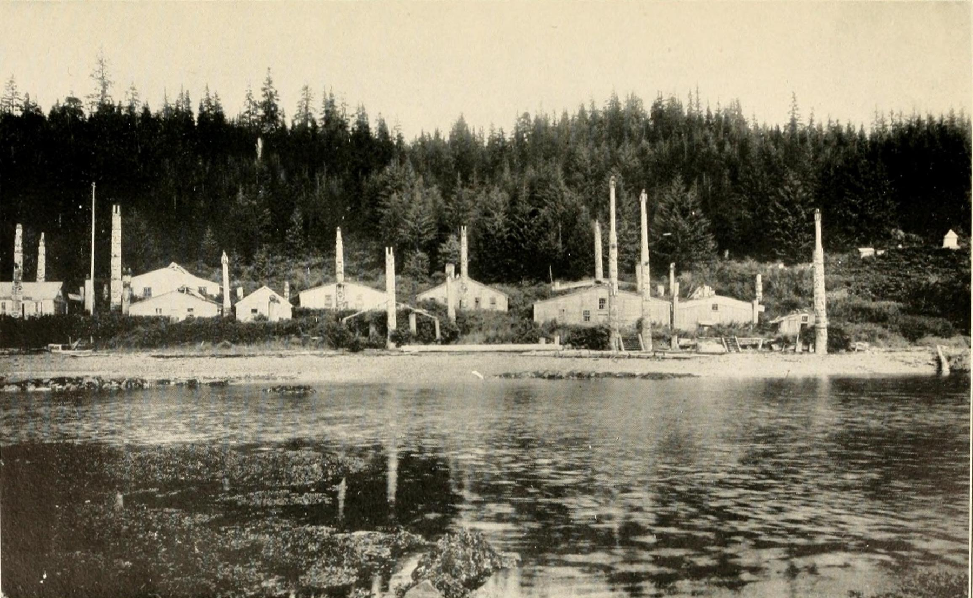
Crest Columns Standing in a Village
A Haida village in Alaska, photographed by E. A. Hegg, published 1908.
© More Lessons Less Planning | morelessonslessplanning.com
Notes:
Give the class twenty silent seconds with the photograph before you say anything, then ask what a person would need to know before this counts as a record.
Reference labels (point to these chart features when teaching): Carved columns along the bank; Plank houses behind them

Slide 7
The Potlatch, and What Observers Got Wrong
"This custom has been described often, but it has been thoroughly misunderstood by most observers. The underlying principle is that of the interest-bearing investment of property."
— Franz Boas, Report of the U.S. National Museum for 1895, printed 1897, page 341
Boas is describing the method of acquiring rank: the potlatch, or the distribution of property. He says observers had been reading it wrong, but he never says which misreading he means.
Warning: The wasteful-destruction story is the misreading his principle rules out, though Boas never names it.
© More Lessons Less Planning | morelessonslessplanning.com
Notes:
This is the hook of the whole lesson. The man writing in 1897 says plainly that the observers before him got it wrong. He never says which misreading he means, so do not put words in his mouth.

Slide 8
Four Words for Rank and Giving
Potlatch
A ceremony at which a family gives away large amounts of property in front of witnesses in order to claim or confirm its position
Rank
A person's standing in the community, which on this coast had to be claimed in public and paid for in property rather than simply inherited quietly
Distribution of property
The act of handing out goods to guests at a ceremony, which Boas described as an interest-bearing investment of property
Blanket
The unit of value Boas recorded on this coast: a single blanket was valued at 50 cents, and a double blanket was valued at three single blankets
Key Concept: Rank on this coast was not announced. It was purchased in public.
© More Lessons Less Planning | morelessonslessplanning.com
Notes:
Rank is the term students most often flatten into wealth. Keep the distinction sharp: wealth is what you have, rank is what witnesses agree you have.

Slide 9
Blankets Were the Money
What | What Boas recorded it was worth
One blanket | The unit of value on this coast; a cheap white woolen blanket valued at 50 cents
A double blanket | Valued at three single blankets
Everything else | Paid for in blankets, or in objects whose value is measured by blankets
Key Concept: Once the gift can be counted, standing can be counted too.
© More Lessons Less Planning | morelessonslessplanning.com
Notes:
These are Boas's own figures from page 341. They matter because a countable unit is what let a whole coast compare one family's claim against another's.

Slide 10
A Name You Have to Pay For
First name
Boas: the child "is given the name of the place where it is born," and keeps that name until about a year old.
✔
Second name
A relative "gives a paddle or a mat to each member of the clan," and the child receives its second name.
✔
Third name
At about 10 or 12 years old a boy "must distribute a number of small presents, such as shirts or single blankets," among his own clan or tribe.
✔
Who helps
"When the youth thus starts out in life, he is liberally assisted by his elders, particularly by the nobility of the tribe."
✔
Key Concept: Even a name had to be paid for in front of witnesses.
© More Lessons Less Planning | morelessonslessplanning.com
Notes:
The wording inside the quotation marks in these rows is Boas's own, from page 341. This is the clearest evidence that property distribution is a record system: a name is an identity claim, and on this coast it was purchased publicly.

Slide 11
Wealth Is Not for Keeping
Boas wrote that "possession of wealth is considered honorable."
Each person aimed to acquire a fortune.
What mattered more was "the ability to give great festivals."
A giver's name gained "greater weight in the councils of the tribe."
The more he distributed, the greater his renown among the people.
Key Concept: Wealth counted only after you had handed it out.
© More Lessons Less Planning | morelessonslessplanning.com
Notes:
Hold the two halves together. Boas does not say wealth was despised; he says holding it was honorable but giving it away was what made it worth holding.

Slide 12
Rivals Fight With Property Only
"Formerly feats of bravery counted as well as distributions of property, but nowadays, as the Indians say, 'rivals fight with property only.'"
— Franz Boas, page 343. The words inside the inner marks are what Boas reports speakers themselves saying.
Boas writes that boys of different clans were pitted against each other by their elders, each urged to outdo his rival, and that chiefs and whole clans competed the same way.
Warning: "the Indians" is Boas's 1897 wording, not the wording this lesson uses.
© More Lessons Less Planning | morelessonslessplanning.com
Notes:
Two things to name out loud: the inner quotation is reported speech from the people themselves, and the phrase the Indians is period language belonging to 1897.

Slide 13
A Gift You Cannot Refuse
Boas: the recipient "is not at liberty to refuse the gift."
He calls it "nothing but an interest-bearing loan."
It "must be refunded at some future time with 100 per cent interest."
Accepting made a guest a witness and a debtor at the same time.
Key Concept: The debt is what kept every witness paying attention.
© More Lessons Less Planning | morelessonslessplanning.com
Notes:
This is the mechanism that makes the whole system a record. A guest who accepts is bound to repay double, which gives that guest a reason to remember exactly what was claimed.

Slide 14
Reading a Crest Column Up Close
The figures
The purpose
The reader
Each carved figure is a crest.
A crest belongs to a whole clan.
Stacked figures name more than one family line.
Some columns keep a dead relative's memory alive.
Some stand in front of a house.
Some are carved into the house front itself.
A column faces the village and the water.
Anyone who knows the crests can read the claim.
The claim holds only if the family paid for it.
Key Concept: You read a column by knowing the crests, not by sounding out letters.
© More Lessons Less Planning | morelessonslessplanning.com
Notes:
Make the reading analogy explicit. Literacy here means knowing which crest belongs to which clan, and that knowledge lived in the community, not in a book.

Slide 15
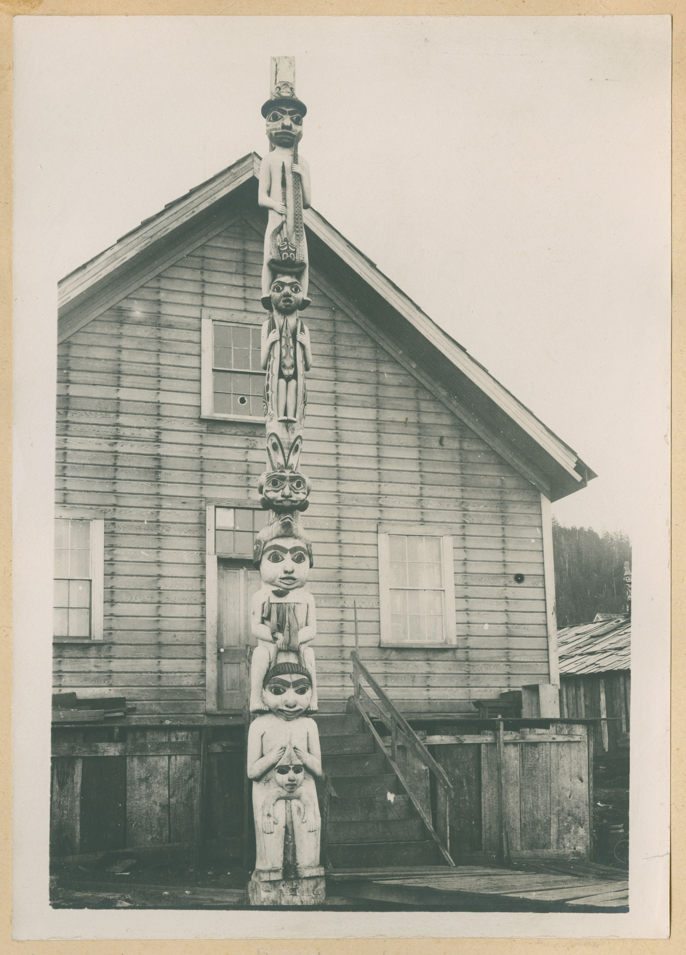
A Carved Crest Column Close Up
A crest column at Wrangell, Alaska. Photo by A. C. Pillsbury, about 1899.
© More Lessons Less Planning | morelessonslessplanning.com
Notes:
Ask students to count the distinct carved figures before you say anything. Then remind them that only somebody who knows the crest system can say whose family this is.
Reference labels (point to these chart features when teaching): Stacked carved figures; House front behind it

Slide 16
Three Words for Reading a Record
Ethnography
A written description of a people's customs, put together by someone who studies them and usually published long after the practices began
Provenance
The record of who set a document down, when, and whose hands it passed through before it reached us
Co-researcher
A person from inside the community who gathers and records information alongside an outside researcher, and whose notes become part of the published report
Key Concept: Ask who held the pen before you decide what a source can prove.
© More Lessons Less Planning | morelessonslessplanning.com
Notes:
These three terms are the historical thinking vocabulary of the unit. Co-researcher is the one that changes how students read the 1897 report.

Slide 17
Who Wrote This Down: Boas and Hunt
Franz Boas
George Hunt
Worked on this coast in the 1880s and 1890s.
He was not a member of any of these nations.
He wrote the account up and signed his name to it.
Raised at Fort Rupert among the Kwakwaka'wakw.
He spoke Kwak'wala, the language of the people described.
The title page credits the notes in the report to him.
Key Concept: The title page names notes made by Mr. George Hunt. This is a collaboration.
© More Lessons Less Planning | morelessonslessplanning.com
Notes:
Correct the reflex here. This is not an outsider's summary of something overheard; the title page itself says the account rests on notes made by a man raised inside the community.

Slide 18
What Kind of Book This Is
The account sits in the Report of the U.S. National Museum for 1895.
The Government Printing Office published it in 1897.
That makes it a United States government document, free to reprint.
Its full title uses the older spelling of the nation's name.
Boas and Hunt worked among the Kwakwaka'wakw in British Columbia.
Key Concept: The crest pages cover the northern nations, Tlingit and Haida included; the potlatch pages describe the Kwakwaka'wakw.
© More Lessons Less Planning | morelessonslessplanning.com
Notes:
Two jobs on this slide. Establish that the source is a government publication, and place each half of the Part 4 passage with the right nations: the crest paragraph is Boas on the northern coast, the potlatch paragraphs are the Kwakwaka'wakw in British Columbia.

Slide 19
Banned: 1885 to 1951
Canada, 1885
Canada made the potlatch illegal. The ban stayed on the books until 1951.
✔
The United States
Federal assimilation policy in the same decades pressed Native families to give up ceremonies of this kind.
✔
Why it matters here
Boas and Hunt were writing down a ceremony that governments were working to stop.
✔
What survived
Families kept holding potlatches, and the ceremony is practiced openly today.
✔
Key Concept: A record made while a practice is outlawed is part of its provenance.
© More Lessons Less Planning | morelessonslessplanning.com
Notes:
Keep this factual and non-partisan. The point students need is a provenance point: the timing of the record is not an accident.

Slide 20
What These Records Can and Cannot Settle
The record | What it can show | What it cannot settle
A crest column | Which crests a family claimed, and that they paid to raise it | The year it was carved, unless somebody wrote that down
A potlatch | That a rank was claimed before witnesses who owed a return | What was said, once the last witness has died
The 1897 report | How the system worked in one region in the 1880s and 1890s | How it worked centuries earlier, or in every nation on the coast
Key Concept: Naming what a record cannot settle is doing history well.
© More Lessons Less Planning | morelessonslessplanning.com
Notes:
This grid is the model for Activity Part 3. Walk one row across with the class so the shape of the thinking is visible before they do it alone.

Slide 21
Two Systems, One Job
A writing system
The coast's system
Marks on paper stand for sounds.
A stranger who knows the alphabet can read it.
If the paper burns, the record is gone.
Carved crests stand for families and their stories.
A person who knows the crests can read it.
Witnesses carry the claim, and the debt keeps them honest.
Key Concept: Both systems store a claim so somebody can check it later.
© More Lessons Less Planning | morelessonslessplanning.com
Notes:
This is the synthesis slide. Do not let students leave with a ranking; the two systems have different failure modes, not different amounts of worth.

Slide 22
Key Takeaways
Pacific Northwest Coast nations kept exact records without an alphabet.
★
A crest column displays the crests a family owns the right to show.
★
A potlatch claimed rank by giving property away in front of witnesses.
★
Boas called the potlatch an interest-bearing investment of property.
★
The 1897 report rests on notes made by George Hunt, a Kwak'wala speaker.
★
© More Lessons Less Planning | morelessonslessplanning.com
Notes:
Close on takeaway four. It is the sentence that replaces the misconception most students walked in with.

