Slide 1
Three Colonial Regions, Three Economies
Geography, trade, and labor in British North America
© More Lessons Less Planning | morelessonslessplanning.com
Notes:
Open with the puzzle: colonies under one empire developed noticeably different ways of producing and trading goods.

Slide 2
Learning Targets
Compare how geography shaped work across three colonial regions.
★
Explain why New England relied on the sea and commerce.
★
Explain why the Middle Colonies sold grain abroad.
★
Connect plantation crops to coerced labor in Southern colonies.
★
Judge how a 1775 writer described colonial work.
★
© More Lessons Less Planning | morelessonslessplanning.com
Notes:
Have students choose one target they can already approach and one that will require new evidence.

Slide 3
One Coast, Different Conditions
Mercantilism
An imperial system that directed colonial trade to increase the parent country's wealth
Climate
The length and reliability of growing seasons
Soil
The ease of producing food and a saleable surplus
Waterways
Routes that lowered the cost of moving heavy goods to market
Key Concept: Geography created possibilities; institutions and choices shaped outcomes.
© More Lessons Less Planning | morelessonslessplanning.com
Notes:
Use this slide as the comparison frame. Return to the same five variables as each region appears.

Slide 4
New England: Sea, Timber, and Household Plots
Subsistence farming
Raising food mainly to feed a household rather than to sell for profit
Sea
Coastal waters and good harbors supported fishing and shipping
Forest
Timber supplied boards, masts, and shipbuilding material
Mixed work
Households combined agriculture, maritime trades, and crafts
Did You Know: The 1775 account valued fishery at more than half of one New England total.
© More Lessons Less Planning | morelessonslessplanning.com
Notes:
Stress adaptation rather than failure: limited grain potential encouraged a varied mix of household agriculture, fishing, timber, crafts, and commerce.

Slide 5
Middle Colonies: Grain and Market Towns
1
2
Harvest conditions
Staple crop
Fertile valleys and longer seasons supported grain surpluses.
A major product produced in large amounts for a region's trade
3
4
Cash crop
Routes to buyers
A crop grown mainly to be sold rather than consumed by the grower
Rivers and merchants moved wheat toward coastal towns and overseas markets.
Key Concept: Fertile land mattered because transport and buyers turned surplus grain into trade.
© More Lessons Less Planning | morelessonslessplanning.com
Notes:
Treat the source's praise of New York wheat as evidence of the author's commercial viewpoint, not as a neutral ranking of regions.

Slide 6
Southern Colonies: Tobacco, Rice, and Indigo
Tobacco, rice, and indigo brought revenue from distant buyers.
Long growing seasons supported tobacco and, farther south, rice and indigo.
Large landholdings concentrated production for Atlantic buyers.
Export agriculture required planting, tending, harvesting, and processing.
Colonial laws enabled landowners to command other people's labor.
Warning: Climate helps explain crop choice, but it does not excuse systems of coercion.
© More Lessons Less Planning | morelessonslessplanning.com
Notes:
Separate the environmental explanation for crop choice from the legal and political explanation for coerced labor.

Slide 7
Labor Was Not One System
Production setting
Different forms of coercion
Large estates organized land and workers for saleable output.
Large landholdings concentrated authority.
Slavery existed in every region; its importance differed sharply.
Some laborers served under time-limited contracts.
Racial bondage imposed lifelong, inheritable status.
Violence and law denied freedom and family security.
Warning: Both systems coerced labor, but duration, legal status, race, and heredity made them fundamentally unequal.
© More Lessons Less Planning | morelessonslessplanning.com
Notes:
Make the comparison explicit without false equivalence. Contractual limits did not make service benign, and they did not make it the same as lifelong hereditary bondage.

Slide 8
Connecting Colonies to Atlantic Markets
Triangular trade
A network of Atlantic routes linking Europe, Africa, the Americas, and the Caribbean
Regional economy
The pattern of work, production, and trade that develops in a particular area
Imperial rules
Trade laws that favored English ships and channels
Forced migration
The coerced movement of enslaved Africans through Atlantic routes
Remember: A three-sided diagram is a model of a much larger and less tidy network.
© More Lessons Less Planning | morelessonslessplanning.com
Notes:
Use routes as a network model, not a claim that every ship sailed a perfect triangle. Name forced migration as a central human reality of Atlantic exchange.

Slide 9
Read a Map as an Argument
1. Source it
John Mitchell made the map for a British imperial audience in 1755.
✔
2. Find exchange
Port - A coastal or river city where ships load, unload, and exchange goods.
✔
3. Trace routes
Follow coasts and rivers that connected settlements with inland areas.
✔
4. Read power
Notice which boundaries, place names, and territorial claims receive emphasis.
✔
Note: Deck page 10 is the full-page map; record map observations in Section 7.
© More Lessons Less Planning | morelessonslessplanning.com
Notes:
Preview the four-step routine, then move directly to the dedicated map slide. Students should distinguish what is visible from what requires historical context.

Slide 10
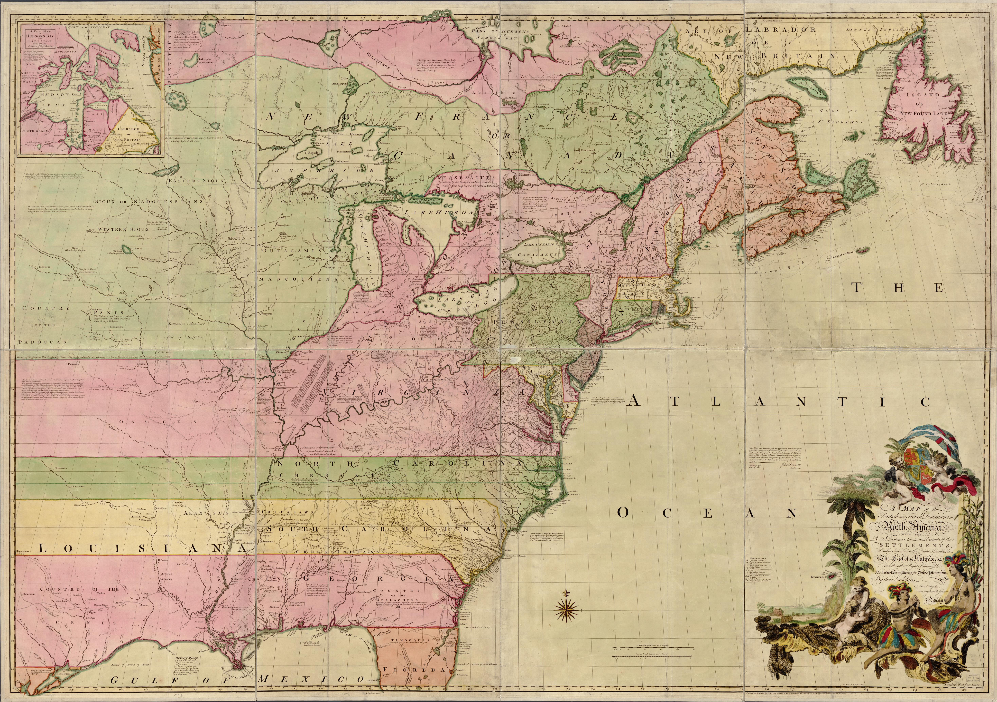
Mitchell's Map of British North America, 1755
© More Lessons Less Planning | morelessonslessplanning.com
Notes:
Allow thirty silent seconds before discussion. Ask students to identify a visible pattern first, then interpret what that pattern may suggest.
Reference labels (point to these chart features when teaching): Atlantic settlements; Western claims

Slide 11
Who Wrote American Husbandry?
Publication
A two-volume work issued in London in 1775 under the description 'by an American'
Authorship
The writer's name is not established; the classroom citation identifies Anonymous
Citation
Anonymous, American Husbandry (1775).
Plantation
A large agricultural estate organized to produce crops for sale with a controlled labor force
Source lens
Commercial observations that also reduce enslaved people to labor inputs
Warning: A detailed source can still carry harmful assumptions and a limited viewpoint.
© More Lessons Less Planning | morelessonslessplanning.com
Notes:
Model sourcing before close reading: identify date, publication context, anonymity, measures of value, and the author's dehumanizing treatment of enslaved people.

Slide 12
Three Passages, Three Patterns
Region or term | Evidence or meaning
New England | Fishery, ships, livestock, and timber show mixed production
New York | High-quality wheat in large exports shows a grain surplus
Virginia and Maryland | Tobacco, grain, and lumber show diverse output
Indentured servant | A worker bound by contract to labor for a set term, often in exchange for passage
Writer's lens | Totals and rankings value people and land by commercial output
Key Concept: The passages offer regional evidence and reveal the writer's commercial priorities.
© More Lessons Less Planning | morelessonslessplanning.com
Notes:
Have students distinguish source observations in the first four bullets from the interpretation in the final bullet.

Slide 13
Why Economic Patterns Diverged
1. Geography
Climate, soil, forests, rivers, and coastlines changed production opportunities.
✔
2. Production and land
Colonial production expanded on Indigenous homelands through purchases, coercive law, broken agreements, and violence.
✔
3. Markets
Merchants and imperial rules connected local goods to distant buyers.
✔
4. Labor and law
Chattel slavery - A hereditary system that legally treated enslaved people as property for life.
✔
Remember: A cause chain explains interaction; no single link explains an entire region by itself.
© More Lessons Less Planning | morelessonslessplanning.com
Notes:
Ask students to build one complete chain for each region and identify where the chain includes a human decision rather than a physical condition.

Slide 14
Key Takeaways
On Wampanoag and other Native homelands, New England mixed sea and farm work.
★
Lenape and Haudenosaunee trade routes shaped Middle Colony farms and ports.
★
Chesapeake growth on Powhatan homelands tied land, seasons, and coercive law.
★
Enslaved labor reached every region, tied by Atlantic trade and imperial rules.
★
The 1775 account offers evidence through a commercial, dehumanizing lens.
★
© More Lessons Less Planning | morelessonslessplanning.com
Notes:
Close by asking students to state one difference, one connection, and one caution about the primary source.

