Slide 1
The World of Homer: Mycenaean Greece
The real Bronze Age world behind the epics - myth vs. history.
© More Lessons Less Planning | morelessonslessplanning.com
Notes:
Open with the hook. In July 2026 Christopher Nolan released The Odyssey, a film retelling of Homer's epic (rated R, so not for class screening). The story is legend - but there was a real Bronze Age Greek world behind Homer's poems. Its center was Mycenae, a fortified citadel of warrior-kings who left behind Cyclopean walls, the Lion Gate, shaft graves full of gold, and clay tablets written in Linear B. Today students explore that real world and learn to separate the archaeology (what we can prove) from the myth (the poetic memory Homer preserved centuries later). The lesson ends with the words of Pausanias, a real Greek traveler who described the ruins of Mycenae, which students will analyze.

Slide 2
Learning Targets
Explain who the Mycenaeans were and how their world lies behind Homer's epics
★
Describe the archaeology of Mycenae - the walls, the gold, and Linear B
★
Analyze how historians separate the real Bronze Age from the myth in Homer
★
© More Lessons Less Planning | morelessonslessplanning.com
Notes:
Read each target aloud. Target 1 maps to slides 3-5 (Homer, the Mycenaeans, and the citadel of Mycenae). Target 2 maps to slides 6-11 (the walls and Lion Gate, the shaft-grave gold, Linear B, and the tholos tombs). Target 3 maps to slides 12-14 (the Trojan War and Schliemann, Pausanias, and the myth-vs-history synthesis) and drives the Primary Source Spotlight analysis of Pausanias. The quiz and activity test all three.

Slide 3
Homer and the Real World Behind the Epics
Homer and the Epics
Myth vs. History
HOMER: the poet credited with the Iliad and the Odyssey
The epics were composed around the 8th century BCE
That is centuries AFTER the Mycenaean world fell
The poems are a distant, poetic memory
This unit separates MYTH from real history
The Bronze Age world Homer describes was real
But his heroes and gods are poetic memory
Archaeology, not the epics, gives us the facts
Key Concept: HOMER composed the Iliad and the Odyssey about the 8th century BCE - centuries after the real Mycenaean world had already fallen.
© More Lessons Less Planning | morelessonslessplanning.com
Notes:
Set up the frame. HOMER is the name given to the poet credited with the Iliad and the Odyssey, epics composed around the 8th century BCE - centuries after the Mycenaean world had fallen. This is the key idea students often miss: Homer was NOT an eyewitness. He lived and composed hundreds of years after the Bronze Age palace world of Mycenae had already collapsed, so his epics are a distant, poetic memory of that world, not a documentary record of it. This unit is about separating MYTH (the poems) from real history (the archaeology). The Bronze Age world behind the epics was real - but the giants, gods, and larger-than-life heroes are the poet's memory, not proven fact.

Slide 4
The Mycenaeans: A Real Bronze Age World
Mycenaean civilization
MYCENAEAN CIVILIZATION was the powerful Bronze Age Greek culture (about 1600 to 1100 BCE) centered on fortified palace-citadels like Mycenae, Tiryns, and Pylos
The Bronze Age
The BRONZE AGE was the era when tools and weapons were made mainly of bronze; in Greece it ended around 1100 BCE, centuries before Homer
About 1600 to 1100 BCE
The span when Mycenaean civilization flourished across mainland Greece, long before Homer composed his epics
A real world
Mycenae was a real, wealthy, warlike society of kings and warriors - not a poet's invention
Key Concept: MYCENAEAN CIVILIZATION was a real Bronze Age Greek world (about 1600 to 1100 BCE) of fortified palace-citadels.
© More Lessons Less Planning | morelessonslessplanning.com
Notes:
Establish the real civilization. MYCENAEAN CIVILIZATION was the powerful Bronze Age Greek culture (about 1600 to 1100 BCE) centered on fortified palace-citadels like Mycenae, Tiryns, and Pylos. The BRONZE AGE was the era when tools and weapons were made mainly of bronze; in Greece it ended around 1100 BCE, centuries before Homer. The point of the slide is that this was a real, wealthy, warlike society of kings and warriors - not a poet's invention. About 1600 to 1100 BCE is the span when Mycenaean civilization flourished across mainland Greece, long before Homer composed his epics around the 8th century BCE.

Slide 5
Mycenae: Citadel of a Warrior-King
The Citadel of Mycenae
The Warrior-King
MYCENAE: fortified citadel in the Peloponnese
It gave its name to Mycenaean civilization
Built high above the plain of Argos
Ruled by powerful WARRIOR kings
WANAX: the Mycenaean word for the supreme king
The wanax ruled the palace and its economy
Kings were buried with gold, weapons, and masks
Power was built on war, trade, and tribute
Key Concept: MYCENAE was a fortified citadel ruled by a WANAX - the warrior-king who controlled the palace and its wealth.
© More Lessons Less Planning | morelessonslessplanning.com
Notes:
Focus on the citadel and its king. MYCENAE was the fortified Bronze Age citadel in the Peloponnese that gave its name to Mycenaean civilization; its warrior kings ruled from a walled palace above the plain of Argos. The WANAX was the Mycenaean word for the supreme king who ruled a palace-citadel and its economy. The wanax controlled land, workshops, stored goods, and tribute, and was buried with gold, weapons, and masks that show how rich these rulers were. Mycenaean power was built on war, trade, and tribute - a real kingdom, not a legend.

Slide 6
The Cyclopean Walls and the Lion Gate
Cyclopean walls
The CYCLOPEAN WALLS were the massive stone walls of Mycenae, built of boulders so large that later Greeks believed only the giant CYCLOPES could have lifted them
A folk explanation
The story of the CYCLOPES was a folk myth people used to explain the walls - not literal history
The Lion Gate
The LION GATE was the main gate into the citadel, crowned by a carved stone relief of two lions flanking a central column
Oldest in Europe
The Lion Gate relief is often called the oldest monumental sculpture in Europe
Key Concept: The CYCLOPEAN WALLS and the LION GATE guarded Mycenae; the 'Cyclopes' story was a folk myth, not real history.
© More Lessons Less Planning | morelessonslessplanning.com
Notes:
Cover the defenses. The CYCLOPEAN WALLS were the massive stone walls of Mycenae, built of boulders so large that later Greeks believed only the giant CYCLOPES could have lifted them - a folk explanation, not literal history. This is a perfect myth-vs-history moment: the walls are real, but the giant-builder story is a myth the later Greeks invented to explain stones they could not imagine humans moving. The LION GATE was the main gate into the citadel, crowned by a carved stone relief of two lions (lionesses) flanking a central column - often called the oldest monumental sculpture in Europe. The next slide shows a photograph of the Lion Gate so students can see the real thing.

Slide 7
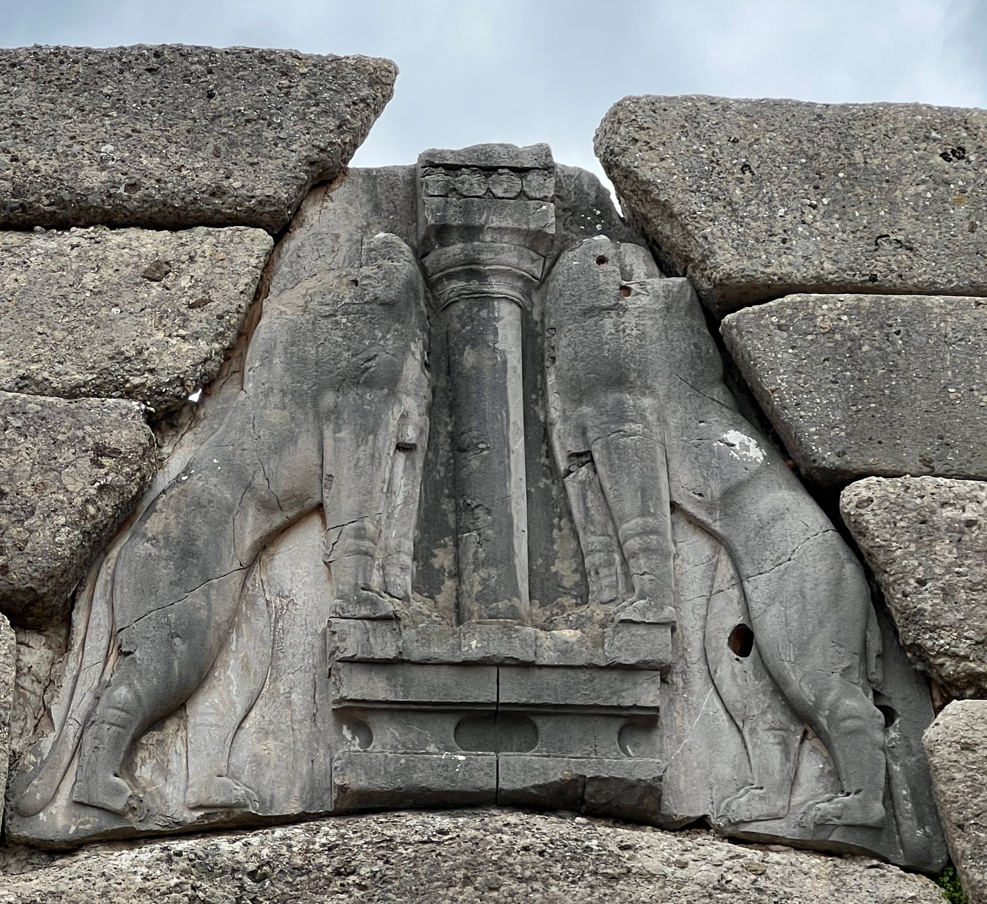
The Lion Gate at Mycenae
The Lion Gate relief at Mycenae: two lionesses flanking a central column
© More Lessons Less Planning | morelessonslessplanning.com
Notes:
This is a close photograph of the famous relief carved above the Lion Gate at Mycenae. Have students notice the two lions (lionesses) standing on either side of a central column on an altar, and the massive stone blocks of the triangular relieving slab framing the carving - often called the oldest monumental sculpture in Europe. The huge framing blocks are the kind of stones that made later Greeks believe only giants could have built the citadel. The carving has survived for more than 3,000 years.
Reference labels (point to these chart features when teaching): the two carved lionesses; the central column they flank

Slide 8
The Shaft Graves and the Gold of Mycenae
The Shaft Graves
The 'Mask of Agamemnon'
SHAFT GRAVES: deep rectangular tombs cut in rock
SCHLIEMANN excavated them at Mycenae in 1876
He found gold masks, weapons, and jewelry
The gold shows how rich the kings were
Schliemann NICKNAMED one gold mask for Agamemnon
The MASK actually dates to about 1550 BCE
That is ~300 years too early for a Trojan-War king
The name is a modern label, not a fact
Fact: The 'MASK OF AGAMEMNON' is Schliemann's 1876 nickname - the mask is ~300 years too old to be Agamemnon's.
© More Lessons Less Planning | morelessonslessplanning.com
Notes:
Cover the gold and the famous mask honestly. SHAFT GRAVES were deep rectangular tombs cut into the rock at Mycenae; Schliemann found several filled with gold masks, weapons, and jewelry. Heinrich SCHLIEMANN, a 19th-century archaeologist, excavated Mycenae in 1876. When he uncovered a gold funeral mask, he nicknamed it the 'Mask of Agamemnon' after the legendary king of the Iliad. Be honest with students: this is a modern NICKNAME, not a fact. The mask actually dates to about 1550 BCE - roughly 300 years before any plausible Trojan-War-era Agamemnon - so it cannot be his death mask. Present it honestly as 'a gold funeral mask Schliemann nicknamed the Mask of Agamemnon.' The gold is real and shows how wealthy the kings were; the name is a story Schliemann attached to it.

Slide 9
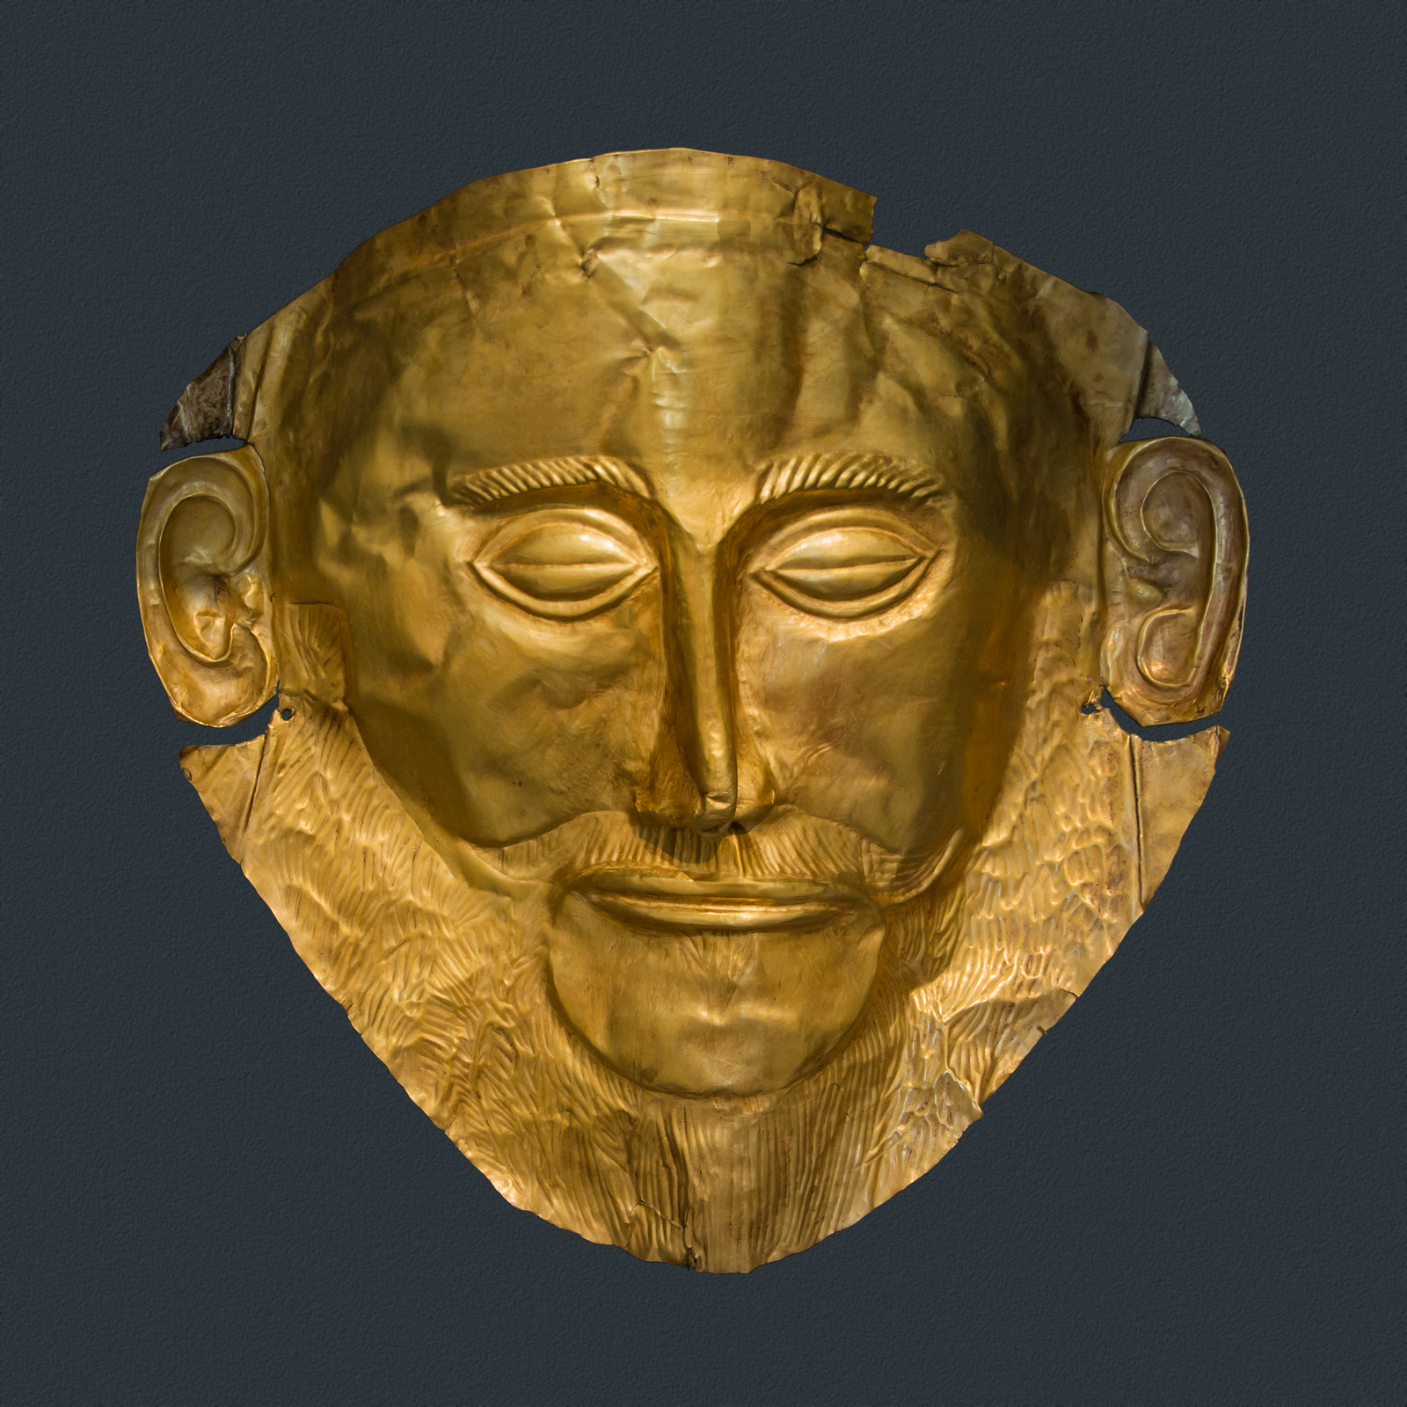
The 'Mask of Agamemnon'
A gold Mycenaean funeral mask Schliemann nicknamed the 'Mask of Agamemnon'
© More Lessons Less Planning | morelessonslessplanning.com
Notes:
Show the gold mask honestly. This is a real photograph of the gold funeral mask from a Mycenaean shaft grave, now in the National Archaeological Museum in Athens. Schliemann nicknamed it the 'Mask of Agamemnon' in 1876, but it dates to about 1550 BCE, centuries before any Trojan-War-era king, so the name is a modern label, not proof of who it shows. Have students notice the hammered gold, the bearded face, and the closed eyes - it was made to cover the face of a dead king. The craftsmanship is real Mycenaean evidence of wealth and skill; the famous name is not.
Reference labels (point to these chart features when teaching): hammered gold face; beard and closed eyes

Slide 10
Linear B: Inventories, Not Epics
Linear B
LINEAR B was the earliest written Greek, pressed onto clay tablets to record inventories, goods, and offerings
Deciphered in 1952
Michael VENTRIS deciphered the Linear B script in 1952, proving it was an early form of Greek
Not poetry
The tablets list sheep, grain, bronze, and offerings - administration, NOT Homer's epics
Everyday records
Linear B shows how the palace economy was managed day to day, not the stories of gods and heroes
Key Concept: LINEAR B tablets record inventories and offerings - administration, not poetry; Michael Ventris deciphered them in 1952.
© More Lessons Less Planning | morelessonslessplanning.com
Notes:
Cover the writing honestly. LINEAR B was the earliest written Greek, pressed onto clay tablets to record inventories and offerings; it was deciphered in 1952 by Michael Ventris and contains administration, not poetry. This is an important honesty point: the tablets do NOT contain Homer's epics or any stories. They are lists - so many sheep, so much grain and bronze, offerings to the gods, rations for workers. Michael VENTRIS, working with Alice Kober's earlier analysis and John Chadwick, cracked the script in 1952 and proved it was an early form of Greek. Linear B shows how the palace economy was managed day to day; it is powerful evidence of a literate, organized kingdom, but it tells us nothing about the Trojan War.

Slide 11
The Tholos Tombs: The 'Treasuries' of Mycenae
The Beehive Tombs
The 'Treasury of Atreus'
THOLOS TOMBS: large beehive-shaped stone tombs
Built of stone rings that narrow to a point
Made for Mycenaean kings and their families
Grander than the earlier shaft graves
The greatest tholos is the TREASURY of Atreus
Later Greeks thought it held gold, not the dead
So the beehive tomb got the name 'treasury'
Pausanias later described these same tombs
Key Concept: THOLOS TOMBS were beehive-shaped royal tombs; the grandest is the 'TREASURY of Atreus,' misnamed by later Greeks.
© More Lessons Less Planning | morelessonslessplanning.com
Notes:
Cover the great tombs and set up Pausanias. THOLOS TOMBS were large beehive-shaped stone tombs the Mycenaeans built for their rulers, made of stone rings that narrow to a point - grander than the earlier shaft graves. The greatest is the so-called TREASURY of Atreus. Its name is another myth-vs-history moment: later Greeks assumed such a huge stone chamber must have held a king's gold, so they called it a 'treasury,' when it was really a royal tomb. Pausanias, the traveler students will read at the end of the lesson, described these same underground 'treasuries' when he visited the ruins of Mycenae. The beehive design is real Mycenaean engineering; the 'treasury' name is a later guess.

Slide 12
The Trojan War: Myth, Memory, and Schliemann
The Trojan War
The TROJAN WAR was the legendary war between the Greeks and the city of Troy told in Homer's Iliad
Schliemann at Troy
SCHLIEMANN also dug at Troy in the 1870s, believing Homer's epics pointed to real places
A poetic memory
The Iliad preserves a distant, POETIC memory - not a documentary record of any real war
Myth and history mixed
A real Bronze Age conflict may lie behind the legend, but the poem is not proof of it
Key Concept: The TROJAN WAR is legend; Schliemann dug at Troy, but the Iliad is a poetic memory, not a documentary record.
© More Lessons Less Planning | morelessonslessplanning.com
Notes:
Handle the Trojan War carefully. The TROJAN WAR was the legendary war between the Greeks and the city of Troy told in Homer's Iliad. Heinrich SCHLIEMANN, the same man who dug at Mycenae, also excavated at the site of Troy (Hisarlik, in modern Turkey) in the 1870s, believing Homer's epics pointed to real places. He did find a real Bronze Age city there - but finding Troy does NOT prove the war happened as Homer told it. The Iliad preserves a distant, POETIC memory, not a documentary record of any real war. Historians accept that a real Bronze Age conflict may lie behind the legend, but the poem itself is not proof of it. This is the heart of myth vs. history: real places, poeticized story.

Slide 13
Pausanias: A Late Eyewitness to the Ruins
Pausanias the Traveler
A Late Eyewitness
PAUSANIAS: a Greek traveler of the 2nd century CE
He wrote a guidebook to the ruins of Greece
He walked Mycenae and described what he saw
He saw the walls, the Lion Gate, and the tombs
He visited about 1,400 years AFTER Mycenae fell
The RUINS were already ancient in his day
He is an eyewitness to the ruins, not the palace world
His account still guides archaeologists today
Fact: PAUSANIAS visited ~1,400 years after Mycenae fell - a late eyewitness to the RUINS, not to Mycenaean life.
© More Lessons Less Planning | morelessonslessplanning.com
Notes:
Introduce the primary source honestly. PAUSANIAS was a Greek traveler of the 2nd century CE whose Description of Greece records the ruins of Mycenae - the Lion Gate, the walls, and the tombs - already ancient in his day. Be precise about the time gap: Pausanias visited around 175 CE, roughly 1,400 years AFTER the palace world of Mycenae had fallen (about 1100 BCE). That makes him a late eyewitness to the RUINS, not to Mycenaean civilization itself. He walked the same Lion Gate and 'treasuries' students just studied and wrote down what he saw and the legends attached to them. His account is genuinely useful - it still guides archaeologists - but it is a report on ancient ruins, not a witness to the living kingdom. Students will analyze his words in the activity.

Slide 14
Myth vs. History: What the Evidence Shows
Question | Myth (Homer's epics) | History (archaeology)
Was Mycenae real? | A golden kingdom of heroes | A real Bronze Age citadel of stone and gold
Who built the walls? | The giant Cyclopes | Mycenaean workers and engineers
What do we read? | Poems of gods and heroes | Linear B lists of grain and bronze
Is Homer an eyewitness? | The epics feel first-hand | No - composed centuries after Mycenae fell
Big Idea: ARCHAEOLOGY gives us the real Bronze Age; HOMER preserves a distant MYTH. Both are evidence, but they are not the same.
© More Lessons Less Planning | morelessonslessplanning.com
Notes:
Synthesize the whole lesson. Walk the table row by row to contrast MYTH (Homer's epics) with HISTORY (archaeology). Was Mycenae real? The myth says a golden kingdom of heroes; the archaeology shows a real Bronze Age citadel of stone and gold. Who built the walls? The myth says the giant Cyclopes; history says Mycenaean workers and engineers. What do we read? The myth gives poems of gods and heroes; history gives Linear B lists of grain and bronze. Is Homer an eyewitness? The epics feel first-hand, but Homer composed them centuries after Mycenae fell. The big idea: ARCHAEOLOGY gives us the real Bronze Age, while HOMER preserves a distant MYTH. Both are useful evidence, but they are not the same, and a good historian keeps them apart.

Slide 15
Key Takeaways
MYCENAE was a real Bronze Age citadel - the world behind Homer's epics
★
The CYCLOPEAN WALLS, LION GATE, and shaft-grave gold are real archaeology
★
LINEAR B records inventories, not epics; the 'Mask of Agamemnon' is a nickname
★
HOMER is a distant poetic memory; archaeology gives the real Bronze Age
★
© More Lessons Less Planning | morelessonslessplanning.com
Notes:
Close the lesson. Review the four takeaways aloud. Students should be able to (a) explain that Mycenae was a real Bronze Age citadel behind Homer's epics, (b) describe the archaeology - the Cyclopean walls, the Lion Gate, the shaft-grave gold, and the Linear B tablets - and what each proves, and (c) separate the real Bronze Age history from the poetic myth in Homer. Remind them the 'Mask of Agamemnon' is a modern nickname and Linear B holds inventories, not epics. The activity's Primary Source Spotlight will ask them to read Pausanias' description of the ruins of Mycenae and connect it to the myth-vs-history idea.

