Slide 1
The War Ends
V-E Day to the United Nations: Ending the War, Building the Peace
© More Lessons Less Planning | morelessonslessplanning.com
Notes:
Open by telling the class that winning the war and building a lasting peace turned out to be two very different jobs, and this lesson covers both.

Slide 2
Learning Targets
Sequence the events from V-E Day through Japan's formal surrender.
★
Explain what the Potsdam Conference and Declaration decided and demanded.
★
Describe how Germany and Japan were occupied after their surrenders.
★
Explain why the Nuremberg and Tokyo trials shaped modern international law.
★
Describe the founding and purpose of the United Nations.
★
Describe the war's human toll using sourced estimate ranges.
★
© More Lessons Less Planning | morelessonslessplanning.com
Notes:
Point at target six, the toll estimate target, and tell students now that every number in this lesson will be given as a range with its source.

Slide 3
V-E Day and the War That Continued
Germany signed its surrender on May 7-8, 1945, ending fighting in Europe.
The Western Allies mark May 8 as V-E Day, Victory in Europe Day.
Crowds celebrated in London, Paris, and New York within hours.
Japan kept fighting for three more months after Germany's surrender.
American planners were already weighing an invasion of Japan.
Key Concept: V-E Day ended the war in Europe, not the whole war.
© More Lessons Less Planning | morelessonslessplanning.com
Notes:
Set the stage: Germany's surrender did not end World War II. The Pacific war continued for three more months, and that gap is the whole first half of this lesson.

Slide 4
The Potsdam Conference
Who attended
Truman, Churchill (later Attlee), and Stalin
✔
When
July 17 to August 2, 1945
✔
Where
Potsdam, near Berlin, Germany
✔
What they planned
How to occupy and govern defeated Germany
✔
Fact: Churchill lost the British election mid-conference and was replaced by Attlee.
© More Lessons Less Planning | morelessonslessplanning.com
Notes:
This is the meeting where the occupation of Germany got planned and the ultimatum to Japan got written. Both threads come back later in the deck.

Slide 5
The Potsdam Declaration
On July 26, 1945 the Allies issued a public ultimatum to Japan.
It demanded the unconditional surrender of Japan's armed forces.
It warned of prompt and utter destruction if Japan refused.
It said nothing about the atomic bomb or the emperor's future.
Japan's government publicly rejected the declaration's terms.
Key Concept: An ultimatum is a final demand that leaves no room to negotiate.
© More Lessons Less Planning | morelessonslessplanning.com
Notes:
Students will read MacArthur's own remarks in the Activity's Primary Source Spotlight, so make sure they can name exactly what Potsdam demanded and what it left out.

Slide 6
Words to Know: The Path to Surrender
V-E Day
Victory in Europe Day, May 8, 1945, marking Germany's surrender to the Allies
Potsdam Conference
The July-August 1945 meeting near Berlin where Truman, Churchill/Attlee, and Stalin planned the postwar treatment of Germany
Potsdam Declaration
The July 26, 1945 Allied ultimatum demanding Japan's unconditional surrender or face prompt and utter destruction
Instrument of Surrender
The document Japanese and Allied representatives signed aboard the USS Missouri on September 2, 1945, formally ending World War II
Remember: You will use all four of these words again in the Activity packet.
© More Lessons Less Planning | morelessonslessplanning.com
Notes:
Read each definition aloud once. These four terms cover everything up through the formal signing; the next vocabulary slide picks up with occupation and justice.

Slide 7
Japan Announces Surrender
Emperor Hirohito recorded a surrender message on August 14, 1945.
The recording was broadcast to the Japanese public on August 15.
It was the first time most citizens had ever heard the emperor's voice.
Hirohito called on the Japanese people to endure the unendurable.
Scattered fighting by holdouts continued for days after the broadcast.
Did You Know? August 15 is still marked in Japan as the end of the war.
© More Lessons Less Planning | morelessonslessplanning.com
Notes:
The broadcast on August 15 is what most people mean by 'Japan surrendered' in casual speech, but the WAR did not legally end until the formal signing two and a half weeks later.

Slide 8
September 2, 1945: The Formal Surrender
Where
Aboard the USS Missouri, anchored in Tokyo Bay
✔
Japan's signer
Foreign Minister Mamoru Shigemitsu
✔
Allied signer
General Douglas MacArthur
✔
What was signed
The Instrument of Surrender
✔
Key Concept: September 2, 1945 is the internationally recognized end of WWII.
© More Lessons Less Planning | morelessonslessplanning.com
Notes:
This is the legal end of World War II. Tell students they will read MacArthur's own opening remarks from this ceremony in the Activity's Primary Source Spotlight.

Slide 9
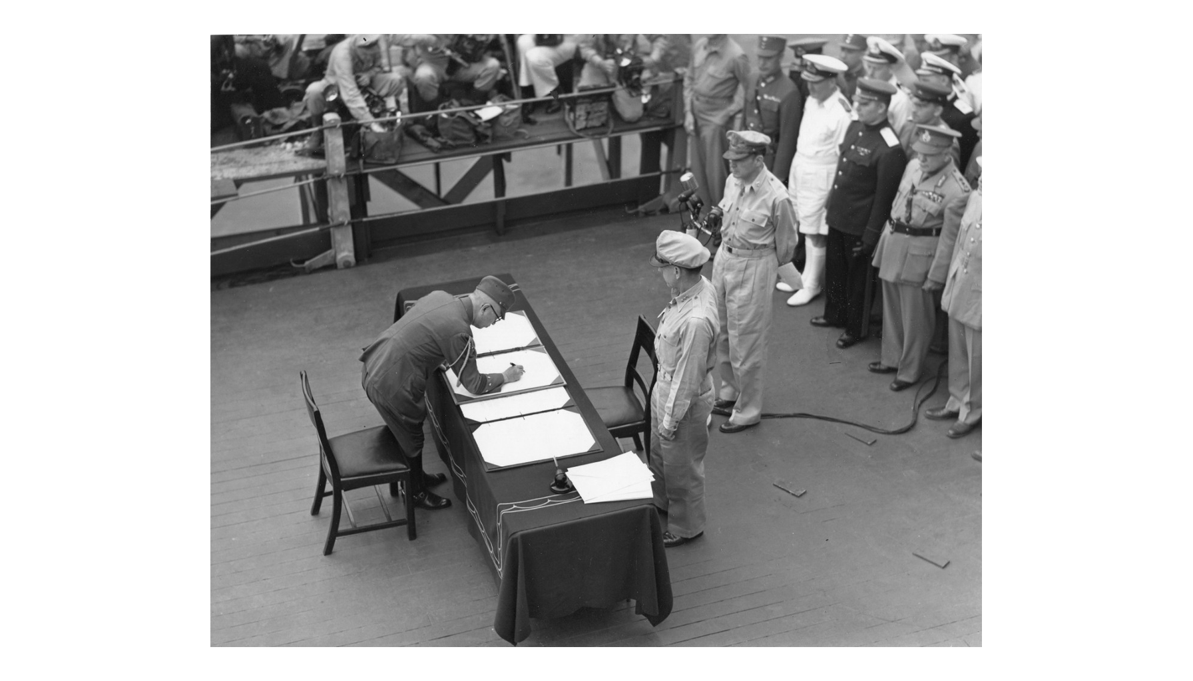
The Surrender Ceremony, September 2, 1945
Note: U.S. Navy photograph.
© More Lessons Less Planning | morelessonslessplanning.com
Notes:
Give the class a few silent seconds with the photograph before you speak. Then point out that this exact scene, on this exact ship, is the moment World War II legally ended.
Reference labels (point to these chart features when teaching): Signing table on deck; Assembled delegations

Slide 10
The Allied Occupation of Japan
1945-1952
1947
Length of the occupation
Year Japan's new constitution took effect
Supreme Commander: General Douglas MacArthur led SCAP
Governing style: Indirect rule through Japan's existing government
Key reform: Article 9 renounced war as national policy
Fact: SCAP stands for Supreme Commander for the Allied Powers.
© More Lessons Less Planning | morelessonslessplanning.com
Notes:
MacArthur signed the surrender on the Missouri and then ran the occupation for years afterward. That continuity is worth pointing out explicitly.

Slide 11
Germany Divided: Four Occupation Zones
Defeated Germany was divided into four occupation zones.
The United States, Britain, France, and the Soviet Union each ran one.
Berlin was divided the same way, though it sat inside the Soviet zone.
The Allies had planned this division earlier, at Yalta and Potsdam.
Occupying powers began denazification and rebuilding in their zones.
Key Concept: Berlin's split inside the Soviet zone later fed the Cold War.
© More Lessons Less Planning | morelessonslessplanning.com
Notes:
Do not over-explain the Cold War here; just plant the flag. Slide 19 comes back to this as one of the unresolved tensions of the settlement.

Slide 12
Words to Know: Justice After War
Occupation Zone
One of the four areas Germany was divided into after surrender, each administered by a different Allied power
Nuremberg Trials
The 1945-1946 tribunal at Nuremberg, Germany, that prosecuted top Nazi leaders for war crimes
Crimes Against Humanity
A legal charge created at Nuremberg for atrocities committed against civilian populations, separate from ordinary war crimes
Remember: These three words carry into Activity Part 1 and Part 4.
© More Lessons Less Planning | morelessonslessplanning.com
Notes:
Crimes Against Humanity is the term to slow down on. It was a brand-new legal category in 1945, invented because existing law had no charge that fit what happened.

Slide 13
The Nuremberg Trials
Allied judges tried top Nazi leaders at Nuremberg, 1945 to 1946.
The International Military Tribunal (IMT) heard the main case.
Defendants faced charges including crimes against humanity.
Twelve defendants were sentenced to death; others got prison terms.
The trials created a public legal record of Nazi atrocities.
Fact: Nuremberg was chosen partly because it had hosted major Nazi rallies.
© More Lessons Less Planning | morelessonslessplanning.com
Notes:
The point students should leave with is precedent: this was the first time an international tribunal put national leaders on trial for atrocities, and it set rules still used today.

Slide 14
The Tokyo Tribunal
When it opened
1946, in Tokyo, Japan
✔
Who took part
Eleven Allied nations, including the Philippines and China
✔
The charges
Crimes against peace and other war crimes
✔
A key sentence
Former Prime Minister Hideki Tojo was sentenced to death
✔
When it ended
Proceedings continued until November 1948
✔
Key Concept: Nuremberg and Tokyo together shaped modern international law.
© More Lessons Less Planning | morelessonslessplanning.com
Notes:
Point out that Tokyo's judge panel was broader than Nuremberg's, including nations like the Philippines and China who had suffered under Japanese occupation.

Slide 15
Words to Know: Building the Postwar World
Tokyo Tribunal
The 1946-1948 International Military Tribunal for the Far East, which prosecuted Japan's wartime leaders in Tokyo
United Nations
The international organization founded in 1945 to prevent future wars and promote cooperation among nations
Demobilization
The process of releasing millions of soldiers from military service and returning them to civilian life after the war
Remember: These three words carry into Activity Part 1 and Part 5.
© More Lessons Less Planning | morelessonslessplanning.com
Notes:
This closes out the ten-term vocabulary list. Demobilization is the least dramatic term in the lesson, but it is the term that explains what happened to the tens of millions of people who had been fighting.

Slide 16
Founding the United Nations
We the peoples of the United Nations determined to save succeeding generations from the scourge of war...
— Preamble, Charter of the United Nations, signed June 26, 1945
Fifty nations signed the Charter in San Francisco; the United Nations officially began operating on October 24, 1945.
Did You Know? October 24 is marked each year as United Nations Day.
© More Lessons Less Planning | morelessonslessplanning.com
Notes:
Read the quote aloud slowly. It was written the same summer as the surrender ceremonies this lesson covers, by people who had just lived through the deadliest war in history.

Slide 17
Counting the War's Toll
Category | Estimated Toll
Global deaths, all causes | 70 to 85 million
Soldiers killed worldwide | 21 to 25 million
Civilians killed worldwide | 40 to 55 million
Displaced persons in Europe alone | about 40 million
Note: These are scholarly estimate ranges, not exact counts.
© More Lessons Less Planning | morelessonslessplanning.com
Notes:
These same categories return in Activity Part 3 with a fuller country-by-country table. Set the expectation now that every number here is a range, not a precise count.

Slide 18
Coming Home: Demobilization and Rebuilding
Demobilization sent millions of soldiers back to civilian life.
The United States discharged over ten million troops by 1946.
Rebuilding Europe's cities, farms, and economies took years.
The U.S. later funded reconstruction through the Marshall Plan of 1948.
Rationing and shortages continued in many countries after the fighting.
Key Concept: Demobilization means releasing soldiers from military service.
© More Lessons Less Planning | morelessonslessplanning.com
Notes:
This is the least dramatic slide in the lesson and that is the point: after the ceremonies and the trials, someone still had to bring millions of people home and rebuild.

Slide 19
The Postwar Balance Sheet
What the Settlement Achieved
What It Left Unresolved
War-crimes tribunals set precedents used today
The United Nations gave nations a forum short of war
Millions of soldiers safely returned home
Germany's zones hardened into a Cold War divide
The Allies disagreed sharply over Eastern Europe
Exact death tolls remain estimates, not settled facts
Think About It: Ending a war and building a lasting peace are not the same task.
© More Lessons Less Planning | morelessonslessplanning.com
Notes:
Do not resolve this slide for students; let both columns sit side by side. This is the exact tension Activity Part 5 asks them to take a position on.

Slide 20
Key Takeaways
V-E Day, May 8, ended the war in Europe; Japan fought on three more months.
★
The Potsdam Conference and Declaration set the terms for ending the war.
★
Japan formally surrendered aboard the USS Missouri on September 2, 1945.
★
Occupation, Nuremberg, and Tokyo reshaped Germany, Japan, and international law.
★
The United Nations was founded in 1945 to help prevent a third world war.
★
© More Lessons Less Planning | morelessonslessplanning.com
Notes:
Close by connecting these five takeaways to Activity Part 5: did the 1945 settlement build a foundation sturdy enough for a lasting peace?

