Slide 1
The Vietnam War
How a reported incident at sea authorized an expanding war
© More Lessons Less Planning | morelessonslessplanning.com
Notes:
Open with the framing question: how much power should Congress give a President based on a single reported incident? Focus on causes, decisions, and consequences as the story unfolds.

Slide 2
Learning Targets
Explain containment and the domino theory in early Vietnam policy
★
Describe how the 1954 Geneva Accords divided Vietnam
★
Explain what was reported about the 1964 Tonkin incident
★
Analyze the Gulf of Tonkin Resolution as a primary source
★
Explain how the resolution led to escalation and the war's end
★
© More Lessons Less Planning | morelessonslessplanning.com
Notes:
Point out that target three is the one the evidence-weighing slide addresses directly, and target four is what the Activity's Primary Source Spotlight assesses.

Slide 3
Cold War Containment and the Domino Theory
After 1945, U.S. policy aimed to contain communism, not defeat the USSR
Containment - the strategy of stopping communism without full-scale war
Domino theory - if one country fell to communism, neighbors would too
U.S. leaders applied both ideas to Vietnam, a French colony
Key Concept: containment shaped nearly every Cold War decision, Vietnam included.
© More Lessons Less Planning | morelessonslessplanning.com
Notes:
containment - the Cold War strategy of stopping the spread of communism without full-scale war. domino theory - the idea that if one country fell to communism, neighboring countries would fall too. Keep the framing on policy: these two ideas are the lens U.S. leaders used for every Vietnam decision that follows.

Slide 4
France Leaves, Vietnam Divides
The French Defeat
The Geneva Accords
Vietnamese forces defeated the French at Dien Bien Phu in 1954
The battle ended nearly a century of French colonial rule
Geneva Accords - the 1954 deal ending the war, dividing Vietnam
17th parallel - dividing line: communist North, non-communist South
The North was led by communist Ho Chi Minh
Fact: the division at the 17th parallel was meant to be temporary.
© More Lessons Less Planning | morelessonslessplanning.com
Notes:
Geneva Accords - the 1954 agreement that ended the French war in Vietnam and temporarily divided the country at the 17th parallel. 17th parallel - the line that divided Vietnam into a communist North and a non-communist South after 1954. Note for accuracy: national elections meant to reunify the country under the Accords were never held.

Slide 5
Sending Military Advisors
Who Sent Them
Presidents Eisenhower and Kennedy sent U.S. military advisors to South Vietnam.
✔
What They Did
Military advisors - U.S. personnel who trained South Vietnam's army without serving in direct combat roles.
✔
How Many
By 1963 more than 16,000 U.S. advisors were serving in South Vietnam.
✔
Key Point: advisors, not combat troops, were the first stage of U.S. involvement.
© More Lessons Less Planning | morelessonslessplanning.com
Notes:
military advisors - U.S. personnel sent to train and assist South Vietnam's army without serving in direct combat roles. This is the last slide before the Gulf of Tonkin incident; the advisor buildup is the bridge between the 1954 division and the events of August 1964.

Slide 6
The Gulf of Tonkin Incident
Aug. 2, 1964: USS Maddox reported fired on by North Vietnamese boats
Gulf of Tonkin incident - the reported August 1964 naval encounters
Aug. 4: the Maddox reported a second attack in darkness, stormy seas
President Johnson ordered retaliatory air strikes based on the reports
Fact: the USS Maddox was on an intelligence patrol in the Gulf of Tonkin.
© More Lessons Less Planning | morelessonslessplanning.com
Notes:
Gulf of Tonkin incident - the reported August 1964 naval encounters between U.S. and North Vietnamese forces that became the basis for congressional action. The August 2 encounter is well documented. What is reported here about August 4 is exactly that: a report. The next slide is dedicated to weighing what was reported against what was later concluded - do not resolve that question on this slide.

Slide 7
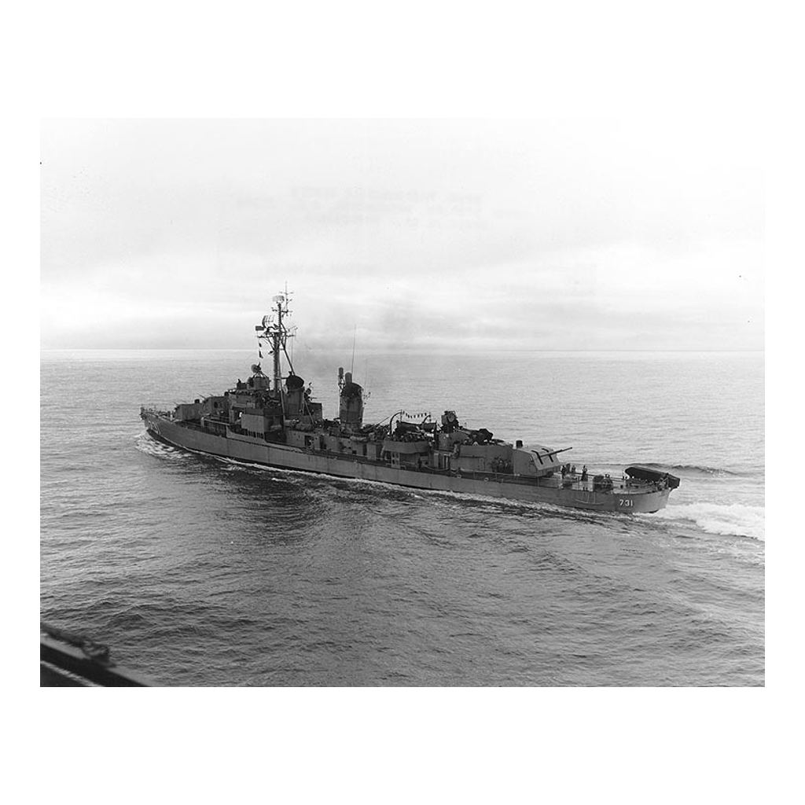
USS Maddox, the Ship at the Center of the Incident
Note: the Maddox, photographed the year before the incident
© More Lessons Less Planning | morelessonslessplanning.com
Notes:
The USS Maddox (DD-731), photographed in 1963, one year before the reported Gulf of Tonkin incident. An ordinary destroyer photograph - use it to put a real ship to the name, not to illustrate the incident itself.

Slide 8
What Was Reported, and What Was Concluded
What Congress Knew in 1964
What Was Concluded Later
Navy commanders reported a second attack on August 4
The public and Congress were told ships were attacked twice
Congress voted based on the information they had at the time
Declassified National Security Agency (NSA) records later raised doubts
The August 4 events remain debated among historians today
The August 2 encounter is well documented and not in dispute
Key Point: what Congress acted on and what was later concluded are two different questions.
© More Lessons Less Planning | morelessonslessplanning.com
Notes:
Teach this slide as evidence-weighing, not as a settled fact in either direction. Do not say the August 4 attack 'never happened' and do not say North Vietnam 'attacked twice' as flat fact. Teach exactly three things: what was reported at the time, what Congress acted on, and what was later concluded from declassified evidence.

Slide 9
Congress Acts: The Gulf of Tonkin Resolution
Johnson asked Congress for authority to respond to the reports
The House voted 416-0 and the Senate voted 88-2 in favor
Congress passed the resolution on August 7, 1964
Gulf of Tonkin Resolution - authorized 'all necessary measures'
Fact: only two members of Congress, both senators, voted against the resolution.
© More Lessons Less Planning | morelessonslessplanning.com
Notes:
Gulf of Tonkin Resolution - the law that authorized the President to take 'all necessary measures' to respond in Vietnam. Johnson signed it into law on August 10, 1964. This is the hinge point of the whole causal chain: an evidence-uncertain incident produced a near-unanimous, broad authorization within days.

Slide 10
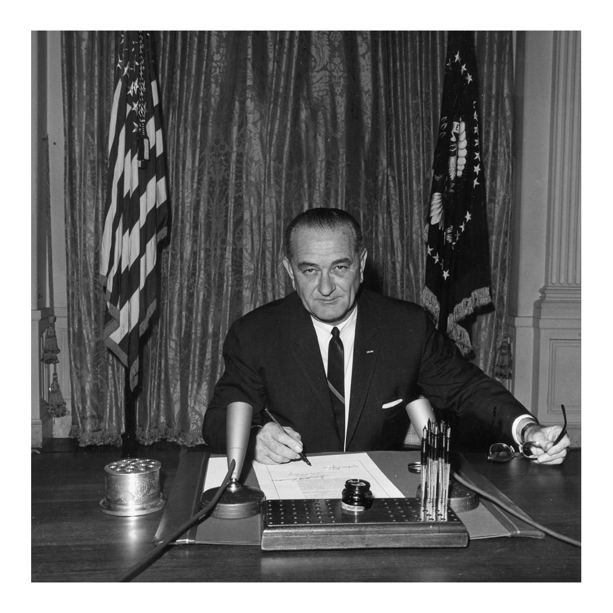
Signing the Gulf of Tonkin Resolution
Note: the White House, August 10, 1964
© More Lessons Less Planning | morelessonslessplanning.com
Notes:
President Johnson signing the Gulf of Tonkin Resolution into law on August 10, 1964, three days after Congress passed it. A quiet signing photograph is the moment a reported incident became binding law.

Slide 11
Inside the Resolution: What the Law Said
"All necessary measures"
Broad wording that did not name a specific action or set a limit.
No declaration of war
Congress did not formally declare war on North Vietnam.
Commander in Chief
Backed the President's power to act without further votes.
Used for years afterward
Johnson and Nixon both cited it to expand military action.
Key Concept: the resolution's broad wording is what let it authorize so much.
© More Lessons Less Planning | morelessonslessplanning.com
Notes:
This slide is the payoff of the evidence-weighing slide: the resolution's vague, sweeping wording is exactly why it mattered that Congress voted so fast on uncertain evidence. Every later escalation traces its legal authority back to this text.

Slide 12
Escalation Begins
Rolling Thunder - sustained U.S. bombing campaign starting in 1965
March 1965: first U.S. combat troops landed at Da Nang
By 1968 more than 500,000 U.S. troops were serving in Vietnam
Escalation - each step growing larger, traced back to the resolution
Key Point: every escalation after 1964 traced its authority to this resolution.
© More Lessons Less Planning | morelessonslessplanning.com
Notes:
Rolling Thunder - the sustained U.S. bombing campaign against North Vietnam that began in 1965. escalation - each step of U.S. involvement growing larger, with its legal authority traced back to the Gulf of Tonkin Resolution. Focus on the policy decisions and troop numbers that mark each stage of escalation.

Slide 13
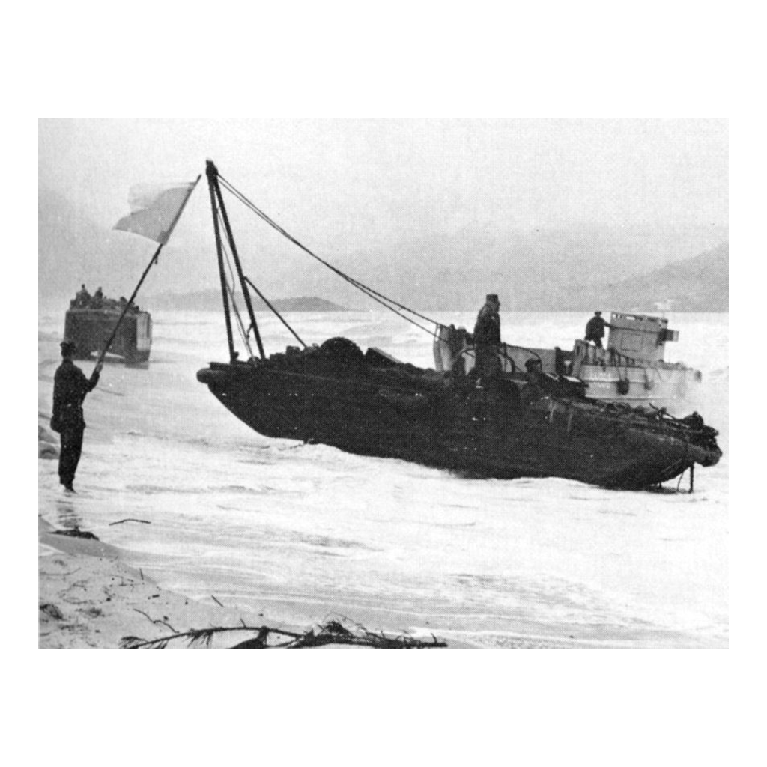
U.S. Marines Land at Da Nang, March 1965
Note: Red Beach 2, near Da Nang, March 1965
© More Lessons Less Planning | morelessonslessplanning.com
Notes:
A Marine landing craft approaching Red Beach 2 near Da Nang, with a member of the beach party signaling with a flag, March 1965. A calm, procedural landing photograph - use it to mark the shift from advisors to ground troops, not to depict combat.

Slide 14
The Draft and the Credibility Gap
The Draft
The Selective Service draft supplied troops for the growing war; draft calls rose sharply after 1965.
✔
The Credibility Gap
Credibility gap - the widening distance between what the government said about the war and what was actually happening.
✔
On Television
Nightly television coverage brought the war into American homes.
✔
Key Concept: the credibility gap grew directly from contested reports like this one.
© More Lessons Less Planning | morelessonslessplanning.com
Notes:
credibility gap - the widening distance between what the government said about the war and what was actually happening. Tie this directly back to the evidence-weighing slide: contested reporting is part of why the credibility gap became a defining feature of the war's politics.

Slide 15
Vietnamization, Withdrawal, and the End
Nixon's Vietnamization shifted combat back to South Vietnam's army
The U.S., North Vietnam, South Vietnam, and the Viet Cong signed, Jan. 1973
The Accords ended direct U.S. combat and set a withdrawal timetable
North Vietnamese forces took Saigon in April 1975, ending the war
Fact: the last U.S. combat troops left Vietnam in 1973, two years before the war ended.
© More Lessons Less Planning | morelessonslessplanning.com
Notes:
Focus on policy and dates: Vietnamization, the Paris Peace Accords, the 1973 withdrawal timetable, and the 1975 end. Name the date and outcome of the fall of Saigon plainly.

Slide 16
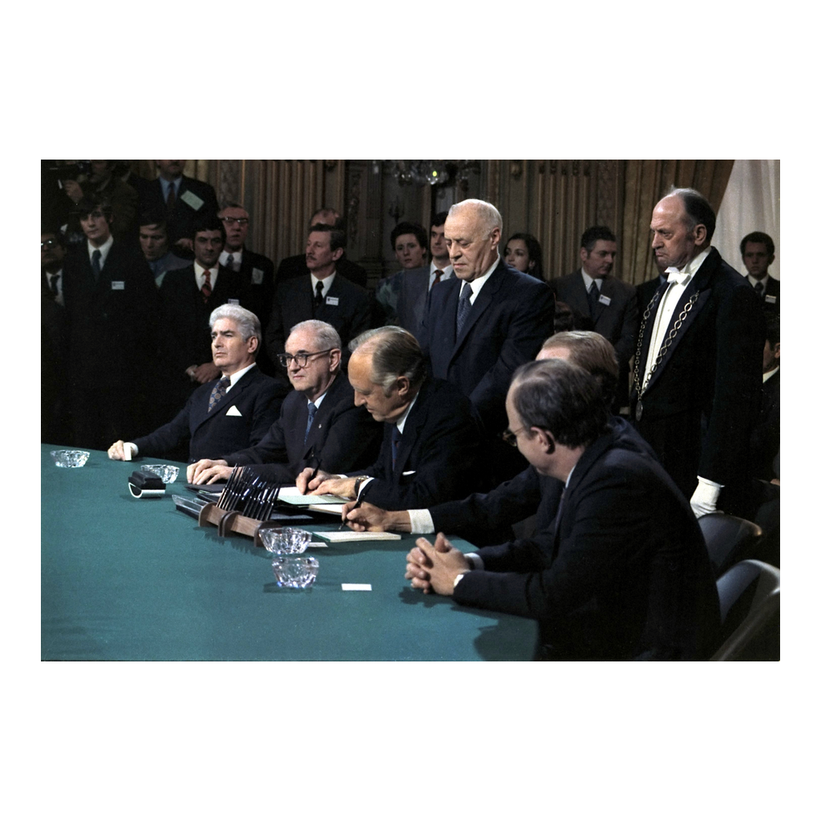
Signing the Paris Peace Accords
Note: Paris, January 27, 1973
© More Lessons Less Planning | morelessonslessplanning.com
Notes:
U.S. Secretary of State William Rogers signing the Paris Peace Accords, January 27, 1973, ending direct U.S. combat involvement in Vietnam. A formal signing photograph - use it to mark the legal end of U.S. combat involvement, not the end of the war itself.

Slide 17
What Changed After the War
Congress Responds
In 1973 Congress passed the War Powers Resolution to limit a President's power to commit troops without approval.
✔
The Cost
More than 58,000 U.S. service members died in the war.
✔
Vietnam Reunified
North and South Vietnam were reunified as one communist country in 1976.
✔
A Lasting Lesson
The Gulf of Tonkin Resolution became a case study in how much power Congress gives a President based on limited evidence.
✔
Key Point: the war changed how much Congress trusts a single incident report.
© More Lessons Less Planning | morelessonslessplanning.com
Notes:
Close the content arc by connecting back to the Essential Question: the war did not just end in 1975, it changed how Congress writes and limits authorizations for military action.

Slide 18
Key Takeaways
Containment and the domino theory drove U.S. policy toward a divided Vietnam
★
A reported incident, not a declared war, triggered congressional authorization
★
Congress acted fast on contested evidence and gave broad, lasting power
★
That authorization enabled years of escalation before the war ended in 1975
★
© More Lessons Less Planning | morelessonslessplanning.com
Notes:
Close by returning to the opening question: how much power should Congress give a President based on one reported incident? Push students toward the Essential Question with evidence, which is exactly what Activity Part 5 asks them to write.

