Slide 1
The Trump Tariffs: A Case Study
How the 2018-2026 U.S. tariff escalation reshaped trade with China and the EU - who benefited, who paid, and what the data show
© More Lessons Less Planning | morelessonslessplanning.com
Notes:
Open with a case-study framing. The 2018-2026 U.S. tariff escalation is the largest peacetime tariff campaign in 90 years. It started under Trump in 2018, was kept and expanded by Biden in 2024, and is now bipartisan U.S. policy on China. Today students play Senator Marcus Reed's policy analyst, tracing what the tariffs were, what they did to U.S. consumers and U.S. industries, and what data the senator should cite when he votes on extension. Tell students this is a real ongoing case - the next round of tariff decisions is happening in 2026.

Slide 2
Learning Targets
Trace the Trump tariff strategy from 2018 through 2026
★
Identify the targeted industries and how China and the EU retaliated
★
Evaluate evidence on consumer cost vs jobs gained
★
© More Lessons Less Planning | morelessonslessplanning.com
Notes:
Read each target aloud. Connect target 1 to the Section 232 / 301 slides and the U.S.-China escalation timeline; target 2 to the China retaliation and EU dispute slides; target 3 to the studies and the Activity Part 5 policy memo. Tell students the surprise of this lesson: every U.S. household paid an estimated $400-$800 per year because of the 2018-2019 tariffs - even households that never bought anything from China directly. By the end of class students should be able to explain why.

Slide 3
What Is the Trump Tariff Strategy?
The Strategy in One Sentence
How It Was Executed
Use tariffs as leverage on trading partners
Punish unfair foreign trade practices
Protect U.S. steel, aluminum, autos, EVs
Reshore manufacturing back to the U.S.
Section 232 (national security) on steel and aluminum
Section 301 (unfair trade) on Chinese goods
Tariffs on EU steel and aluminum allies too
Biden kept and expanded most of it in 2024
Key Concept: The Trump tariff strategy used tariffs as both PROTECTION (shield U.S. industries) and LEVERAGE (force foreign concessions).
© More Lessons Less Planning | morelessonslessplanning.com
Notes:
Anchor the strategy. The Trump administration's tariff strategy from 2018 onward had two stated goals: (1) protect U.S. industries (steel, aluminum, washing machines, autos, EVs) from cheaper foreign competition; (2) punish what U.S. officials called unfair Chinese trade practices including forced technology transfer and intellectual property theft. The execution used two existing U.S. trade laws: Section 232 of the Trade Expansion Act of 1962 (national security justification, used for steel and aluminum on basically every U.S. trading partner) and Section 301 of the Trade Act of 1974 (unfair trade practices, used specifically for China). The 2024 Biden expansion KEPT most Trump tariffs and added 100 percent on Chinese EVs, 50 percent on solar panels, 25 percent on EV batteries. Tariffs on China are now bipartisan U.S. policy.

Slide 4
Section 232 and Section 301 Explained
Section 232
1962 trade law; tariffs on national security grounds; used in 2018 for 25% steel and 10% aluminum tariffs
Section 301
1974 trade law; tariffs against unfair foreign trade; used for China Lists 1-4 covering ~$360B of Chinese goods
China List 1 (2018)
$34B of Chinese goods at 25%; mostly industrial machinery, electronics, and aerospace inputs
China List 2 (2018)
$16B at 25%; semiconductors, plastics, chemicals; took effect August 2018
China Lists 3 + 4A (2018-2019)
$200B + $110B at 25% and 7.5%; Lists 3 and 4A reached consumer goods like clothing and furniture
Note: Section 232 = national-security tariffs; Section 301 = unfair-trade tariffs. Together they cover most Trump-era tariffs.
© More Lessons Less Planning | morelessonslessplanning.com
Notes:
The two trade laws Trump used. Section 232 is older (1962, signed by JFK) and lets the president impose tariffs if imports threaten U.S. national security. Trump invoked Section 232 in 2018 for steel (25 percent) and aluminum (10 percent) on basically EVERY U.S. trading partner including allies like the EU, Canada, and Mexico - this is what triggered the EU retaliation later in the lesson. Section 301 (1974) lets the U.S. Trade Representative impose tariffs in response to unfair foreign trade practices. Trump invoked Section 301 specifically against China across four lists totaling about $360 billion of Chinese goods. List 1 (July 2018) was $34B at 25 percent. List 2 (August 2018) was $16B at 25 percent. List 3 (September 2018) was $200B initially at 10 percent, then raised to 25 percent in 2019. List 4A (September 2019) was $110B at 7.5 percent and reached consumer goods. Together these are the bulk of the 2018-2019 escalation visible on the next slide's chart.

Slide 5
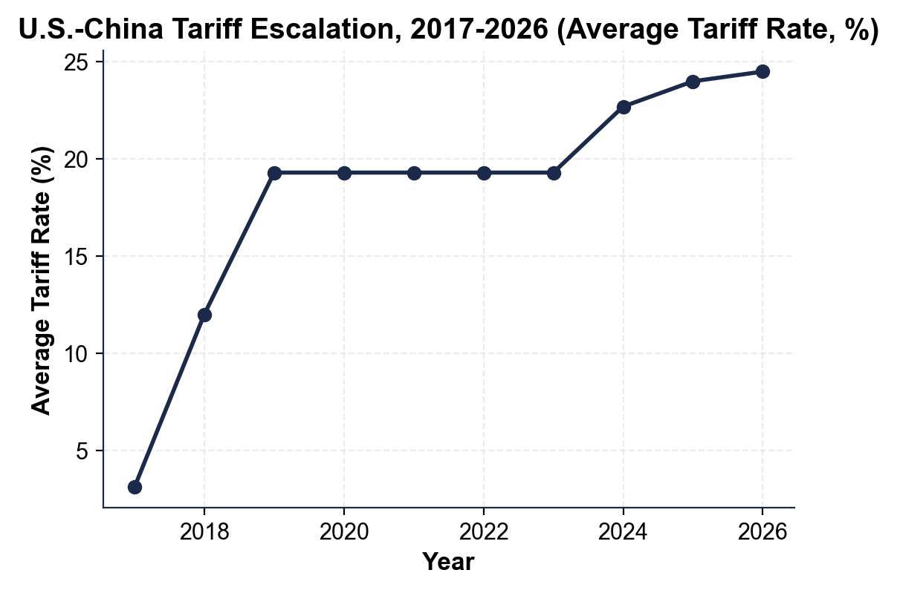
U.S.-China Tariff Escalation Timeline
Note: Avg rate ~3% (2017) to ~19% (2019) to ~23% (2024) to ~24% (2026).
© More Lessons Less Planning | morelessonslessplanning.com
Notes:
Read the chart left to right. 2017: the long-running pre-Trump baseline of about 3 percent. 2018-2019: jumps to roughly 19 percent as the Section 232 steel and aluminum tariffs and the Section 301 China Lists 1-4 take effect. 2020-2023: stays at 19 percent through the Phase One trade deal and the Biden first term. 2024: rises again to about 23 percent after the Biden expansion (100 percent EVs, 50 percent solar, 25 percent EV batteries, plus extended Trump-era tariffs). Projected 2025-2026: approaches 24-25 percent. The chart's two big jumps mark the two policy waves: 2018 (Trump) and 2024 (Biden continuation/expansion). This chart is the activity Part 4 evidence.
Reference labels (point to these chart features when teaching): 2017: ~3%; 2024: ~23%

Slide 6
China's Retaliatory Tariffs
What China hit first
U.S. soybeans, pork, corn, and beef - hitting U.S. farmers hard in the Midwest farm states
✔
Why those products
China bought a lot of them, the farm states were politically important, and Brazil could substitute
✔
How big
$110B+ of U.S. exports faced Chinese tariffs; soybean exports to China dropped about 75%
✔
Trump farm aid response
Market Facilitation Program paid U.S. farmers ~$28B in 2018-2019 to offset losses
✔
Phase One deal (2020)
China promised to buy more U.S. farm goods under Phase One; soybean share never fully returned
✔
Big Idea: Retaliation is part of the cost. China hit U.S. farmers; taxpayers paid ~$28B in farm aid; soybean share never recovered.
© More Lessons Less Planning | morelessonslessplanning.com
Notes:
China's retaliation. After Trump imposed Section 301 China List 1 in July 2018, China retaliated within hours - hitting U.S. soybeans, pork, corn, beef, and cars at 25 percent. The choice of products was strategic: China imported a lot of U.S. agricultural goods, the affected states (Iowa, Nebraska, Illinois, Indiana, Missouri) were politically important to Trump, and Brazil could supply substitute soybeans. U.S. soybean exports to China dropped about 75 percent in 2018 - billions of dollars in lost sales. The Trump administration responded with the Market Facilitation Program, a roughly $28 billion taxpayer-funded subsidy paid to U.S. farmers in 2018-2019 to offset losses. The Phase One trade deal in January 2020 had China promise to buy more U.S. agriculture, but China only hit about 60 percent of the pledged purchases and U.S. soybean market share in China never fully recovered. This is the cost of retaliation - and a cost most students won't have heard about.

Slide 7
The EU Steel and Aluminum Dispute
What Trump Did
What the EU Did Back
March 2018: 25% tariff on EU steel
Plus 10% tariff on EU aluminum
Same Section 232 - national security claim
EU called it unjustified and illegal under WTO rules
25% on U.S. bourbon (Kentucky)
25% on U.S. motorcycles (Harley-Davidson)
25% on U.S. jeans (Levi's), peanut butter
Filed WTO complaint; tariffs paused in 2021 deal
Did You Know? Harley-Davidson moved some EU production to Thailand to dodge the EU tariff - a signal that retaliation can move U.S. jobs OUT.
© More Lessons Less Planning | morelessonslessplanning.com
Notes:
The EU dispute. In March 2018 Trump used Section 232 (national security) to impose 25 percent tariffs on EU steel and 10 percent on EU aluminum. The EU - a long-time U.S. ally - called this unjustified, since EU steel was no national-security threat to the U.S. The EU retaliated symbolically: 25 percent tariffs on U.S. products that mapped to politically important U.S. states. Bourbon (Kentucky, home of Senate Majority Leader Mitch McConnell). Motorcycles (Harley-Davidson, Wisconsin). Jeans (Levi's, California). Peanut butter and orange juice (Florida). Harley-Davidson's response was telling: the company moved some of its EU-bound motorcycle production to Thailand to avoid the EU tariff. Tariffs aimed at protecting U.S. jobs sometimes RELOCATED U.S. jobs offshore. The dispute was eventually paused in late 2021 with a Biden-Brussels deal on steel and aluminum quotas. The lesson: retaliation has real costs and can backfire.

Slide 8
The 2024-2025 Expansion
100% on Chinese EVs
50% on Solar Panels
25% on EV Batteries
Biden, May 2024
Quadrupled the rate from 25% to 100%
Aim: prevent BYD, Geely from entering U.S.
Effect: no Chinese EVs sold in U.S. at all
Biden, May 2024
Doubled the rate; raised solar install costs
Aim: protect U.S. solar manufacturers
Cost: slowed rooftop solar adoption
Biden, phased 2024-2026
Doubled the rate from 12.5% to 25%
Aim: build U.S. battery supply chain
Effect: higher costs for U.S. EV makers
Key Point: The 2024-2025 Biden expansion was bigger in % than the 2018 Trump round on the targeted products - but narrower in coverage.
© More Lessons Less Planning | morelessonslessplanning.com
Notes:
The 2024-2025 expansion. In May 2024 the Biden administration announced a major expansion of tariffs on Chinese clean-energy and transportation goods. The headline was the 100 percent tariff on Chinese electric vehicles - quadrupling the existing 25 percent rate. The stated goal was to prevent low-priced Chinese EVs (BYD, Geely, Nio) from entering the U.S. market and undercutting Tesla, GM, and Ford. The effect was effectively zero Chinese EVs sold in the U.S. - even at the old 25 percent, Chinese EVs were not yet in U.S. showrooms; at 100 percent they will not be. The 50 percent solar panel tariff was meant to protect U.S. solar manufacturers (a few thousand jobs in places like Georgia and Tennessee) but raised the cost of residential and commercial solar installations - slowing rooftop solar adoption. The 25 percent EV battery tariff (phased through 2026) was meant to encourage U.S. battery manufacturing but raised costs for U.S. EV makers in the short run. Like the 2018 Trump round, the 2024 Biden round used PROTECTION as the rationale and produced higher consumer costs in exchange for some U.S. industry protection.

Slide 9
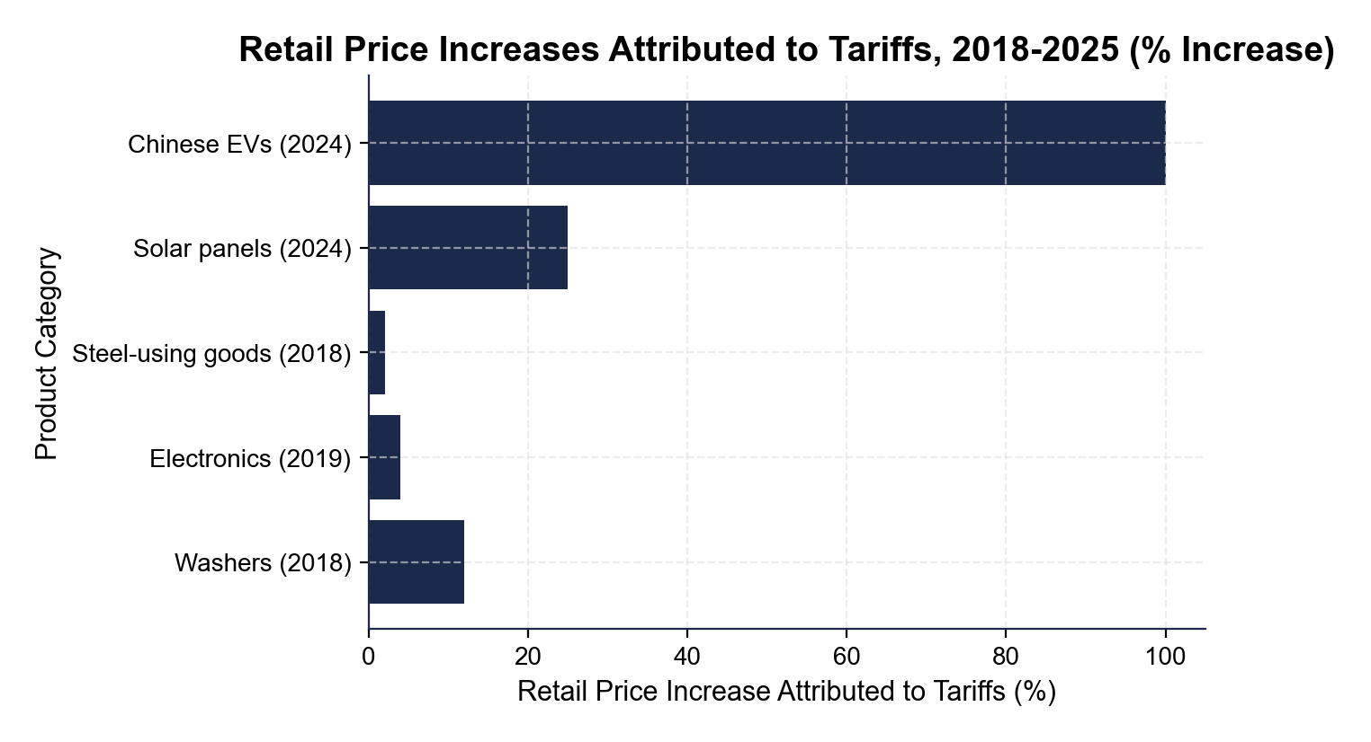
Retail Price Increases Attributed to Tariffs
Note: Bars show U.S. retail price hikes for products hit by 2018-2025 tariffs.
© More Lessons Less Planning | morelessonslessplanning.com
Notes:
Read the bars top to bottom. Washing machines: about 12 percent retail price increase after the 2018 Section 201 tariff (cleanest natural experiment in the lesson). Consumer electronics: about 4 percent under the 2019 Section 301 List 4A 7.5 percent tariff. Steel-using goods (canned food, autos, appliances): about 2 percent on average from the 2018 25 percent steel tariff filtering through. Solar panels: about 25 percent after the 2024 50 percent tariff (high pass-through plus installation costs). Chinese EVs: effectively a 100 percent retail price increase from the 2024 Biden 100 percent tariff (which is why no Chinese EVs are sold in U.S. dealerships). The chart shows the actual consumer cost of the tariffs - the dollar amount American shoppers pay because of the policy. This is the activity Part 4 evidence.
Reference labels (point to these chart features when teaching): Washers: ~12%; Chinese EVs: ~100%

Slide 10
Who Benefited (Some Manufacturers)
U.S. steel mills
Higher prices, ~8,000 jobs added by 2019; firms like U.S. Steel and Nucor saw profits rise
U.S. washing machine factories
Whirlpool gained market share; ~1,800 U.S. washer jobs added in 2018-2019
U.S. aluminum smelters
Tariffs helped a smaller industry; about 1,300 jobs reopened
U.S. solar manufacturers
2024 50% tariff protected First Solar and a few Georgia-based competitors
U.S. EV makers (long term)
100% Chinese EV tariff buys time for Tesla, GM, Ford to scale; not yet a clear win
Tip: The benefits are real but small in number. About 11,000 U.S. jobs added across all protected sectors - roughly 0.007% of the U.S. workforce.
© More Lessons Less Planning | morelessonslessplanning.com
Notes:
Who benefited. Tariffs DO protect some U.S. workers and firms - this is the protection motive working as designed. After the 2018 Section 232 steel tariff, U.S. steel prices rose, U.S. mills became more profitable, and about 8,000 U.S. steel jobs were added by 2019 (still a small fraction of the ~85,000 total U.S. steel workers). After the 2018 Section 201 washing machine tariff, Whirlpool gained market share against Samsung and LG and added about 1,800 U.S. washer jobs. The aluminum tariff led to about 1,300 U.S. smelter jobs reopening. Solar manufacturers - mostly First Solar in Ohio plus a few Georgia-based firms - benefited from the 2024 50 percent panel tariff. EV manufacturers (Tesla, GM, Ford) get protection from BYD and Geely under the 2024 100 percent EV tariff, though it is too early to call that a clear win. Total U.S. jobs added across all protected sectors: roughly 11,000 - real for those workers, but small relative to the ~158 million U.S. workforce. The next slide shows where these jobs are geographically concentrated.

Slide 11
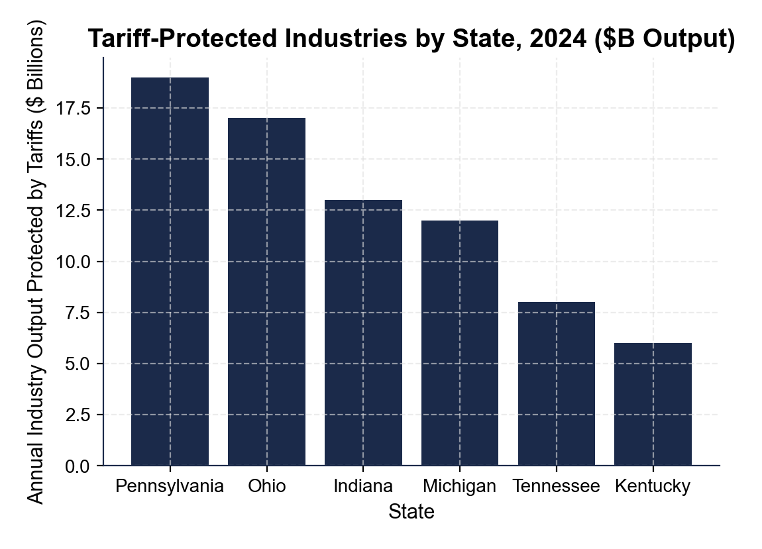
Tariff-Protected Industries by State
Note: 6 states absorb most protection; consumer costs hit all 50 states.
© More Lessons Less Planning | morelessonslessplanning.com
Notes:
Read the chart top to bottom. Pennsylvania has about $19 billion in protected industry output (the highest, driven by Pittsburgh-area steel and aluminum mills). Ohio: about $17 billion in steel and auto output. Indiana: about $13 billion in steel and EV-component output. Michigan: about $12 billion in auto and EV output. Tennessee: about $8 billion in solar-panel and EV-component output. Kentucky: about $6 billion in steel-using and aluminum output. Total across these six states: about $75 billion in protected industry output. The chart's geographic concentration is the key insight. Six mostly Midwest manufacturing states absorb most of the protection benefit. The other 44 states - which still pay tariff-driven higher prices on washers, electronics, and solar panels - receive much less of the benefit. This asymmetry is what the activity Part 5 policy memo asks students to weigh.
Reference labels (point to these chart features when teaching): PA: ~$19B; KY: ~$6B

Slide 12
Who Paid (Consumers and Exporters)
U.S. consumers
Federal Reserve and NBER studies: 95-100% pass-through; Peterson Institute: $400-$800/year per household
U.S. importers (small share)
Walmart, Best Buy, Apple absorbed about 5% of the tariff cost; foreign exporters absorbed ~0%
U.S. farmers
Lost ~75% of soybean exports to China in 2018; ~$28B in Market Facilitation Program farm aid
U.S. exporters
Bourbon, motorcycles, jeans, peanut butter, orange juice - hit by EU and China retaliatory tariffs
Foreign exporters (China, EU)
Paid CLOSE TO ZERO directly; lost some U.S. sales as quantity demanded fell
Big Idea: The cost was paid by U.S. consumers (most), U.S. taxpayers (farm aid), and U.S. exporters - not by China.
© More Lessons Less Planning | morelessonslessplanning.com
Notes:
Who paid. The cost of the 2018-2026 U.S. tariff campaign was paid mostly by Americans - in three different ways. (1) U.S. CONSUMERS paid the largest share through higher retail prices: Federal Reserve and NBER studies found 95-100 percent pass-through to consumer prices, and the Peterson Institute estimated the average household paid $400-$800 per year. (2) U.S. TAXPAYERS paid the farm aid: about $28 billion in the Market Facilitation Program in 2018-2019 to compensate farmers for Chinese retaliation. (3) U.S. EXPORTERS paid through lost foreign sales: bourbon distillers, Harley-Davidson, Levi's, peanut farmers, orange growers, soybean farmers, and pork producers all faced retaliatory tariffs from China and the EU and lost market share - some of which has not been recovered. Foreign exporters (Chinese and EU firms) absorbed close to ZERO of the tariff cost directly; they only lost a portion of their U.S. sales as quantity demanded fell. The data are unambiguous: 'tariff on China' did not mean China paid. Americans paid almost all of it.

Slide 13
Did the Tariffs Work?
Successes (Real but Small)
Costs (Large and Documented)
~11,000 U.S. jobs in protected industries
Section 232 = leverage in 2020 USMCA renegotiation
Forced China to make some Phase One commitments
Built bipartisan U.S. consensus on China
$400-$800/year per U.S. household (Peterson)
$51B/year total U.S. cost (NBER 2019)
~$28B Market Facilitation Program farm aid
U.S. soybean share in China still below 2017
Real Talk: The Peterson Institute estimates each protected U.S. steel job costs about $900,000/year - over 14x the typical industrial wage.
© More Lessons Less Planning | morelessonslessplanning.com
Notes:
Did the tariffs work? This is the policy question students will answer in the activity Part 5 memo. The honest answer: it depends on whose welfare you weight. The successes are real but small - about 11,000 U.S. jobs protected, USMCA renegotiated under tariff threat, China made some Phase One commitments, and bipartisan U.S. consensus emerged on confronting China. The costs are large and documented in peer-reviewed research - $400-$800 per household per year, $51 billion per year total cost (NBER 2019), $28 billion in farm aid, and lasting damage to U.S. soybean exports to China. The Peterson Institute analysis of the 2018 Section 232 steel tariff specifically estimated the consumer cost per protected steel job at approximately $900,000 per year - more than 14 times the typical U.S. industrial wage of about $60,000. (Other published estimates range from $650,000 to $900,000 per protected job depending on methodology.) The ECONOMIC verdict from most studies is that the tariffs cost more than they protected on a per-job basis. The POLITICAL/STRATEGIC verdict is more contested - tariffs gave U.S. negotiators leverage and signaled a hard line on China that both parties now support. The activity asks students to weigh these tradeoffs.

Slide 14
Key Takeaways
Trump used Section 232 (steel/aluminum) and Section 301 (China) tariffs
★
China retaliated on U.S. soybeans; the EU on bourbon and motorcycles
★
Biden KEPT and EXPANDED the tariffs in 2024 (100% EVs, 50% solar)
★
U.S. consumers paid 95-100% pass-through; foreign exporters paid ~0%
★
About 11,000 U.S. jobs protected - but at a high cost to consumers
★
© More Lessons Less Planning | morelessonslessplanning.com
Notes:
Read each takeaway. Connect back to learning targets. Target 1 (trace the strategy): takeaways 1, 3 - Section 232 / 301 + the 2024 Biden expansion. Target 2 (targeted industries + retaliation): takeaway 2 - China hit soybeans, EU hit bourbon and motorcycles. Target 3 (evaluate consumer cost vs jobs gained): takeaways 4, 5 - U.S. households and exporters paid almost all of it; the protected jobs are real but cost roughly $900,000 per protected steel job per year per the Peterson Institute (published estimates range $650K-$900K). The activity Part 5 policy memo will require students to weigh both sides using specific numbers from the case.

