Slide 1
The Trojan War: Myth vs. History
Did it really happen? Weighing the evidence behind Homer's epic.
© More Lessons Less Planning | morelessonslessplanning.com
Notes:
Open with the hook. In July 2026 Christopher Nolan released The Odyssey, a film retelling of Homer's epic (rated R, so not for class screening). The Trojan War is the backstory the Odyssey's hero, Odysseus, is trying to return home from. For 3,000 years people have asked: did the Trojan War really happen? Today students become the investigators. They will weigh the evidence - the destruction layers at the hill of Hisarlik, the records of the Hittite empire, the Bronze Age collapse of Greece, and Homer's own epics - and learn the honest historian's habit of judging what each source can and cannot show. The goal is NOT to declare a verdict, but to frame the question and weigh the evidence, ending with Herodotus, an ancient historian who did the same thing.

Slide 2
Learning Targets
Explain the question and why historians weigh evidence, not declare a verdict
★
Describe the main lines of evidence and what each can and cannot show
★
Analyze how a historian source-checks a story, using Herodotus as a model
★
© More Lessons Less Planning | morelessonslessplanning.com
Notes:
Read each target aloud. Target 1 maps to slides 3-4 (the question and Homer's epics). Target 2 maps to slides 5-11 (Hisarlik, the destruction layers, Schliemann, the Hittite clues, and the Bronze Age collapse). Target 3 maps to slides 12-14 (Herodotus, weighing the evidence, and the myth-vs-history synthesis) and drives the Primary Source Spotlight analysis of Herodotus. The quiz and activity test all three. Stress that the whole unit rewards careful evidence-weighing, not a yes/no answer.

Slide 3
Did the Trojan War Really Happen?
The Legend
The Historian's Job
TROJAN WAR: the legendary ten-year war in Homer's Iliad
The Greeks (Achaeans) besiege the city of Troy
It is one of the most famous stories ever told
But a famous story is not the same as proven history
This lesson WEIGHS the evidence about the war
MYTH (the epic story) vs. real history (the evidence)
The goal is NOT a simple yes-or-no verdict
We judge what each source can and cannot show
Key Concept: The TROJAN WAR is a legendary ten-year war in Homer's Iliad. This lesson does not declare it true or false - it WEIGHS the evidence.
© More Lessons Less Planning | morelessonslessplanning.com
Notes:
Set up the whole lesson. The TROJAN WAR is the legendary ten-year war between the Greeks (the Achaeans) and the city of Troy told in Homer's Iliad. It is one of the most famous stories ever told - but a famous story is not the same as proven history. The point of the lesson is to WEIGH the evidence rather than to declare a verdict. Separate MYTH (the epic story) from real history (what the evidence can support). Tell students plainly: by the end they will NOT get a simple yes-or-no answer, because honest historians do not have one. What they will get is the skill of judging what each source can and cannot show. That is the difference between myth and history.

Slide 4
Homer's Epics: Poetry, Not Reportage
Homer
HOMER was the poet credited with the Iliad and the Odyssey, epics composed around the 8th century BCE
8th century BCE
The epics were composed around the 8th century BCE - centuries AFTER any Bronze Age war they describe (around 1200 BCE)
Oral tradition
ORAL TRADITION means the stories were passed down by word of mouth for generations before they were ever written down
Poetry, not reportage
The epics are grand poetry meant to be performed, not eyewitness news reports of real events
Key Concept: HOMER composed the epics ~8th century BCE, centuries after any war, after generations of ORAL TRADITION - poetry, not reportage.
© More Lessons Less Planning | morelessonslessplanning.com
Notes:
Establish why the epics cannot be treated as a record. HOMER was the poet credited with the Iliad and the Odyssey, epics composed around the 8th century BCE. The events they describe - if they happened at all - would date to around 1200 BCE, centuries earlier. So Homer was NOT an eyewitness; he composed hundreds of years after any possible war. ORAL TRADITION means the stories were passed down by word of mouth for generations before they were ever written down, changing and growing with each retelling. The epics are grand poetry meant to be performed at festivals, not eyewitness news reports. That gap - centuries of oral retelling between the possible events and Homer's poems - is the first and most important reason historians treat the Iliad as a distant memory, not reportage.

Slide 5
Hisarlik: The Hill That Might Be Troy
A Real Place
A Real Fortress
HISARLIK: a hill in northwest Turkey
Its ruins are the ones most archaeologists call Troy
NINE major building levels (Troy I to IX) are stacked here
Cities were rebuilt on the rubble for thousands of years
TROY VI was a prosperous, strongly fortified city (~1300 BCE)
Its thick, sloping stone walls were serious defenses
So there really WAS an important city on this spot
The next slide shows the actual walls of Troy VI
Key Concept: HISARLIK, a hill in NW Turkey, holds NINE stacked settlement levels (Troy I-IX); TROY VI (~1300 BCE) was a real, strongly fortified city.
© More Lessons Less Planning | morelessonslessplanning.com
Notes:
Establish the real place. HISARLIK is a hill in northwest Turkey; its ruins are the ones most archaeologists identify as Troy. The key detail: the mound holds NINE major building levels, labeled Troy I to IX, stacked one on top of another because cities were rebuilt on the rubble of the last for thousands of years. This is the evidence that a real, important city stood here. TROY VI was a prosperous, strongly fortified layer (around 1300 BCE) with thick, sloping stone walls - serious defenses that show this was a wealthy, well-defended city, exactly the kind of place a legend might grow around. Be careful with students: finding a real, strong city is powerful evidence for a real Troy, but it does not by itself prove Homer's war. The next slide shows a photograph of the actual Troy VI walls.

Slide 6
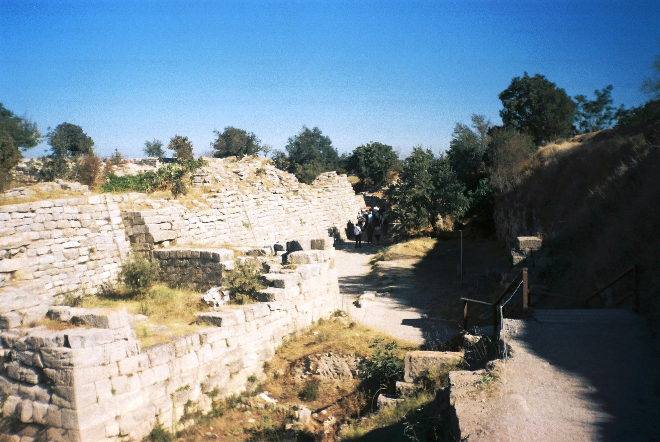
The Walls of Troy VI at Hisarlik
The excavated fortification walls of Troy VI at Hisarlik, Turkey
© More Lessons Less Planning | morelessonslessplanning.com
Notes:
This is a real photograph of the excavated fortification walls of Troy VI at Hisarlik. Have students notice the thick, sloping stone wall and the large fitted stone blocks - these are serious Bronze Age defenses, evidence of a wealthy, well-protected city around 1300 BCE. Point out that the wall is real and impressive, but a strong wall does not tell us WHO attacked the city, or when, or whether the ten-year war of the Iliad ever took place. The stones are evidence of a real fortress; they are not evidence of Homer's specific story.
Reference labels (point to these chart features when teaching): the thick sloping stone wall; the large fitted stone blocks

Slide 7
Troy's Destruction Layers: VI and VIIa
Troy VI
TROY VI (around 1300 BCE) was the strong, prosperous city whose walls were damaged - many scholars think by an earthquake, not a war
Troy VIIa
TROY VIIa (around 1180 BCE) is the layer that shows signs of burning and violent destruction, which some scholars link to a war
Scholars disagree
Scholars DISAGREE about which layer, if any, matches Homer's Trojan War - the evidence does not point clearly to one
Destroyed more than once
The city on this hill was destroyed and rebuilt more than once - so 'the fall of Troy' could point to several different events
Key Concept: TROY VI (~1300 BCE) likely earthquake-damaged; TROY VIIa (~1180 BCE) burned. Which layer, if any, is Homer's war is DEBATED.
© More Lessons Less Planning | morelessonslessplanning.com
Notes:
This is the heart of the evidence, and it must stay honest. The city at Hisarlik was destroyed and rebuilt more than once, so 'the fall of Troy' could point to several different events. TROY VI (around 1300 BCE) was the strong, prosperous layer whose walls were damaged - but many scholars think the damage came from an EARTHQUAKE, not a war, because of how the walls cracked and fell. TROY VIIa (around 1180 BCE) is a poorer, crowded rebuild that shows clear signs of BURNING and violent destruction, which some scholars link to a war or raid. Here is the honest bottom line students must carry: scholars DISAGREE about which layer, if any, matches Homer's Trojan War. The destruction is real; connecting any single layer to Homer's specific ten-year war is not established. Do not let students leave thinking Troy VIIa 'is' the Trojan War - that is one hypothesis, not a proven fact.

Slide 8
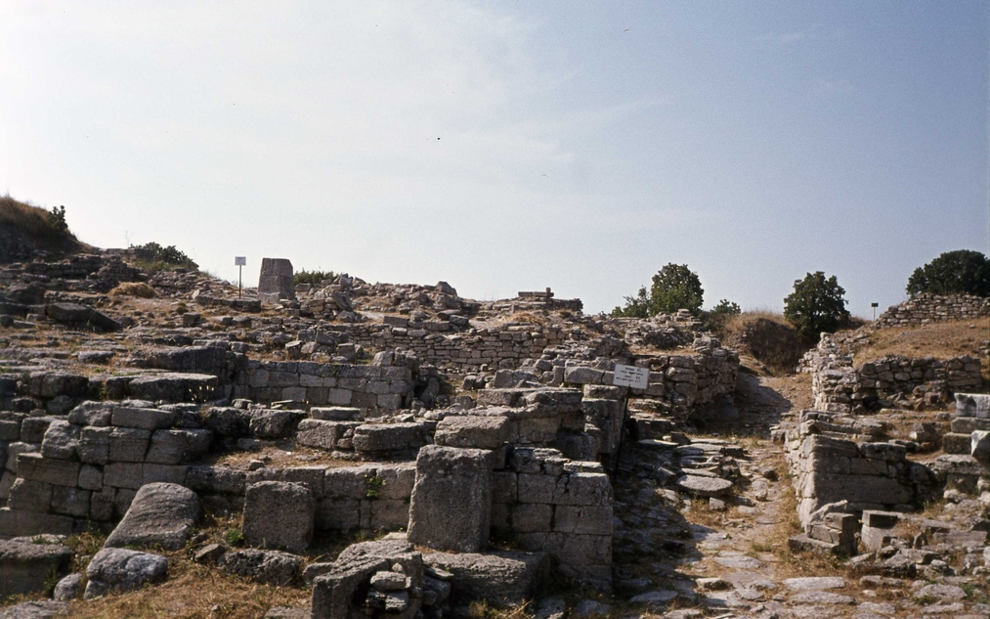
The Hisarlik Excavation Site
Hisarlik (Troy): stacked ruined walls from many settlement layers
© More Lessons Less Planning | morelessonslessplanning.com
Notes:
This is a real photograph of the wider Hisarlik archaeological site, showing stacked ruined walls and stone remains from the many settlement layers built one on top of another. Have students notice how walls from different periods sit at different heights across the excavated mound - a physical picture of the Troy I-IX layers described on the previous slide. This is why archaeologists can say a city was destroyed and rebuilt many times: they can literally see the layers. Remind students that seeing the layers proves repeated destruction, but it does not, by itself, tell us which layer (if any) was Homer's Troy.
Reference labels (point to these chart features when teaching): walls from different periods; the excavated mound

Slide 9
Schliemann Digs for Homer's Troy
The Man Who Dug for Troy
An Honesty Problem
SCHLIEMANN: a 19th-century businessman-archaeologist
He dug at HISARLIK in the 1870s
He believed Homer's epics pointed to a real Troy
His work helped prove a real city stood on the hill
He named a gold hoard 'PRIAM'S TREASURE'
He linked it to King Priam of Homer's Troy
But the gold is OVER A THOUSAND YEARS too old for that war
His fast digging also damaged the very layers he sought
Fact: SCHLIEMANN dug at Hisarlik in the 1870s seeking Homer's Troy; his 'Priam's Treasure' is more than a thousand years too old for the epic war.
© More Lessons Less Planning | morelessonslessplanning.com
Notes:
Cover Schliemann honestly. Heinrich SCHLIEMANN was a wealthy 19th-century businessman who became an archaeologist, convinced that Homer's epics pointed to a real Troy. In the 1870s he dug at HISARLIK and helped prove that a real, important city had stood on the hill - a genuine contribution. But his story carries two honesty problems. First, he found a hoard of gold and jewelry and named it 'PRIAM'S TREASURE' after the king of Troy in the Iliad - but the gold actually dates centuries too early to belong to any Trojan-War-era king, so the name is a guess, not a fact. Second, his digging was fast and rough, and it damaged some of the very layers he was trying to find. Schliemann shows both sides of the story: he proved a real Troy existed, but he also shows how easily excitement about a legend can run ahead of the evidence.

Slide 10
Hittite Clues: Wilusa and Ahhiyawa
Wilusa
WILUSA is a city named in Hittite records, widely thought to be the same place the Greeks called (W)Ilios or Troy
Ahhiyawa
AHHIYAWA is a power named in Hittite texts, plausibly the Mycenaean Greeks - the Achaeans of Homer
A conflict in the region
The Hittite texts mention tension and conflict around Wilusa involving Ahhiyawa - suggestive of real friction in the area
Suggestive, not proof
These names are a suggestive correlation with Homer's world, NOT proof that the epic events happened
Key Concept: Hittite records name WILUSA (likely Troy) and AHHIYAWA (likely the Greeks) - suggestive clues, NOT proof of the epic.
© More Lessons Less Planning | morelessonslessplanning.com
Notes:
Cover the written clues from outside Greece. The Hittites ran a great Bronze Age empire in Anatolia, and their clay-tablet records survive. Two names stand out. WILUSA is a city named in Hittite records that is widely thought to be the same place the Greeks called (W)Ilios or Troy - the sounds match closely. AHHIYAWA is a power named in Hittite texts that is plausibly the Mycenaean Greeks, the Achaeans of Homer. The texts even mention tension and conflict around Wilusa involving Ahhiyawa. This is genuinely exciting: independent records, not Greek, seem to name Troy, the Greeks, and friction between them. But students must hold the honest line: these names are a SUGGESTIVE correlation with Homer's world, not PROOF that the ten-year war of the Iliad happened. They tell us the places and peoples may have been real and in contact; they do not confirm the epic's events.

Slide 11
The Mycenaean Greeks and the Bronze Age Collapse
The Greeks of the Epic
A World That Burned
MYCENAEAN GREEKS: the Bronze Age people of mainland Greece
They are the Achaeans Homer names as Troy's attackers
They built fortified palace-citadels and traded widely
They were a real power around 1600-1100 BCE
Around 1200 BCE came the BRONZE AGE COLLAPSE
Mycenaean palaces burned or were abandoned
Many eastern Mediterranean cities fell at the same time
This is a wide SYSTEMS collapse, not one Greek siege
Key Concept: The MYCENAEAN GREEKS fell in the BRONZE AGE COLLAPSE (~1200 BCE) - a wide systems-collapse, NOT proof of a siege of Troy.
© More Lessons Less Planning | morelessonslessplanning.com
Notes:
Give the Greek side of the evidence, honestly. The MYCENAEAN GREEKS were the Bronze Age people of mainland Greece - the Achaeans Homer names as the attackers of Troy. They were a real power (about 1600-1100 BCE) who built fortified palace-citadels and traded across the Mediterranean, so Homer's 'Greeks' had a real historical model. But around 1200 BCE came the BRONZE AGE COLLAPSE: Mycenaean palaces burned or were abandoned, and many eastern Mediterranean cities fell at roughly the same time. Students often want to connect these burnings to the Trojan War, so be careful: this was a wide SYSTEMS collapse affecting a whole region, with many causes debated (raiders, drought, earthquakes, internal revolt), not evidence of a single ten-year Greek siege of Troy. The collapse is real history; it explains why the palace world ended and why Homer, centuries later, remembered a lost heroic age - but it is not proof of the epic war.

Slide 12
Herodotus Questions Homer
The Father of History
The Helen-in-Egypt Story
HERODOTUS: a Greek writer of the 5th century BCE
Often called the 'father of history'
He investigated stories and checked them against evidence
He did not simply accept Homer's version of the war
Egyptian priests told him HELEN never reached Troy
They said she was held in Egypt the whole war
Herodotus reasoned Troy would have returned her if they could
This is a VARIANT tradition, not the proven 'true story'
Fact: HERODOTUS (5th century BCE) questioned Homer and reported an Egyptian tradition that HELEN was in Egypt, not Troy - a variant, not proof.
© More Lessons Less Planning | morelessonslessplanning.com
Notes:
Set up the primary source. HERODOTUS was a Greek writer of the 5th century BCE, often called the 'father of history' because he investigated stories, traveled widely, and checked what people told him against evidence and reason. Crucially, he did NOT simply accept Homer's version of the Trojan War. In Egypt, priests told him that HELEN never reached Troy at all - that she was held in Egypt for the whole war. Herodotus reasoned that if Helen had really been inside Troy, the Trojans would have handed her back rather than let their city be destroyed, so the Egyptian version made sense to him. Be precise with students: this Helen-in-Egypt story is a VARIANT tradition, not the proven 'true story' of the war. Its real value is not that it solves anything - it is that we can watch an ancient historian doing exactly what this lesson teaches: questioning a famous story and weighing whether it makes sense. Students will read his own words in the activity.

Slide 13
Weighing the Evidence
Evidence | What it CAN show | What it CANNOT show
Destruction layers at Hisarlik | A real city, destroyed more than once | Which layer, if any, is Homer's war
Hittite records (Wilusa, Ahhiyawa) | Real places and peoples, possibly in conflict | That the epic's events actually happened
The Bronze Age collapse (~1200 BCE) | The Mycenaean palace world really ended | That it was caused by a ten-year siege of Troy
Homer's epics | What later Greeks remembered and valued | A reliable, eyewitness record of the war
Big Idea: Each source can show SOME things and not others. No single piece of evidence PROVES the Trojan War happened as Homer told it.
© More Lessons Less Planning | morelessonslessplanning.com
Notes:
Synthesize the evidence honestly, row by row. The DESTRUCTION layers at Hisarlik can show a real city that was destroyed more than once, but not which layer, if any, is Homer's war. The HITTITE records (Wilusa, Ahhiyawa) can show real places and peoples possibly in conflict, but not that the epic's events actually happened. The BRONZE AGE collapse can show that the Mycenaean palace world really ended around 1200 BCE, but not that it was caused by a ten-year siege of Troy. Homer's EPICS can show what later Greeks remembered and valued, but not a reliable eyewitness record of the war. The big idea students must take away: each kind of evidence can show some things and not others, and no single piece PROVES the Trojan War happened as Homer told it. That is why historians WEIGH sources instead of declaring a verdict.

Slide 14
Myth vs. History: What We Can and Cannot Say
Myth vs. history
MYTH VS. HISTORY is the skill of telling the poetic story apart from what the evidence can actually support
What we CAN say
A REAL, fortified Troy existed at Hisarlik and was destroyed more than once - the archaeology supports this
What we CANNOT say
A HOMERIC-scale ten-year Panhellenic war, exactly as the Iliad describes, is NOT established by the evidence
The honest position
Frame the question, present the evidence, and let the evidence set the limits of what we claim
Big Idea: We CAN say a real Troy existed and was destroyed more than once. We CANNOT say a Homeric ten-year war happened as told.
© More Lessons Less Planning | morelessonslessplanning.com
Notes:
Close the argument honestly. MYTH VS. HISTORY is the skill of telling the poetic story apart from what the evidence can actually support. State the two halves plainly. What we CAN say: a REAL, fortified Troy existed at Hisarlik and was destroyed more than once - the archaeology supports this, and the Hittite records and Mycenaean world give it a real setting. What we CANNOT say: a HOMERIC-scale ten-year Panhellenic war, exactly as the Iliad describes it, is NOT established by the evidence. The honest historian's position is to frame the question, present the evidence, and let the evidence set the limits of what we claim, rather than forcing a yes-or-no verdict. That balance - confident about the real city, careful about the epic war - is exactly what students should be able to explain by the end of the lesson.

Slide 15
Key Takeaways
A REAL fortified Troy existed at HISARLIK and was destroyed more than once
★
The city fell more than once; which layer is Homer's war is DEBATED
★
HITTITE records and the BRONZE AGE COLLAPSE are suggestive clues, not proof
★
HOMER wrote centuries later; historians WEIGH evidence, not declare a verdict
★
© More Lessons Less Planning | morelessonslessplanning.com
Notes:
Close the lesson. Review the four takeaways aloud. Students should be able to (a) say confidently that a real fortified Troy existed at Hisarlik and was destroyed more than once, (b) describe the destruction layers (Troy VI earthquake-damaged, Troy VIIa burned) and explain that which layer, if any, is Homer's war is debated, (c) explain that the Hittite records and the Bronze Age collapse are suggestive but not proof, and (d) explain that Homer wrote centuries later, so historians weigh the evidence instead of declaring the war simply true or false. The activity's Primary Source Spotlight will ask them to read Herodotus questioning Homer and connect it to this evidence-weighing skill.

