Slide 1
The Treaty of Versailles
Peace Terms and the Argument Over the Next War
© More Lessons Less Planning | morelessonslessplanning.com
Notes:
Open by separating the armistice from the treaty. Tell students the closing task is an argument, not a summary.

Slide 2
Learning Targets
Explain what the Treaty of Versailles required Germany to give up.
★
Describe what Article 231 actually says and what it was nicknamed.
★
Explain why the treaty set no reparations total in 1919.
★
Use evidence to debate whether the treaty caused the next war.
★
© More Lessons Less Planning | morelessonslessplanning.com
Notes:
Read target 3 aloud. It is the target students most often get wrong on the quiz.

Slide 3
Paris, 1919: The Winners Write the Peace
The armistice of November 11, 1918 stopped the fighting.
Delegates from 32 nations met in Paris beginning January 1919.
The Big Four led: Wilson, Lloyd George, Clemenceau, and Orlando.
Versailles was the 1919 peace treaty with Germany that ended World War I.
It was signed June 28, 1919 and entered into force January 10, 1920.
Key Concept: An armistice is only a cease-fire. The war ended legally when the treaty entered into force in January 1920.
© More Lessons Less Planning | morelessonslessplanning.com
Notes:
Write the two dates on the board side by side: signed 28 June 1919, in force 10 January 1920. Students confuse them constantly.

Slide 4
Germany Was Not Invited to Negotiate
What Germany Expected
What Germany Got
A peace built on Wilson's Fourteen Points.
Self-determination: a people should choose its own government.
A seat at the table to argue Germany's case.
Terms handed over on May 7, 1919 with no debate.
Objections in writing only; nearly all were refused.
Sign by late June or Allied armies would advance.
Key Concept: Germans called it a Diktat - the German word for a dictated peace imposed without negotiation.
© More Lessons Less Planning | morelessonslessplanning.com
Notes:
The German delegation under Brockdorff-Rantzau filed written observations on 29 May 1919. Almost every one was rejected.

Slide 5
June 28, 1919: The Hall of Mirrors
Signed at the Palace of Versailles, outside Paris.
France chose the Hall of Mirrors on purpose.
Germany had proclaimed its empire in that room in 1871.
Germany's foreign minister and transport minister signed.
The date was exactly five years after Sarajevo.
Did You Know: Germany crowned its new empire in the Hall of Mirrors in 1871 after beating France. France picked the same room in 1919.
© More Lessons Less Planning | morelessonslessplanning.com
Notes:
The 1871 proclamation and the 1919 signature happened in the same room, 48 years apart, with the roles reversed.

Slide 6
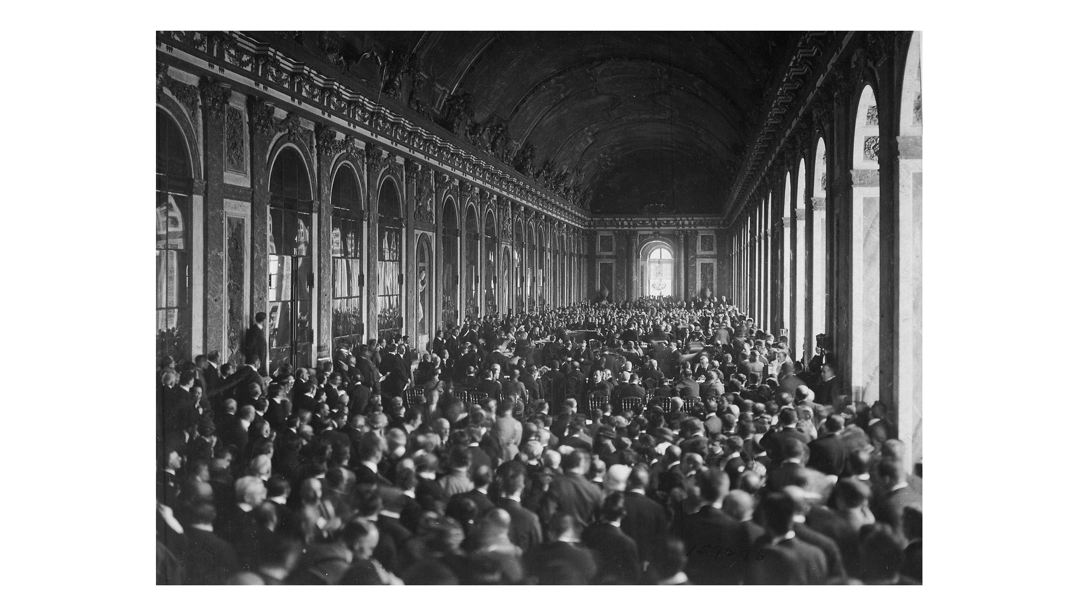
The Signing, June 28, 1919
Hall of Mirrors, 1919
© More Lessons Less Planning | morelessonslessplanning.com
Notes:
Give students fifteen seconds to look at the size of the room and the number of people before moving on.

Slide 7
What Germany Lost: Territory
Territory | What Happened
Alsace-Lorraine | Back to France (Article 51)
Saar Basin | League rule 15 years; coal mines to France
Polish Corridor | A strip of former German land given to Poland to reach the Baltic Sea
Danzig | A Free City under League protection (Article 102)
North Schleswig | To Denmark after a plebiscite in 1920
Colonies | All overseas colonies taken away
Total loss | About 13 percent of territory, 10 percent of people
Note: A plebiscite is a direct public vote in which residents choose which country will govern them.
© More Lessons Less Planning | morelessonslessplanning.com
Notes:
Alsace-Lorraine was taken by Germany in 1871 and restored to France as of the armistice date, 11 November 1918.

Slide 8
What Germany Lost: Military Power
Army capped at 100,000
Article 160: 100,000 men including officers; General Staff dissolved.
✔
No draft
Article 173 abolished compulsory service - volunteers only.
✔
No air force
Article 198 banned all military and naval air forces.
✔
Navy cut to a coast guard
Article 181: 6 battleships, 6 cruisers, 12 destroyers, no submarines.
✔
Rhineland demilitarized
Articles 42-43: no troops or forts west of the Rhine or 50 km east.
✔
Note: A demilitarized zone is an area where a country may not keep troops or fortifications.
© More Lessons Less Planning | morelessonslessplanning.com
Notes:
Germany's army in 1914 was over 800,000 men. The 100,000 cap was roughly an eighth of that.

Slide 9
Article 231: What It Actually Says
Germany accepts responsibility for causing loss and damage.
The words war guilt and guilty appear nowhere in the article.
The article carries no title in the treaty at all.
Its legal job is to establish who must pay for damages.
Two Americans drafted it: Norman Davis and John Foster Dulles.
Key Concept: Article 231 assigns responsibility for loss and damage and names German aggression as the cause. War Guilt Clause is still a nickname.
© More Lessons Less Planning | morelessonslessplanning.com
Notes:
Read the article aloud slowly. Students should hear that it never uses the word guilt.

Slide 10
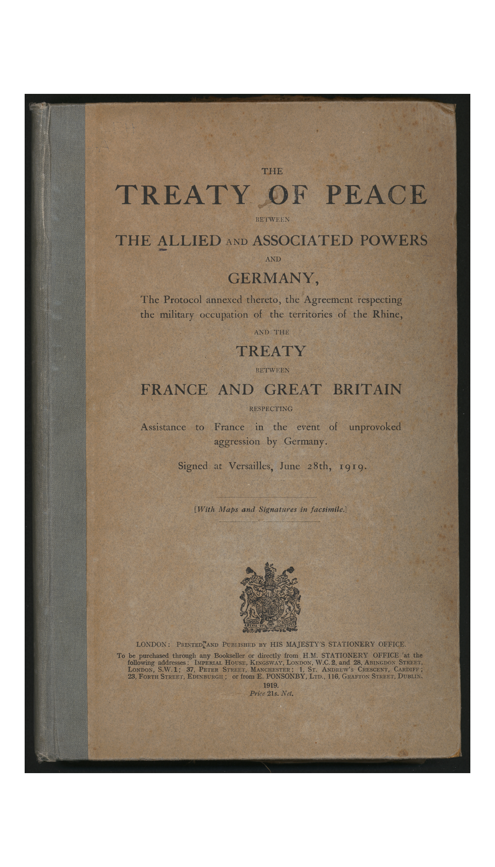
The Treaty as Published in English
English edition, 1919
© More Lessons Less Planning | morelessonslessplanning.com
Notes:
Point out that Article 231 is one clause inside a document of 440 articles.

Slide 11
Responsibility vs. Guilt: Why the Nickname Stuck
What the Article Does
What Germans Heard
Sets up legal liability so bills can be sent.
Article 232 limits the bill to civilian damage.
Near-identical clauses went into the Austrian and Hungarian treaties.
A forced confession that Germany started the war.
Nationalists called it the "war guilt lie."
Attacking the clause became a way to attack the republic.
Big Idea: War Guilt Clause is the popular nickname for Article 231; the phrase war guilt never appears in the treaty.
© More Lessons Less Planning | morelessonslessplanning.com
Notes:
Saint-Germain Article 177 and Trianon Article 161 carry near-identical wording for Austria and Hungary.

Slide 12
Reparations: The Treaty Named No Number
Reparations are payments a defeated nation makes for war damage.
Article 232 admits Germany's resources are not adequate to pay it all.
The bill covers damage done to civilians and their property.
Article 233 created the Inter-Allied Reparation Commission.
That Commission was to set the total Germany owed by May 1, 1921.
Warning: The 132 billion gold marks figure is NOT in the treaty. No sum appears in the 1919 text; Germany signed not knowing.
© More Lessons Less Planning | morelessonslessplanning.com
Notes:
This is the slide that fixes the most common misconception in the unit. Say the words no number appears in the treaty out loud.

Slide 13
Where 132 Billion Gold Marks Came From
Date | What Happened
June 28, 1919 | Treaty signed - liability accepted, no amount set
April 27, 1921 | Reparation Commission fixes the total at 132 billion gold marks
May 5, 1921 | Allied Supreme Council issues the London Schedule of Payments
May 11, 1921 | Germany accepts under threat of occupation of the Ruhr
1924 and 1929 | The Dawes and Young Plans cut and restructure the payments
1932 | The Lausanne Conference effectively ends reparations
Key Concept: The 132 billion figure was set in 1921 by the Reparation Commission, almost two years after the treaty was signed.
© More Lessons Less Planning | morelessonslessplanning.com
Notes:
Every time a student cites 132 billion, ask them for the date. The answer is 1921, not 1919.

Slide 14
The A, B, and C Bonds
A bonds - 12 billion
Set by the London Schedule in May 1921; mostly a balance Germany already owed.
B bonds - 38 billion
The new demand beyond the A bonds. A and B together came to 50 billion gold marks.
C bonds - 82 billion
Historians such as Sally Marks argue these were never meant to be collected.
Think about it: If only 50 of the 132 billion was realistically expected, why announce the larger number in public?
© More Lessons Less Planning | morelessonslessplanning.com
Notes:
Marks calls the C bonds chimerical. Other historians, including Ferguson, argue they retained real coercive force. Present it as a live argument.

Slide 15
How People Reacted
In Germany
In France
In Britain and the U.S.
Called a Diktat and a peace of shame.
Public mourning and flags at half-mast.
The clause became a weapon against the republic.
Many thought the terms were far too soft.
Foch: not peace but an armistice for twenty years.
France wanted stronger security guarantees.
Keynes attacked it as economically ruinous.
The U.S. Senate refused to ratify the treaty.
America made a separate peace with Germany in 1921.
Did You Know: Almost nobody was happy. Germans thought it was too harsh and the French thought it was too soft.
© More Lessons Less Planning | morelessonslessplanning.com
Notes:
Foch's line is the standard attribution, recorded by Paul Reynaud. Keynes published The Economic Consequences of the Peace in 1919.

Slide 16
Did the Treaty Cause World War II?
Yes - the case
No - the case
Reparations and the 1923 Ruhr crisis wrecked the German economy.
The war guilt nickname gave extremists a ready-made grievance.
Germans abroad were denied the self-determination Wilson promised.
Germany paid far less than the treaty demanded.
The Depression, not the treaty, destroyed the republic.
Nations chose not to enforce the treaty in the 1930s.
Key Concept: Historians still argue this. Your job is not to pick the popular answer; it is to defend one answer with evidence.
© More Lessons Less Planning | morelessonslessplanning.com
Notes:
Grade the Part 5 verdict on evidence quality, not on which side the student picks.

Slide 17
Key Takeaways
Signed June 28, 1919; entered into force January 10, 1920.
★
Germany was shown the terms, not allowed to negotiate them.
★
Article 231 assigns responsibility - it never says war guilt.
★
The treaty set no reparations total; 1921 set 132 billion marks.
★
Whether it caused World War II is a live historical debate.
★
© More Lessons Less Planning | morelessonslessplanning.com
Notes:
Use takeaway 3 and 4 as the exit-ticket preview. Those are the two facts most often mixed up.

