Slide 1
The Ticketmaster Monopoly Investigation
The U.S. Department of Justice vs Live Nation-Ticketmaster - a real monopoly investigation you can read yourself.
© More Lessons Less Planning | morelessonslessplanning.com
Notes:
Open with the headline: in May 2024 the U.S. Department of Justice and 30 state attorneys general filed an antitrust lawsuit against Live Nation Entertainment, the parent company of Ticketmaster. This is the biggest U.S. monopoly case since the 1990s Microsoft case - and you can read the actual complaint online. Today we apply everything we learned about monopoly in TK 22 to a real, live case.

Slide 2
Learning Targets
Apply MONOPOLY four features to Live Nation-Ticketmaster and explain DOJ's case
★
Define VERTICAL INTEGRATION and how four businesses can foreclose competition
★
Read real charts; write a Final Investigation Memo recommending a remedy
★
© More Lessons Less Planning | morelessonslessplanning.com
Notes:
Read the three targets aloud. Target 1 connects TK 22 model to a real case. Target 2 introduces the new concept (vertical integration + foreclosure + tying). Target 3 is the synthesis - the Final Investigation Memo at the end of the activity.

Slide 3
What Is This Case?
The 2024 DOJ Suit (Quick Facts)
The Backstory
FILED: May 23, 2024 - Southern District of New York
WHO SUED: U.S. DOJ + 30 state attorneys general
TARGET: Live Nation Entertainment (parent of Ticketmaster)
CHARGE: Monopolization under Sherman Act Section 2
2010: Live Nation + Ticketmaster merger approved under consent decree
2019: DOJ accused Live Nation of repeatedly violating the decree
2022: Taylor Swift Eras Tour ticket meltdown - national outrage
2024: Full antitrust suit filed - the consent decree was not enough
Big Idea: the 2024 case is the U.S. arguing that the 2010 consent decree failed - and structural breakup is the only fix left.
© More Lessons Less Planning | morelessonslessplanning.com
Notes:
Walk the four quick facts on the left. Walk the four backstory beats on the right. Most students will connect the 2022 Eras Tour meltdown - frame it as the moment when consumer-facing monopoly pricing became impossible to ignore.

Slide 4
Recap - What Is a Monopoly?
MONOPOLY (from TK 22)
A market structure with ONE seller, no close substitutes for the product, and high barriers preventing new firms from entering
Why it matters here
The DOJ argues Live Nation-Ticketmaster meets the monopoly definition AND used vertical integration to lock in the position
Big Idea: today we test the DOJ's monopoly claim against the four-features model from TK 22.
© More Lessons Less Planning | morelessonslessplanning.com
Notes:
One-slide recap of the Monopoly definition. The next slide drills the four features.

Slide 5
Recap - The Four Features of Monopoly
1. One seller
Exactly ONE firm dominates the market - or close to one (no real competition)
2. No close substitutes
Buyers have no realistic alternative - they MUST buy from this firm
3. High barriers to entry
Legal, financial, or technological obstacles prevent new firms from entering
4. Price-maker firm
The firm SETS its own price without competitive pressure - tied to features 1-3
Big Idea: the DOJ complaint argues all four features of monopoly are present in the primary concert-ticketing market.
© More Lessons Less Planning | morelessonslessplanning.com
Notes:
One-slide recap of TK 22 four features. The next four slides walk each feature against Ticketmaster.

Slide 6
Feature 1: One Seller? Look at Market Share
Ticketmaster's Share of U.S. Primary Concert Ticketing
What Counts as the Market?
DOJ complaint estimate: roughly 70-80% market share
Major venues: above 90% of NBA, NHL, top amphitheaters
Competitors (AXS, SeatGeek, Eventbrite) split the rest
Image on next slide shows the breakdown
DOJ defines: 'primary ticketing for major concert venues'
Ticketmaster argues: include resale + small venues - share is lower
MARKET DEFINITION is half the antitrust fight
Both sides spend millions on expert economists
Big Idea: how the relevant market is defined determines whether market share is monopoly-level (75%+) or competitive.
© More Lessons Less Planning | morelessonslessplanning.com
Notes:
Walk Ticketmaster's ~75% share. Stress that MARKET DEFINITION is the core fight: the DOJ wants a narrow market (primary major-venue concert ticketing); Ticketmaster wants a broad market (all live entertainment ticketing including resale).

Slide 7
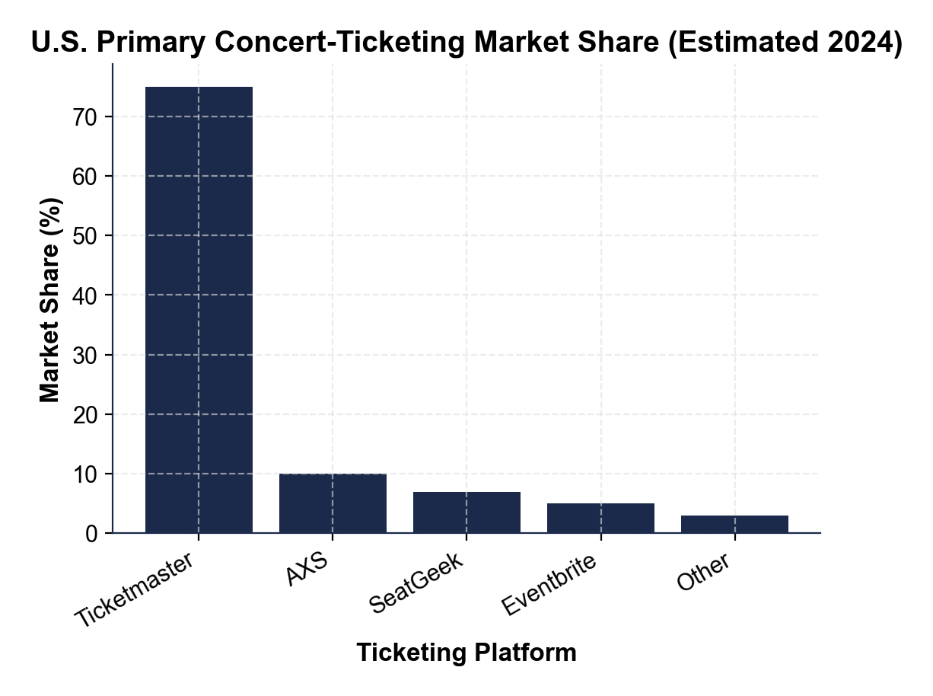
Ticketmaster Market Share - The Picture
U.S. primary concert-ticketing share - Ticketmaster dominates at ~75%.
© More Lessons Less Planning | morelessonslessplanning.com
Notes:
Display the chart full-bleed. Have students read the bar heights aloud. Anchor the 75% figure - this is the market-share evidence the DOJ uses to argue Feature 1 (one seller) is satisfied.
Reference labels (point to these chart features when teaching): Chart 1

Slide 8
Feature 2: No Close Substitutes? Try It Yourself
Tour-specific product
A Drake ticket is not a substitute for a Taylor ticket - each tour is a UNIQUE product fans cannot shop elsewhere
Resale is a different market
StubHub and SeatGeek RESELL - they buy inventory from Ticketmaster primary; they are not real competitors for the first sale
Smaller venues do not count
Tickets at smaller venues exist but not for the major artists fans want - so smaller venues are not real substitutes either
DOJ vs defense framing
DOJ argues no close substitutes for major tours; defense argues 'live entertainment' broadly has many substitutes (sports, movies, theater)
Big Idea: when consumers face ZERO substitution for the artist they want, the monopoly platform has full pricing power.
© More Lessons Less Planning | morelessonslessplanning.com
Notes:
Walk the substitution problem. The legal fight over Feature 2 is: is the relevant 'product' Taylor Swift Eras Tour tickets (no substitutes) or 'live entertainment' broadly (many substitutes)? Same market-definition fight as feature 1.

Slide 9
Feature 3: High Barriers? Venue Exclusivity Contracts
The Three Big Barriers in Ticketing
How Exclusivity Forecloses Competition
1. VENUE EXCLUSIVITY contracts (5-10 year locks)
2. INSTALLED software at every major arena
3. NETWORK EFFECTS - artists go where the buyers are
Madison Square Garden, T-Mobile Arena - signed exclusively with Ticketmaster
Means ZERO other ticketing platform can sell that venue's tickets
Locks competitors out for years at a time
DOJ alleges retaliatory threats against venues that switch
Big Idea: venue exclusivity contracts ARE the legal barrier - a startup ticketer cannot reach customers even with better software.
© More Lessons Less Planning | morelessonslessplanning.com
Notes:
Walk the three barriers. Stress that the venue-exclusivity contract is the CRITICAL one - it directly forecloses any competing ticketer from selling at that venue. The DOJ complaint allegedly documents specific instances of Live Nation threatening venues that consider switching.

Slide 10
Feature 4: Price-Maker? Look at the Fees
The Service-Fee Story
Why This Looks Like Price-Making
FACE VALUE = the ticket price the artist sets
FEES = added by Ticketmaster on top
Service fee + processing fee + facility fee
Often 30-40% on top of face value
Fees are not chosen by the artist or the venue
A typical $100 ticket has a $24 service fee added
Plus $5 processing fee + $6 facility fee = $35 in fees
TOTAL PAID = $135 on a $100 face-value ticket
Big Idea: the service fee is the clearest visible evidence of monopoly pricing power - no competition forces it down.
© More Lessons Less Planning | morelessonslessplanning.com
Notes:
Walk the fee structure. Stress that the consumer cannot avoid fees - the venue has signed exclusivity, so there is no other platform to buy from. THIS is what Feature 4 (price-maker) looks like in this market.

Slide 11
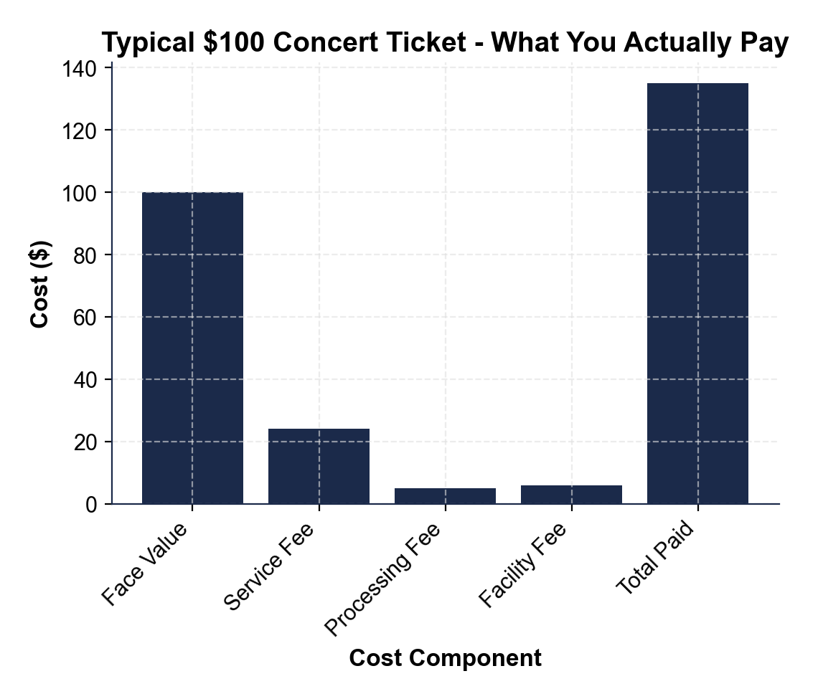
The $100 Ticket Actually Costs $135
$100 face-value ticket actually costs $135 - fees add ~35%.
© More Lessons Less Planning | morelessonslessplanning.com
Notes:
Display the chart. Walk the four bars: Face Value $100, Service Fee $24, Processing Fee $5, Facility Fee $6, Total $135. Stress that the $35 in fees is what Feature 4 (price-maker) looks like in dollar terms.
Reference labels (point to these chart features when teaching): Chart 2

Slide 12
Vertical Integration - The Four-Business Stack
Concert Promotion (~70%)
Live Nation promotes 70% of major U.S. tours - it controls which artists tour where
Venue Ownership (~60%)
Owns or manages 60% of top 100 U.S. amphitheaters - the contracts that lock in ticketing
Ticketing (~75%)
Ticketmaster controls 75% of primary major-venue concert ticketing
Artist Management
Roc Nation-style relationships - influence over which artists tour with Live Nation venues
Big Idea: VERTICAL INTEGRATION = one firm owning multiple supply-chain stages; illegal when used to foreclose competitors.
© More Lessons Less Planning | morelessonslessplanning.com
Notes:
Define vertical integration. Walk the four-business stack. Stress that integration itself is legal - many firms are vertically integrated (Apple owns hardware + software + the App Store). But when integration is used to BLOCK competitors (foreclosure), antitrust kicks in.

Slide 13
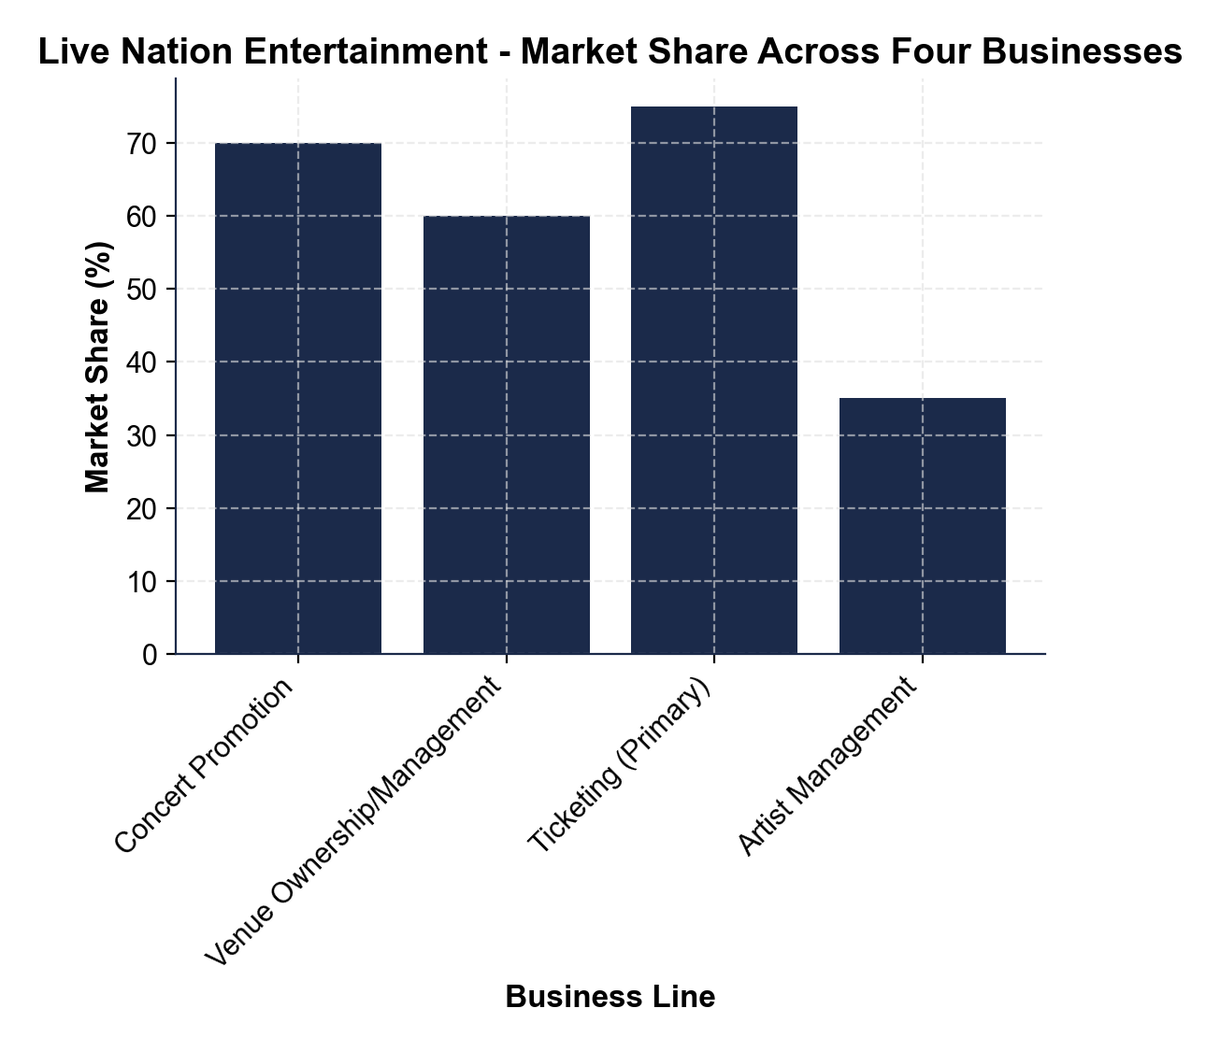
The Live Nation Stack - Visualized
Live Nation owns four major businesses - each reinforces the others.
© More Lessons Less Planning | morelessonslessplanning.com
Notes:
Display the chart. Walk the four columns showing market share or count in each business. This is the evidence backing the vertical integration allegation in the DOJ complaint.
Reference labels (point to these chart features when teaching): Chart 3

Slide 14
The DOJ's Two Big Allegations: Tying + Foreclosure
Tying (Sherman Act Section 1)
Conditioning the sale of one product on the buyer also taking another - 'take Ticketmaster or lose Live Nation concerts'
Foreclosure
Using one market position (venues) to BLOCK competitors from reaching customers in another market (ticketing)
DOJ tying allegation
Live Nation reportedly threatened venues that considered switching ticketers - threats documented in the 2024 complaint
Foreclosure stakes
Even better technology cannot reach customers; competitors never get to scale; innovation in ticketing stalls
Big Idea: tying forces a second product on buyers; foreclosure blocks competitors from reaching customers.
© More Lessons Less Planning | morelessonslessplanning.com
Notes:
Define tying. Define foreclosure. Stress that these are the two specific anticompetitive practices the DOJ is alleging - not just 'monopoly bad' but specific conduct that violates antitrust law.

Slide 15
The Antitrust Laws Behind the Case
The Two Sherman Sections
The Other Antitrust Tools
Section 1 (1890): bans contracts in restraint of trade
Tying + venue exclusivity fall here
Section 2 (1890): bans monopolization
The CORE charge against Live Nation-Ticketmaster
Clayton Act (1914): blocks anti-competitive mergers
Approved the 2010 Live Nation-Ticketmaster merger with conditions
Consent decree: court-enforced settlement
DOJ says this decree was violated repeatedly
Big Idea: U.S. monopoly law dates to 1890 - the Sherman Act broke up Standard Oil (1911) and AT&T (1984).
© More Lessons Less Planning | morelessonslessplanning.com
Notes:
Walk the four laws/concepts. Stress that this case is built on 130+ year old antitrust statutes. Big Tech / modern monopoly cases all run through Sherman + Clayton.

Slide 16
The 2010 Consent Decree - And What Went Wrong
What the 2010 Decree Said
Approved the Live Nation + Ticketmaster merger; forbade retaliation against venues that left Ticketmaster; required arm's-length conduct between the businesses
2019 Violations Alleged
DOJ accused Live Nation of repeated retaliation against switching venues; decree was extended an extra 5 years as penalty
Why the 2024 Complaint Followed
Violations continued even after the extension; conclusion: the conduct remedy failed, so a structural remedy (divestiture) is now needed
Big Idea: when a conduct remedy fails because market power remains, enforcers reach for structural remedies (breakup).
© More Lessons Less Planning | morelessonslessplanning.com
Notes:
Walk the 2010 decree. Walk the alleged violations. Stress that this is the policy logic for the 2024 case: the lighter-touch remedy did not work, so the DOJ is reaching for a heavier remedy (divestiture).

Slide 17
Possible Remedies the DOJ Could Seek
Structural Remedies (Breakup)
Conduct Remedies or Status Quo
DIVESTITURE - force Live Nation to SELL Ticketmaster
FULL BREAKUP - separate all four businesses
Stickier than conduct rules - permanent change
DOJ has reportedly signaled it will seek STRUCTURAL
CONDUCT RULES - rules of behavior (ban exclusivity + retaliation)
Leaves the company intact - easier to win
STATUS QUO - defendant argues market is competitive
2010 consent decree was this type of remedy
Big Idea: the DOJ has reportedly signaled it will seek STRUCTURAL remedies - most likely forcing Live Nation to divest Ticketmaster.
© More Lessons Less Planning | morelessonslessplanning.com
Notes:
Walk the four remedy options. Stress that the DOJ has reportedly indicated structural breakup is the goal. The activity Final Memo asks students to pick a remedy and justify.

Slide 18
Investigation Vocabulary (1 of 3): Vertical Integration + Tying
Vertical integration
ONE firm owns multiple supply-chain stages - Live Nation owns promoter + venues + ticketing + artist mgmt
Tying
Conditioning sale of one product on the buyer also taking another - illegal under Sherman Section 1
Key Point: vertical integration is not automatically illegal - tying is what makes it illegal.
© More Lessons Less Planning | morelessonslessplanning.com
Notes:
Drill these two terms. The next slide has foreclosure and consent decree.

Slide 19
Investigation Vocabulary (2 of 3): Foreclosure + Consent Decree
Foreclosure
Using one market position to BLOCK competitors from reaching customers - venue owner refuses non-Ticketmaster concerts
Consent decree
Court-enforced settlement governing future conduct - the 2010 Live Nation-Ticketmaster decree was allegedly violated
Key Point: the 2010 consent decree allegedly failed - that failure is what justifies a structural remedy in 2024.
© More Lessons Less Planning | morelessonslessplanning.com
Notes:
Drill these two terms. Foreclosure is the central anticompetitive mechanism in the case.

Slide 20
Investigation Vocabulary (3 of 3)
MARKET SHARE - percent of market sales one firm controls (Ticketmaster ~75%)
SERVICE FEE - per-ticket platform charge on face value (often $15-$40)
VENUE EXCLUSIVITY CONTRACT - all tickets through one platform
Legal barrier to entry locking competing ticketers out of major arenas
DIVESTITURE - antitrust remedy forcing sale of part of the business
Principal structural remedy the DOJ is seeking in the 2024 case
Key Point: market share = dominance; service fees = consumer harm; exclusivity contracts = barriers.
© More Lessons Less Planning | morelessonslessplanning.com
Notes:
Walk the four evidence terms. These appear in the Final Memo - students must use them when writing their recommendation.

Slide 21
Key Takeaways
Monopoly is REAL, not just textbook theory
Vertical integration creates monopolies without 100% share
Tying + foreclosure are specific illegal antitrust conducts
Consent decrees often fail - structural remedies follow
Case proceeds in SDNY; trial likely 2026-2027; outcomes uncertain
Big Idea: the TK 22 model (four features of monopoly) explains a real $20+ billion company and a live DOJ case.
© More Lessons Less Planning | morelessonslessplanning.com
Notes:
Synthesize the lesson. The model from TK 22 explained a real case. The Final Memo asks students to use the model to recommend a remedy.

