Slide 1
The Terracotta Army of Qin Shi Huang
How China's first emperor unified the warring states in 221 BCE and built a buried clay army for the afterlife - and why archaeology, not the ancient Shiji text, revealed the soldiers Sima Qian never described.
© More Lessons Less Planning | morelessonslessplanning.com
Notes:
Opening slide. In 221 BCE, the ruler of Qin conquered the last of the warring states and made himself Qin Shi Huang, the First Emperor of a unified China. He standardized writing, money, and roads, ruled through the harsh laws of Legalism, and built an early Great Wall. For his tomb he had an entire army of thousands of life-size clay soldiers made to guard him in the afterlife. Students will learn how he unified China, what the terracotta army was, how it was rediscovered in 1974, and how to analyze the ancient Shiji account of his tomb - while learning the honest limits of that source.

Slide 2
Learning Targets
Explain how Qin Shi Huang unified China in 221 BCE and ruled through Legalism.
★
Describe how standardization and an early Great Wall unified the empire.
★
Explain what the terracotta army was and how it was discovered in 1974.
★
Analyze the ancient Shiji account of the tomb - and what it does NOT mention.
★
© More Lessons Less Planning | morelessonslessplanning.com
Notes:
Read the four learning targets. Today's lesson combines the story of China's first emperor with a history skill: reading an ancient source carefully and figuring out its limits. Keep the big idea in mind - the terracotta army was one part of a vast tomb complex, the ancient Shiji text describes the tomb but never the clay soldiers, and it took archaeology in 1974 to reveal the army the text left out.

Slide 3
China's First Emperor Unites the Warring States
Warring States
The period of rival Chinese kingdoms that fought one another for power until the state of Qin conquered them all.
Qin Shi Huang
China's first emperor, who unified the warring states in 221 BCE and later had a vast tomb complex built to guard him in the afterlife.
Key Concept: In 221 BCE the ruler of Qin ended the WARRING STATES and made himself QIN SHI HUANG, China's first emperor.
© More Lessons Less Planning | morelessonslessplanning.com
Notes:
For centuries, China was split among rival kingdoms in the WARRING STATES period, fighting one another for power. The state of Qin slowly conquered the others, and in 221 BCE its ruler united all of China under one government. He took a brand-new title: QIN SHI HUANG, meaning First Emperor. He was the first person ever to rule a unified China, and he wanted a single strong government with himself at its center. The word 'Qin' is pronounced 'chin' and is often cited as a possible root of the name 'China.'

Slide 4
Ruling Through Legalism
Legalism
The harsh philosophy of strict laws and severe punishments that Qin Shi Huang used to control his empire.
✔
Burning the books
To crush disagreement, the emperor ordered many books and rival ideas destroyed so only his rules would be followed.
✔
Order through fear
Harsh law brought order, but it made the emperor feared and hated, and his dynasty fell soon after his death.
✔
Key Concept: Qin Shi Huang ruled through LEGALISM - strict laws and severe punishments - and even ordered the burning of BOOKS.
© More Lessons Less Planning | morelessonslessplanning.com
Notes:
Qin Shi Huang controlled his huge new empire through LEGALISM, a philosophy that said people obey only strict laws backed by severe punishments. Officials enforced the law harshly, and disobedience was punished cruelly. To stop scholars from praising older ways and criticizing him, the emperor ordered the burning of many BOOKS and the silencing of rival ideas. Legalism did bring order and unity, but it also made the emperor deeply feared. The harshness bred resentment, and his Qin dynasty collapsed only a few years after he died - even as the empire he created endured.

Slide 5
One Empire: Standardization and the Great Wall
Standardization
Making things the same across the empire - one system of writing, one currency, and shared weights, measures, and road widths.
Great Wall
The long defensive barrier the First Emperor created by connecting and extending earlier walls to protect his northern border.
Key Concept: Qin Shi Huang tied China together through STANDARDIZATION and connected older walls into an early GREAT WALL.
© More Lessons Less Planning | morelessonslessplanning.com
Notes:
To make his empire work as one country, Qin Shi Huang used STANDARDIZATION - making things the same everywhere. He ordered one system of writing so all officials could read the same documents, one currency of coins for trade, and shared weights, measures, and even road widths so carts could travel the whole empire. He also connected and extended older defensive walls along the northern border into a single long barrier - an early version of the GREAT WALL of China - to protect against nomadic raiders. These projects tied a huge, once-divided land into a single working empire.

Slide 6
A Tomb Fit for the Afterlife
Afterlife
The life after death the emperor prepared for by having an entire clay army and a palace-like tomb buried with him.
✔
A city-sized tomb
More than 700,000 workers labored for decades on a vast underground tomb complex meant to serve the emperor forever.
✔
Key Concept: Qin Shi Huang built a giant tomb complex to serve him in the AFTERLIFE, worked on by more than 700,000 laborers.
© More Lessons Less Planning | morelessonslessplanning.com
Notes:
Qin Shi Huang feared death and prepared for the AFTERLIFE - the life he believed would continue after he died. He ordered a tomb unlike any other: a vast underground complex meant to give him everything an emperor would need forever. Ancient records say more than 700,000 workers labored for decades to build it. The tomb had a palace-like underground structure and was surrounded by pits filled with treasures and figures. The emperor wanted to rule in death just as he had ruled in life, so his tomb was designed to be a whole world of its own, with an army standing guard nearby.

Slide 7
The Terracotta Army
Terracotta Army
The thousands of life-size clay soldiers, horses, and chariots buried in pits to guard Qin Shi Huang's tomb in the afterlife.
Life-size and individual
Each clay soldier is life-size, and no two faces are exactly alike; they were once painted in bright colors and held real weapons.
Key Concept: The TERRACOTTA ARMY is thousands of life-size CLAY soldiers, horses, and chariots buried to guard the emperor.
© More Lessons Less Planning | morelessonslessplanning.com
Notes:
The most amazing part of the tomb complex is the TERRACOTTA ARMY - thousands of life-size CLAY soldiers, along with horses and chariots, buried in pits to guard the emperor in the afterlife. The figures were arranged in battle formation, as if ready to defend their ruler forever. Each soldier is life-size, and remarkably, no two faces are exactly alike - archaeologists have found infantry, archers, cavalry, and officers, each with different features, hairstyles, and armor. The soldiers were once painted in bright colors and held real bronze weapons. The next slide shows a photograph of the real army as it stands in the excavation pits today.

Slide 8
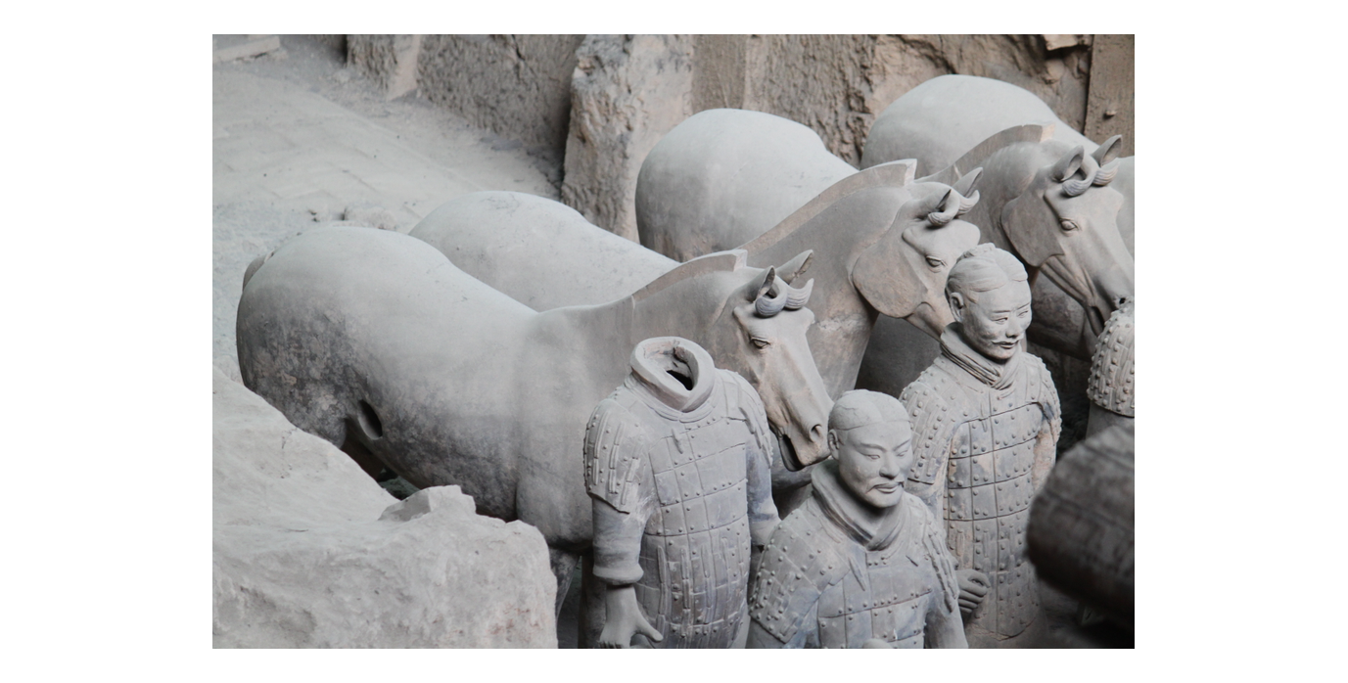
The Real Terracotta Army at Xi'an
Rows of life-size terracotta soldiers and horses in Pit 1 at Xi'an, China.
© More Lessons Less Planning | morelessonslessplanning.com
Notes:
CC0 public-domain photograph of the real Terracotta Army (Pit 1) at the Qin Shi Huang Mausoleum Site near Xi'an. Point out the rows of life-size soldiers and horses standing in battle formation in the excavation pit. Use it purely as a reference visual for the clay army taught on the previous slide - students are not asked to analyze or count the figures as evidence.
Reference labels (point to these chart features when teaching): Life-size clay soldiers; Battle formation in the pit

Slide 9
Lost and Found: The 1974 Discovery
Archaeology
The study of the past through physical remains, which revealed the buried terracotta army in 1974 - something the ancient text never mentioned.
Found by farmers
In 1974, farmers digging a well near Xi'an struck a clay head, and archaeologists then uncovered the vast buried army.
Key Concept: The terracotta army was unknown for over 2,000 years until farmers and ARCHAEOLOGY revealed it in 1974.
© More Lessons Less Planning | morelessonslessplanning.com
Notes:
For more than two thousand years, the terracotta army lay buried and forgotten. Then, in 1974, a group of farmers digging a well in a field near Xi'an struck pieces of a clay figure. Experts were called in, and ARCHAEOLOGY - the study of the past through physical remains - revealed pit after pit of buried soldiers, eventually thousands of them. This is a crucial point: the huge clay army was NOT known from the history books. No famous ancient text described it. It took the physical evidence dug out of the ground in 1974 to prove the terracotta army had ever existed at all.

Slide 10
The Ancient Record: Sima Qian's Shiji
Sima Qian
The Han-dynasty historian who wrote the Shiji, describing the First Emperor's tomb about 100 years after his death.
✔
Shiji
The Records of the Grand Historian, which describes the tomb's rivers of mercury, automatic crossbows, and sealed workmen.
✔
What it leaves out
The Shiji describes the tomb and palace but NEVER mentions the terracotta army - the clay soldiers are absent from the text.
✔
Key Concept: SIMA QIAN's SHIJI describes the tomb's rivers of mercury and crossbows - but it never mentions the terracotta army.
© More Lessons Less Planning | morelessonslessplanning.com
Notes:
About a hundred years after the First Emperor died in 210 BCE, the great Han historian SIMA QIAN wrote about the tomb in the SHIJI (Records of the Grand Historian). His account is vivid: he describes 700,000 workers, rivers and a sea of flowing MERCURY (quicksilver) modeling the whole land, hidden crossbows set to shoot robbers, the heavens set above and the earth's geography below, and the workmen sealed inside so they could not reveal its secrets. But here is the key: the Shiji describes the underground tomb and palace, and it NEVER mentions the terracotta army. The clay soldiers are simply not in the text. Sima Qian wrote about the tomb; archaeology in 1974 found the army the text left out.

Slide 11
Why the Terracotta Army Matters
A source to question
The Shiji is evidence to weigh, not proven fact: it was written 100 years later and the tomb mound has never been excavated.
✔
Where evidence meets text
Modern soil tests found unusually high mercury near the mound - consistent with, though not proof of, the Shiji's mercury rivers.
✔
One ruler's ambition, made visible
Together the clay army and the ancient text show the scale of Qin Shi Huang's power and his demand to rule even in death.
✔
Key Concept: Treat the Shiji as EVIDENCE to question; modern soil tests found high MERCURY near the still-unopened tomb mound.
© More Lessons Less Planning | morelessonslessplanning.com
Notes:
Why does the terracotta army matter so much? First, it shows the staggering scale of Qin Shi Huang's power - only an emperor who unified China could command thousands of clay soldiers and 700,000 workers. Second, it teaches a history lesson: the Shiji is EVIDENCE to question, not proven fact. Sima Qian wrote it about 100 years later, and the central tomb mound has still never been excavated, so we cannot simply assume every detail is true. Yet evidence and text can meet: modern soil tests around the mound found unusually high MERCURY, consistent with - though not proof of - the Shiji's rivers of mercury. The army and the text together reveal one ruler's demand to rule even in death.

Slide 12
Key Takeaways
Qin Shi Huang unified the warring states in 221 BCE and ruled through Legalism.
★
He tied the empire together with standardization and an early Great Wall.
★
The terracotta army guarded his tomb for the afterlife and was found in 1974.
★
Sima Qian's Shiji describes the tomb but never the army - a source to question.
★
© More Lessons Less Planning | morelessonslessplanning.com
Notes:
Recap the four takeaways. The big ideas: in 221 BCE Qin Shi Huang unified the warring states to become China's first emperor and ruled through the harsh laws of Legalism; he tied the empire together through standardization and connected earlier walls into an early Great Wall; he built a vast tomb for the afterlife guarded by the terracotta army, thousands of life-size clay soldiers unknown until farmers and archaeology revealed them in 1974; and the ancient Shiji by Sima Qian describes the tomb's mercury rivers and crossbows but never the clay army - a reminder to treat even a famous source as evidence to question.

