Slide 1
The Swiss Lake Dwellings
How a waterlogged lakebed preserved a whole Neolithic farming village.
© More Lessons Less Planning | morelessonslessplanning.com
Notes:
Open with the hook. About 5,000 to 6,000 years ago, farming families in what is now Switzerland built their homes on wooden posts over and beside Alpine lakes. When the villages were abandoned, they sank into the wet mud - and that mud sealed out the air and preserved wood, cloth, seeds, and food that would have rotted anywhere else. Today students learn how these pile dwellings were built, how the lake dwellers farmed and herded, and how archaeologists reconstruct their daily life. The lesson ends with the 1866 words of Ferdinand Keller, the archaeologist who first studied the sites, which students will analyze.

Slide 2
Learning Targets
Explain what the Swiss lake dwellings were and how they were built
★
Describe daily life in a Neolithic lake-dwelling village
★
Analyze how waterlogged preservation reveals daily Neolithic life
★
© More Lessons Less Planning | morelessonslessplanning.com
Notes:
Read each target aloud. Target 1 maps to slides 3 and 5 (what the villages were and how the pile houses were built). Target 2 maps to slides 4 and 8-11 (Neolithic life, tools, food, farming, herding, daily village life). Target 3 maps to slides 6-7 and 13 (the accidental discovery, waterlogged preservation, and how archaeologists reconstruct the past) and drives the Primary Source Spotlight analysis. The quiz and activity test all three.

Slide 3
What Were the Swiss Lake Dwellings?
The Villages
Pile Dwelling
Ancient farming villages built beside Swiss lakes
Built about 5,000-6,000 years ago (Neolithic)
Homes raised over shallow water or the marshy shore
Found around lakes in Switzerland and the Alps
PILE DWELLING: a house built on wooden posts (piles)
The piles were driven into the bed of a lake or wetland
Also called pile-built houses or lake dwellings
Raised floors kept homes above the damp ground and water
Key Concept: A PILE DWELLING is a house built on wooden posts, called piles, driven into the bed of a lake or wetland.
© More Lessons Less Planning | morelessonslessplanning.com
Notes:
Define the core idea. The Swiss lake dwellings were ancient farming villages built beside the lakes of Switzerland and the Alps about 5,000 to 6,000 years ago, in the Neolithic period. Their signature feature was the PILE DWELLING - a house built on wooden posts, called piles, that were driven into the bed of a lake or wetland. The raised floor kept the homes above the damp ground and the shallow water. These were not tents or caves but sturdy, permanent houses, and dozens of them clustered together to form a village near the shore.

Slide 4
The Neolithic Revolution: A New Way of Life
Neolithic
NEOLITHIC means the New Stone Age, when humans began farming, herding animals, and living in settled villages.
Farming begins
People stopped only hunting and gathering and began to grow crops such as wheat and barley
Domestication
DOMESTICATION is the process of taming wild plants and animals so they can be grown or raised by people
Settling down
Farming let people live in one place year-round in permanent villages instead of wandering
Key Concept: In the NEOLITHIC (New Stone Age) people learned to farm and herd through DOMESTICATION and settled into permanent villages.
© More Lessons Less Planning | morelessonslessplanning.com
Notes:
Set the big context. The lake dwellers lived during the NEOLITHIC, the New Stone Age, when humans began farming, herding animals, and living in settled villages instead of only hunting and gathering. The key that unlocked this new life was DOMESTICATION - the process of taming wild plants and animals so they can be grown or raised by people. Neolithic people grew crops such as wheat and barley and raised tamed animals. Because farming produced a steady food supply in one place, people could stop wandering and live year-round in permanent villages like the lake dwellings.

Slide 5
How the Houses Were Built
Building on Water
The Huts
Villagers cut down trees for timber
Sharpened logs into piles (pointed posts)
Drove hundreds of piles deep into the soft lakebed
Laid a platform of logs across the tops
Built huts of wood, branches, and clay on the platform
WATTLE AND DAUB: branches woven into a wall, packed with clay
Roofs thatched with reeds and straw
The raised floor kept homes dry above water and mud
Big Idea: Builders drove hundreds of wooden piles into the lakebed, laid a log platform on top, and built huts of wood and clay above the water.
© More Lessons Less Planning | morelessonslessplanning.com
Notes:
Explain the engineering. To build a pile dwelling, villagers cut down trees, sharpened the logs into piles, and drove hundreds of them deep into the soft lakebed. Across the tops they laid a platform of logs. On this platform they built huts of wood, branches, and clay. The walls used WATTLE AND DAUB - a building method of weaving branches into a wall and packing it with clay - and the roofs were thatched with reeds and straw. The raised floor kept the homes dry above the water and mud. It was serious construction that took a whole community working together.

Slide 6
An Accidental Discovery: The 1854 Drought
The dry winter
In the winter of 1853-1854 a drought dropped Swiss lake levels to record lows
The find
Villagers digging near Meilen on Lake Zurich struck rows of ancient wooden posts in the mud
Ferdinand Keller
FERDINAND KELLER was the Swiss archaeologist who first studied the lake dwellings after the 1854 drought exposed them
Archaeologist
An ARCHAEOLOGIST is a scientist who studies the past by digging up and examining objects people left behind
Did You Know: A drought in 1854 exposed the posts, and archaeologist FERDINAND KELLER was the first to study and name the lake dwellings.
© More Lessons Less Planning | morelessonslessplanning.com
Notes:
Tell the discovery story. In the winter of 1853 to 1854, a drought dropped the Swiss lake levels to record lows. Villagers near Meilen on Lake Zurich, working to reclaim land from the retreating water, struck rows of ancient wooden posts sticking up from the mud. FERDINAND KELLER was the Swiss archaeologist who first studied the lake dwellings after the 1854 drought exposed them, and he gave them their name. An ARCHAEOLOGIST is a scientist who studies the past by digging up and examining objects people left behind. Keller realized these posts were the remains of a prehistoric village, and the discovery launched a whole field of study.

Slide 7
Waterlogged Preservation: Nature's Time Capsule
Sealed in Wet Mud
Preservation
The village sank into WATERLOGGED mud on the lakebed
Waterlogged means soaked with water, sealing out oxygen
Without oxygen, wood and plants cannot rot away
Everyday objects survived for thousands of years
PRESERVATION: the survival of ancient materials over time
The wet, airless mud gave unusually good preservation
Wood, cloth, seeds, and food remains all survived
Dry-land sites lose these soft materials to decay
Key Concept: WATERLOGGED (airless) mud sealed out oxygen and gave amazing PRESERVATION of wood, plants, and food remains.
© More Lessons Less Planning | morelessonslessplanning.com
Notes:
This is the central concept slide. When the lake-dwelling villages were abandoned, they sank into WATERLOGGED mud on the lakebed. Waterlogged means soaked with water, and that water seals out the oxygen that normally makes things rot. Without oxygen, wood and plants cannot decay, so everyday objects survived for thousands of years. PRESERVATION is the survival of ancient materials over time; the lakebed's wet, airless mud gave unusually good preservation. Wood, cloth, seeds, and food remains all survived here - the very soft materials that vanish at ordinary dry-land sites. That is why the lake dwellings are such an extraordinary window into the Neolithic.

Slide 8
Tools of the Lake Dwellers
Artifact
An ARTIFACT is any object made or used by people in the past, such as a tool, pot, or ornament
Stone tools
Polished stone axes, still fixed in their wooden handles, were used to cut wood
Bone and antler
Pointed tools of bone and antler served as awls, needles, and harpoons
Pottery and cloth
Clay pots stored food, and woven cloth was made from flax and spun thread
Key Concept: The mud preserved thousands of ARTIFACTS - stone axes, bone tools, clay pots, and even woven cloth.
© More Lessons Less Planning | morelessonslessplanning.com
Notes:
Cover the material culture. An ARTIFACT is any object made or used by people in the past, such as a tool, pot, or ornament, and the lake dwellings preserved thousands of them. Archaeologists found polished stone axes still fixed in their wooden handles - the wood survived because of the waterlogged mud. There were pointed tools of bone and antler that served as awls, needles, and harpoons. There were clay pots for storing food and woven cloth made from flax and spun thread. Together these artifacts show a skilled, settled community that made its own tools, containers, and clothing.

Slide 9
What They Ate: The Midden Tells All
Midden
A MIDDEN is a rubbish heap of discarded food remains, bones, and broken tools that shows what people ate and used
Crops
Charred wheat, barley, and stored apples and berries were found preserved in the mud
Meat and dairy
Bones of cattle, sheep, goats, and pigs show they raised animals for food
Wild foods
They still gathered nuts, wild fruit, and fish to add to their farmed food
Big Idea: Archaeologists read the village MIDDEN - its bones and seeds - to learn exactly what the lake dwellers ate.
© More Lessons Less Planning | morelessonslessplanning.com
Notes:
Explain how we know their diet. A MIDDEN is a rubbish heap of discarded food remains, bones, and broken tools that shows what people ate and used. The lake-dwelling middens, preserved in wet mud, are packed with evidence. Archaeologists found charred wheat and barley, along with stored apples and berries. They found the bones of cattle, sheep, goats, and pigs, which show the villagers raised animals for food. And they found nuts, wild fruit, and fish, which show the people still gathered and fished to add to their farmed food. The midden is like a grocery receipt for a Neolithic village.

Slide 10
Farming and Herding by the Lake
Farming
Herding
Cleared fields near the lake to grow crops
Grew wheat, barley, flax, and peas
Ground grain into flour on stone querns
Stored the harvest to last through winter
HERDING: raising and tending domesticated animals
Kept cattle, sheep, goats, and pigs
Animals gave meat, milk, wool, and leather
DOMESTICATION turned wild animals into farm animals
Key Concept: The lake dwellers combined farming with HERDING - raising DOMESTICATED cattle, sheep, goats, and pigs.
© More Lessons Less Planning | morelessonslessplanning.com
Notes:
Show the two halves of their food economy. On the farming side, the lake dwellers cleared fields near the lake and grew wheat, barley, flax, and peas. They ground grain into flour on stone querns and stored the harvest to last through winter. On the herding side, HERDING means raising and tending domesticated animals such as cattle, sheep, goats, and pigs for food and materials. Their animals gave meat, milk, wool, and leather. DOMESTICATION had turned wild animals into farm animals. Combining farming and herding gave the village a reliable, year-round food supply - the foundation of settled Neolithic life.

Slide 11
Daily Life in the Village
A Day by the Lake
A Settled Community
Families lived in clustered huts on the platform
Adults farmed the fields and tended the animals
People spun thread and wove cloth from flax
Children helped gather food and mind the flocks
Dozens of families shared one village
Dugout canoes carried people across the lake
Trade brought stone and tools from far away
Life followed the seasons of planting and harvest
Big Idea: The lake dwellers lived a settled village life - farming, herding, weaving, and trading - very different from wandering hunters.
© More Lessons Less Planning | morelessonslessplanning.com
Notes:
Pull the daily picture together. In a lake-dwelling village, families lived in clustered huts on the shared wooden platform. Adults farmed the fields and tended the animals, people spun thread and wove cloth from flax, and children helped gather food and mind the flocks. Dozens of families made up a single settled community. They crossed the lake in dugout canoes - boats hollowed from a single log - and traded for stone and tools from far away. Life followed the seasons of planting and harvest. This was a stable, cooperative village life, very different from the wandering bands of earlier hunter-gatherers. The next slide shows a modern reconstruction of what such a village looked like.

Slide 12
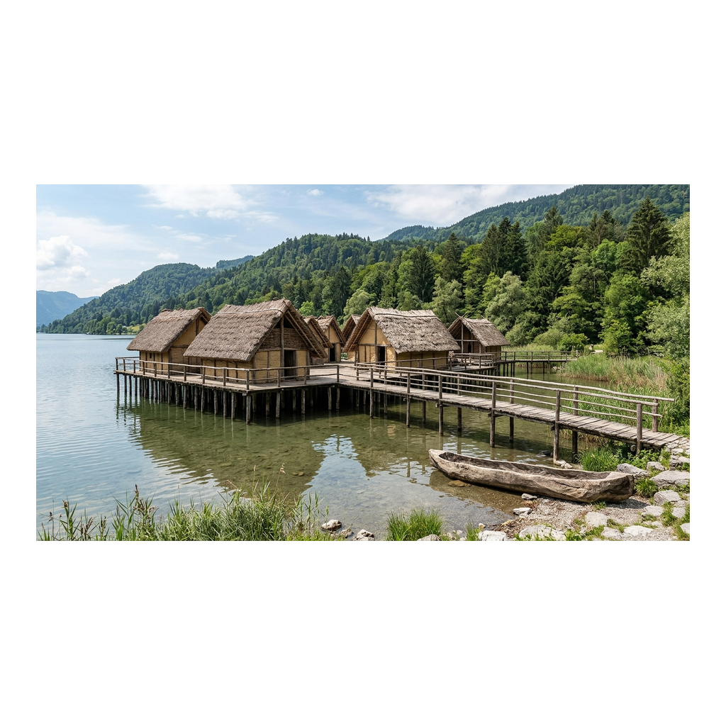
A Reconstruction of a Lake-Dwelling Village
Artist's reconstruction of a Neolithic lake-dwelling village on wooden piles
© More Lessons Less Planning | morelessonslessplanning.com
Notes:
Show the reconstruction. This illustration reconstructs what a lake-dwelling village would have looked like about 5,000 years ago, based on the excavated evidence. Have students notice the wooden piles rising out of the water, the raised platform, and the thatched huts on top. Open-air museums such as the Pfahlbaumuseum at Unteruhldingen on Lake Constance have rebuilt pile dwellings full-size in the same way. Reconstructions like this help us picture the daily life that the mud preserved only in pieces.
Reference labels (point to these chart features when teaching): wooden piles; houses over the water

Slide 13
Reconstructing the Past from Wet Mud
Reading the layers
Every layer of mud holds seeds, bones, wood, and tools in the order they were dropped
Dating the wood
Tree rings in the preserved piles can date exactly when a house was built
A fuller picture
Soft remains - cloth, food, wood - survive here that vanish at dry-land sites
Careful work
Archaeologists record where each artifact lies before removing it from the mud
Key Concept: Because the mud preserved wood, seeds, and cloth, archaeologists can reconstruct daily Neolithic life in unusual detail.
© More Lessons Less Planning | morelessonslessplanning.com
Notes:
Explain the science of reconstruction. The value of the lake dwellings is what archaeologists can learn from them. Every layer of mud holds seeds, bones, wood, and tools in the order they were dropped, so the layers act like a timeline. Tree rings in the preserved wooden piles can date exactly when a house was built. Because soft remains - cloth, food, and wood - survive here that vanish at ordinary dry-land sites, archaeologists get a far fuller picture of daily life. They work carefully, recording exactly where each artifact lies before removing it. Piece by piece, the waterlogged mud lets them reconstruct daily Neolithic life in unusual detail.

Slide 14
On the Lake or Beside It?
The old picture
Early scholars pictured whole villages standing out over open water on tall stilts
New evidence
Many houses actually stood on the marshy shore, flooded only at times
Why it matters
Careful digging changed the story - science corrects its own early guesses
Still true
Either way, the homes were raised on piles and preserved by the wet ground
Did You Know: Newer research shows many 'lake' dwellings stood on the boggy shore, not out over deep water - the science was corrected over time.
© More Lessons Less Planning | morelessonslessplanning.com
Notes:
Model how history gets corrected. When Ferdinand Keller first studied the sites, early scholars pictured whole villages standing out over open water on tall stilts - a dramatic image that filled textbooks for a century. But newer evidence shows that many houses actually stood on the marshy shore, flooded only at times, rather than over deep water. This matters because it shows that careful digging changes the story: science corrects its own early guesses as better evidence comes in. Either way, the key facts hold - the homes were raised on piles and preserved by the wet ground. Good history stays open to new evidence.

Slide 15
Key Takeaways
The Swiss lake dwellings were NEOLITHIC farming villages built on wooden PILES
★
WATERLOGGED mud preserved wood, food, and cloth for thousands of years
★
A drought in 1854 exposed them; FERDINAND KELLER first studied them
★
MIDDENS and ARTIFACTS show a settled life of farming and HERDING
★
© More Lessons Less Planning | morelessonslessplanning.com
Notes:
Close the lesson. Review the four takeaways aloud. Students should be able to (a) describe what a pile dwelling was and how it was built, (b) explain how waterlogged preservation works and why it matters, and (c) describe daily Neolithic life - farming, herding, tools, and food - and how archaeologists reconstruct it. The activity's Primary Source Spotlight will ask them to read Ferdinand Keller's own 1866 report and connect it to what they learned.

