Slide 1
The Swahili Coast Trade Cities
Use an eyewitness account and the coral-stone ruins to reconstruct how Kilwa blended African, Arab, and Indian Ocean cultures.
© More Lessons Less Planning | morelessonslessplanning.com
Notes:
Opening slide. Along the East African coast, cities like Kilwa grew wealthy on Indian Ocean trade and blended African, Arab, and Indian Ocean cultures into a distinctive Swahili civilization. Students will use a written primary source (Duarte Barbosa's description of Kilwa) plus archaeology to reconstruct what these cities were like.

Slide 2
Learning Targets
Locate the Swahili Coast and explain why its cities grew wealthy.
★
Explain how monsoon winds linked East Africa to Arabia, India, and China.
★
Describe how Swahili culture blended African, Arab, and Indian influences.
★
Combine a written primary source with archaeology to reconstruct the coast.
★
© More Lessons Less Planning | morelessonslessplanning.com
Notes:
Read the four learning targets. Today combines a geography story (monsoon winds and Indian Ocean trade) with a history skill (using a primary source and archaeology together to reconstruct a civilization).

Slide 3
The Swahili Coast
Swahili Coast
The chain of East African trading cities along the Indian Ocean, from Somalia to Mozambique.
City-state
An independent, self-governing city and its surrounding land, like Kilwa or Mombasa.
Key Concept: The SWAHILI COAST was a chain of independent trading CITY-STATES along the Indian Ocean.
© More Lessons Less Planning | morelessonslessplanning.com
Notes:
The SWAHILI COAST was the chain of East African trading cities that lined the Indian Ocean shore, stretching from Somalia in the north to Mozambique in the south. These were not one empire but many independent CITY-STATES - each a self-governing city and its surrounding land, such as Kilwa, Mombasa, and Zanzibar. Every city ran its own trade, so the coast held dozens of rival, richly connected port cities rather than a single kingdom.

Slide 4
A World Connected by Monsoon Winds
Indian Ocean trade
The network of sea routes linking East Africa with Arabia, Persia, India, and China.
✔
Monsoon winds
Seasonal winds that reversed direction each year, carrying ships to and from the coast.
✔
Key Concept: MONSOON WINDS reversed direction each year, powering the INDIAN OCEAN TRADE routes.
© More Lessons Less Planning | morelessonslessplanning.com
Notes:
INDIAN OCEAN TRADE was the vast network of sea routes that linked East Africa with Arabia, Persia, India, and China. What made it work were the MONSOON WINDS - seasonal winds that reversed direction each year. From about November the winds blew ships toward Africa; months later they reversed and carried the ships home. Because sailors could count on this yearly cycle, merchants from across the ocean visited the Swahili Coast again and again.

Slide 5
A Blended Coastal Culture
Swahili
The Bantu-based coastal language and culture that blended African, Arab, and Indian Ocean influences.
A shared faith
Islam became the common religion of the merchant class along the coast.
Key Concept: SWAHILI culture blended African roots with Arab and Indian Ocean influences.
© More Lessons Less Planning | morelessonslessplanning.com
Notes:
SWAHILI is the coastal language and culture that blended African roots with Arab and Indian Ocean influences. Swahili began as a Bantu African language but absorbed many Arabic words through centuries of trade. As Arab and Persian traders settled and married into coastal families, the merchant families became Muslim, and Islam became the common faith of the coastal cities. The result was one blended coastal civilization - African at its core, but connected to the wider Muslim and Indian Ocean world.

Slide 6
Kilwa: A City of Coral and Gold
Great Mosque of Kilwa
A large coral-stone mosque whose ruins show the city's wealth and Islamic faith.
✔
Coral stone
Building material cut from ocean reefs, used for mosques, palaces, and homes.
✔
Key Concept: KILWA built the GREAT MOSQUE and its palaces from CORAL STONE cut from ocean reefs.
© More Lessons Less Planning | morelessonslessplanning.com
Notes:
KILWA was the wealthiest Swahili city-state, built on an island off present-day Tanzania, and it grew rich by controlling the southern gold trade. Its merchants were rich enough to build in permanent stone. The GREAT MOSQUE OF KILWA was a large coral-stone mosque whose ruins still stand today and show the city's wealth and Islamic faith. CORAL STONE was building material cut from ocean reefs and used for the mosques, palaces, and stone houses of the wealthy. The next slide shows the ruins of the Great Mosque.

Slide 7
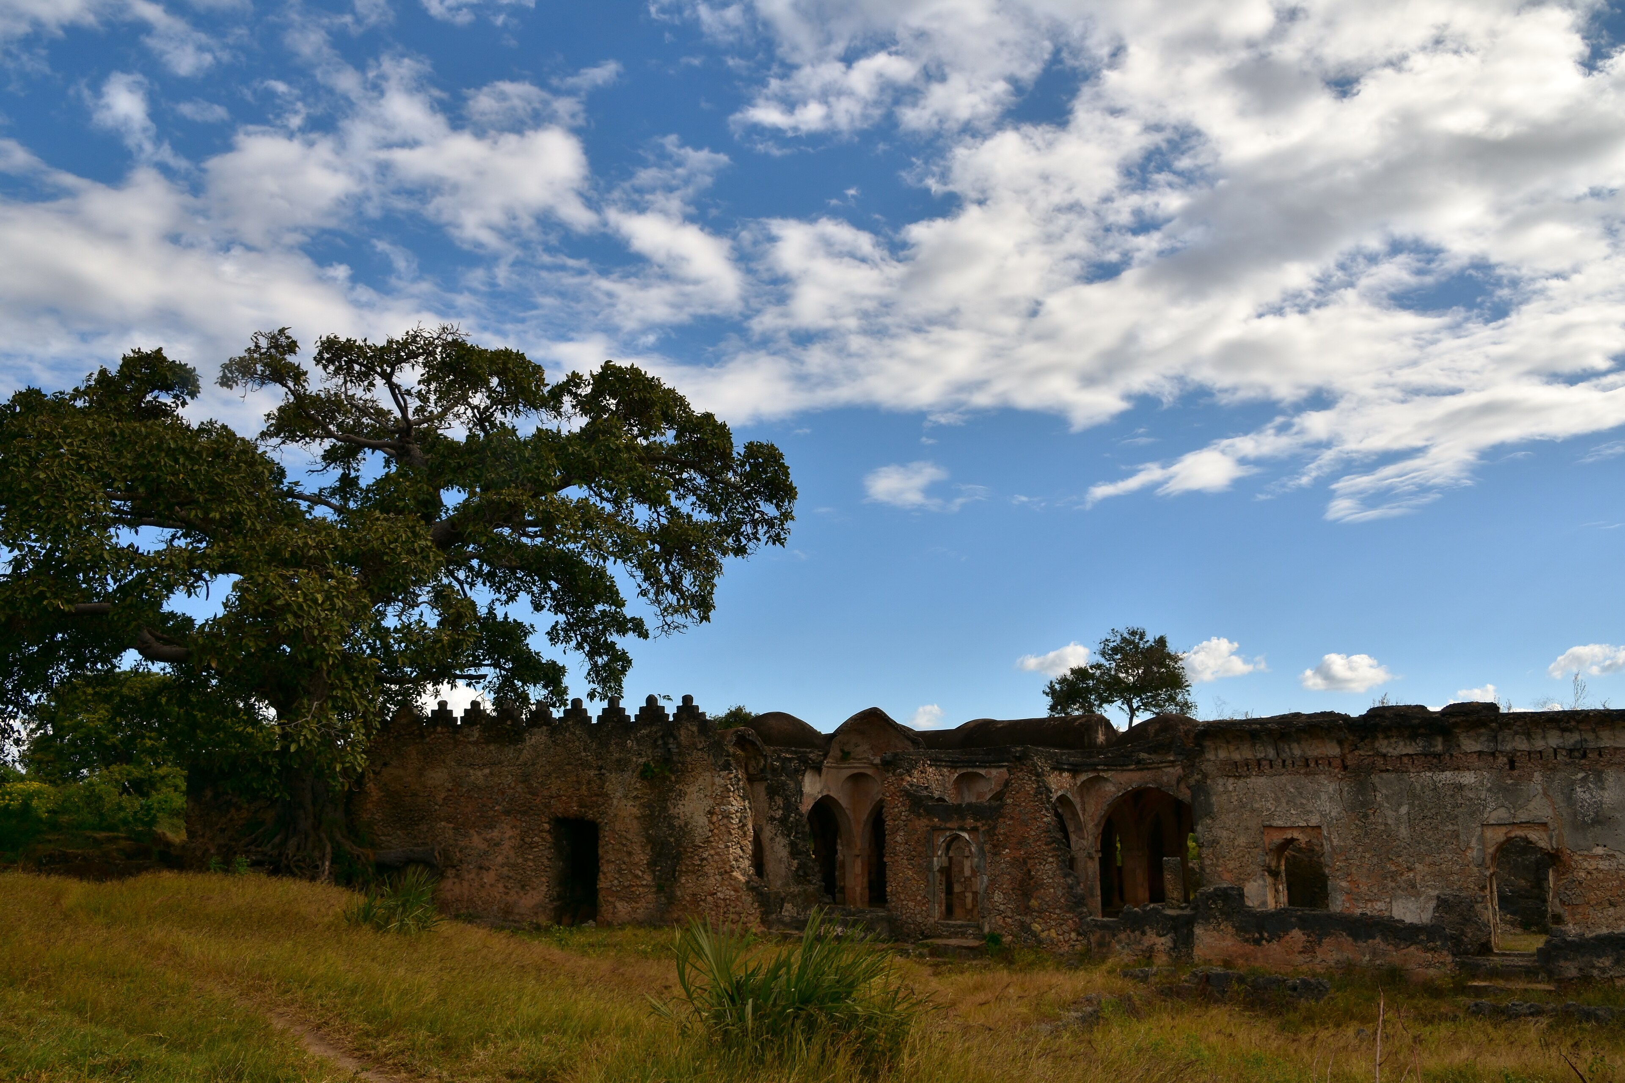
The Great Mosque of Kilwa
The coral-stone ruins of the Great Mosque of Kilwa Kisiwani, Tanzania.
© More Lessons Less Planning | morelessonslessplanning.com
Notes:
Real public-domain photograph of the Great Mosque ruins at Kilwa Kisiwani, Tanzania. Give students a quiet moment to observe the coral-stone arches and domed construction before discussing what the ruins reveal about Kilwa's wealth and Islamic faith.
Reference labels (point to these chart features when teaching): Coral-stone arches; Domed roof structure

Slide 8
Gold, Ivory, and the Merchants
Merchant
A trader who exchanged African gold and ivory for foreign cloth, beads, and porcelain.
Sofala
A southern port that funneled gold from the African interior into the Indian Ocean trade.
Key Concept: MERCHANTS traded African gold and ivory, much of it shipped north through SOFALA.
© More Lessons Less Planning | morelessonslessplanning.com
Notes:
A MERCHANT was a trader who bought and sold goods, and Swahili merchants grew rich by exchanging African gold and ivory for foreign cloth, glass beads, and Chinese porcelain. Much of the gold came from the African interior, near Great Zimbabwe, and reached the coast through SOFALA - a southern port that funneled that gold into the Indian Ocean trade. From Kilwa and Sofala the gold and ivory sailed north to Arabia and east to India, making the Swahili merchants some of the wealthiest people in the medieval world.

Slide 9
Stone Towns of the Coast
Wealthy families lived in multi-story coral-stone houses.
Cities had mosques, palaces, and busy harbor markets.
Traders used copper coins minted at Kilwa itself.
Imported porcelain and cloth filled the homes of the rich.
Key Concept: Swahili stone towns had coral houses, mosques, markets, and their own minted coins.
© More Lessons Less Planning | morelessonslessplanning.com
Notes:
The wealth of the Swahili Coast shows in its stone towns. Wealthy merchant families lived in multi-story coral-stone houses, and each major city had mosques, palaces, and busy harbor markets. Kilwa was rich enough to mint its own copper coins. Archaeologists find imported Chinese porcelain, Indian cloth, and glass beads inside these homes - direct proof of how far the trade reached. Poorer people still lived in simpler mud-and-thatch houses, but the stone core of each city displayed its merchant wealth.

Slide 10
An Eyewitness: Duarte Barbosa
Duarte Barbosa
A Portuguese official who described the wealthy city of Kilwa around 1500.
Primary source
A record of an event made by someone who witnessed or lived through it.
Key Concept: A PRIMARY SOURCE is a record by an eyewitness; Barbosa described Kilwa around 1500.
© More Lessons Less Planning | morelessonslessplanning.com
Notes:
Duarte Barbosa was a Portuguese official who traveled the Indian Ocean and described the wealthy city of Kilwa around 1500, shortly before Portugal attacked it. His written description is a PRIMARY SOURCE - a record of an event or place made by someone who witnessed or lived through it. Because Barbosa was a contemporary eyewitness who described Kilwa as he traveled the Indian Ocean world, his account gives details about the houses, clothing, and trade that ruins alone cannot show. Like all sources, though, it must be read with care.

Slide 11
Reconstructing the Swahili Coast
Written primary source
Barbosa's description gives the city's clothing, trade, and daily wealth.
✔
Archaeology
The coral ruins and traded goods dug up show what really survived.
✔
Key Concept: Historians combine Barbosa's PRIMARY SOURCE with ARCHAEOLOGY to reconstruct the coast.
© More Lessons Less Planning | morelessonslessplanning.com
Notes:
To reconstruct the Swahili Coast, historians combine two kinds of evidence. Barbosa's written PRIMARY SOURCE describes the clothing, houses, and trade of a living city. ARCHAEOLOGY - the coral ruins, copper coins, and traded goods dug up at the sites - shows what physically survived. The two confirm each other: Barbosa says Kilwa traded for foreign goods, and archaeologists find Chinese porcelain and Indian beads in the ruins. Neither source alone is enough; together they give the fullest, most reliable picture.

Slide 12
Why the Swahili Coast Mattered
It made East Africa a full partner in Indian Ocean trade.
It shows a rich, city-building African civilization.
Its blended culture still shapes the Swahili language today.
Portugal's 1500s attacks later disrupted these trade cities.
Key Concept: The Swahili Coast made Africa a wealthy, connected partner in world trade.
© More Lessons Less Planning | morelessonslessplanning.com
Notes:
The Swahili Coast matters because it makes East Africa a full partner in one of history's great trade networks, not a place cut off from the world. It shows a wealthy, city-building African civilization that minted coins and traded across an ocean. Its blended culture still lives on: Swahili is spoken by tens of millions of people today. In the 1500s, Portuguese fleets attacked and disrupted Kilwa and the other trade cities, shifting the balance of Indian Ocean commerce toward Europe.

Slide 13
Key Takeaways
The Swahili Coast was a chain of wealthy East African trading city-states.
★
Monsoon winds powered Indian Ocean trade linking Africa, Arabia, and Asia.
★
Kilwa grew rich on gold and built the Great Mosque from coral stone.
★
Historians reconstruct the coast: Barbosa's primary source + archaeology.
★
© More Lessons Less Planning | morelessonslessplanning.com
Notes:
Recap the four takeaways. The Swahili Coast was a chain of wealthy trading city-states, powered by monsoon-driven Indian Ocean trade, that blended African, Arab, and Indian Ocean cultures. Kilwa grew rich on gold and built in coral stone. The big skill: a written primary source plus archaeology together reconstruct the past.

