Slide 1
The Stock Market: How It Works & Why It Moves
See how exchanges, supply and demand, news, and market indexes move stock prices—and why long-term investors expect ups and downs.
© More Lessons Less Planning | morelessonslessplanning.com
Notes:
Open with the big picture that ties Unit 6 together: earlier toolkits taught what a stock IS (TK53) and how to own many at once (TK55); this one shows how the whole STOCK MARKET works as a system and why prices move. Students follow Jordan Reyes, 17, learning to read the market for the first time. Preview the five ideas: exchanges (the NYSE and Nasdaq) match buyers and sellers; SUPPLY AND DEMAND set every price; a MARKET INDEX like the S&P 500 tracks the whole market with a single number; prices move on news and earnings; and the market swings between BULL markets (sustained rises) and BEAR markets (sustained falls). The headline that frames the whole lesson: over 25 years a broad market index climbed from 1500 to 4500 - up 200% - even though it crashed hard three times (the dot-com bust, the 2008 crisis, and the 2020 COVID dip). That shape is why a long-term investor learns to stay calm when the market drops instead of panic-selling at the bottom.

Slide 2
Learning Targets
Explain how stock exchanges like the NYSE and Nasdaq match buyers and sellers
★
Explain how supply and demand set prices and why prices move on news
★
Describe what a market index measures and how bull and bear markets differ
★
Use percent change to size a market move and know why investors stay calm
★
© More Lessons Less Planning | morelessonslessplanning.com
Notes:
Read the four targets aloud and tell students the lesson follows Jordan Reyes, learning to read the stock market for the first time. Target 1 is the marketplace: a STOCK EXCHANGE (the NYSE, the Nasdaq) is an organized market that matches buyers and sellers and lists the price of every trade. Target 2 is the price mechanism: SUPPLY AND DEMAND set prices - more buyers than sellers pushes a price up, more sellers than buyers pushes it down - and prices move on news and earnings because good or bad news changes how many people want to buy or sell. Target 3 is the big-picture tools: a MARKET INDEX like the S&P 500 tracks the whole market with one number, and the market swings between BULL markets (sustained rises) and BEAR markets (sustained falls). Target 4 is the one calculation and the takeaway: PERCENT CHANGE = ((new - old) / old) x 100 sizes any move (and defines bull vs bear), and because the market has always recovered from its drops, a long-term investor stays calm and stays invested.

Slide 3
What Is the Stock Market?
The stock market
The STOCK MARKET is the whole system of exchanges, buyers, and sellers where shares of public companies are bought and sold
A share is part-ownership
A share of stock is a small piece of ownership in a public company - the market is where those pieces change hands
It connects buyers and sellers
The market's job is to connect people who want to BUY shares with people who want to SELL them, and agree on a price
It runs on set hours
The U.S. market trades on weekdays (about 9:30 a.m. to 4:00 p.m. Eastern); prices update constantly while it is open
Key Concept: The STOCK MARKET is the whole system where shares of public companies are bought and sold, connecting buyers with sellers.
© More Lessons Less Planning | morelessonslessplanning.com
Notes:
Define what the stock market actually is before any of the mechanics. The STOCK MARKET is the whole system of exchanges, buyers, and sellers where shares of public companies are bought and sold - not one place or one company, but a network that connects everyone trading shares. Remind students from TK53 that a share of stock is a small piece of ownership in a public company; the stock market is simply where those pieces of ownership change hands. Its whole job is to connect people who want to BUY shares with people who want to SELL them and help them agree on a price. Point out the practical detail that the U.S. market trades on weekdays during set hours (about 9:30 a.m. to 4:00 p.m. Eastern), and while it is open the prices update constantly as trades happen. Jordan Reyes is opening a market-tracking app for the first time and seeing prices tick up and down - that motion is thousands of buyers and sellers agreeing on new prices moment by moment. The rest of the lesson explains where those prices come from and why they move.

Slide 4
Stock Exchanges: The NYSE and Nasdaq
What an exchange does
The two biggest U.S. exchanges
A STOCK EXCHANGE matches buyers and sellers
It reports each trade's price so the market can see it
Companies list shares there; computers now match most orders
NYSE: the largest exchange, with many established companies
Nasdaq: known for technology companies and fully electronic
Both match trades and report prices; a stock usually lists on one
Key Concept: A STOCK EXCHANGE (like the NYSE or Nasdaq) is an organized marketplace that matches buyers and sellers and lists each trade's price.
© More Lessons Less Planning | morelessonslessplanning.com
Notes:
Explain the marketplaces where trading actually happens. A STOCK EXCHANGE is an organized marketplace that matches buyers and sellers and lists the price of every trade, so everyone in the market sees the same current price. Bust the old-movie image: while the NYSE still has a trading floor, most trading today is done by computers matching buy and sell orders in a fraction of a second. Companies LIST their shares on an exchange so the public can buy and sell them. Introduce the two biggest U.S. exchanges by name: the NYSE (New York Stock Exchange) is the largest and lists many older, established companies, while the NASDAQ is known for technology companies and is fully electronic (no physical floor). Both do the same core job - match buyers with sellers and report the price of every trade. A given stock is usually listed on one exchange, but once a trade happens its price is public everywhere, which is why Jordan sees the same price for a company no matter which app he checks. The exchange is the referee that keeps prices fair and visible; the next slide explains how those prices are actually set.

Slide 5
Supply and Demand Set the Price
How a price is set
Jordan watches a price move
SUPPLY AND DEMAND set every stock price - buyers and sellers agree on it
More BUYERS than sellers (demand > supply): the price rises
More SELLERS than buyers (supply > demand): the price falls
The MARKET PRICE is the price of the most recent trade
Good news comes out: more people want to buy, so the price is bid UP
Bad news comes out: more people want to sell, so the price is pushed DOWN
No trade happens until a buyer and a seller agree on a number
That agreed number becomes the new market price everyone sees
Key Concept: SUPPLY AND DEMAND set every price - more buyers push it up, more sellers push it down. The MARKET PRICE is the last agreed trade.
© More Lessons Less Planning | morelessonslessplanning.com
Notes:
Teach the engine behind every price: supply and demand. SUPPLY AND DEMAND are the forces that set every stock price - a price is simply the number a buyer and a seller agree on. The rule students must lock in: when there are more BUYERS than sellers (demand is greater than supply), the price rises, because buyers compete and bid it up; when there are more SELLERS than buyers (supply is greater than demand), the price falls, because sellers compete and accept less. The MARKET PRICE is the price of the most recent trade - the last number a buyer and seller actually agreed on. Make it concrete with Jordan. When good news comes out about a company, more people want to buy it, so the price gets bid UP. When bad news comes out, more people want to sell, so the price gets pushed DOWN. Crucially, no trade happens - and the price does not officially change - until a buyer and a seller agree on a number; that agreed number becomes the new market price everyone sees. This is the same supply-and-demand idea students may know from economics, applied to shares of stock: the price is not set by the company or the exchange, but by the crowd of buyers and sellers, minute by minute.

Slide 6
Market Indexes: The S&P 500 and the Dow
Market index
A MARKET INDEX is a single number that tracks a basket of stocks, so you can see how the whole market moved at a glance
The S&P 500
The S&P 500 tracks 500 large U.S. companies and is the index most often used to represent the overall U.S. stock market
The Dow
The Dow Jones Industrial Average tracks 30 big, well-known companies - an older, narrower index you will hear quoted on the news
Why an index helps
Instead of checking thousands of stocks, you watch one index number to know if the market as a whole went up or down
Key Concept: A MARKET INDEX (like the S&P 500 or the Dow) tracks a basket of stocks with one number, so you see how the whole market moved.
© More Lessons Less Planning | morelessonslessplanning.com
Notes:
Give students the tools that summarize the whole market. A MARKET INDEX is a single number that tracks a basket of stocks, so instead of checking thousands of individual prices you can glance at one number and know how the whole market moved. Introduce the two most-quoted U.S. indexes by name. The S&P 500 tracks 500 large U.S. companies and is the index most often used to represent the overall U.S. stock market - when people say 'the market was up today,' they usually mean the S&P 500. The Dow Jones Industrial Average (the Dow) tracks just 30 big, well-known companies; it is older and narrower, but you will still hear it quoted constantly on the news. Explain why an index is so useful: it rolls thousands of individual supply-and-demand moves into one figure, so Jordan can tell in a second whether it was an up day or a down day for the market as a whole, and can compare today to last year or ten years ago. This is exactly what the chart later in the lesson shows - one broad index tracked over 25 years - and it is what index funds from the last toolkit (TK55) are built to match. The index is the scoreboard for the whole market.

Slide 7
Why Prices Move: News, Earnings, and Percent Change
News and earnings move prices
PERCENT CHANGE = ((new - old) / old) x 100
Prices move when NEWS changes how many people want to buy or sell
EARNINGS reports (a company's profits) are the biggest regular mover
Beat expectations: more buyers, demand up, price up
Miss expectations: more sellers, supply up, price down
PERCENT CHANGE sizes a move: ((new value - old value) / old value) x 100
A $50 stock beats earnings and jumps to $58: (58-50)/50 x 100 = +16.0%
If it had missed and fallen to $44: (44-50)/50 x 100 = -12.0%
Positive percent change is a gain; negative is a drop
Key Concept: Prices move on NEWS and EARNINGS. PERCENT CHANGE = ((new - old) / old) x 100 sizes the move - a $50 stock rising to $58 is +16.0%.
© More Lessons Less Planning | morelessonslessplanning.com
Notes:
Explain why prices move and give students the one calculation of the lesson. Prices move because NEWS changes how many people want to buy or sell - and the single biggest regular mover is EARNINGS, a company's report of its profits. Connect it straight back to supply and demand: when a company BEATS expectations, more people want to buy, demand rises above supply, and the price goes up; when it MISSES expectations, more people want to sell, supply rises above demand, and the price goes down. Now teach the labeled foundational model that sizes any move: PERCENT CHANGE = ((new value - old value) / old value) x 100. Work the example on the slide. A stock is $50 before an earnings report; it beats and jumps to $58 the next day: (58 - 50) / 50 x 100 = 8/50 x 100 = +16.0%. If instead it had missed and fallen to $44: (44 - 50) / 50 x 100 = -6/50 x 100 = -12.0%. Point out the sign rule: a positive percent change is a gain, a negative one is a drop, and the size of the number tells you how big the move was. Students will use this exact formula to measure the crashes and recoveries on the market-index chart and to decide what counts as a bull or bear market. Emphasize the two steps: subtract old from new, then divide by the OLD value (the starting point), then multiply by 100.

Slide 8
Bull Markets and Bear Markets
Bull market
A BULL MARKET is a sustained rise in prices - about +20% or more off a low - when investors are optimistic and buying
Bear market
A BEAR MARKET is a sustained fall in prices - about -20% or more off a high - when investors are fearful and selling
How we measure it
We use PERCENT CHANGE off the recent high or low: a fall of 20%+ is a bear, a rise of 20%+ off a low is a bull
They repeat
Markets cycle between bull and bear phases; over 25 years a broad index had three big bears but still climbed from 1500 to 4500
Key Concept: A BULL MARKET is a sustained +20% rise off a low; a BEAR MARKET is a sustained -20% fall off a high - measured with percent change.
© More Lessons Less Planning | morelessonslessplanning.com
Notes:
Name the two big phases of the market and tie them to the percent-change formula. A BULL MARKET is a sustained RISE in stock prices - roughly +20% or more off a recent low - a stretch when investors are optimistic and buying (picture a bull thrusting its horns UP). A BEAR MARKET is a sustained FALL in prices - roughly -20% or more off a recent high - a stretch when investors are fearful and selling (picture a bear swiping its paws DOWN). Show students how we actually measure these: we take the PERCENT CHANGE off the recent high or low. A drop of about 20% or more from a high is a bear market; a rise of about 20% or more off a low is a bull market. The most important point for a young investor: these phases REPEAT - the market cycles between bull and bear over and over. Preview the chart on the next slide: over 25 years a broad market index went through three big bear markets (the dot-com bust, the 2008 crash, and the 2020 COVID dip) yet still climbed from 1500 to 4500, up 200%. Bears feel scary in the moment, but historically they have been followed by bulls that carried the market to new highs. The next slide shows this as a chart so students can see the bull runs and bear dips, and the following slide is about how to respond to them.

Slide 9
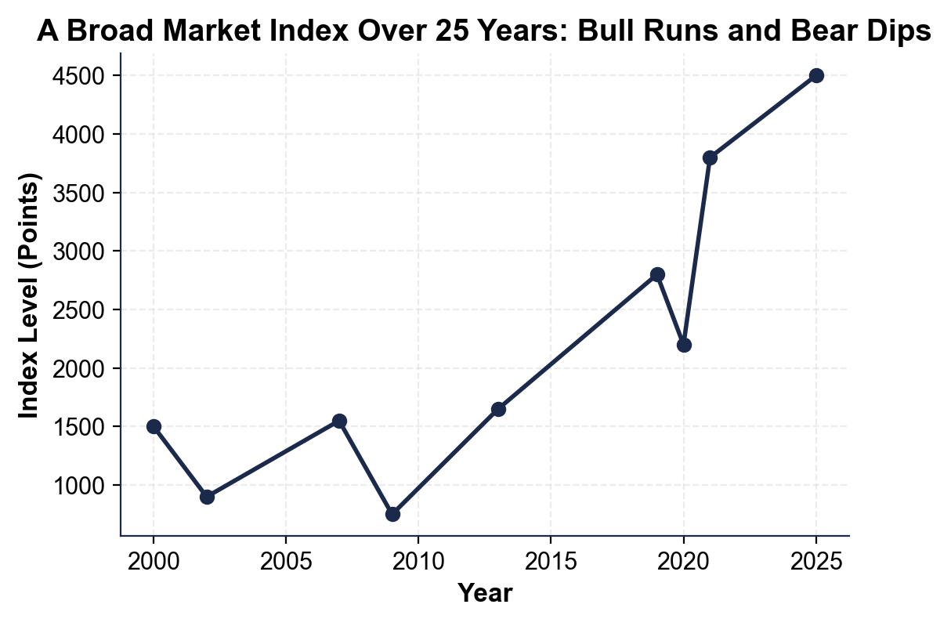
A Broad Market Index Over 25 Years: Bull Runs and Bear Dips
One broad index over 25 years: it crashes three times but ends far higher.
© More Lessons Less Planning | morelessonslessplanning.com
Notes:
Have students read the single-line market-index chart. The x-axis is the year (2000 to 2025) and the y-axis is the index level in points, tracking one broad market index (an S&P-500-style index of 500 big U.S. companies). Trace the shape with students: it starts at 1500 in 2000, falls to 900 by 2002 (the dot-com bust, a bear), recovers to 1550 by 2007, then crashes to 750 by 2009 (the financial-crisis bear, the deepest dip), climbs back to a new high of 1650 by 2013, runs up to 2800 by 2019 (a long bull), drops to 2200 in 2020 (the fast COVID bear), then surges to 3800 by 2021 and 4500 by 2025. The two big lessons the picture makes obvious: the market falls hard sometimes (three clear bear dips) AND it has recovered and reached new highs every time, climbing from 1500 to 4500 - up 200% - over the 25 years. This is the chart Activity Part 3 reads: students find the bear dips, use percent change to size them, and see why staying invested through the drops beats trying to time them.
Reference labels (point to these chart features when teaching): Bear dips: 2002, 2009, 2020; Long-run climb: 1500 to 4500

Slide 10
Staying Calm When the Market Drops
Drops are normal and temporary
Bear markets are a normal part of investing; historically the market has recovered from every one and gone on to new highs
✔
Time in the market beats timing
TIME IN THE MARKET means staying invested through the ups and downs beats trying to guess when to jump out and back in
✔
Selling in a panic locks in the loss
Selling after a drop turns a paper loss into a real one and often misses the fast recovery that follows a bear
✔
A drop can be a discount
For a long-term investor still adding money, lower prices in a bear market mean buying shares on sale for the recovery
✔
Key Concept: Bear-market drops are normal and temporary - TIME IN THE MARKET beats timing, and panic-selling locks in a loss and misses the recovery.
© More Lessons Less Planning | morelessonslessplanning.com
Notes:
Turn the whole lesson into the one habit that matters most for a young investor: staying calm when the market drops. Start with the reassurance the chart just proved: bear markets are a NORMAL part of investing, and historically the market has recovered from every one and gone on to new highs - the index climbed from 1500 to 4500 over 25 years despite three big crashes. Teach TIME IN THE MARKET: staying invested through the ups and downs beats trying to guess the perfect moment to jump out and back in, because no one can reliably time the drops and recoveries. Warn about the biggest mistake: selling in a panic after a drop turns a paper loss (the balance is just lower on screen) into a real, locked-in loss, and it usually means missing the fast recovery that often follows a bear market - the market frequently rebounds hardest right after the bottom. Then reframe a drop for a long-term investor who is still adding money: lower prices in a bear market are like a sale, a chance to buy more shares cheaply that grow when the market recovers. The judgment students should leave with: a market drop is a test of temperament, not a reason to sell. If your money is invested for the long run, the smartest move during a bear market is usually to stay calm, keep contributing, and let time in the market do its work. This connects back to TK51 (why save) and TK52 (compound interest and time): the investor who stays in the market is the one who captures the long-run growth.

Slide 11
Key Takeaways
The STOCK MARKET is the exchange system that matches buyers and sellers
★
SUPPLY AND DEMAND set every price; prices move on news and earnings
★
A MARKET INDEX like the S&P 500 tracks the whole market with one number
★
PERCENT CHANGE = ((new - old) / old) x 100; bull is +20% up, bear is -20% down
★
The market recovers from drops, so TIME IN THE MARKET beats panic-selling
★
© More Lessons Less Planning | morelessonslessplanning.com
Notes:
Read each takeaway and connect it to the learning targets. T1 (exchanges) -> the STOCK MARKET is the whole system of exchanges, buyers, and sellers; the NYSE and Nasdaq are organized marketplaces that match buyers with sellers and list every trade's price. T2 (supply and demand) -> SUPPLY AND DEMAND set every price (more buyers push it up, more sellers push it down), and prices move on news and especially earnings, which change how many people want to buy or sell. T3 (index) -> a MARKET INDEX like the S&P 500 (500 big U.S. companies) or the Dow tracks the whole market with a single number, the scoreboard for the market. T4 (percent change + bull/bear) -> PERCENT CHANGE = ((new - old) / old) x 100 sizes any move; a sustained rise of about +20% off a low is a bull market, a sustained fall of about -20% off a high is a bear market. T-final (stay calm) -> the market has recovered from every past drop and reached new highs (1500 to 4500 over 25 years despite three crashes), so TIME IN THE MARKET - staying invested through the swings - beats panic-selling. The spine of the lesson: understand how the market works so you are not scared of it, and stay calm and invested when it drops. As the sixth toolkit of Unit 6, this connects the earlier saving-and-investing ideas (why save, compound interest, stocks, bonds, index funds) into how the market as a whole behaves.

