Slide 1
The St. Bartholomew's Day Massacre
How religious hatred exploded into mass violence in 1572 Paris.
© More Lessons Less Planning | morelessonslessplanning.com
Notes:
Opening slide. This lesson examines, as HISTORY, how deep religious division in France turned into the mass violence of the St. Bartholomew's Day Massacre in 1572. Frame the whole lesson clinically and analytically: we describe what happened and why - the causes, the scale, and the consequences - as historical questions. Keep a neutral, comparative tone toward both Catholics and Protestants. This is history, not a verdict on any faith, and we do not dwell on graphic detail.

Slide 2
Learning Targets
Explain the background: France divided between Catholics and Huguenots.
★
Explain the causes and course of the massacre of August 24, 1572.
★
Describe the scale, consequences, and significance of the massacre.
★
Analyze an eyewitness memoir and explain how division turned to violence.
★
© More Lessons Less Planning | morelessonslessplanning.com
Notes:
Learning targets. Target 1 sets the religious background: the Reformation split France between Catholics and Huguenots (French Protestants who followed Calvinism), leading to the Wars of Religion from 1562. Target 2 explains the causes and course of the massacre - the royal wedding, the attack on Coligny, the king's order, and the killing that began on August 24, 1572. Target 3 describes the scale (thousands killed), consequences (deeper division, resumed wars), and significance. Target 4 practices sourcing on Marguerite de Valois's eyewitness memoir and explains how division turned into violence.

Slide 3
France's Wars of Religion
In the 1500s the Reformation split France between Catholics and Protestants.
French Protestants were called HUGUENOTS and followed CALVINISM.
From 1562, France was torn by a series of civil WARS OF RELIGION.
Catholics and Huguenots fought over faith, power, and survival.
These wars set the stage for the violence of 1572.
Key Concept: The Reformation split France; from 1562, Catholics and HUGUENOTS fought a series of WARS OF RELIGION.
© More Lessons Less Planning | morelessonslessplanning.com
Notes:
Set the religious background. In the sixteenth century the Protestant REFORMATION (studied earlier in the unit) spread into France and split the country between Catholics and Protestants. French Protestants were called HUGUENOTS, and they followed CALVINISM - the Protestant teachings of John Calvin. Beginning in 1562, France was torn by a series of civil WARS OF RELIGION between Catholics and Huguenots, fought over faith, political power, and survival. Explain to students that these long, bitter wars are the essential background: the St. Bartholomew's Day Massacre did not come out of nowhere, but grew out of decades of religious conflict. Keep the framing neutral - describe the division without taking a side.

Slide 4
Who Were the Huguenots?
The Huguenots
French Protestants who followed CALVINISM, the teachings of John Calvin.
A religious minority
They were a MINORITY in a mostly Catholic France, and faced suspicion.
Who they were
Many were nobles, merchants, and skilled workers whose numbers were growing.
Key Concept: The HUGUENOTS were French followers of CALVINISM - a growing religious MINORITY in mostly Catholic France.
© More Lessons Less Planning | morelessonslessplanning.com
Notes:
Explain who the Huguenots were. The HUGUENOTS were French Protestants who followed CALVINISM, the teachings of the reformer John Calvin. In a country that was overwhelmingly Catholic, they were a religious MINORITY, and they faced suspicion and periods of persecution from the Catholic majority. Many Huguenots were nobles, merchants, and skilled workers, and their growing numbers and influence alarmed the Catholic crown and the Catholic majority. Present this factually and neutrally: describe who the Huguenots were and their place in French society, without endorsing or judging their beliefs. This helps students understand why tensions ran so high by 1572.

Slide 5
The Royal Wedding of August 1572
To ease tensions, the crown arranged a royal WEDDING.
Catholic princess MARGUERITE DE VALOIS married Protestant HENRY OF NAVARRE.
The August 1572 wedding was meant to be a step toward PEACE.
It drew many leading Huguenots to strongly Catholic Paris.
Instead of peace, the gathering set the stage for disaster.
Key Concept: The 1572 wedding of Catholic MARGUERITE DE VALOIS and Protestant HENRY OF NAVARRE drew Huguenot leaders to Paris.
© More Lessons Less Planning | morelessonslessplanning.com
Notes:
Explain the immediate setup. To try to ease the tensions between Catholics and Huguenots, the French crown arranged a high-profile royal WEDDING: the Catholic princess MARGUERITE DE VALOIS (sister of the king) would marry the Protestant prince HENRY OF NAVARRE, a leader of the Huguenots. The August 1572 wedding in Paris was meant to be a public step toward PEACE and reconciliation between the two sides. Explain the fateful irony to students: because it was a Huguenot leader's wedding, it drew many of the most important Huguenot nobles into strongly Catholic Paris. Instead of bringing peace, that gathering of Huguenot leaders in one hostile city set the stage for the disaster that followed. Keep the tone factual.

Slide 6
The Royal Court and Catherine de' Medici
Catherine de' Medici
The queen mother who held great power over her son, King CHARLES IX.
The royal fear
The crown feared the growing power of the Huguenot leaders at court, especially Coligny.
A fateful choice
Advisors urged the king to strike first at the Huguenot leaders gathered in Paris.
Key Concept: The queen mother CATHERINE DE' MEDICI and King CHARLES IX faced the Huguenot leaders gathered in Paris.
© More Lessons Less Planning | morelessonslessplanning.com
Notes:
Introduce the royal decision-makers. CATHERINE DE' MEDICI was the queen mother of France, and she held great influence over her son, the young King CHARLES IX. Explain the political fear at the heart of the crisis: the crown had grown alarmed at the rising influence of the Huguenot leaders at court, especially Admiral Coligny, who was close to the king. With the Huguenot nobles all gathered in Paris for the wedding, some royal advisors - including, historians believe, Catherine de' Medici - urged the king to strike first and remove the Huguenot leadership. Present this as historians reconstruct it: the exact decisions are debated, but the crown moved from fear to a fateful choice to attack. The next slide shows a portrait of Catherine de' Medici. Keep the framing analytical.

Slide 7
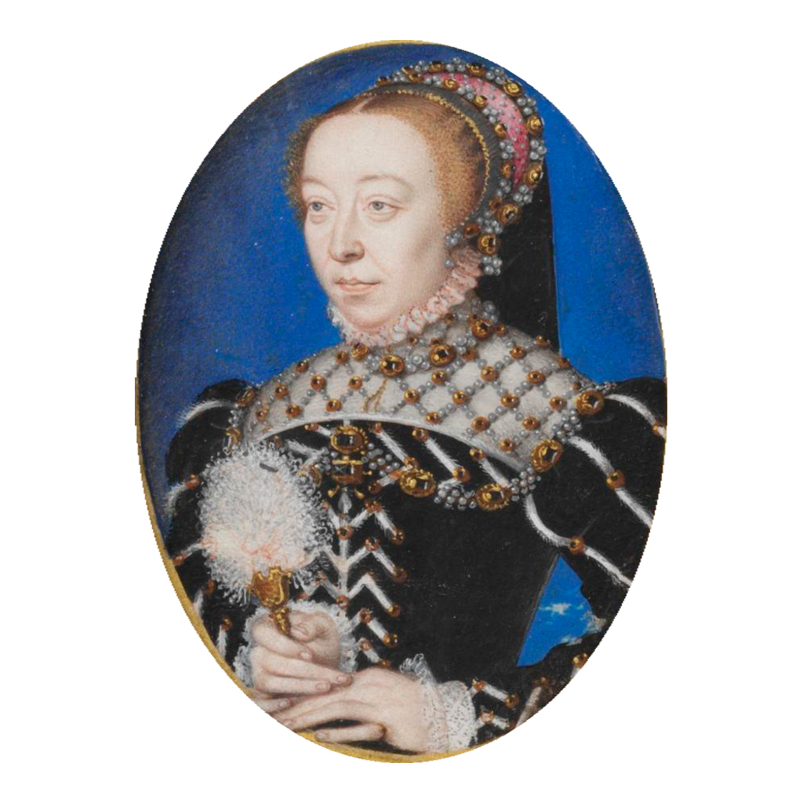
A Portrait of Catherine de' Medici
A 16th-century portrait of Catherine de' Medici, queen mother of France.
© More Lessons Less Planning | morelessonslessplanning.com
Notes:
This is a 16th-century portrait of Catherine de' Medici, the queen mother of France. Use it simply to put a face to the powerful figure students are studying - the mother of King Charles IX, widely blamed by historians for urging the strike against the Huguenot leaders. Note honestly that it is a painting from the period, not a photograph. It is a real historical portrait in the public domain, not a modern illustration. (This non-graphic portrait deliberately replaces the era's graphic massacre paintings, which are not appropriate to display.)

Slide 8
The Attack on Admiral Coligny
Admiral Gaspard de COLIGNY was the leading Huguenot noble and a royal advisor.
On August 22, 1572, an assassin shot and wounded Coligny in the street.
The failed assassination enraged and frightened the Huguenots in Paris.
Fearing Huguenot revenge, royal advisors pushed for a decisive strike.
King CHARLES IX gave the order to kill the Huguenot leaders.
Key Concept: The attempted assassination of Admiral COLIGNY on August 22, 1572, pushed the crown toward a deadly decision.
© More Lessons Less Planning | morelessonslessplanning.com
Notes:
Explain the trigger. Admiral Gaspard de COLIGNY was the most important Huguenot noble and a trusted advisor to the king. On August 22, 1572 - just days after the wedding - an assassin shot and wounded Coligny in a Paris street; the attempt failed to kill him. Explain the chain of fear that followed: the attack enraged and alarmed the Huguenots gathered in Paris, and royal leaders, now fearing Huguenot revenge, pushed for a decisive strike to remove the Huguenot leadership entirely. Under this pressure, King CHARLES IX gave the order to kill the Huguenot leaders. Present the sequence factually, and note for students that historians still debate exactly who was behind the first attack on Coligny. Keep the account clinical, without graphic detail.

Slide 9
The Massacre Begins (August 24, 1572)
Before dawn on August 24, 1572 - ST. BARTHOLOMEW'S DAY - the killing began.
Royal guards killed Coligny and other Huguenot leaders first.
Catholic mobs in Paris then turned on ordinary Huguenots.
Victims were targeted specifically for their Protestant faith.
Thousands of Huguenots were killed in Paris within a few days.
Key Concept: The ST. BARTHOLOMEW'S DAY MASSACRE began before dawn on August 24, 1572, as royal forces and Catholic mobs killed Huguenots in Paris.
© More Lessons Less Planning | morelessonslessplanning.com
Notes:
Explain what happened - factually and without graphic detail. Before dawn on August 24, 1572 - the Catholic feast of ST. BARTHOLOMEW'S DAY - the killing began in Paris. Royal guards first killed Admiral Coligny and the other Huguenot leaders who had come for the wedding. Then Catholic mobs in the city turned on ordinary Huguenots. Make the key analytical point for students: the violence was religious - people were targeted specifically because they were Protestant. Within a few days, thousands of Huguenots were killed in Paris. Treat this clinically: state what happened and who was targeted, but do not dwell on the manner of the killing. The point is to understand how religious hatred and political fear turned into mass violence, not to describe suffering for its own sake.

Slide 10
The Violence Spreads Across France
From Paris outward
As news of the Paris killings spread, massacres broke out in the PROVINCES - cities such as Lyon, Rouen, and Bordeaux.
Sectarian violence
SECTARIAN violence is violence between groups divided along religious lines; the killing continued into the autumn.
A nationwide wave
The Paris killings acted as a spark that set off similar killings of Huguenots across France.
Key Concept: From Paris, the massacre spread across France as massacres in the PROVINCES killed Huguenots for weeks - a wave of SECTARIAN violence.
© More Lessons Less Planning | morelessonslessplanning.com
Notes:
Explain how the massacre spread. The killing did not stay in Paris. As news of the Paris massacre spread to other French cities, massacres broke out in the PROVINCES over the following weeks. Catholic mobs killed Huguenots in cities such as Lyon, Rouen, and Bordeaux, and the violence continued into the autumn in some regions. Give students the analytical term: this was SECTARIAN violence - violence between groups divided along religious lines. Explain that the Paris killings acted as a signal or spark that set off similar killings elsewhere. Keep the account factual and geographic - trace where and when the violence spread, without graphic description of the killing itself.

Slide 11
The Scale of the Killing
In Paris
Historians estimate perhaps 2,000 to 3,000 Huguenots were killed.
Across France
Possibly 10,000 or more died as the violence spread nationwide.
Why numbers vary
Exact tolls are UNCERTAIN because sixteenth-century records are incomplete.
Key Concept: Historians estimate THOUSANDS died - perhaps 2,000-3,000 in Paris and 10,000 or more across France.
© More Lessons Less Planning | morelessonslessplanning.com
Notes:
Give students a careful, honest sense of scale. Historians estimate that THOUSANDS of Huguenots were killed. In Paris alone, perhaps 2,000 to 3,000 people died; across all of France, as the violence spread, possibly 10,000 or more died. Be honest about the uncertainty: exact death tolls are UNCERTAIN because sixteenth-century records are incomplete and estimates vary among historians. Explain why this matters for how we study history: we can be confident the event was one of the deadliest of the Wars of Religion, even if we cannot give a single exact number. Present the numbers soberly, as a measure of the scale of the tragedy, not as a spectacle.

Slide 12
Consequences: Deeper Division
The massacre did NOT destroy the Huguenot movement.
Survivors grew more determined and more distrustful of the crown.
The Wars of Religion resumed and grew more bitter.
HENRY OF NAVARRE survived by publicly converting to Catholicism.
The killing deepened the DIVISION between Catholics and Huguenots.
Key Concept: The massacre deepened France's DIVISION; the Wars of Religion resumed, and HENRY OF NAVARRE survived to fight on.
© More Lessons Less Planning | morelessonslessplanning.com
Notes:
Explain the consequences. Make the central point clearly: the massacre did NOT destroy the Huguenot movement. Instead, surviving Huguenots grew more determined and far more distrustful of the crown, and the Wars of Religion soon resumed and grew even more bitter. Tell the story of HENRY OF NAVARRE, the Protestant groom: he survived the massacre by publicly converting to Catholicism (he later returned to Protestantism, and still later converted again to become King Henry IV of France). The deepest consequence was that the killing hardened and DEEPENED the division between Catholics and Huguenots rather than ending it. Present the outcomes analytically: violence meant to settle the conflict instead prolonged it.

Slide 13
Why the Massacre Matters
A shock to Europe
The massacre shocked much of Europe; Protestants across Europe saw it as proof of the dangers they faced.
A symbol
It became a symbol of how religious HATRED and fear can turn into mass violence, hardening divisions for decades.
A warning
It is still studied today as a warning about religious PERSECUTION and how tension can become organized killing.
Key Concept: The massacre became a lasting symbol of how religious HATRED can explode into mass violence.
© More Lessons Less Planning | morelessonslessplanning.com
Notes:
Explain the lasting significance. The St. Bartholomew's Day Massacre shocked much of Europe and left a long shadow. Explain to students why it still matters historically: it became a powerful symbol of how religious HATRED and fear can turn into mass violence. Protestants across Europe saw it as proof of the dangers they faced from Catholic powers, and it hardened the divisions of the French Wars of Religion for decades to come. Note that the event is still studied today as a warning about religious PERSECUTION and about how quickly ordinary tension can become organized killing. Keep the framing analytical and forward-looking: the value of studying it is understanding causes so such violence can be recognized and prevented.

Slide 14
How Do We Know? An Eyewitness Memoir
Our primary source is a MEMOIR by Marguerite de Valois (Queen Margot).
She was inside the royal palace, the Louvre, on the night of the massacre.
We read her account in a public-domain 1845 English TRANSLATION.
A memoir is a firsthand account written later from memory.
It shows one eyewitness's experience, not the whole picture.
Tip: Marguerite de Valois's MEMOIR is a firsthand eyewitness account - read it for what she saw, not for the whole story.
© More Lessons Less Planning | morelessonslessplanning.com
Notes:
Set up the Primary Source Spotlight and teach how to read it. Our primary source is a MEMOIR by MARGUERITE DE VALOIS - 'Queen Margot' - the Catholic princess whose wedding to Henry of Navarre had drawn the Huguenots to Paris. She was inside the royal palace, the Louvre, on the very night the massacre began, so she was a genuine eyewitness. Students read her account in a public-domain 1845 English TRANSLATION (Bohn's Standard Library), lightly modernized for readability. Teach students what KIND of source this is: a memoir is a firsthand account written later from memory, so it gives a vivid, close-up view of what one person experienced - but it shows only her vantage point, not the full scale of the massacre or the decisions behind it. A careful historian reads it for what she personally saw and looks to other sources for the whole picture.

Slide 15
Understanding Religious Violence as History
We study it as HISTORY
We stay fair and human
We explain how fear, POLITICS, and division turned into violence.
We do not use it to judge any religion.
Both Catholics and Huguenots included ordinary, sincere people.
Understanding causes helps prevent such violence from recurring.
Key Concept: We study the massacre analytically - explaining how fear, POLITICS, and religious division turned into violence - never to judge a faith.
© More Lessons Less Planning | morelessonslessplanning.com
Notes:
Model the honest, academic stance - this is the tone anchor for the whole lesson. Tell students plainly how we study a hard event like this. First, we study it as HISTORY: our job is to explain how religious fear, POLITICS, and division combined to turn into mass violence - not to put any religion 'on trial.' Second, we stay fair and human: both Catholics and Huguenots included ordinary, sincere people, and many on both sides were victims, bystanders, or reluctant participants caught in a terrible situation. Third, we study causes because understanding how tension becomes killing helps societies recognize and prevent such violence in the future. Remind students that condemning the violence is not the same as condemning a faith - the massacre was a human and political catastrophe, and that is how historians approach it.

Slide 16
Key Takeaways
The Reformation split France between Catholics and HUGUENOTS.
★
The 1572 royal wedding drew Huguenot leaders into Catholic Paris.
★
The attack on COLIGNY triggered the ST. BARTHOLOMEW'S DAY MASSACRE.
★
The killing began August 24, 1572, and spread across France.
★
Thousands died, and the massacre deepened France's DIVISION.
★
It stands as a symbol of how religious HATRED can turn into violence.
★
© More Lessons Less Planning | morelessonslessplanning.com
Notes:
Close the loop and hold the analytical frame. If students remember a few things, make them these. The Reformation split France between Catholics and HUGUENOTS (French Protestants), leading to decades of Wars of Religion. In 1572 a royal wedding meant to bring peace drew the Huguenot leaders into strongly Catholic Paris. The attempted assassination of Admiral COLIGNY triggered a decision by King Charles IX, urged by Catherine de' Medici, to strike; and the ST. BARTHOLOMEW'S DAY MASSACRE began before dawn on August 24, 1572. The killing spread from Paris across France, thousands of Huguenots died, and the massacre deepened France's DIVISION and reignited the Wars of Religion. In the end it stands as a lasting symbol of how religious HATRED and political fear can turn into mass violence - which is exactly why we study it carefully, as history.

