Slide 1
The Space Race
Cold War rivalry reaches for the Moon
© More Lessons Less Planning | morelessonslessplanning.com
Notes:
Open by asking: if two rival superpowers were racing to prove whose technology and system was better, where would you expect that race to happen? Space became the answer - the same rockets built to deliver nuclear weapons could also launch satellites and astronauts, so leading in space became a very public way to win the Cold War argument.

Slide 2
Learning Targets
Explain why the Soviet launch of Sputnik in 1957 shocked the United States.
★
Describe how early Soviet space firsts put the U.S. on the defensive.
★
Explain why Kennedy committed the U.S. to landing a man on the Moon.
★
Trace the Apollo program from its setbacks to the July 1969 Moon landing.
★
Evaluate what the Space Race reveals about Cold War rivalry and cooperation.
★
© More Lessons Less Planning | morelessonslessplanning.com
Notes:
Point out that target three is the one the Activity's Primary Source Spotlight assesses: students read NASA's actual July 1969 press kit and explain what it reveals about the era.

Slide 3
Two Superpowers, One New Battlefield
After 1945, the U.S. and Soviet Union became Cold War rivals
Both built long-range rockets to deliver nuclear weapons
Those same rockets could also launch satellites into orbit
Leading in space became a way to prove a nation's power
This competition became known as the Space Race
Key Concept: rocket technology could launch a weapon or a satellite.
© More Lessons Less Planning | morelessonslessplanning.com
Notes:
Space Race - the Cold War competition between the United States and the Soviet Union to achieve firsts in spaceflight and space exploration. This is the umbrella term for the whole lesson; every event that follows is a move in this same competition.

Slide 4
Sputnik Shocks the World
On October 4, 1957, the USSR launched Sputnik 1
It was the first artificial satellite ever put into orbit
Sputnik was about the size of a beach ball and beeped by radio
Americans could hear its signal and see it cross the night sky
The launch stunned the U.S., which had no satellite of its own
Fact: Sputnik orbited Earth once about every 96 minutes.
© More Lessons Less Planning | morelessonslessplanning.com
Notes:
Sputnik 1 - the first artificial satellite, launched by the Soviet Union on October 4, 1957. This is the shock that starts the Space Race; American confidence in its own technological lead was badly shaken.

Slide 5
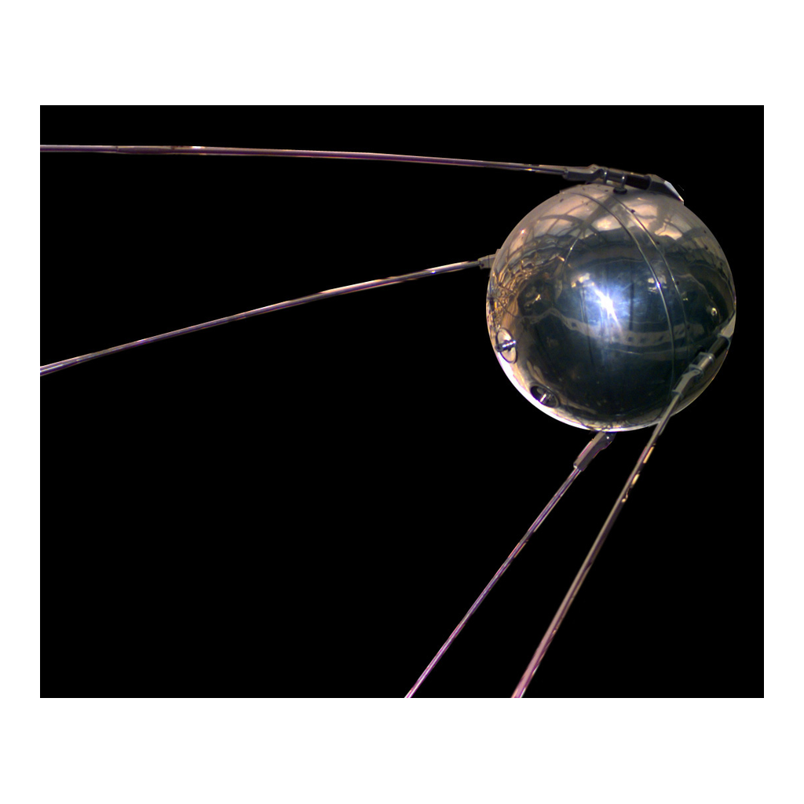
Sputnik 1, 1957
A full-scale replica of Sputnik 1
© More Lessons Less Planning | morelessonslessplanning.com
Notes:
Give students ten seconds to look before narrating. Point out how small and simple Sputnik actually was - four whip antennas on a polished metal sphere. This is a reference image, not an evidence task.

Slide 6
America Answers: NASA Is Born
The Wake-Up Call
Sputnik convinced Congress the U.S. was falling behind.
✔
Explorer 1
The U.S. launched its own satellite in January 1958.
✔
NASA
In 1958, Congress created NASA to run the space program.
✔
Two Programs
The Space Race now had two dedicated national programs.
✔
Note: Explorer 1 discovered the Van Allen radiation belts.
© More Lessons Less Planning | morelessonslessplanning.com
Notes:
NASA - the National Aeronautics and Space Administration, the U.S. federal agency created in 1958 in response to Sputnik. NASA becomes the answer to every 'who is doing this for the U.S.' question for the rest of the lesson.

Slide 7
The Soviets Strike Again: A Human in Orbit
On April 12, 1961, cosmonaut Yuri Gagarin flew Vostok 1
Gagarin became the first human to travel into space
His flight orbited the Earth once in about 108 minutes
The USSR had now beaten the U.S. to two major firsts
The pressure on the U.S. to respond grew even greater
Key Concept: the USSR led the Space Race through 1961.
© More Lessons Less Planning | morelessonslessplanning.com
Notes:
Vostok 1 - the Soviet spacecraft that carried Yuri Gagarin, the first human in space, on April 12, 1961. This is the second Soviet first in under four years and it is what finally pushes Kennedy to commit to the Moon on the next slide.

Slide 8
Kennedy Sets a Goal: The Moon
May 25, 1961
Kennedy asked Congress to commit to a Moon landing.
✔
The Goal
Land a man on the Moon and return him safely to Earth.
✔
The Deadline
"Before this decade is out" - meaning by the end of 1969.
✔
The Apollo program
NASA's program built to reach that specific goal.
✔
Fact: Kennedy set this goal only weeks after Gagarin's flight.
© More Lessons Less Planning | morelessonslessplanning.com
Notes:
Apollo program - the NASA program, running from 1961 to 1972, built to land Americans on the Moon and bring them safely home. Everything from this slide to the Moon landing slide is the Apollo program in motion.

Slide 9
Building the Skills to Get There
The U.S. still had to learn skills it did not yet have
Project Mercury put the first American astronauts into orbit
Project Gemini practiced spacewalks and docking in orbit
Each skill was a building block the Moon mission required
By 1966, NASA had practiced nearly everything Apollo needed
Note: docking two spacecraft in orbit was a Gemini first.
© More Lessons Less Planning | morelessonslessplanning.com
Notes:
This slide is the bridge between Kennedy's promise and the actual Moon landing - the U.S. did not know how to do most of what Apollo required in 1961, so Mercury and Gemini existed to learn each piece one at a time.

Slide 10
A Tragedy on the Launch Pad
January 27, 1967
Apollo 1 ran a routine launch pad test.
✔
The Fire
A fire broke out inside the sealed command module.
✔
The Loss
Astronauts Grissom, White, and Chaffee died.
✔
The Response
NASA grounded the program to investigate and redesign.
✔
Important: the fire happened during a ground test, not a flight.
© More Lessons Less Planning | morelessonslessplanning.com
Notes:
Apollo 1 - the January 1967 launch pad fire that killed astronauts Gus Grissom, Ed White, and Roger Chaffee during a test. Handle this respectfully and factually; the point for students is that the setback led directly to a safer, redesigned spacecraft.

Slide 11
Apollo 8: First to Circle the Moon
In December 1968, Apollo 8 launched toward the Moon
Its crew became the first humans to orbit another world
They orbited the Moon on Christmas Eve, 1968
The crew read from Genesis and photographed Earthrise
Apollo 8 proved NASA could safely travel to the Moon
Fact: Apollo 8 did not land - it proved the trip itself was safe.
© More Lessons Less Planning | morelessonslessplanning.com
Notes:
Apollo 8 - the December 1968 mission in which astronauts became the first humans to orbit the Moon. This is the dress rehearsal that proves the Saturn V and the crew could safely make the round trip before anyone attempted an actual landing.

Slide 12
Launch: Apollo 11 Leaves Earth
On July 16, 1969, Apollo 11 launched from Florida
A Saturn V rocket carried the crew toward the Moon
The crew: Neil Armstrong, Buzz Aldrin, Michael Collins
Saturn V remains one of the most powerful rockets built
The launch began a four-day journey to the Moon
Key Concept: Saturn V was the vehicle Apollo 11 needed to fly.
© More Lessons Less Planning | morelessonslessplanning.com
Notes:
Saturn V - the powerful multistage rocket NASA built to launch the Apollo spacecraft toward the Moon. This launch is the moment the whole Apollo program - Mercury, Gemini, Apollo 1's redesign, and Apollo 8's dress rehearsal - is finally put to the real test.

Slide 13
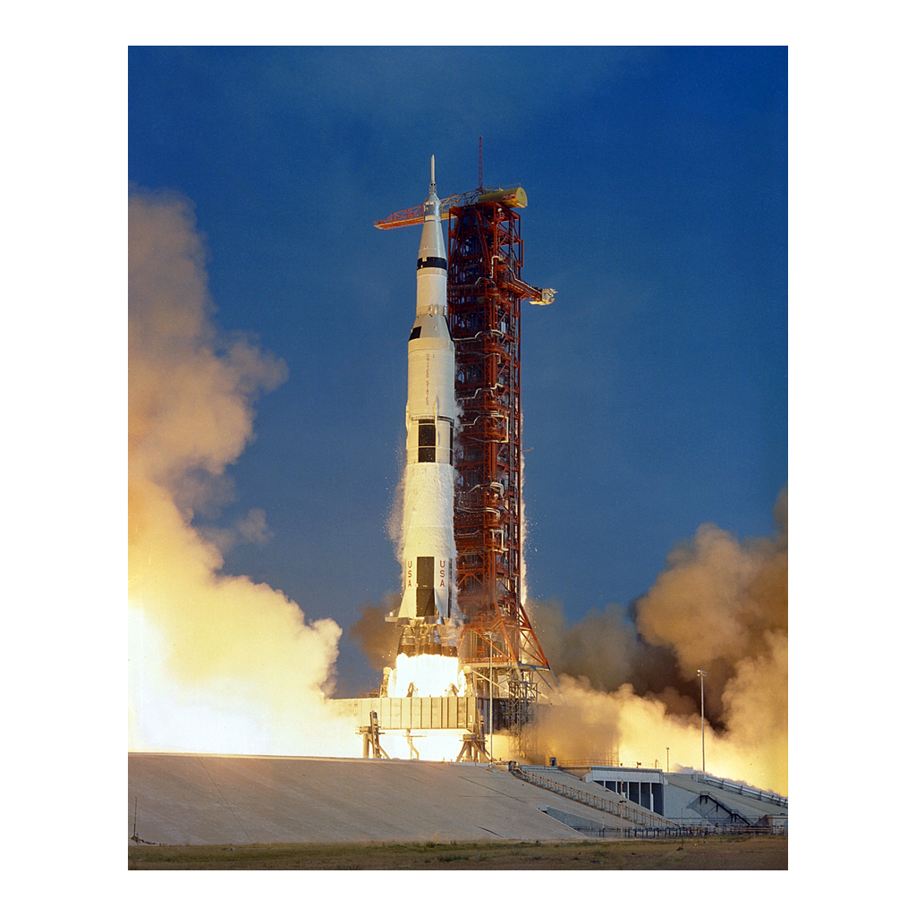
Apollo 11 Launch, July 16, 1969
The Saturn V rocket lifts off from Kennedy Space Center
© More Lessons Less Planning | morelessonslessplanning.com
Notes:
Give students ten seconds to look before narrating. Point out the sheer scale of the rocket against the launch tower and the size of the exhaust cloud. This is a reference image, not an evidence task.

Slide 14
One Small Step
July 20, 1969
The Lunar Module Eagle landed in the Sea of Tranquility.
✔
10:56 p.m. EDT
Armstrong became the first human to step onto the Moon.
✔
The Words
"That's one small step for man, one giant leap for mankind."
✔
Apollo 11
The mission that finally delivered on Kennedy's 1961 promise.
✔
Fact: Armstrong and Aldrin spent about two and a half hours outside.
© More Lessons Less Planning | morelessonslessplanning.com
Notes:
Apollo 11 - the July 1969 mission that landed the first humans, Neil Armstrong and Buzz Aldrin, on the Moon. This is the payoff of the entire lesson; every earlier slide built toward this exact moment.

Slide 15
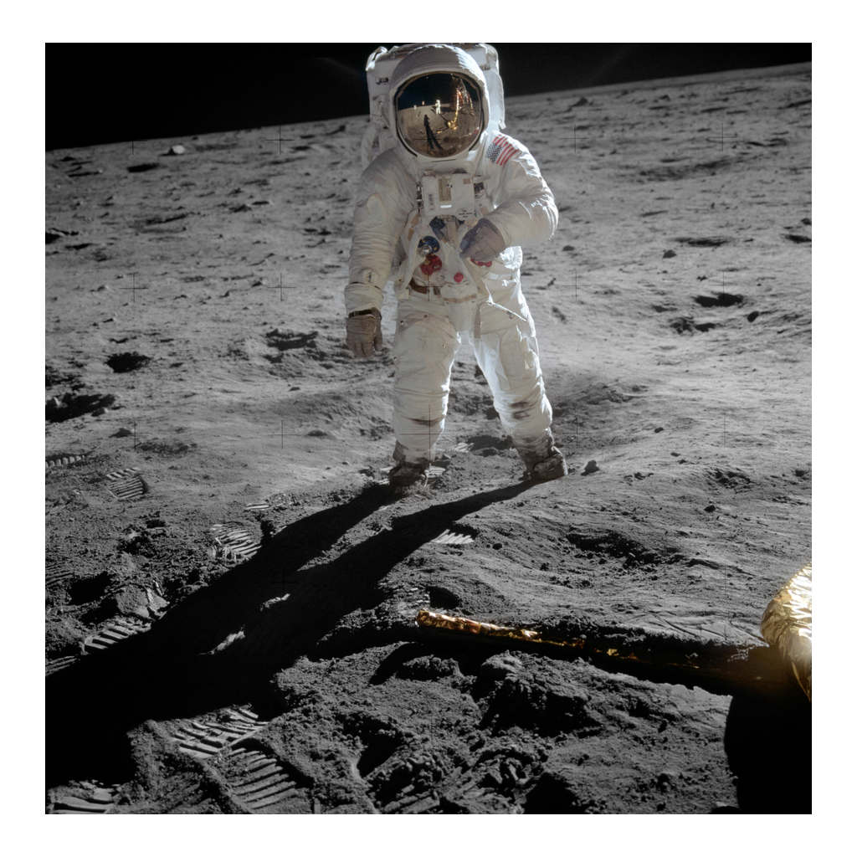
Buzz Aldrin on the Moon, July 20, 1969
Aldrin near the Lunar Module Eagle, photographed by Armstrong
© More Lessons Less Planning | morelessonslessplanning.com
Notes:
Give students ten seconds to look before narrating. This is the famous 'Visor' photograph - point out the reflection of Armstrong and the Lunar Module visible in Aldrin's gold visor. This is a reference image, not an evidence task.

Slide 16
Coming Home, and Five More Landings
Apollo 11 splashed down in the Pacific on July 24, 1969
The crew was quarantined as a precaution after return
Five more Apollo missions landed astronauts on the Moon
Apollo 13, in 1970, survived a crisis without landing
The Apollo program ended with Apollo 17 in December 1972
Note: twelve astronauts walked on the Moon between 1969-1972.
© More Lessons Less Planning | morelessonslessplanning.com
Notes:
This slide closes out the Apollo program itself before the lesson moves to the bigger-picture legacy. Apollo 13 is worth a one-sentence mention since students may know the phrase 'Houston, we've had a problem.'

Slide 17
From Rivals to Partners: 1975
A Thaw Begins
By the mid-1970s, U.S.-Soviet tensions had begun to ease.
✔
July 1975
An American Apollo docked with a Soviet Soyuz in orbit.
✔
A First
It was the first joint U.S.-Soviet human spaceflight.
✔
The Handshake
Astronauts and cosmonauts shook hands, symbolizing a thaw.
✔
Key Concept: the same rivals who raced now worked together.
© More Lessons Less Planning | morelessonslessplanning.com
Notes:
Apollo-Soyuz Test Project - the 1975 joint U.S.-Soviet mission that docked spacecraft in orbit, easing Cold War tensions in space. This is a deliberate turn in the lesson - the same rivalry that drove Sputnik and Apollo now produces cooperation instead.

Slide 18
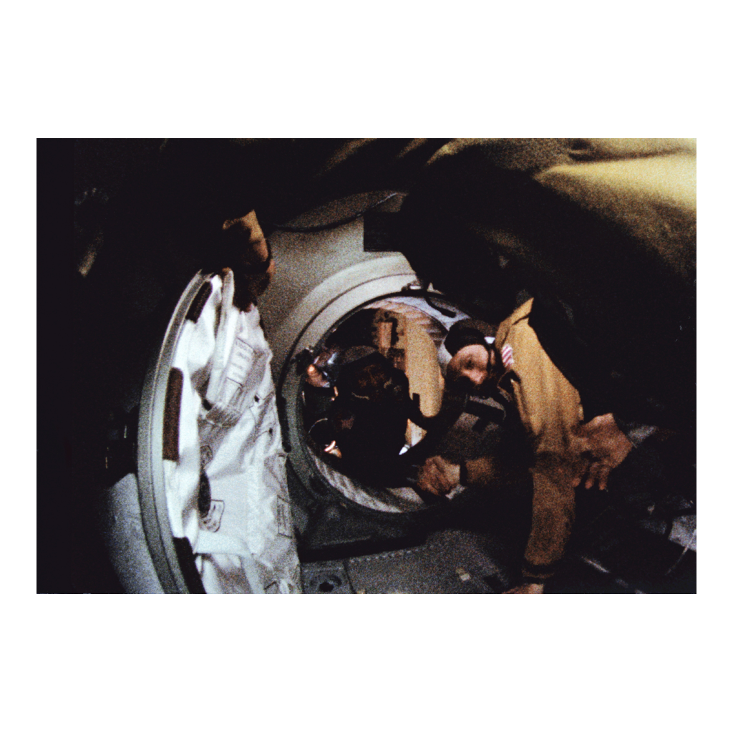
The Apollo-Soyuz Handshake, 1975
Stafford and Leonov shake hands in orbit, July 1975
© More Lessons Less Planning | morelessonslessplanning.com
Notes:
Give students ten seconds to look before narrating. Point out this is inside the docking tunnel connecting the two spacecraft, not on the ground. This is a reference image, not an evidence task.

Slide 19
What the Space Race Proved
Cold War rivalry pushed both nations to huge achievements
The Moon landing was a scientific and a propaganda victory
Space technology led to satellites used in daily life today
Rivalry eventually gave way to cooperation by 1975
The Space Race shows Cold War competition cut both ways
Fact: modern GPS and weather satellites trace back to this era.
© More Lessons Less Planning | morelessonslessplanning.com
Notes:
This is the analysis slide that pulls the whole lesson together before Key Takeaways. Push students to hold both truths at once: rivalry produced genuine achievement, and it was also a very expensive, very public competition for prestige.

Slide 20
Key Takeaways
Sputnik's 1957 launch shocked the U.S. and started the Space Race
★
Kennedy committed the U.S. to landing on the Moon after Gagarin's flight
★
Apollo 11 fulfilled that promise on July 20, 1969
★
By 1975, the same rivals docked spacecraft together in orbit
★
© More Lessons Less Planning | morelessonslessplanning.com
Notes:
Close by returning to the opening question: where would two rival superpowers compete without fighting a war? Space was the answer, and by the end of the story, the answer changed from competition to cooperation.

