Slide 1
The Scramble for Africa
How profit and prejudice fused to drive Europe's rush to carve up Africa - and what it cost African peoples.
© More Lessons Less Planning | morelessonslessplanning.com
Notes:
Opening slide. In barely thirty years, European powers seized almost the entire African continent. This lesson examines WHY they did it - the mix of economic greed and racial ideology - and the human cost to the African peoples who were conquered.

Slide 2
Learning Targets
Explain the economic motives that drove the Scramble for Africa.
★
Analyze the racial ideology and 'civilizing mission' used to justify conquest.
★
Describe how the Berlin Conference let Europe divide Africa.
★
Evaluate the human cost, and recognize African resistance and agency.
★
© More Lessons Less Planning | morelessonslessplanning.com
Notes:
Read the four learning targets. Today we examine both WHY Europe conquered Africa - money and ideology - and what that conquest cost the peoples who lived there, including how they resisted.

Slide 3
Africa Before the Scramble
Africa was not empty: it held kingdoms, empires, and trading cities.
States such as the Sokoto Caliphate, Asante, and Ethiopia governed millions.
Long-distance trade routes carried gold, salt, ivory, and cloth across Africa.
Europeans imposed conquest on these existing African societies.
Key Concept: Africa was never empty. It held kingdoms, empires, trading cities, and long-distance trade networks long before Europeans arrived.
© More Lessons Less Planning | morelessonslessplanning.com
Notes:
Before the Scramble, Africa was home to hundreds of organized societies: powerful kingdoms and empires such as the Sokoto Caliphate, the Asante (Ashanti) kingdom, and the ancient Christian empire of Ethiopia, along with busy trading cities. Long-distance trade routes carried gold, salt, ivory, and cloth across the continent. Europeans did not find an empty land - they imposed conquest on existing African nations and peoples.

Slide 4
The Scramble for Africa
Scramble for Africa
The rapid conquest and division of nearly the entire African continent by European powers between the 1880s and 1914.
Imperialism
The policy of extending a nation's power by taking territory and controlling the economy and politics of other peoples.
About 90 percent
In roughly 1880-1914, Europeans seized about 90 percent of the African continent.
A few powers
Britain, France, Germany, Belgium, Portugal, and Italy took the largest shares.
Key Concept: The SCRAMBLE FOR AFRICA was the rapid conquest and division of nearly the whole continent by European powers between the 1880s and 1914.
© More Lessons Less Planning | morelessonslessplanning.com
Notes:
The SCRAMBLE FOR AFRICA was the rapid conquest and division of nearly the entire African continent by European powers between the 1880s and 1914. It was driven by IMPERIALISM - the policy of extending a nation's power by taking territory and controlling other peoples. In roughly thirty years, Europeans seized about 90 percent of Africa. Only a handful of powers - Britain, France, Germany, Belgium, Portugal, and Italy - took the largest shares.

Slide 5
Why Africa? The Economic Motives
Raw materials
European factories wanted rubber, gold, diamonds, copper, and palm oil from Africa.
✔
New markets
Colonies were places to sell European manufactured goods.
✔
National prestige
Owning colonies was treated as a sign of a great, powerful nation.
✔
Strategic control
Powers grabbed ports, rivers, and routes to protect trade and empire.
✔
Key Concept: The engine of the Scramble was profit - RAW MATERIALS for factories, new markets for goods, and national prestige.
© More Lessons Less Planning | morelessonslessplanning.com
Notes:
The Industrial Revolution gave Europe a hunger for profit that Africa seemed able to feed. Factories wanted RAW MATERIALS - rubber, gold, diamonds, copper, and palm oil. Colonies were also new markets where Europeans could sell manufactured goods. Owning colonies was treated as a sign of national prestige and power. Powers also grabbed ports, rivers, and routes to protect trade and empire. Money, not just glory, was the engine of conquest.

Slide 6
The Ideology Used to Justify Conquest
Europeans claimed a CIVILIZING MISSION: that empire would 'civilize' Africans.
This claim was used to excuse conquest - it was false, not a fact.
Imperialists also leaned on SCIENTIFIC RACISM, a false ranking of 'races.'
Historians study this ideology to see how profit and prejudice were fused.
Key Concept: Europeans JUSTIFIED conquest with the CIVILIZING MISSION and SCIENTIFIC RACISM - claims used to excuse empire, NOT facts.
© More Lessons Less Planning | morelessonslessplanning.com
Notes:
Profit alone was hard to defend, so Europeans justified conquest with ideology. Many claimed a CIVILIZING MISSION: the idea that empire would 'civilize' and Christianize Africans. This claim was used to excuse conquest - it was not true, and it ignored Africa's own civilizations. Imperialists also leaned on SCIENTIFIC RACISM, the false, pseudo-scientific belief that human 'races' could be ranked. Historians study this ideology, always as a documented belief of the imperialists, to see how profit and prejudice were fused together.

Slide 7
Cecil Rhodes: Empire and Ideology
CECIL RHODES was a British mining magnate, rich from southern African mines.
He grew his fortune on southern African diamonds and gold.
Rhodes argued the 'Anglo-Saxon race' should rule the world.
His dream was a British empire from Cape Town to Cairo. Next: an 1892 cartoon.
Key Concept: CECIL RHODES, a British mining magnate, preached that the 'Anglo-Saxon race' should rule as much of the world as possible.
© More Lessons Less Planning | morelessonslessplanning.com
Notes:
CECIL RHODES puts a face on the fusion of profit and prejudice. He was a British mining magnate who grew rich on southern African diamonds and gold, and later became prime minister of the Cape Colony. Rhodes argued that the people he called the 'Anglo-Saxon race' should rule as much of the world as possible - a belief historians present as his documented ideology, not as fact. His dream was a British empire and railway stretching from Cape Town to Cairo. The next slide shows a famous 1892 cartoon mocking that ambition.

Slide 8
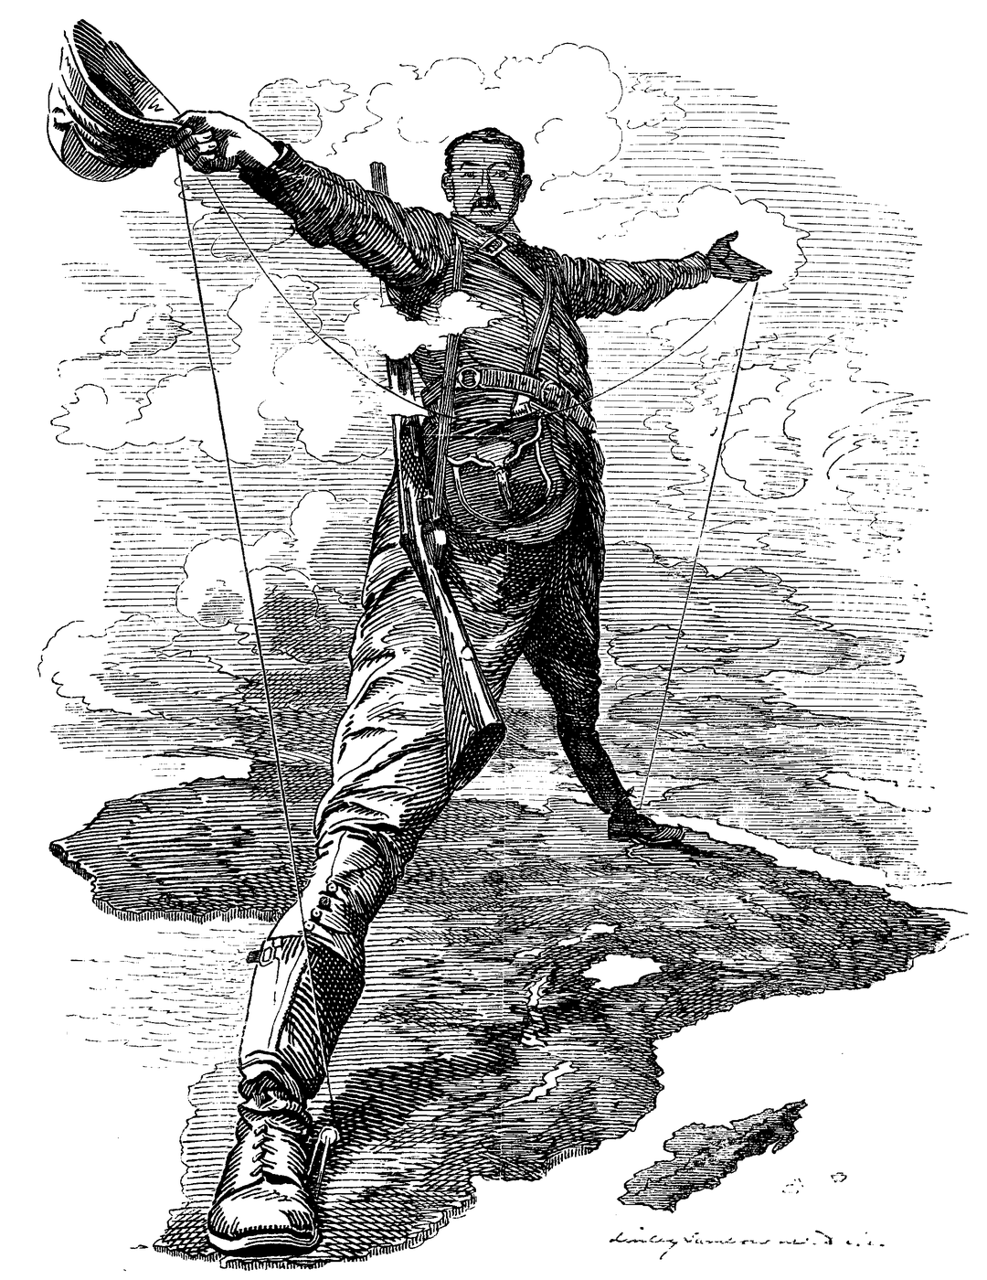
The Rhodes Colossus (Punch, 1892)
'The Rhodes Colossus,' a Punch cartoon (1892) of Rhodes bestriding Africa.
© More Lessons Less Planning | morelessonslessplanning.com
Notes:
This is Edward Linley Sambourne's 1892 Punch cartoon 'The Rhodes Colossus.' It shows Cecil Rhodes drawn as a giant standing astride the entire African continent, one foot at Cape Town and one at Cairo, holding a telegraph line across the whole length of Africa. The cartoon satirizes Rhodes's ambition to build a British empire down all of Africa. Use it as a reference image, not as evidence for any single graded claim.
Reference labels (point to these chart features when teaching): Rhodes astride Africa; Telegraph line across Africa

Slide 9
The Berlin Conference (1884-85)
Berlin Conference
The 1884-85 meeting where European powers set rules for dividing Africa among themselves.
No Africans present
Not a single African ruler or representative was invited to the table.
Effective occupation
A rule that a power had to physically control land to claim it, which pushed rapid armed conquest.
Paper borders
Europeans drew straight-line borders that ignored existing African nations and peoples.
Key Concept: At the BERLIN CONFERENCE (1884-85), European powers set rules to divide Africa - with NO African representatives present.
© More Lessons Less Planning | morelessonslessplanning.com
Notes:
To avoid war among themselves, European powers met at the BERLIN CONFERENCE of 1884-85. There they set rules for dividing Africa among themselves. Not a single African ruler or representative was invited to the table. One rule was EFFECTIVE OCCUPATION: a power had to physically control territory to claim it, which pushed a rush of armed conquest. Europeans drew straight-line borders on maps that ignored existing African nations, languages, and peoples - borders that still cause conflict today.

Slide 10
The Human Cost
Exploitation
African land, labor, and resources were used for European profit, often by force.
✔
Forced labor
Colonizers forced Africans to work mines, plantations, and rubber forests.
✔
The Congo
In King Leopold's Congo Free State, brutal rubber quotas led to millions of deaths.
✔
Lost freedom
African peoples lost their land, their governments, and their freedom.
✔
Key Concept: Conquest meant EXPLOITATION - African land, labor, and resources taken for European profit, often through force and violence.
© More Lessons Less Planning | morelessonslessplanning.com
Notes:
The Scramble carried a terrible human cost. Conquest meant EXPLOITATION: African land, labor, and resources used for European profit, often through force and violence. Colonizers used forced labor to work mines, plantations, and rubber forests. In King Leopold's Congo Free State, brutal rubber quotas and violence led to millions of African deaths. Across the continent, African peoples lost their land, their governments, and their freedom. The profits of empire were paid for in African lives.

Slide 11
African Resistance and Agency
RESISTANCE means organized African opposition to European conquest.
At Adwa in 1896, Ethiopia defeated Italy and kept its independence.
The Zulu, the Herero, and Samori Toure's forces fought European armies.
Africans also resisted through diplomacy, strikes, and cultural survival.
Key Concept: Africans did not accept conquest passively - RESISTANCE ranged from armed war to diplomacy across the whole continent.
© More Lessons Less Planning | morelessonslessplanning.com
Notes:
Africans did not accept conquest passively. RESISTANCE means organized African opposition to European conquest. At the Battle of Adwa in 1896, Ethiopia defeated an invading Italian army and kept its independence - the most famous African victory of the era. The Zulu kingdom, the Herero and Nama peoples, and Samori Toure's forces in West Africa all fought European armies. Africans also resisted through diplomacy, strikes, religious movements, and by preserving their languages and cultures. African agency is part of this story.

Slide 12
Reference Guide: The Drive to Conquer
Scramble for Africa
The rapid conquest and division of nearly all of Africa by Europe, 1880s-1914.
Imperialism
Extending a nation's power by taking territory and controlling other peoples.
Berlin Conference
The 1884-85 meeting where Europe set rules to divide Africa, no Africans present.
Raw materials
Resources such as rubber, gold, diamonds, and palm oil that European factories wanted.
Civilizing mission
The claim that empire would 'civilize' Africans - a justification, not a fact.
Key Concept: The Scramble, imperialism, the Berlin Conference, raw materials, and the civilizing mission explain WHY and HOW Europe conquered Africa.
© More Lessons Less Planning | morelessonslessplanning.com
Notes:
Review slide with five exact definitions: Scramble for Africa, Imperialism, Berlin Conference, Raw materials, and Civilizing mission.

Slide 13
Reference Guide: Rule, Cost, and Resistance
Scientific racism
The false belief that human 'races' could be ranked, used to excuse domination.
Effective occupation
The Berlin rule that a power had to physically control land to claim it.
Cecil Rhodes
A British mining magnate who preached Anglo-Saxon expansion in southern Africa.
Exploitation
Using African land, labor, and resources for European profit, often by force.
Resistance
Organized African opposition to conquest, such as Ethiopia's win at Adwa (1896).
Key Concept: Scientific racism, effective occupation, Rhodes, exploitation, and resistance name the ideology, method, cost, and response.
© More Lessons Less Planning | morelessonslessplanning.com
Notes:
Review slide with five exact definitions: Scientific racism, Effective occupation, Cecil Rhodes, Exploitation, and Resistance.

Slide 14
Key Takeaways
Between the 1880s and 1914, Europe seized about 90 percent of Africa.
★
The Scramble fused economic profit with a false racial ideology.
★
The Berlin Conference divided Africa with no Africans present.
★
Conquest brought exploitation, but Africans resisted and kept their agency.
★
© More Lessons Less Planning | morelessonslessplanning.com
Notes:
Recap the four takeaways. The big idea: the Scramble for Africa was driven by profit fused with a false racial ideology, organized by Europeans without African voices, and carried a heavy human cost - yet African peoples resisted and were never passive.

