Slide 1
The Scientific Revolution: Copernicus and Galileo
How Galileo's telescope turned observation into evidence and challenged the Earth-centered universe
© More Lessons Less Planning | morelessonslessplanning.com
Notes:
Open with the lesson question: how did looking through a telescope change what people believed about the universe? Preview that Galileo gathered evidence by direct observation, and that this shift from authority to observation marks the birth of modern science. Keep the Church conflict factual and neutral throughout.

Slide 2
Learning Targets
Compare the geocentric and heliocentric models
★
Explain how Galileo used the telescope for evidence
★
Use Jupiter's moons and Venus as evidence for heliocentrism
★
Describe the Galileo-Church conflict in neutral terms
★
Explain why observation marks the birth of modern science
★
© More Lessons Less Planning | morelessonslessplanning.com
Notes:
The five targets keep the lesson centered on evidence: the two competing models, Galileo's telescope, the specific observations, the neutral account of the Church conflict, and why observation-based reasoning marks modern science.

Slide 3
Who Was Galileo Galilei?
Galileo Galilei was born in 1564 in Pisa, Italy.
He was an Italian astronomer, physicist, and mathematician.
He built and improved the telescope for studying the sky.
He trusted observation - evidence he could see - over authority.
His discoveries made him famous across Europe.
Key Concept: Galileo built evidence by observation, using the telescope to study the sky himself.
© More Lessons Less Planning | morelessonslessplanning.com
Notes:
Galileo Galilei was born in 1564 in Pisa, Italy. He was an astronomer, physicist, and mathematician. He improved the telescope and pointed it at the sky, choosing to trust careful observation over long-accepted authority. This habit of testing ideas against what he could see is the thread of the whole lesson.

Slide 4
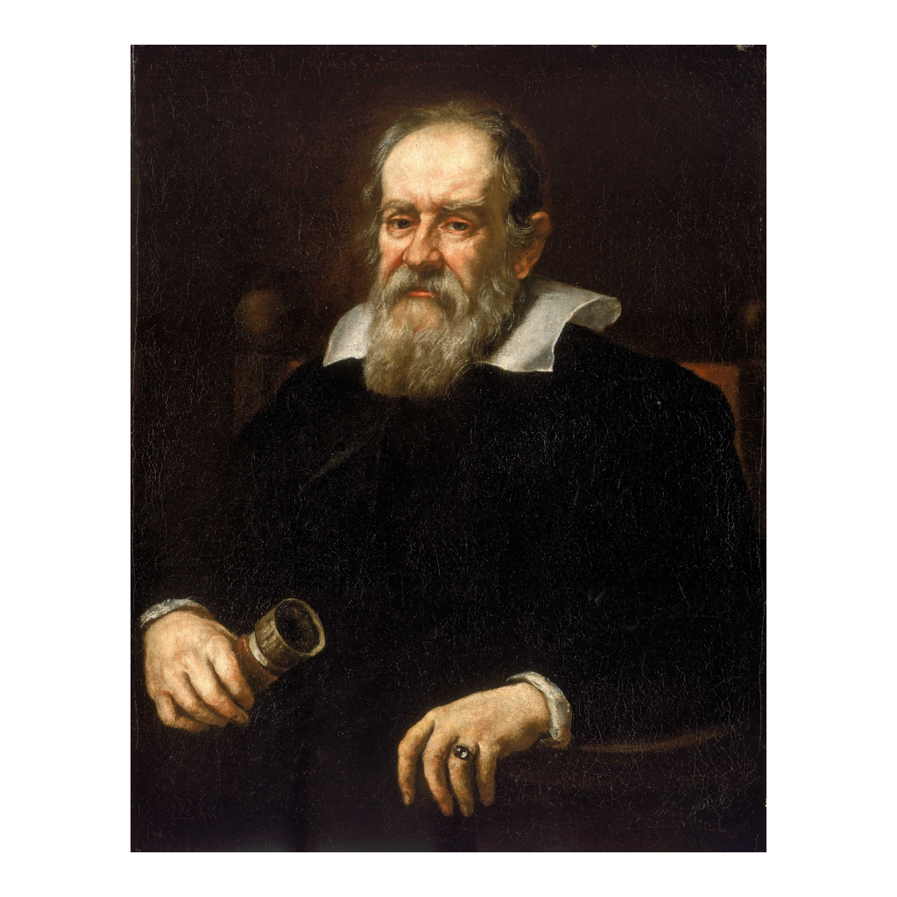
Galileo Galilei, portrait by Justus Sustermans (1636)
Galileo Galilei, painted by Justus Sustermans, 1636
© More Lessons Less Planning | morelessonslessplanning.com
Notes:
This is a period portrait of Galileo painted by Justus Sustermans in 1636, held at the National Maritime Museum, Greenwich. Use it as a historical reference image, not as evidence for any claim beyond identifying Galileo.

Slide 5
The Geocentric Model
Earth at the Center
Widely Accepted
The geocentric model places Earth at the center
The Sun, Moon, and planets orbit the Earth
Named the Ptolemaic model after Ptolemy
It was accepted for over a thousand years
The Catholic Church supported this model
It matched what people saw with the naked eye
Key Concept: The geocentric (Ptolemaic) model put the Earth at the center, and the Church supported it for centuries.
© More Lessons Less Planning | morelessonslessplanning.com
Notes:
The geocentric model places the Earth at the center of the universe, with the Sun, Moon, and planets orbiting the Earth. It is called the Ptolemaic model after the ancient astronomer Ptolemy. It was widely accepted for over a thousand years and was supported by the Catholic Church, partly because it matched what people saw with the naked eye each day.

Slide 6
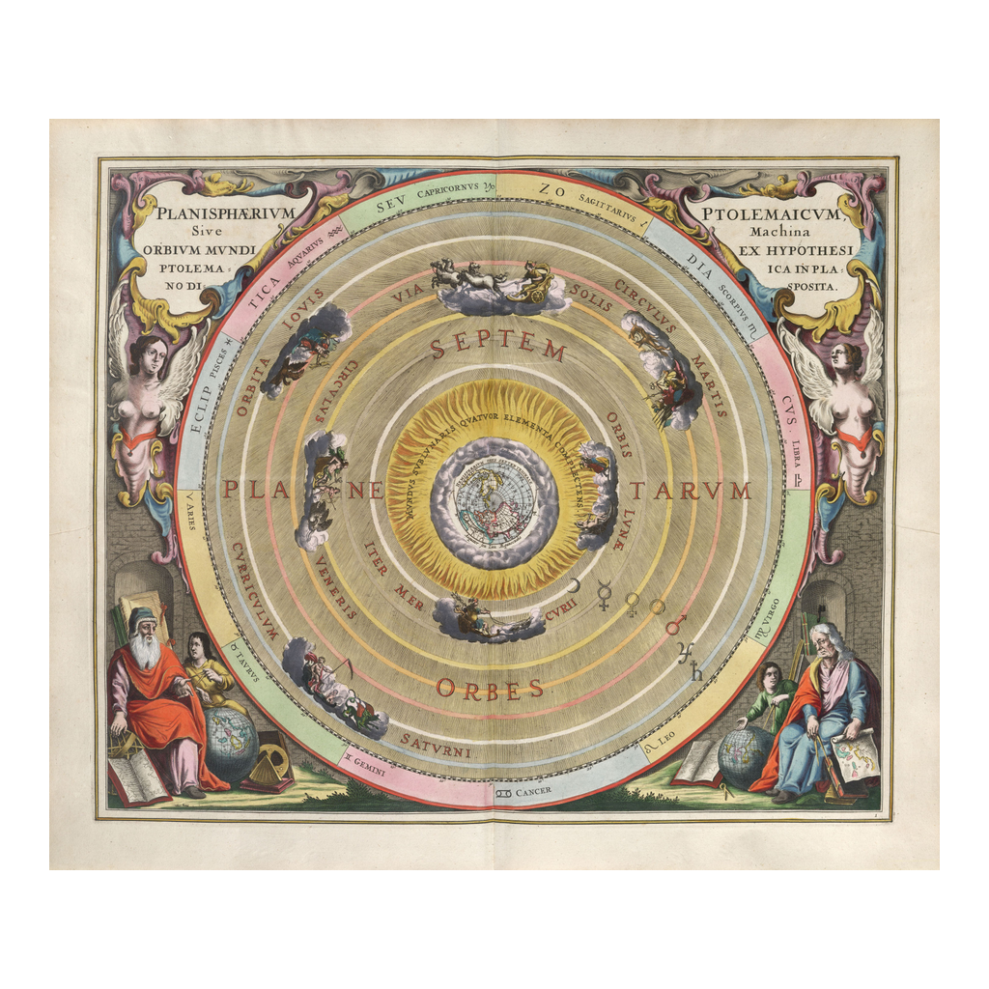
A Geocentric (Ptolemaic) Chart of the Heavens
Ptolemaic (Earth-centered) celestial chart, Andreas Cellarius, 1660
© More Lessons Less Planning | morelessonslessplanning.com
Notes:
This is a 1660 celestial chart by Andreas Cellarius showing the geocentric (Ptolemaic) system, with the Earth at the center and the planets arranged in circles around it. Use it to picture what the Earth-centered model looked like to educated Europeans.
Reference labels (point to these chart features when teaching): Earth at the center; Planets circle the Earth

Slide 7
The Heliocentric Model
Sun at the Center
A New Idea
The heliocentric model places the Sun at the center
The Earth and planets orbit the Sun
Called the Copernican model after Copernicus
Nicolaus Copernicus proposed it in 1543
At first it had little direct evidence
Galileo's telescope would later support it
Key Concept: The heliocentric (Copernican) model put the Sun at the center; Copernicus proposed it in 1543.
© More Lessons Less Planning | morelessonslessplanning.com
Notes:
The heliocentric model places the Sun at the center, with the Earth and planets orbiting the Sun. It is called the Copernican model after Nicolaus Copernicus, who proposed it in 1543. At first this idea had little direct evidence to support it. Galileo's telescope observations would later provide that evidence.

Slide 8
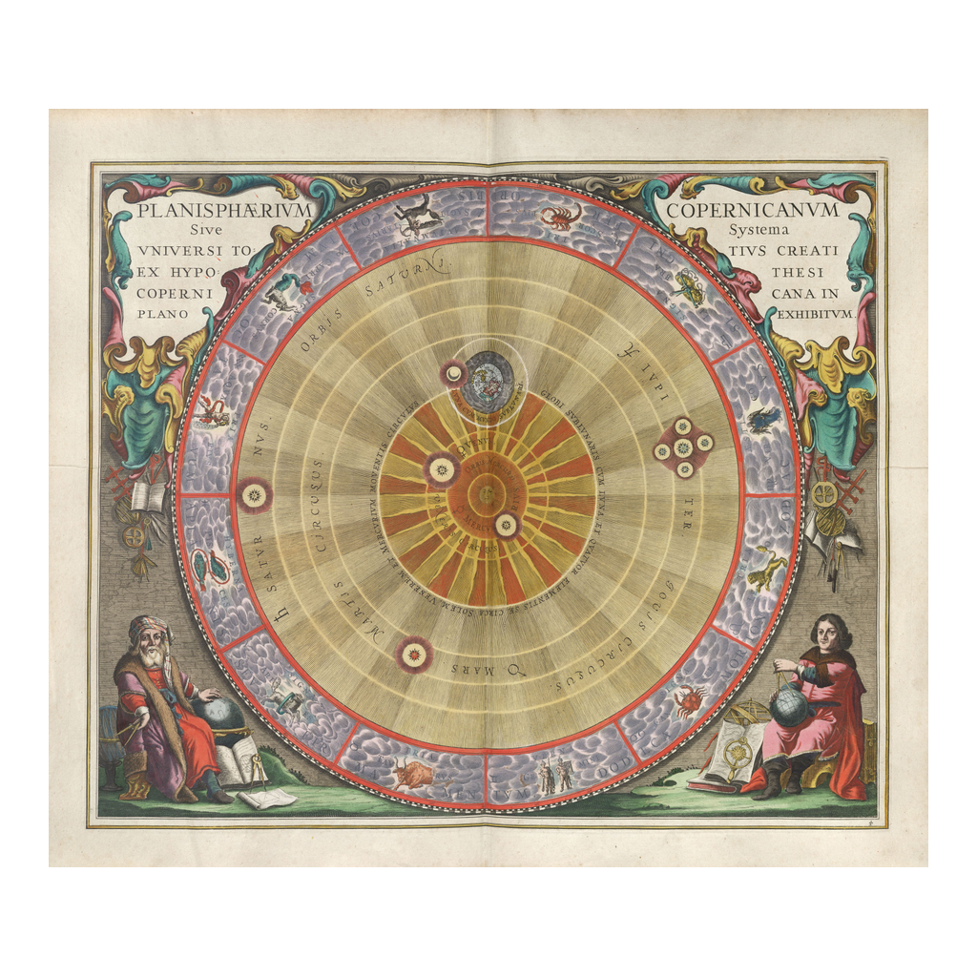
A Heliocentric (Copernican) Chart of the Heavens
Copernican (Sun-centered) celestial chart, Andreas Cellarius, 1660
© More Lessons Less Planning | morelessonslessplanning.com
Notes:
This is a 1660 celestial chart by Andreas Cellarius showing the heliocentric (Copernican) system, with the Sun at the center and the Earth as one of the planets orbiting it. Compare it directly with the Ptolemaic chart to see how the two models differ.
Reference labels (point to these chart features when teaching): Sun at the center; Earth as one orbiting planet

Slide 9
Galileo's Telescope (1609-1610)
1609
1610
Galileo built his own telescope
He reported his sky discoveries
Tool: A telescope uses lenses to make distant objects appear closer.
Aim: Galileo pointed it at the Moon, planets, and stars.
Result: He saw details no one had ever recorded before.
Remember: In 1609-1610 Galileo used the telescope to observe the sky and record new evidence.
© More Lessons Less Planning | morelessonslessplanning.com
Notes:
In 1609 Galileo built and improved his own telescope, an instrument that uses lenses to make distant objects appear closer and larger. In 1609 and 1610 he pointed it at the Moon, the planets, and the stars and recorded details no one had ever seen before. These recorded observations became the evidence he published in 1610.

Slide 10
What Galileo Saw: Four Discoveries
1. Jupiter's Moons
2. Phases of Venus
3 and 4. Moon and Sun
Four moons circling Jupiter
He called them the Medicean Stars
Key evidence in this lesson
Venus shows changing lit shapes
Like the phases of the Moon
Shows Venus orbits the Sun
Craters and mountains on the Moon
Sunspots on the surface of the Sun
The heavens were not perfect
Key Concept: Galileo recorded four discoveries: Jupiter's four moons, the phases of Venus, the Moon's craters, and sunspots.
© More Lessons Less Planning | morelessonslessplanning.com
Notes:
Galileo made four major discoveries with his telescope. First, four moons circling Jupiter, which he named the Medicean Stars. Second, the phases of Venus, changing lit shapes like the Moon's phases. Third, craters and mountains on the Moon. Fourth, sunspots on the surface of the Sun. Together the Moon's craters and the Sun's spots showed the heavens were not the perfect, unchanging spheres people had assumed.

Slide 11
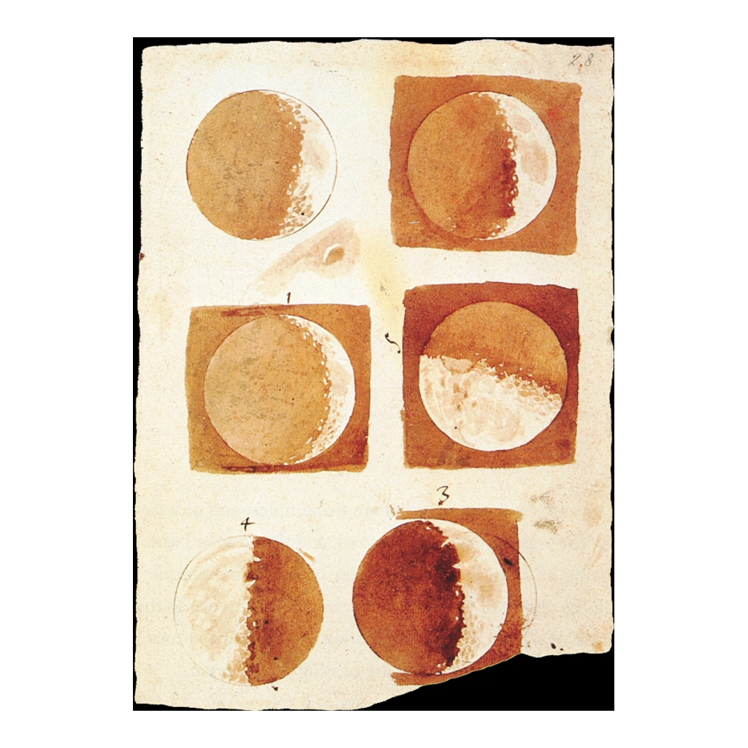
Galileo's Own Drawings of the Moon
Galileo's telescope drawings of the Moon's phases, from Sidereus Nuncius (1610)
© More Lessons Less Planning | morelessonslessplanning.com
Notes:
These are Galileo's own drawings of the Moon from Sidereus Nuncius (1610). They show a rough, cratered surface with mountains and shadows, not the smooth perfect sphere people had imagined. Use them to show that Galileo recorded what he actually saw.
Reference labels (point to these chart features when teaching): Rough, cratered surface; Shadowed mountains

Slide 12
Jupiter's Four Moons: The Key Evidence
In January 1610 Galileo saw small stars beside Jupiter.
Night after night their positions changed.
He counted four bodies that stayed near Jupiter.
He concluded they were moons orbiting Jupiter.
He named them the Medicean Stars.
Remember: Galileo's four moons orbit Jupiter, not the Earth - direct evidence from many nights of observation.
© More Lessons Less Planning | morelessonslessplanning.com
Notes:
In January 1610 Galileo saw small star-like bodies beside Jupiter. Watching night after night, he found their positions changed and that there were four of them, always staying near Jupiter. He concluded they were moons orbiting Jupiter, and he named them the Medicean Stars. This is the evidence students read in the Primary Source Spotlight.

Slide 13
Why the Moons Mattered
The Old Assumption
The New Evidence
The geocentric model said everything orbits Earth
Nothing was supposed to circle another body
Four moons clearly orbit Jupiter, not Earth
So not everything orbits the Earth
The phases of Venus show Venus orbits the Sun
Key Concept: If moons orbit Jupiter and Venus orbits the Sun, then not everything orbits the Earth.
© More Lessons Less Planning | morelessonslessplanning.com
Notes:
The geocentric model assumed everything in the sky orbits the Earth. Galileo's four moons clearly orbit Jupiter, not the Earth, so not everything orbits the Earth. The phases of Venus were further evidence, because they show Venus orbits the Sun. Together these observations supported the heliocentric model.

Slide 14
Conflict with the Church
The Catholic Church supported the geocentric model.
Galileo's evidence supported the heliocentric model.
In 1616 Church officials warned Galileo about the idea.
In 1633 Galileo was tried and told to withdraw it.
He spent his last years under house arrest.
Key Concept: The Church backed the geocentric model; Galileo was warned in 1616 and tried in 1633.
© More Lessons Less Planning | morelessonslessplanning.com
Notes:
Describe this dispute neutrally and factually. The Catholic Church supported the geocentric model, while Galileo's evidence supported the heliocentric one. In 1616 Church officials warned Galileo about promoting the idea. In 1633 he was tried and told to withdraw his support for it, and he spent his last years under house arrest. Present these as historical facts without taking a side.

Slide 15
Reference Guide: Models of the Universe
geocentric
A model that places the Earth at the center of the universe, with the Sun, Moon, and planets orbiting the Earth.
heliocentric
A model that places the Sun at the center, with the Earth and planets orbiting the Sun.
Ptolemaic model
The Earth-centered model of the universe named for the ancient astronomer Ptolemy.
Copernican model
The Sun-centered model of the universe proposed by Nicolaus Copernicus.
telescope
An instrument that uses lenses to make distant objects appear closer and larger.
Tip: These five terms name the two models, the astronomers behind them, and the tool that gathered the evidence.
© More Lessons Less Planning | morelessonslessplanning.com
Notes:
Review the five terms exactly as defined: geocentric, heliocentric, Ptolemaic model, Copernican model, and telescope. Students use these definitions to complete the Reference Guide in the Activity.

Slide 16
Reference Guide: Galileo's Evidence
Sidereus Nuncius
Galileo's 1610 book, The Starry Messenger, that reported his telescope discoveries.
phases of Venus
The changing lit shapes of Venus that show Venus orbits the Sun.
sunspots
Dark spots on the surface of the Sun that Galileo observed through his telescope.
Medicean Stars
The name Galileo gave to the four moons he discovered orbiting Jupiter.
observation
Information gathered by carefully watching and measuring the natural world.
Tip: These five terms name Galileo's book, his key observations, and the method that made them evidence.
© More Lessons Less Planning | morelessonslessplanning.com
Notes:
Review the five terms exactly as defined: Sidereus Nuncius, phases of Venus, sunspots, Medicean Stars, and observation. Students use these definitions to complete the Reference Guide in the Activity.

Slide 17
The Birth of Modern Science
Do
Test ideas against evidence you can observe and record.
✔
Do
Let others check your observations for themselves.
✔
Say
Galileo trusted observation over long-accepted authority.
✔
Say
Observation-based evidence marks the birth of modern science.
✔
Read carefully
A model is only as strong as the evidence that supports it.
✔
Key Concept: Modern science began when observation became the test of what is true.
© More Lessons Less Planning | morelessonslessplanning.com
Notes:
Close on the method. Galileo tested ideas against evidence he could observe and record, and he let others check his observations. This habit of trusting observation over long-accepted authority is why his work is called the birth of modern science. A model is only as strong as the evidence that supports it.

Slide 18
Key Takeaways
Geocentric put Earth at the center; heliocentric put the Sun at the center.
★
Copernicus proposed the heliocentric model in 1543, but lacked direct evidence.
★
Galileo used the telescope in 1609-1610 to gather that evidence.
★
Jupiter's moons and the phases of Venus show not everything orbits Earth.
★
Trusting observation over authority marks the birth of modern science.
★
© More Lessons Less Planning | morelessonslessplanning.com
Notes:
Close with the essential question. Each takeaway connects an observation to the shift from the geocentric to the heliocentric model, and to why observation-based evidence marks the birth of modern science.

