Slide 1
The Samurai Warrior Code
Loyalty, honor, and skill in combat in the world of feudal Japan's warrior class.
© More Lessons Less Planning | morelessonslessplanning.com
Notes:
Opening slide. The samurai were the hereditary warrior class of feudal Japan. This lesson is about the values that defined them - loyalty to one's lord, personal honor, and skill in combat - later gathered under the name bushido. Keep the tone honest and academic: these values were real and demanding, but the later 'perfect warrior' image is idealized, and the famous name 'bushido' for a written code came centuries after the age of the great war tales.

Slide 2
Learning Targets
Explain who the samurai were and where they fit in feudal Japan.
★
Describe the code's values: loyalty to one's lord, honor, and combat skill.
★
Explain that 'bushido' as a written code was named centuries later.
★
Analyze a primary source: a scene from The Tale of the Heike.
★
© More Lessons Less Planning | morelessonslessplanning.com
Notes:
Learning targets. Point out target 3 is where the lesson refuses to simplify: the samurai's values were lived custom in the Genpei era, and the named written code 'bushido' came much later. Target 4 practices sourcing - a war epic celebrates an ideal and is not a neutral report.

Slide 3
Who Were the Samurai?
The SAMURAI were the hereditary WARRIOR class of feudal Japan.
They served a lord in war and were rewarded with land or income.
Samurai trained to fight from childhood and lived by a strict code.
Their rank was HEREDITARY - it passed from father to son.
At their height they were a small armed elite, not most of the people.
Key Concept: The SAMURAI were the hereditary WARRIOR class of feudal Japan, sworn to serve a lord.
© More Lessons Less Planning | morelessonslessplanning.com
Notes:
The SAMURAI were the hereditary WARRIOR class of feudal Japan. A samurai served a lord in war and was rewarded with land, income, or protection. Samurai trained to fight from childhood - in swordsmanship, archery, and horsemanship - and lived by a demanding code of conduct. Their rank was HEREDITARY: it passed from father to son, so a person was born into the samurai class rather than choosing it. Important perspective for students: at their height the samurai were a small armed elite, perhaps only a small percentage of Japan's population, not the majority of ordinary farmers, artisans, and merchants.

Slide 4
Feudal Japan: Shogun, Daimyo, and Samurai
Shogun
The supreme military ruler of Japan, who held real power while the emperor reigned in name only.
Daimyo
A powerful landholding lord who controlled a province and whom samurai served in exchange for support.
Big idea: A SHOGUN ruled Japan by military power; DAIMYO lords held the land; SAMURAI served the daimyo.
© More Lessons Less Planning | morelessonslessplanning.com
Notes:
In feudal Japan power ran through a military hierarchy. The emperor reigned as a symbol, but real power belonged to the SHOGUN, the supreme MILITARY ruler who governed in the emperor's name. Below the shogun stood the DAIMYO, powerful LANDHOLDING lords who controlled provinces. Each daimyo was served by SAMURAI - warriors who fought for him in exchange for land, income, or protection. Point out to students how much this resembles the lord-and-vassal bonds of medieval Europe they studied earlier in the unit: loyalty and service exchanged for land and protection, a feudal relationship on the other side of the world.

Slide 5
Loyalty to One's Lord
LOYALTY to one's lord was the CORE value of the samurai code.
A samurai owed faithful SERVICE to his daimyo, even unto death.
Betraying your lord brought the deepest shame a samurai could know.
Loyalty was PERSONAL - sworn to a lord, not to an abstract nation.
The bond ran both ways: the lord owed protection and reward in return.
Key Concept: LOYALTY - faithful service to one's lord even unto death - was the CORE value of the samurai code.
© More Lessons Less Planning | morelessonslessplanning.com
Notes:
LOYALTY to one's lord was the CORE value of the samurai code - the value the war tales praise most. A samurai owed faithful SERVICE to his daimyo, and the ideal held that he should serve even unto death. Betraying one's lord brought the deepest shame a samurai could know and could disgrace his whole family. Stress one nuance for students: this loyalty was PERSONAL - it was sworn to a particular lord, a specific person, not to an abstract nation or flag the way modern patriotism works. And the feudal bond ran both ways: in return for a samurai's service, the lord owed him protection, land, or reward. Loyalty was a two-way obligation, not one-way obedience.

Slide 6
Personal Honor
Honor
A samurai's personal REPUTATION and dignity, defended even at the cost of his life.
✔
A public thing
Honor was PUBLIC - won by brave conduct and lost by cowardice or betrayal.
✔
Shame
A dishonored samurai lost face, and his disgrace could shame his whole family.
✔
Key Concept: HONOR - a samurai's personal reputation and dignity - was defended even at the cost of life.
© More Lessons Less Planning | morelessonslessplanning.com
Notes:
The second great value was HONOR - a samurai's personal REPUTATION and dignity. The ideal held that honor was worth more than life itself and should be defended even at the cost of one's life. Help students see that honor was a PUBLIC thing: it was won by brave and correct conduct and lost by cowardice, dishonesty, or betrayal, in the eyes of other warriors. A dishonored samurai 'lost face,' and his disgrace could shame not just himself but his whole family and lord. Honor and loyalty worked together: a loyal samurai gained honor, and a betrayer lost it. This is why, in the war tales, warriors care so intensely about how their conduct will be remembered.

Slide 7
Skill in Combat and the Katana
The Warrior's Training
The Katana
Skill in COMBAT was expected of every samurai.
They trained for years in swordsmanship, archery, and riding.
A warrior was judged by courage and skill in battle.
The KATANA was the samurai's curved SWORD.
It was his signature weapon and a symbol of his status.
By later law, only samurai could carry two swords.
Fact: The KATANA, the samurai's curved sword, was his signature weapon and a mark of his rank.
© More Lessons Less Planning | morelessonslessplanning.com
Notes:
The third value was skill in COMBAT. A samurai was expected to be a master of war, trained for years in swordsmanship, archery on horseback, and riding. In battle he was judged by his courage and his skill, and reputation was won or lost by how he fought. The samurai's signature weapon was the KATANA - a curved SWORD, famous for its sharpness and craftsmanship. The katana was more than a tool: it was a symbol of the samurai's status, and in later centuries only samurai were legally allowed to carry two swords, marking them off from everyone else. The next slide shows a real 19th-century Japanese woodblock print of samurai in armor in battle.

Slide 8
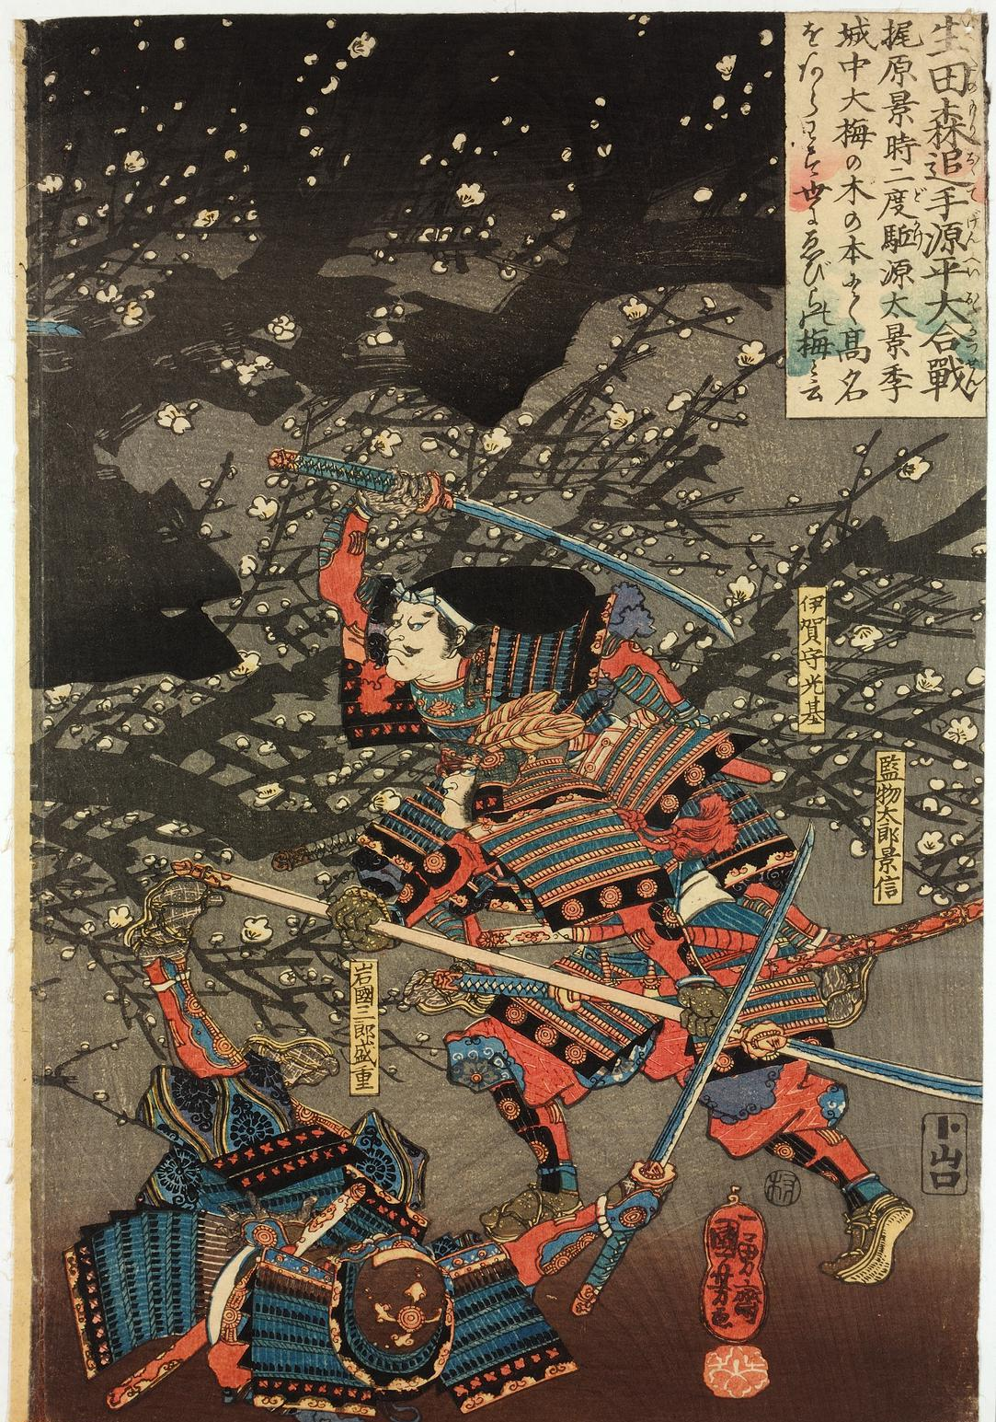
Samurai in Armor
Samurai in armor fighting with swords (Utagawa Kuniyoshi, 1845).
© More Lessons Less Planning | morelessonslessplanning.com
Notes:
A detail from a woodblock triptych by Utagawa Kuniyoshi (1845), 'The Great Genpei Battle at the Ikuta Forest.' It shows samurai in full lamellar armor - the plates laced together in rows - fighting with drawn swords among plum blossoms at night. Point out for students that this is a 19th-century artist's dramatic picture of a 12th-century battle, made about 650 years after the events, so it shows the ideal of heroic samurai combat rather than a photograph of the real fight. But it captures the essentials students just learned: the layered armor, the helmets, the swords, and the intensity of close combat that a samurai trained his whole life for.
Reference labels (point to these chart features when teaching): Lamellar armor and helmets; Drawn swords in combat

Slide 9
The Way of the Warrior
The samurai's values - loyalty, honor, courage - guided how a warrior lived.
In the Genpei and Kamakura eras these were LIVED customs, not a written code.
There was no single rulebook that samurai read and obeyed.
The ideals were taught by example, war tales, and family tradition.
The famous NAME for this code, bushido, came CENTURIES later.
Important: In the samurai's early centuries, the warrior's values were LIVED CUSTOM - not a single written code.
© More Lessons Less Planning | morelessonslessplanning.com
Notes:
This slide keeps the lesson honest, and it matters. The samurai's values - loyalty, honor, and courage - genuinely guided how a warrior was supposed to live. But in the Genpei and Kamakura eras (the 1100s-1300s), these ideals were LIVED customs, not rules copied from a single written code. There was no rulebook titled 'The Samurai Code' that a young warrior read and obeyed. Instead the ideals were passed down by example, by the war tales that praised heroic warriors, and by family and clan tradition. The famous NAME we now use for this code - bushido, 'the way of the warrior' - was attached and written down CENTURIES later. So students should picture the early samurai code as a shared culture of expectations, not a printed set of laws.

Slide 10
Seppuku: Death Before Dishonor
Seppuku
RITUAL suicide by which a samurai could die with honor rather than face capture or disgrace.
✔
Why
A defeated or shamed samurai might choose death to protect his honor and family name.
✔
Read it critically
Seppuku was a real practice, but the romantic 'perfect warrior' image oversimplifies it.
✔
Key Concept: SEPPUKU was ritual suicide by which a samurai could die with honor rather than face capture or disgrace.
© More Lessons Less Planning | morelessonslessplanning.com
Notes:
One of the most striking - and most misunderstood - samurai practices was SEPPUKU: a form of RITUAL suicide. The ideal held that a defeated, trapped, or disgraced samurai could choose death to die with honor rather than face capture, torture, or lasting shame, protecting his own honor and his family's name. Teach this carefully and critically. Seppuku was a real practice, and it flowed logically from the values of honor and loyalty. But students should treat the romantic 'perfect warrior who calmly chooses a beautiful death' image with caution: real people faced fear, pain, and pressure, the practice changed a great deal over the centuries, and later writers and filmmakers romanticized it. Understanding seppuku means seeing both the ideal it expressed and the human reality behind it.

Slide 11
The Genpei War and The Tale of the Heike
Genpei War
The 1180-1185 civil war between the Taira and Minamoto clans for control of Japan.
The Tale of the Heike
The medieval Japanese war epic that memorializes and idealizes samurai conduct in that war.
Fact: The GENPEI WAR (1180-1185) between the Taira and Minamoto is remembered in THE TALE OF THE HEIKE, a war epic.
© More Lessons Less Planning | morelessonslessplanning.com
Notes:
Now we reach the source of many famous samurai stories. The GENPEI WAR of 1180-1185 was a CIVIL war between two great warrior clans - the Taira (also called the Heike) and the Minamoto (the Genji) - for control of Japan. The Minamoto won, and their leader founded the first shogunate. The war produced THE TALE OF THE HEIKE, the medieval Japanese war EPIC that memorializes and idealizes the conduct of samurai on both sides. One of its most famous scenes takes place at the Battle of Ichi-no-tani in 1184, where a Minamoto warrior named Kumagai Naozane meets a young Taira noble named Atsumori on the beach - the exact scene shown on the next slide and read in the Activity's Primary Source Spotlight.

Slide 12
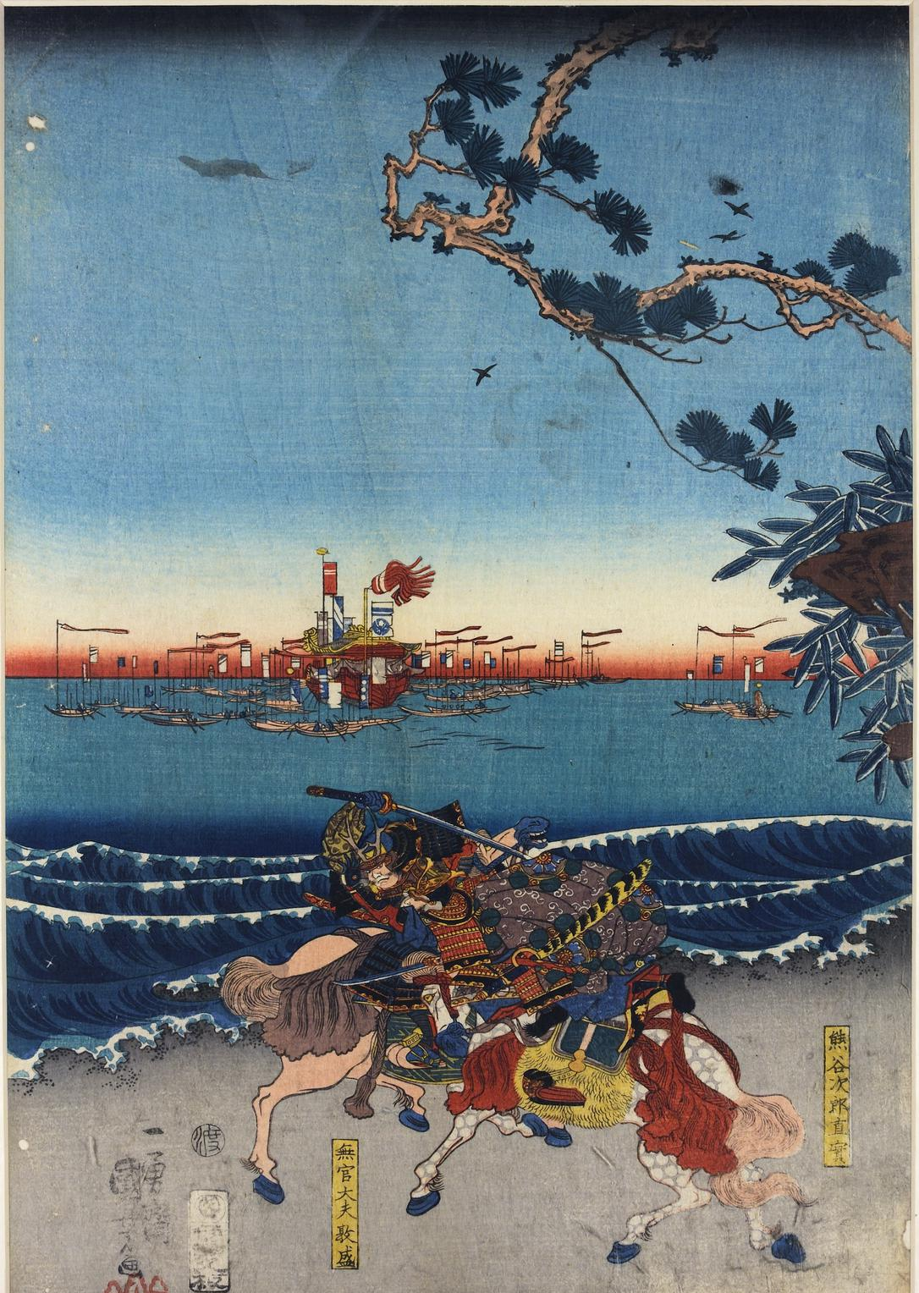
Kumagai and Atsumori at Ichi-no-tani
Kumagai and Atsumori at Ichi-no-tani (Utagawa Kuniyoshi, 1845).
© More Lessons Less Planning | morelessonslessplanning.com
Notes:
A woodblock print by Utagawa Kuniyoshi (1845) of the most famous scene in The Tale of the Heike: at the Battle of Ichi-no-tani in 1184, the Minamoto warrior Kumagai Naozane (named in the right cartouche) calls the young Taira noble Atsumori (named in the lower cartouche) back from the boats to fight. The two clash on horseback in the surf while the Taira fleet floats offshore under a red sunset. Remind students this is a 19th-century artist's heroic vision of a 12th-century moment, painted about 650 years later - it dramatizes the ideal of honorable combat, and it sets up exactly the primary source they will analyze in the Activity.
Reference labels (point to these chart features when teaching): Two mounted samurai in armor; The Taira fleet offshore

Slide 13
An Epic, Not a Battle Report
The Tale of the Heike is a literary war EPIC, not a neutral news report.
It was performed ALOUD for centuries before it was written down.
It dramatizes and idealizes how samurai were supposed to act.
Its Buddhist theme is impermanence - even the mighty Taira fall.
Read it for the IDEAL it celebrates, not as verified eyewitness fact.
Warning: The Tale of the Heike is a literary EPIC that idealizes samurai conduct - not a documentary record.
© More Lessons Less Planning | morelessonslessplanning.com
Notes:
This is a crucial honesty slide. The Tale of the Heike is a literary war EPIC - a work of art meant to move and inspire - not a neutral eyewitness news report. For centuries it was performed ALOUD by traveling chanters (often blind monks who accompanied themselves on a lute) before it was ever fixed in writing, and each performance shaped it. The epic DRAMATIZES and idealizes how samurai were supposed to act: brave, loyal, and honorable even in defeat. Its deep theme is Buddhist - the impermanence of all things, sometimes called mono no aware, the pathos of a world where even the mighty Taira clan rises only to fall. So students should read the Heike for the IDEAL it celebrates and the values it teaches, not as a verified, factual record of exactly what happened in battle.

Slide 14
Bushido: A Name Added Later
Bushido
'The way of the warrior' - the later NAME for the samurai code of loyalty, honor, and courage.
✔
When it was written
Written codes came in the peaceful TOKUGAWA era (1600s on), long after the Genpei War.
✔
Made famous
Nitobe Inazo's 1900 book 'Bushido' popularized the word for the modern world.
✔
Important: BUSHIDO, 'the way of the warrior,' is a LATER name for the samurai code - written down long after the Genpei War.
© More Lessons Less Planning | morelessonslessplanning.com
Notes:
Now the lesson pays off its honesty theme. BUSHIDO means 'the way of the warrior,' and it is the later NAME for the samurai code of loyalty, honor, and courage. But the word and the written codes came late. Formal writings about the warrior's way appeared mostly in the peaceful TOKUGAWA era (from the 1600s on), when the samurai had become administrators rather than constant fighters and looked back on an idealized warrior past. The single most important reason the world knows the word today is Nitobe Inazo's 1900 English book 'Bushido: The Soul of Japan,' which popularized a tidy, unified code for modern readers. So no one should say 'the samurai followed a written code called bushido in 1185.' The values were real and old; the neat, named, written code is a later creation.

Slide 15
How Do We Know? Reading the Heike
Much of the samurai's fame comes from war TALES like the Heike.
But a tale is meant to inspire, so it can exaggerate or invent.
The Heike was shaped by generations of performers before being written.
Historians CROSS-CHECK it against court diaries and official records.
Ask what a source is FOR before trusting its every detail.
Tip: The Heike inspires more than it reports - historians CROSS-CHECK it against diaries and records.
© More Lessons Less Planning | morelessonslessplanning.com
Notes:
This sourcing slide sets up the Primary Source Spotlight. Much of the samurai's lasting fame comes from war TALES like The Tale of the Heike - which means much of the 'samurai image' comes from literature meant to inspire, and literature can exaggerate, simplify, or invent for effect. The Heike in particular was shaped by generations of performers before it was written down, so its speeches and details are not court transcripts. That is why historians do not simply trust it: they CROSS-CHECK the epic against court diaries, temple records, and government documents from the period. The habit to teach is to ask what a source is FOR before trusting its every detail - an epic is for inspiring and remembering, a diary for private record, an official document for administration. Match each source to what it can actually tell you.

Slide 16
Legacy of the Samurai Code
Real values
Loyalty, honor, and courage genuinely shaped samurai life for centuries.
✔
A polished myth
Later ages POLISHED the samurai into a perfect, romantic ideal.
✔
Modern uses
The bushido image was later borrowed for modern politics and pop culture.
✔
Honest view
Admire the ideals, but remember the real samurai were COMPLEX people.
✔
Note: The samurai's real values endured - but later ages POLISHED them into a romantic myth we should read critically.
© More Lessons Less Planning | morelessonslessplanning.com
Notes:
Close the loop with the legacy. The samurai's core values - loyalty, honor, and courage - were real and genuinely shaped warrior life for centuries; that is not a myth. But later ages POLISHED the samurai into a perfect, romantic ideal, smoothing away the fear, politics, cruelty, and ordinary human failings of real warriors. In the modern era the tidy 'bushido' image was borrowed and reshaped for new purposes - by nationalist politics in the early 1900s, and today by films, anime, and video games. The honest view a good history student takes is to admire the genuine ideals of the code while remembering that the real samurai were COMPLEX people living in a violent world, not the flawless heroes of the war tales. Hold the ideal and the reality at once.

Slide 17
Key Takeaways
The SAMURAI were the hereditary warrior class of feudal Japan, sworn to a lord.
★
Their code valued LOYALTY to one's lord, personal HONOR, and skill in COMBAT.
★
In the Genpei era the code was lived custom; 'bushido' was named later.
★
SEPPUKU let a samurai die with honor - a real practice, often romanticized.
★
The Tale of the Heike memorializes samurai ideals but is an EPIC, not a report.
★
Admire the values, but read the 'perfect warrior' image critically.
★
© More Lessons Less Planning | morelessonslessplanning.com
Notes:
Close the loop. If students remember one thing, make it this: the samurai were feudal Japan's warrior class, and their code valued loyalty to one's lord, personal honor, and skill in combat. Then make them hold the honest frame: in the age of the great war tales these values were lived custom, not a written rulebook - the named code 'bushido' came centuries later, popularized around 1900. Seppuku was a real practice often romanticized. And The Tale of the Heike, our great window onto the samurai, is a literary epic that idealizes its heroes. A good history student admires the real ideals while reading the 'perfect warrior' image critically.

