Slide 1
The Salem Witch Trials, 1692
US History - Unit 2: Colonial America
© More Lessons Less Planning | morelessonslessplanning.com
Notes:
Open by naming the stakes plainly: twenty people died because a Massachusetts court accepted a kind of evidence no one else in the room could see or check.

Slide 2
Learning Targets
Explain what happened at Salem in 1692, and why it began.
★
Describe how one accusation became an arrest and a trial.
★
Explain what spectral evidence was, and why judges later barred it.
★
Judge how fear and gossip shaped who was accused.
★
Explain how the trials ended, and what officials later admitted.
★
© More Lessons Less Planning | morelessonslessplanning.com
Notes:
Read target three aloud twice - the whole lesson turns on that one word, spectral.

Slide 3
A Community Already on Edge
Old grievances
New pressure
Farm families had feuded for years over land lines and fences.
The village had split bitterly over paying its own minister's salary.
A frontier war with France and Native allies raged to the north.
War refugees were crowding into the village and nearby towns.
Note: None of this caused the trials by itself - it made the village primed to believe the worst.
© More Lessons Less Planning | morelessonslessplanning.com
Notes:
Set the scene before naming a single accused person. Students should leave able to name at least two sources of tension in the village.

Slide 4
Two Words for the Place and Its People
Goodwife
The everyday title for a married woman of ordinary rank, often shortened to Goody
Salem Village
The inland farming community north of Salem Town where the 1692 accusations began
Tip: Both words appear again on the reference guide, so spell them exactly as shown here.
© More Lessons Less Planning | morelessonslessplanning.com
Notes:
'Goody' shows up constantly in the 1692 record. Students who don't know it is a title, not a name, get lost fast.

Slide 5
It Started in a Minister's House
Two girls in the minister's household began having fits in January 1692.
Betty Parris, nine, and Abigail Williams, eleven, felt pain no one else saw.
A doctor examined the girls and could find no physical illness to explain it.
Once medicine came up empty, neighbors began suggesting an unnatural cause.
By late February the girls were naming names, and accusations spread out.
Did You Know: A neighbor had Tituba bake a 'witch cake' from rye meal and the girls' urine, fed to a dog, to try to identify who was harming them.
© More Lessons Less Planning | morelessonslessplanning.com
Notes:
Keep this factual - a doctor tried, medicine failed, and only then did the explanation turn to witchcraft. That order matters for target four.

Slide 6
Two Words for What the Accusers Said
Spectral evidence
Testimony that an accuser saw the shape of a person hurting them when no one else present could see it
Afflicted
The word used in 1692 for the accusers who said they were being tormented
Key Concept: Spectral evidence is always a claim someone made in court, never a fact anyone else could check.
© More Lessons Less Planning | morelessonslessplanning.com
Notes:
This is the hinge of the whole lesson. Do not let students slide into writing 'her specter attacked them' as if it were a fact - it was always testimony.

Slide 7
The First Three Accused
Tituba
Sarah Good
Sarah Osborne
An enslaved woman in the Parris household.
Questioned on March 1, 1692, the same day as Good and Osborne.
She confessed and named others as fellow witches.
A homeless woman who survived by begging door to door.
She denied every charge against her.
She was later convicted and executed.
An older woman in a bitter inheritance dispute with neighbors.
She denied the charges and rarely attended church.
She died in jail before any trial was held.
Note: All three accused were already on the edges of the community before a single accusation was made.
© More Lessons Less Planning | morelessonslessplanning.com
Notes:
Ask students what these three women have in common before you tell them. The pattern - already vulnerable, already gossiped about - is the point.

Slide 8
Two Words for the Questioning
Examination
The public questioning of an accused person, held in front of the whole town, to decide whether the case went on to trial
Magistrate
A colonial official with the power to question suspects, order arrests, and send a case on to trial
Remember: Magistrates asked the questions - the accused had no lawyer present to object.
© More Lessons Less Planning | morelessonslessplanning.com
Notes:
Distinguish an examination from a trial here; students conflate the two, and the next slide depends on the distinction.

Slide 9
Inside the Meetinghouse
The room
The procedure
Hundreds of spectators packed the village meetinghouse.
The session opened with a prayer led by a minister.
The accused was refused permission to pray in her own defense.
Hathorne and Corwin asked the questions, one after another.
Watch out: This was a public hearing to decide on a trial, not the trial itself.
© More Lessons Less Planning | morelessonslessplanning.com
Notes:
March 21, 1692. This is the scene the Activity's Primary Source Spotlight comes from - Lawson's eyewitness account of exactly this kind of session.

Slide 10
A Question That Assumed the Answer
The opening question asked why you hurt these children - never whether you did.
It asked for a reason, not for proof that anything had happened at all.
An accused person who denied everything was, to the room, only lying about it.
Historians call this a presumption of guilt built into the process itself.
A modern court proves guilt first; this process assumed it from the start.
Key Concept: A leading question can convict before any evidence is heard.
© More Lessons Less Planning | morelessonslessplanning.com
Notes:
Have students rewrite the magistrate's question as a neutral one. The gap between the two versions is the whole point of this slide.

Slide 11
What Lawson's Account Can and Cannot Show
What it can show
What it cannot show
Lawson was an eyewitness who published his account before that year ended.
It can show what witnesses said and how the room reacted.
Lawson was a minister writing to make a case, not a neutral clerk.
It is not the court's own official written record.
Note: Every primary source can answer some questions and not others - name which is which before you trust it.
© More Lessons Less Planning | morelessonslessplanning.com
Notes:
Tie this directly to the Activity's Primary Source Spotlight, which uses this exact excerpt.

Slide 12
Two Words for the Trials
Court of Oyer and Terminer
The special court created in 1692 to hear and decide the Salem witchcraft cases
Confession
An admission of guilt; in 1692 those who said the charge was true and named others were not among those executed
Tip: 'Oyer and terminer' is legal French for 'to hear and to decide.'
© More Lessons Less Planning | morelessonslessplanning.com
Notes:
The second word sets up the next slide's pattern directly - keep the definition precise: confessing AND naming others.

Slide 13
The Jails Are Already Full
Massachusetts had gone years without a valid charter or a settled court system.
Governor Phips arrived in May 1692 to jails already crowded with the accused.
He created a special court that same month just to hear and decide these cases.
William Stoughton led the new court, and its first hanging came within weeks.
The court existed for one purpose: clear the backlog the examinations created.
Warning: A court built to clear a backlog is a court built to move fast, not to move carefully.
© More Lessons Less Planning | morelessonslessplanning.com
Notes:
This is the pivot from examination to trial. Make sure students see that the court was a REACTION to the jail crowding, not a calm, planned process.

Slide 14
Confess and Live, Deny and Hang
Confessed and named others
Maintained innocence
Held in jail, but not among those executed.
Some later took their confessions back.
Convicted and sentenced to death.
All nineteen who were hanged had denied the charges to the end.
Key Concept: The court built a real incentive to confess, whether or not the confession was true.
© More Lessons Less Planning | morelessonslessplanning.com
Notes:
Ask directly: what would you have done? Let the discomfort sit before moving to the numbers slide.

Slide 15
The Numbers
What was counted | The number
People hanged, June to September 1692 | 19
Person pressed to death for refusing to plead | 1, Giles Corey
People who died in jail awaiting trial | At least 5
People jailed on witchcraft charges that year | Well over 100
Watch out: These are documented counts, not a measure of who was truly guilty of anything.
© More Lessons Less Planning | morelessonslessplanning.com
Notes:
Have a student read the top row aloud. State each number factually - no dramatized retelling of the executions themselves.

Slide 16
Two Words for Taking It Back
Petition
A signed written request asking officials to take a specific action
Recant
To publicly take back a statement you made earlier
Note: Both words describe what people did once the trials began to turn.
© More Lessons Less Planning | morelessonslessplanning.com
Notes:
These two words set up the next two slides directly - ministers wrote petitions, and accusers recanted years later.

Slide 17
Ministers Object, and the Court Shuts Down
The objection
The shutdown
Increase Mather wrote in October 1692 against the court's methods.
He argued one innocent condemned was worse than ten suspected witches escaping.
Phips dissolved the special court in late October 1692.
A replacement court barred spectral evidence; most cases were acquitted.
Remember: The trials did not end because everyone agreed the accused were innocent - they ended because the standard of evidence was thrown out.
© More Lessons Less Planning | morelessonslessplanning.com
Notes:
Land this distinction hard: the standard of proof changed first, before public opinion did. This is the hinge back toward slide 6's vocabulary.

Slide 18
Saying It Was Wrong
1697
1706
1711
Massachusetts held a colony-wide day of fasting over what had happened.
Judge Samuel Sewall's public confession was read aloud in his own church.
Ann Putnam Jr., one of the original accusers, publicly apologized.
She told her church she had been deluded into accusing innocent people.
The colony's legislature restored the names and rights of many convicted.
It approved payments to survivors and to families of the dead.
Note: These apologies came years apart, and some of the accused never received either one.
© More Lessons Less Planning | morelessonslessplanning.com
Notes:
Ask which of the three - fasting day, Sewall's apology, Putnam's apology - students find most meaningful, and why. There is no single right answer.

Slide 19
How Later Americans Pictured It
Nobody present in 1692 recorded these examinations in a drawing or painting.
In 1853, 161 years later, painter T. H. Matteson imagined what it looked like.
He added a body search for a witch's mark, not part of this lesson's account.
He also painted accusers collapsing in fits at the front of a crowded room.
The next slide shows the painting itself - identify what the artist invented.
Warning: A famous picture of an event is not the same thing as evidence of that event.
© More Lessons Less Planning | morelessonslessplanning.com
Notes:
This is a media-literacy pivot, not a new historical claim. The painting teaches how 1692 was LATER imagined, never what happened in 1692.

Slide 20
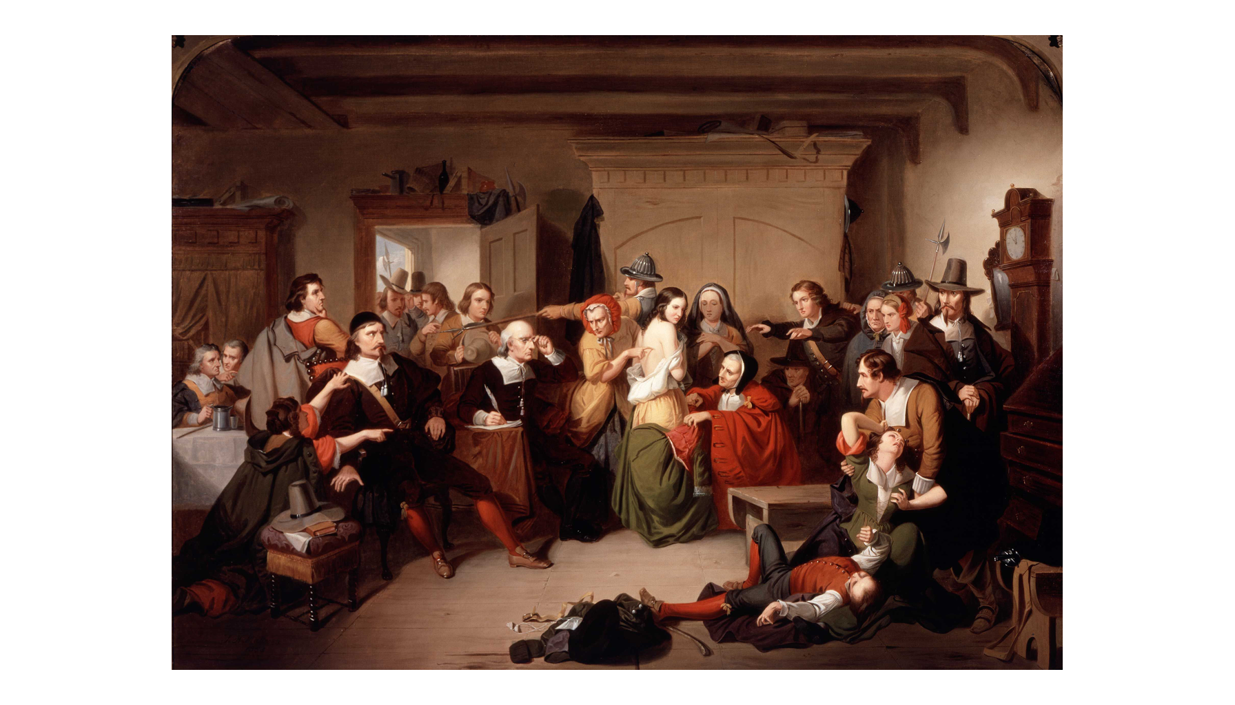
Examination of a Witch, Painted in 1853
Painted in 1853, 161 years later. The artist invented this scene.
© More Lessons Less Planning | morelessonslessplanning.com
Notes:
Teacher discretion: the painting depicts a partially undressed woman being searched for a witch's mark, a real documented historical practice. Preview the image before class. Use only the full, uncropped composition - never a tightly cropped variant that enlarges the disrobed figure.
Reference labels (point to these chart features when teaching): Added: body search; Added: fainting fit

Slide 21
Key Takeaways
A minister's household, old grievances, and a frontier war left Salem on edge.
★
Spectral evidence let an unseen, unprovable claim count as proof in court.
★
The court rewarded confession: name others to live, or deny it and hang.
★
Nineteen were hanged, one man pressed to death, and several more died in jail.
★
Objections from ministers, not new evidence, made the governor end the court.
★
© More Lessons Less Planning | morelessonslessplanning.com
Notes:
Close on the mechanism, not the mystery: a standard of evidence that could not be disproved, applied by a court under pressure, in a village already divided.

