Slide 1
The Russian Revolution
How War Weariness Toppled a 300-Year Dynasty
© More Lessons Less Planning | morelessonslessplanning.com
Notes:
Open by naming the puzzle: in January 1917 Russia was a monarchy that had lasted three centuries. Eleven months later it was governed by a party that had been illegal. Tell students the lesson explains how that happened.

Slide 2
Learning Targets
Explain how World War I drained Russia's army, food supply, and railroads.
★
Trace the February Revolution from bread protests to the tsar's abdication.
★
Explain why dual power left the Provisional Government weak and divided.
★
Explain how the Bolsheviks took power and moved to end Russia's war.
★
© More Lessons Less Planning | morelessonslessplanning.com
Notes:
Read the four targets aloud. Point out that targets 2 and 4 are both about a government falling - the lesson is really one causal chain told twice.

Slide 3
Three Years of War
Russia entered World War I in 1914 with Europe's largest army.
By 1917 millions of Russian soldiers were dead, wounded, or captured.
Factories could not supply enough rifles, boots, or shells.
Defeats at the front turned soldiers against their officers.
Key Concept: Russia's army was huge but poorly supplied and poorly led.
© More Lessons Less Planning | morelessonslessplanning.com
Notes:
Russia mobilized more men than any other combatant and lost more of them. Casualty estimates vary widely by source, so the deck says 'millions' rather than pinning a disputed figure. Emphasize supply: units were sent forward short of rifles and boots.

Slide 4
The Home Front Breaks Down
In the Cities
On the Railroads
Bread and fuel ran short in Petrograd during the winter of 1916-17.
Prices rose faster than wages, so a day's pay bought less food.
The rail network moved troops first, so grain sat in the countryside.
Engines and track wore out with no parts to repair them.
Note: Russia had food, but the railroads could not get it to the cities.
© More Lessons Less Planning | morelessonslessplanning.com
Notes:
This is the key mechanism of the lesson. Russia's 1916 harvest was adequate. The failure was distribution: a rail system built for peacetime traffic was carrying troops and munitions, and it was wearing out faster than it could be repaired.

Slide 5
Nicholas II Takes Command
Summer 1915
Tsar Nicholas II left Petrograd to take personal command of the army.
✔
Every defeat is his
Because he led the army, soldiers blamed him personally for losses.
✔
Government left behind
Empress Alexandra and unpopular ministers ran the government at home.
✔
Rasputin
The court adviser Grigori Rasputin fed public distrust of the royal family.
✔
Tip: Taking command tied the tsar's name to every battlefield defeat.
© More Lessons Less Planning | morelessonslessplanning.com
Notes:
Nicholas II took personal command in late August 1915 on Russia's calendar, which is early September on the Western calendar, and he did it against the advice of most of his ministers. The political cost was severe: it removed his last layer of protection from blame and left day-to-day government to an unpopular circle in the capital.

Slide 6
The February Revolution
23 February 1917 (8 March): women textile workers struck over bread.
Within days a general strike shut down Petrograd.
Soldiers ordered to fire on the crowds refused and joined them.
Russia used the Julian calendar, 13 days behind the Western one.
Key Concept: The revolution began as a bread protest, not a party plot.
© More Lessons Less Planning | morelessonslessplanning.com
Notes:
No political party organized the February Revolution. It began with women textile workers marking International Women's Day and demanding bread, spread into a general strike, and became a revolution the moment the Petrograd garrison refused to fire on the crowds.

Slide 7
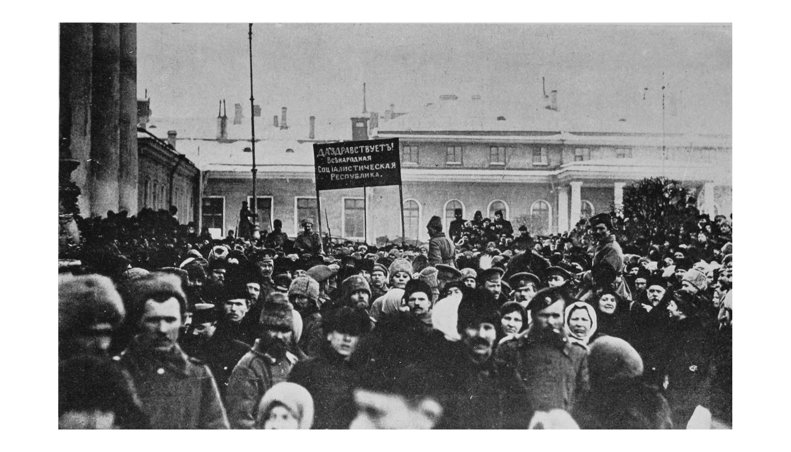
The Streets of Petrograd
Demonstration, March 1917
© More Lessons Less Planning | morelessonslessplanning.com
Notes:
Let students look for ten seconds before you say anything. This is a pro-republic demonstration photographed in Petrograd in March 1917 on the Western calendar - the weeks of the February Revolution. Ask what they notice about how many ordinary people are in the street, then return to the previous slide's sequence.

Slide 8
The Tsar Abdicates
2 March 1917 (15 March): Nicholas II signed an abdication.
Abdication means a ruler formally gives up the throne.
He gave up the throne for himself and for his son Alexei.
His brother Michael refused the crown the next day.
Romanov rule of Russia ended after about 300 years.
Did You Know: No one planned the tsar's fall - it took eight days.
© More Lessons Less Planning | morelessonslessplanning.com
Notes:
Nicholas II abdicated on 2 March 1917 (15 March on the Western calendar), first for himself and then also for his son Alexei. Grand Duke Michael declined the throne the following day, which ended the monarchy outright rather than transferring it.

Slide 9
Dual Power: Two Rival Authorities
Provisional Government
Petrograd Soviet
Formed by Duma politicians to govern until elections.
Held the legal title but little real control.
Led by Prince Lvov, then by Alexander Kerensky from July 1917.
A soviet is an elected council of workers and soldiers.
Controlled the railroads, telegraph, and the soldiers' loyalty.
Called for a peace without annexations as early as March 1917.
Key Concept: Dual power means two bodies claimed authority at the same time.
© More Lessons Less Planning | morelessonslessplanning.com
Notes:
The Provisional Government held formal authority but could not act without the Petrograd Soviet, which held practical control of communications, transport, and the garrison. This split is the single best explanation for why nothing decisive got done between March and October.

Slide 10
Who Was in the Petrograd Soviet?
Soviet
An elected council of workers and soldiers, Russian for 'council'.
Order No. 1
A March 1917 order telling soldiers to follow the Soviet, not officers.
Mensheviks and Socialist Revolutionaries (SRs)
The moderate socialists who led the Petrograd Soviet in early 1917.
Bolsheviks
The majority faction of the Russian Social Democratic Labour Party.
Why 'majority'?
The name comes from one 1903 party vote, not from being the larger group.
Watch out: The Petrograd Soviet was not Bolshevik-run in early 1917.
© More Lessons Less Planning | morelessonslessplanning.com
Notes:
This slide exists to prevent a common error. In the spring of 1917 the Petrograd Soviet was led by Mensheviks and Socialist Revolutionaries. The Bolsheviks only won a majority in it in September 1917 on Russia's calendar. 'Bolshevik' means the majority faction of the Russian Social Democratic Labour Party after the party split in 1903 - it was not a separate party at the start.

Slide 11
The Fatal Decision: Keep Fighting
The promise
The offensive
The cost
Russia had treaties with Britain and France.
The new government chose to keep fighting.
A June 1917 attack (July in the West) failed badly.
Whole units deserted and walked home.
Hunger and casualties continued.
Support for the government drained away.
Big Idea: The war weariness that toppled the tsar now doomed his replacement.
© More Lessons Less Planning | morelessonslessplanning.com
Notes:
The Provisional Government inherited the war and chose to continue it, partly out of treaty obligation to Britain and France and partly to keep a claim on postwar gains. The failed June 1917 offensive destroyed what credibility it had left.

Slide 12
Lenin Returns
Lenin returned to Petrograd in April 1917 after years in exile.
He refused to support the Provisional Government.
His slogan promised 'Peace, Land, Bread' to a starving country.
'All power to the Soviets' offered a rival government.
Key point: Lenin's promises answered the three things Russians wanted most.
© More Lessons Less Planning | morelessonslessplanning.com
Notes:
Lenin returned to Petrograd in April 1917 and immediately broke with the other socialist parties, refusing any cooperation with the Provisional Government. 'Peace, Land, Bread' matched grievance for grievance: end the war, redistribute land to peasants, feed the cities.

Slide 13
The October Revolution
24-25 October 1917 (6-7 November): Red Guards seized key sites.
Red Guards were armed factory workers loyal to the Bolsheviks.
They took bridges, the telegraph, stations, and the state bank.
The Winter Palace fell in the early hours of 26 October (8 Nov).
The Petrograd Soviet's Military Revolutionary Committee ran it.
Watch out: The Bolsheviks overthrew the Provisional Government, not the tsar.
© More Lessons Less Planning | morelessonslessplanning.com
Notes:
The seizure was run by the Military Revolutionary Committee of the Petrograd Soviet. It was an operation against infrastructure - bridges, telegraph, stations, the state bank - rather than a battle. The tsar had been gone for eight months; the government that fell was the Provisional Government.

Slide 14
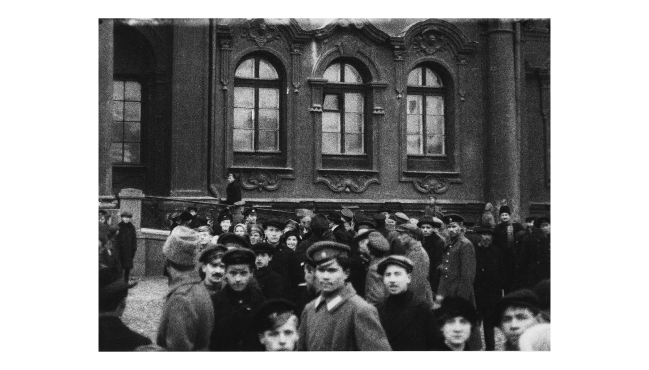
The Winter Palace
After the capture, 1917
© More Lessons Less Planning | morelessonslessplanning.com
Notes:
Photographed by Pyotr Novitsky outside the Winter Palace after its capture on 26 October 1917. Show it without comment first. Ask students to hold this picture in mind for the next slide, which compares the famous image of the storming with the written record.

Slide 15
The Storming That Mostly Wasn't
The picture
Films and posters show a huge crowd charging the Winter Palace.
✔
The record
Defenders were a few cadets and a women's battalion, and most left.
✔
Casualties
Only a handful of people died taking the palace that night.
✔
Why it matters
Later Soviet films built a heroic image the evidence does not support.
✔
Think about it: Who benefits when a takeover is retold as a heroic battle?
© More Lessons Less Planning | morelessonslessplanning.com
Notes:
The iconic images of the storming come from later Soviet re-enactments and from Sergei Eisenstein's 1928 film October, not from 1917. Contemporary accounts describe a thin, dwindling defense and very few deaths. This is a useful, low-stakes lesson in reading sources critically.

Slide 16
The Decree on Peace
Adopted 26 October 1917 (8 November) by the Congress of Soviets.
It proposed an immediate armistice - an agreement to stop fighting.
The decree called for an immediate peace without annexations.
It was addressed to all warring peoples and their governments.
The Bolsheviks hoped exhausted peoples elsewhere would demand peace.
Key Concept: An armistice pauses fighting while peace terms are worked out.
© More Lessons Less Planning | morelessonslessplanning.com
Notes:
The Decree on Peace was adopted by the Second All-Russian Congress of Soviets on the night of 26 October 1917 (8 November on the Western calendar). It proposed an immediate armistice and negotiations for a peace without annexations or indemnities, and it addressed the peoples of the warring countries as well as their governments. Students read an excerpt in the Activity.

Slide 17
From Decree to Treaty
Date | What happened
8 Nov 1917 | The Decree on Peace calls for an armistice and open talks.
15 Dec 1917 | Russia and the Central Powers sign an armistice.
Feb 1918 | Russia switches to the Western (Gregorian) calendar.
3 Mar 1918 | The Treaty of Brest-Litovsk ended Russia's war with Germany.
The price | Russia gave up Poland, the Baltic lands, Finland, and Ukraine.
Remember: Russia left World War I, but paid an enormous price in land.
© More Lessons Less Planning | morelessonslessplanning.com
Notes:
The Allies did not answer the Decree on Peace; the Central Powers did. An armistice was signed on 15 December 1917 and the Treaty of Brest-Litovsk on 3 March 1918. Because Russia adopted the Western calendar in February 1918, the treaty date needs no second date.

Slide 18
Key Takeaways
Historians still debate how much of 1917 was war pressure and how much choice.
★
The tsar fell in February; the Provisional Government fell in October.
★
Dual power left Russia with two authorities and no clear command.
★
The Provisional Government kept fighting, and its support drained away.
★
The Bolsheviks' first major act was the Decree on Peace.
★
© More Lessons Less Planning | morelessonslessplanning.com
Notes:
Close by returning to the causal chain: the war produced shortages, the shortages produced protest, protest ended the monarchy, dual power paralyzed its replacement, and the promise to end the war carried the Bolsheviks into power.

