Slide 1
The Reign of Terror
How the Committee of Public Safety's power to defend the Revolution became a Reign of Terror that consumed even Robespierre himself
© More Lessons Less Planning | morelessonslessplanning.com
Notes:
Open with the lesson question: how did a government created to defend liberty end up executing thousands of people, including its own leader? Preview the arc: the Committee of Public Safety, the Law of Suspects, Robespierre's justification of terror as virtue, and the Thermidorian Reaction that finally consumed him.

Slide 2
Learning Targets
Explain why the Committee of Public Safety got emergency powers
★
Describe the Law of Suspects and the Revolutionary Tribunal
★
Explain Robespierre's argument that terror was "an emanation of virtue"
★
Analyze how the Terror consumed its own revolutionary leaders
★
Evaluate the gap between revolutionary ideals and revolutionary practice
★
© More Lessons Less Planning | morelessonslessplanning.com
Notes:
The five targets keep the lesson centered: the Committee's creation, the Law of Suspects and Revolutionary Tribunal, Robespierre's virtue-and-terror justification, the Terror consuming its own, and the ideals-versus-practice gap.

Slide 3
Robespierre and the Committee of Public Safety
In April 1793, the National Convention created the Committee of Public Safety.
It was a 12-member body with emergency powers to defend the Revolution.
Robespierre joined the Committee and became its dominant voice by July 1793.
Robespierre was known as "the Incorruptible" for his strict principles.
The Committee could act fast, without waiting for the full Convention to debate.
Key Concept: In 1793 the National Convention gave the 12-member Committee of Public Safety emergency powers to defend the Revolution.
© More Lessons Less Planning | morelessonslessplanning.com
Notes:
In April 1793, the National Convention created the Committee of Public Safety, a 12-member executive body with emergency powers to defend the Revolution. Robespierre joined the Committee and became its dominant voice by July 1793. Known as the Incorruptible for his strict principles, he helped the Committee act fast, without waiting for the full Convention to debate.

Slide 4
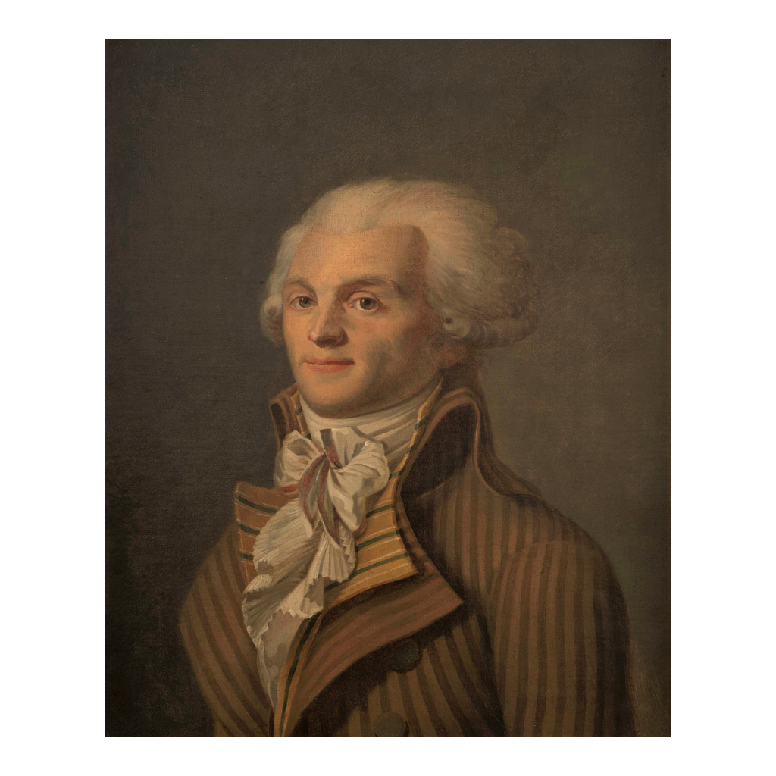
Maximilien Robespierre
Portrait of Maximilien Robespierre (c. 1790)
© More Lessons Less Planning | morelessonslessplanning.com
Notes:
This is a period portrait of Maximilien Robespierre, painted around 1790, showing him in formal eighteenth-century dress. Use it as a historical reference image, not as evidence for any single fact.

Slide 5
A Republic at War
Enemies Beyond the Borders
Enemies Within
The First Coalition (rival European monarchies) invaded France's borders
Foreign kings wanted to end the Revolution by force
Civil war in the Vendee (a rebel region) opposed the Convention
Fear of spies and traitors spread inside France
The Convention gave the Committee emergency powers
Key Concept: Foreign invasion and civil war in the Vendee convinced the Convention to grant the Committee of Public Safety emergency powers.
© More Lessons Less Planning | morelessonslessplanning.com
Notes:
Armies of the First Coalition invaded France's borders, as foreign kings wanted to crush the Revolution and restore the monarchy. At the same time, civil war raged in the Vendee region and fear of spies and traitors spread inside France. Facing enemies at home and abroad, the Convention gave the Committee emergency powers to meet both threats.

Slide 6
The Law of Suspects, September 1793
In September 1793, the Convention passed the Law of Suspects.
It let the government arrest anyone merely suspected of disloyalty.
Suspects included former nobles, priests, and government critics.
No solid proof of a crime was required, only suspicion.
Thousands of people were arrested under this law.
Key Concept: The Law of Suspects (Sept. 1793) allowed arrest on suspicion alone, with no proof of a crime required.
© More Lessons Less Planning | morelessonslessplanning.com
Notes:
In September 1793, the Convention passed the Law of Suspects, letting the government arrest anyone merely suspected of being an enemy of the Revolution. Suspects included former nobles, priests, and people who simply criticized the government. No solid proof of a crime was required, only suspicion, and thousands of people were arrested under this law.

Slide 7
The Revolutionary Tribunal
A Different Kind of Court
Few Protections
Created to try suspects quickly
Trials often lasted only minutes
Defendants had little chance to prepare a defense
Most trials ended in conviction
The guillotine carried out the sentence
Key Concept: The Revolutionary Tribunal tried suspects quickly, with few legal protections for the accused.
© More Lessons Less Planning | morelessonslessplanning.com
Notes:
The Revolutionary Tribunal was created to try suspects quickly, and trials often lasted only minutes. Defendants had little chance to prepare a defense, and most trials ended in conviction, with the guillotine carrying out the sentence.

Slide 8
The Guillotine and the Terror
The guillotine became the public symbol of the Terror.
It stood in Paris's Place de la Revolution, where crowds gathered to watch.
Revolutionaries saw it as swift and equal for noble or commoner.
Public executions were meant to warn anyone who opposed the Revolution.
The guillotine turned justice into public spectacle.
Key Concept: The guillotine was seen as a swift, equal death for every class, and it became the public symbol of the Terror.
© More Lessons Less Planning | morelessonslessplanning.com
Notes:
The guillotine became the public symbol of the Terror, standing in Paris's Place de la Revolution where crowds gathered to watch. Revolutionaries saw it as swift and equal, the same death for a noble or a commoner. Public executions were meant to warn anyone who opposed the Revolution, turning justice into public spectacle.

Slide 9
The Scale of the Terror
16,594
~40,000
official death sentences by revolutionary tribunals
historians' estimated total deaths, including summary executions
Who: Victims ranged from nobles to former revolutionary allies
When: Executions peaked during the summer of 1794
Where: Most sentences were carried out by guillotine in Paris and other cities
Key Concept: Revolutionary tribunals handed down about 16,594 official death sentences, and historians estimate total Terror deaths as high as 40,000.
© More Lessons Less Planning | morelessonslessplanning.com
Notes:
Revolutionary tribunals handed down about 16,594 official death sentences between September 1793 and July 1794. Historians estimate total deaths, including summary executions without trial, as high as 40,000. Victims ranged from nobles to former revolutionary allies, with executions peaking during the summer of 1794.

Slide 10
Terror Consumes Its Own
Georges Danton had been one of the Revolution's leading voices.
By early 1794, Danton argued the Terror should ease and trials should slow down.
The Committee saw this as a dangerous weakness.
In April 1794, Danton and his allies were arrested, tried, and executed.
No one, not even a founding revolutionary, was safe from the Terror.
Key Concept: In April 1794 the Committee executed Danton, once a leading revolutionary, showing the Terror could consume its own allies.
© More Lessons Less Planning | morelessonslessplanning.com
Notes:
Georges Danton had been one of the Revolution's leading voices, but by early 1794 he argued the Terror should ease and trials should slow down. The Committee saw this as a dangerous weakness, and in April 1794 Danton and his allies were arrested, tried, and executed. No one, not even a founding revolutionary, was safe from the Terror.

Slide 11
Robespierre's Justification: Virtue and Terror
Terror is nothing other than justice, prompt, severe, inflexible; it is therefore an emanation of virtue.
— Maximilien Robespierre, February 5, 1794
Delivered to the National Convention as leader of the Committee of Public Safety.
Key Concept: On February 5, 1794, Robespierre told the National Convention that terror was "an emanation of virtue."
© More Lessons Less Planning | morelessonslessplanning.com
Notes:
On February 5, 1794, Robespierre delivered a major speech to the National Convention, arguing that terror was nothing other than justice, prompt, severe, and inflexible, and therefore an emanation of virtue. This is the central justification students will read in full in the Primary Source Spotlight.

Slide 12
Fear as Policy
Watching Everyone
A Broken Promise
Surveillance committees watched for signs of disloyalty
Citizens were encouraged to denounce suspected enemies
The Rights of Man had promised fair trials for all
Under the Terror, suspicion alone could mean arrest
Ideals and practice grew further and further apart
Key Concept: The Terror's surveillance and denunciations broke the due-process rights the Revolution had promised in 1789.
© More Lessons Less Planning | morelessonslessplanning.com
Notes:
Local surveillance committees watched neighbors for signs of disloyalty, and citizens were encouraged to denounce suspected enemies. The Declaration of the Rights of Man had promised due process and fair trials, but under the Terror, suspicion alone could mean arrest and execution. The gap between revolutionary ideals and revolutionary practice grew wide.

Slide 13
Cracks in the Committee
By the summer of 1794, the killing showed no sign of slowing.
Members of the Convention feared Robespierre would turn on them next.
Rumors spread that Robespierre was planning new arrests among his own allies.
Fear that had once united revolutionaries now turned them against each other.
The same weapon Robespierre had used against others now threatened him.
Key Concept: By summer 1794 fear and rumor turned members of the Convention against Robespierre himself.
© More Lessons Less Planning | morelessonslessplanning.com
Notes:
By the summer of 1794, the killing showed no sign of slowing, and members of the Convention feared Robespierre would turn on them next. Rumors spread that he was planning new arrests among his own allies. Fear that had once united revolutionaries now turned them against each other, and the same weapon Robespierre had used against others now threatened him.

Slide 14
The Thermidorian Reaction, 9 Thermidor
On 9 Thermidor (July 27, 1794), the National Convention turned on Robespierre.
Members shouted him down and voted for his arrest.
Robespierre was seized along with his closest allies.
The Convention had finally broken the Committee's grip on power.
The Terror's chief architect was now its target.
Key Concept: On 9 Thermidor (July 27, 1794), the National Convention arrested Robespierre, breaking the Committee's grip on power.
© More Lessons Less Planning | morelessonslessplanning.com
Notes:
On 9 Thermidor, July 27, 1794, the National Convention finally turned on Robespierre. Members shouted him down and voted for his arrest, and he was seized along with his closest allies. The Convention had finally broken the Committee's grip on power, and the Terror's chief architect was now its target.

Slide 15
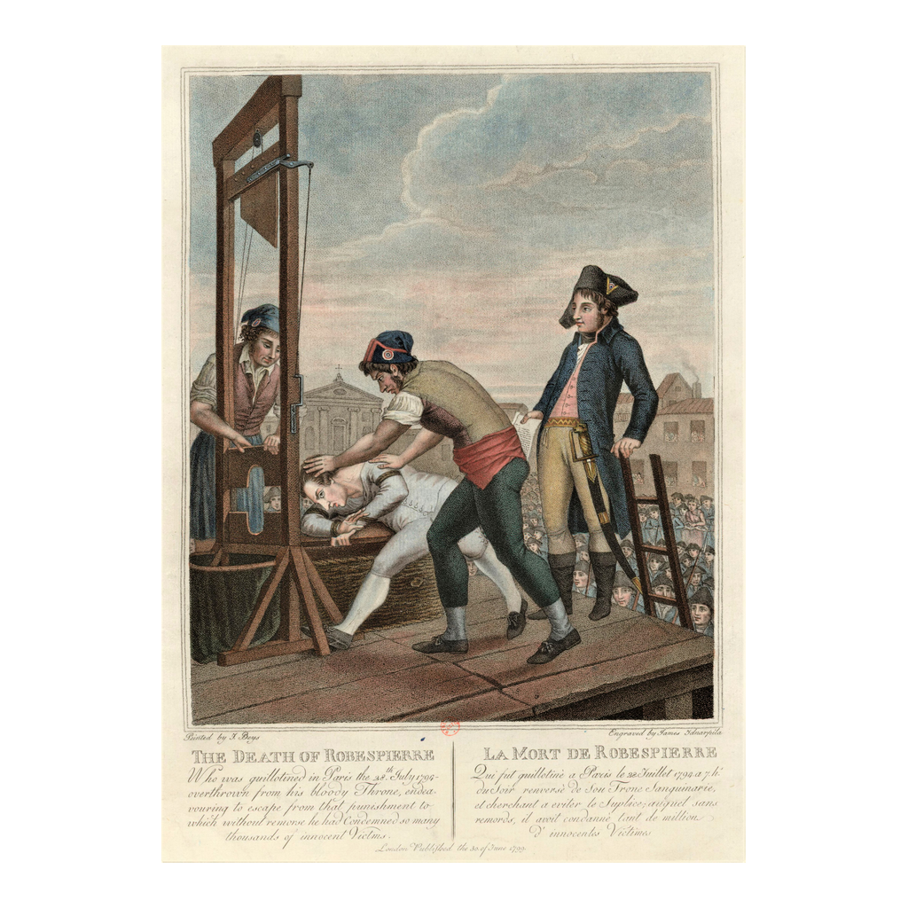
The Execution of Robespierre, 28 July 1794
English caricature engraving of Robespierre's execution (c. 1799)
© More Lessons Less Planning | morelessonslessplanning.com
Notes:
This is an English caricature engraving from around 1799 depicting the execution of Robespierre. As a satirical print made after the event, it exaggerates for effect rather than recording it neutrally. Use it as a historical reference image, not as proof of exactly how the execution looked.

Slide 16
The End of the Terror
Robespierre's Fall
After the Terror
Robespierre was executed without trial on July 28, 1794
About 100 of his closest allies were executed within days
The Revolutionary Tribunal's power was sharply cut back
The Law of Suspects lost its force
France entered the less violent Thermidorian era
Key Concept: Robespierre's execution on July 28, 1794, ended the Reign of Terror and began the Thermidorian era.
© More Lessons Less Planning | morelessonslessplanning.com
Notes:
Robespierre was executed without trial on July 28, 1794, and roughly 100 of his closest allies were executed within days. The Revolutionary Tribunal's power was sharply cut back, the Law of Suspects lost its force, and France entered a new, less violent phase called the Thermidorian era.

Slide 17
Reference Guide: From Committee to Tribunal
Committee of Public Safety
The 12-member body given emergency powers to defend the Revolution in 1793.
Maximilien Robespierre
The Committee's dominant leader, known as "the Incorruptible."
Law of Suspects
The Sept. 1793 decree allowing arrest on mere suspicion of disloyalty.
Reign of Terror
The 1793-1794 period when France executed thousands of suspected enemies.
Revolutionary Tribunal
The court that tried suspects quickly, with few legal protections.
Tip: These five terms trace the story from the Committee's creation to the court that enforced the Terror.
© More Lessons Less Planning | morelessonslessplanning.com
Notes:
Review the five terms exactly as defined: Committee of Public Safety, Maximilien Robespierre, Law of Suspects, Reign of Terror, and Revolutionary Tribunal. Students use these definitions to complete the Reference Guide in the Activity.

Slide 18
Reference Guide: Terror and Its End
guillotine
The execution device seen as swift and equal for every class.
"virtue and terror"
Robespierre's claim that terror was a necessary emanation of virtue.
Thermidorian Reaction
The July 1794 turn when the Convention ended the Terror.
9 Thermidor
The date (July 27, 1794) the Convention had Robespierre arrested.
National Convention
The legislature that governed France from 1792 to 1795.
Tip: These five terms name the instrument of the Terror, its justification, and the reaction that ended it.
© More Lessons Less Planning | morelessonslessplanning.com
Notes:
Review the five terms exactly as defined: guillotine, virtue and terror, Thermidorian Reaction, 9 Thermidor, and National Convention. Students use these definitions to complete the Reference Guide in the Activity.

Slide 19
Key Takeaways
In April 1793 the National Convention created the Committee of Public Safety.
★
The Law of Suspects and Tribunal let it arrest and execute suspects.
★
Robespierre justified the Terror as "an emanation of virtue" in February 1794.
★
The Terror consumed even revolutionary allies like Danton.
★
On 9 Thermidor the Convention finally turned on Robespierre himself.
★
© More Lessons Less Planning | morelessonslessplanning.com
Notes:
Close with the essential question. Each takeaway connects the Committee of Public Safety, the Law of Suspects, Robespierre's justification, and the Thermidorian Reaction to the gap between revolutionary ideals and revolutionary practice.

