Slide 1
The Persian Wars and the Battle of Marathon
How a vastly outnumbered Greek force defeated the Persian Empire on the plain of Marathon in 490 BCE.
© More Lessons Less Planning | morelessonslessplanning.com
Notes:
Opening slide. In 490 BCE the Persian Empire, the largest empire in the world, sent an army across the sea to punish Athens. On the plain of Marathon a much smaller Greek force met them - and won. Students will trace how the Greeks did it and why the victory mattered.

Slide 2
Learning Targets
Explain why the Persian Empire under Darius I invaded Greece in 490 BCE.
★
Describe how Athenian hoplites and the phalanx formation fought.
★
Analyze Miltiades's plan to strengthen the wings and envelop the Persians.
★
Explain why the victory at Marathon mattered for Greek independence.
★
© More Lessons Less Planning | morelessonslessplanning.com
Notes:
Read the four learning targets. Today combines a dramatic battle story with a history skill: reading Herodotus, our main ancient source, and telling what actually happened from later legend.

Slide 3
The Persian Empire Invades
Persian Empire
The vast empire, ruled by King Darius I, that sent an army to invade Greece in 490 BCE.
Darius I
The Persian king who ordered the invasion of Greece that was defeated at Marathon.
Key Concept: The PERSIAN EMPIRE, ruled by DARIUS I, invaded Greece in 490 BCE to punish Athens.
© More Lessons Less Planning | morelessonslessplanning.com
Notes:
The PERSIAN EMPIRE was the vast empire, ruled by King DARIUS I, that sent an army to invade Greece in 490 BCE. It was the largest and richest empire in the world. DARIUS I was the Persian king who ordered the invasion of Greece that was defeated at Marathon. He invaded to punish Athens, which had sent ships to help Greek cities in Ionia rebel against Persian rule. Note: this is the FIRST Persian war under Darius - not the later invasion by his son Xerxes in 480 BCE.

Slide 4
Landing at Marathon
Marathon
The coastal plain about 26 miles northeast of Athens where the armies met in 490 BCE.
✔
The landing
The Persians landed a large army on the beach at Marathon, hoping to march on Athens.
✔
Outnumbered
About 10,000 Athenians and 1,000 Plataeans faced a much larger Persian force.
✔
Key Concept: The Persians landed at MARATHON, a plain about 26 miles northeast of Athens, in 490 BCE.
© More Lessons Less Planning | morelessonslessplanning.com
Notes:
MARATHON is the coastal plain about 26 miles northeast of Athens where the Greeks defeated the Persians in 490 BCE. The Persians chose this wide, flat beach to land their large army and their cavalry, planning to march south on Athens. Waiting for them were about 10,000 Athenian citizen-soldiers and roughly 1,000 soldiers from the small allied city of Plataea - badly outnumbered by the Persian force. Remember the distance: about 26 miles from Marathon to Athens. That number matters later.

Slide 5
The Athenian Hoplite
Hoplite
A heavily armored Greek citizen-soldier who fought with a long spear and a large round shield.
Citizen-soldier
An ordinary Greek man who bought his own armor and fought to defend his own city.
Key Concept: A HOPLITE was a heavily armored Greek citizen-soldier with a long spear and round shield.
© More Lessons Less Planning | morelessonslessplanning.com
Notes:
A HOPLITE was a heavily armored Greek citizen-soldier who fought with a long spear and a large round shield. Each hoplite bought his own bronze helmet, breastplate, greaves, spear, and heavy round shield called a hoplon. Because hoplites were ordinary citizens defending their own homes and families, they had strong reason to fight hard. Their heavy armor and long spears made them powerful in close combat - far better protected than most of the lightly armored Persian infantry.

Slide 6
The Phalanx
Phalanx
A tight rectangular block of hoplites standing shoulder to shoulder with overlapping shields.
✔
The shield wall
Each shield protected the man to the left, forming a solid wall of bronze and spears.
✔
Strength
Moving together, the phalanx could push through enemy lines like a wall.
✔
Key Concept: A PHALANX was a tight block of hoplites with overlapping shields, forming a moving wall.
© More Lessons Less Planning | morelessonslessplanning.com
Notes:
A PHALANX was a tight rectangular block of hoplites standing shoulder to shoulder with overlapping shields. Each man's round shield covered his own left side and the right side of the man next to him, so the whole formation became a solid wall of bronze bristling with spear points. As long as the hoplites kept their discipline and moved together, the phalanx could shove forward and break an enemy line. It was the deadliest infantry formation of its day.

Slide 7
A Desperate Run to Sparta
Pheidippides
The Athenian runner sent about 140 miles to Sparta to ask for military help before the battle.
✔
Why run
Athens knew it could not beat Persia alone and begged Sparta to send its army.
✔
The result
The Spartans agreed to come but were delayed by a religious festival and arrived too late.
✔
Key Concept: PHEIDIPPIDES ran about 140 miles to Sparta for help before the battle - this is the run Herodotus records.
© More Lessons Less Planning | morelessonslessplanning.com
Notes:
Before the fighting, Athens sent PHEIDIPPIDES, a professional runner, about 140 miles to Sparta to ask for military help before the battle. This is the run the historian Herodotus actually describes. Athens knew it could not defeat the huge Persian army alone. The Spartans agreed to help but said their religious law delayed them, so they arrived after the battle was over. IMPORTANT: the famous later story of a runner racing about 26 miles from Marathon to Athens to gasp Victory! and then drop dead is a LATER legend, not in Herodotus. Herodotus's runner went to Sparta before the battle.

Slide 8
Miltiades and the Plataeans
Miltiades
The Athenian general whose battle plan defeated the Persians at Marathon.
Plataea
The small city-state that was Athens's only ally on the battlefield at Marathon.
Key Concept: The general MILTIADES led the Athenians, joined only by their ally PLATAEA.
© More Lessons Less Planning | morelessonslessplanning.com
Notes:
MILTIADES was the Athenian general whose battle plan defeated the Persians at Marathon. He had once lived in Persian-controlled lands and understood how the Persians fought. With the Spartans still on the road, the only help Athens had was PLATAEA, the small city-state that was Athens's only ally on the battlefield at Marathon. About 1,000 Plataean soldiers stood with the roughly 10,000 Athenians. It was Miltiades who convinced the Athenian commanders to attack rather than wait.

Slide 9
The Battle Plan: Envelopment
Envelopment
Miltiades's tactic of thinning the center and strengthening the wings to surround the Persian army.
✔
The trap
The thin center pulled back while the strong wings crushed the Persian sides and wrapped around.
✔
The result
The Persians were surrounded on the flanks and driven back toward their ships in panic.
✔
Key Concept: Miltiades used ENVELOPMENT - thin center, strong wings - to surround the Persians.
© More Lessons Less Planning | morelessonslessplanning.com
Notes:
Miltiades's plan was ENVELOPMENT: his tactic of thinning the center and strengthening the wings to surround the Persian army. He stretched his line as wide as the Persian line but deliberately made the middle thin and packed extra hoplites onto the two wings. When the armies clashed, the strong Greek wings smashed the weaker Persian sides, then turned inward and wrapped around the Persian center. Surrounded on the flanks, the Persians broke and ran back toward their ships. It was a brilliant use of the phalanx.

Slide 10
The Charge at a Run
Charge at a run
The Greeks ran the last stretch, nearly a mile, instead of marching slowly.
✔
Beat the archers
Running fast meant less time exposed to the deadly Persian archers.
✔
First to do it
Herodotus says they were the first Greeks to charge the enemy at a run.
✔
Full-force hit
The heavy phalanx hit the Persian line before the archers could break it.
✔
Key Concept: The Greeks charged at a RUN to cross the archers' killing zone fast and hit hard.
© More Lessons Less Planning | morelessonslessplanning.com
Notes:
Instead of marching slowly, the Greeks charged the last stretch of open ground - nearly a mile - at a run. Running fast across that killing zone meant fewer seconds exposed to the deadly Persian archers, whose arrows could break a slow, tight formation. Herodotus says the Athenians were the first Greeks he knew of to charge the enemy at a run. The heavy phalanx slammed into the Persian line with full force before the archers and lighter infantry could stop it.

Slide 11
Honoring the Fallen: The Soros
About 192 Athenians died at Marathon; the Persians lost thousands.
The Athenian dead were buried on the field under a mound called the Soros.
The mound still stands on the plain of Marathon today.
The next slide shows the Marathon Tomb (Soros).
Key Concept: The 192 Athenian dead were buried at Marathon under a mound called the Soros.
© More Lessons Less Planning | morelessonslessplanning.com
Notes:
About 192 Athenians died at Marathon, while the Persians lost thousands. To honor their fallen citizen-soldiers, the Athenians buried the dead right on the battlefield under a great earth mound called the Soros. Burying the dead on the field itself, rather than bringing them home, was a special honor reserved for the heroes of Marathon. The mound still rises on the plain of Marathon today. The next slide shows it.

Slide 12
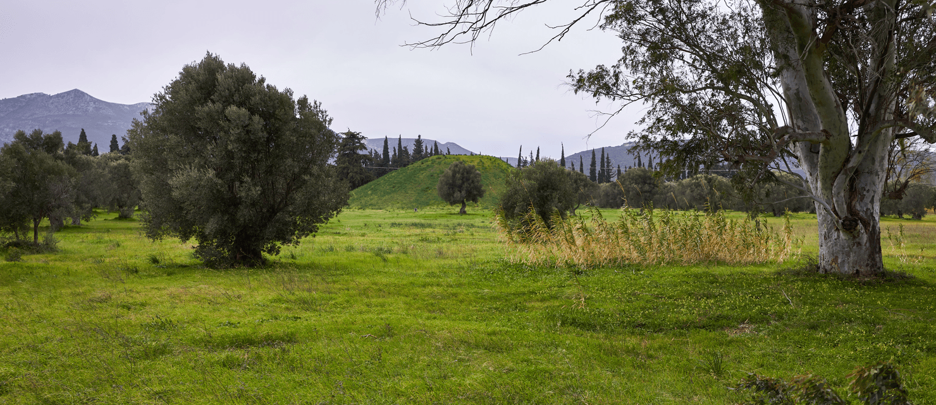
The Marathon Tomb (Soros)
The Soros: the burial mound over the 192 Athenians who died at Marathon.
© More Lessons Less Planning | morelessonslessplanning.com
Notes:
Real public-domain (CC0) photograph of the Marathon Tomb, the Soros, on the plain of Marathon. Give students a quiet moment to see that this is a real place they could visit, then connect it to the 192 Athenians buried here.
Reference labels (point to these chart features when teaching): The earth mound (Soros); Plain of Marathon

Slide 13
Why Marathon Mattered
Marathon saved Athens and kept Greece independent from Persia.
It proved the huge Persian army could be beaten, boosting Greek morale.
It gave Athens confidence that shaped its golden age of democracy and culture.
Persia would return under Xerxes ten years later, in 480 BCE.
Key Concept: Marathon preserved Greek independence and proved the Persians could be defeated.
© More Lessons Less Planning | morelessonslessplanning.com
Notes:
The victory at Marathon mattered far beyond one battle. It saved Athens and kept Greece independent from the Persian Empire. Just as important, it proved the huge Persian army was not unbeatable, giving the Greeks new confidence and morale. That confidence helped fuel the Athenian golden age of democracy, art, and philosophy that followed. The Persians were not finished, though: Darius's son Xerxes would return with an even larger invasion ten years later, in 480 BCE.

Slide 14
Herodotus and the Marathon Legend
Herodotus
The Greek historian, called the Father of History, whose account is our main source for Marathon.
Fact vs. legend
The modern marathon race is named for the battle, but the runner-drops-dead story is a later legend.
Key Concept: HERODOTUS is our main source; the modern marathon race is named for the battle, but the death-run is a legend.
© More Lessons Less Planning | morelessonslessplanning.com
Notes:
HERODOTUS was the Greek historian, called the Father of History, whose account is our main source for the Battle of Marathon. He wrote The Histories about 60 years after the battle. The modern 26-mile marathon race IS named after this battle - but the popular story of a runner racing from Marathon to Athens, gasping Victory!, and dropping dead is a LATER legend told by writers like Plutarch and Lucian, centuries later. Herodotus does NOT tell that story. His runner, Pheidippides, went about 140 miles to Sparta BEFORE the battle to ask for help. Good historians tell the difference between the source and the legend.

Slide 15
Key Takeaways
In 490 BCE the Persian Empire under Darius I invaded Greece at Marathon.
★
Outnumbered Athenians and Plataeans fought as hoplites in the phalanx.
★
Miltiades used envelopment - thin center, strong wings - to win.
★
Marathon kept Greece independent; Herodotus is our main source.
★
© More Lessons Less Planning | morelessonslessplanning.com
Notes:
Recap the four takeaways. The big ideas: an outnumbered Greek force beat the Persian Empire through the phalanx, Miltiades's envelopment, and a fast charge; the victory preserved Greek independence; and Herodotus - not later legend - is our main source.

