Slide 1
The Opium Wars and China
How a trade deficit in silver, a prohibited import, and a clash over whose law applied ended in the Treaty of Nanjing
© More Lessons Less Planning | morelessonslessplanning.com
Notes:
Open with the lesson question: how did a British shortage of silver end with a Chinese port city under British rule? Preview the arc: the Canton System, the trade deficit, the opium trade, Lin Zexu's enforcement in 1839, the war, and the 1842 Treaty of Nanjing.

Slide 2
Learning Targets
Explain why Britain ran a trade deficit with Qing China in the early 1800s.
★
Describe how the opium trade reversed the flow of silver into China.
★
Analyze Lin Zexu's 1839 enforcement and his letter to Queen Victoria.
★
Explain how industrial technology shaped the First Opium War's outcome.
★
Evaluate the Treaty of Nanjing and why it is called an unequal treaty.
★
© More Lessons Less Planning | morelessonslessplanning.com
Notes:
Read the targets aloud. Point out that targets 1 and 2 are economics, target 3 is enforcement and diplomacy, and targets 4 and 5 are war and treaty. Students will need all five for the Part 5 verdict.

Slide 3
The Canton System: Trade on Qing Terms
Qing China limited all foreign sea trade to one port, Canton (Guangzhou).
Foreign merchants traded only through licensed Chinese firms called the Cohong.
Foreign traders could not travel inland or petition Qing officials directly.
Under this system trade was a privilege the Qing court granted, not a right.
British merchants disliked the limits but accepted them in order to buy tea.
Britain sent envoys in 1793 and 1816 to ask for more ports; both were refused.
Key Concept: The Canton System was the Qing rule limiting foreign sea trade to the single port of Canton through licensed merchant firms.
© More Lessons Less Planning | morelessonslessplanning.com
Notes:
Before 1842, Qing China set the terms of foreign sea trade. All of it ran through one port, Canton (Guangzhou), and through licensed Chinese merchant firms known as the Cohong. Foreign traders could not travel inland or petition Qing officials directly. Trade was a privilege the court granted, not a right foreigners held. British merchants disliked the limits but accepted them because they wanted tea. Britain sent envoys in 1793 (Macartney) and 1816 (Amherst) to ask for more ports and direct diplomatic contact, and both missions were refused.

Slide 4
Britain's Trade Deficit With Qing China
What Britain Wanted
What China Accepted
Tea: British demand grew every decade
Silk and porcelain for British buyers
Rhubarb root, sold in Britain as medicine
Payment in silver, not in British goods
Little demand for British wool or metal
Silver flowed out of Britain into China
Key Concept: A trade deficit is when a country buys more from a trading partner than it sells to that partner.
© More Lessons Less Planning | morelessonslessplanning.com
Notes:
British demand for Chinese tea grew every decade, along with silk, porcelain, and rhubarb root sold in Britain as a medicine. Chinese buyers, meanwhile, had little demand for British wool or metal goods, so China accepted payment in silver. The result was a trade deficit: Britain bought far more from China than it sold to China, and silver flowed steadily out of Britain and into China.

Slide 5
Opium as the Balancing Commodity
British merchants needed a good Chinese buyers would pay silver for.
The East India Company grew opium in Bengal, in British-ruled India.
The Company auctioned it in India; private traders shipped it to China.
Qing edicts banned opium sales in 1729 and banned imports from 1796.
About 4,500 chests a year arrived in the early 1820s.
By the late 1830s the figure was over 30,000 chests a year.
Note: Because Qing law prohibited it, this was smuggling carried on outside the legal trade at Canton.
© More Lessons Less Planning | morelessonslessplanning.com
Notes:
British merchants needed a commodity Chinese buyers would pay silver for. The British East India Company grew opium in Bengal, in British-ruled India, and auctioned it there; private traders then shipped it to China. Qing edicts banned opium sales in 1729 and banned imports from 1796, so the shipments were illegal. Volume climbed sharply: about 4,500 chests a year in the early 1820s, and over 30,000 chests a year by the late 1830s. Revenue from the Indian opium auctions helped fund British rule in India, which is why the trade was hard for London to give up.

Slide 6
The Silver Flow Reverses
1820s
30,000+
Silver starts leaving China
Chests a year by the late 1830s
Qing tax base: Counted in silver; the outflow hit the treasury
Copper vs silver: Silver rose in value against farmers' copper coins
Real tax burden: Earn in copper, owe taxes in silver
Official view: Qing memorials: a public-health and law problem
Key Concept: The court read the outflow as a money problem and a law problem at once.
© More Lessons Less Planning | morelessonslessplanning.com
Notes:
By the 1820s the flow reversed: silver began leaving China. Because Qing tax revenue was counted in silver, the outflow hit the treasury directly. As silver grew scarcer its value rose against the copper coins ordinary farmers used, so peasants who earned in copper but owed taxes in silver faced a heavier real tax burden. Officials writing memorials to the emperor described the trade as both a public-health problem and a law-enforcement problem, since a prohibited cargo was arriving openly along the southern coast.

Slide 7
The Qing Debate: Legalize or Prohibit?
The Case for Legalizing
The Case for Prohibiting
Tax the trade instead of losing revenue
Enforcement was failing along the coast
Legalize it so trade can be measured
The state could not enforce its own law
The outflow of silver had to be stopped
Strict punishment would deter merchants
Did You Know: In 1838 the Daoguang Emperor chose strict prohibition and sent an official to Canton to enforce it.
© More Lessons Less Planning | morelessonslessplanning.com
Notes:
Qing officials argued the question out in memorials to the throne. One group wanted to legalize the trade so the government could tax it rather than lose revenue to smugglers, arguing that enforcement was already failing along the southern coast and that legal trade could at least be measured and taxed. The other group argued that legalizing would be an admission that the state could not enforce its own law, that the outflow of silver had to be stopped, and that strict punishment would deter merchants on both sides. In 1838 the Daoguang Emperor sided with prohibition.

Slide 8
Lin Zexu Is Sent to Canton
Lin Zexu was a respected Qing official known for honest administration.
Lin Zexu became imperial commissioner in late 1838 and reached Canton in 1839.
He ordered foreign merchants to surrender all opium held on their ships.
He demanded written bonds promising never to bring the cargo again.
British Superintendent Charles Elliot first refused, then ordered surrender.
Merchants handed over more than 20,000 chests in the spring of 1839.
Key Concept: Lin Zexu was the Qing imperial commissioner sent to Canton in 1839 to enforce the ban on the opium trade.
© More Lessons Less Planning | morelessonslessplanning.com
Notes:
Lin Zexu was a respected provincial governor with a reputation for honest administration. The Daoguang Emperor named him imperial commissioner at the very end of 1838, and he reached Canton in March 1839 with authority to end the trade. Lin ordered foreign merchants to surrender all opium held on their ships and demanded written bonds promising never to bring the cargo again on pain of death. Britain's Superintendent of Trade, Charles Elliot, first refused, then ordered British merchants to surrender their cargo to him so he could hand it over, effectively making the British government responsible for the loss. Merchants handed over more than 20,000 chests in the spring of 1839.

Slide 9
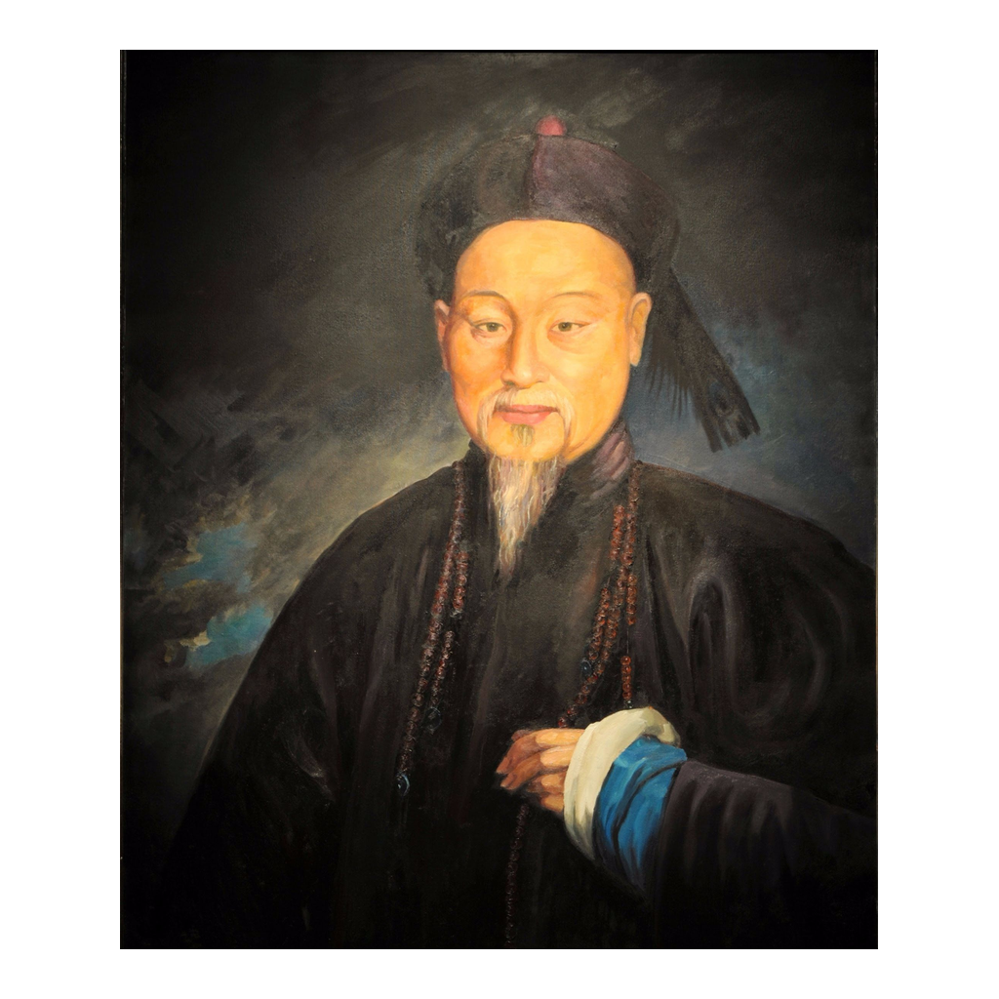
Lin Zexu
Lin Zexu, Qing imperial commissioner at Canton (painted portrait)
© More Lessons Less Planning | morelessonslessplanning.com
Notes:
A painted portrait of Lin Zexu in Qing official dress. The painter is not securely identified, so present it as a period-style studio portrait rather than a documented likeness. Use it as a historical reference image, not as evidence for any specific claim about his policy.

Slide 10
The Destruction at Humen, June 1839
Take custody
Lin took custody of 20,283 chests - the exact figure behind the more than 20,000 surrendered.
✔
Move to Humen
The cargo was carried to Humen (the Bogue), a coastal site at the Pearl River mouth.
✔
Destroy at the shore
Workers destroyed the chests in trenches dug at the shore and flushed the remains out to sea.
✔
Do it in public
The work ran for over three weeks in public view, with foreign observers present.
✔
Report to the throne
Lin reported the destruction to the Daoguang Emperor as proof the ban was enforced.
✔
Did You Know: Humen is the coastal site where Lin Zexu had over 20,000 confiscated chests destroyed in 1839.
© More Lessons Less Planning | morelessonslessplanning.com
Notes:
Lin took custody of 20,283 chests surrendered by foreign merchants at Canton and had them carried to Humen (known to the British as the Bogue), a coastal site at the mouth of the Pearl River. Workers destroyed the chests in trenches dug at the shore and flushed the remains out to sea. The operation ran for over three weeks in full public view, with foreign observers present, and Lin reported it to the Daoguang Emperor as proof the ban had been enforced. The public staging was the point: the destruction was a statement that Qing law applied to foreigners inside Chinese territory.

Slide 11
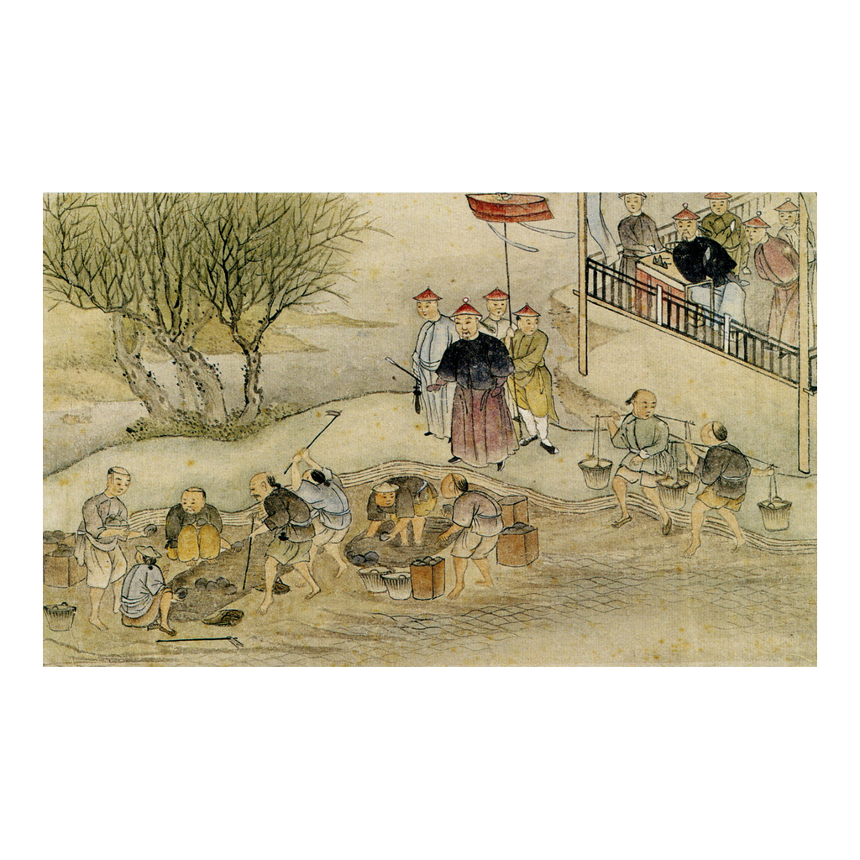
The Destruction of the Opium, 1839
Commissioner Lin and the destruction of the opium in 1839 (Chinese depiction)
© More Lessons Less Planning | morelessonslessplanning.com
Notes:
A 19th-century Chinese depiction of Commissioner Lin and the destruction of the opium in 1839. Treat it as a period representation of the event rather than a photograph of it.

Slide 12
Lin Zexu Writes to Queen Victoria
We have heard that in your own country opium is prohibited with the utmost strictness and severity: this is a strong proof that you know full well how hurtful it is to mankind.
— Lin Zexu, Letter to the Queen of England, 1839
Lin argued that Britain banned the trade at home, that China exported only beneficial goods such as tea, silk, and rhubarb, and that the Queen should have the poppy fields plowed up and grain sown in their place.
Did You Know: Historians have found no evidence the letter ever reached Queen Victoria herself.
© More Lessons Less Planning | morelessonslessplanning.com
Notes:
Alongside the enforcement at Canton, Lin drafted a letter addressed to Queen Victoria. Its argument has three parts: Britain prohibits the trade at home, which proves it knows the harm; China exports only beneficial goods such as tea, silk, and rhubarb; and therefore the Queen should stop the trade at its source by having the poppy fields plowed up and grain sown in their place. Historians have found no evidence the letter ever reached the Queen. An English translation was printed in Canton and reprinted in The Chinese Repository in February 1840. Students read an adapted excerpt in Part 4 of the Activity.

Slide 13
From Standoff to War
After the destruction, Elliot moved British traders out of Canton.
In July 1839 a villager was killed in a brawl involving British sailors.
Lin demanded the accused be handed over for trial in a Qing court.
Elliot refused and tried them himself, claiming British jurisdiction.
This clash over whose law applied became a central war issue.
In April 1840 the Commons debated the war and rejected a censure motion.
Key Concept: The dispute was now about two things at once: a banned trade and whose courts held authority.
© More Lessons Less Planning | morelessonslessplanning.com
Notes:
After the destruction at Humen, Elliot moved British traders out of Canton. In July 1839 a villager named Lin Weixi was killed in a brawl involving British sailors near Kowloon. Lin Zexu demanded the accused be handed over for trial in a Qing court. Elliot refused and tried them himself aboard ship, claiming British jurisdiction over British subjects. That refusal turned the dispute into a question of sovereignty: whose law applied to foreigners inside China. Palmerston had already ordered a naval expedition in late 1839. In April 1840 the House of Commons debated the government's China policy, and a censure motion brought by Sir James Graham was rejected by 271 votes to 262 - a margin of nine.

Slide 14
Why the War Went the Way It Did
Steam and Iron
Guns and Range
Where It Was Fought
The Nemesis was an iron-hulled steam warship built in 1839.
Steam power let ships move against wind and current.
A shallow draft let them enter rivers and inland waterways.
British ships carried heavier, longer-range naval guns.
Qing coastal forts held fixed positions with older cannon.
British ships could bombard from beyond effective return fire.
Britain struck coastal cities and river routes, not inland armies.
In 1842 British ships moved up the Yangtze toward Nanjing.
Cutting the Grand Canal threatened the empire's grain supply.
Key Concept: Technology built in Britain's factories decided a war fought roughly 6,000 miles from home.
© More Lessons Less Planning | morelessonslessplanning.com
Notes:
This is the Unit 11 hinge. The Nemesis, an iron-hulled steam warship built in 1839, could move against wind and current and had a shallow draft that let it enter rivers and inland waterways. British ships carried heavier, longer-range naval guns, while Qing coastal forts held fixed positions with older cannon, so British ships could bombard from beyond effective return fire. Britain also chose where to fight: coastal cities and river routes rather than inland armies. In 1842 British ships moved up the Yangtze toward Nanjing, and cutting the Grand Canal threatened the empire's grain supply and forced negotiations.

Slide 15
The War, 1839-1842
In 1840 a British fleet blockaded Canton and seized the island of Chusan.
British forces took the Bogue forts and Canton in 1841.
In 1841 Britain occupied Hong Kong Island as a base.
In 1842 British forces captured Shanghai and Zhenjiang.
With Nanjing threatened, the Qing court agreed to a treaty.
The First Opium War lasted from 1839 to 1842.
Note: The First Opium War was the 1839 to 1842 war between Britain and Qing China over trade and legal jurisdiction.
© More Lessons Less Planning | morelessonslessplanning.com
Notes:
The fighting opened in 1840: a British fleet blockaded Canton and seized the island of Chusan, off the Zhejiang coast south of the Yangtze estuary, in July of that year. In 1841 British forces took the Bogue forts guarding the Pearl River and Canton itself, and occupied Hong Kong Island as a base before any treaty gave them the right to it. In 1842 they captured Shanghai and Zhenjiang, cutting the Grand Canal. With Nanjing itself threatened, the Qing court agreed to a treaty, signed aboard the British warship HMS Cornwallis on 29 August 1842. The First Opium War lasted from 1839 to 1842.

Slide 16
The Treaty of Nanjing, 1842
Treaty Term | What It Required
Indemnity | China pays Britain 21 million silver dollars
Five treaty ports | Coastal ports: Canton, Amoy, Foochow, Ningpo, Shanghai
Hong Kong Island | Ceded to Britain
Cohong ended | British merchants may trade with any Chinese firm
Published tariff | A fixed tariff to be published, not set by China alone
Key Concept: The Treaty of Nanjing is the 1842 treaty that ended the First Opium War on Britain's terms.
© More Lessons Less Planning | morelessonslessplanning.com
Notes:
The Treaty of Nanjing, signed 29 August 1842, required China to pay Britain an indemnity of 21 million silver dollars for the destroyed opium, merchant debts, and war costs, to open five treaty ports (Canton, Amoy, Foochow, Ningpo, and Shanghai) to British trade and residence, to cede Hong Kong Island, to end the Cohong monopoly so British merchants could trade with any Chinese firm, and to accept a published fixed tariff rather than setting duties on its own. Note carefully what is NOT here: the treaty did not legalize the opium trade, and it did not contain extraterritoriality.

Slide 17
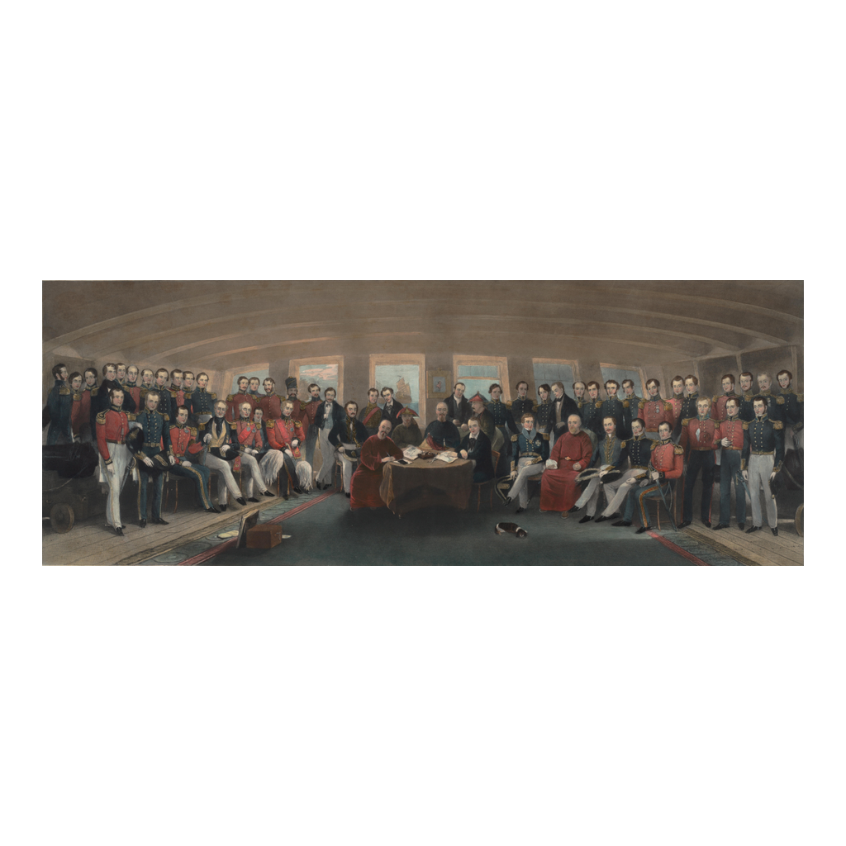
Signing the Treaty of Nanjing, 1842
Signing the Treaty of Nanjing (Nanking), 1846 engraving after John Platt
© More Lessons Less Planning | morelessonslessplanning.com
Notes:
An 1846 British engraving after a painting by Captain John Platt showing the signing of the Treaty of Nanking aboard HMS Cornwallis. It is a British depiction made four years after the event; treat it as a period representation, not a photograph.

Slide 18
Why Historians Call These Unequal Treaties
One-Sided Terms
Extraterritoriality
The Pattern Spreads
Britain gained ports, land, and money; China gained nothing back.
China could no longer set duties on British goods on its own.
An unequal treaty gives a stronger power rights the weaker one does not get.
The 1843 Treaty of the Bogue was signed at Humen and added extraterritoriality.
British subjects faced British, not Qing, law, settling the dispute that helped start the war.
The U.S. and France signed similar treaties in 1844.
Most-favored-nation clauses spread new rights to all treaty powers.
The 1856-1860 war opened more ports and legalized the trade.
Note: Extraterritoriality entered through the 1843 supplementary treaty, not through the 1842 Treaty of Nanjing itself.
© More Lessons Less Planning | morelessonslessplanning.com
Notes:
Historians call these agreements unequal treaties because the obligations ran one way. Britain gained ports, land, and money, and China gained nothing in return; China also lost the ability to set duties on British goods on its own. The 1843 supplementary treaty, the Treaty of the Bogue, added extraterritoriality: British subjects in China would face British law rather than Qing law, which answered the same jurisdiction question that had helped start the war. The United States and France signed similar treaties in 1844, and a most-favored-nation clause meant any new right granted to one power passed automatically to all of them. A second war from 1856 to 1860 opened more ports and legalized the trade.

Slide 19
What the Wars Left Behind
Qing China kept its government but lost control over key trade rules.
Treaty ports became centers of foreign residence and business.
Hong Kong grew into a major British port city.
Chinese reformers pointed to the defeat as proof change was needed.
Later Chinese writers called this the start of a century of humiliation.
The treaty system was not fully dismantled until the 1940s.
Did You Know: China regained full control of its own tariffs and ended extraterritoriality only in the 20th century.
© More Lessons Less Planning | morelessonslessplanning.com
Notes:
The Qing dynasty kept its government and its territory, but lost control over key trade rules: tariffs, which ports foreigners could use, and eventually legal jurisdiction over foreigners. Treaty ports became centers of foreign residence and business, and Hong Kong grew into a major British port city. Chinese reformers pointed to the defeat as proof that change was needed, and later Chinese writers called this the start of a century of humiliation. The treaty system was not fully dismantled until the 1940s.

Slide 20
Reference Guide: Trade and Prohibition
Canton System
The Qing rule limiting foreign sea trade to the single port of Canton through licensed merchant firms.
Trade deficit
When a country buys more from a trading partner than it sells to that partner.
Opium
A plant-based commodity, prohibited by Qing law, that British merchants shipped from India into China.
Lin Zexu
The Qing imperial commissioner sent to Canton in 1839 to enforce the ban on the opium trade.
Humen
The coastal site near Canton where Lin Zexu had over 20,000 confiscated chests destroyed in 1839.
Tip: These five terms cover the economic half of the lesson, from the trade rules to the 1839 enforcement.
© More Lessons Less Planning | morelessonslessplanning.com
Notes:
Reference slide. These five terms cover the economic half of the lesson. Students use these exact definitions to complete the Reference Guide in Part 1 of the Activity, so leave the slide up while they work or point them back to their Guided Notes.

Slide 21
Reference Guide: War and Treaty Terms
First Opium War
The 1839 to 1842 war between Britain and Qing China over trade and legal jurisdiction.
Treaty of Nanjing
The 1842 treaty that ended the First Opium War on Britain's terms.
Indemnity
A payment a defeated country is forced to make to the victor for war costs and losses.
Extraterritoriality
The right of foreigners to be tried under their own country's laws instead of the host country's laws.
Unequal treaty
A treaty imposed by a stronger power that gives it rights the weaker country does not receive in return.
Tip: These five terms cover the war and its settlement, and all five appear in the Part 5 verdict.
© More Lessons Less Planning | morelessonslessplanning.com
Notes:
Reference slide. These five terms cover the war and its settlement. Students use these exact definitions to complete the Reference Guide in Part 1 of the Activity. Remind them that extraterritoriality came from the 1843 supplementary treaty, not from the Treaty of Nanjing itself.

Slide 22
Key Takeaways
Britain paid silver for Chinese tea and ran a large trade deficit.
★
Opium grown in British India reversed that silver flow.
★
Lin Zexu destroyed over 20,000 confiscated chests at Humen in 1839.
★
Iron steamships decided a war fought 6,000 miles from Britain.
★
The 1842 Treaty of Nanjing imposed an indemnity and five treaty ports.
★
Historians call the 1842 and 1843 deals unequal treaties.
★
© More Lessons Less Planning | morelessonslessplanning.com
Notes:
Close by walking the chain one more time: trade deficit, opium as the balancing commodity, silver reverses, prohibition and enforcement, war, treaty. Ask students which link in the chain they would call the true cause of the war, and require evidence for the answer.

