Slide 1
The Olmec Colossal Heads
The first great civilization of Mesoamerica - and the giant basalt heads that reveal a people who left no writing behind.
© More Lessons Less Planning | morelessonslessplanning.com
Notes:
Opening slide. Long before the Maya or the Aztec, a people we call the Olmec built the first great civilization of Mesoamerica on the Gulf Coast of Mexico, from about 1200 to 400 BCE. Their most famous monuments are the colossal heads - giant portraits carved from single blocks of basalt, some nearly three meters tall and weighing more than forty tons. The Olmec left no writing we can read, so almost everything we know about them comes from archaeology. Students will learn who the Olmec were, how and why they made the colossal heads, and how archaeologists reconstruct a civilization from physical remains. They will also read a primary source: the 1869 report of the very first colossal head seen by the modern world, and practice weighing one observer's guesswork against real evidence.

Slide 2
Learning Targets
Describe who the Olmec were and where and when they lived.
★
Explain what the colossal heads are and how they were made and moved.
★
Weigh Melgar's 1869 guesswork against real archaeological evidence.
★
Explain why the Olmec are called the 'mother culture' of Mesoamerica.
★
© More Lessons Less Planning | morelessonslessplanning.com
Notes:
Read the four learning targets. Today's lesson combines the story of the first great Mesoamerican civilization with a history skill: reading a primary source carefully and comparing an early observer's guesses with what archaeology actually shows. Keep the big idea in mind - because the Olmec left no writing we can read, everything rests on physical evidence, and good history means knowing the difference between a guess and real evidence.

Slide 3
Who Were the Olmec?
The Olmec
Mesoamerica
The first major civilization of Mesoamerica.
Lived on the Gulf Coast of Mexico, c. 1200-400 BCE.
Left no writing we can read today.
Southern Mexico and Central America.
Home to the Olmec, and later the Maya and Aztec.
The Olmec came first - about 3,000 years ago.
Key Concept: The OLMEC were the first major civilization of MESOAMERICA, on the Gulf Coast of Mexico, c. 1200-400 BCE.
© More Lessons Less Planning | morelessonslessplanning.com
Notes:
Start with the people. The OLMEC were the first major civilization of Mesoamerica, living on the hot, humid Gulf Coast of what is now southern Mexico from about 1200 to 400 BCE. That is roughly three thousand years ago - long before the more famous Maya or Aztec. MESOAMERICA is the region of southern Mexico and Central America where these early civilizations developed. The Olmec built cities, cleared farmland, traded over long distances, and carved enormous stone monuments. But here is the challenge that shapes the whole lesson: the Olmec left no writing that we can read. Unlike the Egyptians with their hieroglyphs or the Chinese with their records, the Olmec did not leave books or inscriptions we can translate. So almost everything we know about them, we know from the objects they left behind - above all, their colossal heads.

Slide 4
The Colossal Heads
Colossal heads
Giant carved stone portrait heads, up to about 3 meters tall and more than 40 tons, that the Olmec made from single blocks of basalt.
Basalt
The hard volcanic rock the Olmec used to carve the colossal heads; it was quarried far from the cities and moved without wheels or draft animals.
Key Concept: The COLOSSAL HEADS are giant portrait heads - up to 3 meters and 40+ tons - carved from single blocks of hard volcanic BASALT.
© More Lessons Less Planning | morelessonslessplanning.com
Notes:
The most famous Olmec monuments are the COLOSSAL HEADS: giant carved stone portrait heads, each showing a human face. The largest stand up to about three meters tall - taller than a grown adult - and weigh more than forty tons, as much as several cars. Each head was carved from a single block of BASALT, a hard volcanic rock. Basalt is tough and heavy, and it did not come from the Olmec cities themselves - it had to be quarried from volcanic mountains many miles away and hauled to the sites. So far archaeologists have found seventeen of these heads. The next slide shows a real Olmec colossal head up close, so you can see the broad face and the helmet-like covering on the head. Look closely: these are not rough boulders but carefully worked portraits, and every detail was cut by hand from stone harder than steel tools of the time could easily manage.

Slide 5
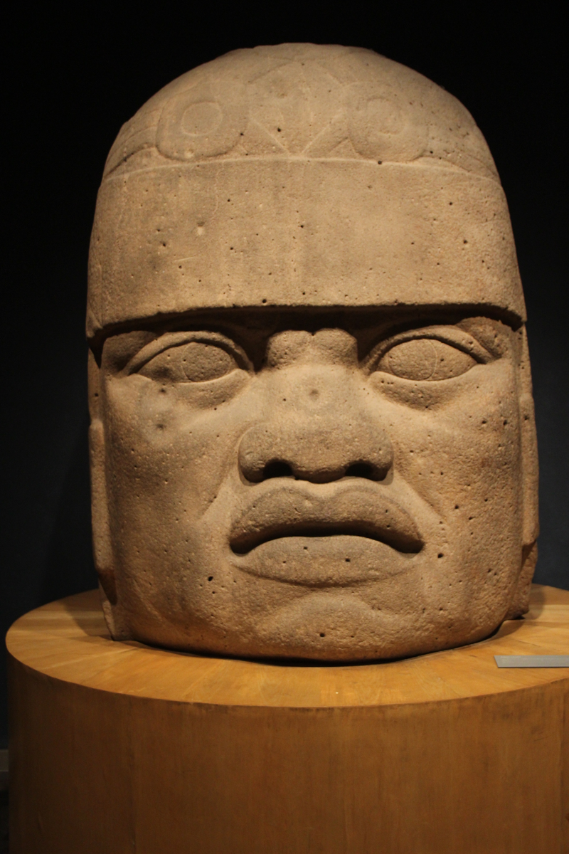
A Colossal Head Up Close
An Olmec colossal head from San Lorenzo - a basalt portrait with a headdress.
© More Lessons Less Planning | morelessonslessplanning.com
Notes:
CC0 photograph of a genuine Olmec colossal head from San Lorenzo, Veracruz (c. 1200-600 BCE), photographed front-on. Point out the broad facial features, the parted lips, and the close-fitting helmet-like covering on the head - the headdress that scholars think marked the person as a ruler. Use it purely as a reference visual to make the previous slide's description concrete; students are not asked to analyze the head as evidence.

Slide 6
Three Great Centers
San Lorenzo
The earliest major Olmec center, flourishing about 1200 BCE, where several of the colossal heads were found.
✔
La Venta
A later major Olmec city that thrived after San Lorenzo, home to colossal heads and a great earthen pyramid.
✔
Tres Zapotes
A late Olmec site in Veracruz, near where the very first colossal head was found and reported to the modern world in 1869.
✔
Key Concept: The Olmec built three great centers over time - SAN LORENZO (earliest), then LA VENTA, and later TRES ZAPOTES.
© More Lessons Less Planning | morelessonslessplanning.com
Notes:
Olmec civilization did not stay in one place; over the centuries its center of power shifted between three great sites. SAN LORENZO was the earliest major Olmec center, flourishing around 1200 BCE. Several of the colossal heads were found there, and it was one of the first true cities in the Americas. After San Lorenzo declined, LA VENTA became the leading Olmec city. La Venta thrived for centuries and is famous for its colossal heads and a huge earthen pyramid, one of the oldest in Mesoamerica. Later still came TRES ZAPOTES, a late Olmec site in the state of Veracruz. Tres Zapotes matters to our lesson for a special reason: it was near there, around 1862, that the very first Olmec colossal head was found by outsiders and reported to the modern world in 1869. Together these three sites trace the long life of Olmec civilization.

Slide 7
An Engineering Mystery
Quarried far away
The basalt for the heads came from volcanic mountains many miles from the Olmec cities and had to be hauled all the way to the sites.
No wheels or draft animals
The Olmec had no wheels for hauling and no draft animals, so many-ton basalt blocks were moved by human muscle - using sledges, rollers, ramps, and rafts.
Key Concept: The Olmec moved many-ton BASALT blocks from distant mountains with NO wheels and NO draft animals - by human effort alone.
© More Lessons Less Planning | morelessonslessplanning.com
Notes:
The colossal heads are not just art - they are an engineering mystery. The BASALT they are carved from was quarried far away, in volcanic mountains that could be fifty or more miles from the Olmec cities. That means each many-ton block had to be moved that whole distance before a single feature was carved. And here is the astonishing part: the Olmec had no wheels for hauling heavy loads and no large draft animals like horses or oxen to pull them. Everything was moved by human muscle. Archaeologists think the Olmec used sledges, wooden rollers, ramps, and rafts to float the stones along rivers, with large teams of workers pulling together. Moving a forty-ton stone this way would have taken enormous organization, planning, and labor. That tells us something important on its own: the Olmec must have been a well-organized society with leaders powerful enough to command huge amounts of work.

Slide 8
Portraits of Rulers
Individual portraits
Each colossal head has different features, so scholars think each one is a portrait of a specific Olmec ruler, not a god or a general type.
Headdress
The close-fitting, helmet-like head covering carved on each colossal head, thought to mark the individual as a ruler.
Key Concept: Each colossal head is likely a PORTRAIT of a specific ruler, shown wearing a distinctive helmet-like HEADDRESS.
© More Lessons Less Planning | morelessonslessplanning.com
Notes:
Who do the colossal heads show? Look closely at several heads and you notice something striking: each face is different. One has full cheeks, another a stern frown, another a slight smile. Because the faces are individual, scholars believe each head is a portrait of a specific Olmec ruler - a real person - rather than a god or a made-up type. Each ruler is shown wearing a HEADDRESS: a close-fitting, helmet-like covering on the head, often decorated with unique markings. These headdresses may have worked like a uniform or a badge of office, marking the individual as a powerful leader. Making a portrait this large and permanent, from stone hauled at huge cost, was a way of honoring a ruler and displaying his power for all to see - and perhaps for future generations to remember. The heads, in other words, are political monuments as well as art.

Slide 9
The First Modern Discovery
A head in a field
Around 1862, near Tres Zapotes in Veracruz, farm workers clearing forest struck a buried stone that turned out to be a colossal head.
✔
Melgar's 1869 report
Jose Maria Melgar y Serrano went to see it and published the first modern description of an Olmec colossal head in 1869.
✔
An honest limit
Melgar could only guess who made it - he had no way to date it or trace the stone, so his report is one observer's account, not proof.
✔
Key Concept: The first modern description of an Olmec colossal head was published by MELGAR y Serrano in 1869 - but he could only GUESS who made it.
© More Lessons Less Planning | morelessonslessplanning.com
Notes:
How did the modern world first learn about the colossal heads? Around 1862, near TRES ZAPOTES in Veracruz, farm laborers clearing forest from a field struck a huge buried stone. When they dug around it, they uncovered a colossal head. A local scholar, JOSE MARIA MELGAR Y SERRANO, heard about it, went to see it, and in 1869 published the first modern description of an Olmec colossal head. His report is a genuine primary source - an eyewitness account of the discovery. But it also shows the limits of early observers. Melgar was amazed by the head's size and craftsmanship, and he wondered who could have made it - but he had no way to date the head or trace where the stone came from. He could only guess, and some of his guesses were wrong. His report is one nineteenth-century observer's account, not proof of who the Olmec really were. To answer that, later archaeologists needed better tools.

Slide 10
How Do We Know? Archaeology vs. Guesswork
Early guesswork
What archaeology shows
Early observers like Melgar could only guess.
With no dating tools, they invented far-fetched origins.
Some 1800s guesses were wrong and even harmful.
Radiocarbon dating fixes the Olmec to c. 1200-400 BCE.
The basalt is traced to nearby Mexican mountains.
Olmec art and gods continue in the later Maya and Aztec.
Key Concept: ARCHAEOLOGY - dating, tracing the stone, and continuity with later cultures - shows the Olmec were an INDIGENOUS Mesoamerican people.
© More Lessons Less Planning | morelessonslessplanning.com
Notes:
This is the heart of the history skill. Because the Olmec left no writing we can read, early observers like Melgar could only GUESS who made the heads, and without any way to date them, some observers in the 1800s invented far-fetched theories that the heads must have come from other continents - guesses that were wrong and, at times, harmful. Modern ARCHAEOLOGY - the study of the human past through physical remains - replaced guesswork with evidence. Archaeologists use radiocarbon dating on material found with the monuments to fix the Olmec to about 1200-400 BCE. They trace the basalt chemically to specific volcanic mountains in Mexico, showing the stone is local. And they see clear continuity between Olmec art, gods, and symbols and those of the later Maya and Aztec. Put together, this evidence shows the Olmec were an INDIGENOUS Mesoamerican people who developed right there on the Gulf Coast. That is how careful evidence beats a confident guess.

Slide 11
The Mother Culture
First and influential
'Mother culture' means the Olmec were the first great Mesoamerican culture, whose art, gods, and ideas shaped later peoples like the Maya and Aztec.
✔
What they passed on
Later Mesoamericans shared Olmec-style features: pyramid-building, a ritual ball game, jaguar and rain-god imagery, and long-distance trade.
✔
A debated label
Some scholars prefer 'sister culture,' arguing Mesoamerican peoples influenced each other; either way, the Olmec were early and important.
✔
Key Concept: The Olmec are called the MOTHER CULTURE - the first great Mesoamerican culture that shaped later peoples, though the label is debated.
© More Lessons Less Planning | morelessonslessplanning.com
Notes:
Why do the Olmec matter beyond their own time? Scholars often call them the MOTHER CULTURE of Mesoamerica. That is the idea that the Olmec were the first great Mesoamerican culture, and that their art, gods, and ideas influenced the peoples who came after them - above all the Maya and the Aztec. When archaeologists look at later Mesoamerican civilizations, they see features that first appear with the Olmec: building pyramids, playing a ritual ball game, using powerful jaguar and rain-god imagery, and trading over long distances. Because so many later traditions seem to begin with the Olmec, they earned the 'mother culture' name. It is worth being honest, though: the label is debated. Some scholars prefer 'sister culture,' arguing that different Mesoamerican peoples shaped one another rather than all flowing from a single source. Either way, one point stands: the Olmec were early, influential, and central to the story of Mesoamerica.

Slide 12
Why the Olmec Matter
The first great civilization here
The Olmec built the first major civilization of Mesoamerica, laying groundwork for everyone who came after.
✔
Monuments as evidence
With no readable writing, their colossal heads and cities are the evidence archaeologists use to reconstruct their world.
✔
Evidence over guesswork
The Olmec show how modern archaeology replaces confident guesses with dated, traceable evidence about the human past.
✔
Key Concept: The Olmec matter as the first great Mesoamerican civilization and as a case study in how ARCHAEOLOGY reveals a people with no writing.
© More Lessons Less Planning | morelessonslessplanning.com
Notes:
Why do the Olmec matter in world history? First, because they were the first great civilization of Mesoamerica. Everything that followed in the region - the Maya cities, the Aztec empire - grew in a world the Olmec helped shape. Second, the Olmec matter because of HOW we know them. They left no writing we can read, so their COLOSSAL HEADS, pyramids, and cities are not just art - they are the main evidence archaeologists use to reconstruct a lost world. And third, the Olmec are a powerful lesson in historical thinking. Early observers like Melgar could only guess who built the heads, and some guesses were wrong. Modern ARCHAEOLOGY replaced those guesses with real evidence - dating the sites, tracing the stone, and following the threads that connect the Olmec to later Mesoamerican cultures. The Olmec remind us that good history is not about the most confident story, but about the evidence that survives.

Slide 13
Key Takeaways
The Olmec were the first major civilization of Mesoamerica, c. 1200-400 BCE.
★
Colossal heads are basalt portraits of rulers, moved without wheels or animals.
★
With no readable writing, we know the Olmec through archaeology, not guesswork.
★
The Olmec are called the 'mother culture' that shaped the Maya and Aztec.
★
© More Lessons Less Planning | morelessonslessplanning.com
Notes:
Recap the four takeaways. The big ideas: the Olmec were the first major civilization of Mesoamerica, on the Gulf Coast of Mexico from about 1200 to 400 BCE, centered on San Lorenzo, La Venta, and Tres Zapotes; their colossal heads are giant basalt portraits of individual rulers wearing helmet-like headdresses, moved many miles without wheels or draft animals; because the Olmec left no writing we can read, we know them through archaeology - dating, tracing the stone, and continuity with later cultures - which shows they were an indigenous Mesoamerican people, not the far-fetched origin Melgar and other early observers could only guess at; and the Olmec are called the 'mother culture' whose art and ideas shaped the later Maya and Aztec, a mainstream if debated label.

