Slide 1
The Odyssey: The Long Journey Home
Map Odysseus's ten-year journey home - and see why cunning, not strength, is the mark of the Greek hero.
© More Lessons Less Planning | morelessonslessplanning.com
Notes:
Open the journey. The Odyssey is the story of one man, Odysseus, trying to get home from the Trojan War - a trip that takes him ten years and nearly costs him everything. This lesson does two things at once: it maps that long journey home (the Greek word is NOSTOS, the homecoming) and it shows what kind of hero Odysseus is. He is not the strongest warrior; he is the cleverest. His weapon is METIS - cunning. But he is also flawed: his pride nearly destroys him. Set the honest frame now: the Odyssey is a work of LITERATURE, an epic poem, not a history report. Odysseus is a legendary hero and the Cyclops is a monster of myth. We read the poem not to learn what 'really happened' but to see what the ancient Greeks admired, feared, and valued.

Slide 2
Learning Targets
How the Odyssey is built: an epic of nostos, told in medias res
★
Why cunning (metis) beats strength: the Cyclops episode and the 'Noman' trick
★
Odysseus as a FLAWED hero: hubris, Poseidon's wrath, and myth vs. history
★
© More Lessons Less Planning | morelessonslessplanning.com
Notes:
Read each target aloud. Target 1 maps to slides 3-4 (what an epic is, the theme of nostos, and how the poem is told in medias res). Target 2 maps to slides 5-9 (metis, the Cyclops episode, the 'Noman' trick, and xenia). Target 3 maps to slides 10-13 (hubris, Poseidon's wrath, and the honest reminder that the Odyssey is literature that reveals Greek values, not a historical record). Stress that Target 3 carries two ideas students must hold together: Odysseus is admirable for his cunning AND genuinely flawed by his pride - the epic itself criticizes his hubris.

Slide 3
An Epic of the Long Journey Home
What the Odyssey Is
The Theme: Getting Home
An EPIC is a long narrative poem of a hero, gods, and great deeds
The hero is ODYSSEUS, king of Ithaca, famous for his cunning
His EPITHET, a fixed descriptive tag, is 'of many wiles'
NOSTOS is the Greek word for the homecoming or return
The whole poem is one long struggle to reach home on Ithaca
After 10 years of war at Troy, the journey home takes 10 more
Key Concept: The Odyssey is an EPIC poem about ODYSSEUS and the theme of NOSTOS - his ten-year struggle to return home from Troy.
© More Lessons Less Planning | morelessonslessplanning.com
Notes:
Define the shape of the story. An EPIC is a long narrative poem that tells of a hero, gods, and great deeds - and the Odyssey is one of the two most famous Greek epics. Its hero is ODYSSEUS, king of the island of Ithaca, and the trait that makes him famous is his cunning; his fixed EPITHET, a repeated descriptive tag, is 'of many wiles' (also 'much-enduring Odysseus'). The engine of the whole poem is one word: NOSTOS, the Greek word for the homecoming or return. Odysseus fought ten years in the Trojan War, and the Odyssey is the story of the ten more years it takes him to get home. Everything - the monsters, the goddesses, the storms - stands between him and Ithaca. Frame it for students: this is a journey story, and the goal is always home.

Slide 4
In Medias Res: Starting in the Middle
In medias res
IN MEDIAS RES is a Latin phrase meaning 'into the middle of things'; the Odyssey opens in the middle of the story, not at the beginning.
The Muse and the invocation
An INVOCATION opens the epic - a call to the Muse to 'sing of the man of many wiles' - the traditional start of a Greek epic.
Flashbacks fill the past
The poem jumps back in time: Odysseus later tells his own past adventures, including the Cyclops, as a flashback.
A crafted structure
This out-of-order structure is a deliberate artistic choice - proof the Odyssey is carefully shaped literature, not a plain diary of events.
Key Concept: The Odyssey is told IN MEDIAS RES - it starts in the middle and fills in the past through flashbacks, a crafted literary structure.
© More Lessons Less Planning | morelessonslessplanning.com
Notes:
Explain how the poem is TOLD, because the structure itself is a clue that this is literature. The Odyssey does not start at the beginning of Odysseus's trip; it begins IN MEDIAS RES, a Latin phrase meaning 'into the middle of things.' The poem opens with an INVOCATION - a call to the Muse to sing of 'the man of many wiles' - the traditional way a Greek epic begins. Then it moves out of order: we meet Odysseus already stranded far from home, and only later does he tell the story of his earlier adventures, including the Cyclops, as a flashback. Make the honesty point: this careful, out-of-order design is a deliberate artistic choice. A real ship's log would run in plain order, start to finish. The Odyssey's crafted structure is evidence that it is shaped literature meant to grip an audience, not a historical record of a real voyage.

Slide 5
Metis: Winning by Wits
Cunning Over Strength
The Mark of This Hero
METIS is cunning, cleverness, and strategic intelligence
It is Odysseus's defining trait, prized above brute strength
He survives by tricks and plans, not by being the strongest
His EPITHET 'of many wiles' names this cunning every time
The Cyclops episode is the clearest example of metis at work
The next slide shows an ancient vase of that very episode
Key Concept: METIS - cunning and strategic intelligence - is Odysseus's defining trait, prized in the epic above brute strength.
© More Lessons Less Planning | morelessonslessplanning.com
Notes:
This is the heart of what kind of hero Odysseus is. METIS is the Greek word for cunning, cleverness, and strategic intelligence - and it is Odysseus's defining trait. The Odyssey prizes metis ABOVE brute strength: Odysseus is not the biggest or strongest warrior, but he is the cleverest, and again and again he survives by tricks and plans where force alone would fail. His fixed EPITHET, 'of many wiles' (also translated 'of many devices'), names this cunning every single time it appears. Tell students that the single clearest example of metis in the whole poem is coming next: the Cyclops episode, where Odysseus is trapped by a giant far too strong to fight - and escapes by being clever, not strong. The next slide shows a real ancient Greek vase of that very scene so students can picture it.

Slide 6
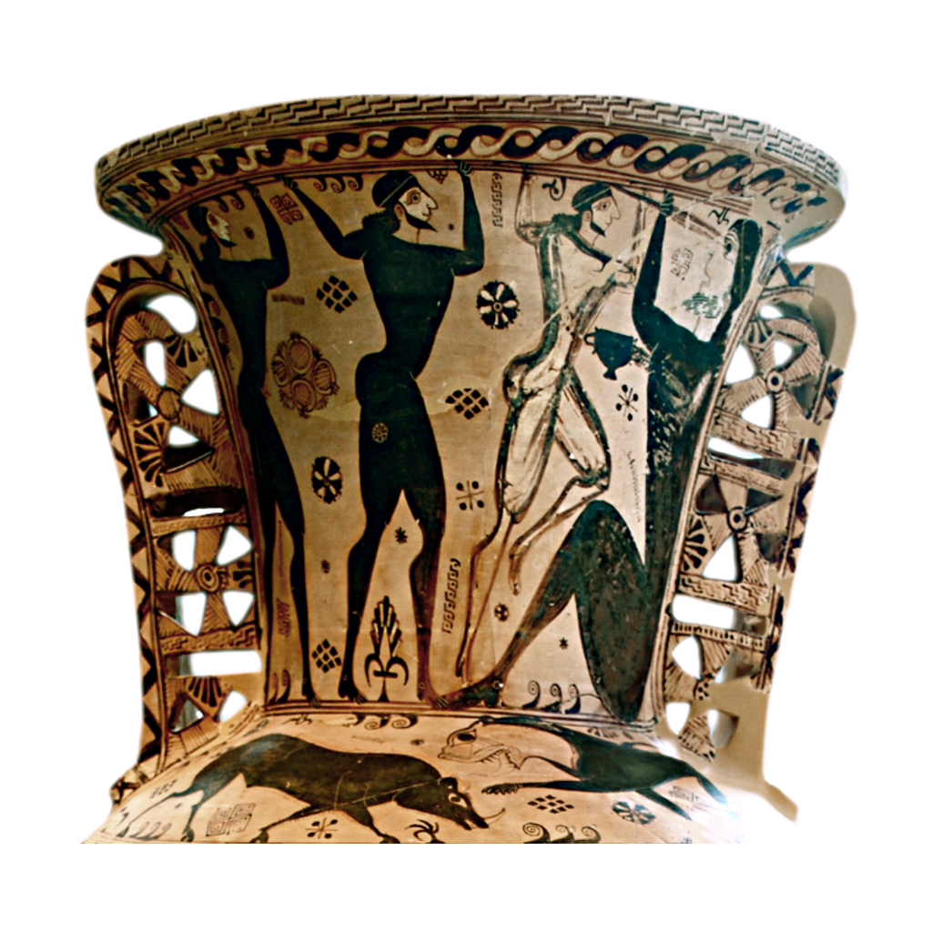
An Ancient Vase: Blinding the Cyclops
The Eleusis amphora (c. 660 BCE): Odysseus and his men blind the Cyclops
© More Lessons Less Planning | morelessonslessplanning.com
Notes:
This is a real ancient Greek vase - the famous Eleusis amphora, painted around 660 BCE, one of the earliest surviving pictures of a scene from the Odyssey. It shows Odysseus and his men driving a great pointed stake into the single eye of the Cyclops. Have students notice the line of figures pushing the long stake together and the giant seated figure. Connect it to the previous slide: this is metis in action - the men are far weaker than the giant, so they win with a clever, coordinated plan, not strength. Stress the honest caption: this is ANCIENT GREEK ART depicting a scene from the myth, not a photograph of a real event. Artists painted these scenes because the story was beloved and widely known - which is itself evidence of how important the Odyssey was to Greek culture.
Reference labels (point to these chart features when teaching): Odysseus and his men; the great stake

Slide 7
The Cyclops Episode: The 'Noman' Trick
Trapped by a Giant
The Plan: Outwit Him
POLYPHEMUS is the one-eyed Cyclops, a son of Poseidon
He traps Odysseus's men in his cave and eats several of them
The giant is far too strong to fight head-on
Odysseus says his name is 'Noman' (Nobody)
The men blind the drunk giant with a sharpened olive stake
They escape tied under the giant's rams at dawn
Key Concept: Trapped by POLYPHEMUS, Odysseus wins by cunning - the 'Noman' name trick, the olive stake, and the escape under the rams.
© More Lessons Less Planning | morelessonslessplanning.com
Notes:
Walk students through the most famous piece of metis in the poem, step by step. POLYPHEMUS is a one-eyed CYCLOPS, a giant and a son of the sea-god Poseidon. He traps Odysseus and his men in his cave, rolls a huge stone across the door, and eats several of the men - and he is far too strong for the men to fight or move the stone. So Odysseus uses cunning in three moves. First, the NAME TRICK: he tells the Cyclops his name is 'Noman' (Nobody). Second, he gets the giant drunk on strong wine and, while he sleeps, the men drive a sharpened, fire-hardened OLIVE STAKE into his single eye, blinding him. Third, when the blinded Cyclops cries out, his neighbors ask who is hurting him - and he shouts that 'Noman' is killing him, so they think nothing is wrong and leave. Then Odysseus ties his men UNDER the giant's woolly rams, and at dawn the sheep carry them safely out of the cave. Every step is brains over brawn. Students read this exact scene, in Butler's 1900 translation, in the Primary Source Spotlight.

Slide 8
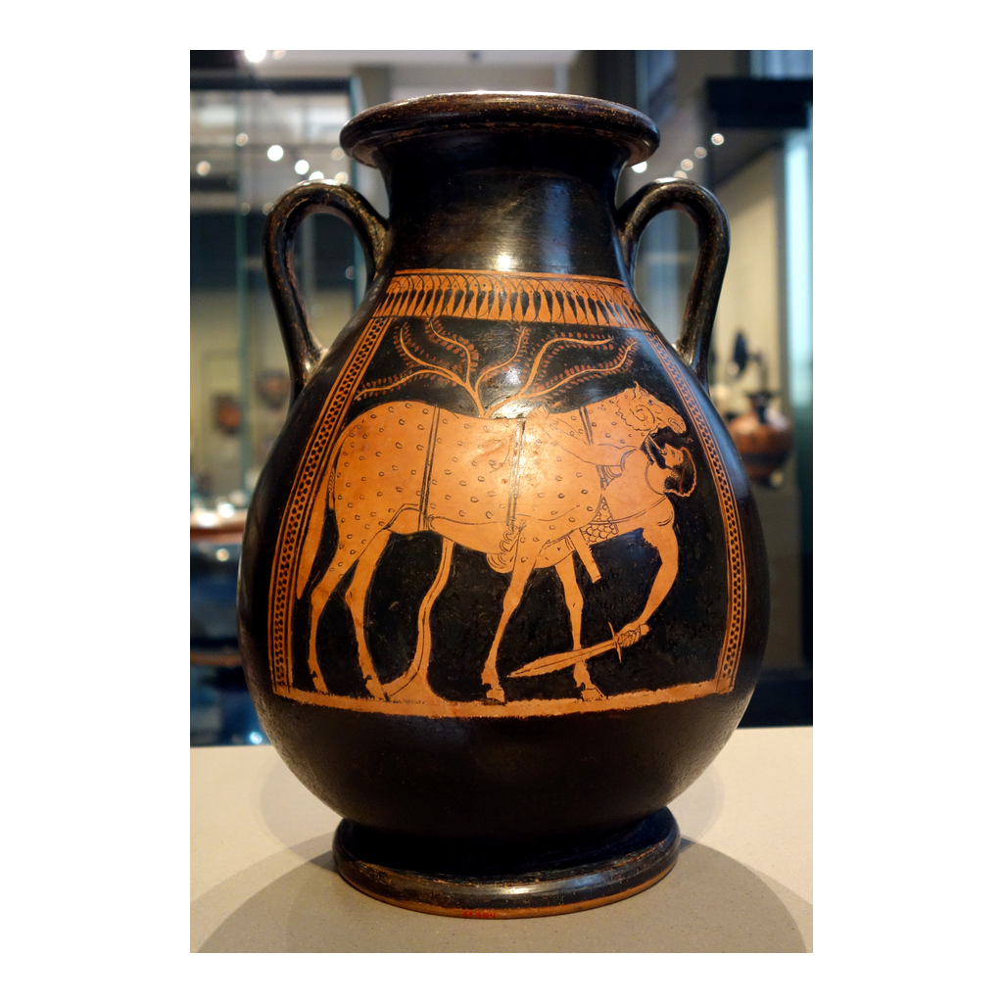
An Ancient Vase: Escape Under the Ram
Ancient Greek vase: Odysseus escapes the cave clinging under a ram
© More Lessons Less Planning | morelessonslessplanning.com
Notes:
This is a real ancient Greek vase painting showing the escape: Odysseus clinging to the underside of a large ram to slip out of the Cyclops's cave. Have students notice the man tucked beneath the animal's belly, hidden in the thick wool. Connect it to the previous slide: the blinded giant sits at the cave mouth feeling the BACKS of his sheep to catch any escaping men, so Odysseus hides where the giant will not feel - underneath. It is the final trick of the episode, cunning once more. Keep the honest caption in view: this is ancient Greek ART of a mythical scene, not a photograph. Like the last vase, it is evidence of how well-known and well-loved the story already was in the ancient world.
Reference labels (point to these chart features when teaching): Odysseus clinging beneath; the ram

Slide 9
Xenia: The Sacred Rules of Hospitality
Xenia
XENIA is the ancient Greek custom of guest-friendship - the sacred rules of hospitality between a host and a guest.
A guest's rights
A good host gives a stranger food, shelter, and safety before even asking the guest's name or business.
The Cyclops breaks xenia
Polyphemus violates xenia horribly: instead of feeding his guests, he eats them - marking him as a monster, not a host.
Why it matters
By showing xenia broken, the epic teaches Greek audiences what proper hospitality should look like - a core cultural value.
Key Concept: XENIA is Greek guest-friendship, the sacred duty of hospitality; the Cyclops is a monster because he eats his guests.
© More Lessons Less Planning | morelessonslessplanning.com
Notes:
Draw out a Greek value the episode teaches. XENIA is the ancient Greek custom of guest-friendship - the sacred, almost religious rules of hospitality that bound a host and a guest. Under xenia, a good host was expected to give a stranger food, shelter, and safety FIRST, often before even asking the visitor's name or business; in return, a guest owed the host respect and gratitude. This mattered deeply in a world with no hotels, where travelers depended on strangers to survive. Now the point: the Cyclops POLYPHEMUS violates xenia in the most horrifying way possible - instead of feeding his guests, he eats them. That is exactly what marks him as a monster rather than a civilized host. Help students see the literary move here: by showing xenia savagely broken, the epic teaches its Greek audience what PROPER hospitality should look like. This is a clear example of the Odyssey revealing Greek values - what the culture prized - rather than reporting real events.

Slide 10
The Flawed Hero: Hubris
A Hero With a Flaw
Pride Backfires
HUBRIS is excessive pride or arrogance that leads a hero into trouble
Odysseus is clever, but he is NOT a perfect hero
As he sails away, pride makes him taunt the blinded Cyclops
He shouts his REAL name - Odysseus of Ithaca - to boast
Now the Cyclops can name him in a curse to his father
The epic criticizes this pride; it does not reward it
Warning: Odysseus's HUBRIS - taunting the Cyclops and shouting his real name - is a real FLAW the epic criticizes, not a triumph to admire.
© More Lessons Less Planning | morelessonslessplanning.com
Notes:
This is a load-bearing honesty point: Odysseus is a FLAWED hero, and the epic knows it. HUBRIS is excessive pride or arrogance that leads a hero into trouble. Here is the turn students must catch: the 'Noman' trick worked perfectly - Odysseus had escaped cleanly and anonymously. But as he sails away, his PRIDE gets the better of him. He cannot resist gloating, so he shouts his REAL name back at the blinded giant - 'Odysseus, sacker of cities, son of Laertes, who lives in Ithaca!' - just to take credit. That boast is a catastrophic mistake, because now Polyphemus knows exactly who blinded him and can name Odysseus in a curse to his father, the god Poseidon. Be explicit with students: the epic does NOT reward this pride as cool or heroic - it presents it as a genuine flaw that costs Odysseus dearly. A perfect-hero story would let the clever trick be a clean win; the Odyssey is more honest and more interesting because its hero's own arrogance nearly destroys him.

Slide 11
Poseidon's Wrath: Why the Journey Is So Long
Poseidon
POSEIDON is the Greek god of the sea and Odysseus's divine enemy; he is also the father of the blinded Cyclops, Polyphemus.
The curse
Because Odysseus boasted his real name, Polyphemus prays to Poseidon to punish him - and the sea-god answers.
Ten hard years
Poseidon's anger drives the storms and disasters that keep Odysseus from home, stretching the journey to ten long years.
Consequence of hubris
The long, painful nostos is the direct price of Odysseus's hubris - pride has a cost that shapes the whole epic.
Key Concept: POSEIDON, sea-god and father of the Cyclops, punishes Odysseus for his boastful pride - which is why the journey home takes ten years.
© More Lessons Less Planning | morelessonslessplanning.com
Notes:
Connect the flaw to the whole shape of the poem. POSEIDON is the Greek god of the sea - and, crucially, the FATHER of the Cyclops Polyphemus. When Odysseus shouted his real name in his pride, he gave the blinded Cyclops the power to curse him by name: Polyphemus prays to his father Poseidon to make sure Odysseus either never reaches home or arrives late, alone, and broken. Poseidon answers that prayer. The god's anger drives the storms, shipwrecks, and disasters that hound Odysseus for years and keep him from Ithaca. Make the through-line explicit for students: the reason the journey home (the nostos) takes TEN long, painful years is, at its root, Odysseus's own HUBRIS. His cunning got him out of the cave; his pride nearly kept him from ever getting home. Cause and effect - flaw and consequence - is built right into the structure of the epic, which is another sign of careful literary design.

Slide 12
Myth, Not History: How to Read the Odyssey
What the Odyssey Is
How to Read It Honestly
It is a work of LITERATURE - an epic poem meant to be performed
Odysseus is a legendary hero; Polyphemus is a monster of MYTH
A one-eyed giant did not really trap real sailors
The poem reveals Greek VALUES: metis, xenia, hubris, and nostos
Do not ask 'did this happen?' - ask what the story reveals
Read it for what the Greeks admired and feared
Big Idea: The Odyssey is myth and literature, NOT history - read it for what it reveals about Greek values, not what 'really happened.'
© More Lessons Less Planning | morelessonslessplanning.com
Notes:
This is the central honesty anchor of the lesson, and it deserves real emphasis. The Odyssey is an EPIC POEM - a work of literature composed to be performed - NOT a history of real events. Say it plainly to students: Odysseus is a LEGENDARY hero, and Polyphemus is a MONSTER OF MYTH. A one-eyed giant did not really trap real sailors in a cave; a sea-god did not really steer storms to punish a boaster. We should never say the journey 'really happened.' So why study it? Because the poem is a window into the ancient Greek MIND. It reveals what the Greeks VALUED and feared: cunning intelligence (metis), the sacred duty of hospitality (xenia), the danger of excessive pride (hubris), and the deep human pull of home (nostos). That is the honest question to bring to the text - not 'is this true?' but 'what does this story show us about what the Greeks admired, feared, and believed a good person should be?' Reading the Odyssey as literature that reveals values is both more accurate and more interesting than treating it as a travel report.

Slide 13
Weighing It: What the Epic Shows and Doesn't
What we CAN say
The Odyssey is a Greek epic that prizes cunning (metis) over strength and shows the danger of pride (hubris) through Odysseus.
What we CAN say
It reveals real Greek values - xenia (hospitality) and nostos (the longing for home) - and is carefully shaped literature.
What we must NOT say
We must NOT say the Cyclops was real, that the journey 'really happened,' or that Odysseus was a flawless, perfect hero.
The honest verdict
Read Odysseus as admirable for his cunning AND genuinely flawed by his pride - and read the poem as literature, not history.
Big Idea: Be confident about what the Odyssey REVEALS - Greek values, a flawed hero - and honest that it is myth and literature, not history.
© More Lessons Less Planning | morelessonslessplanning.com
Notes:
Close by separating what the poem supports from what it does not - the honest-reader move that runs through the whole unit. State clearly what we CAN say with confidence: the Odyssey is a Greek epic that prizes cunning (metis) above brute strength; it shows the danger of pride through Odysseus's hubris; and it reveals genuine Greek values - the sacred duty of hospitality (xenia) and the powerful longing for home (nostos). It is carefully shaped literature, told in medias res. Then state just as clearly what we must NOT say: we cannot say the Cyclops was a real creature, that the ten-year voyage 'really happened,' or that Odysseus was a flawless, perfect hero. The honest verdict holds two things at once: Odysseus is admirable for his cunning AND genuinely flawed by his pride, and the Odyssey is a work of literature that reveals a culture's values - not a historical record. Teaching students to read a story for what it reveals, while staying honest about what it is and is not, is the real goal of the lesson.

Slide 14
Key Takeaways
An EPIC of NOSTOS: Odysseus's ten-year journey home, told in medias res
★
METIS (cunning) beats strength: the 'Noman' trick and escape under the rams
★
FLAWED hero: his HUBRIS (bragging his name) brings POSEIDON's wrath
★
Myth and literature that reveals Greek values - NOT a real history
★
© More Lessons Less Planning | morelessonslessplanning.com
Notes:
Close the lesson. Review the four takeaways aloud. Students should be able to (a) explain that the Odyssey is an EPIC built on the theme of NOSTOS - Odysseus's ten-year journey home - and told IN MEDIAS RES; (b) explain that METIS (cunning) defines Odysseus and beats strength, using the Cyclops episode: the 'Noman' name trick, the olive stake, and the escape under the rams; (c) explain that Odysseus is a FLAWED hero whose HUBRIS - boasting his real name to the Cyclops - brings POSEIDON's wrath and stretches the journey to ten years; and (d) explain that the Odyssey is myth and carefully shaped literature that reveals Greek VALUES (metis, xenia, hubris, nostos), not a historical record of real events. The Primary Source Spotlight asks them to read the Cyclops scene in the Odyssey's own words and connect it to everything above.

