Slide 1
The Odyssey Goes to Hollywood
For 2,800 years storytellers have kept retelling the Odyssey. This capstone builds a skill: how to judge any adaptation against its source.
© More Lessons Less Planning | morelessonslessplanning.com
Notes:
Open the capstone. The Odyssey is one of the oldest stories still being told - and in 2026 it is back in theaters, which is why it is suddenly everywhere. But the point of this lesson is bigger than any one movie: storytellers have been retelling the Odyssey for roughly 2,800 years, in every form imaginable - sung by bards, painted on vases, echoed by Roman poets, translated into English prose, and now filmed. Each of those is an ADAPTATION. This lesson gives students a skill they can reuse for the rest of their lives: how to judge any adaptation against its source - what it KEEPS, what it CHANGES, and what it ADDS - on fair criteria, instead of just saying 'the book was better.' Set the honest tone now: changing a story is what adapting IS, not a mistake, and we do not even know for certain who 'Homer' was.

Slide 2
Learning Targets
Adaptation is ancient and ongoing - changing a source is not a mistake
★
Build reusable criteria to judge any adaptation fairly
★
Read Homer's own words and see the epic endorse retelling
★
© More Lessons Less Planning | morelessonslessplanning.com
Notes:
Read each target aloud. Target 1 maps to slides 3-9 (the Odyssey keeps coming back, what an adaptation is, the ancient retellings, translation as adaptation, and the open Homeric Question). Target 2 maps to slides 10-13, where students build and apply the evaluation criteria - fidelity, theme and values, context, and purpose and audience. Target 3 maps to slides 14-15 and drives the Primary Source Spotlight, where students read Homer's Odyssey, Book I: the invocation of the Muse and the scene of the bard Phemius, in which Telemachus says people 'always applaud the latest songs most warmly.' Stress that the goal is a transferable skill: after this lesson students should be able to pick up ANY adaptation - a film, a novel, a graphic novel - and judge it fairly against its source.

Slide 3
The Odyssey Keeps Coming Back
One Story, Many Tellings
Why It Endures
The Odyssey is an EPIC - a long narrative poem of a hero, gods, and great deeds
It has been retold for roughly 2,800 years, in form after form
Bards sang it; vase painters painted it; poets and novelists reworked it
In 2026 it is a Hollywood film - the newest link in a very long chain
Its core is human: a soldier trying to get home against long odds
Each era retells it in its own language and its own medium
A RETELLING carries the story into a new time and a new audience
The story survives because people keep re-making it
Key Concept: The Odyssey is an EPIC - a long narrative poem of heroes, gods, and great deeds - that people have RETOLD for roughly 2,800 years.
© More Lessons Less Planning | morelessonslessplanning.com
Notes:
Set up the whole capstone with one big idea: the Odyssey never really goes away. An EPIC is a long narrative poem about heroes, gods, and great deeds; the Iliad and the Odyssey are the most famous Greek epics. For roughly 2,800 years people have kept retelling it. Trace the chain out loud so students feel its length: ancient bards SANG it from memory; Greek vase painters PAINTED its scenes on pottery; Roman poets echoed it; later authors translated and reworked it into new languages; and in 2026 it is a Hollywood film. Each of those is a RETELLING - a new telling that carries the story into a new time and a new audience. Why does it endure? Because its core is deeply human: a soldier trying to get home against impossible odds, and the people waiting for him. Every age finds that worth telling again in its own language and its own medium. Make the point that will run through the whole lesson: the story survives precisely BECAUSE people keep re-making it - not in spite of the changes.

Slide 4
What Is an Adaptation? Keep, Change, Add
Adaptation
A new version of an existing story told in a different form, time, or medium.
Source text
The original work an adaptation is based on - for the Odyssey, Homer's Greek epic.
Keep, change, add
Every adaptation KEEPS parts of the source, CHANGES others, and ADDS new material.
Changing is not a mistake
Changing, cutting, and adding is what adaptation IS - not automatically an error.
Key Concept: An ADAPTATION reworks a SOURCE TEXT by keeping, changing, and adding - changing the source is what adapting is, not 'getting it wrong.'
© More Lessons Less Planning | morelessonslessplanning.com
Notes:
Give students the core vocabulary and the honesty anchor at the same time. An ADAPTATION is a new version of an existing story told in a different form, time, or medium - a play made into a film, a poem made into a novel, a Greek epic made into a movie. The original it is based on is the SOURCE TEXT; for the Odyssey, the source is Homer's ancient Greek epic (which, remember, itself came out of centuries of oral tradition, so even the 'source' was once a retelling). Now teach the three moves every adaptation makes: it KEEPS parts of the source, CHANGES others, and ADDS material that was never there. Drive home the anchor that runs through the whole lesson: changing, cutting, and adding is what adaptation IS - it is not automatically a mistake. The critic's job is not to catch every difference and yell 'wrong'; it is to judge whether the changes are good choices for a new purpose and audience. This is the mindset students will use for the rest of the capstone.

Slide 5
The Odyssey Was Always Being Retold
It Started as Oral Tradition
Ancient Retellers
ORAL TRADITION passes stories by spoken performance and memory, not writing
Homer's epic came out of centuries of bards retelling it aloud
So even the 'original' Odyssey was already a product of retelling
No two live performances were ever exactly the same
Greek vase painters retold Odyssey scenes in pictures on pottery
The Roman poet Virgil echoed it in his epic, the Aeneid
Later writers translated and reworked it into new languages
The next slide shows one ancient retelling on a vase
Key Concept: The Odyssey began in ORAL TRADITION - stories passed by spoken performance and memory, so even the source was a retelling.
© More Lessons Less Planning | morelessonslessplanning.com
Notes:
Make the surprising point that the adaptation chain reaches back BEFORE Homer. The Odyssey began in ORAL TRADITION - the passing of stories by spoken performance and memory, with no writing. For centuries, bards retold the story aloud, and each performance was a little different; no two were exactly the same. That means even the 'original' Odyssey we point to was already the product of countless retellings. The chain did not stop once it was written down, either: ancient Greek vase painters retold Odyssey scenes in pictures on pottery (students will see one next); the Roman poet Virgil echoed the epic in his own poem, the Aeneid; and later writers translated and reworked it into new languages. Land the capstone insight: retelling the Odyssey is not a modern habit - it is as old as the Odyssey itself. When a filmmaker adapts it in 2026, they are doing something people have done since before the poem was ever written down. The next slide shows a real ancient vase that retells a famous Odyssey scene.

Slide 6
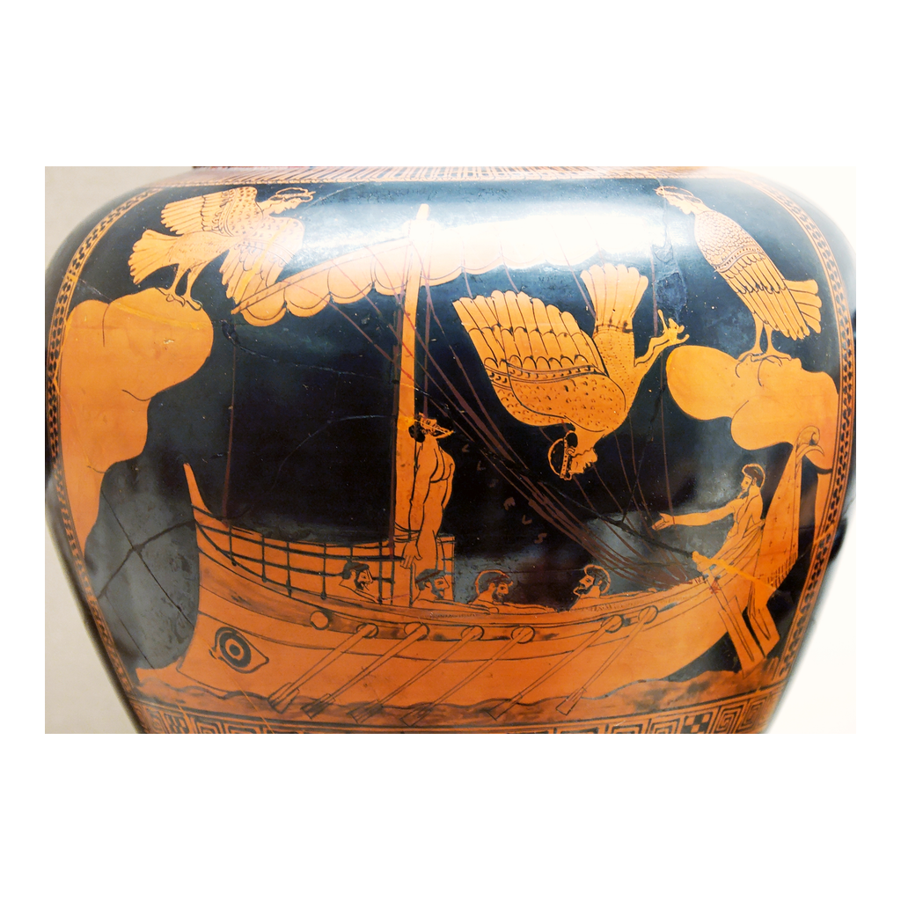
The Siren Vase: An Ancient Retelling
The Siren Vase (c. 480-470 BCE): an ancient retelling of an Odyssey scene
© More Lessons Less Planning | morelessonslessplanning.com
Notes:
This is a real ancient Greek red-figure vase, the famous 'Siren Vase' from around 480-470 BCE. It retells a scene from the Odyssey: Odysseus has himself tied to the mast of his ship so he can hear the Sirens' deadly song without steering into the rocks. Have students notice the figure bound to the mast and the bird-bodied Sirens. Connect it to the previous slide: this vase is an ADAPTATION - an ancient artist retelling the Odyssey in a completely different medium, pictures on pottery, centuries after the story began. Point out what it KEPT (the core scene of Odysseus and the Sirens), what it had to CHANGE (turning words into a single frozen image), and what the medium ADDS (a visual composition a listener never got). It is a perfect early example of the very skill students are building - and it involves no film imagery of any kind.
Reference labels (point to these chart features when teaching): Odysseus tied to the mast; a Siren above the ship

Slide 7
A Translation Is an Adaptation Too
From Greek Verse to English Prose
Choices, Not Just Copying
Homer's Odyssey is Greek poetry in a strict six-beat meter
Samuel Butler's 1900 version turns it into plain English prose
That is a big change - the sound, rhythm, and form are all remade
A translator must choose wording, tone, and even names
Butler picks Roman names: 'Ulysses' for Odysseus, 'Jove' for Zeus
Every translation KEEPS the plot but CHANGES the language
The version students read is already one adaptation
There is no single 'plain' Odyssey - each text is a choice
Key Concept: Even a translation is an adaptation - Butler's 1900 English prose remakes Homer's Greek verse and chooses wording, tone, and names.
© More Lessons Less Planning | morelessonslessplanning.com
Notes:
Surprise students with a case they might not expect: a TRANSLATION is an adaptation too. Homer's Odyssey is Greek poetry in a strict six-beat meter (dactylic hexameter), full of sound and rhythm. When Samuel Butler translated it into English in 1900, he turned it into plain PROSE - no meter, no verse. That is a major change: the sound, the rhythm, and the poetic form are all remade, even though the plot stays the same. Point out the concrete choices a translator makes: Butler chose the Roman names, calling Odysseus 'Ulysses' and Zeus 'Jove' - a decision, not a fact of the text. The lesson for students: every translation KEEPS the plot but CHANGES the language and feel, so the English Odyssey they read is ALREADY one adaptation of the source, made by a specific person with specific choices. There is no single 'plain' or 'neutral' Odyssey in English - every version is a set of choices. This makes translation a perfect, low-stakes example of the keep-change-add skill before students judge a film.

Slide 8
Who Was Homer? The Homeric Question Stays Open
Homeric Question
The open debate over who 'Homer' was - one poet, several poets, or a whole tradition.
Three honest possibilities
'Homer' may have been one gifted poet, several poets, or a name attached to a tradition.
Why it stays open
The poems came from centuries of oral performance; no record of a single author survives.
No true portrait exists
Ancient busts of Homer are idealized and posthumous - imagined long after.
Big Idea: The HOMERIC QUESTION is genuinely open - 'Homer' may have been one poet, several poets, or a name attached to a tradition. We do not know.
© More Lessons Less Planning | morelessonslessplanning.com
Notes:
Pause the adaptation story to be honest about something we cannot resolve: we do not actually know who 'Homer' was. The HOMERIC QUESTION is the long-running, still-unresolved debate over who 'Homer' actually was and how the epics were composed. Give students the three honest possibilities and hold all of them: 'Homer' may have been (1) a single gifted poet, (2) several poets whose work was combined, or (3) simply a name later attached to a long oral tradition of many singers. Explain WHY it stays open: the poems grew out of centuries of oral performance before anyone wrote them down, and no reliable record of a single author survives. Then connect it to the image coming next: ancient marble busts of Homer are idealized and posthumous - they were carved long after, as imagined likenesses, because no one knew what he looked like (or even whether 'he' was one person). Be explicit about the honesty anchor: we do NOT say Homer was definitely one real person, and we do NOT say he definitely never existed. The honest answer is 'we do not know' - and even our source is a tradition of retellings, which is exactly the theme of the capstone.

Slide 9
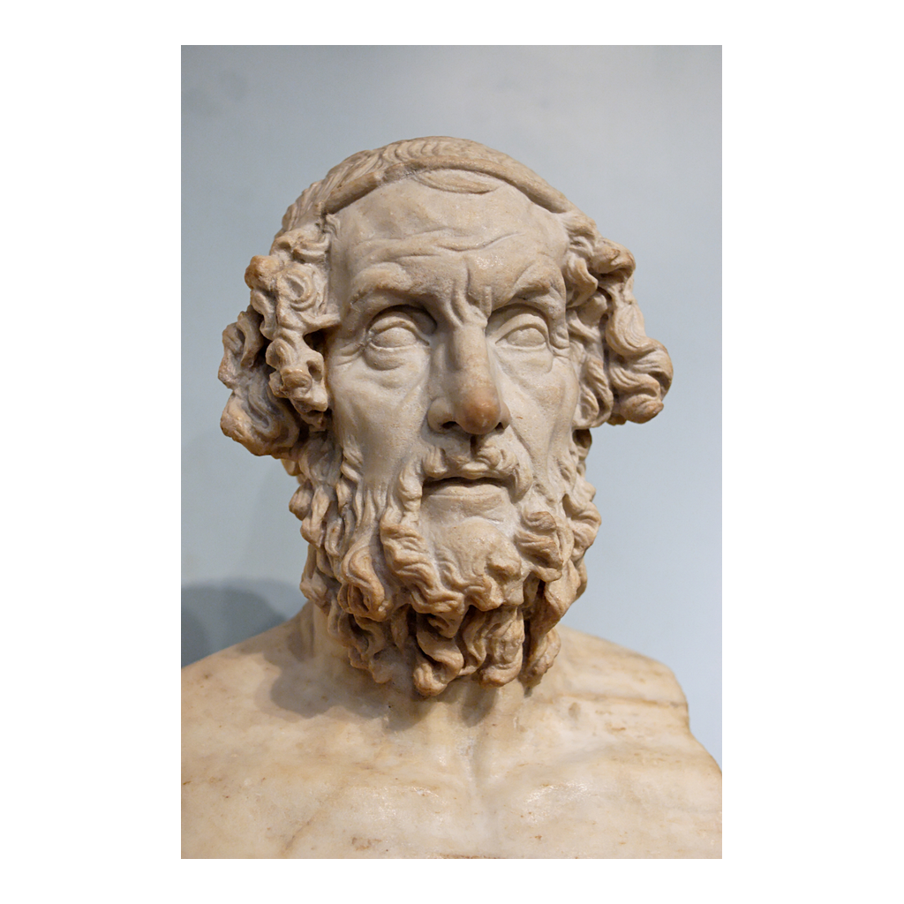
A Marble Bust of Homer
An ancient marble bust of Homer - an idealized, posthumous likeness
© More Lessons Less Planning | morelessonslessplanning.com
Notes:
This is a real ancient marble portrait bust of Homer. It is important to caption it honestly: this is NOT a photograph or a life portrait. It is an IDEALIZED, POSTHUMOUS likeness - carved long after any real 'Homer' would have lived, as an imagined image of what a great blind poet might have looked like. Have students notice the blank, sightless eyes, which reflect the ancient tradition that Homer was blind. Connect it to the previous slide: because the Homeric Question is open, even this famous face is a kind of adaptation - later artists imagining an author they could not have seen. Use it to reinforce the honesty anchor: we do not know who Homer was, so this bust tells us more about how later Greeks and Romans wanted to picture their greatest poet than about any real person. It is a real public-domain artifact, not film imagery.
Reference labels (point to these chart features when teaching): the idealized face; the blind, sightless eyes

Slide 10
Build Your Criteria: Judging Any Adaptation
1. Fidelity to plot and characters
Does the adaptation keep the core plot and the main characters recognizable, or change them - and does the change work?
2. Theme and values
Does it preserve the source's big themes and values - for the Odyssey, ideas like xenia (guest-friendship), nostos (homecoming), and metis (cunning)?
3. Historical and cultural context
Does it respect the world the source came from, or update the setting - and is that update thoughtful or careless?
4. Purpose and audience
Who is the new version FOR, and what is it trying to do? A change that fits its purpose and audience can be a strong choice.
Key Concept: Judge any adaptation on four criteria - fidelity to plot and characters, theme and values, context, and purpose and audience.
© More Lessons Less Planning | morelessonslessplanning.com
Notes:
This is the heart of the capstone skill. Give students a reusable toolkit - four criteria they can apply to ANY adaptation, not just the Odyssey. (1) FIDELITY TO PLOT AND CHARACTERS: does the new version keep the core story and the main characters recognizable, or change them - and does the change work? (2) THEME AND VALUES: does it preserve the source's big ideas? For the Odyssey those are values like xenia (guest-friendship), nostos (the homecoming), and metis (cunning intelligence). (3) HISTORICAL AND CULTURAL CONTEXT: does it respect the world the source came from, or move the setting to a new time or place - and is that update thoughtful or careless? (4) PURPOSE AND AUDIENCE: who is the new version FOR, and what is it trying to do? A change that fits its purpose and audience can be a strong, defensible choice. Stress that these criteria replace the lazy verdict 'the book was better' with real analysis: a good critic names WHICH criterion a change serves or breaks. Students will use exactly these criteria in the activity.

Slide 11
Fidelity vs. Creative License
Two Ends of a Dial
Judge the Choice, Not Just the Change
FIDELITY is how closely an adaptation sticks to the source
CREATIVE LICENSE is the freedom to change, cut, or add
Every adaptation sits between very faithful and very free
Neither end is automatically better - judge the change
High fidelity can honor the source - or feel stiff and lifeless
High creative license can feel fresh - or lose what made the source matter
The critic's job: does THIS change serve the story's purpose?
Taking license is normal adapting, not automatically an error
Key Concept: FIDELITY sticks close to the source; CREATIVE LICENSE changes it freely. Neither is automatically better - judge the choice.
© More Lessons Less Planning | morelessonslessplanning.com
Notes:
Give students the two words that let them talk about adaptation like critics, and place them on a dial rather than a right-vs-wrong line. FIDELITY is how closely an adaptation stays true to its source's plot, characters, and themes - high fidelity sticks close, low fidelity departs freely. CREATIVE LICENSE is the freedom a reteller takes to change, cut, or add to the source for a new purpose or audience. Every adaptation sits somewhere on the dial between very faithful and very free - and, crucially, neither end is automatically better. Make this concrete: high fidelity CAN honor the source, but it can also feel stiff, slow, or lifeless; high creative license CAN feel fresh and exciting, but it can also lose the very thing that made the source matter. So the critic's real question is never just 'did they change it?' - changing is guaranteed. The question is: does THIS particular change serve the story's purpose and audience? Reinforce the anchor one more time: taking creative license is a normal part of adapting, not automatically an error. Students judge the CHOICE, not merely the fact of change.

Slide 12
Keeping the Heart: Theme and Values
Xenia
The Greek sacred custom of guest-friendship - hosts and guests owe each other respect.
Nostos
The Greek idea of the hero's homecoming; the Odyssey is Odysseus's long return to Ithaca.
Metis
The Greek word for cunning intelligence - Odysseus's trait of winning by wits, not force.
The real fidelity test
An adaptation can change the setting and stay faithful if it keeps these core values.
Key Concept: The Odyssey's core values are XENIA (guest-friendship), NOSTOS (homecoming), and METIS (cunning intelligence).
© More Lessons Less Planning | morelessonslessplanning.com
Notes:
Deepen the fidelity criterion by teaching the Odyssey's core values - the 'heart' a faithful adaptation must keep even if it changes everything on the surface. XENIA is the ancient Greek sacred custom of guest-friendship: the duty of hosts to welcome and protect guests, and of guests to respect their hosts. It runs all through the Odyssey - good hosts are rewarded and bad ones (like the suitors devouring Odysseus's house, or the Cyclops who eats his guests) are punished. NOSTOS is the Greek idea of the hero's homecoming or return; the entire Odyssey is the story of Odysseus's long nostos back to Ithaca. METIS is cunning intelligence or clever strategy - Odysseus's defining trait, the way he wins by wits (the wooden horse, the trick on the Cyclops) rather than by brute force. Now make the capstone point about fidelity: the DEEPEST kind of faithfulness is keeping these values, not copying every plot detail. An adaptation could move the whole story to outer space and still be deeply faithful if it honors homecoming, hospitality, and clever survival - or it could copy the ancient plot exactly and still feel hollow if it loses them. This is how students tell surface fidelity from real fidelity.

Slide 13
Purpose and Audience: What a Change Reveals
Every Retelling Has a Reason
A Mirror of Its Own Era
A bard sang for a live feast; a film is made for a global 2026 audience
The purpose shapes what gets kept, cut, and added
Ask WHO the new version is for and WHAT it is trying to do
A change that fits its purpose can be a strong choice
What a reteller changes often reveals their OWN time's values
Roman poets stressed duty; modern versions may stress trauma or family
Reading the changes tells you about the era that made them
So adaptations are evidence about the retellers, not just the source
Key Concept: Ask a retelling's PURPOSE and AUDIENCE - and read what it changes as a clue to the reteller's own era and values.
© More Lessons Less Planning | morelessonslessplanning.com
Notes:
Sharpen the fourth criterion and add the capstone's most sophisticated idea: adaptations are evidence about the people who make them. Every retelling has a PURPOSE and an AUDIENCE. A bard sang for a live feast hall; a Roman poet wrote for an empire; a 2026 filmmaker makes a movie for a global audience with modern expectations. That purpose shapes what gets kept, cut, and added - so the first question is always WHO the new version is for and WHAT it is trying to do. A change that fits its purpose and audience can be a strong, defensible choice, not a flaw. Then the deeper move: what a reteller CHANGES often reveals their OWN era's values. Roman poets tended to stress duty and empire; some modern versions foreground trauma, or family, or the cost of war, because those are the things our era cares about. So when students read the changes carefully, they learn about the time that produced the adaptation, not just about Homer. This flips the whole exercise: an adaptation is a mirror of its own age. That is why studying retellings is real history, not just entertainment - each one is a document of the people who made it.

Slide 14
The Latest Link: The Odyssey in 2026
A New Retelling Arrives
The Hook, Not the Point
In 2026, Christopher Nolan released a film of The Odyssey
It is the newest link in a chain roughly 2,800 years long
Rated R for adult moviegoers - not a school screening
Like every retelling, it keeps, changes, and adds
The film is why the Odyssey is in the news right now
But the SKILL is what lasts: judge any retelling on your criteria
You do not need to see the film to use the criteria you built
The source - Homer - and the skill are the real takeaways
Key Concept: Nolan's 2026 Odyssey film is the newest link in a 2,800-year chain of retellings - a timely hook, but the lasting product is the skill.
© More Lessons Less Planning | morelessonslessplanning.com
Notes:
Bring the long chain up to the present - carefully and factually. In 2026, the director Christopher Nolan released a film version of The Odyssey. Keep the references strictly factual and general: it is a new adaptation, it is the newest link in a roughly 2,800-year chain of retellings, and it is rated R, made for adult moviegoers - which means it is not something to screen in class. Do NOT make any plot claims about the film or describe specific scenes; at authoring time those are unverifiable, and the movie is not our source anyway. The teaching move is to use the film purely as a HOOK: it is why the Odyssey is suddenly everywhere, and that cultural moment is a great way to make an ancient poem feel urgent. But be explicit with students that the film is the hook, not the point. Like every retelling before it, it keeps some things, changes others, and adds new ones - and students can judge ANY version, including this one, using the criteria they built, without ever needing to watch it. The lasting product of this lesson is the source (Homer) and the skill, not the movie.

Slide 15
Judging Honestly: The Book Is Not Always Better
Retire the lazy verdict
'The book is always better' is not analysis - it skips the work of naming what an adaptation actually keeps, changes, and adds.
Name the criterion
A fair judgment points to a criterion: this change strengthens fidelity, or serves the new audience, or loses a core value.
The source was a retelling too
Homer's epic came from oral tradition, so there is no single pure 'original' to defend - only a long chain of tellings.
Honest and confident at once
Be confident using your criteria, and honest that reasonable people can weigh the same change differently.
Big Idea: Retire 'the book is always better.' Judge each adaptation by naming which criterion a change serves or breaks - fairly and honestly.
© More Lessons Less Planning | morelessonslessplanning.com
Notes:
Close the capstone by turning the criteria into a habit of honest judgment. First, retire the lazy verdict: 'the book is always better' is NOT analysis - it is a way of skipping the actual work of naming what an adaptation keeps, changes, and adds. Teach students that a fair judgment always points to a CRITERION: instead of 'it was worse,' say 'this change weakened fidelity to a main character,' or 'this cut served the film's audience,' or 'this addition lost the value of xenia.' Second, remind them of the twist that makes 'the original is sacred' hard to defend: Homer's epic itself came out of oral tradition, so there is no single pure 'original' sitting at the start of the chain - only a long line of retellings, each one adapting the last. Finally, model the honest posture that runs through the whole unit: be CONFIDENT using your criteria - you have real tools now - and HONEST that reasonable people can weigh the same change differently. Judging an adaptation well is not about declaring a winner; it is about explaining your reasoning clearly enough that someone who disagrees still understands why you think what you think.

Slide 16
Key Takeaways
Adaptation is ancient and ongoing - the Odyssey retold for ~2,800 years
★
Every adaptation KEEPS, CHANGES, and ADDS - change is not 'getting it wrong'
★
Judge retellings on criteria: fidelity, values, context, purpose
★
The Homeric Question stays open - even the 'source' was a retelling
★
© More Lessons Less Planning | morelessonslessplanning.com
Notes:
Close the lesson. Review the four takeaways aloud. Students should be able to (a) explain that adaptation is ancient and ongoing - the Odyssey has been retold for roughly 2,800 years, from oral bards and vase painters to a 2026 film; (b) name the three moves every adaptation makes - it KEEPS, CHANGES, and ADDS - and explain that changing the source is what adapting is, not a mistake; (c) apply reusable criteria to judge any retelling: fidelity to plot and characters, theme and values (xenia, nostos, metis), historical and cultural context, and purpose and audience; and (d) explain that the Homeric Question stays genuinely open, and that even the 'source' Odyssey came out of a tradition of retellings, so there is no single pure original. The Primary Source Spotlight asks them to read Homer's own Book I - the invocation of the Muse and the bard Phemius scene - and see the epic itself endorse retelling, since 'people always applaud the latest songs most warmly.'

